Slide 1
Use of Non-Traditional Data in Simulation Model Building
TRB National Planning Applications Conference
Matthew Juckes & Bernard Alpern
Monday, May 6th, 2013
Notes:
1

Slide 2
Project Goals
I-78 EB Ramp Metering Evaluation
Phase 1 –Strategy Screening
Study of various possible lane management programs along the I-78 corridor in New Jersey (AM Peak EB Direction Only)
Phase 2 – Strategy Testing
Modeling of Ramp Metering and Variable Speed Programs along a selected section of the I-78 Corridor using traffic simulation
Phase 3 – Route Diversion
Testing of the impacts of various strategies on the arterial road systems along I-78

Slide 3
Innovation
New Data Collection versus Established methods
Planning/Modeling Data needs
Limited staffing needs with large data sets
Current manual methods can result in human error.

Slide 4
Data Collection Plan
Data Collection Methods
Bluetooth
INRIX
GPS/Laptop Probe Car
Skycomp
Manual Lane Counts
ATR Ramp Counts
Historic Count

Slide 5
Data Collection Plan
Data uses
Bluetooth and INRIX new technologies test bed.
Probe Car safety net for new technologies
Skycomp visual aid
Distribution of travel times to support Stochastic Micro-Simulation

Slide 6
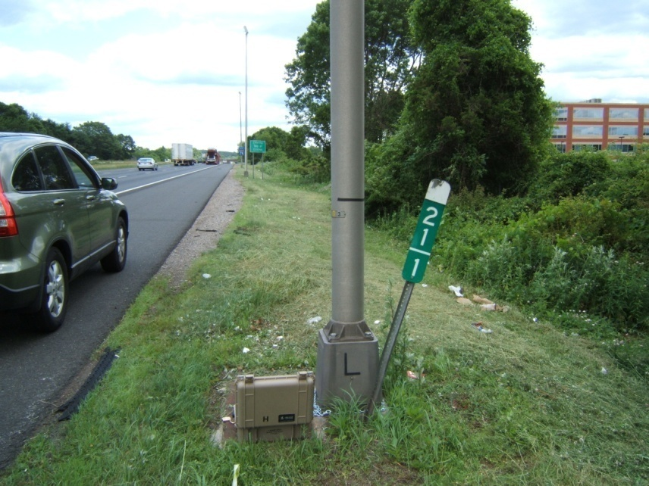
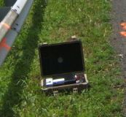
Bluetooth
10 Bluetooth Units
Side of road installation
Guiderail
Light Post
Location #1 / Start

Slide 7
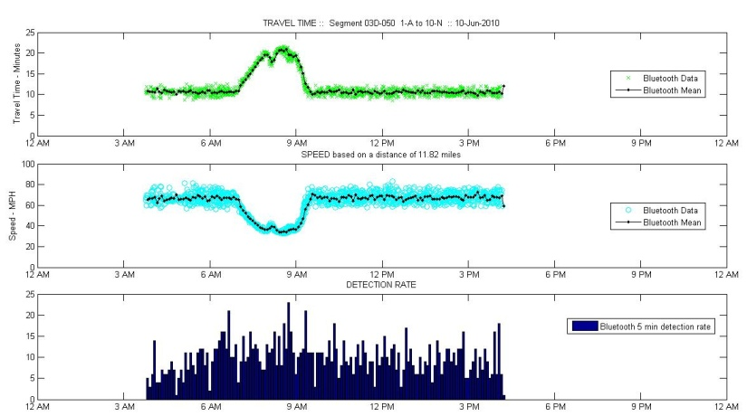
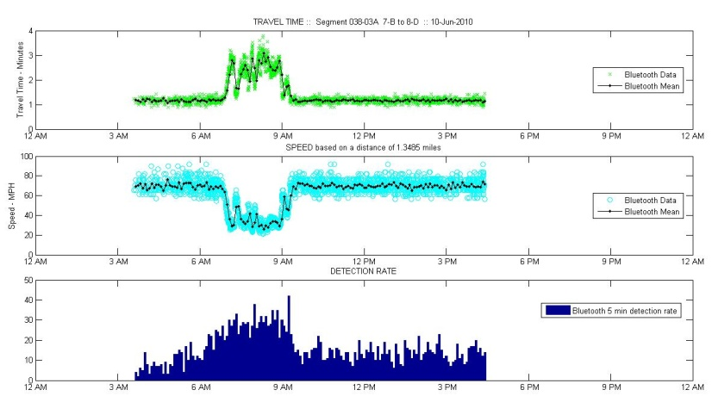
Bluetooth
Travel times and speeds between any two readers
Origin/Destination Data (Not Tested)
Avg Trav. Time
Avg Speed
Hits
Between Exit 18 and I-287
Between Int 24 and Int 26

Slide 8
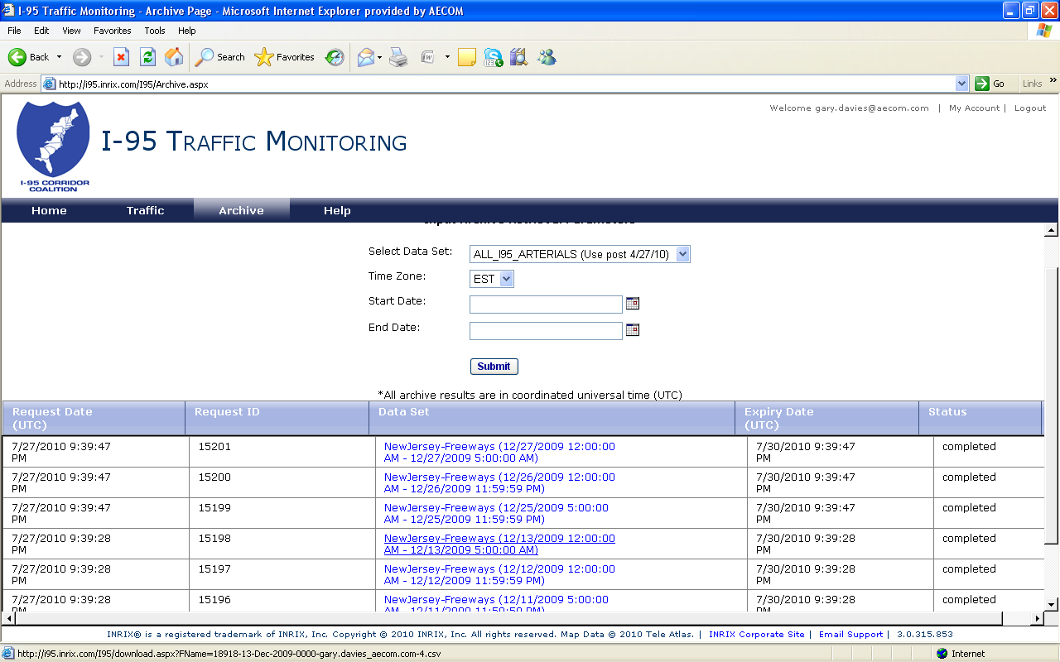
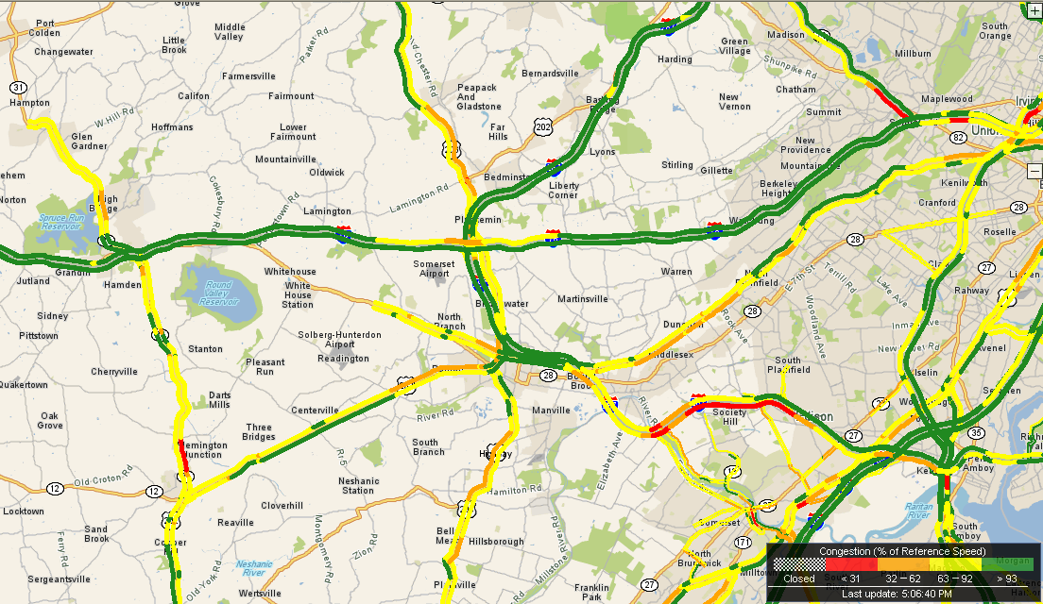
INRIX Real Time Highway Speed Data
Source: INRIX Corporation

Slide 9
INRIX Real Time Highway Speed Data
Large scale collection of travel speeds
Probe vehicles (using GPS) through fleet arrangements
I-95 Corridor Coalition has acquired rights to the data
Typical applications in Real Time
NJ 511 System
I-78 Travel Time via Express/Local
Commercial Providers
Useful By-Product: Archived Travel Speeds
By State Highway Segment
Daily files (All segments, 5 minute periods, 2008 to current)

Slide 10
INRIX Real Time Highway Speed Data

Slide 11
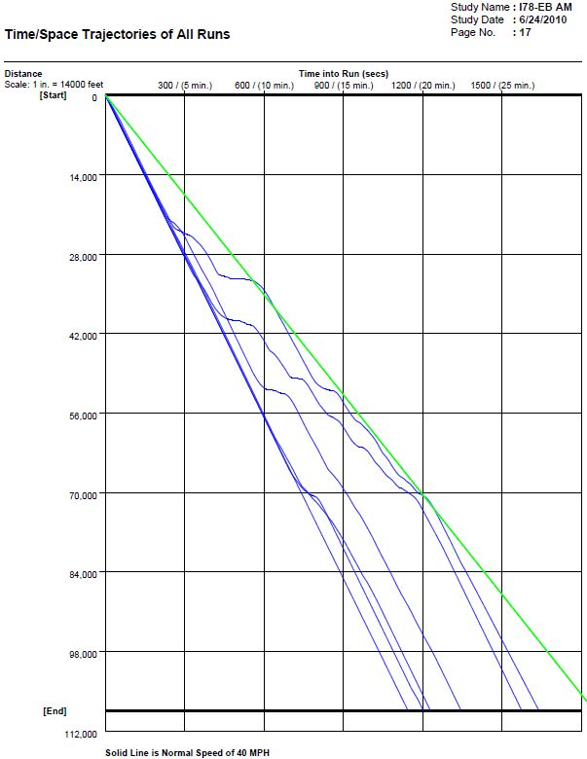
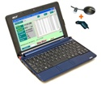
GPS/Laptop Probe Vehicle
PCtravel
GPS linked laptop in probe vehicles

Slide 12
Skycomp Aerial Photography
Aerial photo log of the corridor during the peak period

Slide 13
Traffic Counts
Manual mainline classification counts
ATR ramp counts
Historical state counts

Slide 14
Data Collection Study Results
Summary
High Truck Percentage (11-13% AM peak period)
Bluetooth and INRIX produced usable and comparable data
Standard Methods (Skycomp and GPS Laptop) confirmed Bluetooth and INRIX quality
Volumes slightly lower than historical data indicates
Definite congestion problem along this corridor in the AM peak period
Problem does not occur during any other period

Slide 15
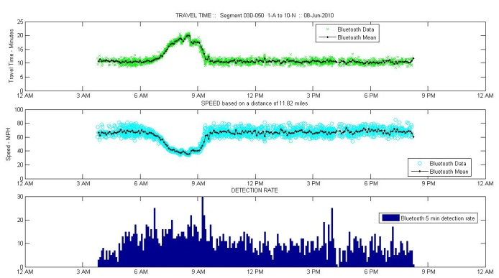
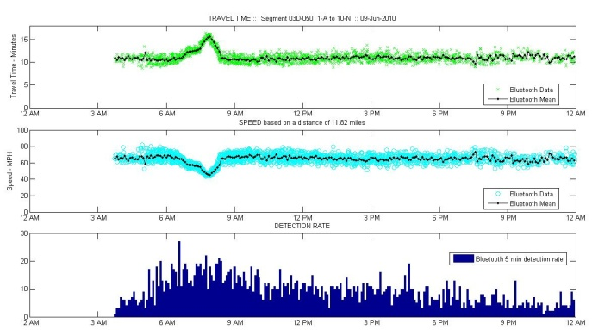
Data Collection Results
Alternate Methods Provide for Daily Comparisons
June 8th and 10th were similar however June 9th had less congestion
Based on these observations model will be used to show impact of daily variation
Avg Trav. Time
Avg Speed
Hits
Tuesday
Wednesday
Thursday

Slide 16
Benefits
Bluetooth
High Granularity, most vehicles today have at least one Bluetooth signal, providing large complete data set;
Unique ids throughout the study enabling use for Origin Destination type studies;
Ease of installation, with ability to create a closed network;
Low cost;
Can put it anywhere – not just for vehicles;
INRIX
Large Historical Dataset;
Large coverage area of interstate roads;
Large user group;
GPS Based Probe
Cheap;
Can be combined with driver/passenger observations;

Slide 17
Limitations
Bluetooth
Point by Point travel time calculation, can produce gaps;
Data set limited to battery life (about a week)
INRIX
Only available on predetermined Interstates and state roads;
Can be costly;
GPS Based Probe
Limited data set;
For long corridors during peaks multiple probes needed even then can miss critical times.

Slide 18
Traffic Simulation

Slide 19
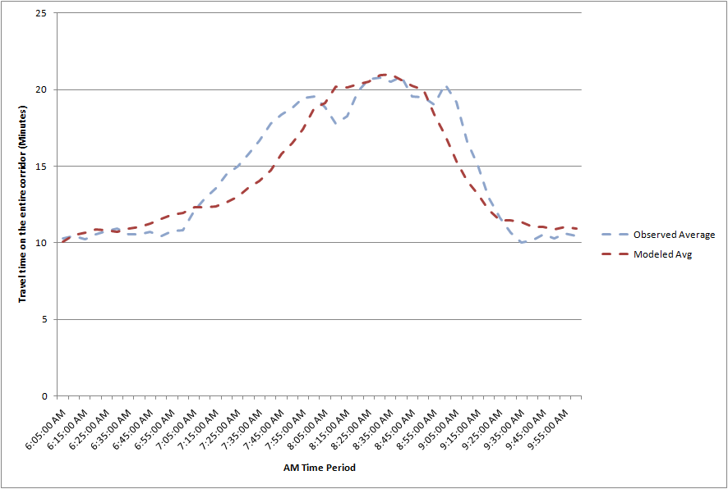
Network Calibration/Validation
Travel Time graphs
Observed Corridor Travel Time compared to Modeled Travel Time (5 random seeds and average)

Slide 20
Ramp Metering Alternatives
Pre-Timed Ramp Metering (PRM)
4 Pre-Timed 2 lane ramps
1 vehicle per lane per 9 secs
Actuated Ramp Metering (ARM)
4 Actuated 2 lane ramps
Mainline Gap controlled
Actuated Ramp Metering + Advanced Lane Management (ALM)
Actuated Scenario + Mainline Variable Speed Limits tied to volume

Slide 21
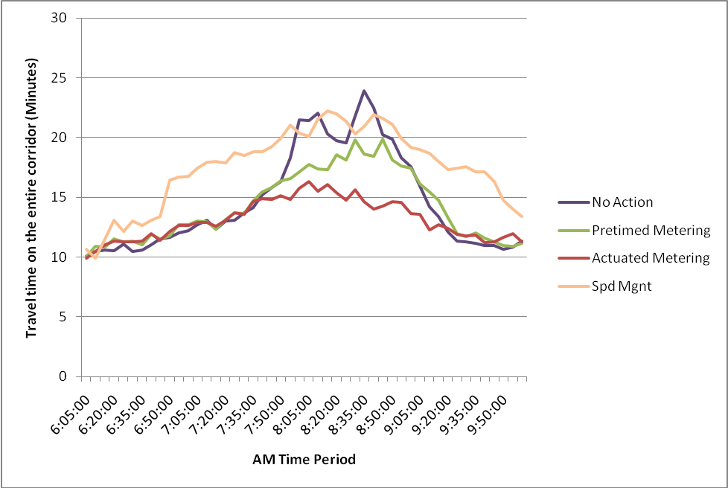
Ramp Metering Alternatives (2010)
Travel Time Comparisons
PRM - up to 5 minutes of mainline travel time saving
ARM - up to 10 minutes of mainline travel time savings
ALM – increased travel times

Slide 22
Findings
The Bluetooth technology was successful in accurately and inexpensively collecting travel time data. Given the ease of use of this technology, it should be considered for larger studies and even for use in Origin–Destination studies. Also, INRIX real-time data was shown to have promise, with the advantage that it is readily available for all freeways in New Jersey and for a lengthy, multiple-year historical data available.
These data sources greatly aid in the calibration and validation of planning and analysis models.
Microsimulation was able to accurately represent the existing conditions and also to show the potential benefits from implementation of some form of ramp metering along the corridor.

Slide 23
Questions
Matthew Juckes
Senior Project Manager
Transport Simulation Systems, Inc,
20 West 22nd Street, Suite 612
New York, NY, 10010
matthew.juckes@aimsun.com
Bernard Alpern
Associate Vice President/Transportation Planning
AECOM
605 Third Avenue
New York , NY, 10005
Bernard.aplern@aecom.com

