Slide 1
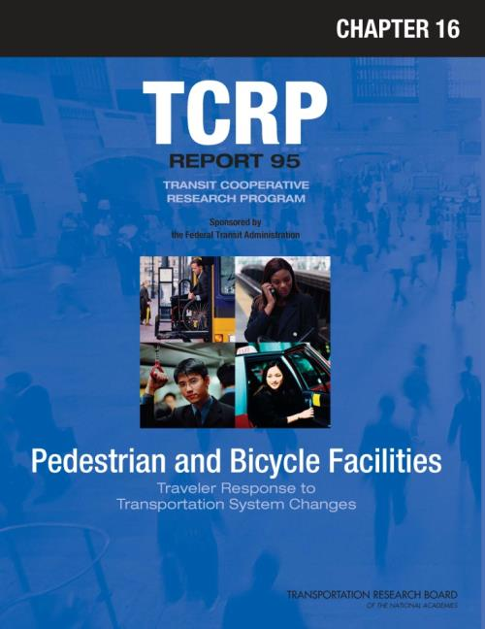
TCRP Report 95 – Chapter 16
Traveler Response to Bicycle and
Pedestrian Facilities
presented to
Planning Applications Conference
Transportation Research Board
Washington, D.C.
May 2013
presented by
Jay Evans
Cambridge Systematics, Inc.
co-authored by
Dick Pratt
Richard H. Pratt, Consultant

Slide 2
Presentation Outline
Introduction
Traveler Response Summary
Other Information
End Notes

Slide 3
Introduction
What the Handbook IS
Travel demand impact manual
Sourcebook on results of transportation actions
Survey of information on usage and feasibility
✓

Slide 4
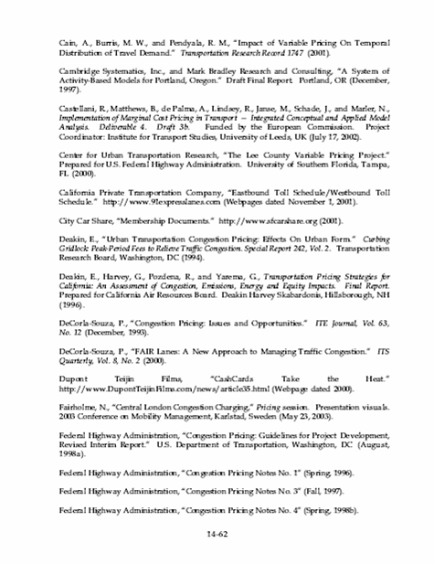
Introduction
What the Handbook IS
(continued)
REFERENCES
TABLES
TEXT

Slide 5
Introduction
What the Handbook Is NOT
Best practices manual
Implementation manual
Design or operation manual
✗

Slide 6
Handbook Organization
General Sections and Topic Area Chapters with Status
Color Key
Final
Published
Deferred
to Future
Project
Introduction
  Ch 1 – Introduction (with Appendices A, B)
Multimodal/intermodal facilities
  Ch 2 – HOV Facilities
  Ch 3 – Park-and-Ride and Park-and-Pool
Transit facilities and services
  Ch 4 – Busways, BRT, and Express Bus
  Ch 5 – Vanpools and Buspools
  Ch 6 – Demand Responsive/ADA
  Ch 7 – Light Rail Transit
  Ch 8 – Commuter Rail
Public transit operations
  Ch 9 – Transit Scheduling and Frequency
  Ch 10 – Bus Routing and Coverage
  Ch 11 – Transit Information and Promotion

Slide 7
Handbook Organization
General Sections and Topic Area Chapters with Status (continued)
Color Key
Final
Published
Transportation pricing
  Ch 12 – Transit Pricing and Fares
  Ch 13 – Parking Pricing and Fees
  Ch 14 – Road Value Pricing
Land use and non-motorized travel
  Ch 15 – Land Use and Site Design
  Ch 16 – Pedestrian and Bicycle Facilities
  Ch 17 – Transit Oriented Development
Transportation demand management
  Ch 18 – Parking Management and Supply
  Ch 19 – Employer and Institutional TDM Strategies

Slide 8
Chapter 16 – Pedestrian and Bicycle Facilities
Authorship
  Lead Authors
    Dick Pratt, Jay Evans, Herb Levinson
  Contributing Authors
    Shawn Turner, C.Y. Jeng, Dan Nabors
Source Data Cutoff
  Generally 2007; Portions 2011
Publication Date
  August 2012

Slide 9
Handbook Organization
Topic Area Chapter Format
Overview and summary
  Objectives of [the system change]
  Types of programs
  Analytical considerations
  Traveler response summary
Response to [the system change]
Underlying traveler response factors
Related information and impacts
Additional resources
Case studies
References

Slide 10
Presentation Outline
Introduction
Traveler Response Summary
Other Information
End Notes

Slide 11
Response by Type of Non-motorized Transportation Strategy
Sidewalks and Along-Street Walking
Street Crossings
Pedestrian Zones, Malls, and Skywalks
Bicycle Lanes and Routes
Shared Use, Off-Road Paths and Trails
Pedestrian/Bicycle Systems and Interconnections
Pedestrian/Bicycle Linkages with Transit
Point-of-Destination Facilities
Pedestrian/Bicycle Friendly Neighborhoods
Non-motorized Transportation Policies and Programs
Walking/Bicycle Promotion and Information

Slide 12
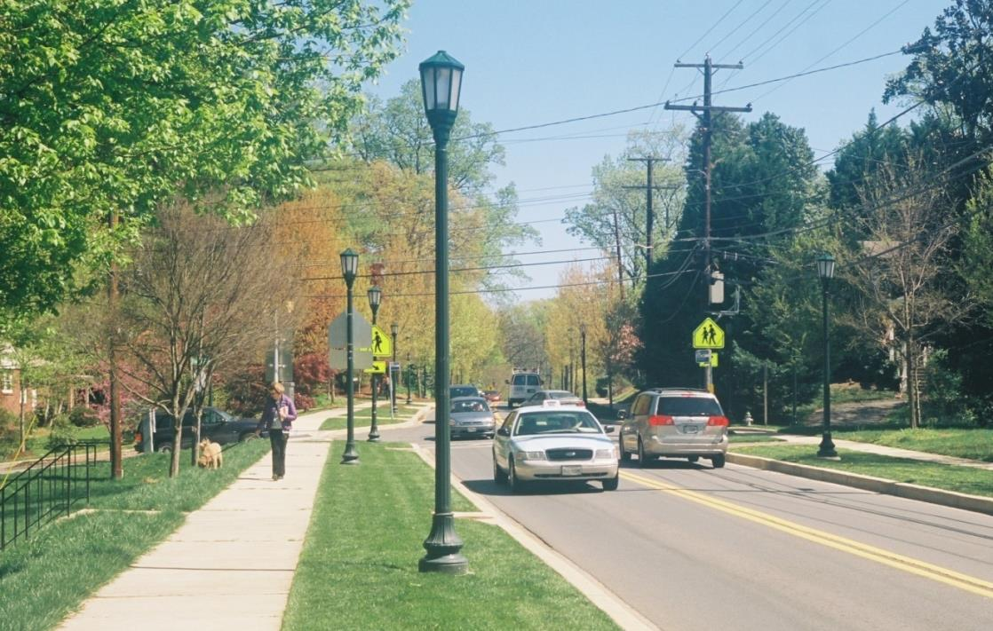
Improvement of MD 547, providing ADA-compliant sidewalks on both sides instead of a degraded walk on one side, was associated with nearly a 70 percent total pedestrian count increase.
Sidewalks and Along-Street Walking
Dick Pratt, photographer

Slide 13
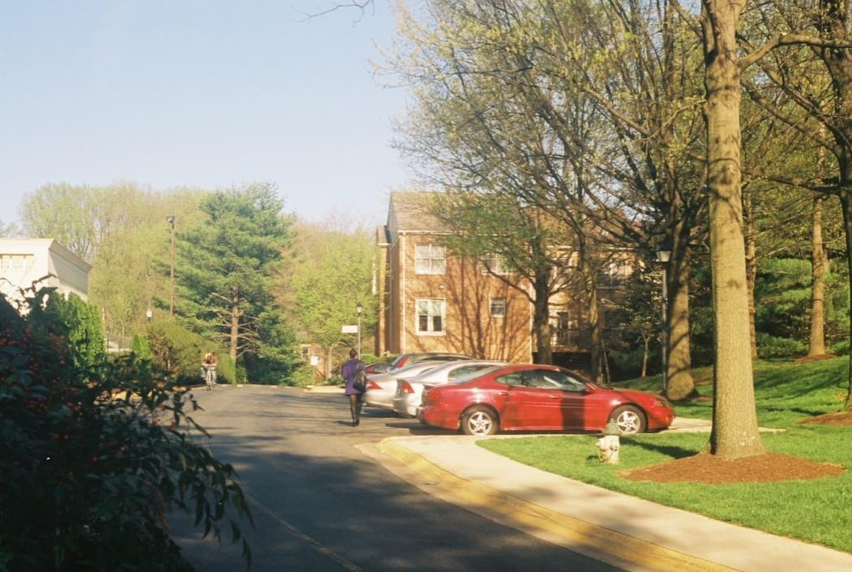
Faced with the 27 percent extra walking distance imposed by this indirect sidewalk, 80 percent of all pedestrians walk in the street behind the back ends of the parked cars.
Sidewalks and Along-Street Walking
Dick Pratt, photographer

Slide 14
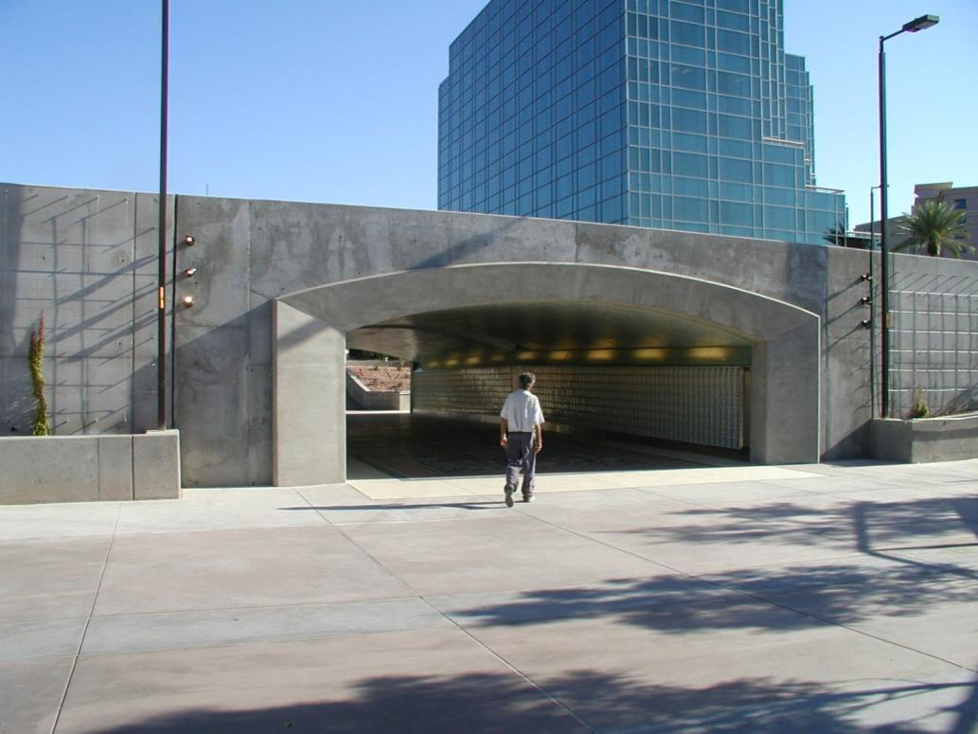
This Phoenix undercrossing uses topography to avoid the grade-change stairs and ramps of conventional overpasses and underpasses, which time-sensitive pedestrians often seek to bypass.
Street Crossings
Courtesy of www.pedbikeimages.org, Dan Burden, photographer

Slide 15
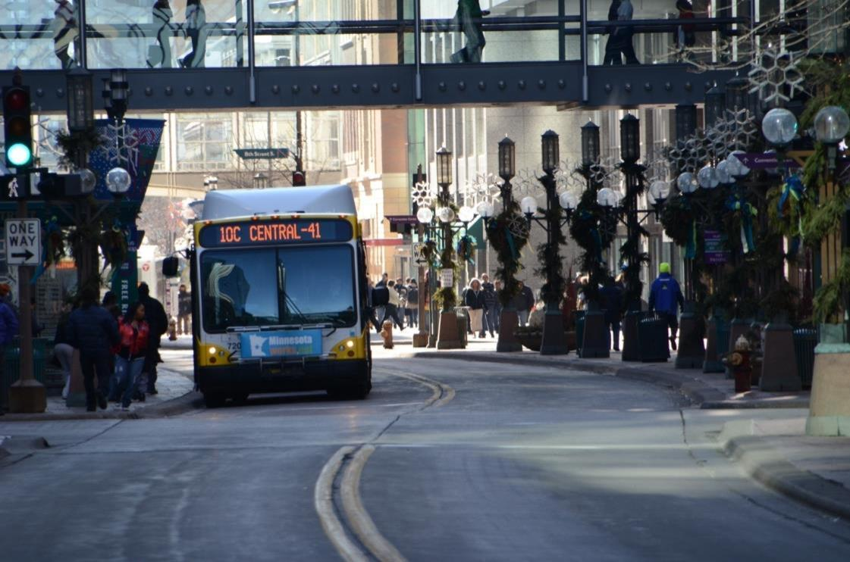
Minneapolis Skyway and Nicollet Mall activity in a downtown core area where total pedestrian flows have crept upward on average for nearly half a century.
Pedestrian Zones, Malls, and Skywalks
Courtesy of Metropolitan Council, St. Paul, MN, Jeff Syme, photographer

Slide 16
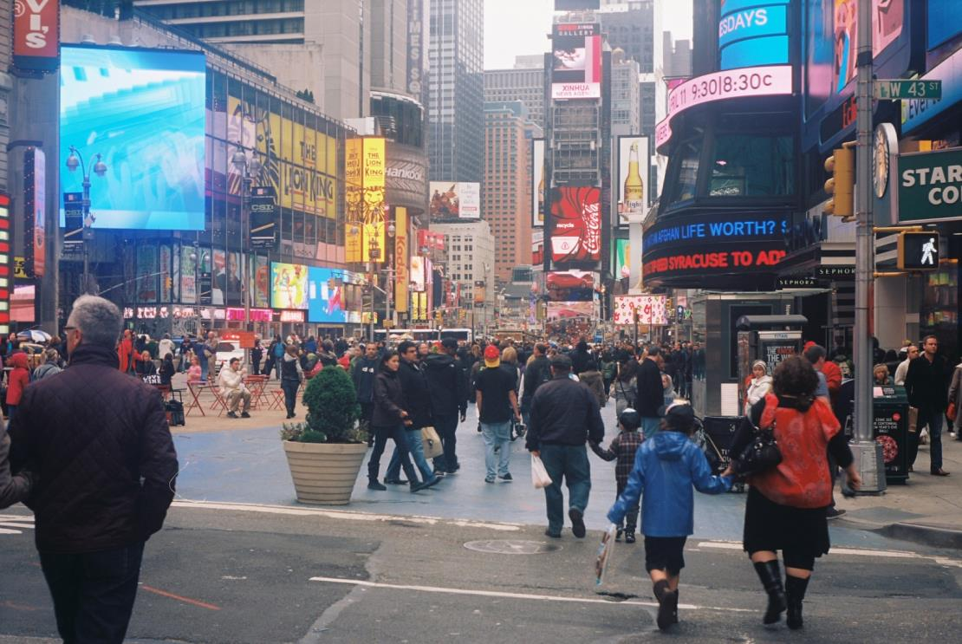
The Times Square Plaza pedestrian-mall component of Broadway’s combination mall, which in sections has bike and traffic lanes and parking per “complete streets” needs, is seen here in pilot project configuration.
Pedestrian Zones, Malls, and Skywalks
Dick Pratt, photographer

Slide 17
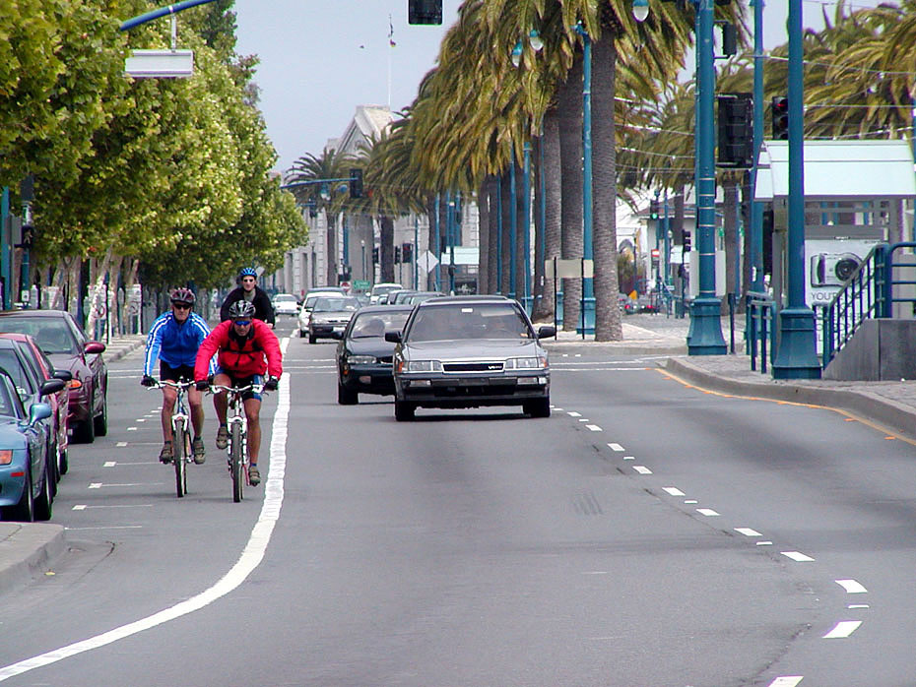
Conventional bike lanes along the Embarcadero are part of a City of San Francisco program that has seen bicycle count increases averaging some 70 percent on individual streets studied.
Bicycle Lanes and Routes
Courtesy of www.pedbikeimages.org, Dan Burden, photographer

Slide 18
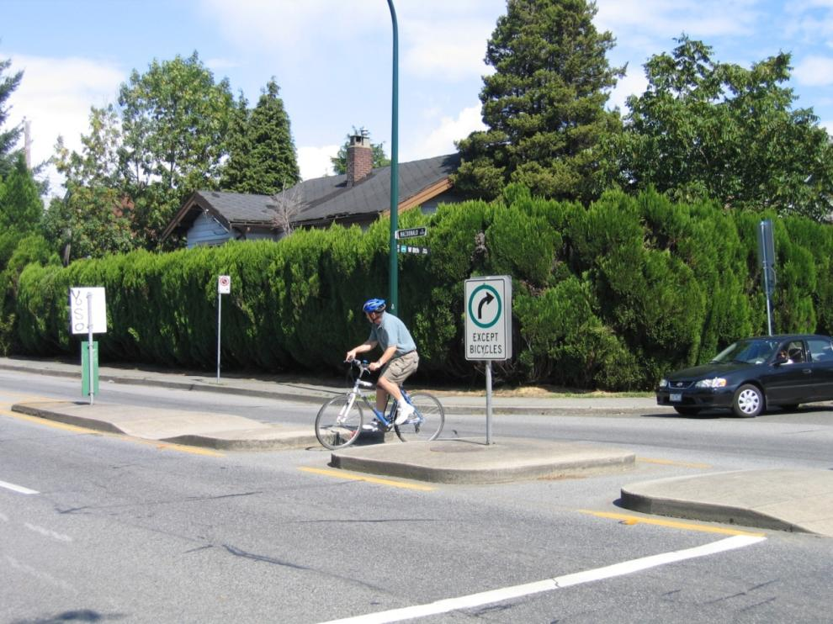
Cyclist on a "Bikeway" (a.k.a., bicycle boulevard) in Vancouver, British Columbia, Canada, illustrating a vehicle traffic diverter, bike cut-through, and arterial-crossing bicycle and pedestrian refuges.
Bicycle Lanes and Routes
Courtesy of www.pedbikeimages.org, Carl Sundstrom, photographer

Slide 19
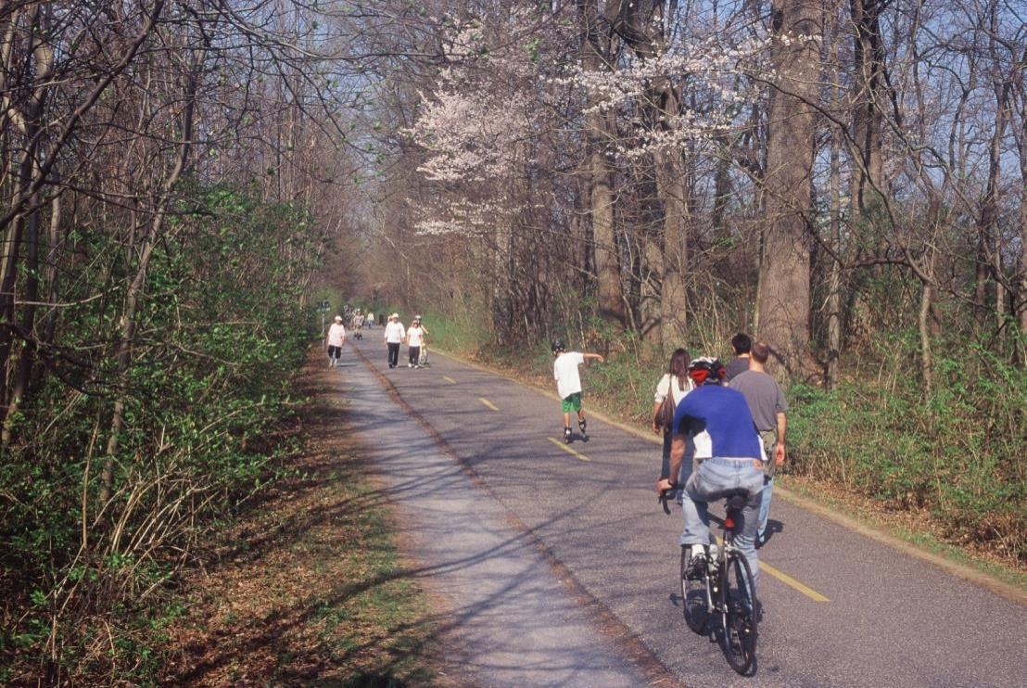
The highly varied weekend traffic mix on the Capital Crescent Trail in Bethesda, MD, illustrates off-road path openness to multiple activities by users of all ages and capabilities.
Shared Use, Off-Road Paths and Trails
Dick Pratt, photographer

Slide 20
Estimated Percent Out-of-the-Way a Portland, OR, Cyclist Would Go…
To Avoid A… | And Use, for the Entire Trip or Bridge Crossing,…
 | A Bicycle Lane | A Bicycle Boulevard | An Off-road Trail
Quiet Street (with no bike lane) | 0% | 14% | 26%
Moderate Traffic Street (with no bike lane) | 31% | 45% | 57%
Highway Bridge (no bike lane) | 20% | N/A | 34%
Bicycle Lanes and Routes
Note: Utilitarian bicycle trips only (recreation/exercise trips not included).

Slide 21
Work-Trip Before-and-After Bicycle Shares for 3 Bike Lane and 4 Off-road Trail Commutersheds in Minneapolis-St. Paul
Bicycle Facility | 1990 Bike Share | 2000 Bike Share | Percentage Point Change | Percent Increase
3 Bike Lanes (average) | 3.5% | 4.9% | 1.4% | 40%
4 Trails:
Cedar Lake Trail | 2.5% | 3.6% | 1.0% | 42%
Kenilworth Trail | 1.7% | 3.0% | 1.3% | 76%
West River Parkway | 5.5% | 7.2% | 1.7% | 31%
U MN Transitway | 6.4% | 7.8% | 1.5% | 23%
Center Cities - All | 1.2% | 1.4% | 0.2% | 20%
Shared Use, Off-Road Paths and Trails
Notes: All facilities implemented during the 1990-2000 period.
Trips under 1 mile excluded, except in “Center Cities” row.

Slide 22
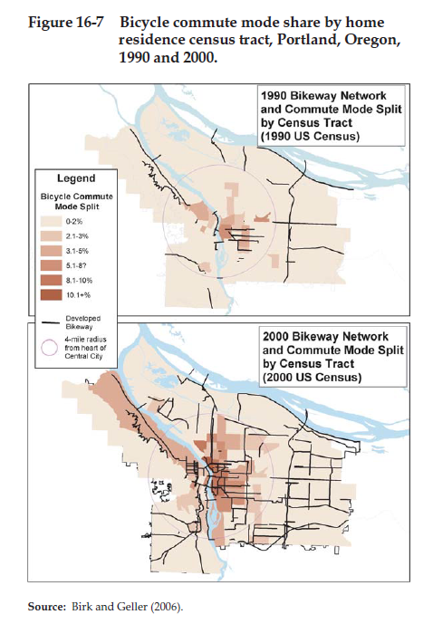
Pedestrian/Bicycle Systems and Interconnections

Slide 23
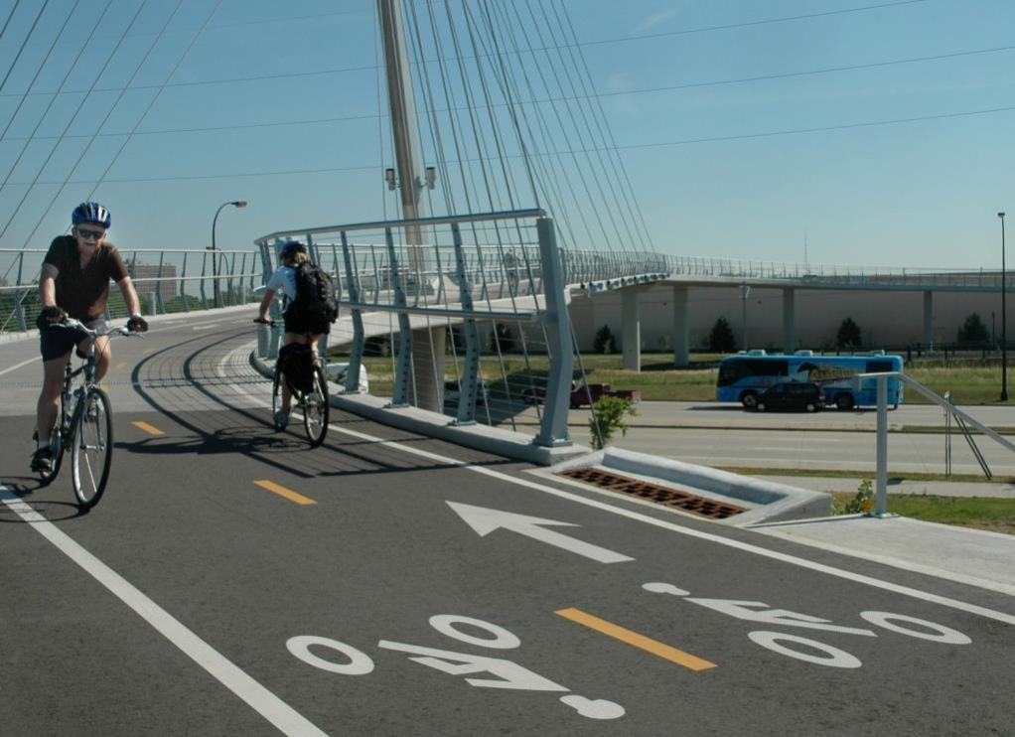
The cable-stayed Sabo Bridge takes the Midtown Greenway across Hiawatha Avenue and the Hiawatha Light Rail line in Minneapolis to reach the Seward and Longfellow neighborhoods.
Pedestrian/Bicycle Systems and Interconnections
Courtesy of Metropolitan Council, St. Paul, MN, Jeanne Landkamer, photographer

Slide 24
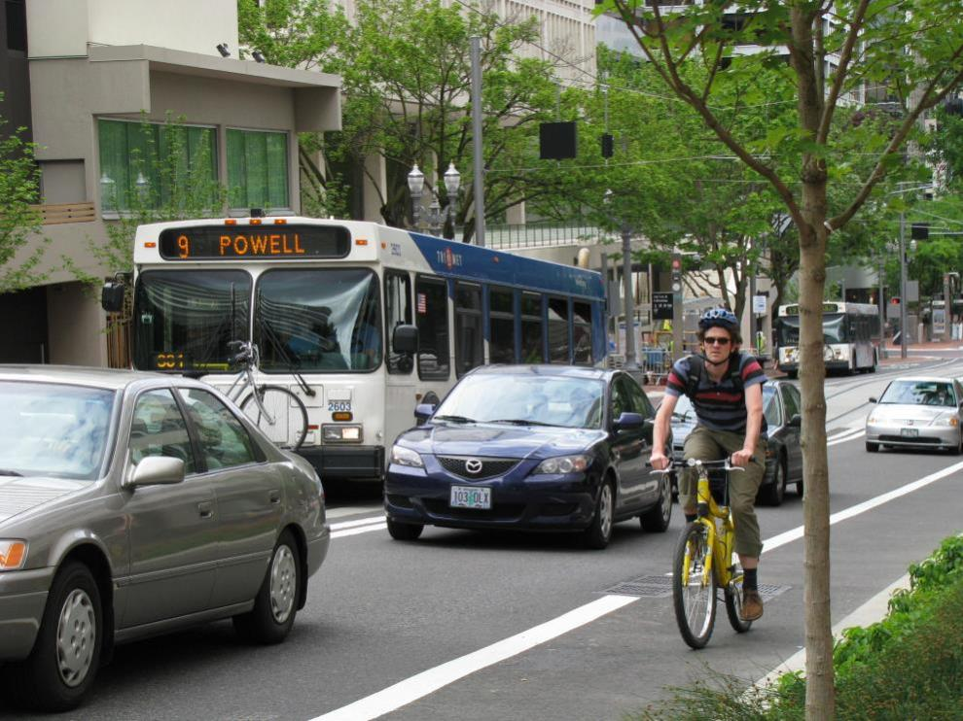
Thanks to bike racks on Portland’s TriMet buses, both buses in this scene are carrying bikes and their riders: a majority of cyclists take their bicycles along rather than parking them at transit stops.
Pedestrian/Bicycle Linkages with Transit
Courtesy of www.pedbikeimages.org, Laura Sandt, photographer

Slide 25
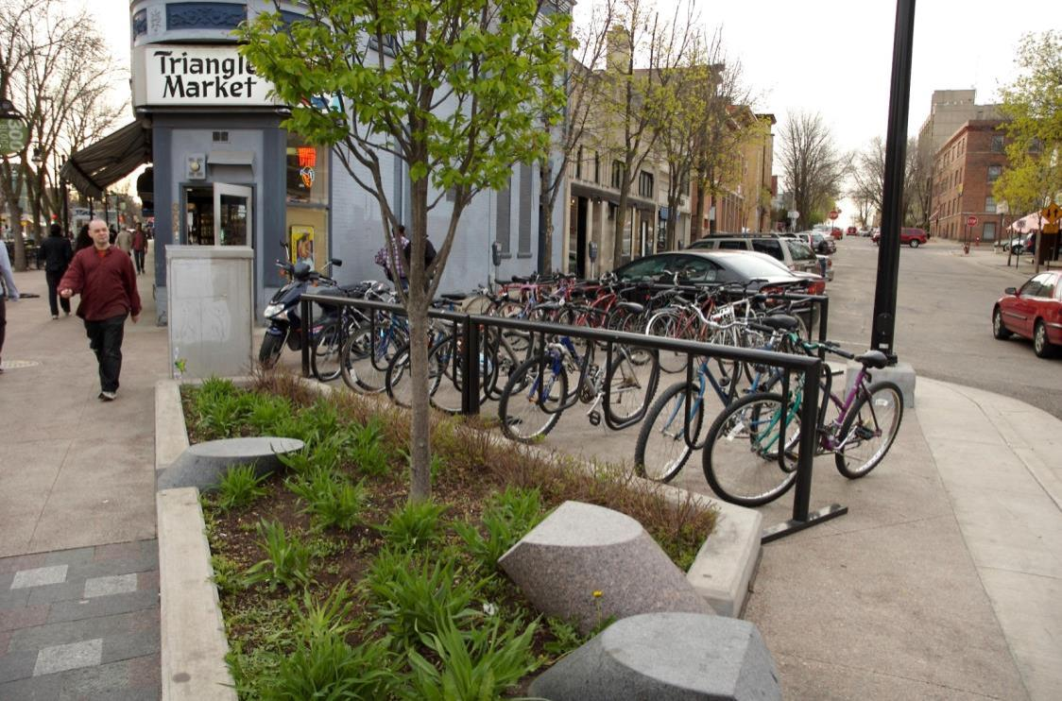
Bike racks such as these in Madison, WI, are preferred by potential cyclists over no parking at all but appear to rank lower than secure covered parking.
Point-of-Destination Facilities
Courtesy of www.pedbikeimages.org, Eric Lowry, photographer

Slide 26
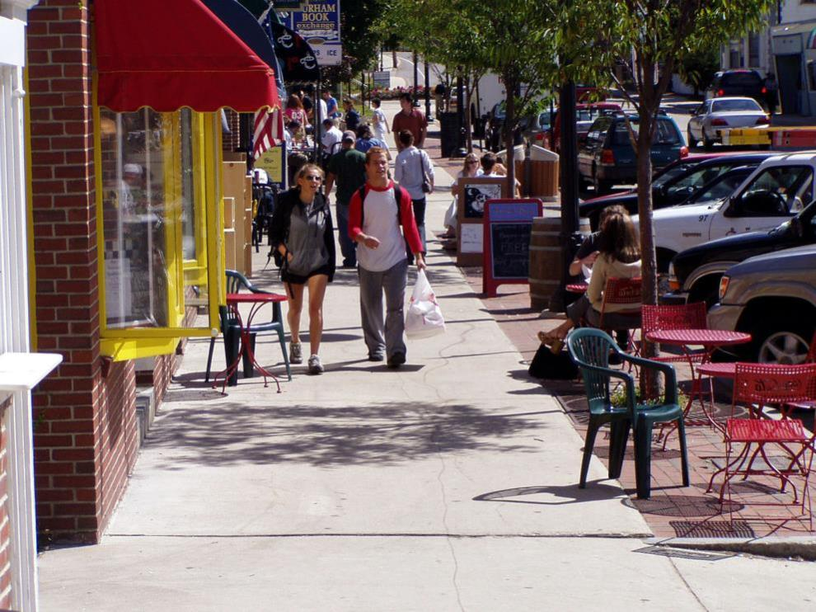
This Durham, NH, streetscape illustrates pedestrian-friendly features such as store placement directly at the back of the broad sidewalk.
Pedestrian/Bicycle Friendly Neighborhoods
Courtesy of www.pedbikeimages.org, Dan Burden, photographer

Slide 27
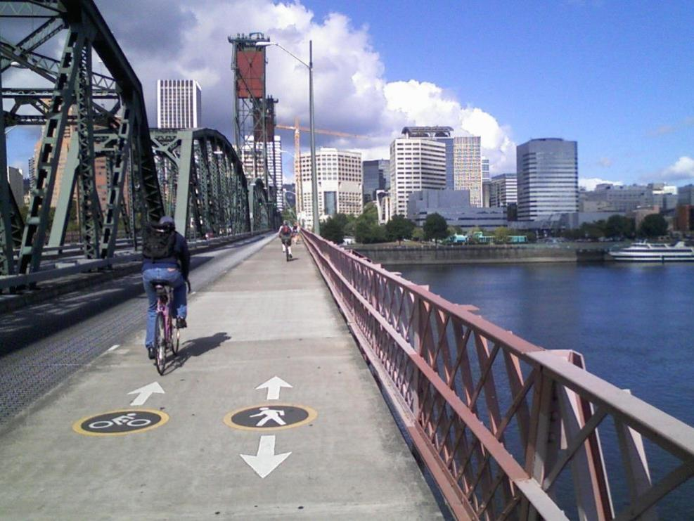
Bicycling on Portland, Oregon’s Hawthorne Bridge increased
45 percent with bridge sidewalk widening; downtown river crossings overall quintupled in 17 years to reach 16,700 bicycles daily in 2008.
Non-motorized Transportation
Policies and Programs
Courtesy of gregraisman/flickr

Slide 28
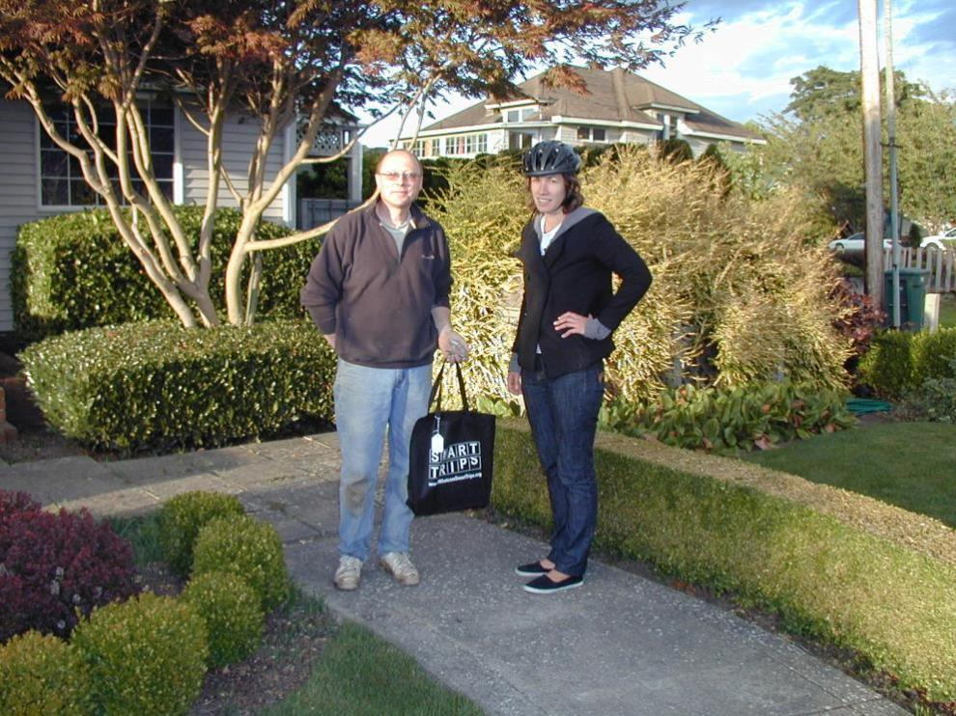
An “Interested” participant receives an information packet as part of the 2008 Bellingham Smart Trips individualized marketing project.
Walking/Bicycle Promotion and Information
Courtesy of Socialdata GmbH and Whatcom Council of Governments, Bellingham, WA

Slide 29
Presentation Outline
Introduction
Traveler Response Summary
Other Information
End Notes

Slide 30
Underlying Traveler Response Factors
Behavioral Paradigms
Environmental Factors
Trip Factors
User Factors
Other Factors and Factor Combinations
Choice of Neighborhood/Self-Selection

Slide 31
Related Information and Impacts
Extent of Walking and Bicycling
Characteristics of Walking and Cycling Overall
Facility Usage and User Characteristics
Travel Behavior Shifts
Time to Establish Facility Use
Safety Information and Comparisons
Public Health Issues and Relationships
Traffic, Energy, and Environmental Relationships
Economic and Equity Impacts

Slide 32
Presentation Outline
Introduction
Traveler Response Summary
Other Information
End Notes

Slide 33
Getting the Handbook
Download Electronic Version
  Free download of PDF versions from TRB/TCRP
  Official Traveler Response Handbook Series page:
  http://apps.trb.org/cmsfeed/TRBNetProjectDisplay.asp?ProjectID=1034
  Official TRB TCRP Report 95, Chapter 16 page:
  http://www.trb.org/Main/Blurbs/167122.aspx
Order Hardcopy Version
  Above chapter link also reaches hardcopy ordering instructions from TRB Bookstore
Be sure to also obtain Chapter 1, Introduction

Slide 34
Contact Information
John (Jay) Evans, P.E., AICP
Cambridge Systematics, Inc.
301-347-0100
jevans@camsys.com
www.camsys.com
Richard H. Pratt
rhpratt@his.com

