Slide 1


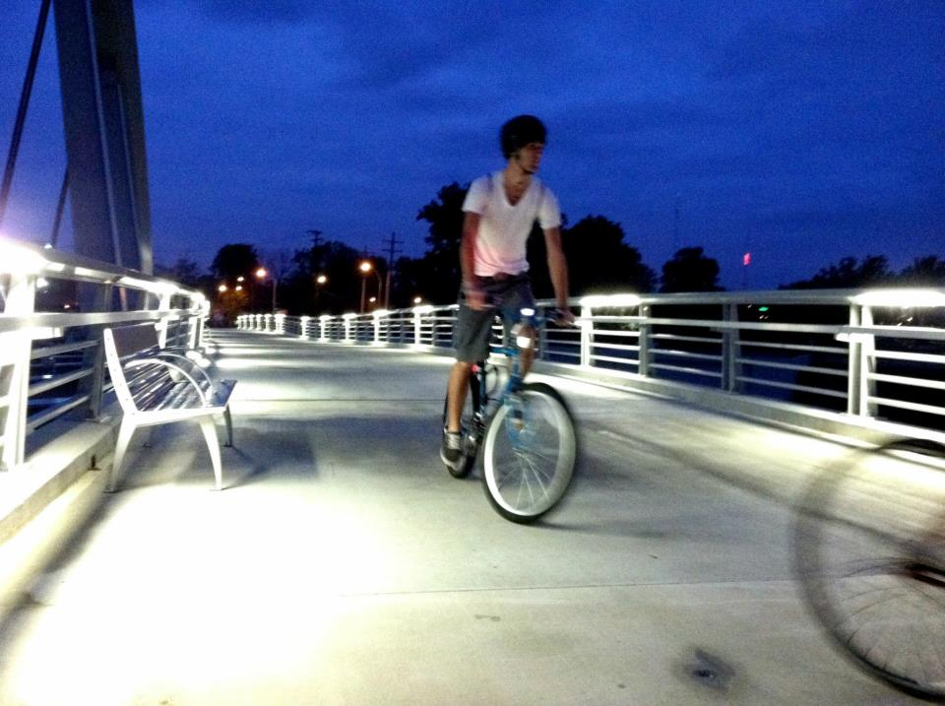
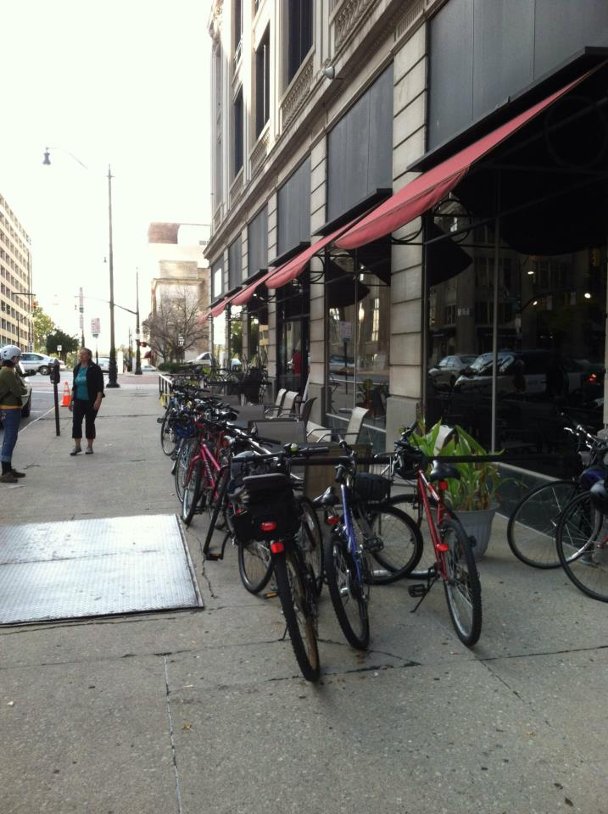
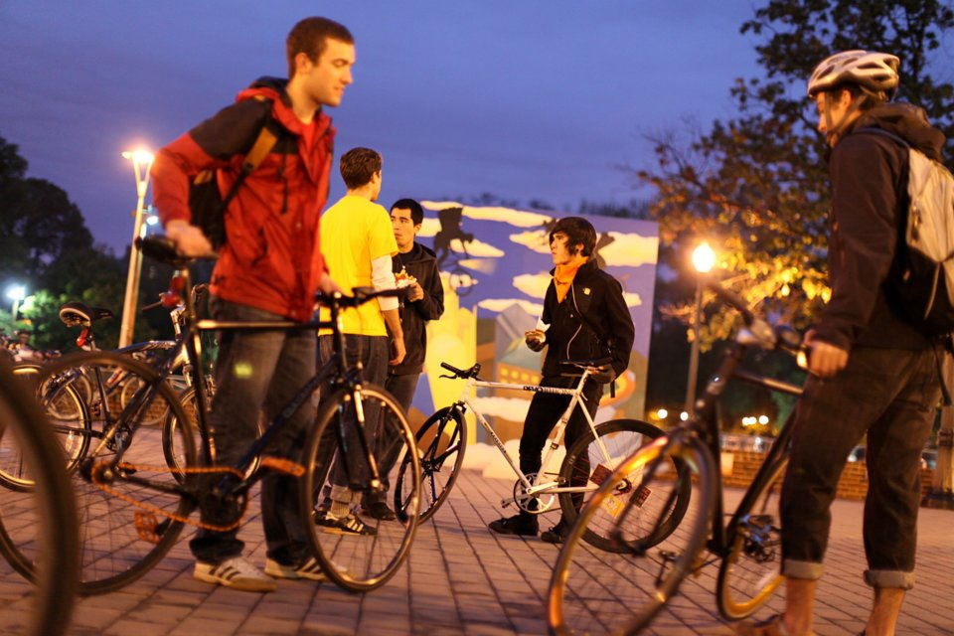
WELCOME
Pike and Wok Travel
Bicycle and Pedestrian Travel
May 6, 2013
Steering Committee Meeting #1

Slide 2
Multimodal Corridors
What are Corridors
  Corridors are an extensive and integrated multi-modal transportation network affording Ohioans the accessibility and mobility needed to move people and goods throughout Ohio.
  Corridors subdivide Ohio’s transportation networks into origins and destinations to facilitate analysis and discussion.
  Corridors are multimodal!!

Slide 3

Corridor Modes
Transportation Mode to be Analyzed
  Aviation
  Bicycle
  Highway
  Maritime
  Rail
  Transit

Slide 4
Corridor Identification Criteria
Volume - a measure of passenger and freight traffic
Classification – Federal or state designations
Connectivity – a consideration of connections to other identified corridors or large population and employment centers

Slide 5
Corridor Categorization
National Corridors - connect large metropolitan areas in Ohio and adjacent regions. These corridors support heavy passenger traffic and are important to the national economy as they carry large volumes of freight both inside and outside Ohio.
Statewide Primary Corridors - connect metropolitan areas within Ohio. They are important to the statewide economy as they carry freight between regions of the state. These corridors have some national travel, but are predominately used for statewide passenger and freight trips.
Statewide Secondary Corridors - connect people and goods within and between regions of the state. They have some national and statewide travel, but are predominantly used for smaller regional trips.
Local Corridors - have lower traffic volumes and provide connectivity between other corridors and local destinations.

Slide 6
Bicycle Corridors
Bicycle Criteria
Classification- A consideration if whether a bike routes is part of a designated bike routes system
Connectivity - a consideration of bike routes which connect to AASHTO bike routes or population centers over 50,000

Slide 7
Bicycle Corridors
Bike Criteria
Corridor Classification | Classification | Connectivity
National | AASHTO US Bike Route System | Connect population centers, both in Ohio and surrounding states
Statewide Primary | Ohio's Bike Trunk Route System | Connect Ohio US Census Designated Urban Areas that are 50,000 in population or greater
Statewide Secondary | To be determined by MPOs and statewide planning process
AND
Notes:
The bike criteria was developed, presented, and discussed in our October 12th steering committee meeting. We also solicited input from all of the MPO bike/ped staff.

Slide 8
Corridor ID Process
How the Bike Trunk Route System was established
  Centroids
  Links
  Routes
  Level of service
  Label the routes

Slide 9
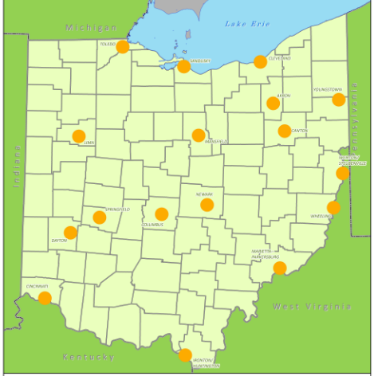
Centroids
Centroids were defined as any population center greater than 50,000
Notes:
Because we are looking at this through a statewide lens, we had to develop criteria that would compliment this.

Slide 10
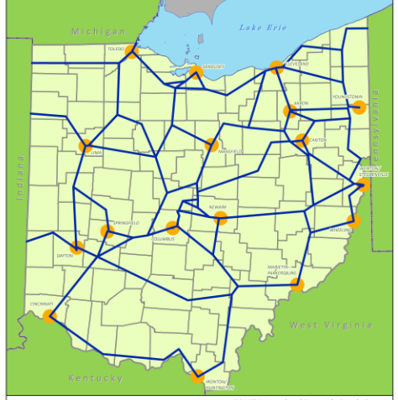
Links
Links were added to connect the centroids…
Notes:
We then took the centroids and created connections from one centroid to the other.

Slide 11
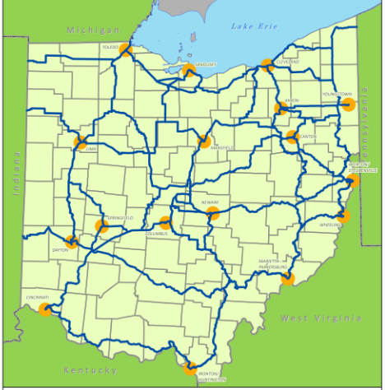
Routes
Routes were defined based on LOS…
Notes:
We then identified routes that seem to make the most sense which include on road and off road segments.

Slide 12
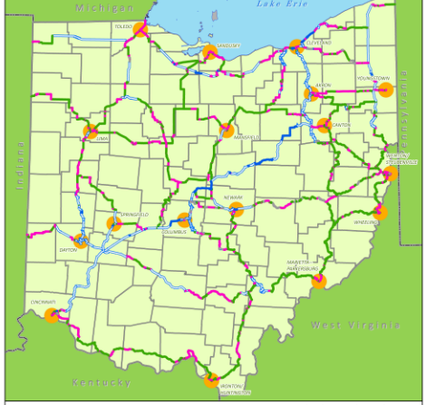
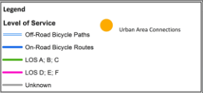
Level of Service
Criteria
Shoulder Width
Lane width
Pavement conditions
Speed limits
Car and truck volumes
Existing bike facilities
Notes:
We then modified the FDOT Level of Service model to see how these potential routes would perform. The model gave each criteria different weights.

Slide 13
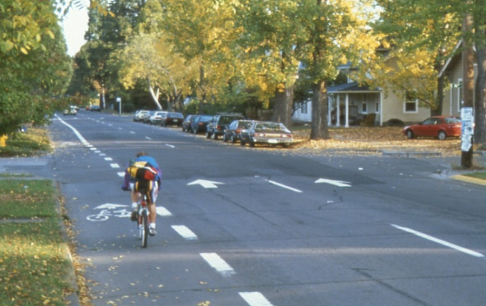
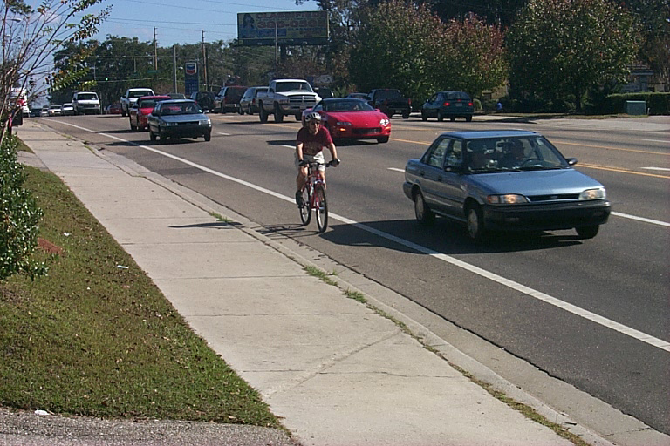
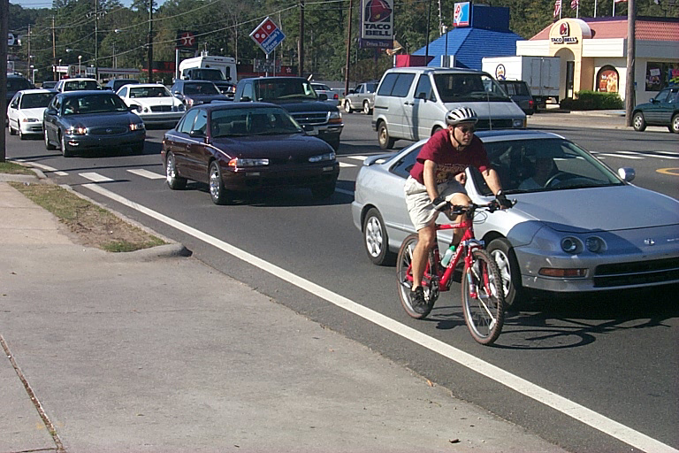
Level of Service
FDOT Bicycle LOS Equation
Planning level application of BLOS model
  Used on over 300,000 centerline miles
  Basis for the segment model in HCM2010
Cyclists rated actual road segments
Published in TRR 1578
A/B
C/D
E/F

Slide 14
Bicycle LOS Model
BLOS = a₁ln(Vol₁₅/L) + a₂SP_{t}(1+10.38HV)² + a₃(1/PC₅)² - a₄(W_{e})² + C
where
Vol₁₅ = volume of directional traffic in 15 minutes time period
L = total number of through lanes
SP_{t} = effective speed limit (see below)
SP_{t} = 1.12ln(SP_{P} -20) + 0.81
SP_{P} = Posted speed limit
HV = percentage of heavy vehicles
PC₅ = FHWA’s five point surface condition rating
W_{e} = Average effective width of outside through lane

Slide 15
Level of Service Categories
Level-of-Service
BLOS Score
A
>
1.5
B
1.5
>
2.5
>
and
C
>
>
2.5
and
3.5
D
>
>
3.5
and
4.5
E
4.5
>
5.5
>
and
F
5.5
>

Slide 16
LOS Inputs & Defaults
  Paved shoulder/bike lane (from data base)
    Derived from pavement width minus lane width
  Outside lane width (default 12’ state, 11’ local)
  Traffic volume (ADT inputted and converted to peak 15 min)
    Defaults for local roads with no volume data
  Motorized vehicle speed (posted speed + 5 mph)
  Percent heavy vehicles (from data base or defaulted to 4%)
  Pavement condition (5 point condition scale from database)

Slide 17
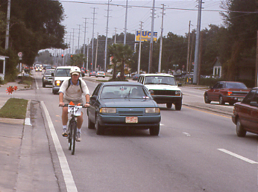
Outside Lane Width
12 Feet – (Typical)

Slide 18
Level of Service
Automating the Process
Spreadsheet testing – logic – sets defaults
Roadway paved?
Roadway not an interstate?
Segment an existing bikeway?
State/local, Urban/rural section?
Sets defaults for, speed, volume, trucks, lane width, shoulders, etc

Slide 19
Using LOS to Establish “Impedance”
A = 1 (The segment passes into the network carrying its original length as impedance)
B = 2
C = 10
D = 30
E = 40
F = 55 (Segment is 55 times more of an impediment than length alone)
Statewide Significant Bikeways = .5

Slide 20
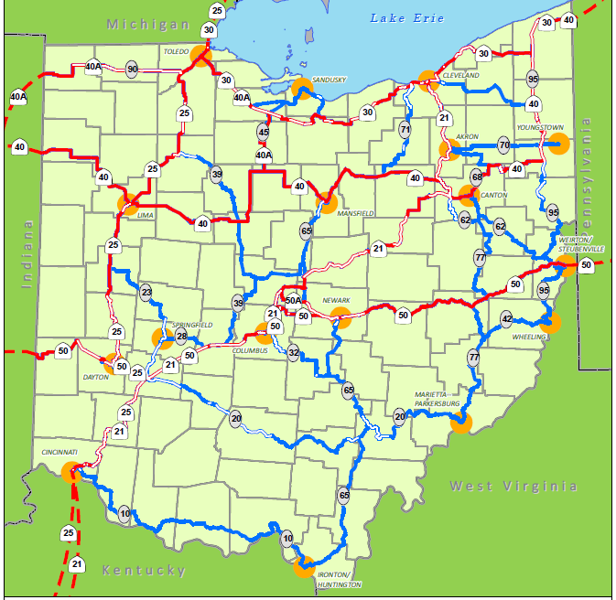
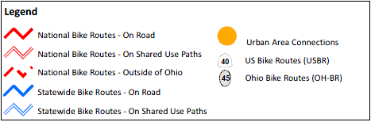
Bicycle Corridors
Notes:
This process has not been field verified. Field verifying these routes with the owner of the roadway or bikeway segment. This will take some time. We will take into account things like topography and surrounding land uses such as curb cuts or industrial/manufacturing zones.

Slide 21
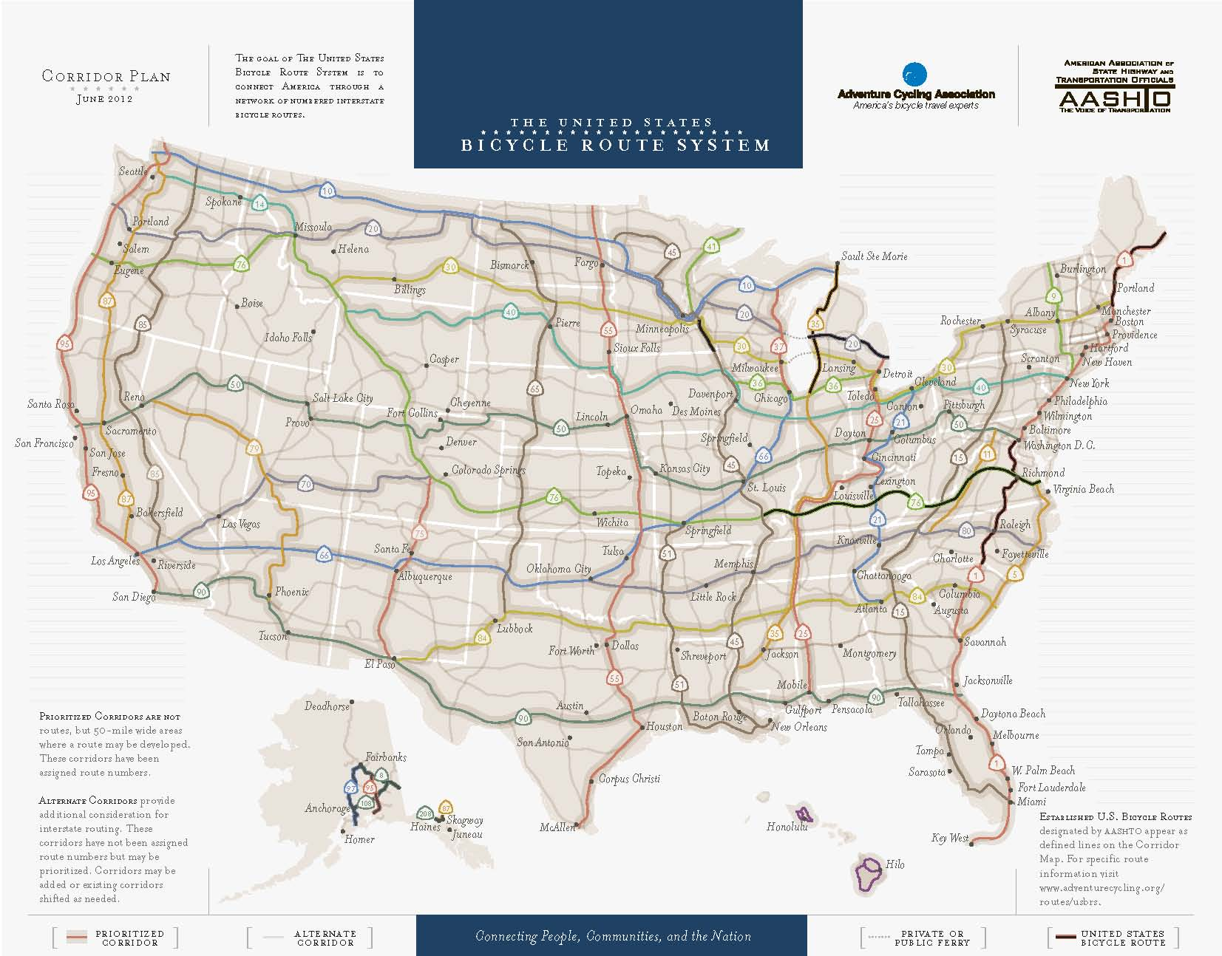
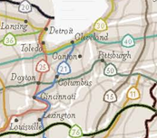
Bicycle Corridors
Routes (Corridors)
Notes:
I think most of you are familiar with the national bike route initiative but I want to spend a few minutes talking about how our red lines or national routes connect into the larger system. DESCRIBE THE ROUTES. The black lines on the map are ones that have already been designated. I have to tell you the fact that Michigan has some already designated is a huge motivator for me to get some of ours designated. Several of us a few years back had a discussion about starting US BR 25 and how it would tie into Cincy and KY. Recently, there has been some interest with MDOT and TMACOG to get their portion of 25 started.
We are currently working on US BR 50. NEXT SLIDE.

Slide 22
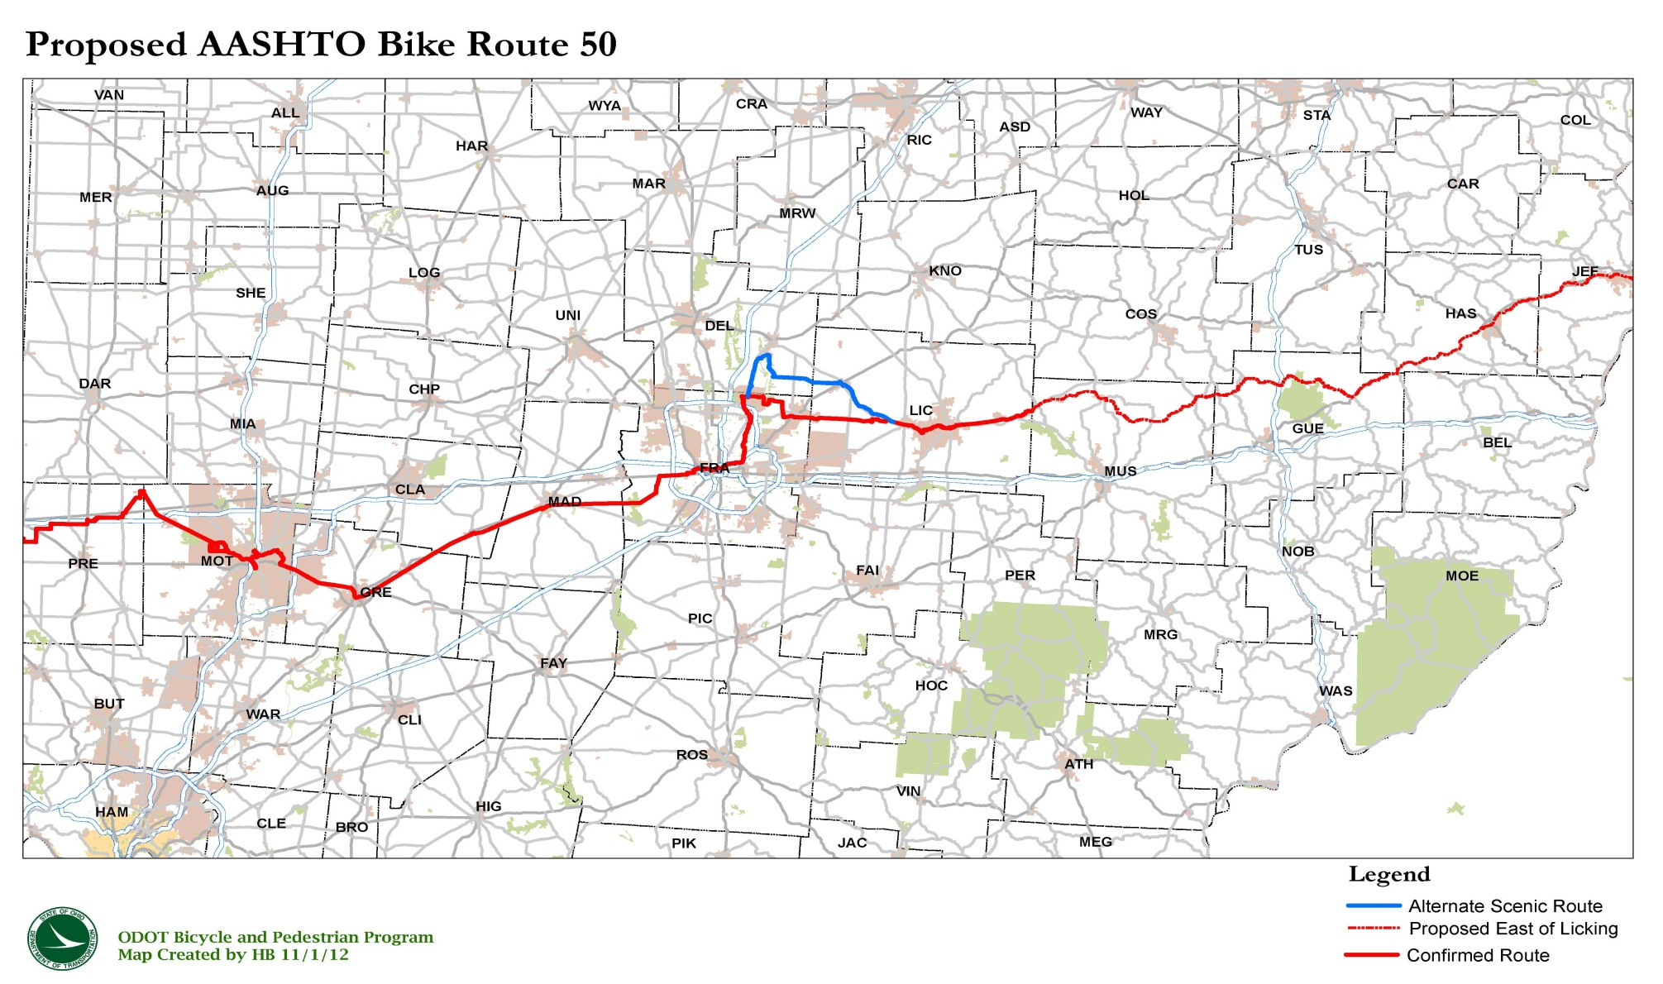
Bicycle Corridors
Notes:
Here is the proposed routing for US BR 50 from Richmond, IN to Steubenville, OH.
So far we:
7 out of 10 counties completed
Collaboration with local and county governments
Resolutions of Support
Application to AASHTO
This process is sort of our “pilot” process and will help us develop a streamlined designation process so we can move forward with the other routes. We’re going to focus on the national routes first.
This route 50 designation is helping us get a good handle on how much work is involved, how to best effectively do field review, what reporting should be required, how to best work through adoptions of resolutions, and how to compile the application for AASHTO.

Slide 23

Questions
Chuck Dyer
Project Manager – Access Ohio 2040
Chuck.Dyer@dot.state.oh.us
(614) 466-3718
Martin Guttenplan, AICP
Senior Transportation Planner – CDM Smith
GuttenplanME@cdmsith.com
(850) 386-9528

