Slide 1

Development and sensitivity testing of alternative mobility metrics in a regulatory context
John Gliebe, RSG, Inc.
James Strathman, Portland State University
Steven Tuttle, RSG, Inc.
Myra Sperley, Oregon DOT Research Section
Prepared for:
TRB Planning Applications Conference
7 May 2013

Slide 2
Acknowledgments
This work was funded by an Oregon DOT Research (SPR 716)
The authors are grateful for the contributions of the following individuals:
  Amanda Pietz,ODOT Research
  Sam Ayash, ODOT TPAU
  Terry Cole, ODOT Region 2
  Kathryn McGovern, PSU
  David Ruelas, PSU
  David Boyd, TAC
  Jazmin Casas , TAC
  Brian Gregor, TAC
  Douglas Norval, TAC
  Lidwien Rahman, TAC
  Michael Rock, TAC
  Mark Vandehey, TAC

Slide 3
Background
Oregon Highway Plan’s (OHP) mobility policies guide planning and programming by Oregon Department of Transportation (ODOT).
ODOT has land use change review responsibilities under the Transportation Planning Rule, as adopted by the state’s Land Conservation and Development Commission.
A single volume-to-capacity (v/c) metric currently supports OHP mobility policies and may be the basis for requiring mitigation. Sometimes this stops the project.
Critics of the single facility-based v/c measure charge that it is focused too narrowly on operational objectives.
In many cases, adherence to this standard has undermined community economic development, compact growth, and non-auto mode share objectives.
Numerous alternative performance measures have been suggested that would better capture these concerns; however, many of them are difficult to predict as an outcome of a particular land use change proposal.

Slide 4
Objectives
Demonstrate the potential use of alternative mobility metrics for evaluation of large-scale land use change proposals
  Related to goals found in the Oregon Highway Plan promoting non-SOV travel and efficient land use patterns
Explore how these metrics co-vary with each other and V/C
  Variation across inputs
  Variation across spatial dimensions
Provide information for consideration of metrics by policy boards or as part of transportation system planning (TSP) process

Slide 5
Case Study Methodology
Chose a representative land use scenario for model based analysis
  Previously analyzed by ODOT without pending decisions
Northgate Lifestyle Center proposal – Medford
  Centrally located
  Served by transit
  Near highway interchanges
  Semi-mixed use
Analyzed “build” and “no build” scenarios
  2010 Opening Year
  2025 Future Year
Sensitivity tests on alternative futures
  Fringe growth
  Scaled up development
  Conserved growth

Slide 6
Criteria for Selection of Metrics
Provides evidence of a change in travel activity that related to an OHP policy (e.g., promoting non-motorized travel modes)
May be theoretically or empirically linked to land use, socio-economic, or transportation system inputs
Robust over a range of inputs values
Can be forecast using established methods and data
Set of metrics should be complementary, avoid redundancy, offer a range of perspectives
Set of metrics should represent all travel modes and markets
Set of metrics should include both facility-specific and area-wide measurements
Should not include direct measurement of non-travel activity
  “Second-order effects” that results from travel-activity
  E.g., economic impacts, safety impacts, environmental impacts

Slide 7
Metrics Selected
Network wide V/C
Total vehicle hours of travel time
Person hours of travel time
Average person trip travel time
Trip length distributions
Mode shares
Regional accessibility to employment/shopping
  By Auto, Transit and Walk
Local accessibility to employment/shopping (20-min. neighborhood)
  By Auto, Transit and Walk

Slide 8
Other Metrics Considered
The study team’s review of literature revealed a long list metrics to consider. Some of the more noteworthy metrics that we rejected for this study, included…
  Land use variables related to urban form, street connectivity, lane miles of bike and pedestrian facilities
  Why? Existence value not easily quantified in terms of travel behavior. Focus should be on the traveler response.
  Reliability indices – planning time index, buffer time index, 95th percentile travel time
  Why? Difficult to forecast and attribute to a facility (area-wide measures). Ambiguous implications—very high congestion—reliably congested.
  Congestion duration, queuing, recurring delay
  Why? Impossible to forecast with static network assignment models. Need DTA.

Slide 9
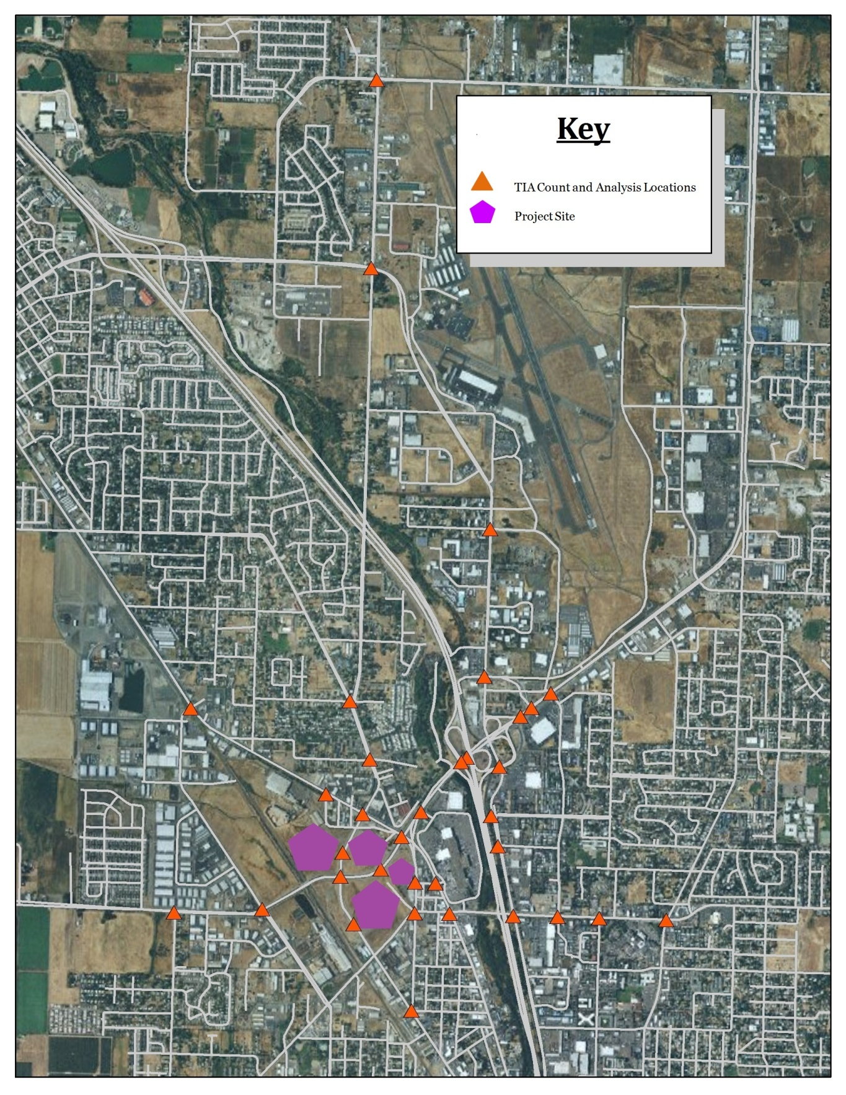
Study Area
219,300 square foot office park
  professional services and light industrial uses
417,500 square feet retail shopping space
167,000 square foot business park
Intra-development Trolley
Trolley following Central Ave

Slide 10
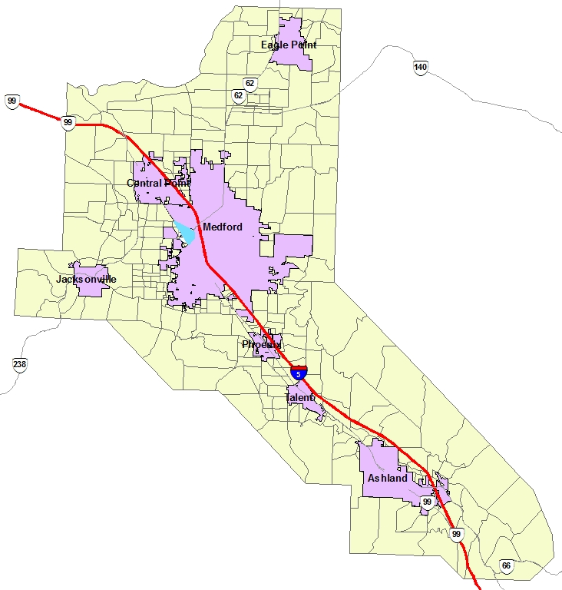
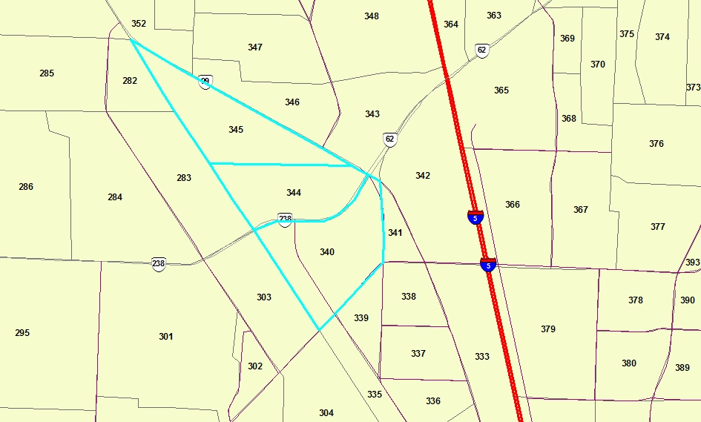
Study Area Cities and TAZ System
Northgate Site

Slide 11
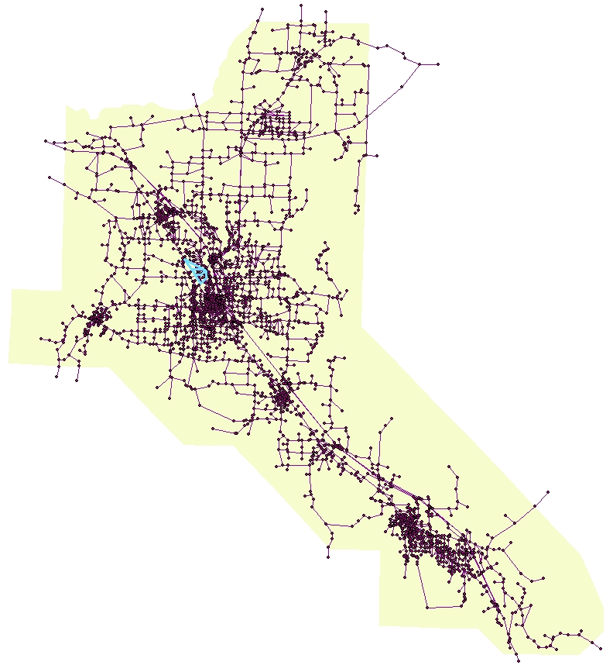
Network Model
Rogue Valley MPO (RVMPO)
Model Version 2, using JEMnR platform
  Supplied by ODOT- TPAU
  Converted from EMME/2 to EMME/3
  759 TAZs, 8671 links, 3016 nodes
  3 TAZs comprise the Northgate development
Northgate Site

Slide 12
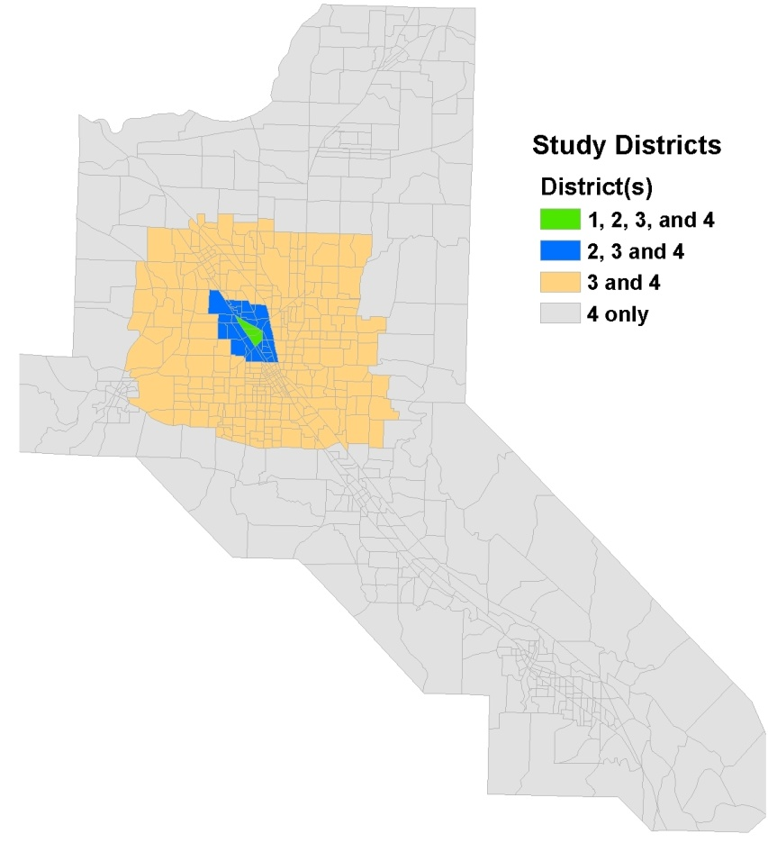
Study Districts Used for Analysis of Spatial Focus
Concentric Study Districts
  Site TAZs
  Approx. 1 mile out
  Approx. 4 miles out
  Entire region

Slide 13
Classifications of Trips by District
Used to establish spatial focus
If either the origin or the destination of a trip belonged to one of the TAZs on the map shown as District 1, then the trip was considered to belong to District 1.
If either the origin or the destination of a trip belonged to one of the TAZs on the map shown as District 2, inclusive of District 1, then the trip was considered to belong to District 2.
If either the origin or the destination of a trip belonged to one of the TAZs on the map shown as District 3, inclusive of Districts 1 and 2, then the trip was considered to belong to District 3.
All trips were considered to be part of District 4. For example, a trip with a trip end in District 1 will also be included in the tabulations for Districts 2, 3 and 4.

Slide 14
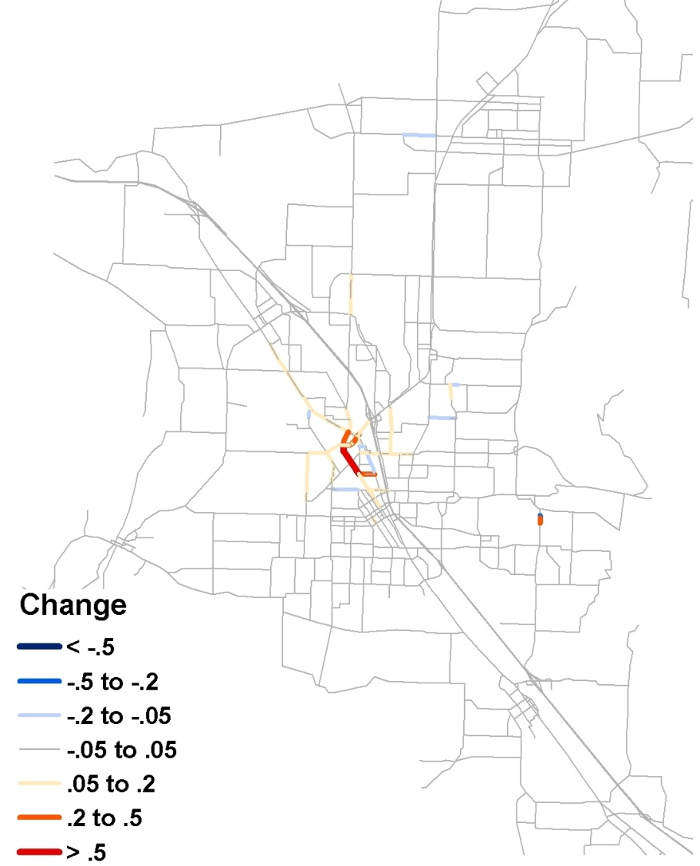
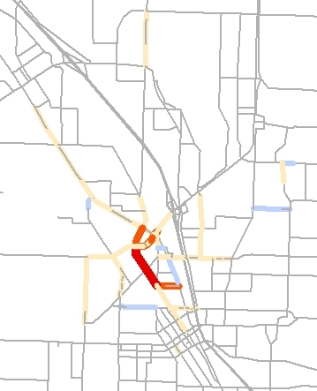
Network Wide V/C Change Analysis
Example: 2025 Baseline vs. Northgate Scenario

Slide 15
Travel Time Metrics
Total Network Travel Time
Person Hours of Travel Time

Slide 16
Trip Length Distributions
Example: 2025 Baseline vs. Build by Study District

Slide 17
Modes
Mode Shares
Trips by Mode

Slide 18
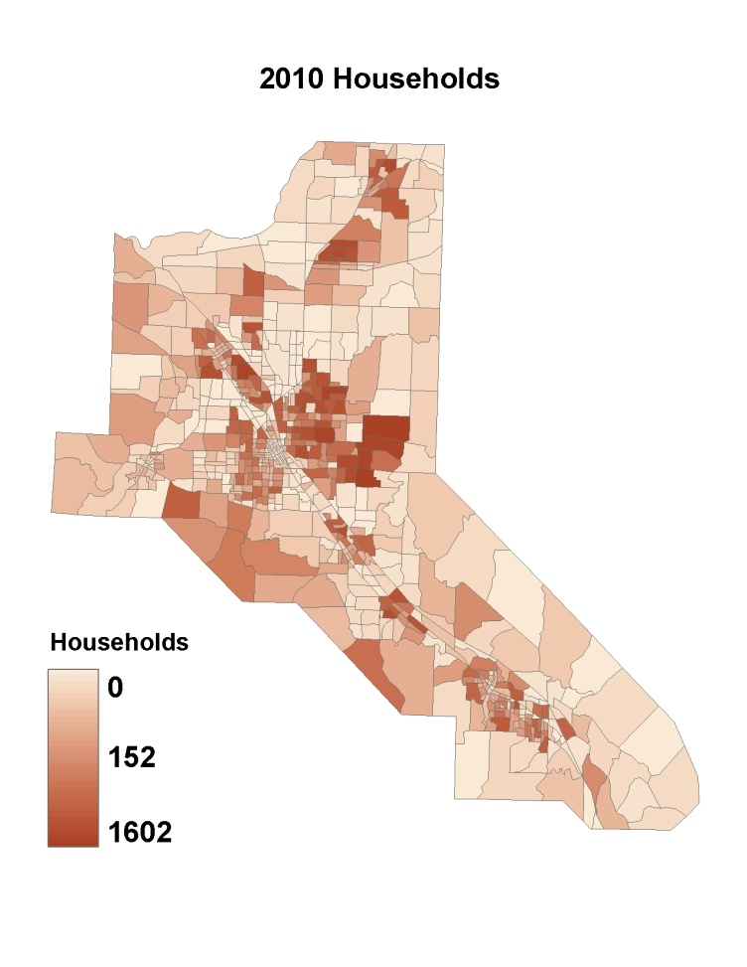
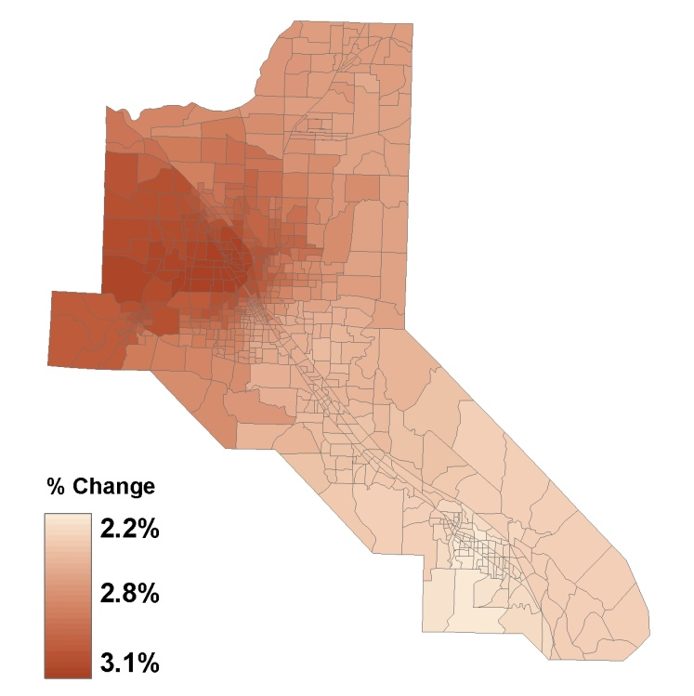
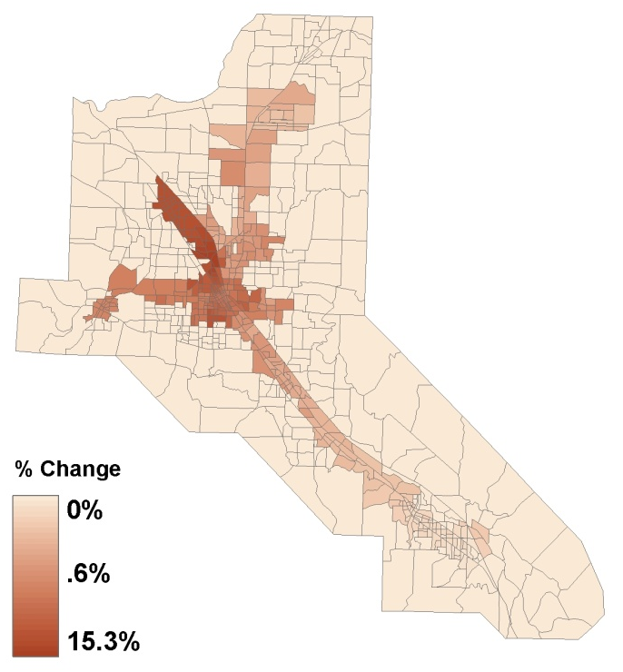
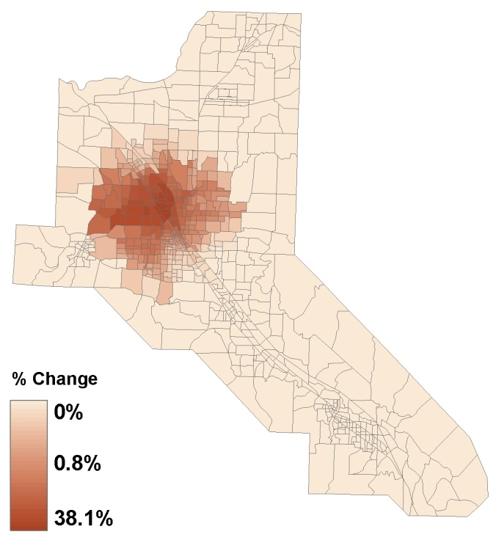
Regional Accessibility Baseline Build Scenario
Total Households
Auto / Highway
Transit
Walk

Slide 19
Local Accessibility
Measuring the 20-minute neighborhood
For example: if your spatial focus is limited to District 3, then the Northgate scenario would result in a 7% increase in access to retail shopping opportunities (employment) in 2010, using the 20-minute neighborhood concept.
Assumptions: walk speed 3 mph, bike speed 9 mph

Slide 20
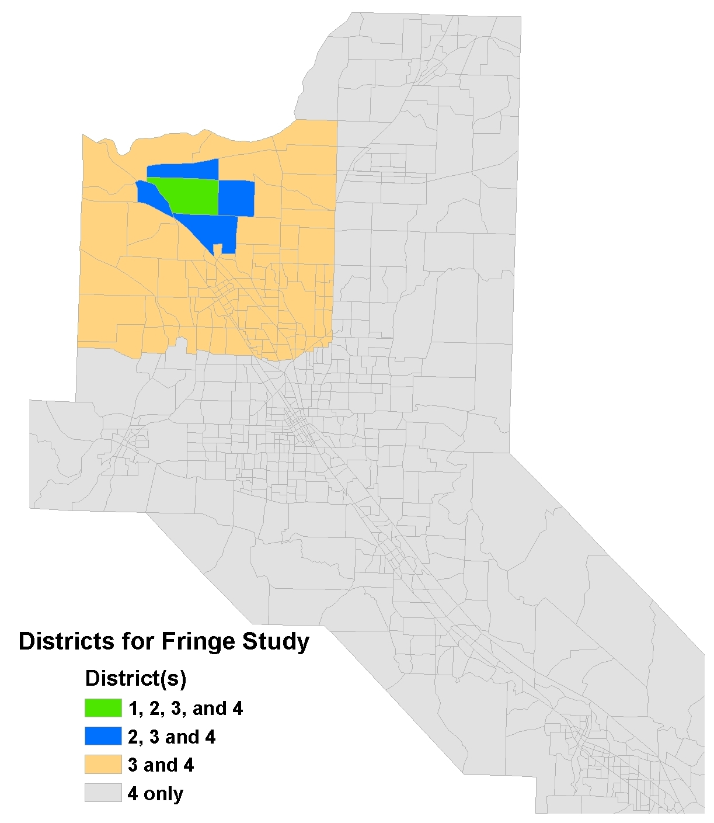
Sensitivity Tests
Relocating the Development to a Fringe Area
Scaling Up the Development
  (2X and 5x)
Conserved Growth
  no net gain in total employment
  Subtracted Northgate employment from elsewhere

Slide 21
Lessons Learned
Fringe Growth
  Lower impact on surrounding transportation facilities
  Fewer total trips attracted, but nearly all auto
  Net V/C, PHT, Average Person minutes, Regional accessibility, number of trips by mode and study district capture differences
Scaled Up Development
  More dramatic positive and negative changes
  Many more local trips, and many more regional trips—offsetting impacts
  Net V/C, PHT, Average Person minutes, Regional accessibility, number of trips by mode and study district capture differences
Conserved Growth
  Shows how a new regional center will draw trips away from other neighborhood locations
  Net impacts may be negative or positive (negative mostly in this case)
  Net V/C and regional accessibility capture differences best

Slide 22
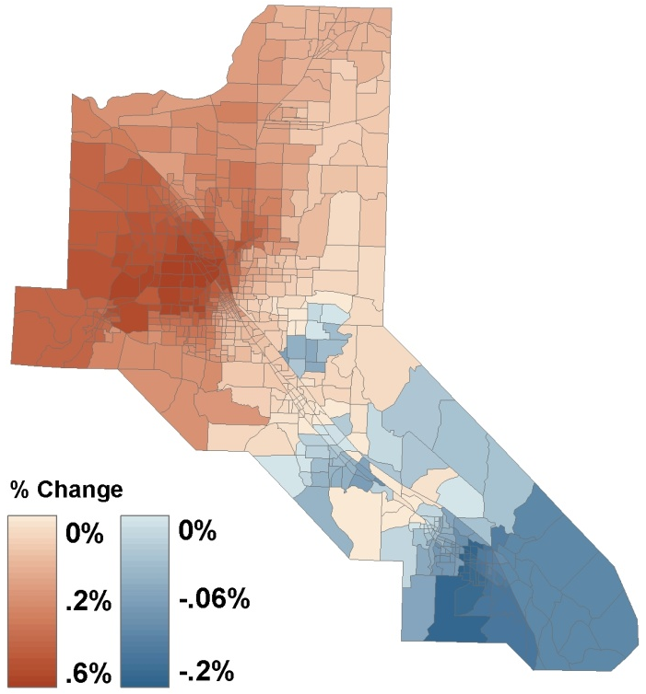
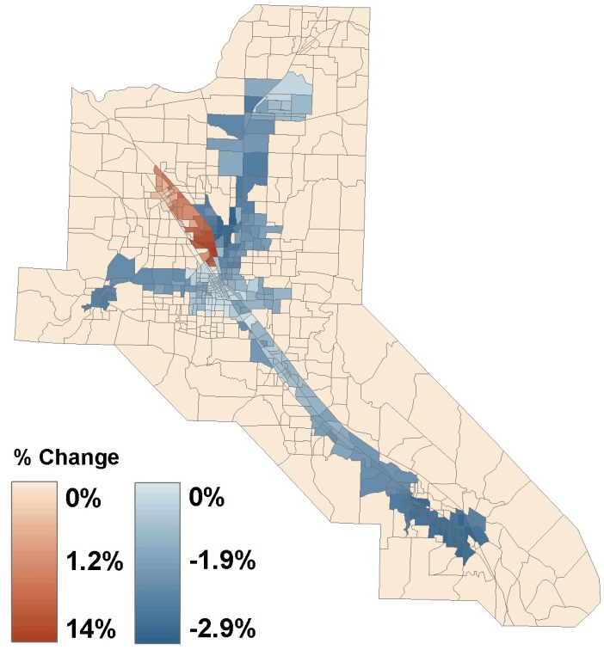
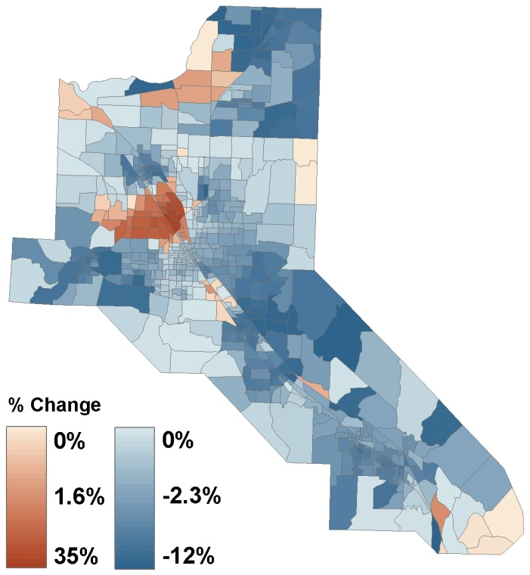
Regional Accessibility Conserved Growth Scenario
Total Households
Auto / Highway
Transit
Walk

Slide 23
Lessons Learned
The geographic distance at which one measures land use change impacts is important—affects attenuate further from the source of change. Not surprising, but important for regulatory usage.
At the regional level, all modeled scenarios led to slight increases in auto travel and slight net reductions in non-auto travel.
The concentration of a large amount of commercial development in a single location has non-linear increasing effects on trip attractions.
Because the model system is production constrained and because the build scenarios assumed only an increase in employment, without increases in households and workers, scenarios involving an increase, decrease or change in location of employment due to the Northgate development all produced the same number of total trips for the region.

Slide 24
Assessment of Metrics
Network-wide V/C Changes
  Best for showing direct impacts and can show offsetting effects if evaluated network wide
  Does not explain why changes occur where they do
Total Network Travel Time and Distance
  Theoretically nice for portraying total network impacts
  Not sensitive enough to local changes---too aggregate
  Potentially misleading—hides problems
  Lacking in insights
Total Person Hours of Travel Time
  Captures both increased trip lengths and mode shifts together
  Potentially misleading (e.g., walk time increase may be beneficial)
  Misses out on external markets and trucks

Slide 25
Assessment of Metrics
Average Person Trip Lengths & Trip Length Distributions
  Nice to show changes in average trip lengths
  Does not provide enough insight on underlying behavior
  Potentially misleading—regression to the mean
Mode Shares
  Percentage shares can be misleading due to small magnitudes of some modes
  Number of trips by mode and total trips are useful as diagnostics, but difficult to use in a standardized way
Regional Accessibility
  Good for showing benefits of travel differentiated by mode
  Needs to be put into context of households (or whoever benefits)
Local Accessibility (20-minute neighborhood)
  Very little regional variation for small areas (need to resize buffer)
  Arbitrary buffer, misleading treatment of trips within buffer

Slide 26
Recommendations for Further Consideration
Network-wide V/C Budget
  Familiar measurement concepts
  May be extended to include V/C “budget”
  Improved V/C on some facilities would offset worsened V/C on others in mitigation negotiations
  Requires precise measurements of V/C using network models that can portray pluses and minuses
Regional Accessibility
  Closely related to economic benefits calculations
  May be derived precisely from econometric formulations
  Should be weighted by households or other beneficiaries
  Could be simplified and standardized
  TBD: form of impedance functions, spatial units

Slide 27
Methodological Recommendations
Limitations of trip-based modeling and static network assignment are “exposed” in this type of analysis.
Activity-based models would respond more appropriately because discretionary, secondary stop making would vary based on accessibility (not production constrained). Tour-based travel paradigms might respond differently, as well.
Dynamic Traffic Assignment (DTA) would enable us to consider additional mobility metrics related to reliability, e.g., recurring delay, duration of congestion, and queuing.

Slide 28
Questions and Answers
For more information:
John Gliebe, RSG 802-295-4999

