Slide 1
New Features to Represent Pricing in the SACSIM
Activity-based Model
Mark Bradley, RSG
John Bowman, JBR&C
Bruce Griesenbeck, SACOG
Joe Castiglione, RSG
John Gibb, DKS

Slide 2
Acknowledgments
Others who contributed to this work….
Gordon Garry, SACOG
Yanmei Ou, SACOG
John Long, DKS
Maren Outwater, RSG
Bryce Lovell, RSG
Leo Duran, RSG
John Mulholland, RSG
John Gliebe, RSG

Slide 3
What is SACSim?
The regional forecasting model used by Sacramento Area Council of Governments (SACOG)
Was one of the first activity-based (AB) models used in regional planning – used for the 2008 and 2012 RTP’s
Was the first application of the DaySim software.
Was the first practical AB model to be applied at the parcel level.

Slide 4
What is DaySim?
DaySim is a modeling approach and software platform to simulate resident daily travel and activities on a typical weekday for the residents of a metropolitan region or state.
In essence, DaySim replaces the trip generation, trip distribution and mode choice steps of a 4-step model, while representing more aspects of travel behavior (auto ownership, trip chaining, time of day scheduling, detailed market segmentation, etc.)
It is built to be integrated into a network software package such as CUBE, TransCAD, EMME or VISUM. It generates resident trip matrices for assignment and uses the network skims from assignment for the next global iteration of DaySim.

Slide 5
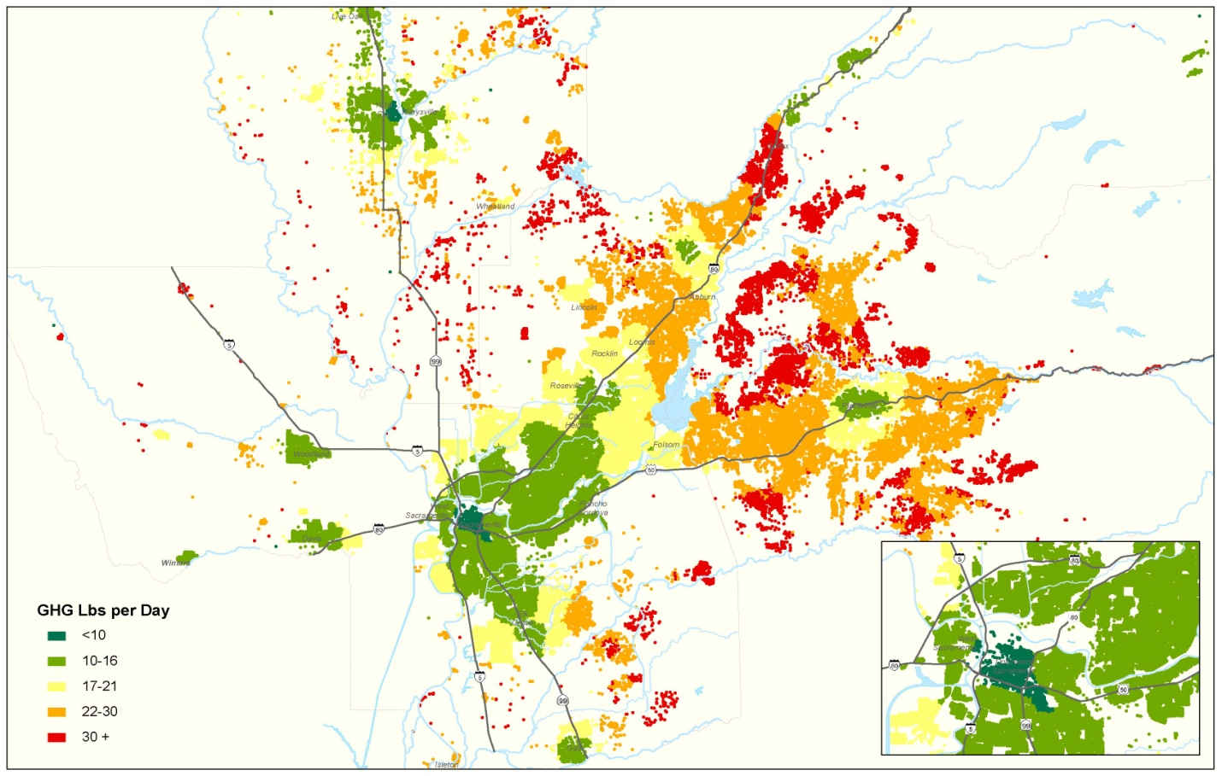
Example: Environment and Climate Change
GHG estimates by residence parcel -- Sacramento Area Council of Governments

Slide 6
Objectives of the SACSim update project
Add capabilities for modeling toll/non-toll choice within DaySim, capable of capturing differences in willingness to pay (VOT) across the population.
Add more detail to parking price sensitivity for workers
Add detail regarding transit pass ownership and fare discounts
Add capabilities to predict choices between premium and non-premium transit services
Add park and ride lot choice model, including lot pricing and capacity constraint across the course of a day
Add bicycle network detail, with multiple factors influencing generalized cost of bike travel
Include better short-distance trip impedance measures using shortest path distances from an all-streets network
Add a model to predict residence parcel for each household in a TAZ

Slide 7
Model components added to DaySim for this project
Upper level models
Transit pass ownership
Availability of free parking at workplace
Lower level models
Path type model, used by many other component models….
  Walk path type model
  Bike path type model (considers various path attributes)
  Auto path type model (toll, non/toll)
  Transit path type model (service type, fare details)
  Park and ride path type model (adds lot choice)
Each of these provides a generalized time logsum across all relevant path types.
Each includes all-streets network distance for short-trips/walk access

Slide 8
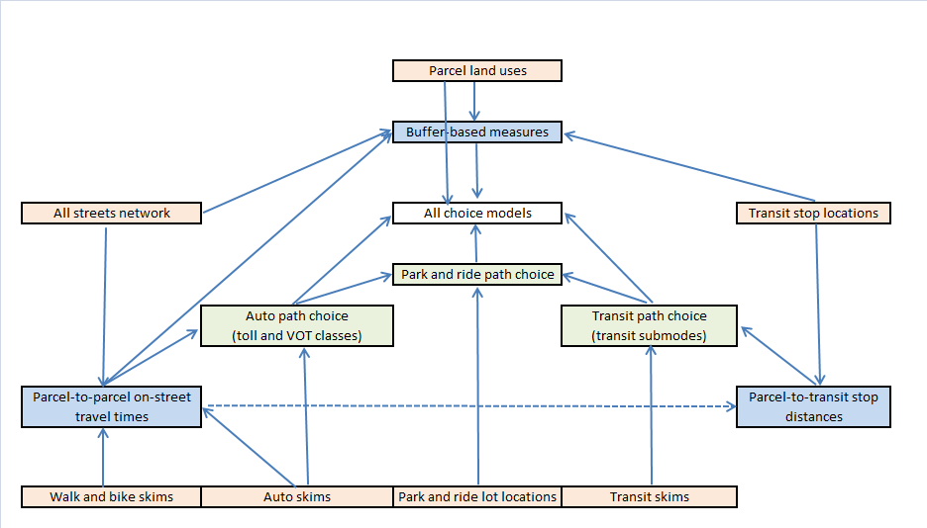
Consistent framework for spatial data to feed into the models

Slide 9
New SACSim mode choice structure
Auto
Transit
Non-motorized
Walk
Bike
SOV
HOV 2
HOV 3+
Auto access
Walk access
Toll
No Toll
Toll
No Toll
Toll
No Toll
Light rail
Com-muter
Local bus
Light rail
Com-muter
Local bus
CUBE Voyager path skims
Park&ride lot choice
CUBE PT path skims

Slide 10
Auto toll/non-toll path type choice model
Applied findings from the SHRP 2 C04 project “Improving Our Understanding of How Highway Congestion and Pricing Affect Travel Demand “ (Vovsha, Bradley, Mahmassani, others)
All auto skim matrix information “filtered” through this model.
If no separate non-tolled network, simply gives generalized time of the best path
Otherwise gives generalized time logsum across the best tolled and non-tolled paths (in units of minutes)

Slide 11
Binary route type (toll / no toll) choice model
V(n,i) = s.b(i) * Time(n,i) + s.c(i) * Distance(n,i) * opcost
V(t,i) = s.a(i) + s.b(i) * Time(t,i) + s.c(i) * (Toll(t,i) + Distance(t,i) * opcost )
P(t,i) = 1 – P(n,i) = exp[V(t,i)] / (exp[V(t,i)] + exp[V(n,i)] )
V(n,i) and V(t,i) are the logit utilities for the best no-toll and toll routes for individual i
P(t,i) and P(n,i) are the corresponding binary logit probabilities.
Time(n,i), Time(t,i), Distance(n,i), Distance(t,i) are the travel time and distance along the best no-toll and toll routes, for individual i, depending on the traveler/trip’s origin, destination, time of day, and value of time (VOT) class.
Toll(n,i) is the toll along the best tolled route for traveler i, depending on the traveler/trip’s origin, destination, time of day, and value of time (VOT) class.

Slide 12
Binary route type (toll / no toll) choice model (2)
V(n,i) = s.b(i) * Time(n,i) + s.c(i) * Distance(n,i) * opcost
V(t,i) = s.a(i) + s.b(i) * Time(t,i) + s.c(i) * (Toll(t,i) + Distance(t,i) * opcost )
P(t,i) = 1 – P(n,i) = exp[V(t,i)] / (exp[V(t,i)] + exp[V(n,i)] )
opcost is the auto operating cost per mile
a(i) is an alternative-specific constant for the tolled route for traveler i
b(i) is the travel time coefficient for traveler i
c(i) is the travel cost coefficient for traveler i
s is a scale factor applied to all coefficients, denoting the scale of this model relative to mode choice. (Affects how much the inferior path choice will contribute to the logsum)

Slide 13
Traveler- & tour-specific model coefficients
Work tours
c(i) = -0.15/$ / [ ((income(i) / 30,000) ^ 0.6 ) * ( occupancy(i) ^ 0.8 ) ]
b(i) = -0.030/min * draw from a log-normal distribution, with mean 1.0 and coef. of variation 0.8
a(i) = -1.00
s = 1.5
Non-work tours
c(i) = -0.15/$ / [ ((income(i) / 30,000) ^ 0.5 ) * ( occupancy(i) ^ 0.7 ) ]
b(i) = -0.015/min * draw from a log-normal distribution, with mean 1.0 and coef. of variation 1.0
a(i) = -1.00
s = 1.5

Slide 14
“Generalized time” logsum from path type choice
V(n,i) = s.b(i) * Time(n,i) + s.c(i) * Distance(n,i) * opcost
V(t,i) = s.a(i) + s.b(i) * Time(t,i) + s.c(i) * ( Toll(t,i) + Distance(t,i) * opcost)
Generalized time GT(i) = LN [ (exp[V(t,i)] + exp[V(n,i)] ) / (s.b(i)) ]
When only one path type is available, this is simply the generalized time for that path type.

Slide 15
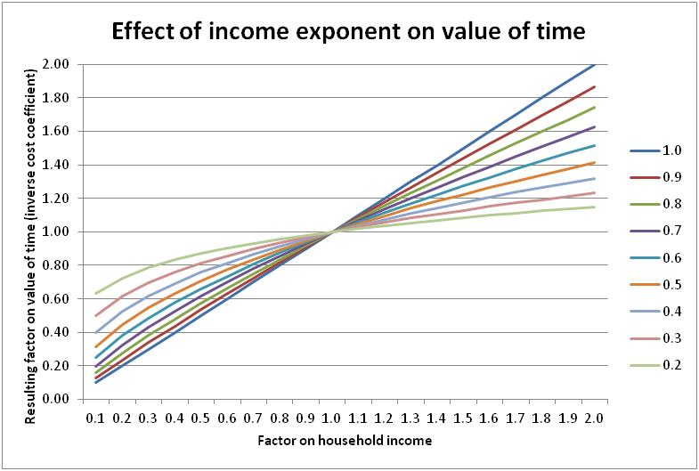
How does VOT vary with income?

Slide 16
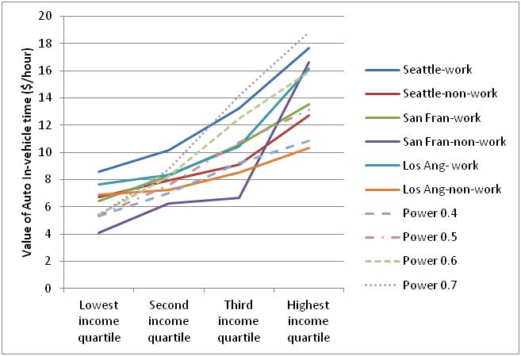
VOT variation with income – various C04 data sets

Slide 17
Shape of Log-Normal Distribution

Slide 18
How is this implemented?
1. Use CUBE to generate time, distance, toll matrices for each combination of :
  Time period: In the range of 5 to 15 different skim periods
  Path type: (1) full network, (2) network excluding tolled links
  VOT threshold: A user-defined number of different values, V(1), V(2), … V(N)
  Occupancy: (1) SOV, (2) HOV 2, (3) HOV 3+ (if necessary)
2. Use DaySim to simulate toll/no toll choice for a given trip, depending on the VOT for that specific person/tour/trip…
  If VOT < V(1), use V(1) skims
  If V(1) < VOT < V(2), use V(2) skims, etc.
  If V(N-1) < VOT, use V(N) skims
Every auto trip predicted by DaySim has a VOT and path choice (full network or non-toll network)
Aggregate trips into vehicle matrices by time period x path type x VOT group for multi-class assignment.

Slide 19
Time of day choice - DaySim Scheduling Models
Scheduling models predict
  Arrival time / departure time for primary destinations
  Arrival /departures times for stops
Key parameters
  Person type, Income
  Overall day pattern
  Available time windows
  Network impedances/costs

Slide 20
Advantages of the approach
An alternative approach is to include all of the toll/non-toll choice in the CUBE path-building.
The main advantages of including path type choice in the AB model:
The model is sensitive to small variations in VOT (more disaggregation)
The model can provide expected utilities (“logsum”) over multiple paths (more consistent with choice theory)
The number of required VOT classes/skims is less, and can be tailored to the complexity of the pricing scenario (more memory-efficient and flexible)

Slide 21
How the path type model outcome is used in DaySim

Slide 22
Transit path type choice model
SACSim now includes 3 different transit path types:
Local bus
Light rail (can include local bus feeder)
Commuter rail/commuter bus (can include local bus, light rail feeder)
Skim variables
In-vehicle time in local bus Allows different
In-vehicle time in light rail disutility of IVT
In-vehicle time in commuter rail/bus by vehicle type
First wait time
Number of transfers
Transfer time
Full fare

Slide 23
How is this implemented?
CUBE PT provides skim matrices with the best path by combination of path type (local bus only, light rail, commuter bus/rail) and time period (AM peak, midday, PM peak, evening, night)
Separate skims by VOT class can be accommodated, but there is probably very little price variation within any single path type
The SACSim transit path type model calculates a generalized time logsum across the available path types for use in other models. Also predicts a single chosen path type (if needed).
Further details
Drive access/egress times from park and ride lot choice model
Walk access/egress times calculated from parcel-to-stop distances
Full fare can be overridden by discount fraction or pass ownership.

Slide 24
Park and ride path type and lot choice model
Applied at the tour level, and park and ride tours are constrained to stop at the same park and ride lot on both half tours.
Uses data on available park and ride lots: location, price, capacity
Applied “on the fly”, like the other path type models. For each transit path type, find the best combined auto/transit path via all possible park and ride lots.
Can be applied with “shadow pricing” across global iterations…. Lot / time of day combinations where simulated occupancy exceeds capacity are given an artificially higher price during those periods.
Currently used only for home-based-work tours

Slide 25
Extension- walk to transit stop choice model
Similar concept as park and ride lot choice model, but at both trip ends.
Instead of assuming the nearest transit stop to each parcel, and using TAZ-TAZ transit skims, do the following:
Create Stop Area-to-Stop Area transit skims, with a “stop area” including all transit stops that are very near each other
For each parcel (or “microzone”) , pre-specify a set of the stop areas within walking distance, and the all-streets network distance to each
For any parcel (or “microzone”) O-D pair, search across all combinations of origin stop areas and transit stop areas to find the combined walk – transit – walk path. (Only the transit part is from skims).
This is not yet being implemented in SACSim, but is being added to Daysim for Philadelphia (and is being implemented by others for San Diego, the Bay Area, and Chicago).

Slide 26
Treatment of transit pricing
Transit skims assume full fare.
User can define fare discount fractions depending on person type.
Example of assumptions
  Child under age 5 80% discount
  Child age 5-15 50% discount
  Grade school student age 16+ 50% discount
  University student 50% discount
  Adult age 65+ 35% discount
The transit pass ownership model overrides the discount factors – transit pass owners are assumed to face 0 fare for an individual trip

Slide 27
Transit pass ownership model - estimation
Estimated on data from the PSRC 2006 Household Travel Survey
Key variables
Person type: Univ. student (+), Part-time worker (-), Retired (-), Child (-), Other non-worker (--)
Log of income (--)
Distance from home parcel to nearest transit stop (--)
Worker - No transit path from home to usual workplace (-)
Student - No transit path from home to usual school (-)
Worker- Improvement in generalized time by transit to workplace by having a transit pass (+)
Home parcel 0-car mode/destination accessibility logsum (+)
Worker work parcel 0-car mode/destination accessibility logsum (+)
Student school parcel 0-car mode/destination accessibility logsum (+)

Slide 28
Transit pass ownership model - application
All persons who are predicted to own a transit pass face 0 marginal cost for using transit at the tour and trip level.
Transit pass ownership can also influence auto ownership and mode choice, above and beyond the marginal cost effect.
The model user can specify a future year/policy cost index, and a cost elasticity for transit pass ownership. The cost elasticity cannot be estimated from household survey data – need other evidence.
This model provides a way to implement several types of policy tests, such as increased employer, school, or government subsidy of transit pass ownership.

Slide 29
Pay to park at workplace model - estimation
Estimated on data from the 2000 SACOG Household Travel Survey
Key variables (+ means higher prob. of paying to park at work):
Part-time worker (+)
Higher income (--)
Log of total employment in the work parcel buffer (+)
Log of paid parking spaces per employee in the work parcel buffer (+)
Frac. Government employment in the work parcel buffer (+)
Frac. Education employment in the work parcel buffer (-)

Slide 30
Pay to park at workplace model - application
Workers who are predicted to have to pay to park at the workplace face the average daily price for paid parking spaces in the usual work parcel buffer.
Otherwise, parking at work is assumed to be free in the work tour and trip level models.
In the future, a capacity-constrained model for choice of a CBD paid parking lot/garage could be implemented, similar to the model for park and ride lot choice

Slide 31
Use of these models thus far….
Being calibrated and tested at SACOG
Tested in Jacksonville as part of the SHRP 2 C10A project (in that case, integrated with Transims network model rather than CUBE)
Recently implemented in Jacksonville and Tampa for upcoming regional forecasting work (integrated with CUBE)
Being implemented in Seattle and Philadelphia (along with models of explicit intra-household interactions (other paper in this TRB session))
Questions?

Slide 32
Greater Temporal Detail in DaySim
Explicitly represent individual travel across entire day
  Interconnected series of tours and trips
  Incorporates detail on available “time windows” when scheduling each activity
  Network performance can vary within short periods (if many different time periods are used in assignment)
Resolution
  Scheduling models use half-hour periods
  Different network temporal resolutions can be accommodated. More periods requires more assignments (or else DTA)

Slide 33
DaySim Software and Hardware
Software
  Programmed in C#, Visual Studio, Microsoft .Net platform
  Optimized memory and data handling
  Two levels of distributed processing for faster runs
    Distribution of households across different processors on a single machine.
    Higher level distribution of households to different physical or virtual machines.
    On a standard PC, simulates about 1 million persons per hour. Less if distributed across multiple machines. (Significantly faster than quoted for other AB model software)
  Client project is customized
  Inputs and outputs are integrated with any travel modeling package
  Same code used for model estimation and application
Hardware
  Runs on 64-bit Windows systems
  Expected minimum configuration:
    Single box with 4+ processing cores (more cores will reduce run times)
    8 GB RAM (16 GB if using more than 1,500 zones)

