Slide 1
FHWA Traveler ANALYSIS FRAMEWORK
Auto, Air, and Rail Tables
Krishnan Viswanathan, CDM Smith
Colin Smith, RSG
Bhargava Sana, RSG
March 18, 2013

Slide 2
Agenda
Purpose
Auto
Air
Rail
Geography

Slide 3
FHWA Traveler Analysis Framework
VMT Forecasting and Analysis Model
Long Distance Passenger Inter-regional Travel Origin Destination Data
National Travel Model
Long distance passenger travel modal choice model
Freight and passenger integration, and multimodal analysis

Slide 4
Project Objective and Deliverables
To provide foundational information for FHWA, and the U.S. DOT in analyzing national and regional significant projects, corridors, policy initiatives, interstate commerce, and role of Federal programs.
Long-distance inter-regional multimodal passenger travel origin destination matrix for 2008 and 2040
A set of documented and transparent methodologies where other agencies and organizations can gain insight knowledge to expedite future developments

Slide 5
Project Team
FHWA
Daniel Jenkins, PM
Roger Mingo Associates
Roger Mingo
CDM Smith
Krishnan Viswanathan
Don Vary
RSG, Inc.
Colin Smith
Bhargava Sana

Slide 6
Data Examined
1995 ATS
2001 NHTS
DK Schifflet (2008)
CA Long Distance Survey (2011)
Ohio Long Distance Survey (2002-2003)

Slide 7
AUTO

Slide 8
Data Examination Conclusions
No existing data are readily available to cover the base year of 2008 for the entire nation
Base year 2008 OD data – need to be synthesized
2040 OD data – need to be forecasted (synthesized)
The only national comprehensive data available is the 1995 ATS

Slide 9
Data Synthesis Method Exploration
Methods desired are ones having the following characteristics:
The least number of input data items needed
Input data items are readily available
Statistically valid

Slide 10
2008 and 2040 Trip Production and Attraction
Trip Productions
Business = 0.47692 x Population (R² = 0.90)
Non Business = 2.19893 x Population (R² = 0.95)
Population data are from Census for 2008 and from Woods and Poole for 2040
Trip Attractions
Business = 1.09773 x QCEW Employment (R² = 0.89)
Non Business = 6.573 x QCEW Leisure & Hospitality and Service Providing industry Employment (R² = 0.91)
QCEW data from BLS for 2008 and Woods and Poole employment data for 2040

Slide 11
Trip Distribution – Formation of OD Pair
Destination Choice Formulation
Business_{j} = 0. 536*(LN(Households_{i}) + 2*LN(Employment_{j})) -2.81*LN(Distance_{ij})
Non Business_{j} = 0.584*(LN(Households_{i})+2*LN(Employment_{j} )) - 2.47*LN(Distance_{ij} )
The utilities are applied at the county level to obtain county to county flow table

Slide 12
Special Generators
National Parks
Obtain 2008 national park visitors
Obtain percent of national park visits that come from 100 +miles from NPS surveys (collected between 2003 to 2011)
Yosemite, Grand Canyon, Shenandoah, Colonial National Historical Park (NHP) (provided mode and resident state information)
Smoky Mountain, Boston NHP, Congaree (provided resident state information)
Apply this percent to total 2008 NPS visitors
Resulting in NPS visitors that come from 100+ miles by auto
Apply non business destination choice model

Slide 13
Special Generators
Cross Border Traffic
Obtain 2008 in bound passengers from BTS
Calculate percent of long distance trips from Statistics Canada border crossing information
Apply this percent to total 2008 in bound passenger data
Resulting in border crossing trips that come from 100+ miles by auto
Allocate these trips to the county where the border crossing is located
Apply non business destination choice model

Slide 14
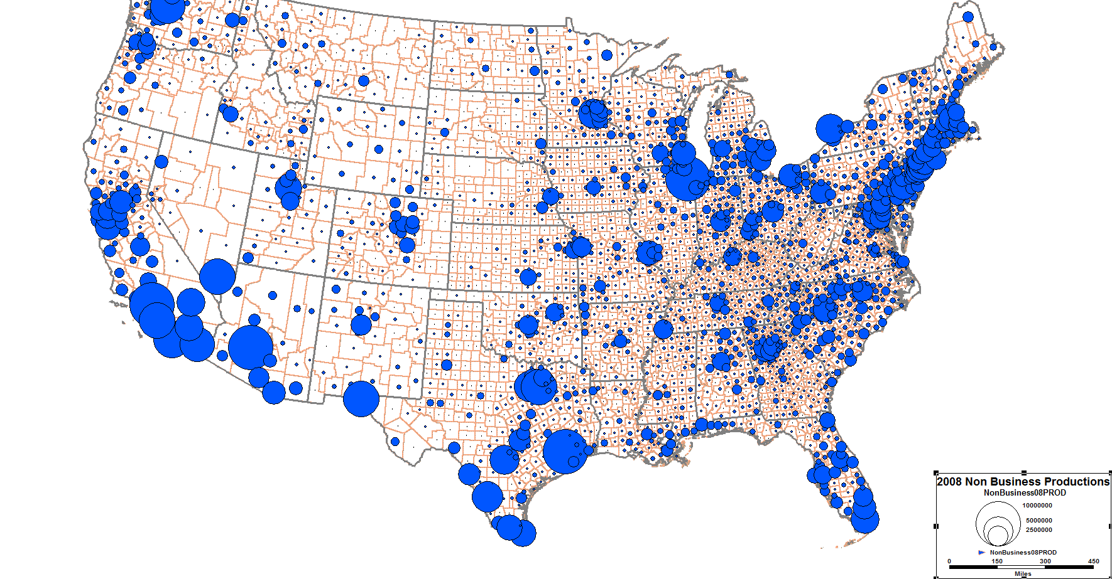
2008 Non Business Trip Productions

Slide 15
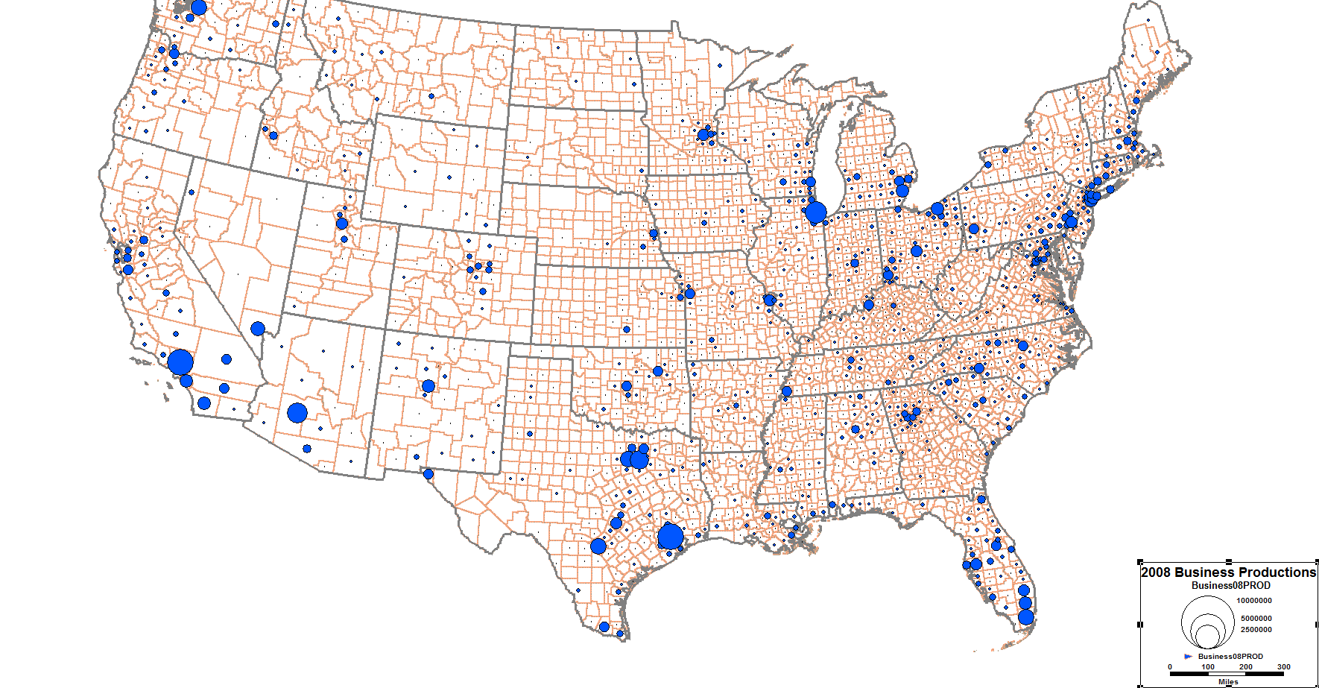
2008 Business Trip Productions

Slide 16
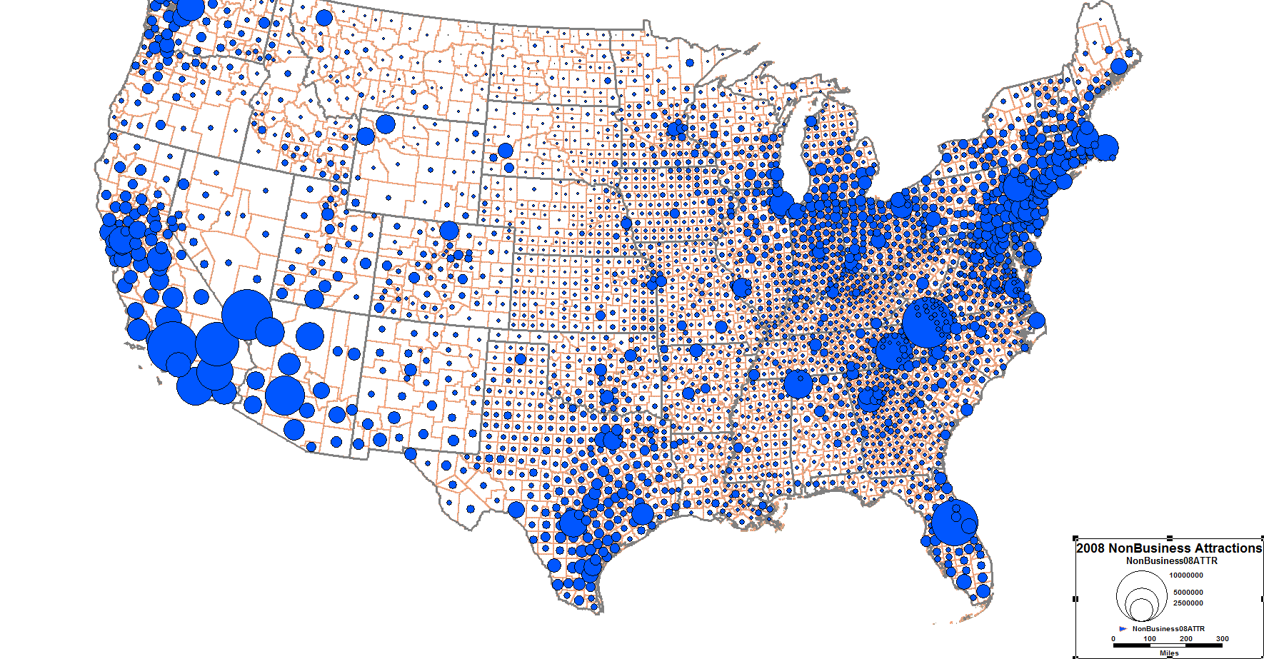
2008 Non Business Trip Attractions

Slide 17
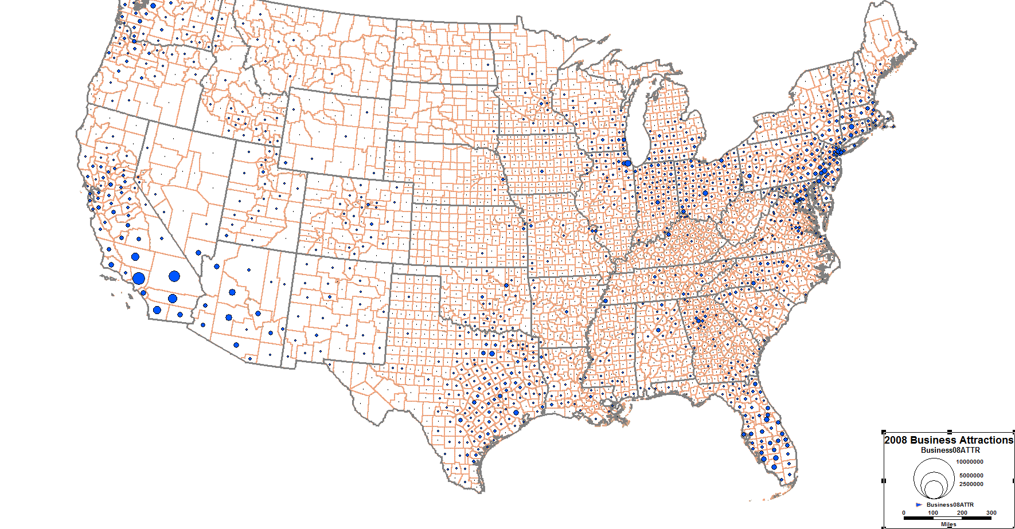
2008 Business Trip Attractions

Slide 18
Trip Length Distribution Auto
Distance Bin | Estimated 2008 Auto | 1995 ATS Auto | 2002/2003 Ohio Long Distance Survey | 2008/2011 California Long Distance Survey (Enhanced) | 2008/2011 California Long Distance Survey (Reduced) |  | Estimated 2040 Auto
100 to 200 miles | 52.6% | 54.9% | 59.7% | 59.3% | 60.1% |  | 50.5%
200 to 300 miles | 18.8% | 20.8% | 15.2% | 13.9% | 13.6% |  | 18.0%
300 to 400 miles | 10.1% | 8.9% | 9.7% | 19.6% | 19.2% |  | 9.8%
400 to 500 miles | 6.2% | 4.5% | 5.5% | 6.4% | 6.2% |  | 5.9%
500 to 600 miles | 4.3% | 2.8% | 3.6% | 0.7% | 0.9% |  | 4.1%
600 to 700 miles | 3.1% | 1.8% | 1.9% | 0.1% | 0.1% |  | 3.0%
700 to 800 miles | 2.2% | 1.3% | 1.8% | 0.0% | 0.0% |  | 2.2%
800 to 900 miles | 1.6% | 1.0% | 1.1% | 0.0% | 0.0% |  | 1.7%
900 to 1000 miles | 1.2% | 0.7% | 0.7% | 0.0% | 0.0% |  | 1.3%
More than 1000 miles | 2.6% | 3.3% | 0.8% | 0.0% | 0.0% |  | 3.5%

Slide 19
Summary Results*
 | Auto | Air | Rail | Bus
Share 1995 | 81.3% | 16.1% | 0.5% | 2.0%
Share 2008 | 82.2% | 14.5% | 0.6% | 2.3%
Share 2040 | 80.1% | 16.7% | 0.6% | 2.2%
Total Growth (1995 to 2008) | 50% | 34% | 81% | 68%
Annual Total Growth (1995 to 2008) | 3.2% | 2.3% | 4.7% | 4.1%
Total Growth (2008 to 2040) | 43% | 69% | 46% | 38%
Annual Total Growth (2008 to 2040) | 1.1% | 1.6% | 1.2% | 1.0%
*We have not included trip numbers because FHWA is currently reviewing the products (and possibly adjusting the bus and geography aggregation). All should be released by the end of the summer.

Slide 20
From Los Angeles County Destination Zones with more than 500,000 auto trips
BUSINESS
NON BUSINESS

Slide 21
From Los Angeles County Destination Zones with more than 100,000 auto trips
BUSINESS
NON BUSINESS

Slide 22
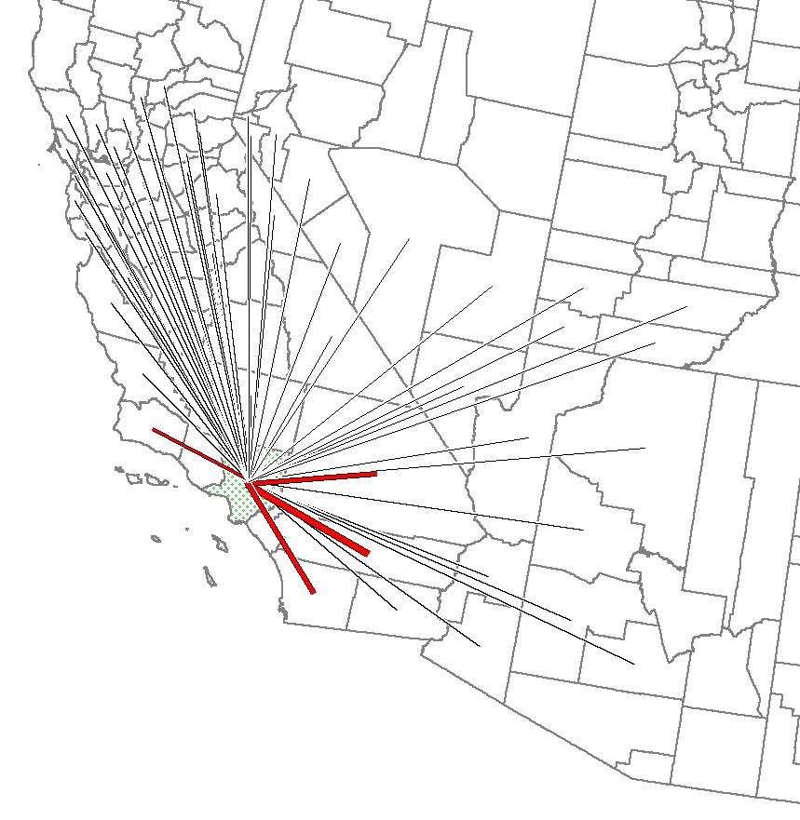
From Los Angeles County Destination Zones with more than 50,000 auto trips
BUSINESS
NON BUSINESS

Slide 23
From Los Angeles County Destination Zones with more than 10,000 auto trips
BUSINESS
NON BUSINESS

Slide 24
From Los Angeles County Destination Zones with more than 5,000 auto trips
BUSINESS
NON BUSINESS

Slide 25
Geography
FAF MSA further separated by State lines
Additional Urban Areas
Further division of the balance of a State (rural area) into geo-contiguous zones

Slide 26
Geography

Slide 27
AIR and Rail

Slide 28
Overview of the approach: 2008 Air and Rail
Objective: develop 2008 county to county air passenger and rail passenger trip tables including access and egress portion of trips
Airport to airport OD from DB1B 10% ticket sample, augmented with T-100 data
Airport access and egress distributions based on either ground access survey data or distribution models estimated using survey data
Station to station OD data obtained from AMTRAK, adjusted to include California Thruway bus passengers
Station access and egress distributions based on models estimated from airport ground access surveys and then calibrated with California survey data

Slide 29
Methodology for Air* OD Table
Origin: County I
Airport access surveys /
trip distribution models
Destination: County IV
25%
Origin: County II
Airport A
1,000,000 passengers
Airport B
50%
50%
50%
DB1B data
Destination: County V
25%
Origin: County III
OD table for airport pair A to B
 | Destination: County IV | Destination: County V
Origin: County I | 125,000 passengers | 125,000 passengers
Origin: County II | 250,000 passengers | 250,000 passengers
Origin: County III | 125,000 passengers | 125,000 passengers
Sum OD tables for all airport pairs to derive total county to county trip table
*Rail OD table uses a similar approach, with AMTRAK data replacing DB1B data, and different trip distribution models used

Slide 30
Data Sources
DB1B
10% sample of airline tickets from reporting carriers (carriers with operating revenues of $20 million or more)
Includes ticket carrier, number of passengers, fare class, flight distance and more
Restricted international data obtained for this project, includes the domestic portion of international itineraries
T-100
Air Carrier Statistics (Form 41 Traffic) is full enumeration of passenger air travel (not sampled)
Contains domestic and international airline market and segment data
Number of passengers for each reporting carrier by airport pair
AMTRAK
Full enumeration of AMTRAK tickets from 2008
Boardings and alightings at 518 stations (18,650 station pairs)
Data obtained directly from AMTRAK: detailed data are confidential: permission received for RSG to process
Data consistent with published station boarding and alighting data

Slide 31
Validation: Trip Length Distribution 2008
Overall trip distribution of DB1B data and county to county trips: results almost identical, confirmation that trip table processing has not introduced errors

Slide 32
Validation: Air Access Trip Lengths 2008
Air access trip distribution compares well with observed distributions from surveys
Some differences due to differences between incomplete set of survey airports and complete set of airports represented in the model
Airport access is limited to 150 miles except for cases where there are no accessible airports; longer access trips account for ~2% of air trips according to survey data

Slide 33
Validation: Trip Length Distribution 2008
Overall trip distribution of rail county to county trips

Slide 34
Validation: Rail Access Trip Lengths 2008
Rail access trip distributions match observed data from CHRSA Survey relatively well
Peakiness in the model distribution caused by using intra-county distances from ORNL skim data meaning that all trips from major counties, e.g. Cook, Los Angeles, New York, give same access distance

Slide 35
Overview of Approach: 2040 Air OD
Based on 2040 airport to airport demand forecast from FAA
Develop revised airport access distributions using 2040 population, employment and enplanements forecasts
Data sources:
2040 FAA airport to airport forecast
2040 forecasts of population and employment by county (W&P CEDDS)
Overall growth 2008 to 2040 is 73%
Growth factor range is large for smaller airports, but narrower for larger airports
50-100% growth

Slide 36
Overview of Approach: 2040 Rail OD
Approach is generally the same as that to develop the 2040 Air OD tables except for lack of future forecasts of rail activity
Data sources:
2008 station to station ODs from AMTRAK
2008 population and employment data by county
2040 forecasts of population and employment by county(W&P CEDDS)
A catchment county area designated around each station based on 2008 results
Growth factor for each station OD pair calculated using population and employment growth in catchment area
Overall 2008 to 2040 growth is 46%
Growth is not based on any assumptions about investments in new infrastructure, e.g. high speed rail

Slide 37
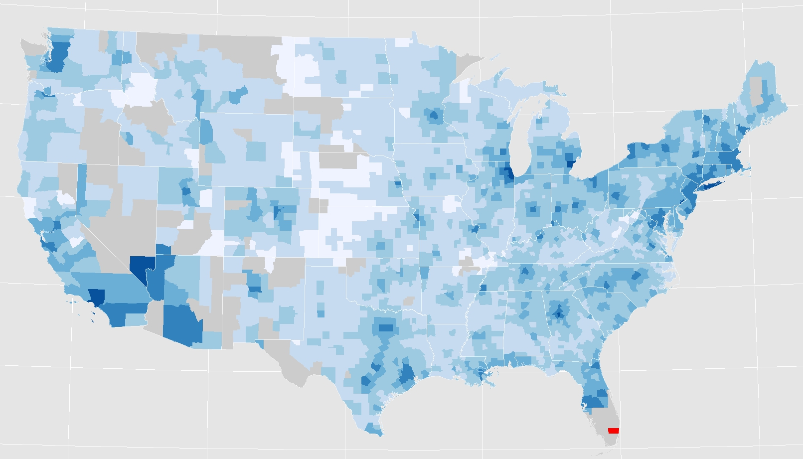
Visualization example: air trips from Broward County, Florida

Slide 38
Next Steps

Slide 39
Final Products
OD flow data by mode (number of trips by mode) for the identified 226 zones

Slide 40
Recommendations and Observations
1: The to be released OD data shall be recognized as synthesized data and shall be used as a starting point for any other project and program.
2: Additional verification and analysis are strongly recommended.
3: New national comprehensive passenger flow OD data survey shall be conducted.

Slide 41
Thank you!

