Slide 1

The Test of Fire: A Comparison of Adapted Four-Step MPO Model Results and Planning Process Findings to Actual Experience
Presented by:
Maureen Paz de Araujo, AICP CTP
Mary Lupa, AICP
Craig T. Casper, AICP
Bret Waters
14th TRB Transportation Planning Applications Conference
May 7, 2013

Slide 2
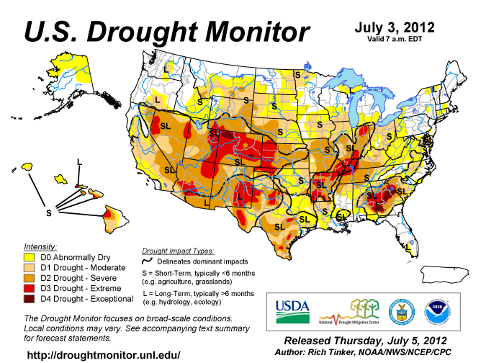
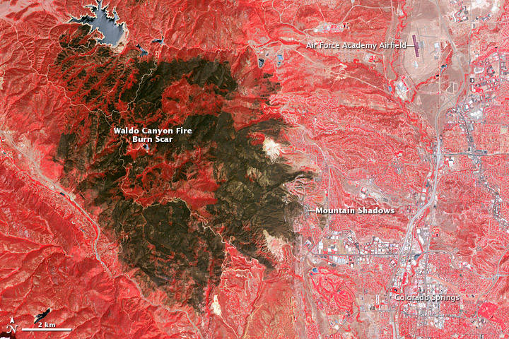
Colorado Wildfires Signal Mounting Wildfire Threat
2
A Changing Trend in Wildfire Incidence
  Extreme drought conditions increase fuel availability
  Urban areas that are located at edge of wildland are placed at risk
2012 Waldo Canyon Fire – Threat to Wildland Urban Interface Realized
Notes:
A Changing Trend in Wildfire Incidence
In the past wildfire incidence primarily affected rural areas
Fires in the past decade signal a change in this pattern
Cause: Drought conditions have produced extremely dry vegetation (fuel availability)
Colorado Springs Area Wildfire Experience
September 2002 - The Hayman fire burned over 138,000 acres. Extremely fast-moving, the largest wildfire in Colorado history fire burned 60,000 acres in its first day. Ultimately, the fire caused over $40 million in damages, burning 600 structures (including 133 homes) and forcing the evacuation of 5,340 persons.
Fall 2007 – Wildfire in Manitou Springs, just south of US 24 burned more than 80 acres. The fire threatened homes, closed roads and the Pikes Peak Cog Railway and forced evacuation of hikers on Barr Trail. With military foam retardant drops, the fire was contained before reaching more populated areas.
August 2008 – A wildfire near Fort Carson burned 100 acres before being contained.
January 2009 – The Orchard Canyon burned 131 acres on Fort Carson, on the south side of Colorado Springs.
March 2009 – A fire on Fort Carson (US Army) burned more than 6,500 acres. The fire jumped the Post’s eastern boundary, threatened buildings and forced evacuation of the area between Fort Carson and Interstate 25.
June 2010 – Wildfire burned 700 acres in area 14 miles northwest of Canon City, just north-northeast of Royal Gorge Bridge/Park. The Park was evacuated.
June 2012 – Colorado fires included: High Park, Springer, and Waldo Canyon . The Waldo Canyon Fire burned within the City of Colorado Springs – thus urban, required evacuation of 32,000 persons and burned 347 of homes.

Slide 3
Colorado Springs Response to Mounting Wildfire Threat
3
Response Elements
  Wildfire Mitigation Plan (WMP) – 2001
  WUI Wildfire Evacuation Appendix – (2008, Updated 2011)
  Community Wildfire Protection Plan (CWPP) – 2011
    Colorado Springs Office of Emergency Management (OEM)
      Wildland Urban Interface Wildfire Mitigation Plan / WUI Wildfire Evacuation Appendix
      Community Wildfire Protection Plan
    Colorado Springs Fire Department
      Neighborhood-level Emergency Notification/Evacuation Plans
    Pikes Peak Area Council of Governments
      Evacuation Modeling/Planning Process
      Wildfire Evacuation Traffic Control Plans
Key Partners
Notes:
The City of Colorado Springs’ response to the mounting wildfire threat was multi-faceted. The response began with development of a City-focused Wildfire Mitigation Plan in 2002. As a part of the planning process, an at-risk Wildland Urban Interface area was identified. The WUI Wildfire Evacuation Appendix development led the City to reach out to PPACG for assistance in developing planning for evacuation traffic control.

Slide 4
Developing a Wildfire Evacuation Planning Approach
4
Options Considered
  Design and Implement Evacuation Signal Control
    Colorado Springs Traffic Operations Center (TOC) Lead
    Utilizing Colorado Springs TOC ITS/Signal Control Software
  Develop Modeling Supported Evacuation Traffic Control Plans
  Use Micro-simulation (VISSIM) for evacuation /traffic control simulation
  Use Travel Demand Model for evacuation /traffic control simulation
Notes:
The City first looked in-house to Traffic Operations Center personnel to support traffic control planning for wildfire event evacuations. Then they went to PPACG develop a way to support analysis on a tight budget - $20K plus in-kind staff support.

Slide 5
Modeling to Support Wildfire Evacuation Traffic Control Plans
5
Selected Modeling & Planning Approach
    Adapt PPACG 4-Step Travel Demand Model for evacuation simulation
    Use available data to support model adaptation and application
    Leverage Technical Steering Committee Expertise
      To establish evacuation protocols to be modeled
      To validate model performance – Are the model results reasonable?
    Use an iterative screening approach to optimize Traffic Control Plans
    Produce Traffic Control Plan maps to meet user requirements
      OEM strategists
      Emergency dispatchers
      Law enforcement traffic control personnel
      Emergency responders

Slide 6
Basis for Evacuation Model – Context and Protocols
6
category | Protocols, Characteristics or Attributes
Define Scenarios | Identify potential fire spread/risk subareas Evaluate no-notice versus notice evacuation Establish background traffic conditions
Traffic Control | Intersection-level control Signal preemption/emergency operation Route closures Traveler information systems Contra-flow operations
Evacuation PROTOCOLS | Required evacuation rate: notice, no-notice, staged evacuation Shelters: locations, capacities Notification means
Evacuee Behavior | Mobilization time, activity sequence, Vehicle occupancy rate
Special Facilities | Evacuation procedures/responsibilities for schools, jails, nursing homes, hospitals and special facilities
Notes:
category
Protocols, Characteristics or Attributes
Define Scenarios
Identify potential impact areas (fire spread/risk districts and neighborhoods)
Consider terrain, elevation, wind conditions/profiles, micro-climate
Evaluate no-notice versus notice evacuation
Establish background (non-evacuating) traffic conditions
Traffic Control
Manned intersection-level control (police personnel)
Signal preemption/emergency operation
Route closures
Traveler information systems
Contra-flow operations
Route guidance and other ITS deployment
PROTOCOLS
Designated evacuation routes
Evacuation rate: notice- pre-evacuation, no-notice, staged evacuation
Time frame
Shelters: locations, capacities
Notification means
Evacuee Behavior
Mobilization time, activity sequence,
Vehicle occupancy rate
Special Facilities
Evacuation of schools, jails, nursing homes, hospitals and special facilities

Slide 7
Basis for Evacuation Model – Required Data Inputs
7
category | Protocols, Characteristics or Attributes
Demographic Data | Automobile ownership by TAZ Number of households by TAZ Number of persons and age distribution by TAZ Disabled representation within households by TAZ Assisted evacuation group quarters population by TAZ Shelter capacity and locations by TAZ
Background Traffic | Background traffic for preload
Evacuee Destinations | Evacuee destinations/splits by TAZ/external station
Road Network | Roadway network layout (links/nodes) Intersection control (type/ approach classification hierarchy) Number of lanes/link capacity Free-flow link speeds

Slide 8
Evacuation Model Application and Planning Process
8
STEP 1
STEP 2
STEP 3
STEP 4
STEP 5
Project Initiation
Create Steering Committee
Establish Modeling & Evacuation Protocols
Adapt PPACG Travel Model
District Level Screening
Identify “pinch points”
Iteratively apply and test traffic control strategies or advance area to Neighborhood Level Screening
Establish traffic control plan
Neighborhood Level Screening
Conduct Screening Analysis at the Neighborhood Level
TRAFFIC CONTROL
STRATEGIES
Evaluate alternative evacuation traffic control strategies
Contra-flow operations
Road closures
No Entry
Regional route restrictions
Establish traffic control plan
Traffic Control Plans
Prepare District Level traffic control plans for six (6) Districts and Manitou Springs
Prepare traffic control plans for two (2) Districts at Neighborhood Level (eight (8) neighborhoods)

Slide 9
Step 1: Project Initiation
9
Establish Technical Steering Committee
  Consultant Project Team
  PPACG Modeling Staff
  Colorado Springs Office of Emergency Management
  Colorado Springs Engineering – TOC
  Colorado Springs Police Department
  Colorado Springs Fire Department
    Choice of background traffic conditions
    Population/vehicles to be evacuated
    Restrictions/shared responsibilities
    Evacuee destinations – “shelter-in-place,” official shelters, other
    Contra-flow/no contra-flow
    Required “time-to-evacuate”
    Resident re-entry restrictions
Establish Modeling/Evacuation Protocols

Slide 10
Step 1: Project Initiation
10
Adapting the PPACG Travel Model for Evacuation Planning
  Use 2010 PM peak hour model to represent background traffic
    Use hourly volume to capacity (V/C) ratios to evaluate “time-to-evacuate”
    Develop Embedded Evacuation Model
    Vehicles to be evacuated from U.S Census auto ownership data
    Assume full evacuation of all households
    Assume each household evacuates two (2) vehicles
    Assume distribution of evacuee destinations:
        Official Shelters (15%)
        Other households in the area (60%)
        Motels (15%)
        Out of the County entirely (10%)
Notes:
Use PPACG Travel Model for Screening-Level Analysis
Use PPACG TDM - 2010 Model Scenario used to represent existing conditions
Adapt PM Peak Hour time-of-day model
Preload PM Peak Hour traffic as background traffic
Develop evacuation trip tables for each district/neighborhood
Use embedded hourly roadway capacity to evaluate “time-to-evacuate” ( modeled link volume to capacity (V/C) ratios)
Conduct iterative analysis to test alternative traffic control strategies
Adapt PPACG Model for Evacuation Planning
Assume background, no-evacuation traffic at PM Peak Hour levels (worst-case, highest traffic volumes)
Assume all households at home – requires full evacuation of all households (worst-case, most vehicles to evacuate)
Use U.S Census auto ownership data to estimate household vehicles to be evacuated
Assume each household evacuates two (2) vehicles – adopted after sensitivity testing was performed for one (1) vehicle per household, two (2) vehicles per household and all household vehicles
Assume evacuee destinations to one of four types of destinations as follows (based on Boulder survey of actual evacuation experience):
Official Shelters (15%)
Other households in the area (60%)
Motels (15%)
Out of the County entirely (Denver area, Pueblo area or other – 10%)
Areas west of Colorado Springs (e.g. Teller County – high wildfire threat areas) excluded as destinations for evacuees

Slide 11
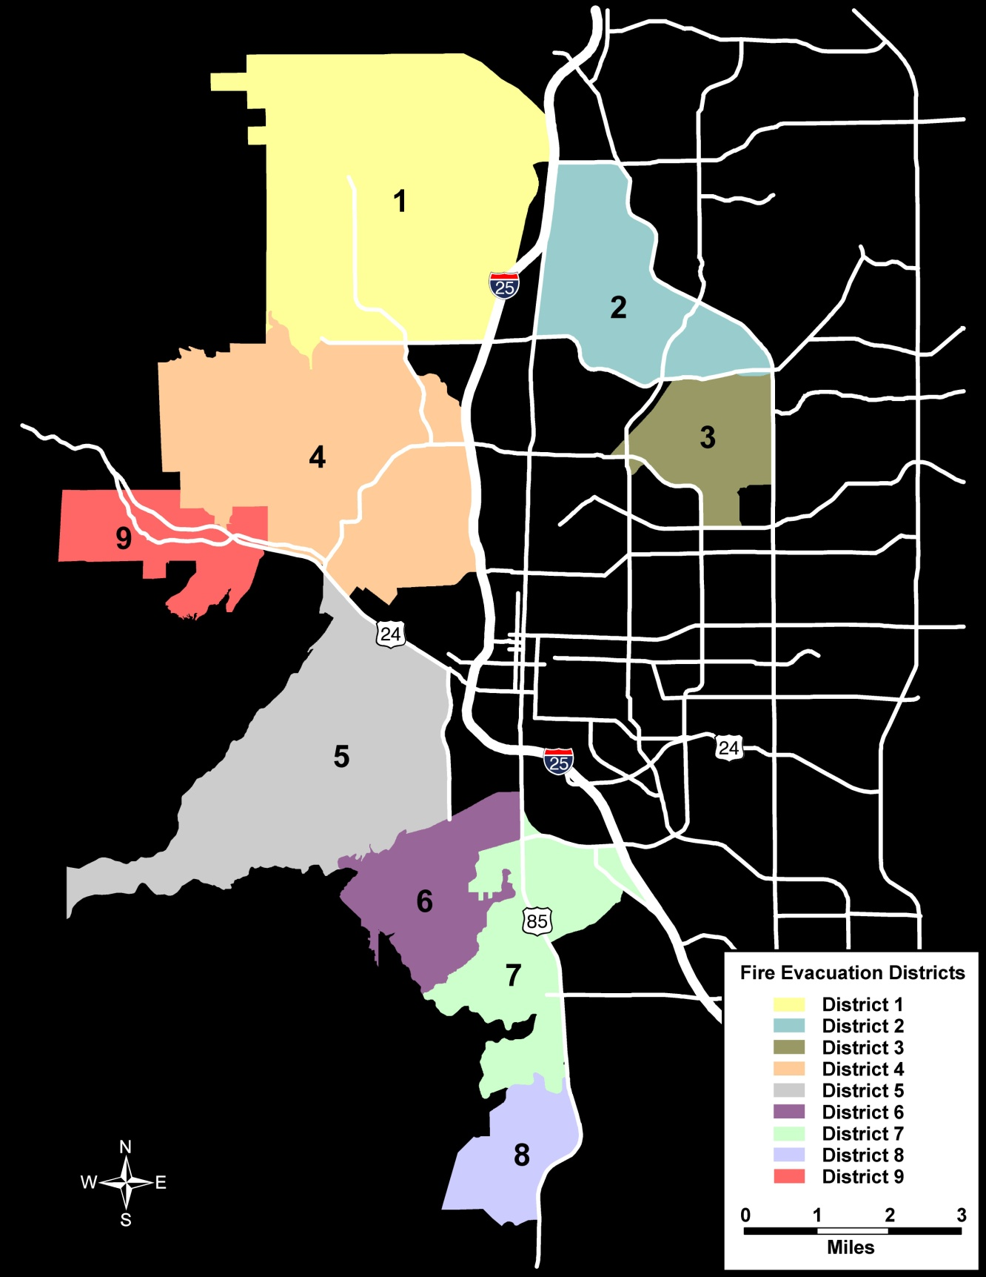
Step 2: District Level Screening
11
Model / evaluate eight (8) wildfire at-risk districts, each incorporating multiple emergency response neighborhoods
Model “times-to-evacuate” and screen for “pinch points” using one-hour roadway capacity as the reference criteria
Develop district-level Traffic Control Plan or advance district to more neighborhood-level analysis

Slide 12
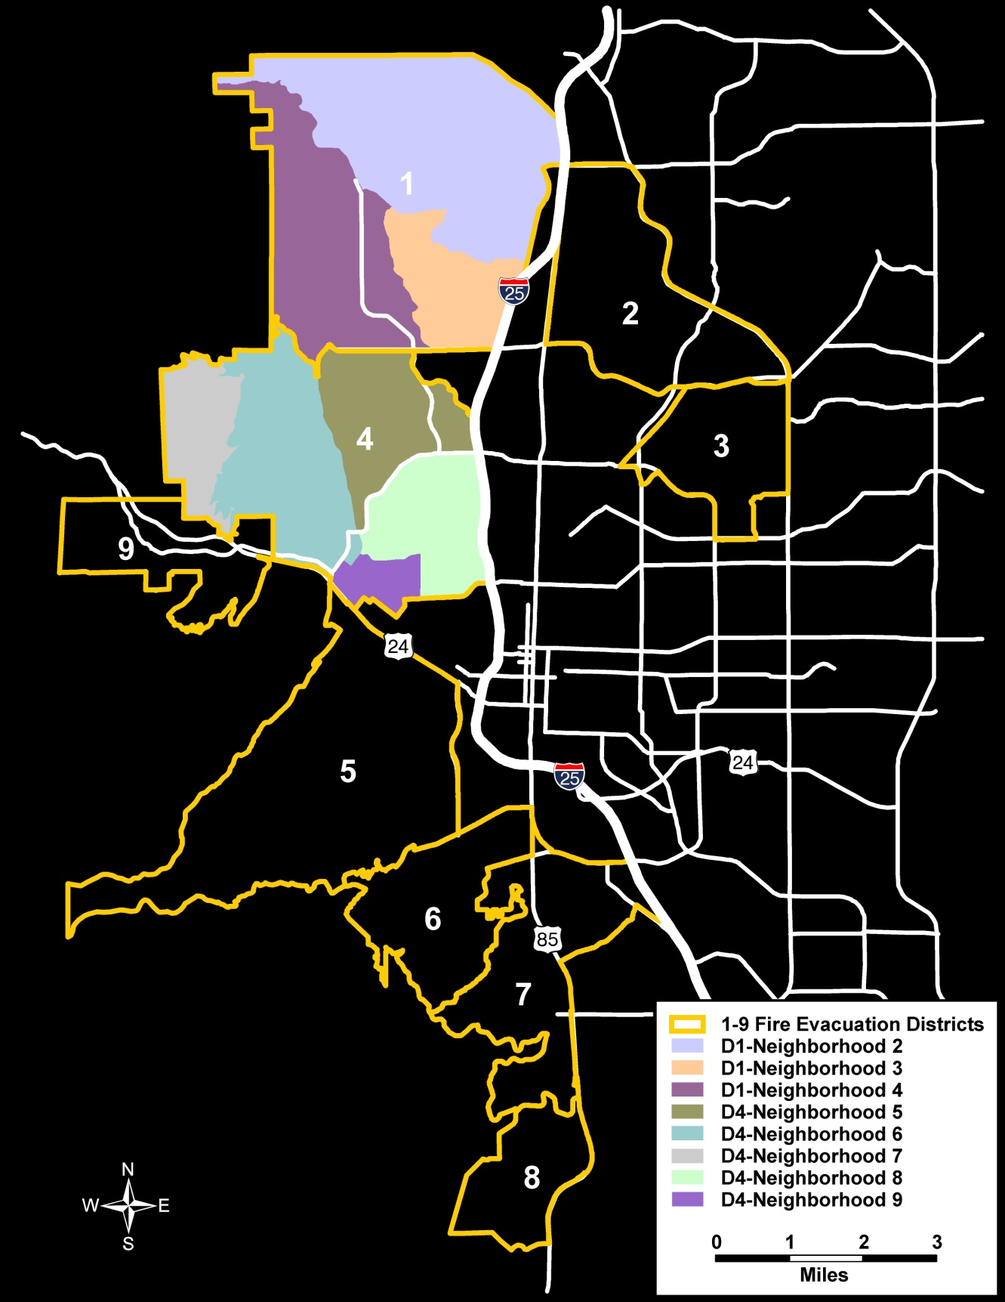
Step 3: Neighborhood Level Screening
12
Model evacuation of selected neighborhoods at risk for wildfire
Model “times-to-evacuate” and screen neighborhoods relative to one-hour roadway capacity reference
Identify neighborhood evacuation “pinch-points” based on “times-to evacuate” that exceed one hour (based on one-hour V/C ratios > 1.0)
Develop neighborhood-level Traffic Control Plan or advance for more detailed traffic control strategy analysis

Slide 13
Step 4: Modeling Traffic Control Strategies
13
STEP 1
STEP 2
STEP 3
STEP 4
STEP 5
Review Baseline Modeling
Identify “pinch points”
Evaluate time-to-evacuate
Assess role of pass-thru traffic
Identify route restriction requirements
Identify options for contra-flow
MODEL PASS-THRU RESTRICTION
Model pass-thru restrictions
Model route restrictions
Model No Entry/Re-Entry
Review PASS-THRU MODELING
Identify “pinch points”
Evaluate time-to-evacuate
Advance to evaluation of traffic control strategies or pass back to Neighborhood Level Screening
MODEL Traffic Control options
Evaluate contra-flow operations
Evaluate road closures
Evaluate regional route travel restrictions
Establish traffic control plan
PREPARE Traffic Control Plans
Prepare Geospatial Data Base for Traffic Control Plans
Prepare Traffic Control Geospatial Mapping (C Size)
8 Neighborhoods
6 Districts
Manitou Springs
ITERATIVE PROCESS

Slide 14
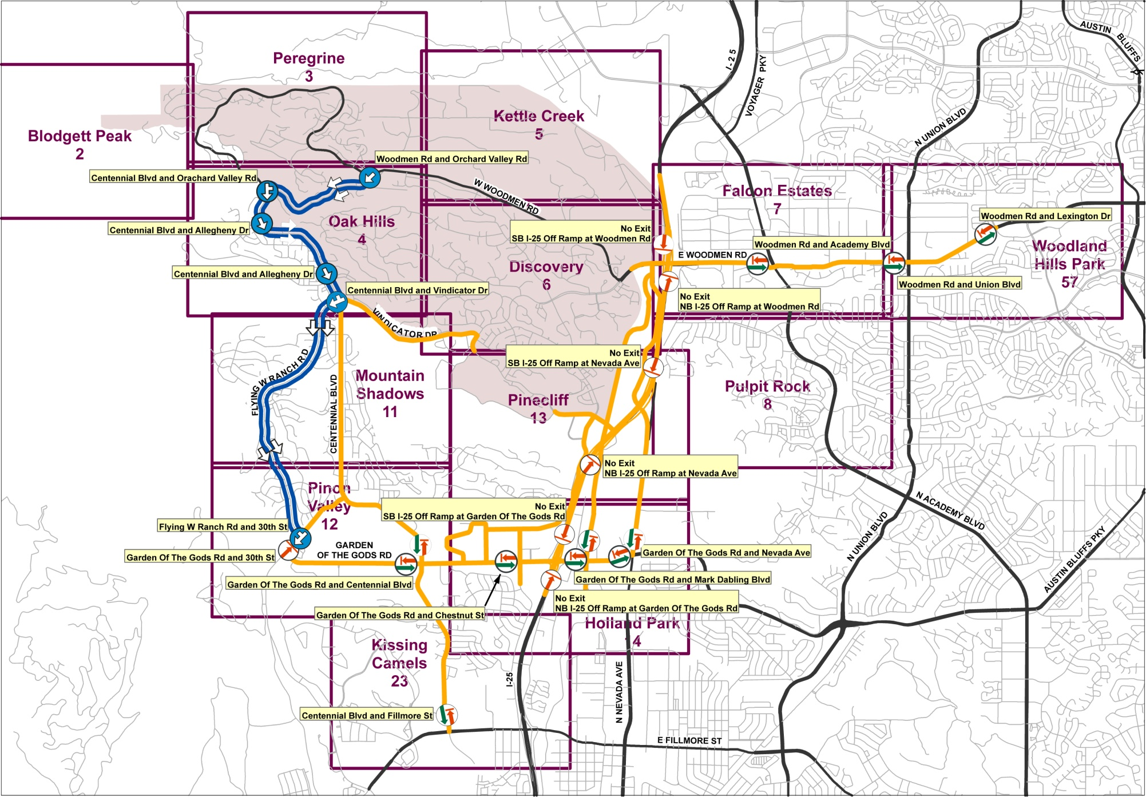
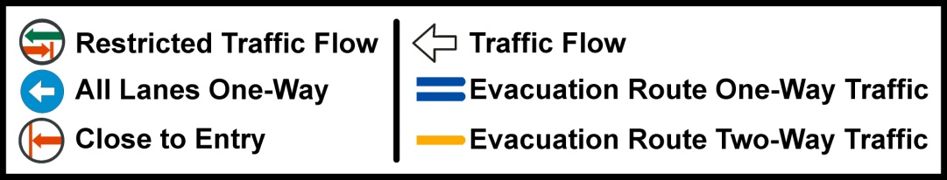
Step 5: Preparing Traffic Control Plans – Full Area Key Map
14

Slide 15
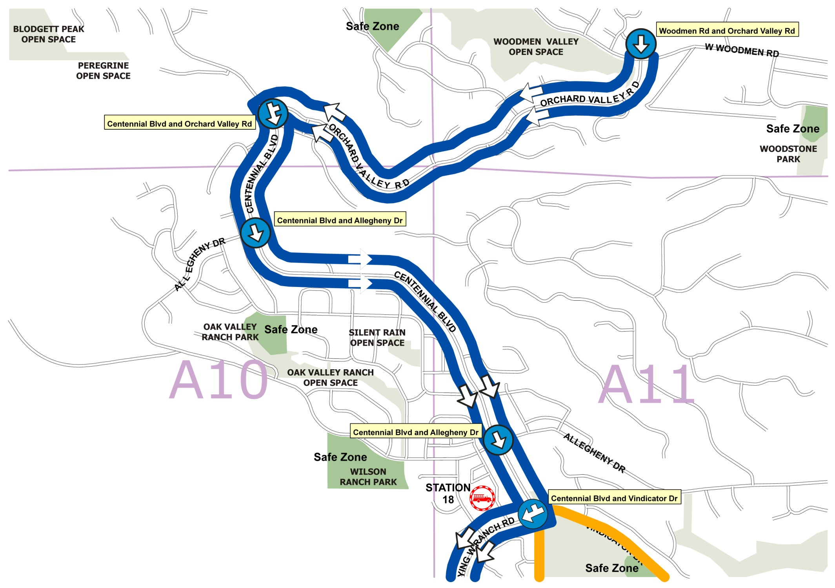
Step 5: Preparing Traffic Control Plans – Individual Map Sheet
15

Slide 16
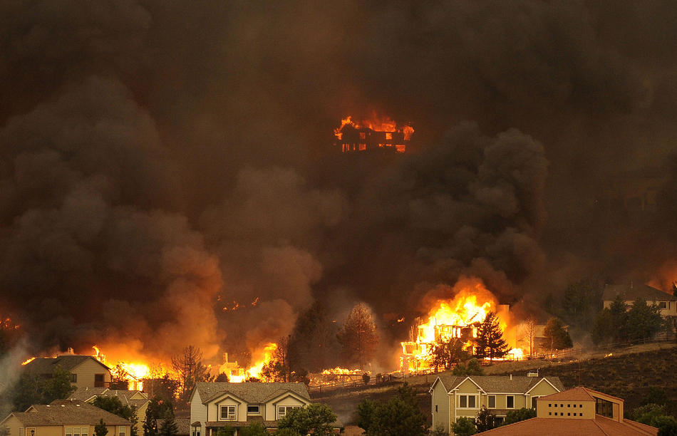
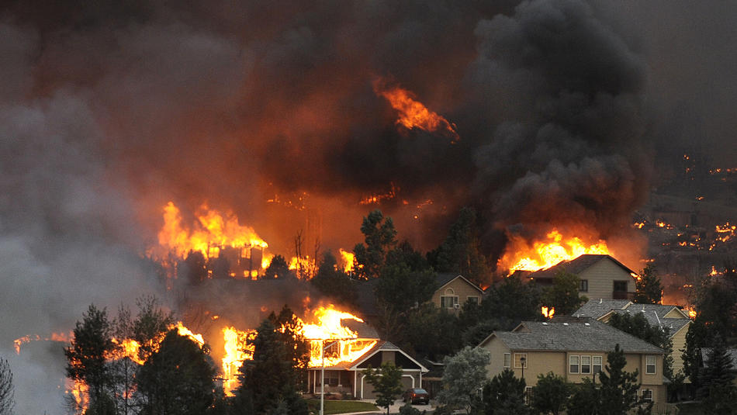
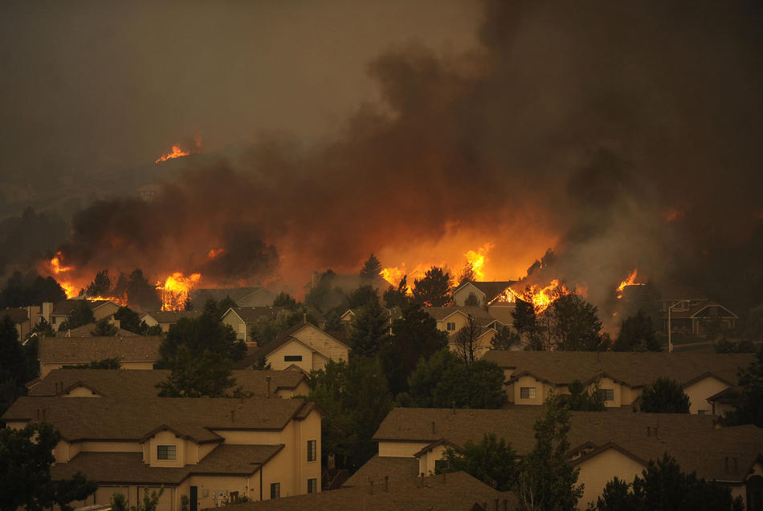
June 26, 2012 – Modeled Worst Case Became Reality
16
  Waldo Canyon Fire Statistics
  18,247 acres burned
  347 homes destroyed plus other structures (Flying W Ranch) – record
  2 fatalities, at least 6 injuries
  32,000 persons evacuated - record
  Insurance claims total $352.6M - record

Slide 17
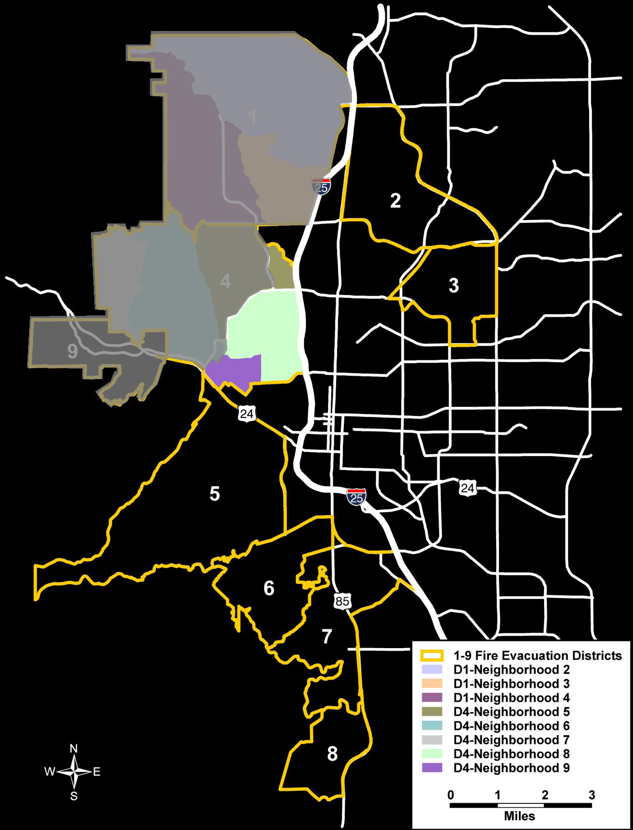
June 23 – June 26, 2012 – 32,000 Persons Evacuated
17
Area | Evacuation Zone | NOTICE Type | Date -Time | Count
4-N6 | Garden of the Gods | Notice-Mandatory | 6/23 - 1410 | Closed
4-N7 | 1-Cedar Heights | Notice-Mandatory | 6/23 - 1422 | 406
Part 1-N4 | 2-Mountain Shadows South | Notice-Voluntary Notice-Mandatory | 6/23 - 1458 6/23 - 1531 | 1,875
9 | Manitou Springs | Notice-Mandatory Allowed to return 6/25 | 6/23 - 1930 | 4,000
Part 1-N4 Part 1-N2 | 3-Oak Valley, Peregrine, North Mountain Shadows | No-Notice Mandatory | 6/26 - 1624 | 6,000
Part 1-N2 | 4- North Rockrimmon | No-Notice Mandatory | 6/26 - 1822
Part 1-N2 Part 1-N3 | 7-SE Rockrimmon | No-Notice Mandatory | 6/26 - 1937 | 20,000
Part 1-N4 Part 1-N3 | 6-Popes Valley, Pine Cliff, Woodmen Valley, Pinon Valley | No-Notice Mandatory | 6/26 - 1950
Part 4-N5 | 8-Kissing Camels | No-Notice Mandatory | 6/26 - 2146
1-N2
1-N4
1-N3
4-N7
4-N5
4-N6
4-N8
9
4-N9
Notes:
Over 32,000 persons were evacuated over a 4-day period, with 26,000 evacuated in a six-hour period on June 26th. The non-notice evacuations on June 26th were carried out in a phased fashion, beginning with the most western areas closest to the fire. The duration required to evacuate each phased are was one to one and half hours each. This is the best available metric of actual time-to-evacuate versus modeled evacuation times.

Slide 18
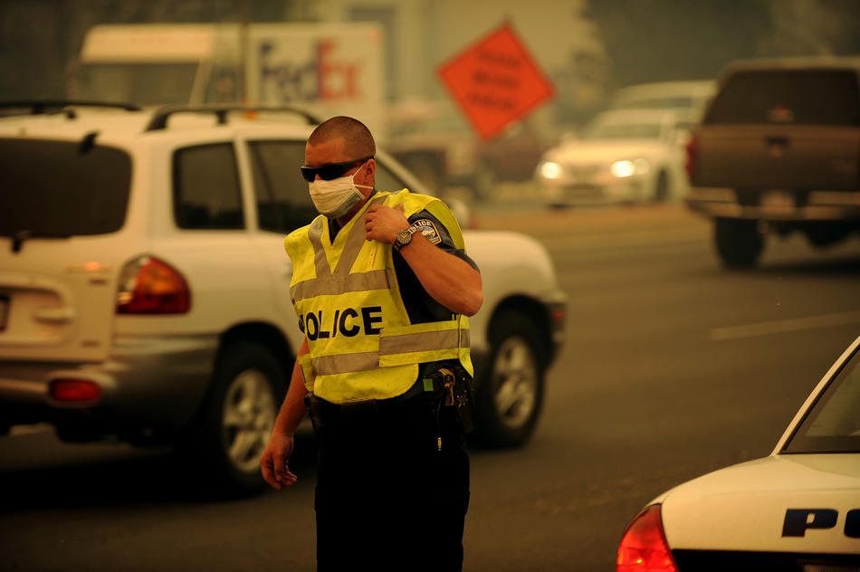
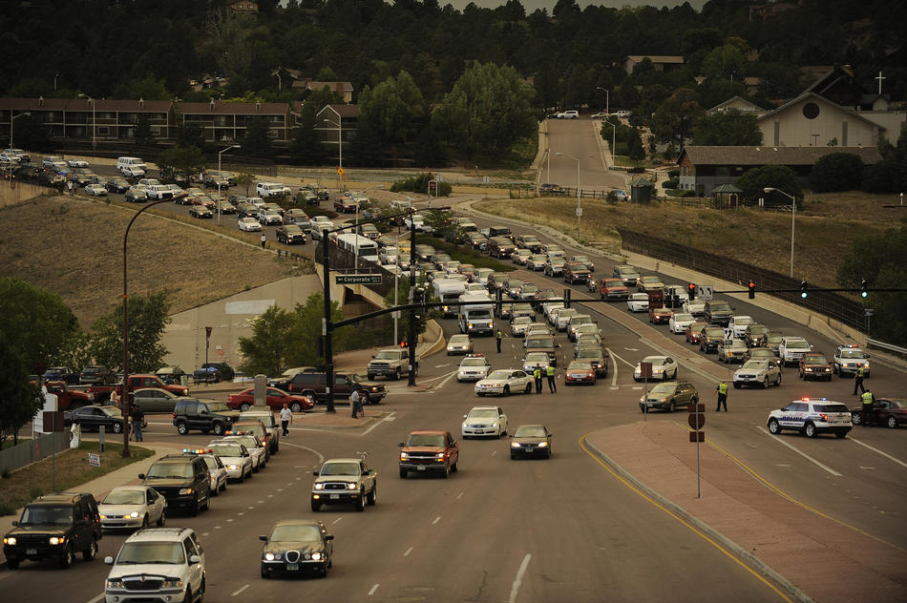
No-Notice Evacuation Employed Full Traffic Control
18
  Traffic Control Measures Implemented
Full/Modified Contra-flow Operations
No-entry / No Re-entry
Roadway Closures
WB Garden of the Gods Road at I-25
NB 30th at Fontmore
Fillmore/Fontmore at Mesa
I-25 / Ramp Operation Closures
All WB traffic from I-25 blocked at the Woodmen Road, Nevada-Rockrimmon, Garden of the Gods Road and Fillmore Street I-25 exits
I-25 closed to non-evacuation traffic
Notes:
On June 26th, driven by strong winds from a dry thunderstorm west of the blaze, the fire jumped the containment line on Rampart Range Road and entered Queen's Canyon. As the fire crested Queen's Canyon, westerly winds gusting 65 mph pushed the fire into Colorado Springs.
Mandatory evacuation orders were issued for west side neighborhoods that had not already been evacuated. Traffic control included:
Full contra-flow and no-entry measures within the evacuation area.
Closure of westbound Garden of the Gods Road at I-25, as well as northbound 30th at Fontmore, and Fillmore/Fontmore at Mesa.
Blocking all westbound traffic from I-25 at the Woodmen Road, Nevada-Rockrimmon, Garden of the Gods Road and Fillmore Street I-25 exits.
Evacuation time – approximately 1.5 hours

Slide 19
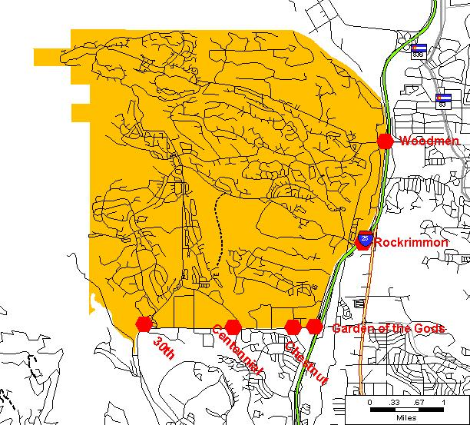
District 1 - Baseline Statistics
19
DISTRICT Statistics
12,300 Households
25,830 Persons
6 Egress Portals
  30th Street
  Centennial Boulevard
  Chestnut Street
  Garden of the Gods/I-25
  Nevada-Rockrimmon/I-25
  Woodmen Road/I-25
District Size
  East-west - 4 miles
  North-south - 4 miles
I-25 provides primary evacuation route
Woodmen
Rockrimmon
Garden of the Gods
30th
Centennial
Chestnut
Notes:
District 1 is bounded by the U.S. Air Force Academy on the north, I-25 on the east, Garden of the Gods Road on the south and the foothills on the west.
The estimated number of households in District 1 is 12,300.
The east-west distance across District 1 is about 4 miles; the north-south distance across the district is also about 4 miles.
Major portals for egress from District 1 are 30th, Street, Centennial Boulevard, Chestnut Street, Garden of the Gods Road, Woodmen Road and the Nevada-Rockrimmon/I-25 Interchange.
I-25 will play a vital role in providing exit routes to evacuation traffic from District 1.

Slide 20
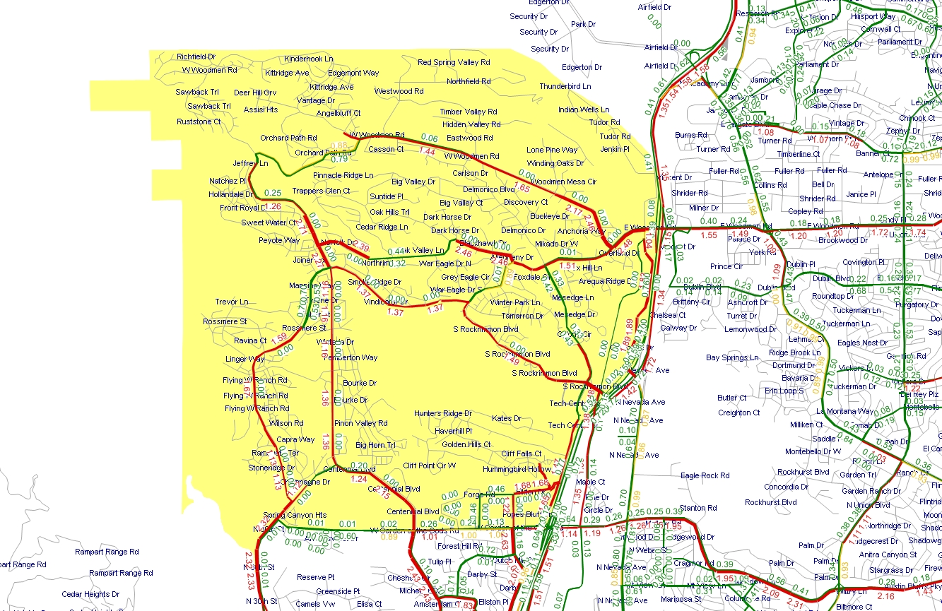
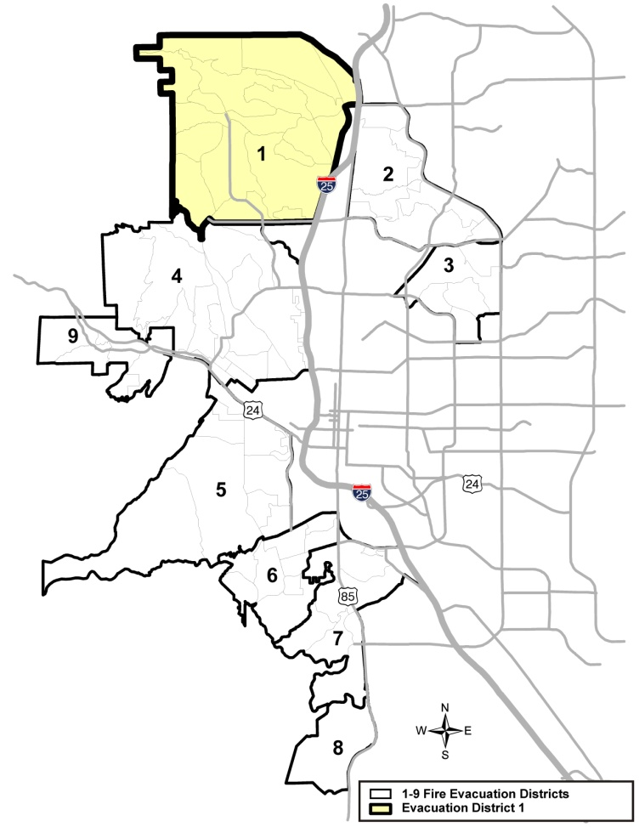
District 1 - Baseline V/C Ratio Results
20
District 1 – Baseline Volume to Capacity Ratio (V/C) Results
LEGEND
Volume to Capacity Ratio
> = 1
0.85 to 1
< = 0.85

Slide 21
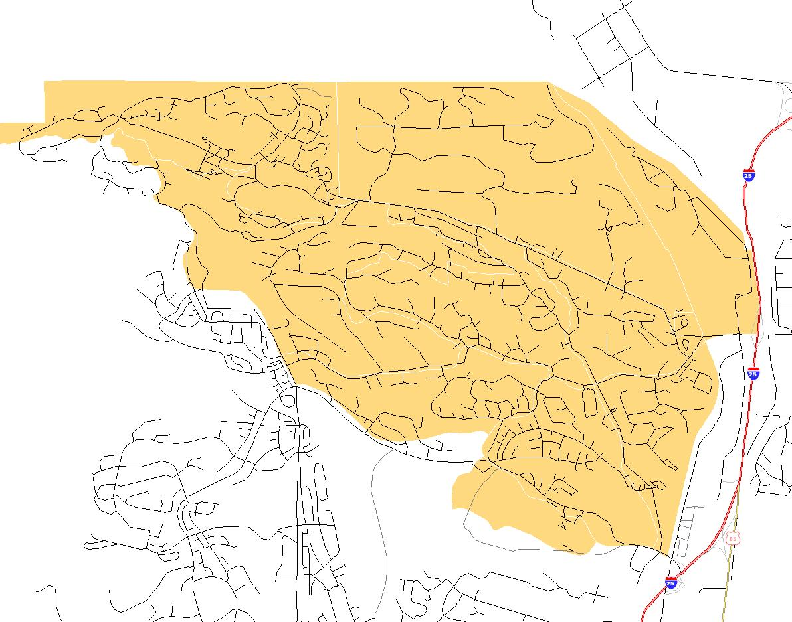
District 1 Neighborhood 2 - Baseline Statistics
21
Neighborhood Statistics
6,700 Households
14,070 Persons
3 Egress Portals
  Centennial Boulevard
  Nevada-Rockrimmon/I-25
  Woodmen Road/I-25
Neighborhood Size
  East-west - 4 miles
  North-south - 3 miles
I-25 provides primary evacuation route
Woodmen Road/
I-25 Interchange
Centennial Boulevard
at Vindicator Drive
Nevada-Rockrimmon /
I-25 Interchange
Notes:
Neighborhood 2, in District 1 is bordered by the US Air Force Academy on the north, I-25 on the east, Rockrimmon Boulevard on the south and the foothills on the west.
The estimated number of households in Neighborhood 2 is 6,700.
The east-west distance across Neighborhood 2 is about 4 miles; the north-south extent of the neighborhood is about 3 miles.
Major portals for egress from the neighborhood are: Centennial Boulevard and the Rockrimmon Boulevard/I-25 and Woodmen Road/I-25 interchanges.
I-25 will play a vital role in providing exit routes to neighborhood evacuation traffic.

Slide 22
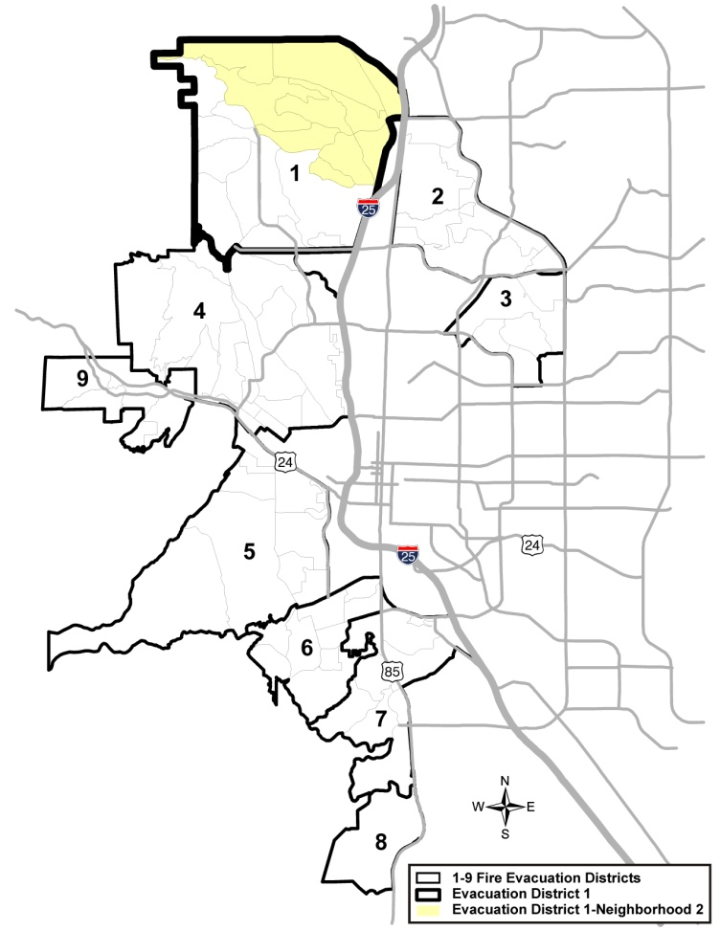
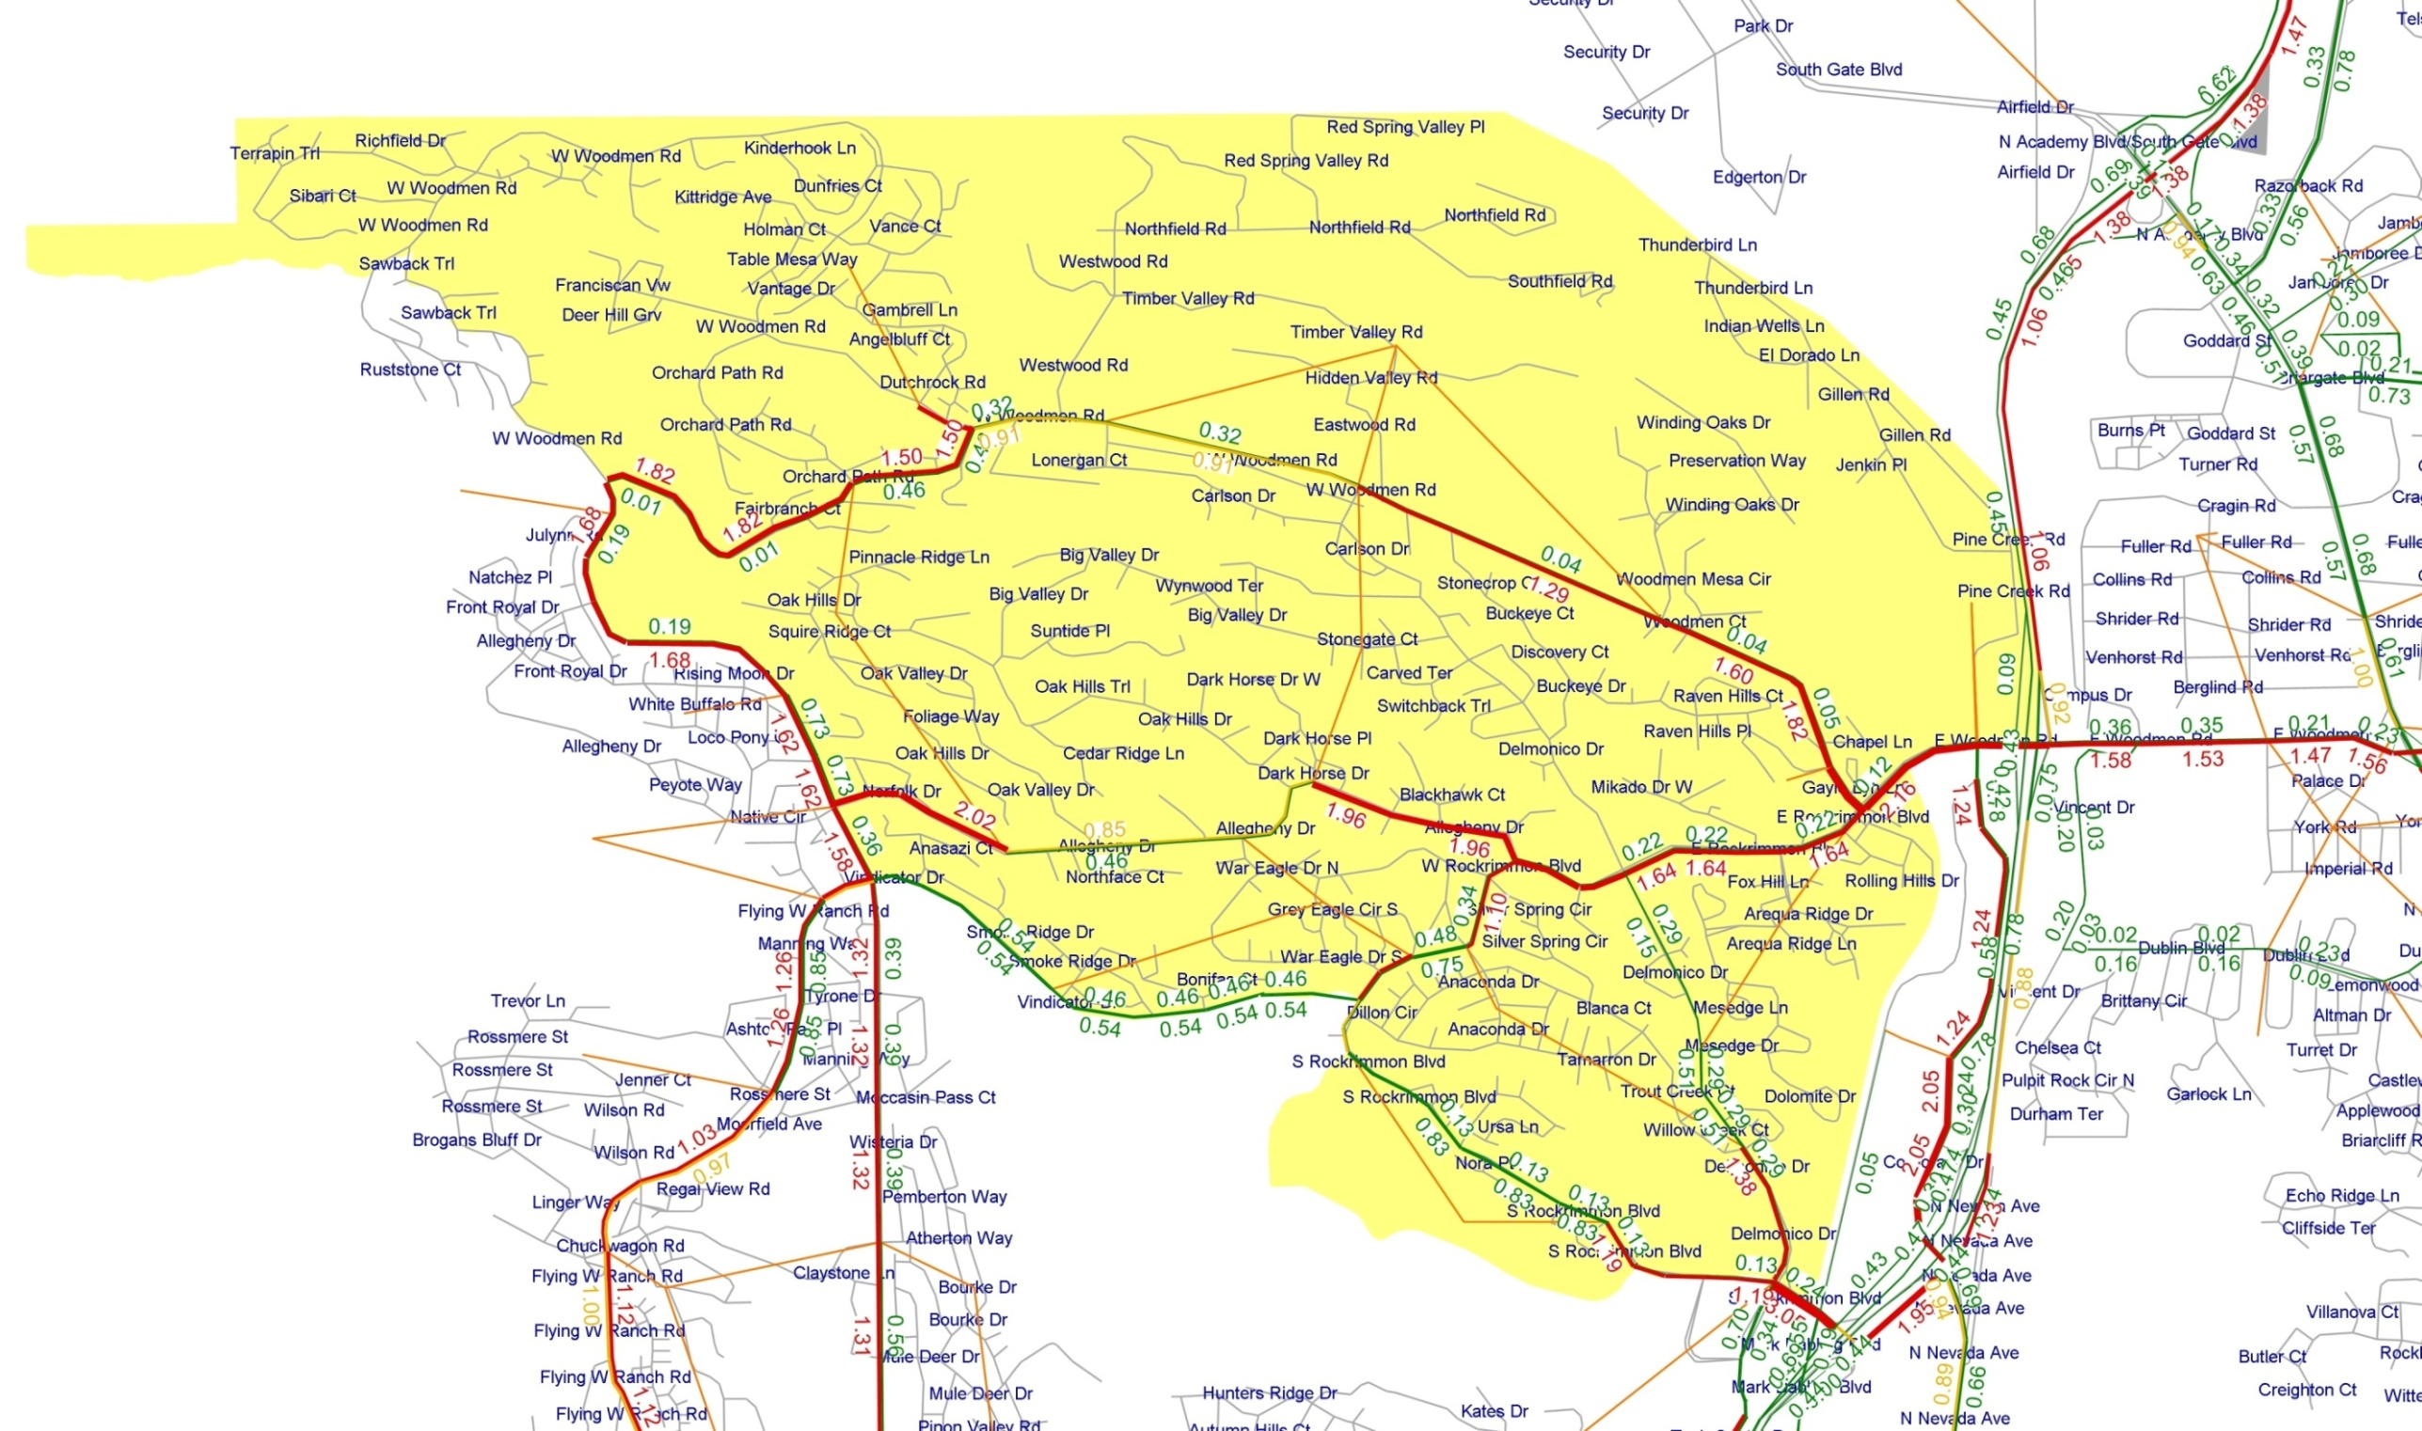
District 1 Neighborhood 2 – Baseline V/C Ratio Results
22
LEGEND
Volume to Capacity Ratio
> = 1
0.85 to 1
< = 0.85
Notes:
Cut-through traffic is eliminated in the baseline
Overburdened routes and potential contra-flow routes are identified

Slide 23
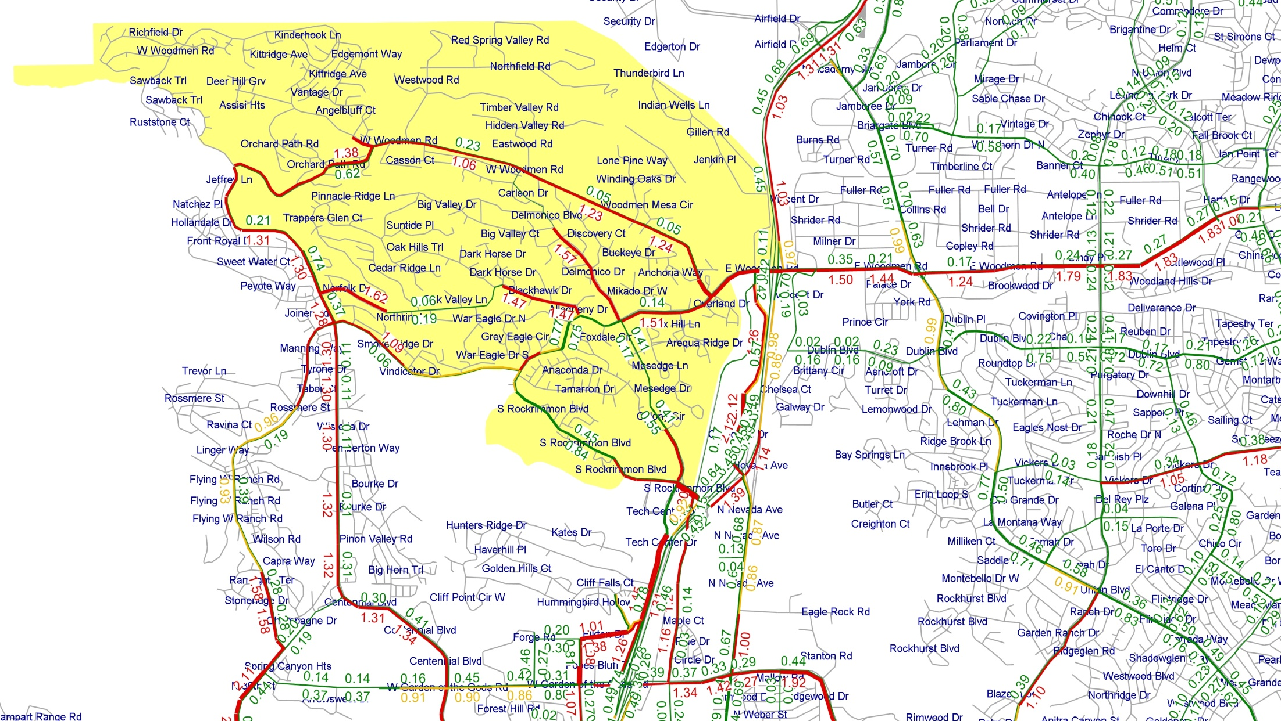
District 1 Neighborhood 2 – Cut Through Traffic Prohibited
23
LEGEND
Volume to Capacity Ratio
> = 1
0.85 to 1
< = 0.85

Slide 24

District 1 Neighborhood 2 - Contra-flow Options
24
Notes:
Refine modeled traffic control to eliminate any cut-through traffic
Identify remaining overburdened internal evacuation routes
Identify potential contra-flow routes
Iteratively test contra-flow options to achieve optimal result

Slide 25
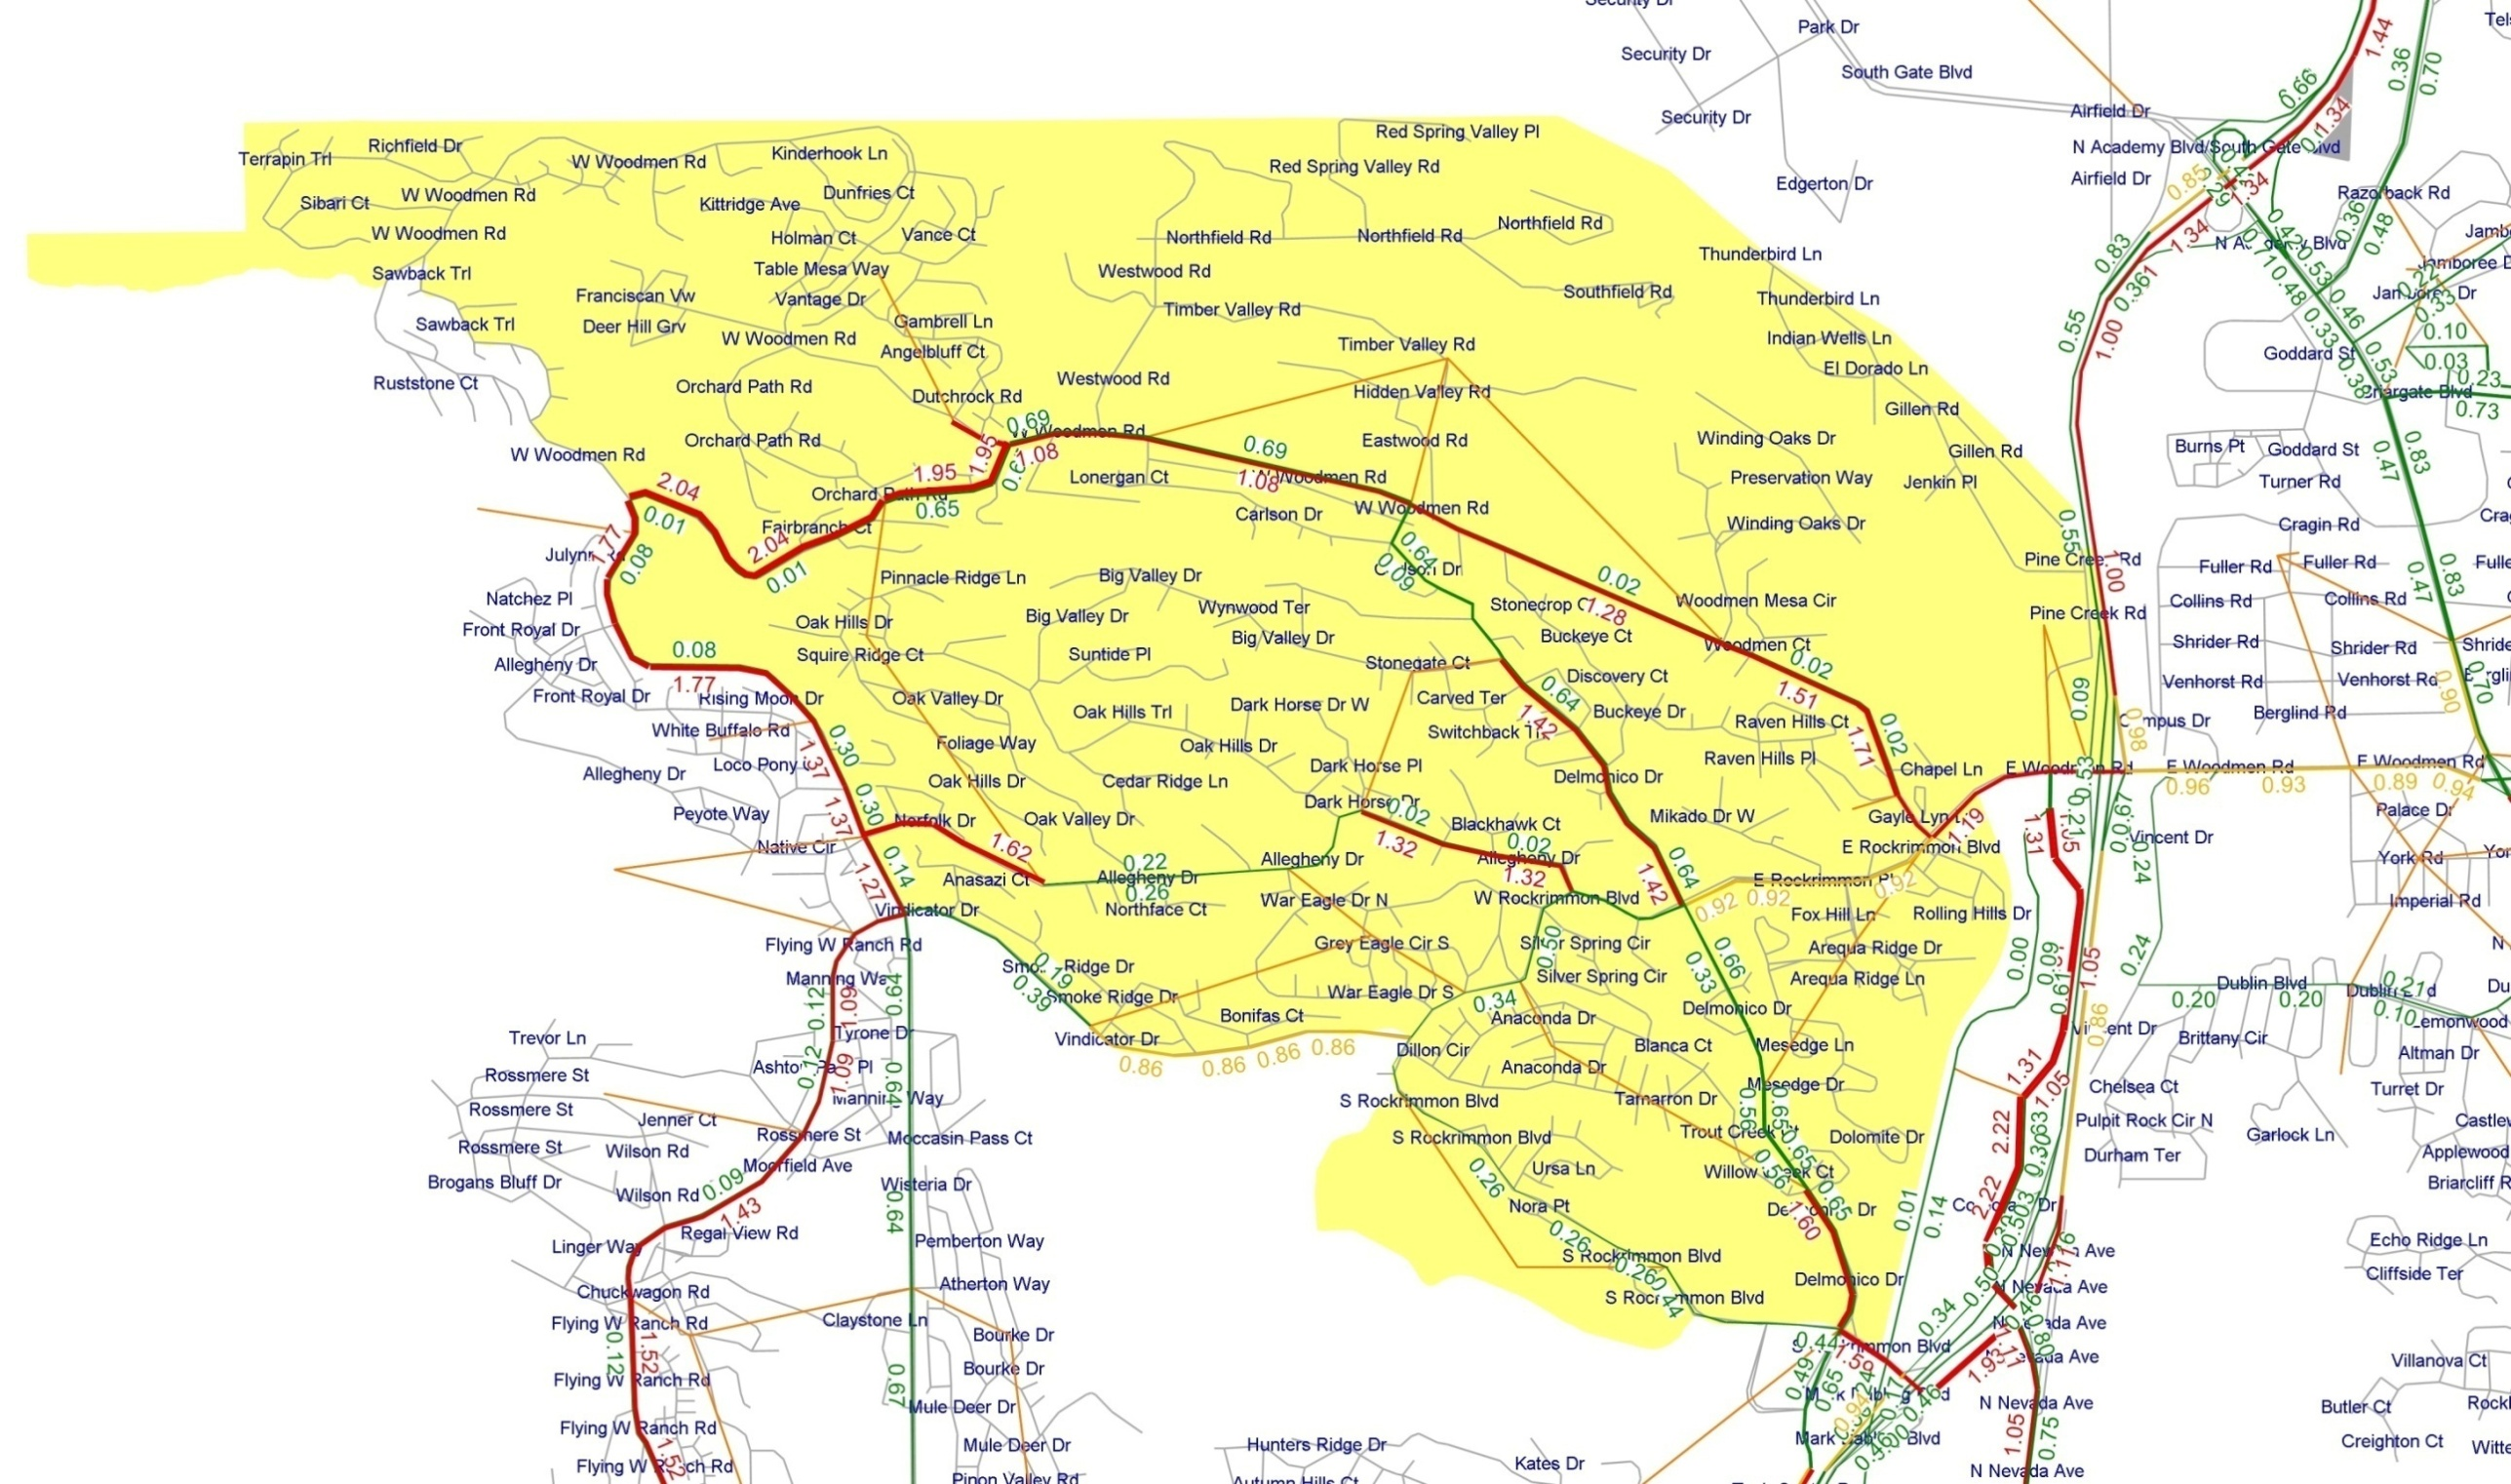
District 1 Neighborhood 2 - Initial Contra-flow Option
25
Notes:
Iteration 1 contra-flow scenario results is examined as basis for the Iteration 2 contra-flow scenario

Slide 26
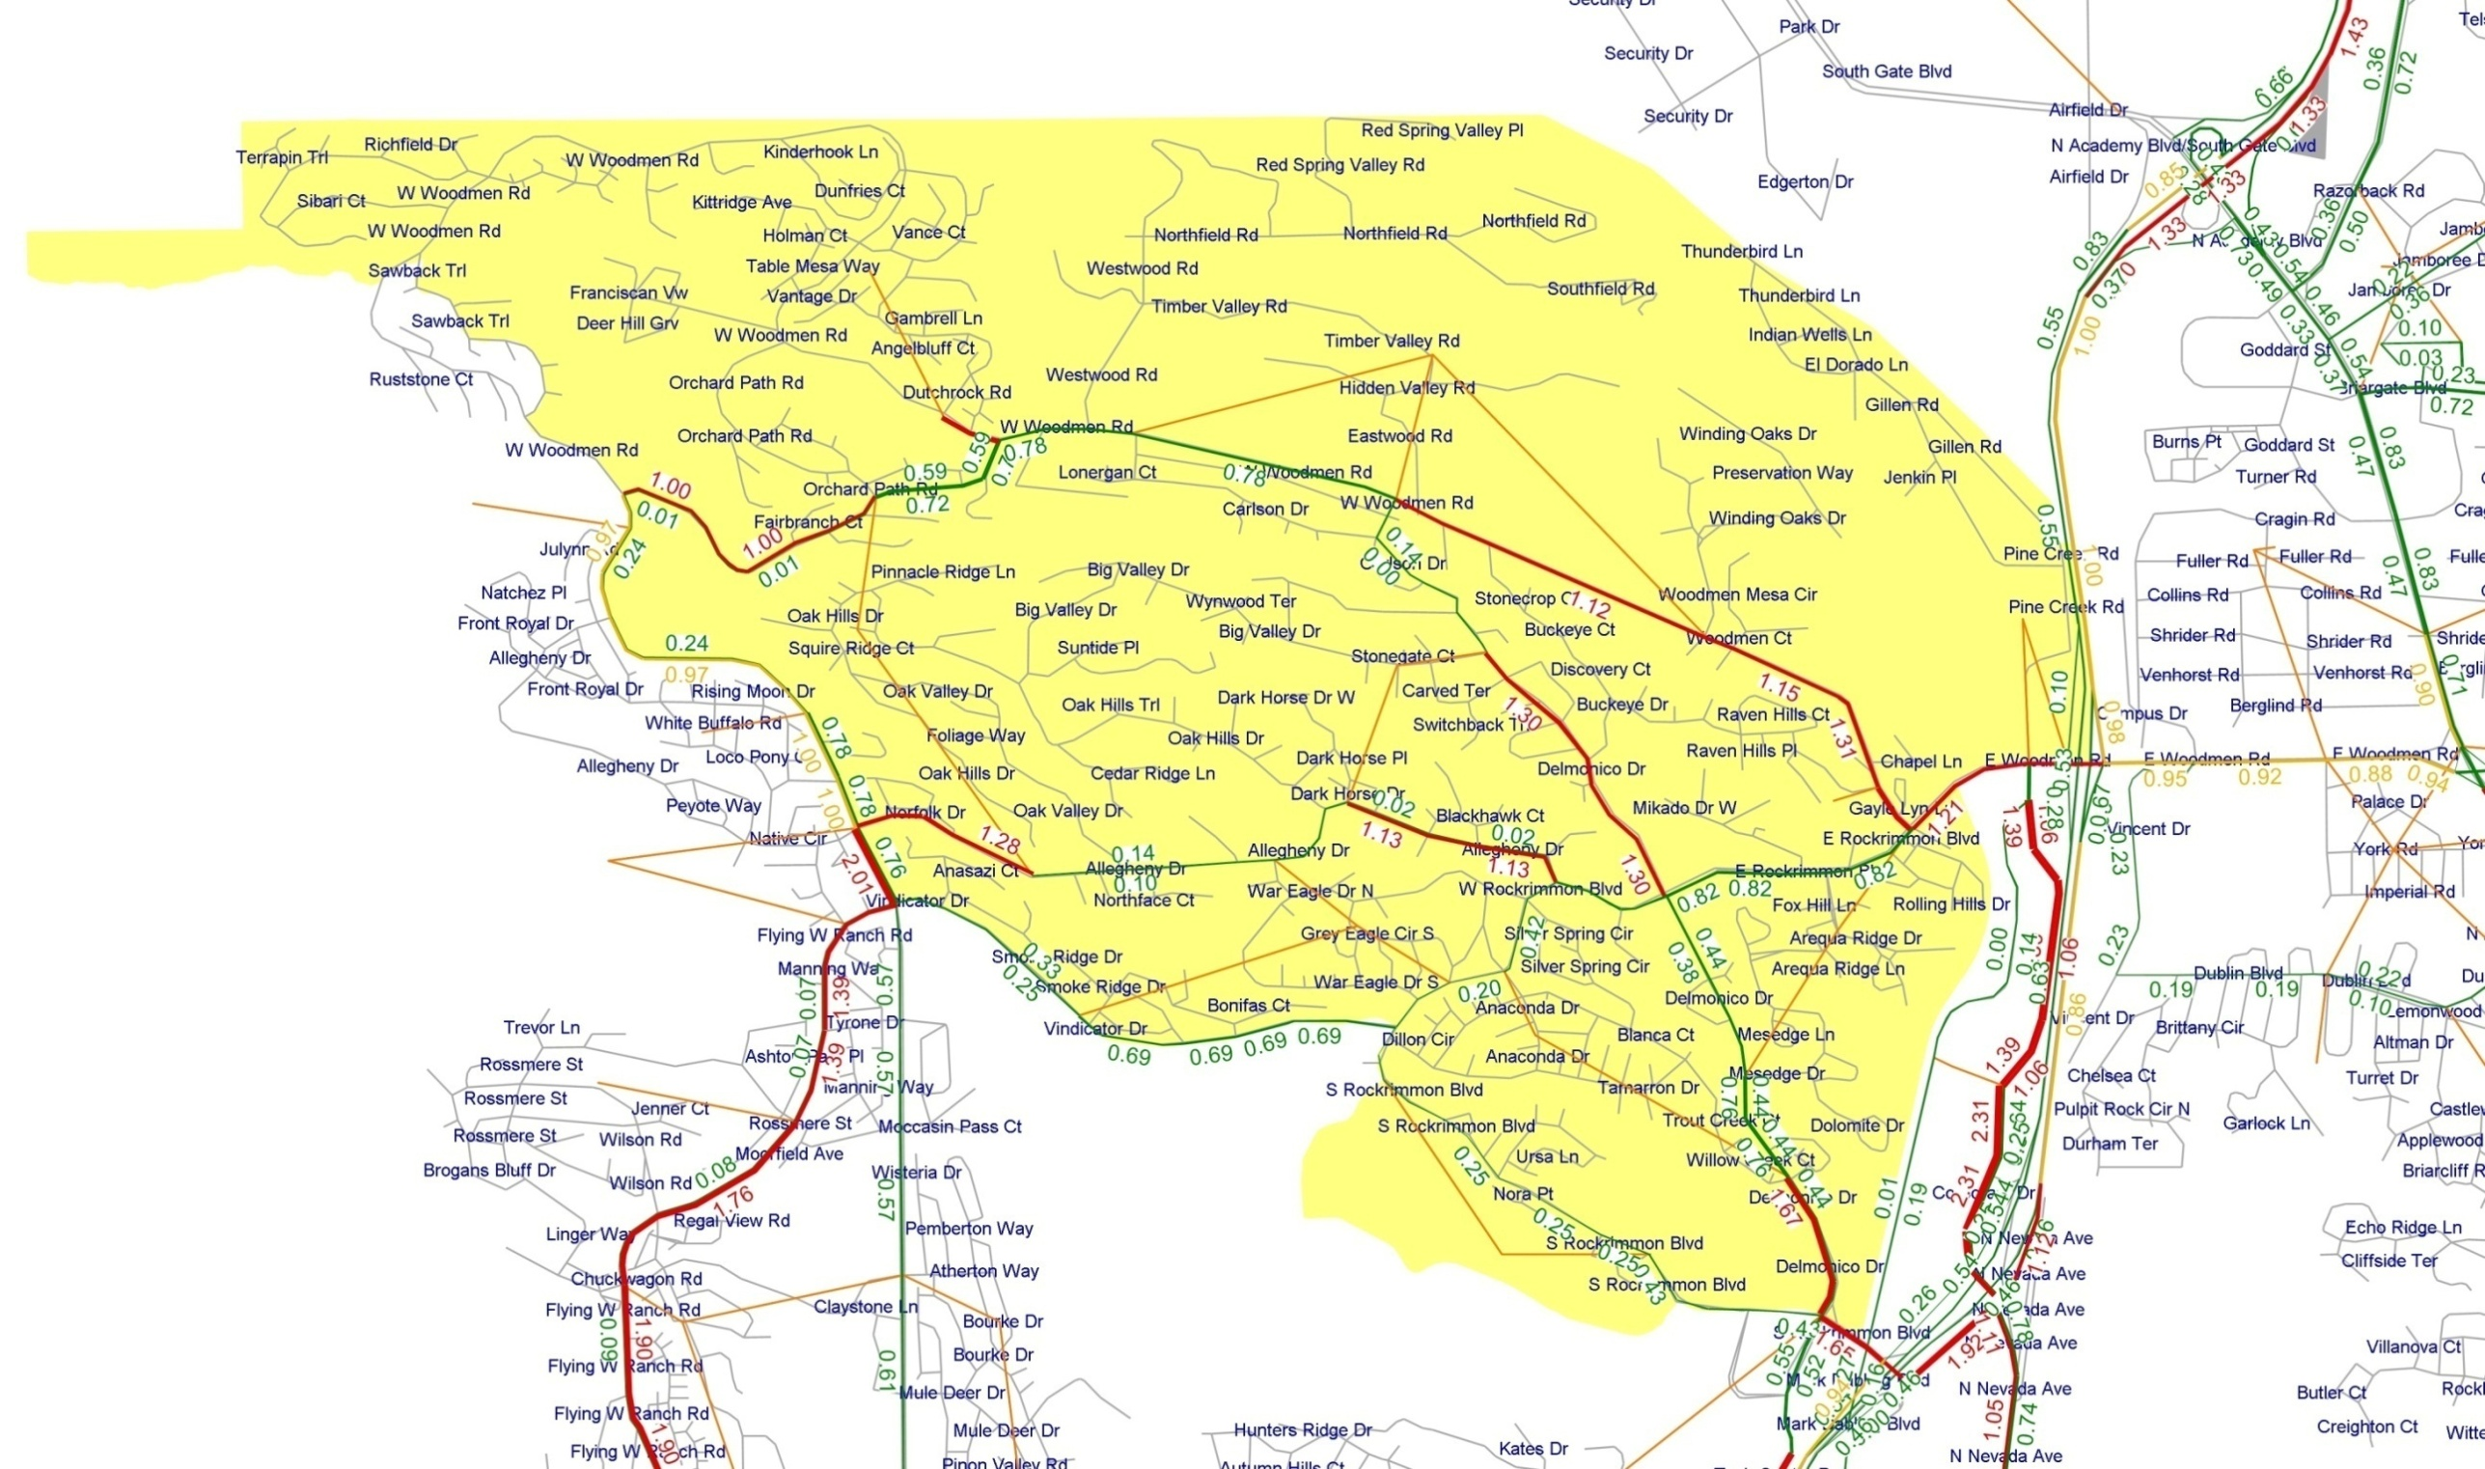
District 1 Neighborhood 2 – Optimized Contra-Flow Option
26
Notes:
Iterative modeling of refined contra-flow alternatives is used to identify a final “best result” contra-flow scenario for inclusion in the Traffic Control Plan

Slide 27
District 1-Neighborhood 2 –Traffic Control Plan Overview Sheet
27

Slide 28
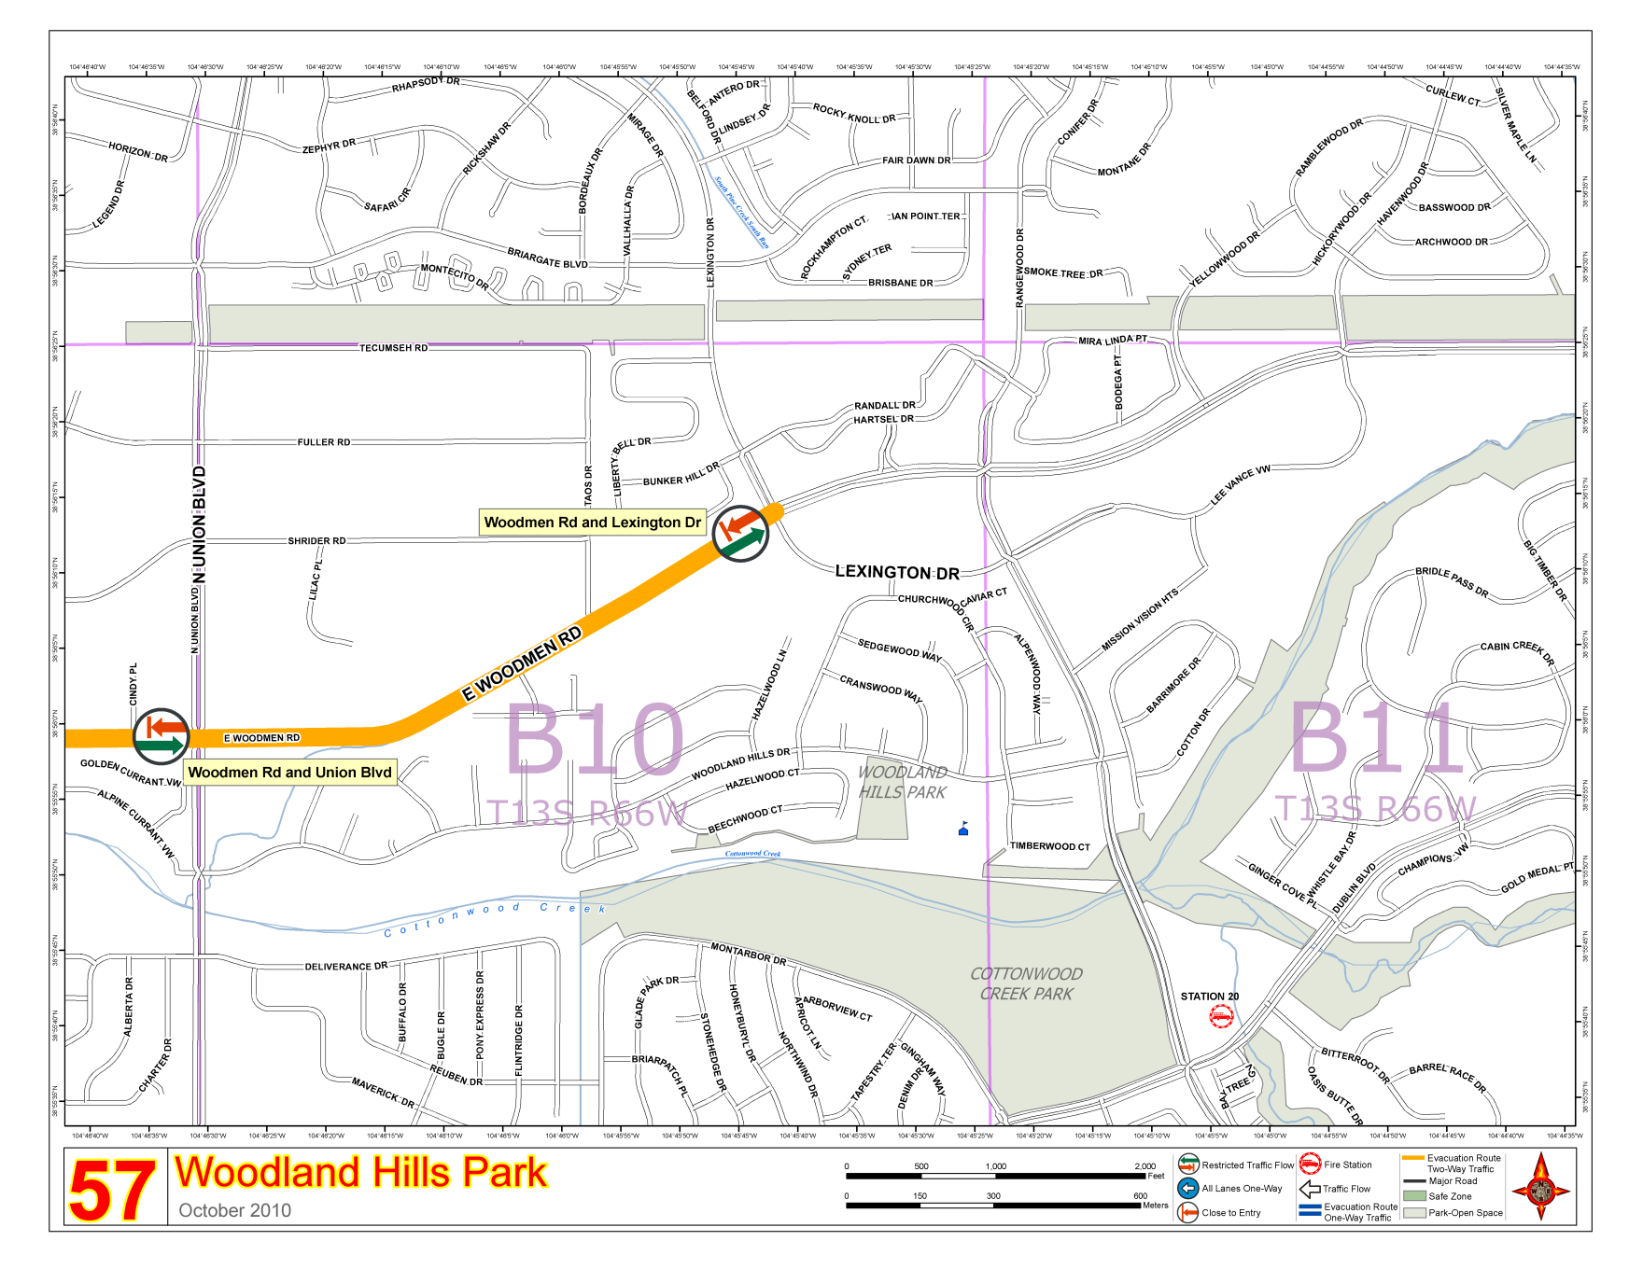
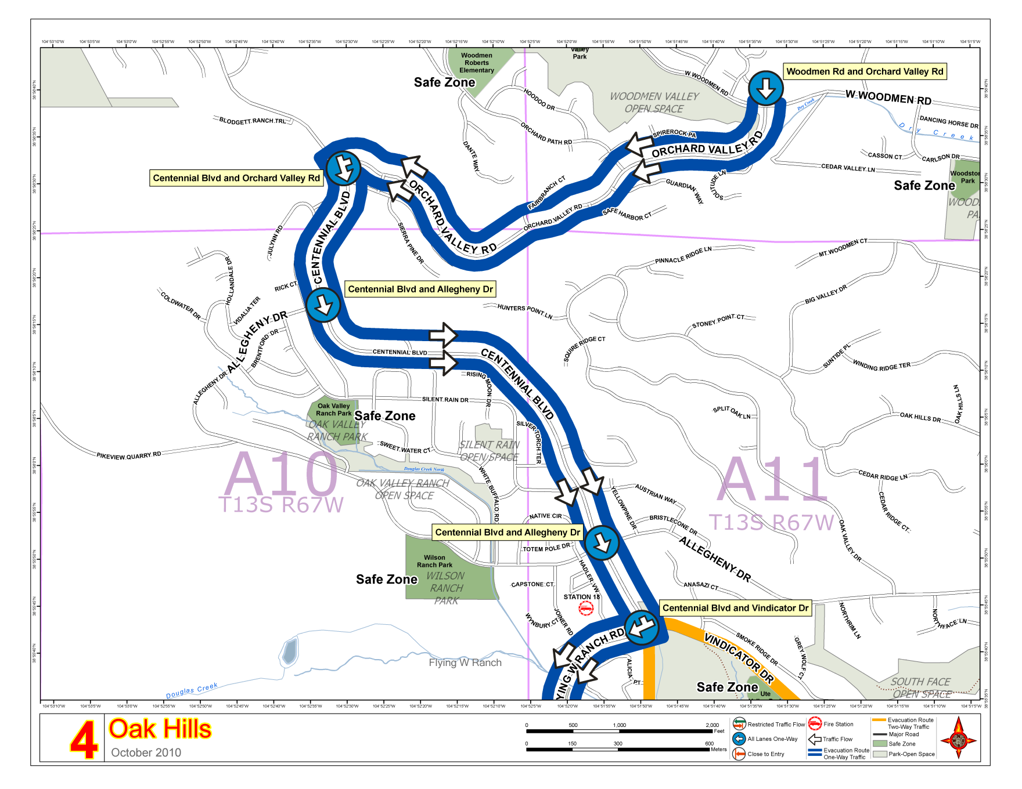
District 1-Neighborhood 2 - Traffic Control Plan Atlas Map Sheets
28

Slide 29
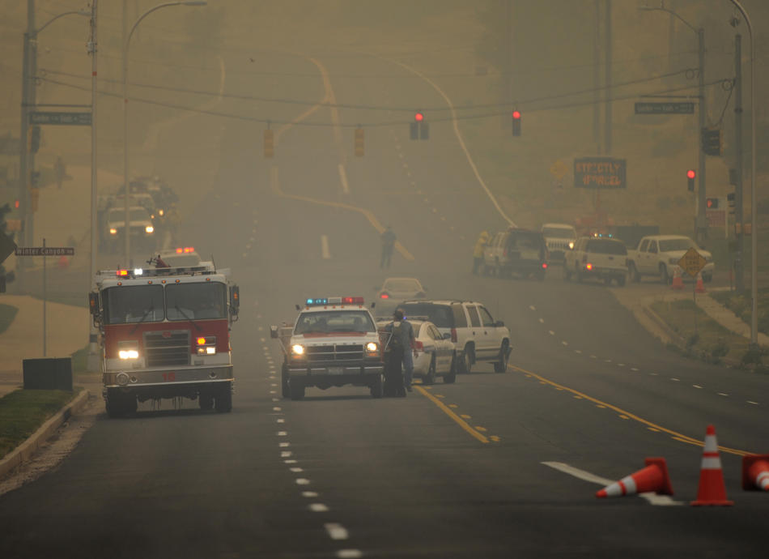
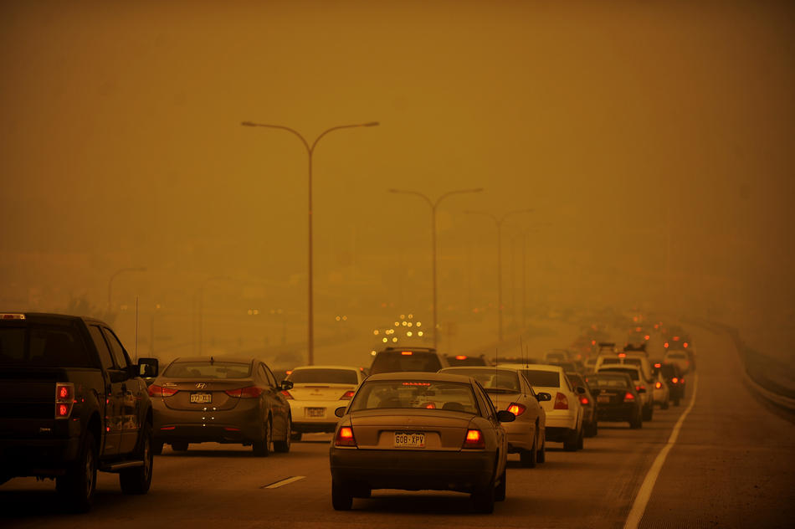
Did Model Results Match Reality?
29
Pre-evacuation of some areas took place over as long as 8 hours
On June 26th no-notice evacuation was phased over 6 hours
The maximum interval between phases was 2 hours
Evacuees reported evacuation times of approximately 1.5 hours
Model results for optimized traffic control show link V/C ratios of 1.3 to 1.67 – coinciding with 1 hour and 20 minutes to 1 hour and 45 minutes

Slide 30
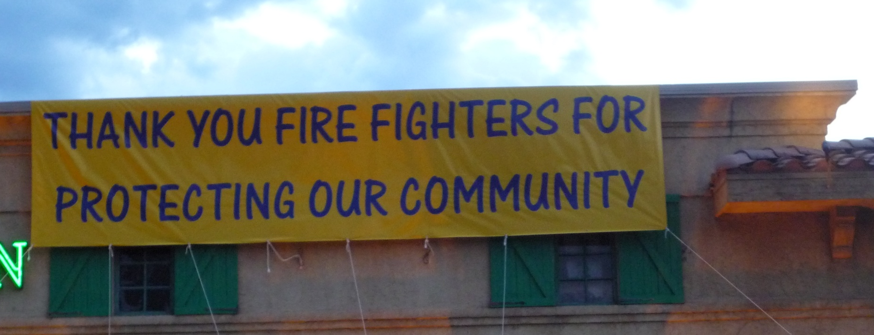
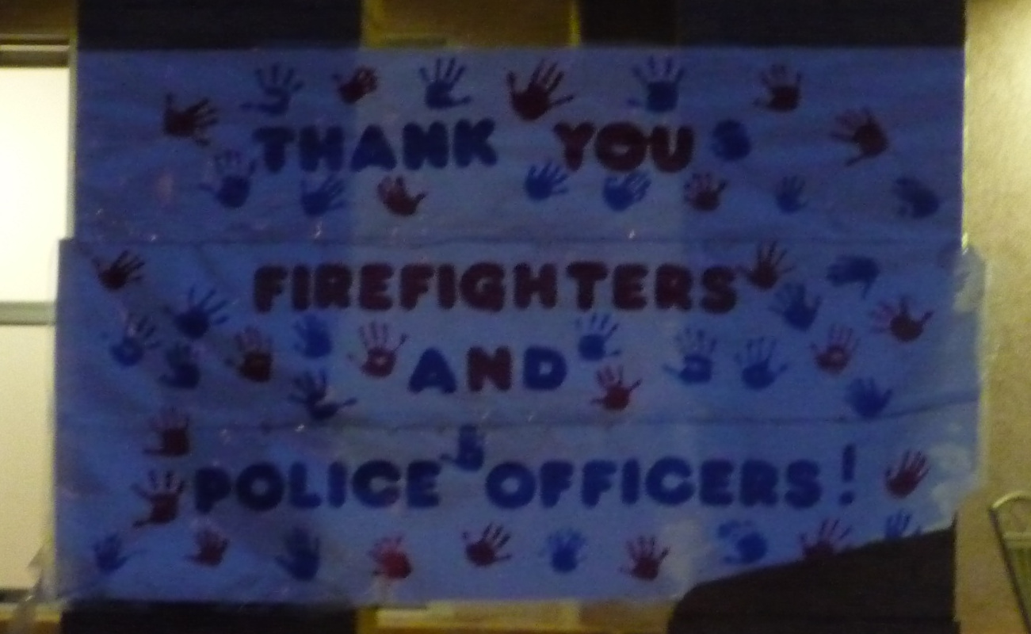
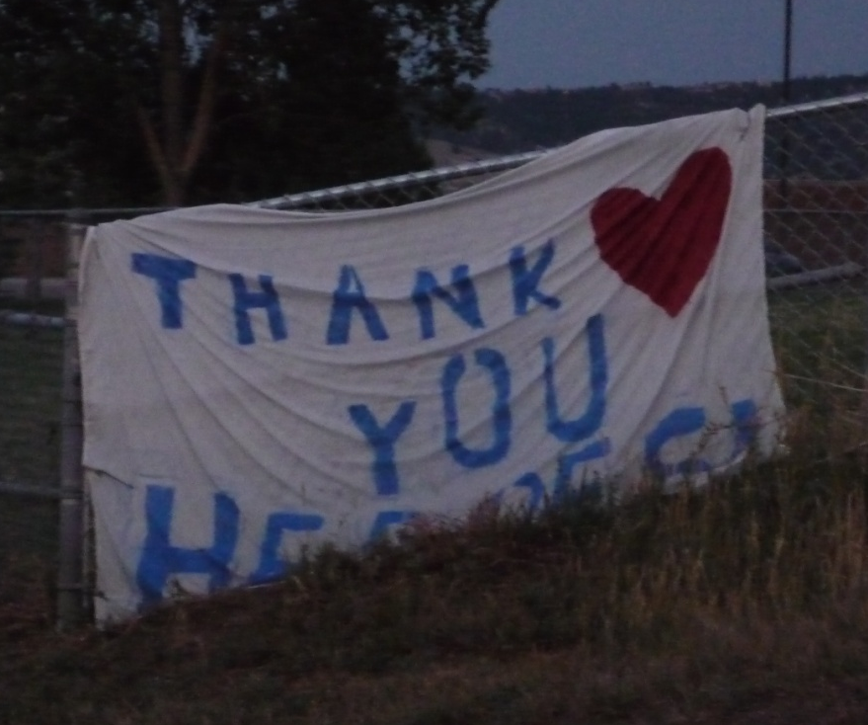
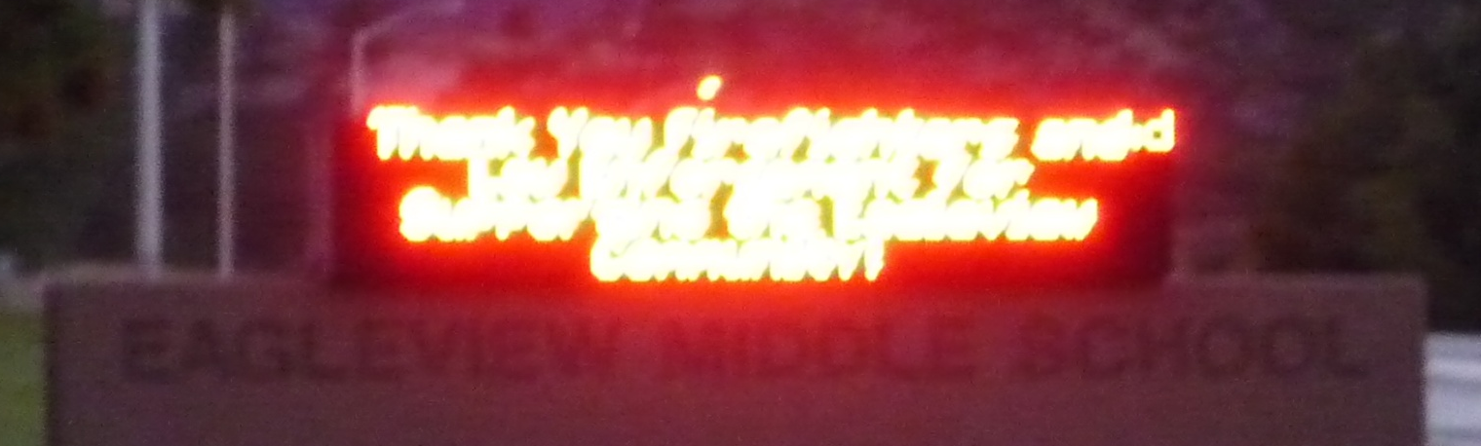
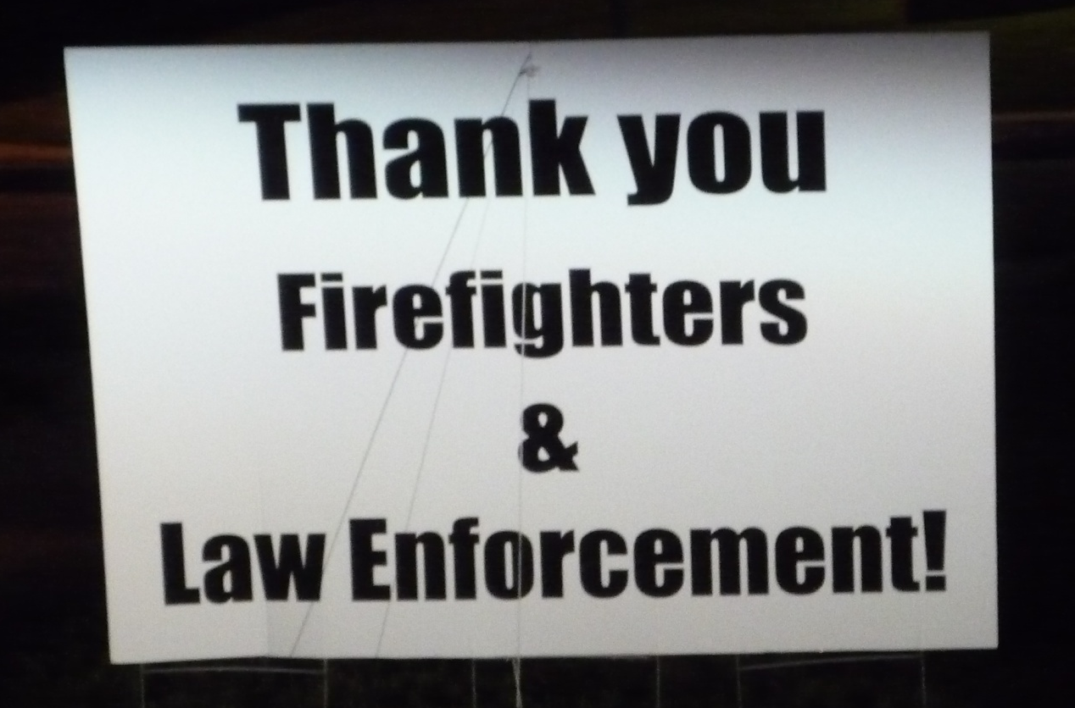
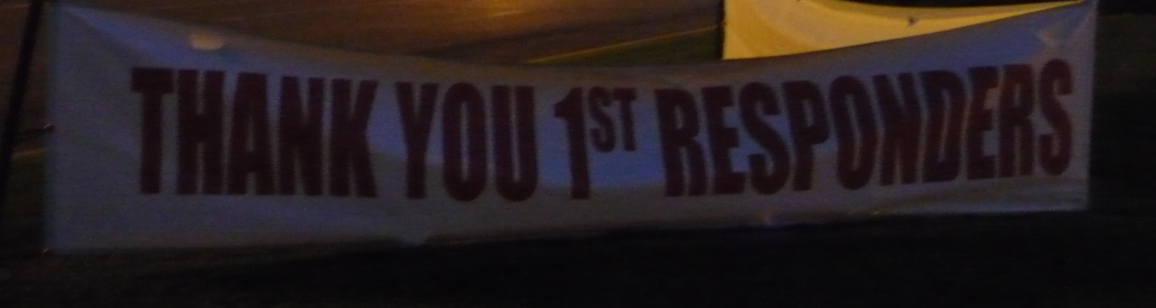
A Grateful Community Says Thank You to Police and Firefighters
30

