Slide 1
Smart Growth Area Planning Tool (SmartGAP): Pilot Test Results
Prepared for
14th TRB National Transportation Planning Applications Conference
May 5-9, 2013, Columbus, Ohio
Presented by
Colin Smith, RSG

Slide 2
Outline
Project Overview
Software
Smart Growth Area Planning Tool (SmartGAP)
Pilot Tests
Atlanta Regional Commission (ARC)
Maryland Department of Transportation (MDOT
Thurston Regional Planning Commission (TRPC)
Publication Release

Slide 3
Acknowledgements
Work funded by Strategic Highway Research Program Project C16
Transportation Research Board
Jo Allen Gause, Project Manager
Stephen Andrle, Director
Technical Expert Task Group (TETG) Members
Project Team
RSG
Fehr & Peers
Robert Cervero
Kara Kockelman
Richard Kuzmyak
Agencies Implementing Pilot Tests
Maryland Department of Transportation
Atlanta Regional Commission
Thurston Regional Planning Commission
Open Source Software Platform (GreenSTEP)
Oregon Department of Transportation

Slide 4
SHRP 2 C 16 Project Overview
Purpose
Provide tools, methods, and resources to evaluate smart growth policies on travel demand
Objectives
Understand critical decision points in the transportation planning process and how smart growth approaches affect demand for capacity
Research the dynamics and inter-relationships of smart growth strategies with the performance of a transportation investment
Identify range of features and capabilities that new tools need to represent
Facilitate improved communication, interaction and partnerships between decision-makers and planners in transportation and land use arenas

Slide 5
Key Practitioner Information Needs
Based on interviews with planning officials
Most agencies are interested in scenario planning as a strategy for evaluating smart growth
Develop a regional scenario planning tool
Many agencies need coordination, cooperation, and communication with local governments on land use policy, since land use regulations are governed by local governments
Develop a tool that can be used by land use and transportation planners to provide opportunities for interaction on common goals
Agencies also want to understand
Induced demand, TDM and urban form
Congestion reduction
Outcomes and performance

Slide 6
Software Tool Design
Evaluates regional scenarios
Built environment
Travel demand
Transportation supply
Policies
Considers households and firms individually
Easy to use and freely distributed
PLACE TYPES
 | Area Type
Development Type | Urban Core | Close in Community | Suburban | Rural
Residential
Employment
Mixed-Use
Transit Oriented Development
Rural/ Greenfield

Slide 7
SmartGAP Process
Household and Firm Model
Urban Form Models
Accessibility Models
Vehicle Models
Travel Demand Models
Congestion
Induced Travel
Policy Adjustments
Performance Metrics
Synthesizes a list of households and firms in the region
Allocates households and firms to the 13 place types
Tags households with transportation accessibility based on highway supply and transit revenue miles
Simulates household vehicle ownership, vehicles types, and vintages
Simulates the amount of daily travel by each household
Estimates congestion based on the amount of travel demand and the highway supply
Adjusts vehicle ownership and amount of travel based on changes to transportation supply and urban form
Adjusts travel demand and congestion based on policies such as ITS, TDM, pricing
Calculates performance metrics such as VMT, delay, emissions, job accessibility, accidents

Slide 8
Induced Demand and Urban Form Effects on Travel
Predicts the change in VMT for each household due to changes in urban form and the short term induced demand effects of increases in transportation supply.
Primary Source:
Meta Analysis
Category | Urban Form Description | Elasticity for Change in VMT
Density | Household/Population Density | -0.04
Diversity | Land Use Mix (entropy) | -0.09
Design | Intersection/Street Density | -0.12
Distance to Transit | Distance to Nearest Transit Stop | -0.05

Slide 9
Transportation Policies
Predicts the Change in VMT for each Household due to Transportation Policies
Primary Source:
GreenSTEP
Pricing Policies
VMT charges (cents per mile)
Parking pricing based on
Percent of workplace and non-workplace parking that is priced
Parking rates per space
ITS strategies
Percentage of freeways with ITS strategies
Percentage of arterials with ITS strategies

Slide 10
Travel Demand Management Strategies
Predicts the Change in Work Trip VMT for each Household due to TDM
Primary Source:
CAPCOA
Vanpool Program | Percent VMT Reduction
Low Level of Participation | 0.30%
Medium Level of Participation | 6.85%
High Level of Participation | 13.40%
Telecommuting | VMT Reduction based on Percent Employees Participating
 | 1% | 3% | 5% | 10% | 25%
9/80 Schedule | 0.07% | 0.21% | 0.35% | 0.70% | 1.75%
4/40 Schedule | 0.15% | 0.45% | 0.70% | 1.50% | 3.75%
Telecommuting 1.5 days a week | 0.22% | 0.66% | 1.10% | 2.20% | 5.50%

Slide 11
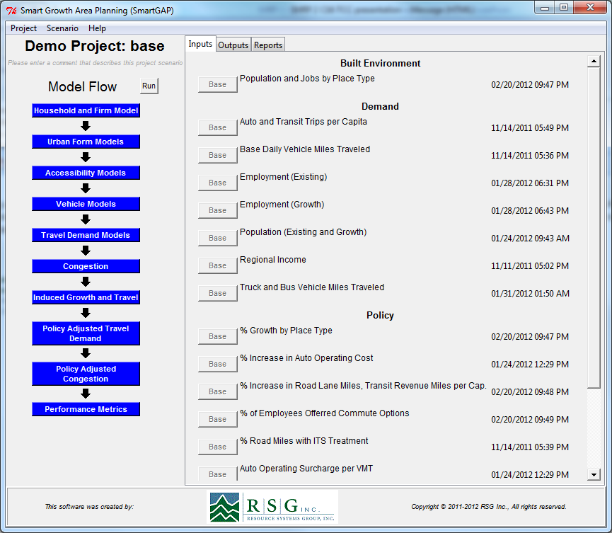
Interface

Slide 12
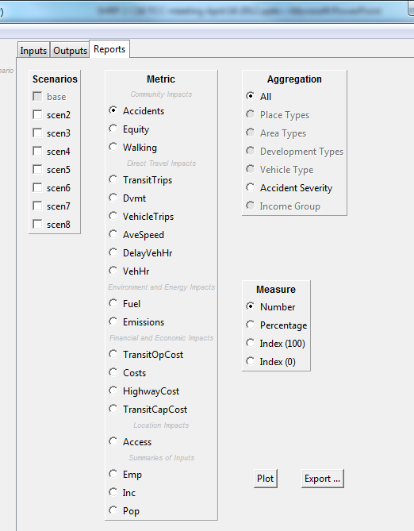
Model Reports
Community Impacts
Direct Travel Impacts
Environment and Energy Impacts
Financial and Economic Impacts
Location Impacts
Input Summaries

Slide 13
Pilot Test Objectives
Four test implementations of the software
Atlanta Regional Commission (ARC)
Thurston Regional Planning Commission (TRPC)
Maryland DOT (region with Maryland/DC area)
RSG tested Portland Metro region
Software testing to understand
Usability of the software
Complexity of developing input data
Usefulness of output metrics
Reasonableness of the results
Generate feedback that will inform
Final updates to the software and user’s guide
Suggestions for future updates

Slide 14
Test Scenarios
Scenario | Land Use | Transportation | Policy
#1 | Baseline | Baseline | Baseline
#2 | Baseline | + 20% in Transit Supply | Baseline
#3 | Baseline | + 20% in Roadway Supply | Baseline
#4 | Baseline | Baseline | +20% in Lane Miles with ITS
#5 | Shift 10% of Population and Employment to Close in Community and 10% to Urban Core. Proportional reduction from Suburban Area | Baseline | Baseline
#6 | Shift 20% of Population and Employment to Close in Community and 20% to Urban Core. Proportional reduction from Suburban Area | Baseline | Baseline
#7 | Shift 30% of Population and Employment to Close in Community and 30% to Urban Core. Proportional reduction from Suburban Area | Baseline | Baseline
#8 | Shift 30% of Population and Employment to Close in Community and 30% to Urban Core. Proportional reduction from Suburban Area | +20% in Transit Supply | +20% in Lane Miles with ITS

Slide 15
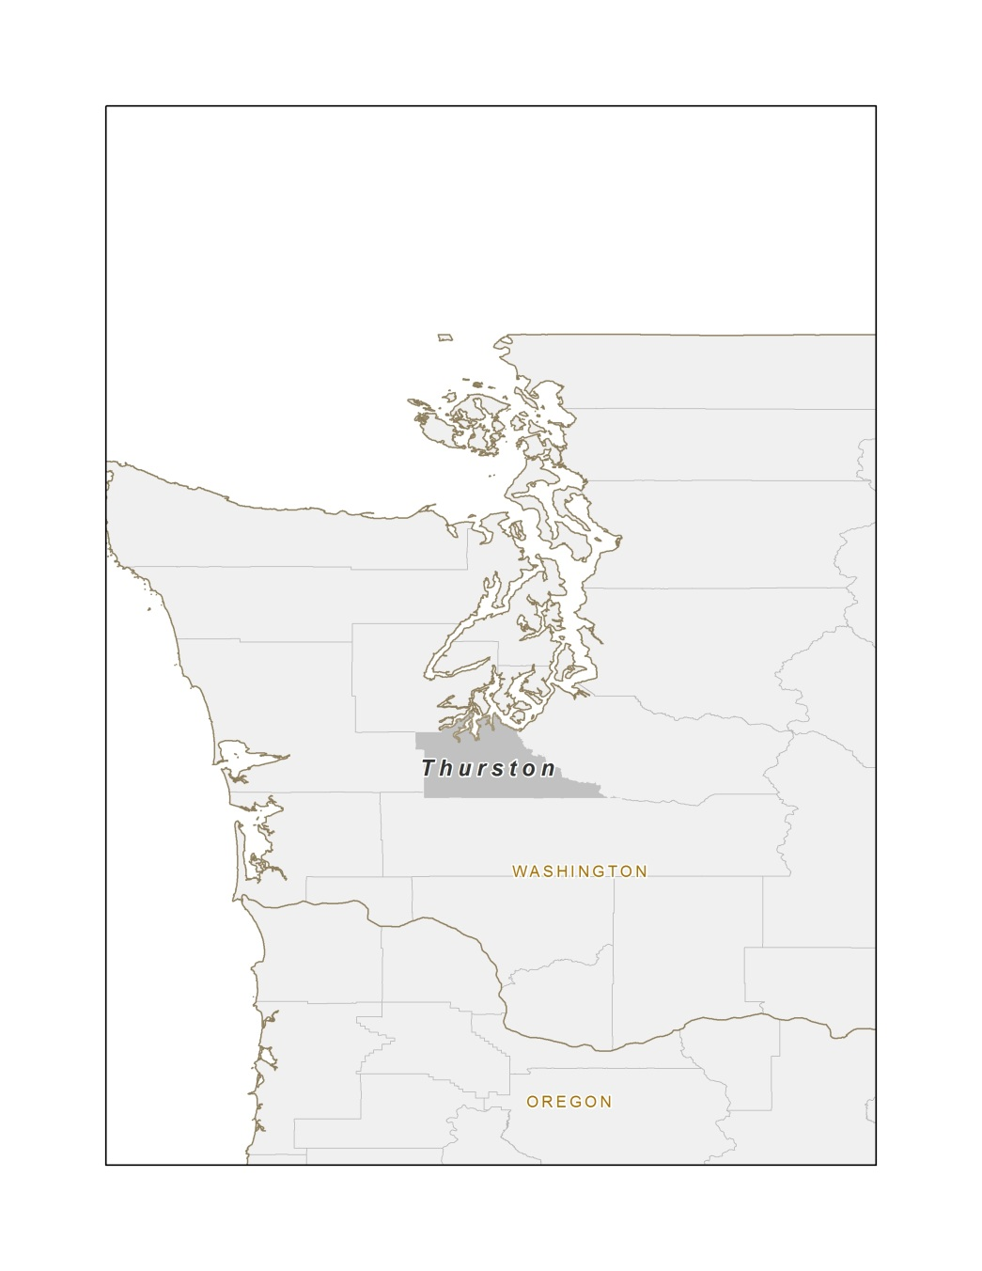
TRPC: Region Overview
Olympia, Washington metropolitan area
Single county, Thurston
2010 population of 250,000 and 2040 projected population of 425,000 (growth of 69%)
2010 employment of 130,000 and 2040 project growth of 100%

Slide 16
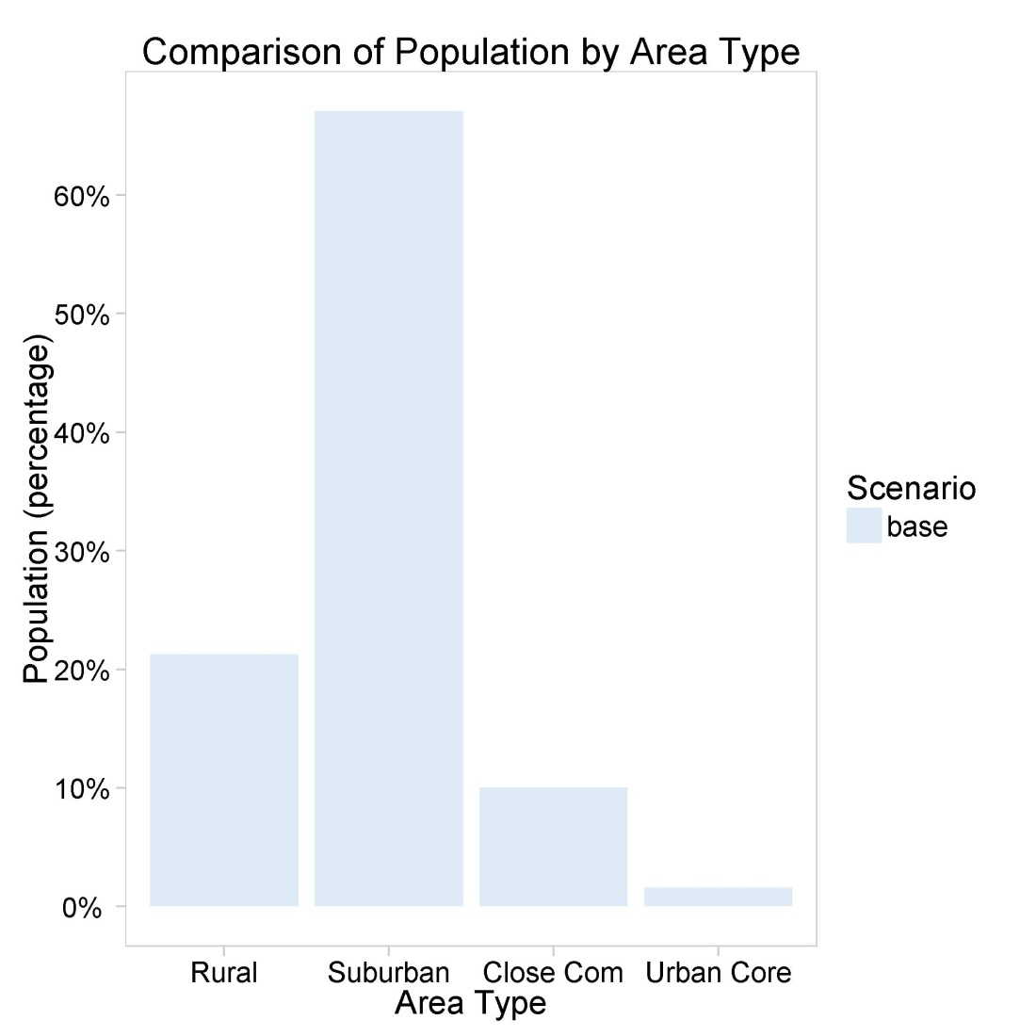
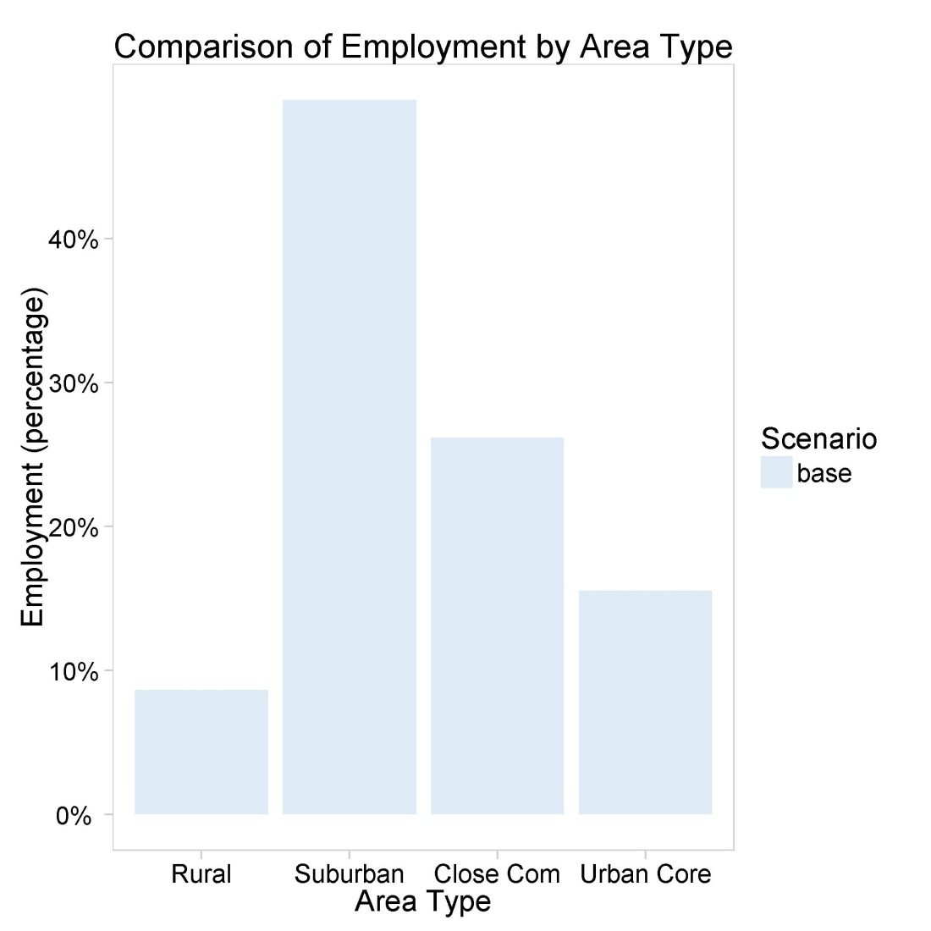
TRPC: Population and employment
Washington
Multnomah
Clackamas
Overall population in the base case is ~65% suburban in 2040, ~20% rural, ~10% CIC and only ~2% urban core
Employment is slightly more evenly distributed, with ~50% in suburban, ~25% CIC, and ~15% urban core

Slide 17
SmartGAP Place Types

Slide 18
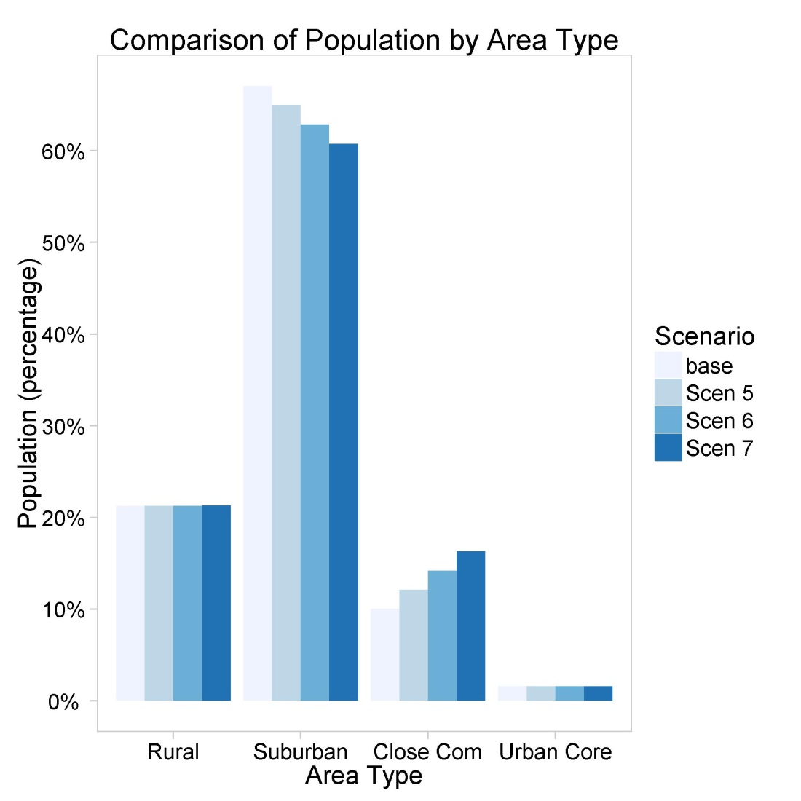
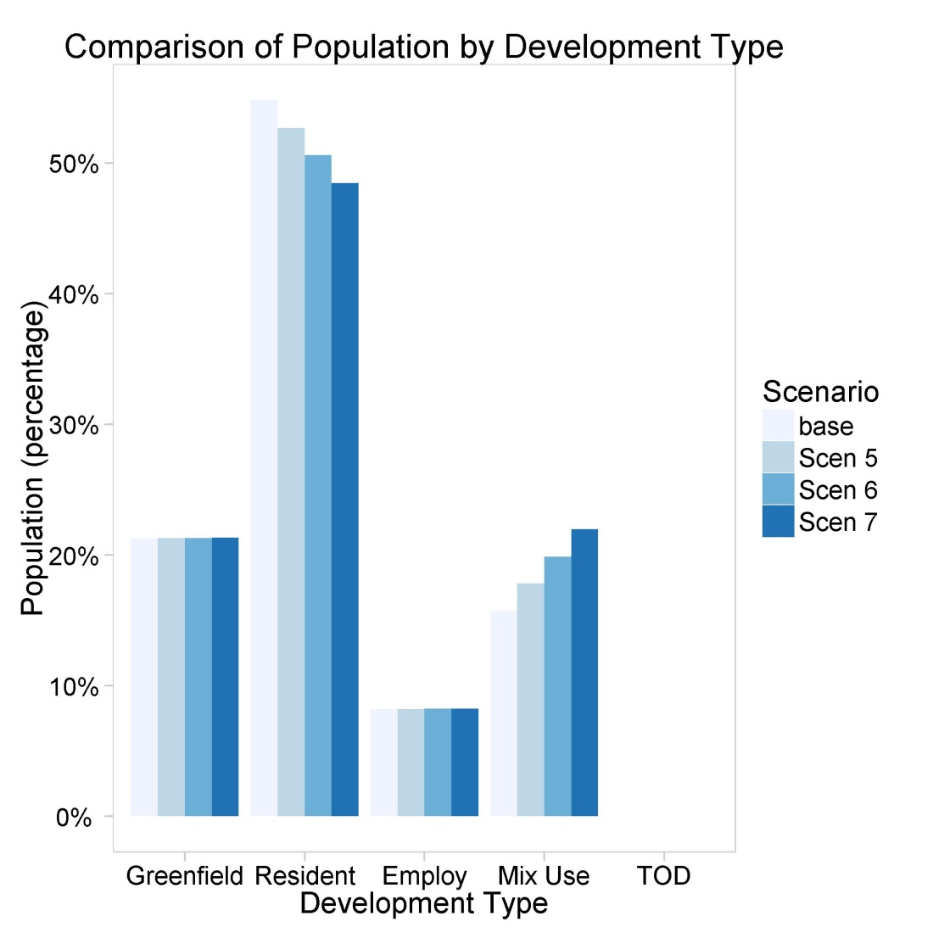
TRPC: Population allocation
Washington
Multnomah
Clackamas
TRPC moved relatively modest amounts of growth from suburban to close in communities for their land use allocation scenarios
Similarly, new residential growth was moved in modest amounts from residential areas to mixed use areas

Slide 19
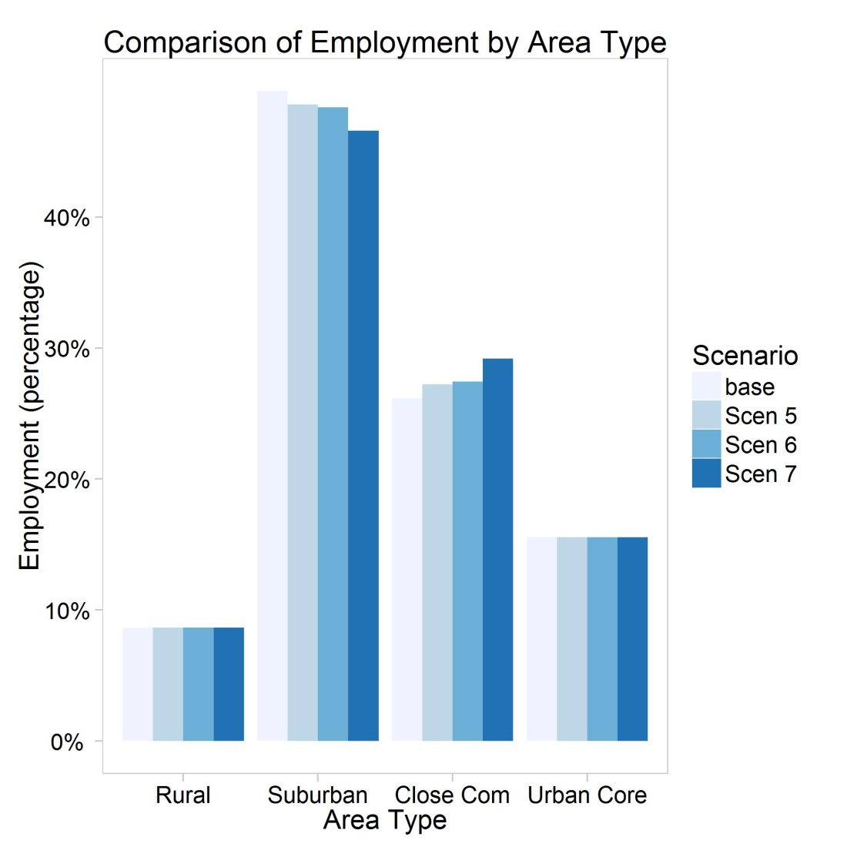
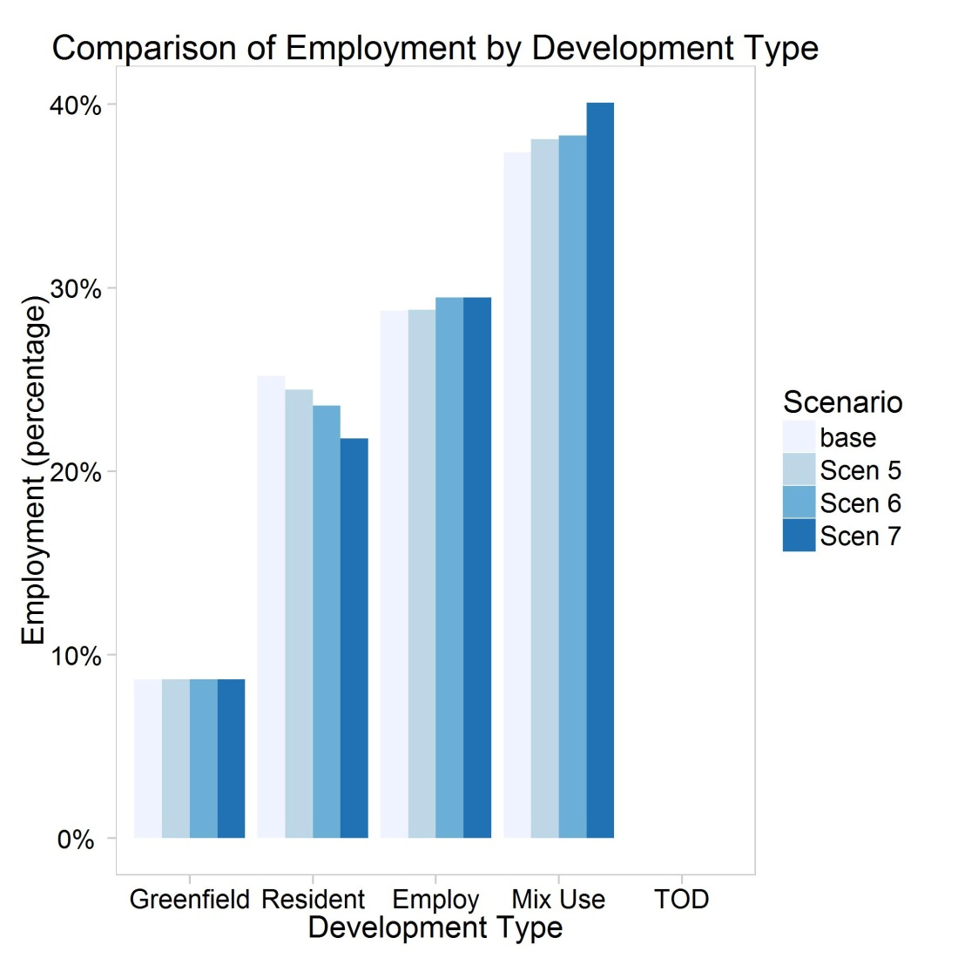
TRPC: Employment allocation
Washington
Multnomah
Clackamas
TRPC was similarly conservative with employment and moved relatively small amounts of growth from suburban to close in communities for their land use allocation scenarios
For new employment growth, small amounts were moved from residential areas to mixed use areas

Slide 20
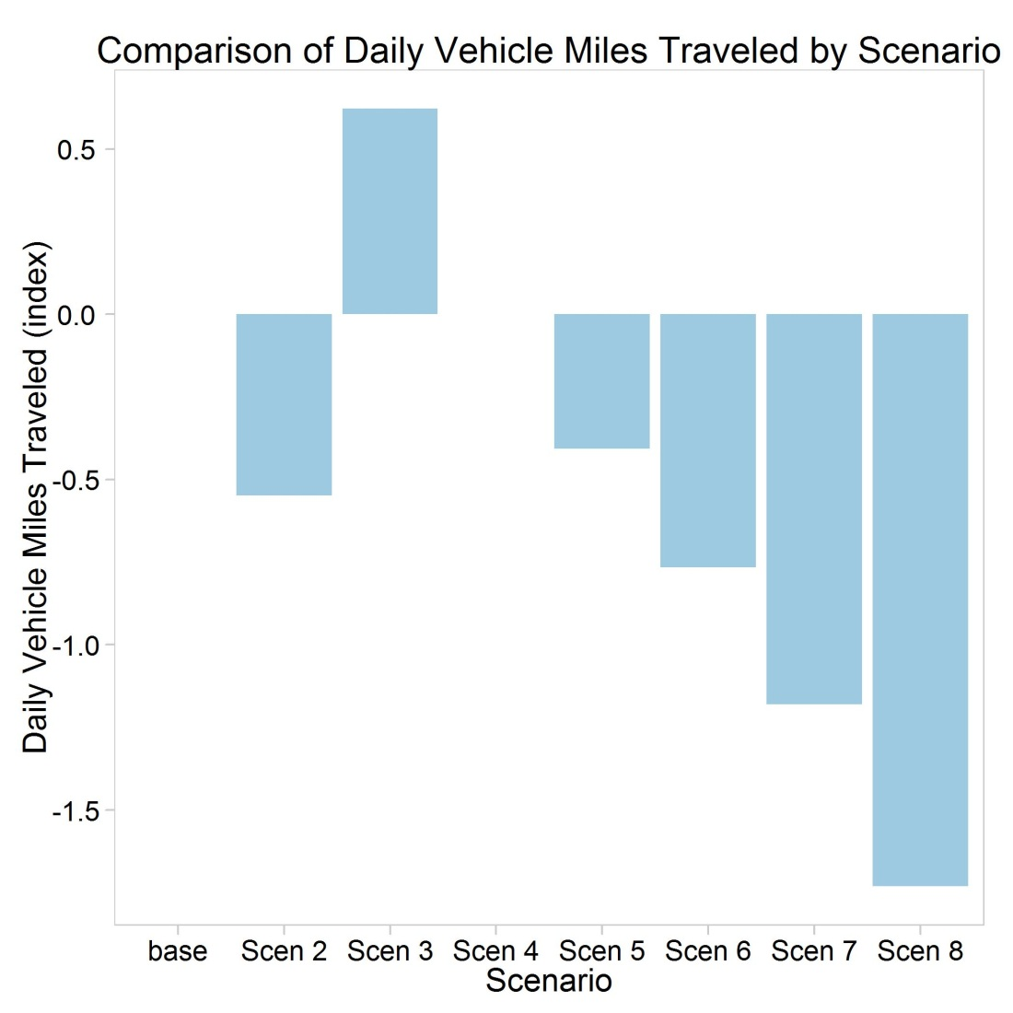
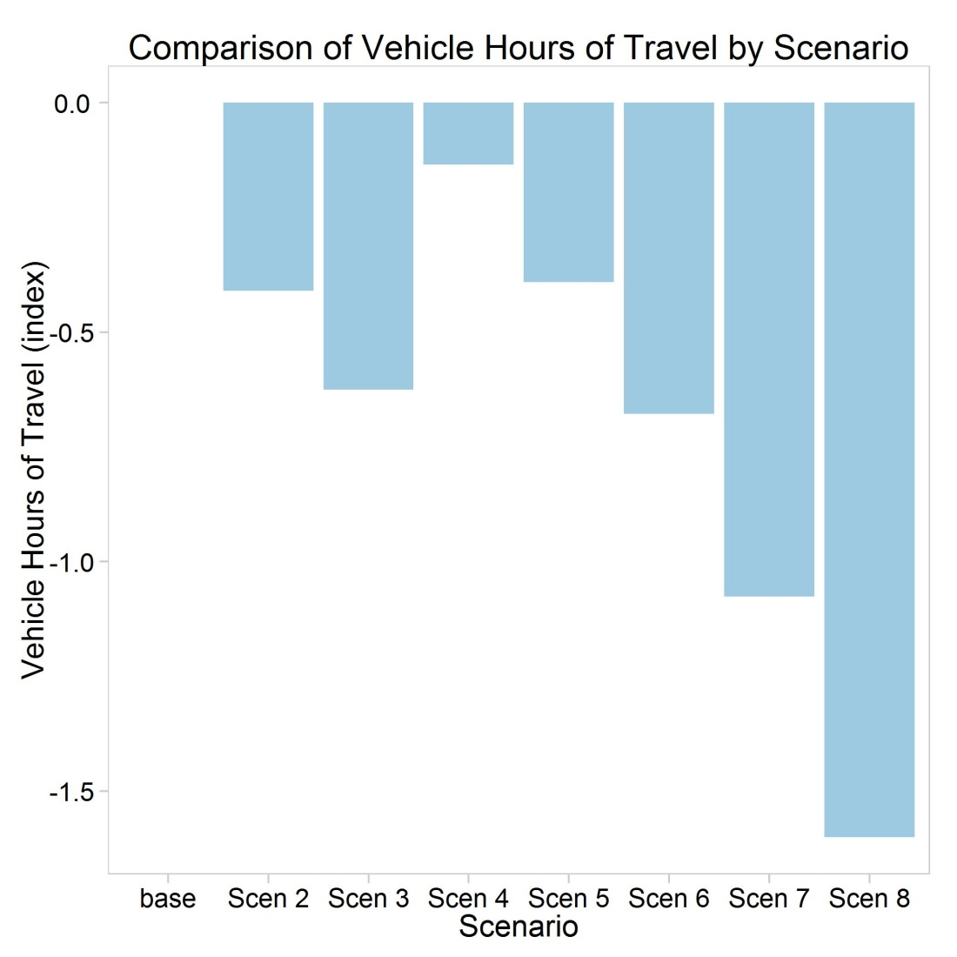
Change in Vehicle Miles and Vehicle Hours Traveled
Multnomah
Clackamas
VMT is sensitive to changes in demand and supply. The third scenario – adding highway lane miles – increases VMT slightly. Other scenarios – adding transit, or focusing development in central areas – reduces VMT.
VHT responds slightly differently. VMT reductions tend to result in lower VHT, but also policies that reduce congestion can reduce VHT even with no change or an increase in VMT.

Slide 21
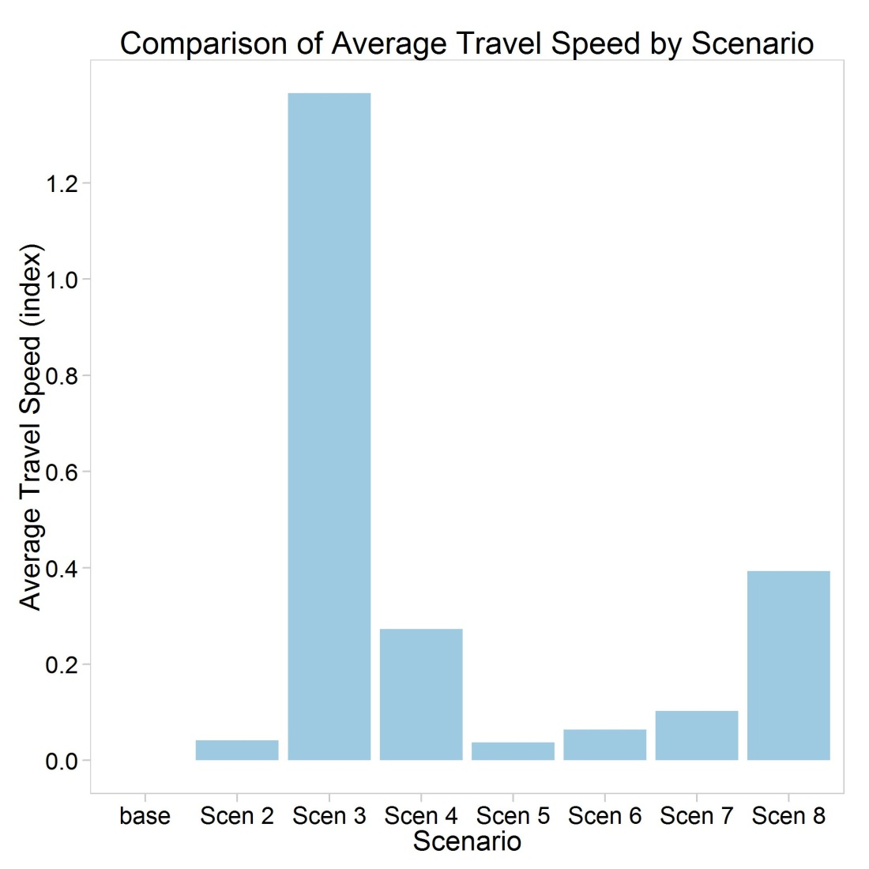
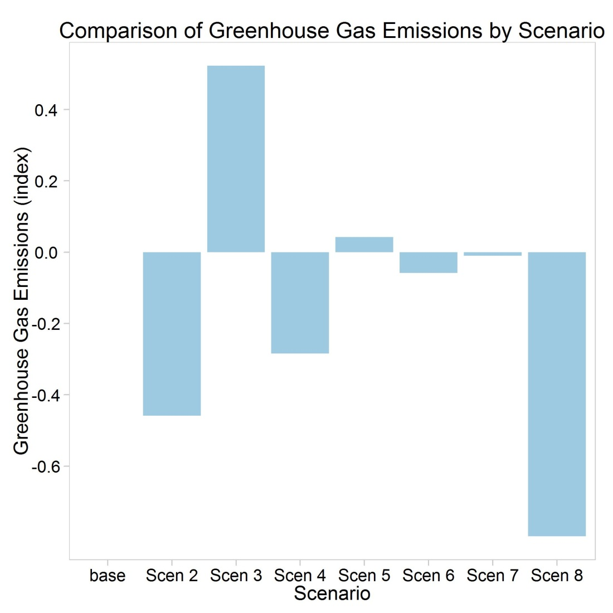
Changes in Average Speeds and GHG Emissions
Washington
Multnomah
Clackamas
The pattern of reductions in GHG is affected by both change in VMT and also changes in congestion and travel speeds. Congestion reduction through ITS and additional transit provision have the largest impacts on GHG emissions

Slide 22
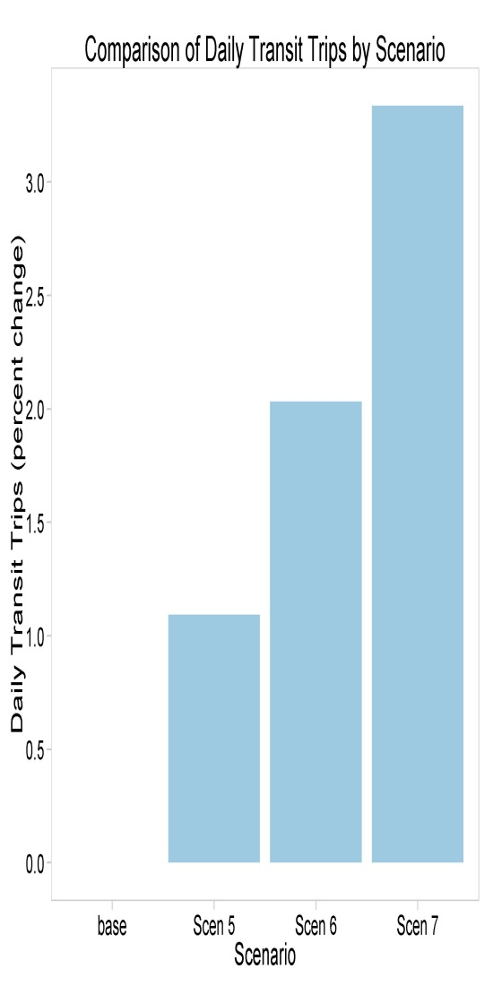
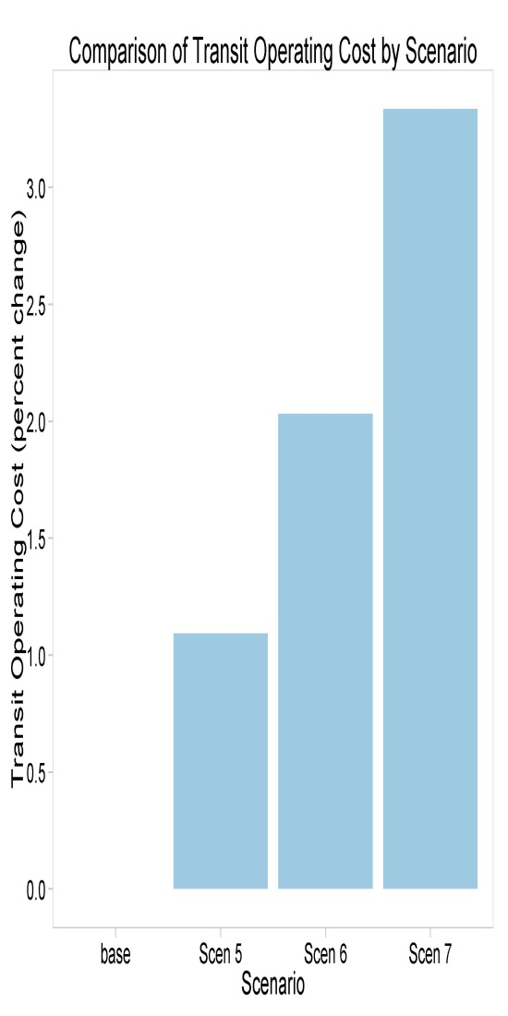
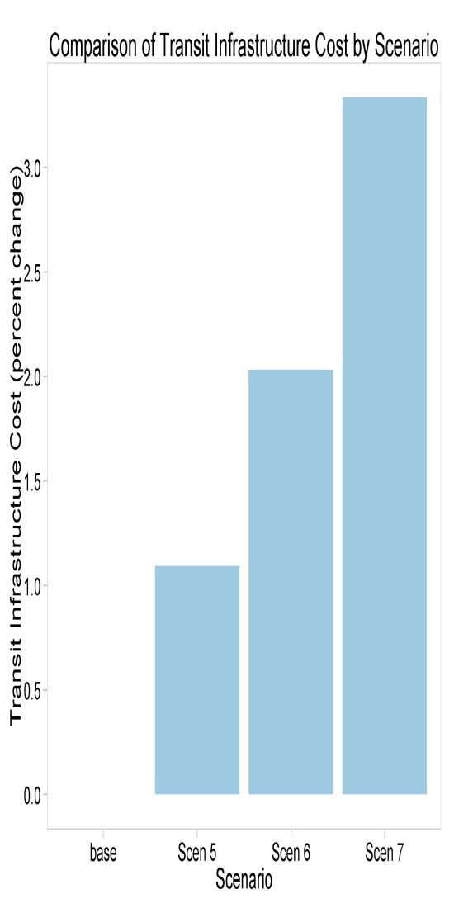
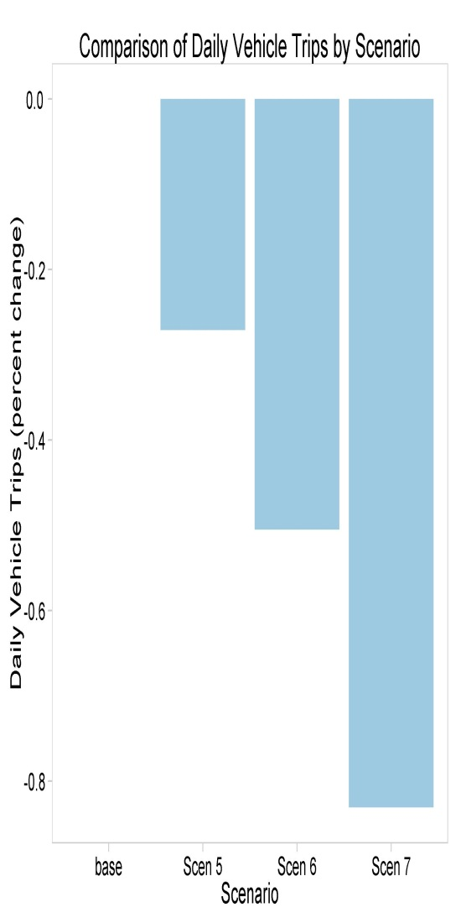
Transit and Vehicle Trips and Transit Costs
Transit Trips
Transit Operating Costs
Transit Capital Costs
Vehicle Trips
Washington
Multnomah
Clackamas
Transit trip metric is based on land use effects only: allocating growth to more transit accessible locations (i.e. CIC and mixed use) increases transit use.
Operating costs and capital costs are proportion to use so follow the same pattern.
Vehicle trips are calculated in a similar way to transit trips – again the calculation is only based on land use effects. Allocating growth to more central and mixed use areas reduces vehicle trips.

Slide 23
Pilot Test Summary
Performance metrics were consistent with expectations
Installation and input file preparation were easy
TRPC were able to run the model across their network to allow multiple users within the MPO to use the same installation
Regional policy scenario testing is useful for
Smaller MPOs and local jurisdictions without advanced travel demand models
Provides a fast way for agencies with good travel demand modeling tools to pre-screen policy scenarios before undertaking extensive travel demand modeling exercises that are resource intensive
Run times are reasonable
Atlanta Regional Commission (ARC) took ~ 1 hour 45 minutes
Thurston Regional Planning Commission (TRPC) took ~ 4 minutes
Maryland DOT (MDOT) took ~17 minutes for Montgomery County and ~2 minutes for Cecil County
RSG Test Bed for Portland Metro Region took ~ 25 minutes

Slide 24
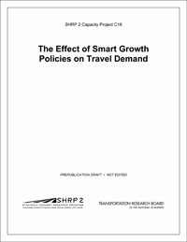
Publications
Prepublication versions are now available!
The final report, SmartGAP user’s guide, and SmartGAP software are now available at:
http://www.trb.org/Main/Blurbs/168761.aspx

Slide 25
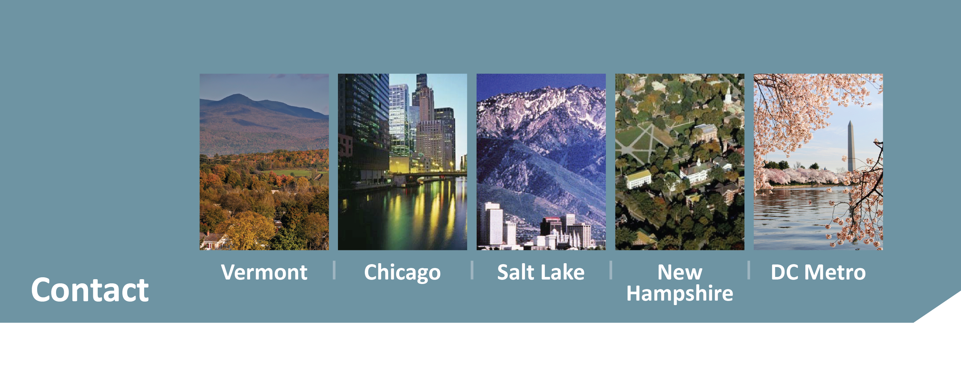
Maren Outwater
RSG
maren.outwater@rsginc.com
414-446-5402
www.rsginc.com
Colin Smith
RSG
colin.smith@rsginc.com
802-295-4999
www.rsginc.com
Notes:
25

