Slide 1
GIS Techniques and Algorithms to Automate the Processing of GPS-Derived Travel Survey Data
Praprut Songchitruksa, Ph.D., P.E.
Mark Ojah
Texas A&M Transportation Institute
14th TRB National Transportation Planning Applications Conference
Columbus, OH
May 8, 2013

Slide 2
Outline
Project Background
Objectives
Algorithm Development and Refinement
Algorithm Implementation
Validation and Comparison with CATI

Slide 3
Project Background
Conventional travel survey data were collected using household trip diaries and the Computer Assisted Telephone Interview (CATI) technique.
Issues with CATI data
  Require significant time and effort on the part of respondents.
  Missing/Unreported/Incorrectly reported trips are inevitable.
Notes:
Therefore GPS travel data obtained from subsample of respondents to improve modeling results (trip rate correction factors applied to entire CATI sample).

Slide 4
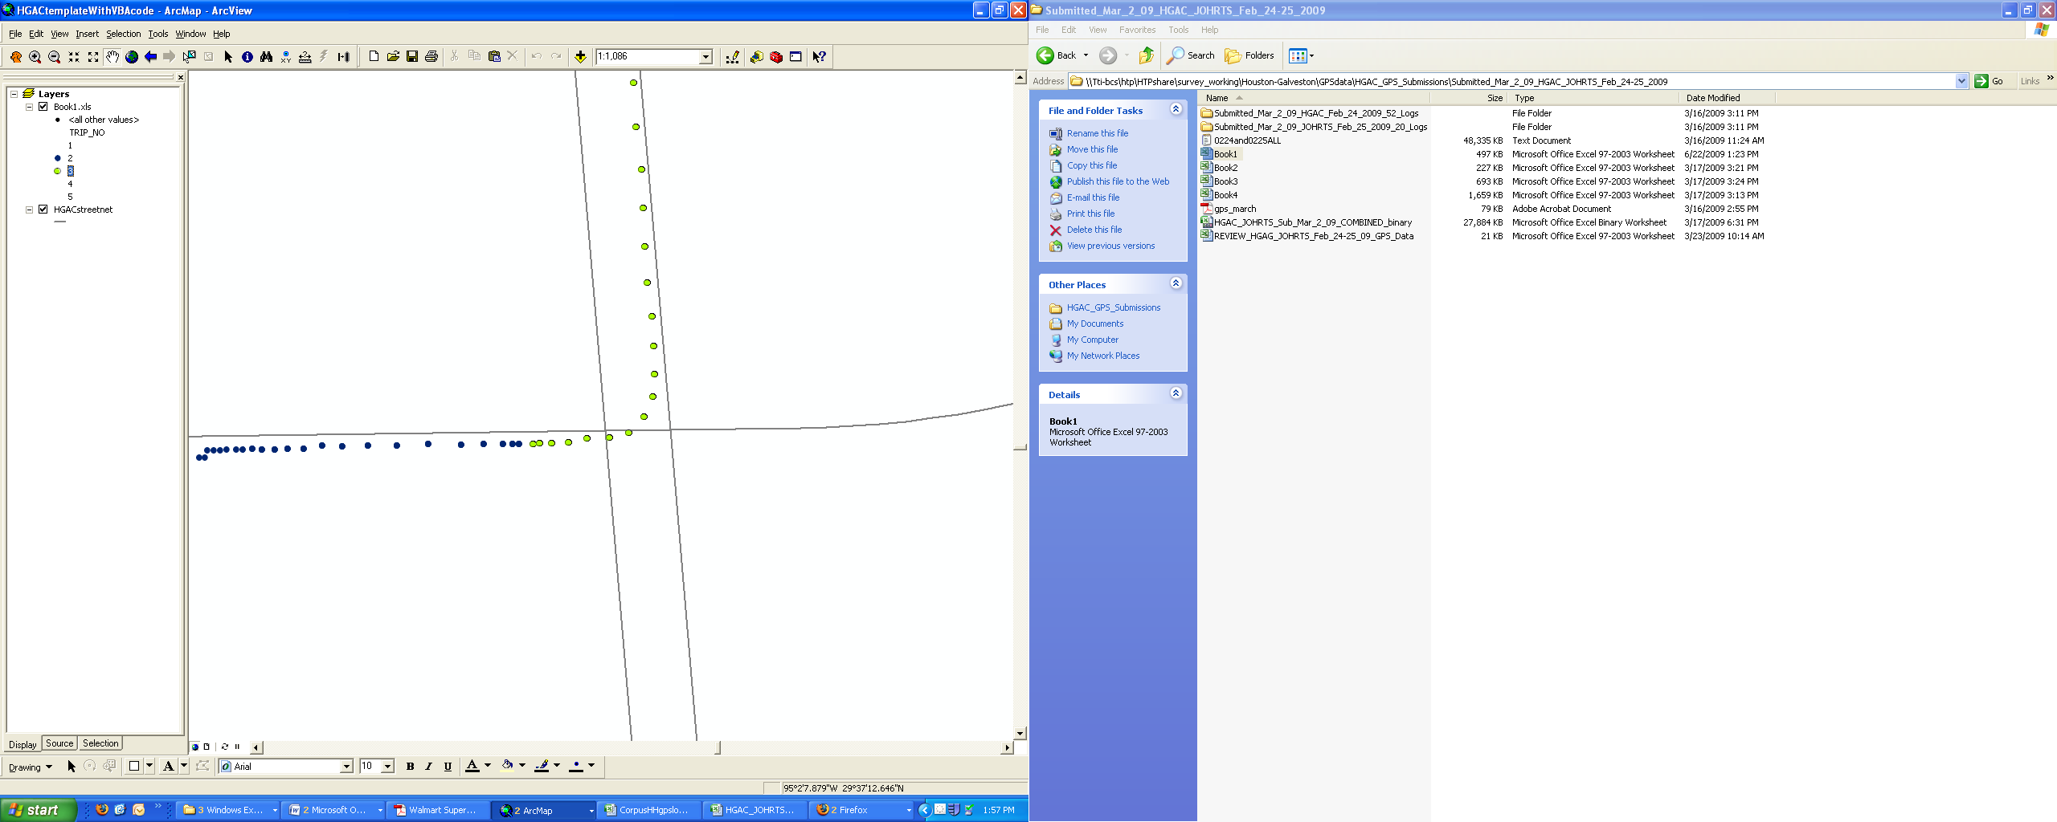
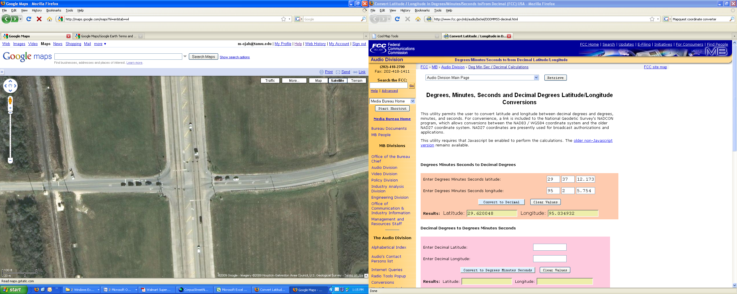
Issues with GPS Data Processing
Dwell time threshold alone is often inadequate.
Example
  Long stop due to congestion/traffic control (e.g., at-grade railroad crossings, signal stops, etc.)

Slide 5
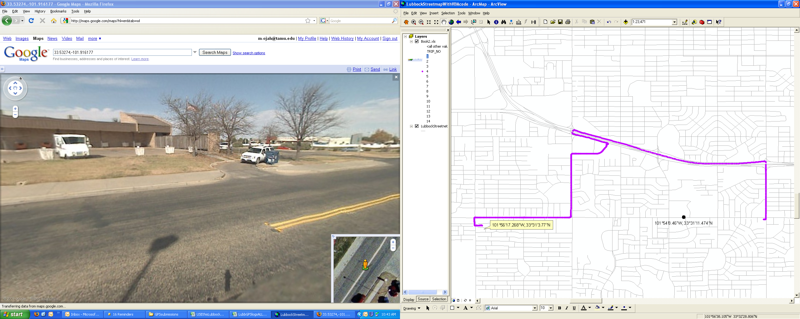
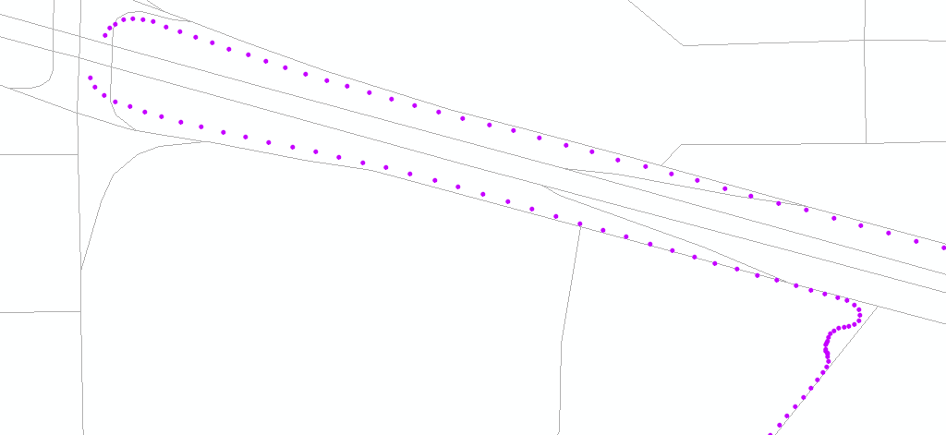
Missed Trip Ends
Stops of short dwell time are often missed.

Slide 6
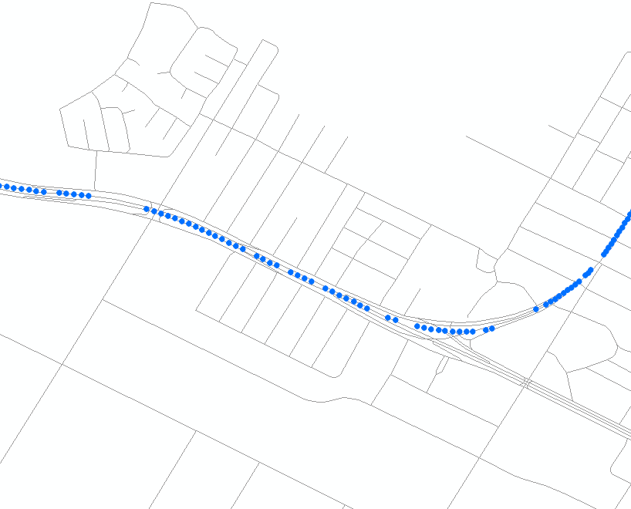
Poor GPS Signal Reception
Spotty data and signal acquisition delay can be misleading and falsely identified as a trip end.

Slide 7
Objectives
Develop an algorithm to automate the processing of in-vehicle GPS data.
Validate the algorithm-generated results against ground truth data.
Compare the algorithm-generated results with CATI data.

Slide 8
GPS Data Processing Algorithm
Four primary steps
  Split trips using GPS data attributes.
  Identify missed trip ends using GIS-based street network.
  Classify trip types.
  Compile trip-by-trip summary and generate trip statistics.

Slide 9
Trip Splitting
Two basic criteria
  Minimum dwell time: 2 minutes
  Minimum trip length: 0.6 miles (reduces the number of false trips from GPS signal interruptions)
The threshold should be conservative in this step.

Slide 10
Identify Missed Trip Ends
Overlay GIS network and use GPS data attributes and spatial relationships to identify additional trip ends
Goal: Detect missed trip ends while minimizing false positives such as traffic stops at traffic control devices.
Criteria for additional trip ends
  Minimum trip-end dwell time (15 seconds)
  Minimum buffer to closest network link (40 feet)
  Minimum radius to the last trip end (0.1 miles)
  Minimum trip length (along GPS paths) from the last trip end (0.2 miles)

Slide 11
Trip Classification
Compile trip ends from first and second steps.
Identify and exclude external trips using a geofencing technique.
Import geocoded home and work locations for each household to generate trip types (HBW, HBO, and NHB).
Include only “full households” for comparison with CATI (i.e. only households with both GPS and CATI data available for all vehicles).
Classification parameters
  Maximum radius for home/work location: 0.3 miles
  Exception radius for the first origin trip end: 1.3 miles (to account for longer cold-start signal acquisition)

Slide 12
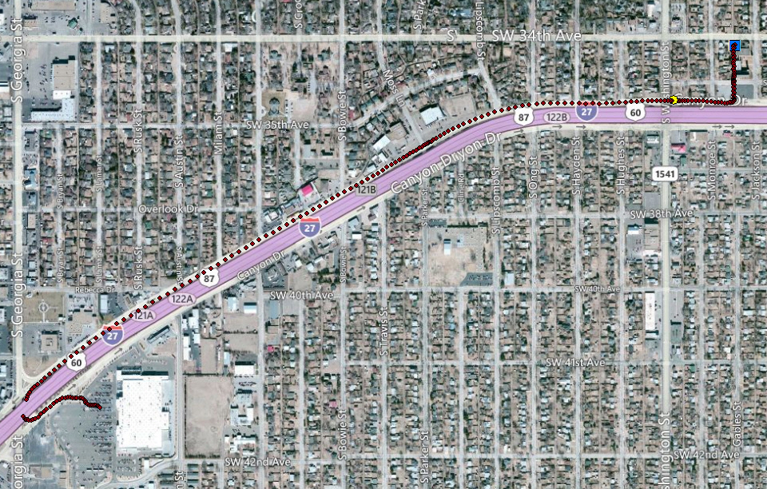
Algorithm-Generated GPS Trips
GPS signal blockage from overpass is properly recognized as part of the same trip.
Yellow Dot: 15 sec < Dwell Time < 120 sec
Blue Rectangle: Dwell Time >120 sec

Slide 13
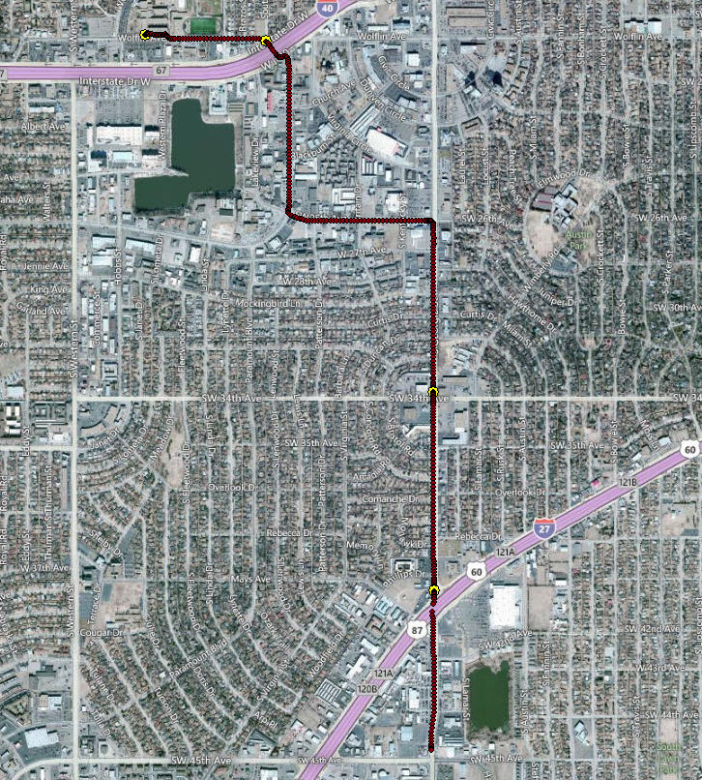
Algorithm-Generated GPS Trips
Short stops due to traffic control (dwell time between 15 and 120 seconds) are not mistaken as trip ends.
Yellow Dot: 15 sec < Dwell Time < 120 sec

Slide 14
Algorithm-Generated Trip Summary
TripNum | HHID | UnitID | Beg_HWO | Beg_LocDateTime | End_HWO | End_LocDateTime | TripLength | TripTime | DwellTime | TripType
2101_193_0001 | 2101 | 193 | H | 2007-09-11 06:48:10 | O | 2007-09-11 06:49:27 | 0.3506 | 1.28 | 50.47 | HBO
2101_193_0002 | 2101 | 193 | O | 2007-09-11 07:39:55 | H | 2007-09-11 07:42:43 | 0.6309 | 2.8 | 298.13 | HBO
2101_193_0003 | 2101 | 193 | H | 2007-09-11 12:40:51 | O | 2007-09-11 12:43:00 | 0.8123 | 2.15 | 4.05 | HBO
2101_193_0004 | 2101 | 193 | O | 2007-09-11 12:47:03 | H | 2007-09-11 12:50:54 | 1.1639 | 3.85 |  | HBO
2104_106_0001 | 2104 | 106 | H | 2007-09-11 08:52:37 | W | 2007-09-11 08:58:38 | 3.0051 | 6.02 | 2.8 | HBW
2104_106_0002 | 2104 | 106 | W | 2007-09-11 09:01:26 | O | 2007-09-11 09:07:14 | 2.0434 | 5.8 | 262.08 | NHB
2104_106_0003 | 2104 | 106 | O | 2007-09-11 13:29:19 | O | 2007-09-11 13:31:15 | 0.5531 | 1.93 | 0.27 | NHB
2104_106_0004 | 2104 | 106 | O | 2007-09-11 13:31:31 | H | 2007-09-11 14:05:09 | 5.0993 | 33.63 | 306.18 | HBO
2104_106_0005 | 2104 | 106 | H | 2007-09-11 19:11:20 | O | 2007-09-11 19:18:18 | 4.2203 | 6.97 | 3.9 | HBO
2104_106_0006 | 2104 | 106 | O | 2007-09-11 19:22:12 | H | 2007-09-11 19:30:53 | 4.3412 | 8.68 |  | HBO
For each trip, the trip information is checked for its reasonableness (e.g. speed within plausible range). A trip is flagged as invalid if its characteristics do not pass these checks.
Several relevant tables can be generated from the trip-by-trip table, e.g., trip rates by trip types, dwell time/trip length distribution, etc.

Slide 15
Algorithm Implementation
R (Open-Source http://www.r-project.org)
  Base Package
  RPyGeo Package (Execute geoprocessing commands within R)
  Several other packages
ArcGIS Geoprocessing Using Python

Slide 16
Algorithm Validation
Ground truth data are obtained from basic spreadsheet processing using a 2-minute dwell time threshold and then followed by manual review/edit of all GPS traces.
Parameters used in the new algorithm have been finetuned during this validation process.

Slide 17
Validation Results
Amarillo, TX
Trip Type | Ground Truth # | Algorithm # | Ground Truth % | Algorithm % | Algorithm – Ground Truth
HBO | 499 | 537 | 43.9% | 47.3% | 3.4%
HBW | 96 | 116 | 8.5% | 10.2% | 1.8%
NHB | 541 | 482 | 47.6% | 42.5% | -5.2%
Total | 1136 | 1135 | Total Trip Difference |  | -1
 |  |  | % Trip Diff |  | -0.1%
Waco, TX
Trip Type | Ground Truth # | Algorithm # | Ground Truth % | Algorithm % | Algorithm – Ground Truth
HBO | 378 | 362 | 48.5% | 46.4% | -2.1%
HBW | 61 | 66 | 7.8% | 8.5% | 0.6%
NHB | 340 | 352 | 43.6% | 45.1% | 1.5%
Total | 779 | 780 | Total Trip Difference |  | 1
 |  |  | % Trip Diff |  | 0.1%

Slide 18
Comparison between GPS and CATI
Extract CATI data for households that participated in GPS survey.
Only “full households” are included for comparison.
Algorithm processes CATI data into same format as GPS results.

Slide 19
GPS vs CATI – Trip Rates by Trip Types
Amarillo, Texas
 | HBW |  | HBO |  | NHB |  | Total
 | GPS | CATI | GPS | CATI | GPS | CATI | GPS | CATI
Full Households (134 Households, 200 Vehicles)
Trips | 125 | 141 | 580 | 516 | 589 | 441 | 1,294 | 1,098
Trips/Vehicle | 0.63 | 0.72 | 2.94 | 2.62 | 2.99 | 2.24 | 6.57 | 5.57
Trips/Household | 0.93 | 1.05 | 4.33 | 3.85 | 4.40 | 3.29 | 9.66 | 8.19
Lubbock, Texas
 | HBW |  | HBO |  | NHB |  | Total
 | GPS | CATI | GPS | CATI | GPS | CATI | GPS | CATI
Full Households (145 Households, 197 Vehicles)
Trips | 139 | 182 | 590 | 551 | 771 | 577 | 1,500 | 1,310
Trips/Vehicle | 0.71 | 0.92 | 2.99 | 2.80 | 3.91 | 2.93 | 7.61 | 6.65
Trips/Household | 0.96 | 1.26 | 4.07 | 3.80 | 5.32 | 3.98 | 10.34 | 9.03

Slide 20
Difference in Mean Trip Rates (GPS-CATI)
Amarillo, Texas
Household Income | Household Size |  |  |  | Weighted Average
 | 1 | 2 | 3 | 4+
$0-$14,999 | 0.56 | 1.00 | - | 1.25 | 0.84
$15,000-$29,999 | 0.33 | 3.22 | 1.50 | 3.67 | 2.19
$30,000-$49,999 | 0.67 | -0.11 | 3.00 | 1.00 | 0.62
$50,000-$74,999 | -1.00 | 1.15 | 1.57 | 0.00 | 0.77
$75,000+ | -0.50 | 2.50 | 2.17 | 2.50 | 2.29
Total | 0.33 | 1.68 | 1.94 | 1.65 | 1.47
Less than 5 households
Lubbock, Texas
Household Income | Household Size |  |  |  | Weighted Average
 | 1 | 2 | 3 | 4+
$0-$14,999 | 2.40 | 4.00 | - | 6.50 | 3.75
$15,000-$29,999 | 1.80 | 0.28 | 3.50 | -1.86 | 0.52
$30,000-$49,999 | 5.50 | 0.78 | 0.71 | 2.00 | 1.41
$50,000-$74,999 | 1.00 | 1.28 | 1.88 | 0.60 | 1.30
$75,000+ | 3.00 | 1.95 | 2.00 | -0.13 | 1.06
Total | 2.29 | 1.54 | 1.86 | 0.19 | 1.31
The positive values indicate higher GPS trip rates and thus the tendency toward trip underreporting in the CATI survey.

Slide 21
Findings
Significant efficiency improvement in GPS data processing.
Algorithm performs well for detecting trips in GPS data. Trip counts are very close to ground truth validation.
Challenge remains in trip type classifications. Accuracy may be improved with newer GPS units.
Overall trip underreporting by CATI versus GPS is in the range of 10%-15%.
Notes:
Improved sensitivity and shorter cold start signal acquisition delay.

Slide 22
Future Research/Improvements
Improve trip type classification
  Look at travel activity pattern over multiple days
  Correlate trip end locations with land use layers
  Consider demographics and/or structural characteristics of stops (e.g. short pick-up/drop-off stop versus longer ones)
  Hybrid approach
Improve users’ experience
  Enhance user interface
Explore applicability and modification needs for processing non-vehicle GPS devices across multiple modes (e.g., smart phone with walk, bike, transit, etc.).

Slide 23
Questions?
Contact Information
Praprut Songchitruksa
979-862-3559
praprut@tamu.edu

