Slide 1
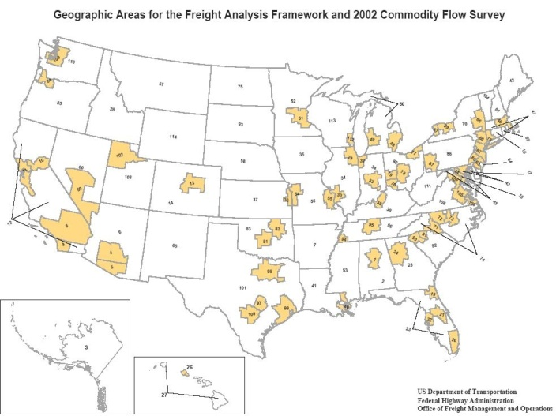
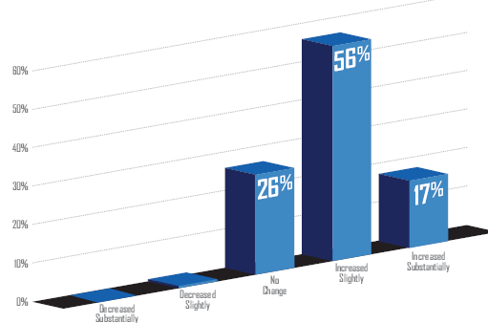
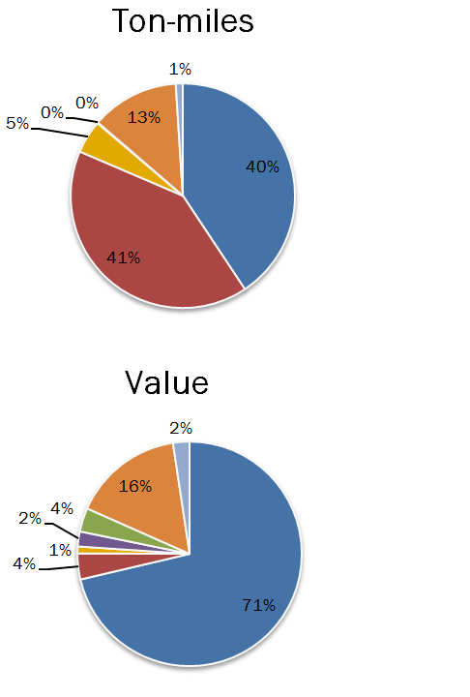


Development of a Statewide Freight
Trip Forecasting Model for Utah
Prepared by:
  Chad Worthen RSG
  Kaveh Shabani RSG
  Maren Outwater RSG
  Walt Steinvorth UDOT
14th TRB Applications Conference
May 06, 2013

Slide 2
Freight Model Components
Long-Haul
Commodity Flow Freight Model
Short-Haul
Commercial Vehicle & Truck Model
Generation | Trip end production & attraction in tons by 12 commodity groups
Distribution | Use gravity models to link together trip ends
Mode Share | Determine tonnage moved by truck & other modes
Assignment | Assign medium & heavy trucks to roadway
Generation | Trip end production & attraction in vehicles
Distribution | Use gravity models to link together trip ends
Assignment | Assign light, medium & heavy commercial vehicles & trucks to roadway
  Long-haul uses Transearch & socioeconomic data, short-haul uses socioeconomic data
  Long-haul includes national component, short-haul is just statewide
  Replaces the commercial and truck component in existing statewide model
Details
Introduction
Model Steps
Issues
Closing

Slide 3
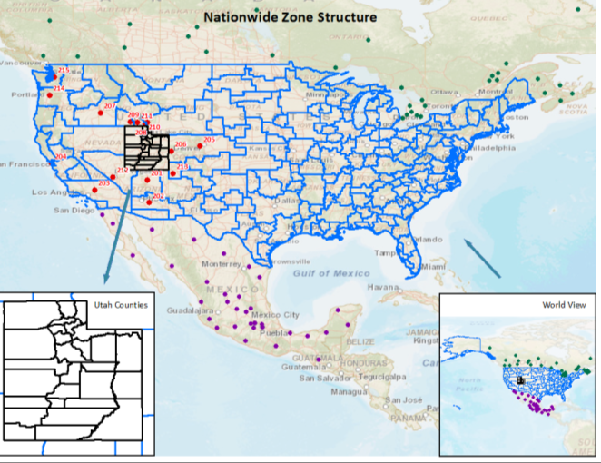
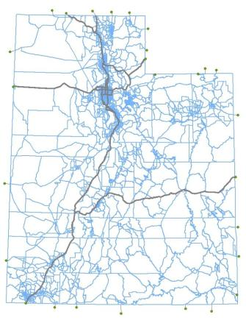
Geographic Scope
Part 1: National Zone Structure
Part 2: Statewide Zone Structure
  284 zones
  ~3,500 zones
Introduction
Model Steps
Issues
Closing

Slide 4
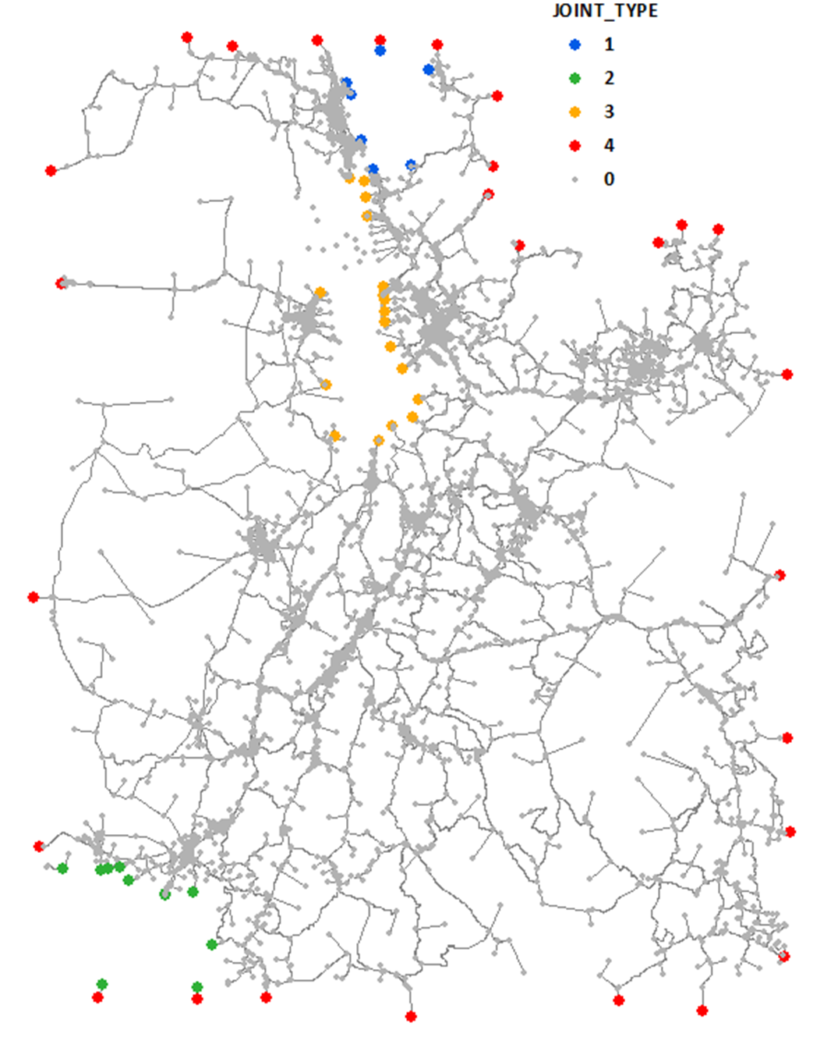
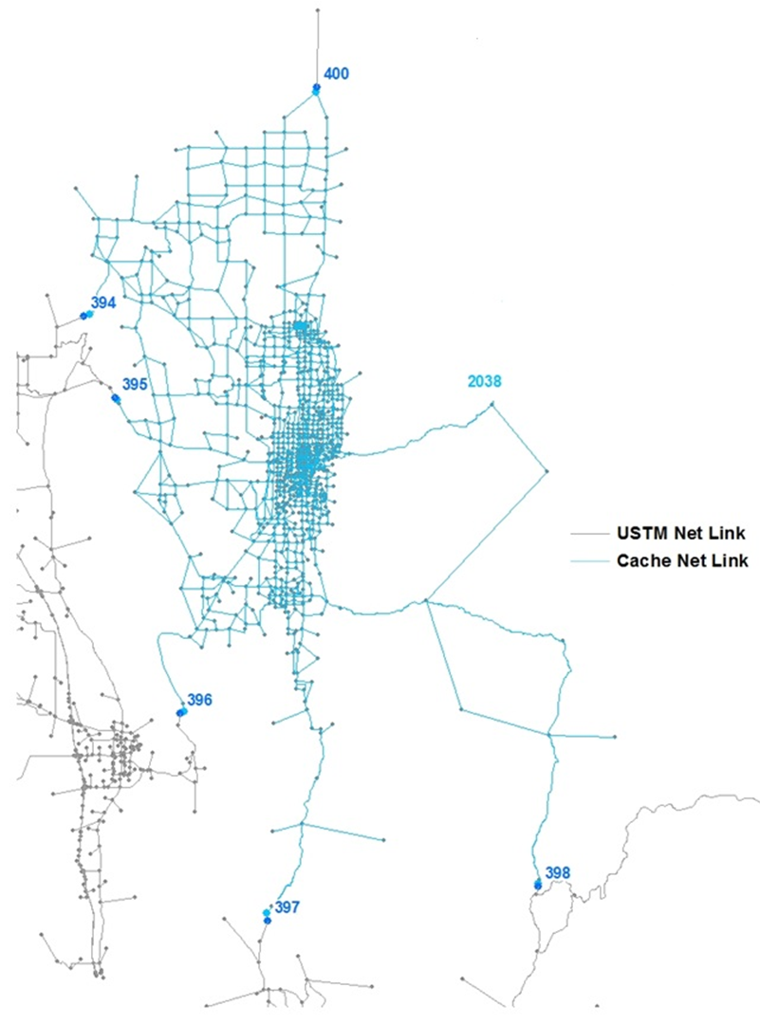
MPO Integration
USTM Connection to Cache
USTM Connection to Dixie
USTM Connection to Wasatch
USTM External Node
USTM Internal Node
Stand alone application added to USTM
To merge MPO model inputs to USTM inputs
  Highway networks
  TAZ shapefiles
  SE data files
  Trip tables
Creates sub-area networks
Introduction
Model Steps
Issues
Closing

Slide 5
GENERATION

Slide 6
Short Haul Generation
 | Vehicle Type | Variables | Light | Medium | Heavy
Moving People | School Bus | Households | 0.00029 | 0.00116 | -
 | Shuttle Service | Households + Total Employment | 0.00174 | 0.00019 | -
 | Private Transport | Total Employment | 0.00126 | 0.00014 | -
Goods | Package/Product/ Mail | Households + Total Employment | 0.00044 | 0.00001 | 0.00001
 | Urban Freight | Agriculture + Mining + Construction Employment | 0.32908 | 0.33920 | 0.49432
 |  | Industrial | 0.27809 | 0.28404 | 0.29545
 |  | Retail | 0.26327 | 0.29695 | 0.18466
 |  | Other | 0.12956 | 0.07981 | 0.02557
 |  | Households | 0.07441 | 0.11620 | 0.10795
 | Construction | Households + Total Employment + 2 * Construction Employment | 0.00810 | 0.00248 | 0.00579
Services | Safety | Households + Total Employment | 0.00418 | 0.00205 | 0.00230
 | Utility Vehicles | Households | 0.00779 | 0.00288 | -
 | Business/Personal Services | Households + Total Employment | 0.08249 | 0.01689 | -
Introduction
Model Steps
Issues
Closing

Slide 7
Long Haul Generation
Long Haul Trip End Model Estimation
Multivariate and multi-tier regression analyses
More than one trip generation equation for a commodity group
Better measures of fitness (RMSE, R², t-stat, p-value)
Grouping counties based on reasonable characteristics (rural, urban, etc.)
Using some advanced outlier-detection methods
Overall measures of influence (Cook’s Distance and DFBETA)
Unusual observations (questionable employment or tonnages or ratio)
Regression both with and without outliers (and all reasonable combination of variables)
Details
Introduction
Model Steps
Issues
Closing

Slide 8
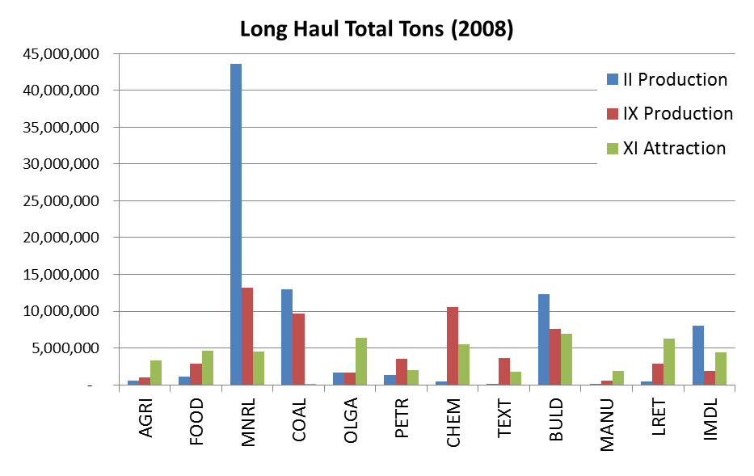

Long Haul Generation
Too high?
Metallic Ores
Sand
and
Gravel
More than 200 active pits and quarries across the state!
About 35 million tons of gravel, sand and crushed stone produced in 2009
MNRL
Nonmetallic Minerals
Produced by commercial operators and by state and county agencies in most counties in Utah
Introduction
Model Steps
Issues
Closing

Slide 9
DISTRIBUTION

Slide 10
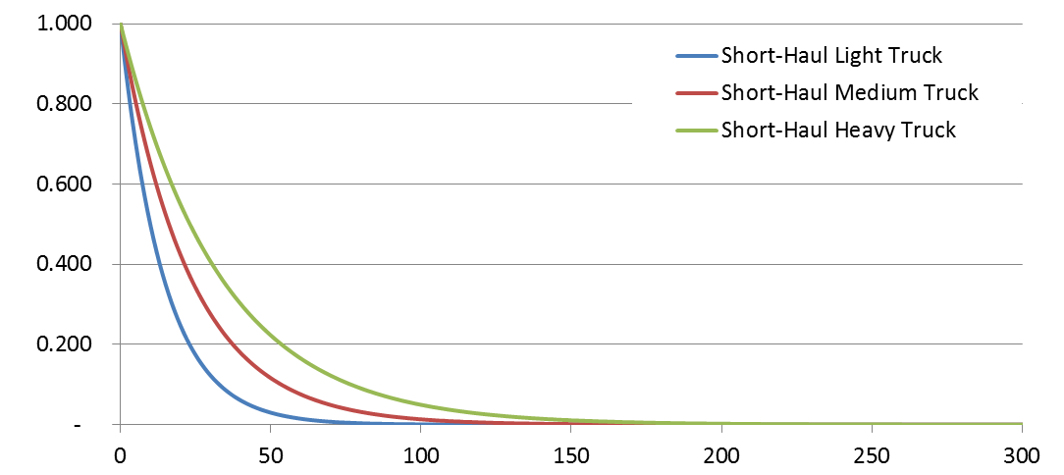
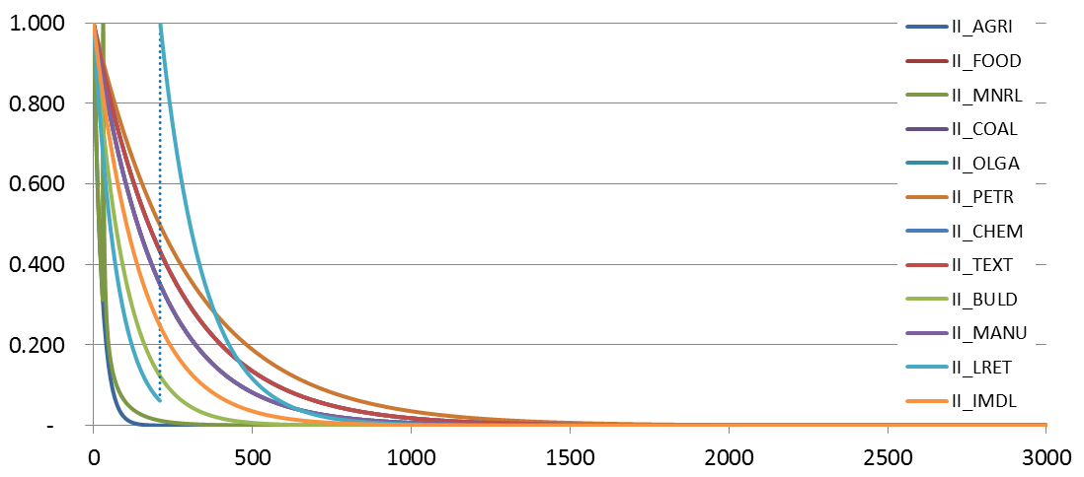
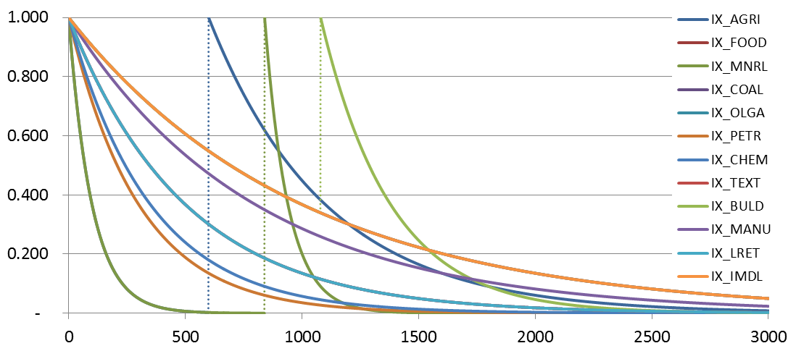
Friction Factors
Short-Haul
Based on QRFM II and other area freight model
Exponential function form
Unique curve for light, medium and heavy
Long-Haul
Calibrated using Transearch and national skims
Exponential, Gamma and Step function forms
Unique curve for each commodity
Unique set for internal-external movements (II, IX and XI)
Note: internal-internal (II), internal-external (IX), external-internal (XI), and external-external (XX)
Details
Introduction
Model Steps
Issues
Closing

Slide 11
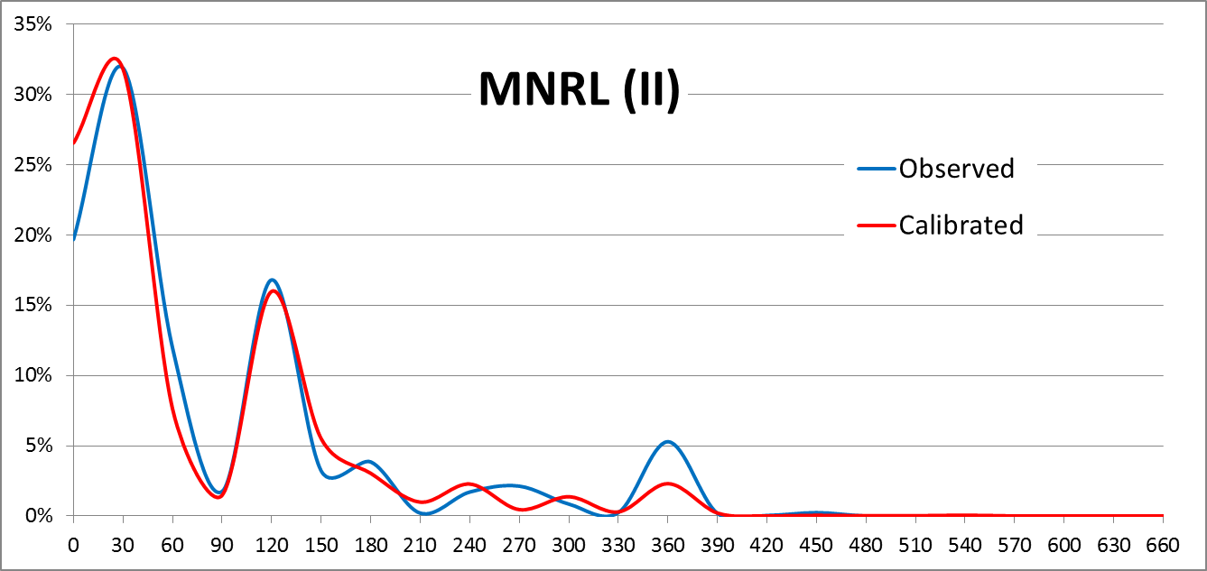
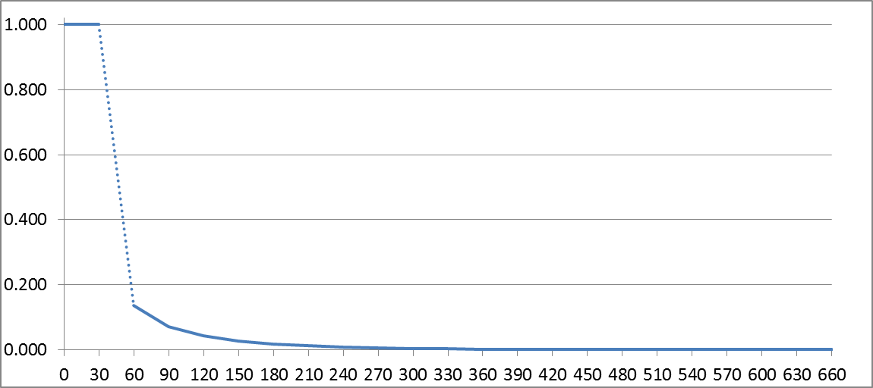

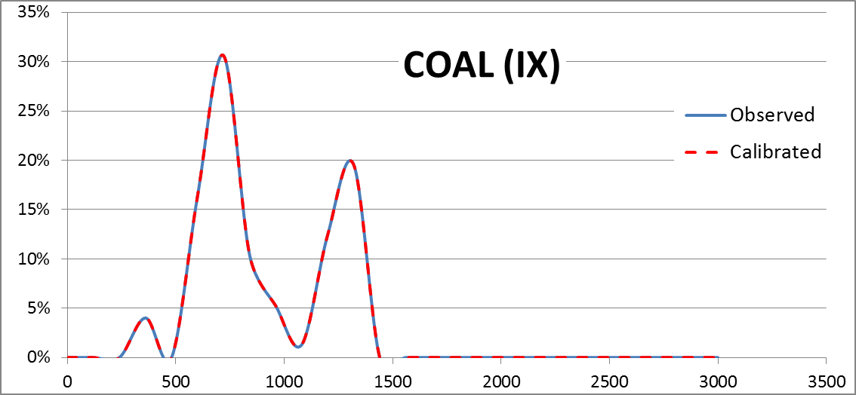
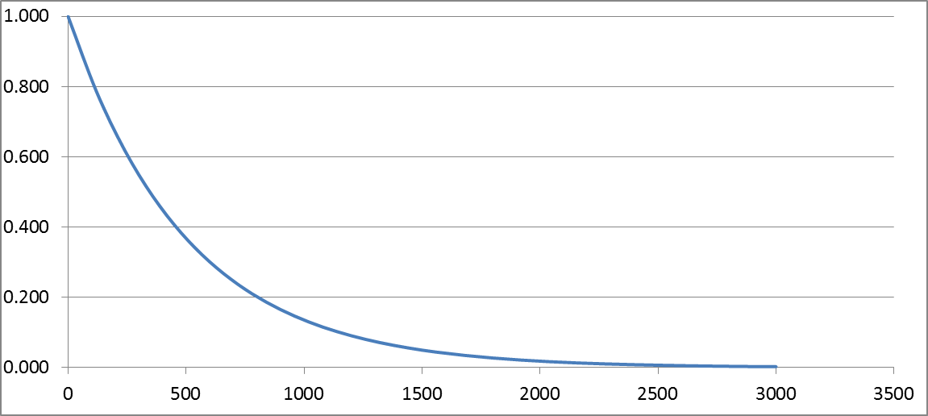
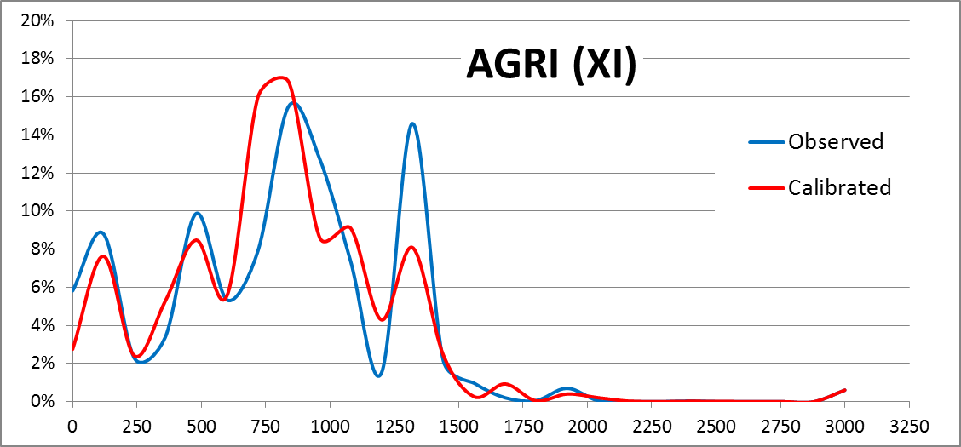
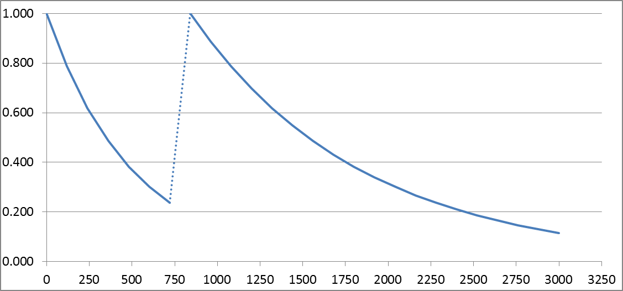
Trip Length Frequency Validation (Example)
Used step function to get the best match
(MNRLs very important because of high total tons)
Got a perfect match with a simple exponential function (several related friction factors also worked)
One of the worst cases, ended up using a step function to get the best match
Introduction
Model Steps
Issues
Closing

Slide 12
MODE SHARE

Slide 13
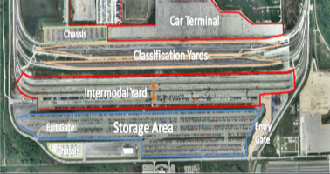

Modes and Mode Share
Mode share not mode choice model
Long haul only
Modes
    Truck – primary mode & purpose of model
    Intermodal (IMX) – to identify truck element
    Goods moved by combination of TRUCK and RAIL
    Connections happen at railroad terminals
    No ports and airports terminals
    Other – modes not assigned
    Pipeline and air
    These modes are not assigned
Source: http://people.hoftsra.edu
    Mode Share
  Mode shares determined by Transearch
    Exceptions:
    Coal
    Oil and gas
Details
Introduction
Model Steps
Issues
Closing

Slide 14
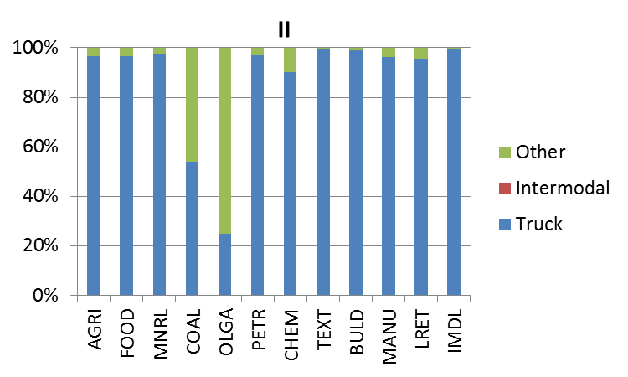
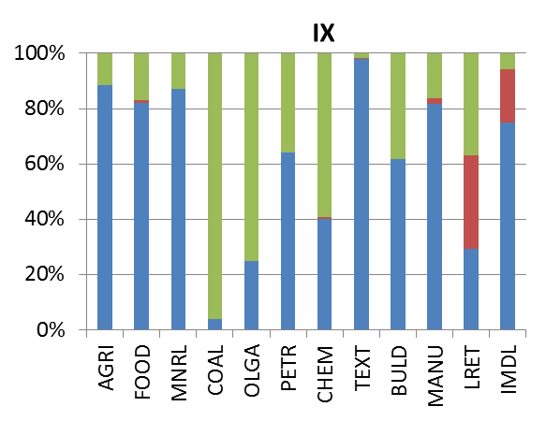
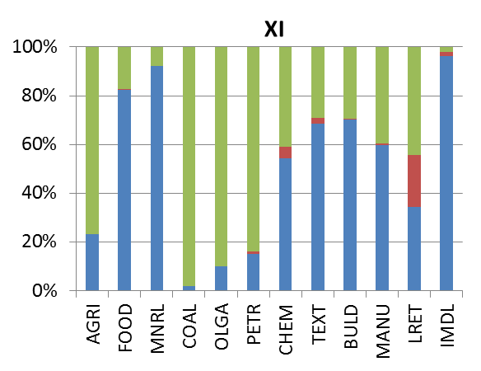
Mode Share by Commodity Group
  Most II goods moved by truck
  IX & XI goods have larger share moved by modes other than truck
  Mineral, which had very high tonnage, is dominated by truck mode
Introduction
Model Steps
Issues
Closing

Slide 15
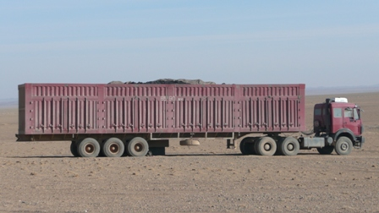
Payload Factor
Average tons/truck
Utah allows very large bulk carrier trucks (doubles) that are not allowed by most states
Commodity |  | Average Payload (Tons)
1 | Agricultural/meat/fish | 23.5
2 | Prepared foodstuff | 23.1
3 | Metal & Nonmetal Ores | 26.3
4 | Coal | 48.4
5 | Crude Petroleum & Gas | 30.9
6 | Petroleum or Coal Products | 32.3
7 | Chemicals | 18.7
8 | Textile & Paper | 13.5
9 | Building material & machinery | 22.6
10 | Manufactured equipment | 16.5
11 | Lumber & Retail | 19.5
12 | Intermodal & Mail | 25.9
State | Payload Factor (tons/truck)
Colorado | 27
Montana | 24
Utah | 48
Wyoming | 33
USA | 26
Note: Data is for medium and heavy trucks
Source: Vehicle Inventory and Use Survey (VIUS, 2002)
Source: Vehicle Inventory and Use Survey (VIUS, 2002)
Appeared unreasonably high
Almost double the national average
Introduction
Model Steps
Issues
Closing

Slide 16
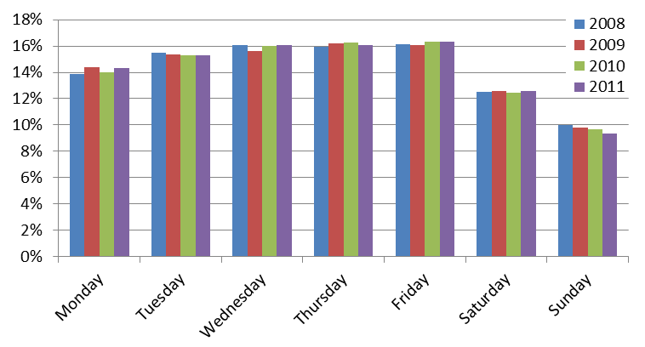
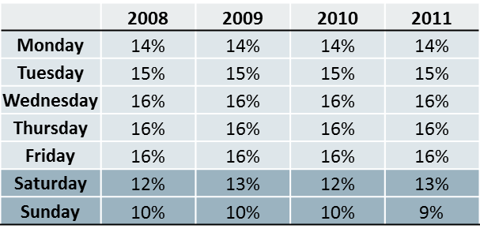

Annual Factor
Average Working Days per Year
Days/Year | Description
365 | 7 Days a week (No Holidays)
359 | 7 Days a week (Less 6 Major Holidays)
312 | 6 Days a week (No Holidays)
306 | 6 Days a week (Less 6 Major Holidays)
260 | 5 Days a week (No Holidays)
254 | 5 Days a week (Less 6 Major Holidays)
Distribution in truck counts shows stronger weekday trend
  More important, validation suggests that goods are distributed 5 days/week regardless if goods shipped weekdays or weekends
Details
Medium + Heavy Truck Counts
Introduction
Model Steps
Issues
Closing

Slide 17
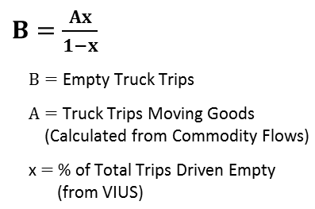
Percent Empty
% Driven Empty with Utah Home Base
by commodity group (for heavy trucks)
Commodity |  | % Empty (Input to the model)
 |  | <= 50 Miles | 51-100 Miles | 101-200 Miles | 201-500 Miles | >500 Miles
1 | Agricultural/meat/fish | 35% | 30% | 39% | 25% | 21%
2 | Prepared foodstuff | 50% | 34% | 50% | 15% | 8%
3 | Metal & Nonmetal Ores | 37% | 47% | 45% | 27% | 13%
4 | Coal | 50% | 50% | 32% | 33% | 8%
5 | Crude Petroleum & Gas | 48% | 35% | 51% | 45% | 13%
6 | Petroleum or Coal Products | 49% | 48% | 49% | 50% | 30%
7 | Chemicals | 33% | 24% | 24% | 43% | 6%
8 | Textile & Paper | 39% | 40% | 40% | 27% | 10%
9 | Building material & machinery | 39% | 38% | 34% | 34% | 21%
10 | Manufactured equipment | 36% | 23% | 50% | 5% | 27%
11 | Lumber & Retail | 18% | 28% | 28% | 12% | 7%
12 | Intermodal & Mail | 48% | 49% | 50% | 17% | 6%
The % empty return trips were calculated using the following formula, applied to the transposed truck trip matrices.
Source: 2002 VIUS database (note: some values interpolated)
Details
Introduction
Model Steps
Issues
Closing

Slide 18
ASSIGNMENT

Slide 19
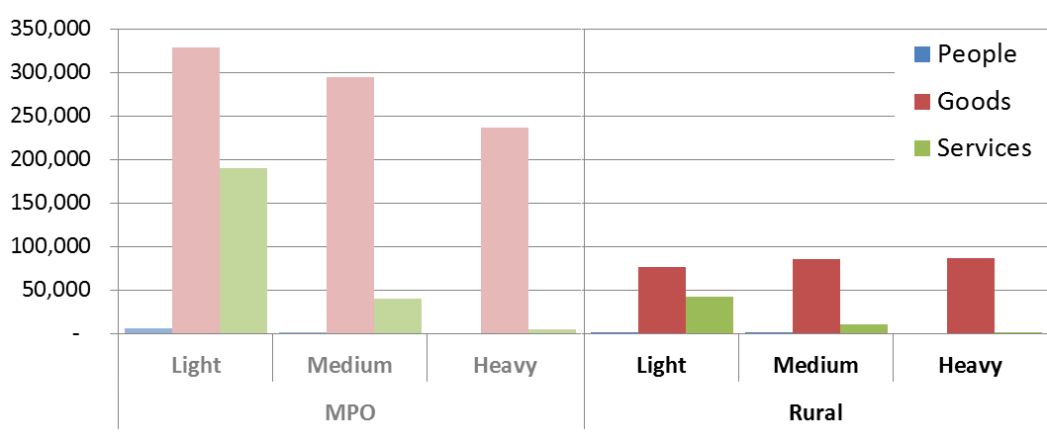
Truck Trip Summary SHORT HAUL
Short-Haul Truck Trips (per day)
Gray text indicates data to be replaced by MPO models
Trips proportional to socioeconomic activity, most of which occurs in MPO areas
Internal short-haul trips inside MPO areas are replaced by data from MPO models
Introduction
Model Steps
Issues
Closing

Slide 20
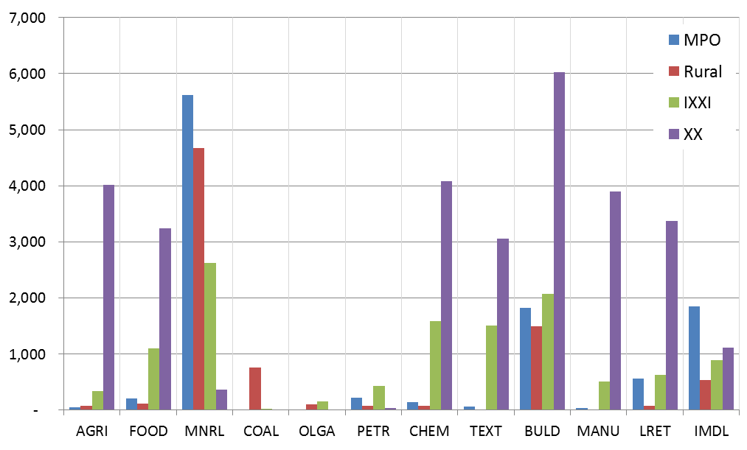
Truck Trip Summary LONG HAUL
Long-Haul Truck Trips (per day)
Utah has a high percentage of external through trips (nearly half of all long-haul trips)
Mineral commodity type dominate the internal truck trips
All long-haul trips used by MPO models
Introduction
Model Steps
Issues
Closing

Slide 21
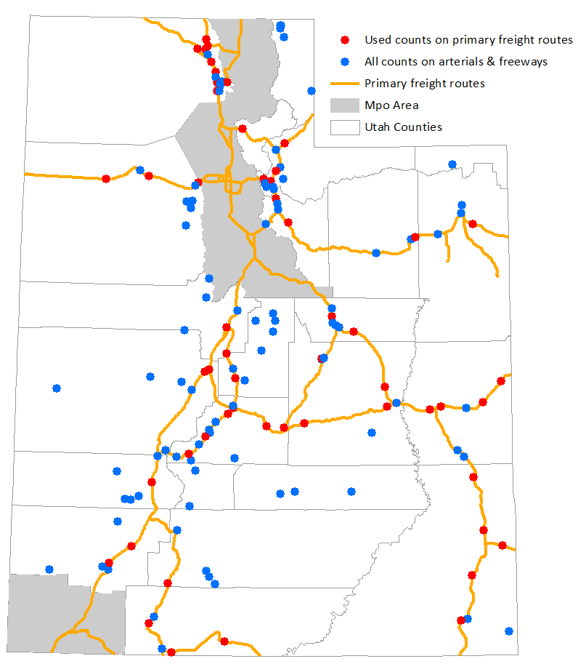
Traffic Count Validation Locations
154 Truck Counts in Validation
    110 Arterial
    44 Freeway
58 Truck Counts on Primary Freight Corridor
    28 Arterial
    30 Freeway
Introduction
Model Steps
Issues
Closing

Slide 22
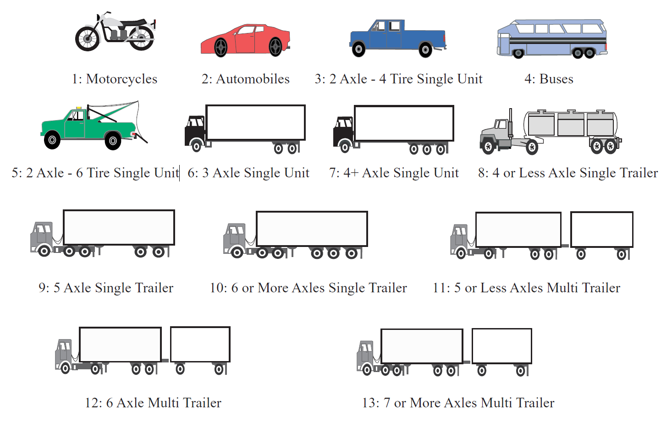
Truck Classification
Commercial Vehicle and Truck Classification
LT | Light | FHWA Class 1-3
MT | Medium | FHWA Class 4-7
HT | Heavy | FHWA Class 8-13
FHWA Vehicle Classification
Introduction
Model Steps
Issues
Closing

Slide 23
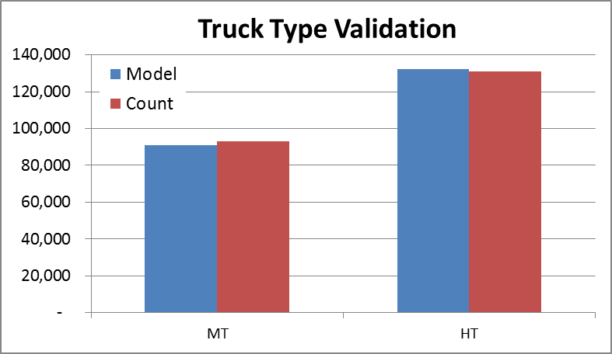
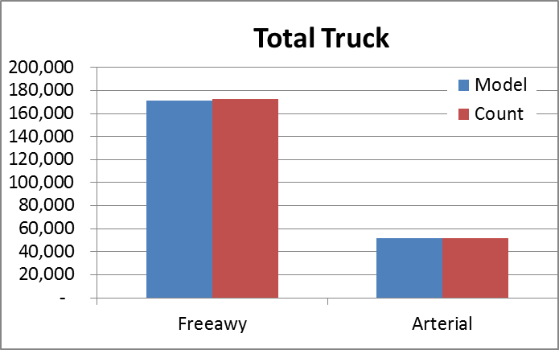
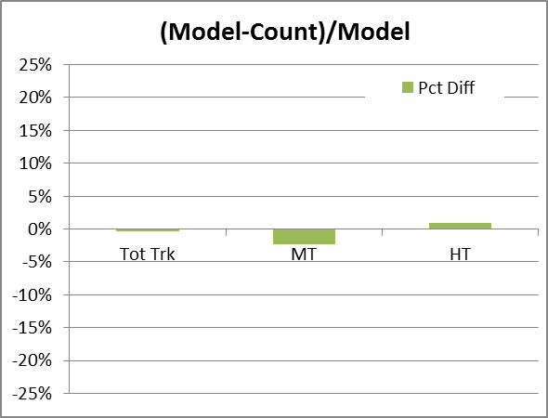
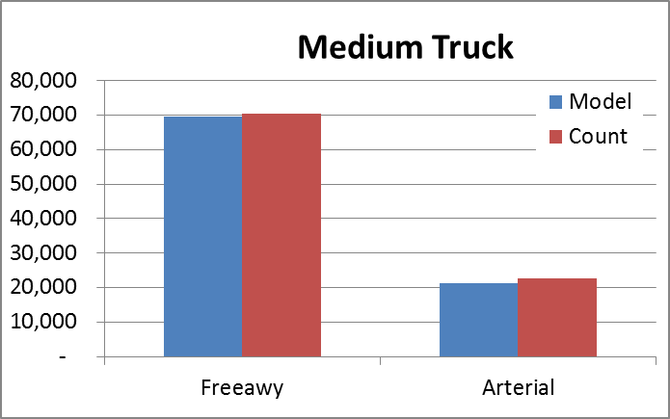
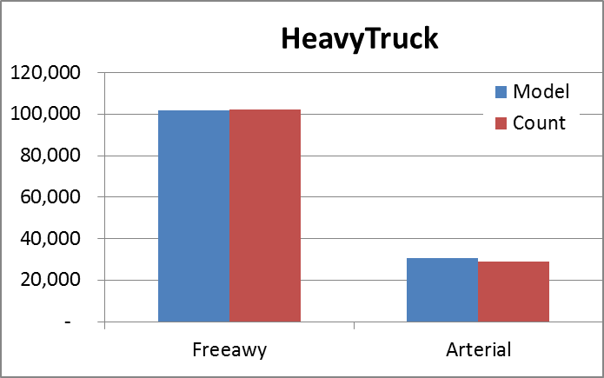
Volume Validation
Primary Freight Corridor in Non-MPO Area Only
Corridor level validation still needed
Details
Introduction
Model Steps
Issues
Closing

Slide 24
Data Issues

Slide 25
Long Haul Commodity Database
Long-haul freight highly reliant on commodity flow database (Transearch)
For certain commodities, Transearch data appeared suspect
    Commodities:
    Coal
    Crude oil
    Refined petroleum
    Issue:
    Total tons
    Distribution
    Mode share
    Other data sources needed to validate/correct commodity flow data:
    National
    Energy Information Administration (EIA)
    United States Bureau of Transportation Statistics (BTS)
    Commodity Flow Survey (CFS)
    Freight Analysis Framework (FAF3)
    Local
    Utah Geological Survey
    Utah Division of Oil, Gas & Mining-Department of Natural Resources
Introduction
Model Steps
Issues
Closing

Slide 26
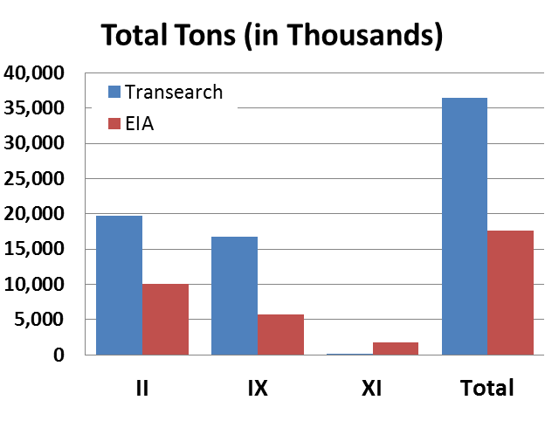
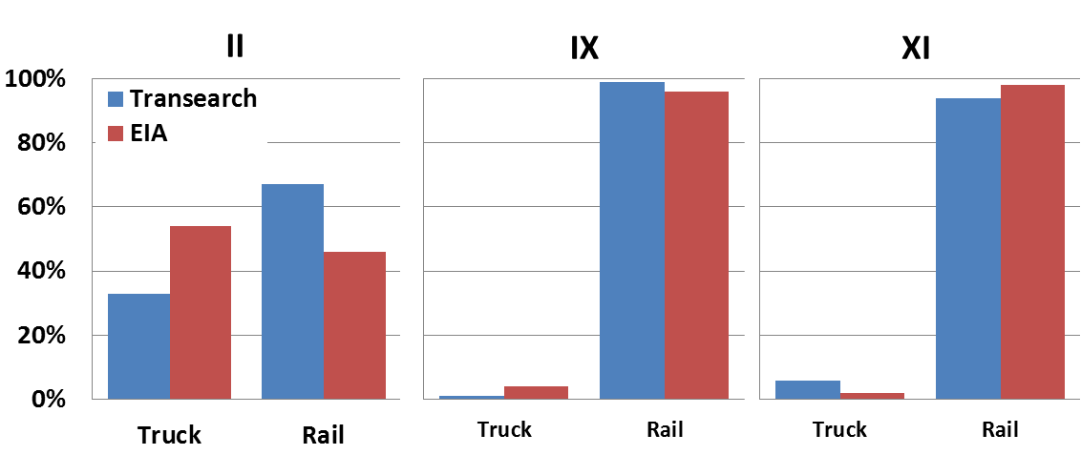
Coal Movement
Transearch had too much coal for Utah
Total Tons
Distributed to wrong counties
(in thousands)
Mode share close for IX & XI, but off for II
Distribution
Mode Share
Introduction
Model Steps
Issues
Closing
Notes:
Utah is one of the highest coal producing states (ranked 14th in 2008), and neighbor to the highest coal producing state, Wyoming.
Assumed coal is produced at coal mines and attracted to coal-fired power plants. Mines and power plants were located with GIS data and compared to the county distribution from Transearch.

Slide 27
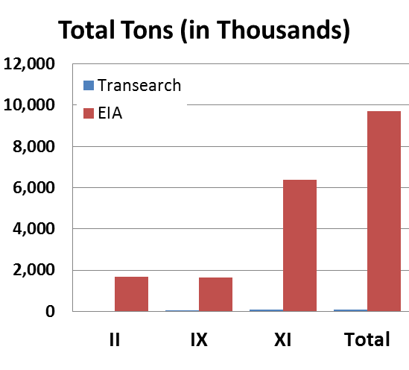
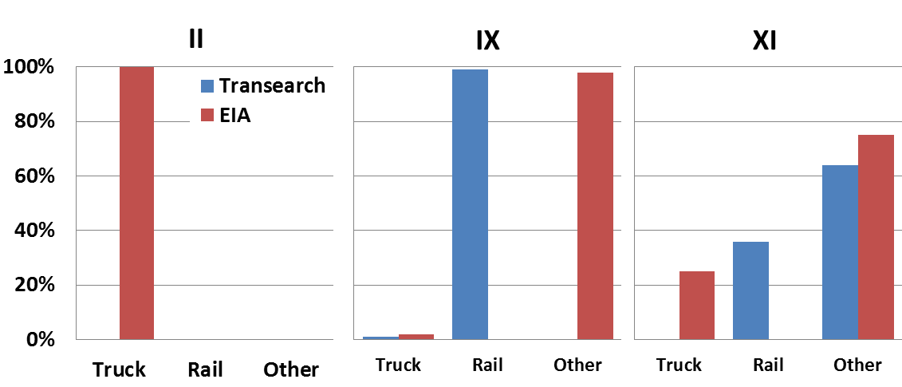
Crude Oil Movement
Transearch had zero crude oil for Utah
Total Tons
Distributed to wrong counties
(in thousands)
Mode share very different for II, IX & XI
Distribution
Mode Share
Details
Introduction
Model Steps
Issues
Closing
Notes:
Utah is one of the highest crude oil producing states (ranked 11th in 2011), and neighbor to the two highest coal producing states, Wyoming and Colorado.
Crude oil was produced at wells and attracted to refineries.

Slide 28
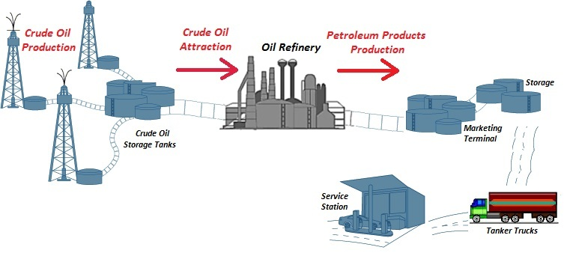
Petroleum Products Movement
Crude oil is produced at wells and attracted to refineries
So
Refined petroleum productions
should be synced with the
crude oil-refined petroleum products supply chain
Total tonnage >>> Not changed from Transearch
Introduction
Model Steps
Issues
Closing

Slide 29

Conclusions & Lessons Learned
Be aware of the limitations of data sources
  Use local knowledge/judgment
  Use publicly available data (e.g. EIA, FAF) for an economical way to overcome data limitations
  Trade off between the level of detail needed and available resources
Data
Modeling
Trip-based freight method worked well for Utah
  Not a lot of intricate modal details
  Mostly interested in truck volumes on highways
Future
Utah Freight Model is still a work in progress
  MPOs implementing freight component
  Corridor-level calibration needed
Freight
Introduction
Model Steps
Issues
Closing

Slide 30



San Diego
Evansville
Chad Worthen, RSG
chad.worthen@rsginc.com
801-456-4901
Kaveh Shabani, RSG
kaveh.shabani@rsginc.com
801-456-4904
Maren Outwater, RSG
maren.outwater@rsginc.com
414-446-5402
Walt Steinvorth, UDOT
msteinvorth@utah.gov
801-965-3864
Notes:
30

Slide 31
APPENDIX

Slide 32
12 Long Haul Commodity Groups
Long Haul
1 | AGRI | Agriculture/meat/fish
2 | FOOD | Prepared foodstuff
3 | MNRL | Metal & Nonmetal Ores
4 | COAL | Coal
5 | OLGA | Crude Petroleum & Natural Gas
6 | PETR | Petroleum or Coal Products
7 | CHEM | Chemicals
8 | TEXT | Textile & Paper
9 | BULD | Building materials & Machinery
10 | MANU | Manufactured equipment
11 | LRET | Lumber & Retail
12 | IMDL | Intermodal & Mail
Forecast tons then convert tons to vehicles
National and Utah-based flows
Based on purchased commodity flow data (Transearch) and additional data (COAL, OLGA, PETR)
Return

Slide 33
Commodity Group Detail
Commodity Group | STCC | Commodity Description
1 | 1 | Farm Products
1 | 8 | Forest Products
1 | 9 | Fresh Fish Or Marine Products
2 | 20 | Food or Kindred Products
2 | 21 | Tobacco Products
3 | 10 | Metallic Ores
3 | 14 | Nonmetallic Minerals
4 | 11 | Coal
5 | 13 | Crude Petroleum or Natural Gas
6 | 29 | Petroleum or Coal Products
7 | 28 | Chemicals or Allied Products
7 | 30 | Rubber or Misc. Plastics
8 | 22 | Textile Mill Products
8 | 23 | Apparel or Related Products
8 | 26 | Pulp, Paper or Allied Products
8 | 27 | Printed Matter
8 | 31 | Leather or Leather Products
9 | 32 | Clay, Concrete, Glass or Stone
9 | 33 | Primary Metal Products
9 | 34 | Fabricated Metal Products
9 | 35 | Machinery
10 | 36 | Electrical Equipment
10 | 37 | Transportation Equipment
10 | 38 | Instrum, Photo Equip, Optical Eq
11 | 19 | Ordnance or Accessories
11 | 24 | Lumber or Wood Products
11 | 25 | Furniture or Fixtures
11 | 39 | Misc. Manufacturing Products
11 | 40 | Waste or Scrap Materials
11 | 41 | Misc. Freight Shipments
11 | 46 | Misc. Mixed Shipments
12 | 42 | Shipping Containers
12 | 43 | Mail or Contract Traffic
12 | 44 | Freight Forwarder Traffic
12 | 45 | Shipper Association Traffic
12 | 47 | Small Packaged Freight Shipments
12 | 48 | Waste Hazardous Materials
12 | 49 | Hazardous Materials Or Substances
12 | 50 | Secondary Traffic
Return

Slide 34
Long Haul Generation Variables
Long Haul Trip End Model Estimation
 |  | Production Variables | Attraction Variables
1 | AGRI | Farm | Wholesale Trade, Manufacturing
2 | FOOD | Manufacturing | Manufacturing, Retail, Wholesale Trade
3 | MNRL | Minerals, Manufacturing | Construction, Manufacturing
4 | COAL | Mines | Power plants
5 | OLGA | Wells | Refineries
6 | PETR | Refineries | Wholesale Trade, Retail
7 | CHEM | Manufacturing | Wholesale Trade, Manufacturing
8 | TEXT | Manufacturing, Wholesale Trade | Wholesale Trade, Retail
9 | BULD | Manufacturing | Manufacturing, Construction
10 | MANU | Manufacturing | Wholesale Trade, Manufacturing, Retail, Transportation
11 | LRET | Wholesale Trade, Manufacturing, Retail | Wholesale Trade, Manufacturing, Retail, Transportation
12 | IMDL | Wholesale Trade, Manufacturing | Transportation, Manufacturing, Other
Pivot off base-year Transearch data
Generation equations determine spatial location inside Utah & calculate "new" tonnage
Controls to interpolated Transearch data at state-level
Production & attraction variables differ slightly for internal & external movements
Return

Slide 35
Regression Equations (IIP)
″II″ Production
Commodity Description and code |  | R² | Number of Obs. | Considered Variables | Coefficient | t-stat | p Value
1 | Agricultural/meat/fish
 | Tier 1-Main data points | 0.68 | 18 | Frm | 22.04 | 6.06 | 0.000
 | Tier 2-Outlier data points | 0.73 | 3 | Frm | 49.73 | 2.33 | 0.145
2 | Prepared foodstuff | 0.64 | 14 | Mnfct | 11.35 | 4.85 | 0.000
3 | Metal & Nonmetal Ores | 0.69 | 10 | Mnrl+ Mnfct | 349.46 | 4.51 | 0.001
4 | Coal | - | - | Produced at mines | - | - | -
5 | Crude Petroleum & Gas | - | - | - | - | - | -
6 | Petroleum Products | - | - | Produced at Refineries | - | - | -
7 | Chemicals | 0.71 | 8 | Mnfct | 3.30 | 4.13 | 0.004
8 | Textile & Paper | 0.97 | 11 | Mnfct + Whlsl | 0.76 | 18.65 | 0.000
9 | Building materials & machinery | 0.77 | 22 | Mnfct | 78.33 | 8.49 | 0.000
10 | Manufactured equipment | 0.92 | 9 | Mnfct | 1.26 | 9.67 | 0.000
11 | Lumber & Retail | 0.52 | 20 | Mnfct + Whlsl + Rtl | 0.60 | 4.51 | 0.000
12 | Intermodal & Mail | 0.93 | 25 | Mnfct + Whlsl | 59.82 | 17.81 | 0.000
Return

Slide 36
Regression Equations (IIA)
″II″ Attraction
Commodity Description and code |  | R² | Number of Obs. | Considered Variables | Coefficient | t-stat | p Value
1 | Agricultural/meat/fish | 0.78 | 5 | Whlsl + Mnfct | 8.64 | 3.79 | 0.019
2 | Prepared foodstuff | 0.88 | 29 | Rtl + Whlsl + Mnfct | 2.95 | 14.59 | 0.000
3 | Metal & Nonmetal Ores | 0.96 | 27 | Cnst + Mnfct | 168.97 | 25.16 | 0.000
4 | Coal | - | - | Attracted to power plants | - | - | -
5 | Crude Petroleum & Gas | - | - | Attracted to refineries | - | - | -
6 | Petroleum or Coal Products | 0.96 | 28 | Whlsl + Rtl | 4.37 | 25.68 | 0.000
7 | Chemicals | 0.70 | 28 | Whlsl + Mnfct | 1.69 | 7.95 | 0.000
8 | Textile & Paper | 0.95 | 25 | Whlsl + Rtl | 0.54 | 20.99 | 0.000
9 | Building material & machinery | 0.97 | 29 | Cnst, | 35.23 | 2.31 | 0.029
 |  |  |  | Mnfct | 62.86 | 4.63 | 0.000
10 | Manufactured equipment | 1.00 | 23 | Whlsl, | 1.22 | 5.81 | 0.000
 |  |  |  | Trns, Wrhs, | 0.63 | 3.13 | 0.005
 |  |  |  | Rtl | 0.20 | 5.30 | 0.000
11 | Lumber & Retail | 0.81 | 29 | Rtl+Whlsl+Mnfct+ Trns | 0.75 | 11.09 | 0.000
12 | Intermodal & Mail | 0.82 | 27 | Other+Mnfct+ Trns | 5.66 | 10.89 | 0.000
Return

Slide 37
Regression Equations (IXP)
″IX″ Production
Commodity Description and code |  | R² | Number of Obs. | Considered Variables | Coefficient | t-stat | p Value
1 | Agricultural/meat/fish
 | Tier 1-Main data points | 0.84 | 25 | Frm | 141.32 | 11.22 | 0.000
 | Tier 2-Outlier data points | 0.82 | 4 | Frm | 192.59 | 3.76 | 0.033
2 | Prepared foodstuff
 | Tier 1-Main data points | 0.51 | 23 | Mnfct | 16.41 | 4.78 | 0.000
 | Tier 2-Outlier data points | 0.88 | 3 | Mnfct | 26.05 | 3.79 | 0.063
3 | Metal & Nonmetal Ores
 | Tier 1-Main data points | 0.80 | 23 | Mnrls + Mnfct | 33.46 | 9.44 | 0.000
 | Tier 2-Outlier data points | 0.86 | 5 | Mnrls + Mnfct | 4136.17 | 5.02 | 0.007
4 | Coal | - | - | Produced at Mines | - | - | -
5 | Crude Petroleum & Gas | - | - | Produced at Wells | - | - | -
6 | Petroleum or Coal Products | - | - | Produced at Refineries | - | - | -
7 | Chemicals | 0.50 | 23 | Mnfct | 55.77 | 4.65 | 0.000
8 | Textile & Paper | 0.63 | 23 | Mnfct + Whlsl | 16.66 | 6.07 | 0.000
9 | Building materials & machinery | 0.71 | 27 | Mnfct | 48.35 | 7.89 | 0.000
10 | Manufactured equipment
 | Tier 1-Main data points | 0.72 | 20 | Mnfct | 3.61 | 7.03 | 0.000
 | Tier 2-Outlier data points | 0.98 | 3 | Mnfct | 5.13 | 8.90 | 0.012
11 | Lumber & Retail | 0.81 | 27 | Mnfct + Whlsl + Rtl | 8.63 | 10.48 | 0.000
12 | Intermodal & Mail | 0.98 | 27 | Mnfct + Whlsl | 11.37 | 32.23 | 0.000
Return

Slide 38
Regression Equations (XIA)
″XI″ Attraction
Commodity Description and code |  | R² | Number of Obs. | Considered Variables | Coefficient | t-stat | p Value
1 | Agricultural/meat/fish | 0.44 | 29 | Whlsl + Mnfct | 38.89 | 2.59 | 0.015
2 | Prepared foodstuff | 0.80 | 27 | Rtl + Whlsl + Mnfct | 11.48 | 10.08 | 0.000
3 | Metal & Nonmetal Ores
 | (Tier 1-Border Counties) | 0.71 | 6 | Cnst + Mnfct | 103.90 | 3.50 | 0.017
 | (Tier 2-Middle Counties) | 0.62 | 23 | Cnst + Mnfct | 2.25 | 6.00 | 0.000
4 | Coal | - | - | Attracted to Power Plants | - | - | -
5 | Crude Petroleum & Gas | - | - | Attracted to refineries | - | - | -
6 | Petroleum or Coal Products | 0.80 | 29 | Whlsl + Rtl | 7.17 | 10.43 | 0.000
7 | Chemicals
 | Tier 1-Main data points | 0.59 | 26 | Whlsl + Mnfct | 22.41 | 5.99 | 0.000
 | Tier 2-Outlier data points | 0.95 | 3 | Whlsl + Mnfct | 33.27 | 6.40 | 0.024
8 | Textile & Paper
 | Tier 1-Main data points | 0.73 | 24 | Whlsl + Rtl | 3.45 | 7.98 | 0.000
 | Tier 2-Outlier data points | 0.98 | 5 | Whlsl + Rtl | 8.52 | 14.51 | 0.000
9 | Building materials & machinery
 | Tier 1-Main data points | 0.76 | 26 | Cnst + Mnfct | 19.96 | 8.93 | 0.000
 | Tier 2-Outlier data points | 0.98 | 3 | Cnst + Mnfct | 35.95 | 9.78 | 0.010
10 | Manufactured equipment | 0.63 | 27 | Rtl + Whlsl + Mnfct + Trns | 1.72 | 6.66 | 0.000
11 | Lumber & Retail | 0.87 | 29 | Rtl + Whlsl + Mnfct + Trns | 14.89 | 13.41 | 0.000
12 | Intermodal & Mail | 0.93 | 29 | Other+ Mnfct + Trns | 2.82 | 18.87 | 0.000
Return

Slide 39
Friction Factor Equations (II)
Return

Slide 40
Friction Factor Equations (IX)
Return

Slide 41
Friction Factor Equations (XI)
Return

Slide 42
Intermodal Mode
Goods moved by combination of TRUCK and RAIL
Connections happen at railroad terminals (no ports and airports terminals)
Locations in Utah
BTS
Bureau of Transportation Statistics
CTA
by David Middendorf in 1998
IANA
Intermodal Association of North America
Google Map
4 locations
5 Locations
5 Locations
5 Locations
Distributing freight between Intermodal locations
Based on each location’s storage area/tracks percentage of total
Different for “Coal” and “Oil and Gas”
(IX)
Source: http://people.hoftsra.edu
Return

Slide 43
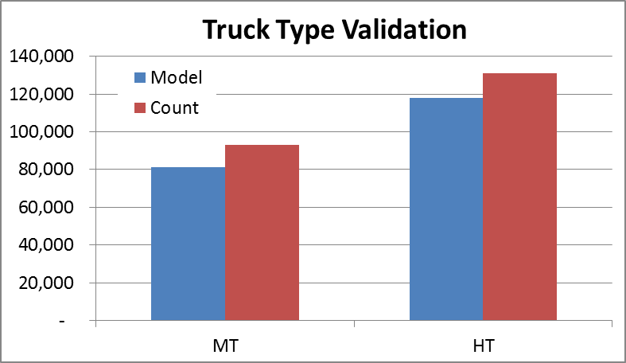
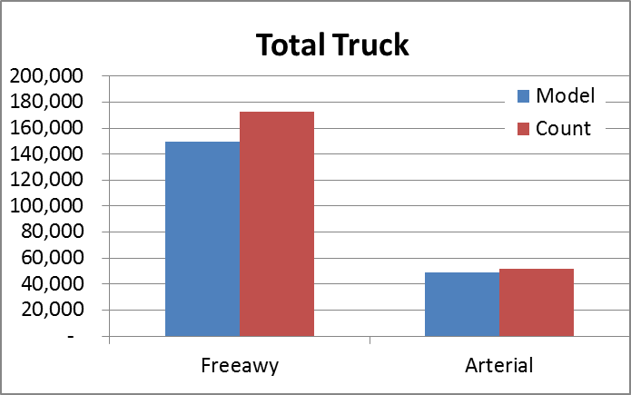
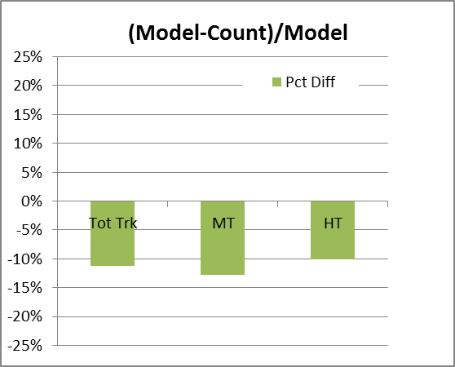
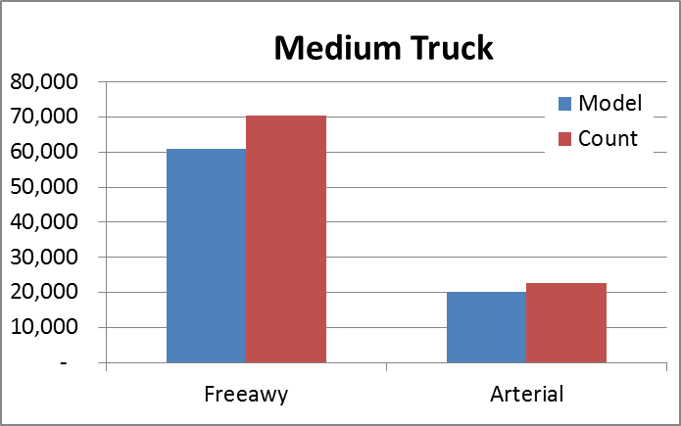
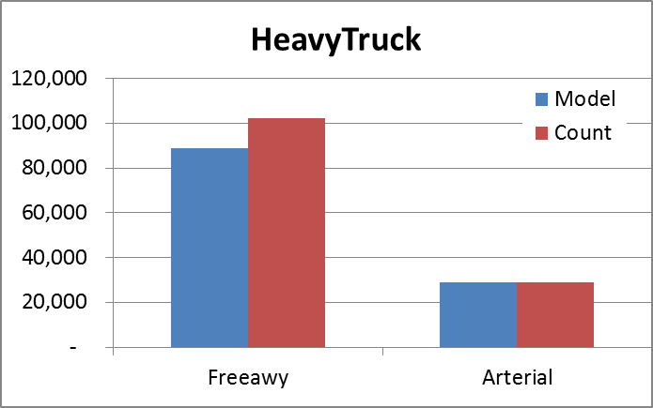
Volume Validation
Primary Freight Corridor in Non-MPO Area Only
Using Annual Factor = 306 (instead of 260)
Return 1
Return 2
Introduction
Model Steps
Issues
Closing

Slide 44
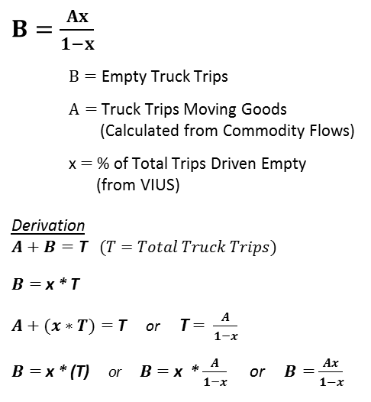
Derivation of % Empty Truck Equation
In the VIUS survey, the driver was asked what % of the time did they drive empty.
This question presupposes the % of total trip time that was driven empty.
To calculate the number of truck trips driven empty, we apply the formulas outlined in this derivation.
Return
Introduction
Model Steps
Issues
Closing

Slide 45
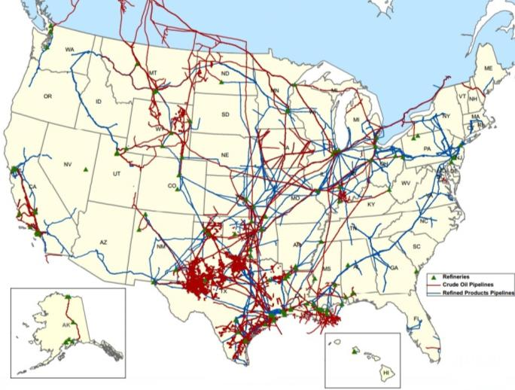
U.S. Crude Oil and Refined Products Pipelines
Pipelines from Wyoming and Colorado
Source: American Petroleum Institute (API)
Return

Slide 46
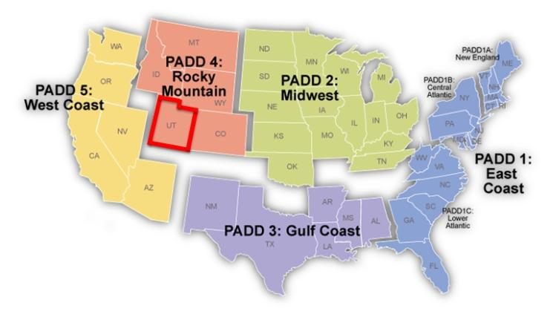
Crude Oil Movement PADD
Generation & Mode Share : “Energy Information Administration” and “Utah Geological Survey” data
Distribution: crude oil is produced at wells and attracted to refineries
PADD: Petroleum Administration for Defense Districts
PAD District 4 (Rocky Mountain)
Colorado, Idaho, Montana, Utah, Wyoming
Return
Source: U.S. Energy Information Administration (EIA)

