Slide 1
Incorporating utility-based bike-to-transit paths in a tour-based model for Portland, Oregon
John Gliebe, Resource Systems Group, Inc.
Bill Stein, Metro
Bud Reiff, Metro
Dick Walker, Metro
Prepared for:
TRB Planning Applications Conference
6 May 2013

Slide 2
Background
Bicycling-related plans and policies are a focal point of transportation system planning in the Portland region
Bicycling was identified as the commute mode of 6% of the city’s workers in the 2010 Census
Observed 69 times in a 2011-2012 regional household-travel survey
  60 linked trips involved taking a bike on transit
  9 linked trips were bike-park-and-ride
Metro (MPO) interested in adding bike-transit-access to its regional modeling system to respond to related policy and planning questions
Metro now developing a new activity-based model system (DASH project)

Slide 3
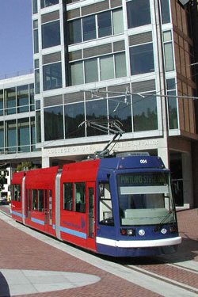
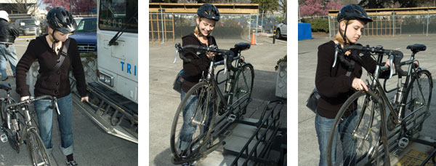
Bike Facilities on Transit Vehicles
Bicycles are allowed on:
  Ti-Met and C-Tran Buses (up to 2)
    mounted on front rack
  MAX light rail cars (6 to 8)
  Streetcars (up to 2)
  WES commuter rail train cars (up to 4)
Source: http://trimet.org/howtoride/streetcar.htm
(accessed May 3, 2013 )
Source: http://trimet.org/howtoride/bikes/bikesonbuses.htm (accessed May 3, 2013 )

Slide 4
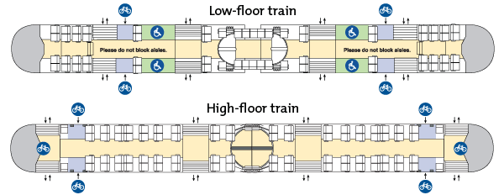
Bicycle Storage Capacity
Bicycles may be brought on-board light rail and commuter rail cars, but only in certain designated locations (6 to 8)
  Bike storage areas also available to persons with suitcases and strollers—first come first serve
  Can share priority seating areas if not needed by persons with disabilities or senior citizens
Source: http://trimet.org/howtoride/bikes/bikesonmax.htm (accessed May 3, 2013 )

Slide 5
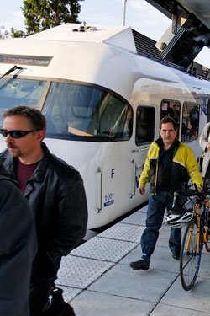
Challenges in Modeling Bike Capacity on Transit
Available capacity for bringing bikes on board is a function of:
  Number of passengers competing for space
  Number of bicyclists competing for space
  For rail, number of cars in train
Tools have yet to be developed to model this properly
Resolved: Leave capacity constrained modeling of bike-access-to-transit for future research
Source: http://trimet.org/howtoride/wes.htm
(accessed May 3, 2013 )

Slide 6
Oregon Household Activity Survey
Portland, OR and Vancouver, WA portions 2011-2012
Households: 6,449
Persons: 15,339
Percent of households that “own and use” bikes on a regular basis: 51.8%
Percent “own and use a bike on a regular basis”
  All ages: 17.4%
  Ages 16+: 21.5%
  Age 35+: 20.9%
  Age 55+: 14.9%

Slide 7
Identification of Bike-Transit Trips and Tours
Unlinked trip records in the OHAS allow identification of bike-transit linkages, but ambiguities abound
Home
Change Mode
Change Mode
Work
Bike
Transit
Bike
Home
Change Mode
Shop
Work
Bike
Transit
Bike
Home
Change Mode
Walk
Shop
Transit
Change Mode
Work
Bike
Bike
Home
Change Mode
Walk
Shop
Transit
Work
Home
Bike
Bike?

Slide 8
Oregon Household Activity Survey
Tours
  Total: 19,782
  Work Primary Purpose: 5,391
  School Primary Purpose: 2,796
Bike-Transit identified:
Primary Purpose | Tours | Trips
Return Home (trip only) |  | 24
Work | 27 | 20
School/University |  | 1
Work-related | 1 | 2
Household maintenance |  | 1
Shopping | 1 | 4
Personal Appointment | 3 | 2
Eat Meal | 1 | 3
Civic/Volunteer | 1 | 1
Visit | 1 | 1
35 tours
59 trips
7 trips are classified as “intermediate stops” on tour

Slide 9
Descriptive Statistics
Average trip distance on bike-transit tours
  (representative trip from home to primary destination)
  Bike Distance (access+egress): 6.15 miles
    Bike Distance Home->Transit Stop (access): 2.04 miles
    Bike Distance Transit Stop->Destination (egress): 4.11 miles
  Transit In-Vehicle Distance: 5.93 miles
    Outbound: 4.92 miles
    Return: 7.10 miles
Bike-transit by sub-mode
  Bus: 28
  Light Rail/CR: 30
  Streetcar: 1

Slide 10
Modeling Bike-On-Transit Paths
Various combinations of boarding and alighting stations offer different utility advantages. For example,…
  Higher frequency transit line
  Avoid transit transfers
  Preferred transit vehicle type
  Minimum or maximum time/distance on bike
  Safer bike route
Home
Work
Choose a boarding station
Choose an alighting station

Slide 11
Tour-Based Path and Stop Choices
Need to consider both outbound and return journeys
4 transit stop choices
Outbound
Home
Work
Choose a boarding station
Choose an alighting station
Return
Home
Work
Choose an alighting station
Choose a boarding station

Slide 12
Options for Modeling Bike-Transit Paths
Create “long walk” links
  Average bike-transit path from home to station area is 2 miles, but average distance from alighting station is closer to 4 miles
  Stop density is high for bus
Create “slow drive” access links
  No obvious places to focus connections
  Auto park-and-ride lots not a strong attractor
  LRT stations/stops might be best
Neither option takes advantage of Metro’s recent advances in bicycle route choice modeling and transit vehicle and station-area attribute effects

Slide 13
Portland Metro Bicycle Route Choice Model
Route choice model estimated from 2007 GPS travel survey of 164 area bicyclists (1 to 2 weeks each)
~1,500 trips with destinations (not a circuit)
Segmented by commuters and non-commuters
Model can be used to generate zone-to-zone skims
  Representative path dis-utility
  Distance based on this path

Slide 14
Estimated Bike Route Attribute Elasticities
Source: Joe Broach, Portland State University

Slide 15
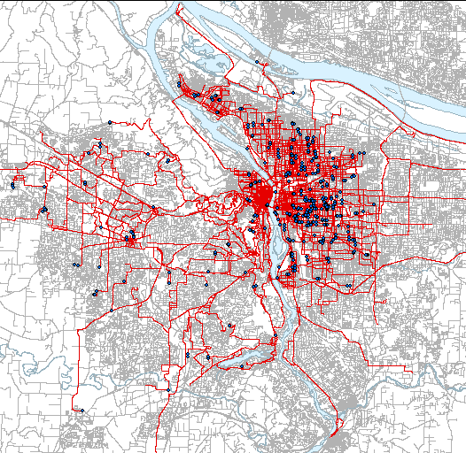
Observed Bike Paths from 2007 GPS Survey
Source: Joe Broach, Portland State University

Slide 16
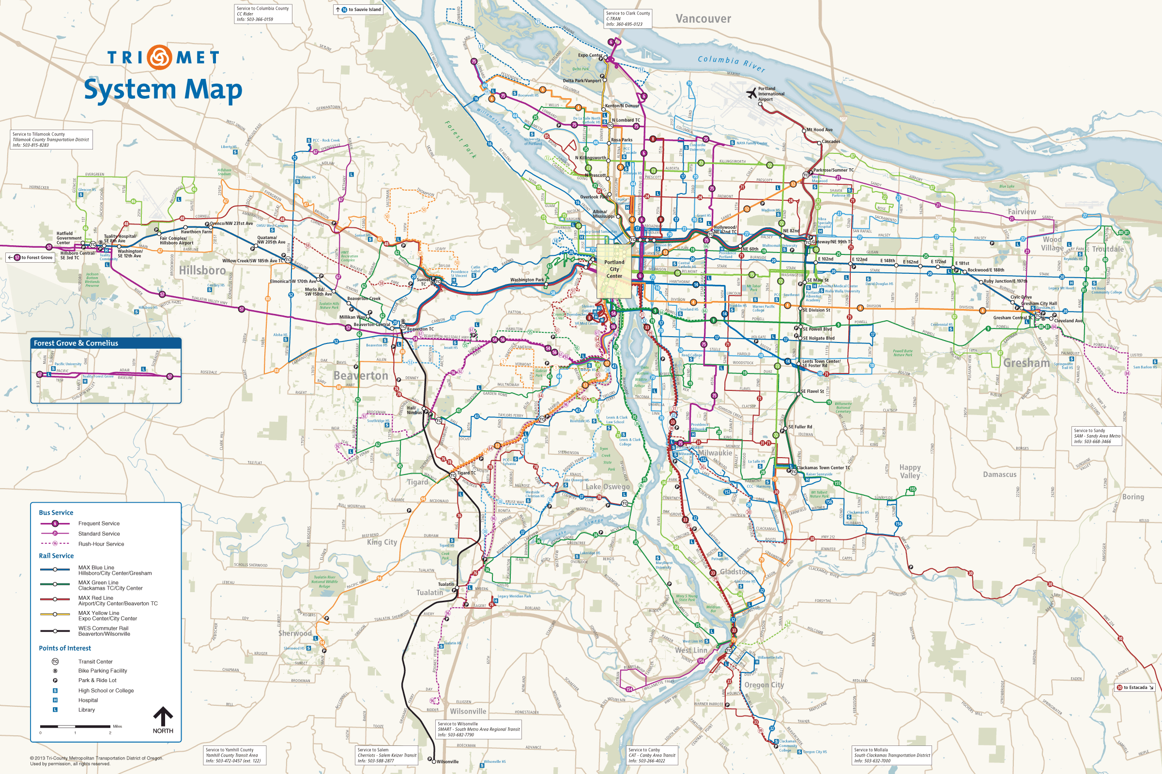
Portland, Oregon Regional Transit System
Source: http://trimet.org/maps/trimetsystem.htm (accessed May 3, 2013 )

Slide 17
Portland Metro Transit Network Model
Transit path finder allows travel on all feasible combinations of transit vehicles—local and express bus, light rail, streetcar, commuter rail
Preference for vehicle types (e.g., light rail) reflected in utility constants from a 2009 SP survey
Represent increment in utility for proportion of path in-vehicle travel time on these preferred modes
  E.g., 20 minutes on LRT + 10 minutes on Bus (Peak)
  .66*.1858 + .33*0 = .1245
Additive Constant | Light Rail | Street Car | Bus
Peak | 0.1858 | - | -
Off-Peak | 0.1442 | 0.0984 | -

Slide 18
Portland Metro Transit Network Model
Preference for certain station area attributes reflected in utility constants and waiting time adjustment factors, derived from 2009 SP survey
    Constants averaged by boardings
    Multiplicative factors adjust (discount) for perceived wait time
Stop Type | Description
A, B, C | Large platform, Transit center, Enhanced shelter
D | Basic shelter
E | Pole
Additive Constant | A, B, C | D | E
Peak | 0.1582 | 0.0531 | -
Off-Peak | 0.1075 | 0.0756 | -
Wait Time Factors | A, B, C | D | E
Peak | 88% | 93% | 100%
Off-Peak | 86% | 94% | -

Slide 19
Approach
Use bicycle route choice model to choose best bike paths to and from alternate transit stops (TAZ proxies)
Use transit-walk path finder (Emme/3) to find best transit paths
  Ignore walk-access travel times and replace with bike distances from bike model
Select combinations of boarding and alighting stops as bundled path alternatives, using importance sampling
  For each journey by direction, choose a boarding station and an alighting station
Calibrate bike-transit path distance coefficients as part of a tour mode choice model
  Home-to-transit stop bike distance portion
  Transit-stop-to-non-home destination bike distance portion
  Light rail bias constant

Slide 20
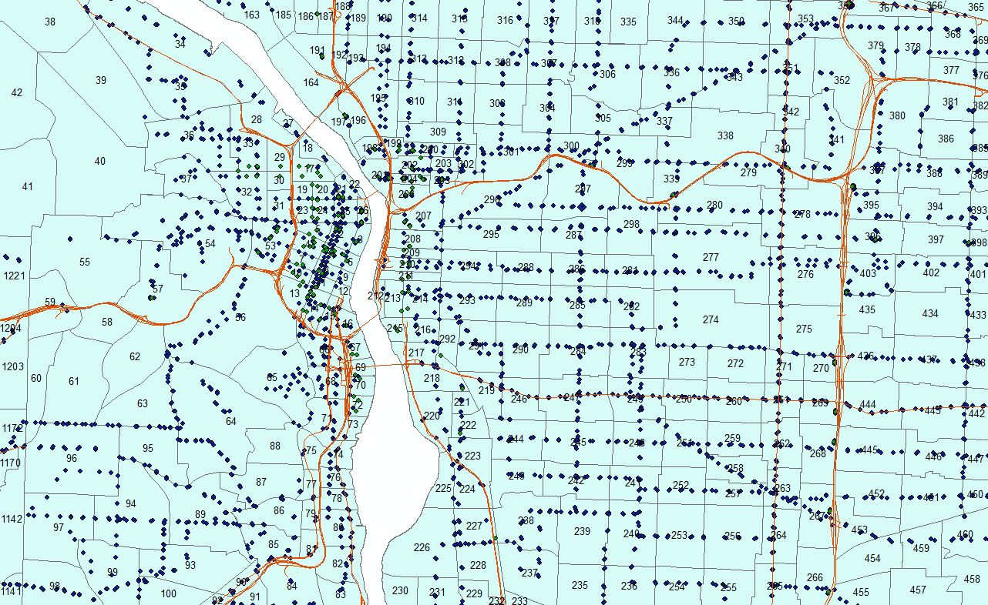
Transit Network Stop Density
Model Area: 178 Rail stops
9,397 Bus stops
2,162 TAZs

Slide 21
Estimation Assumptions
May choose bike-transit on one half tour and just plain bike on other half
Travelers may not leave their bike overnight or to pick one up after leaving home and ride it home
  Outbound and return modes must be either bike-transit or just plain bike
  Going out by bike, bike-transit, and returning home by car sometimes observed (rare), but not modeled
Bicycling is available to persons who have been identified as owning and using a bike (~21%)
  Plan to create a separate mobility model to predict this
LRT is the transit vehicle type in 30 of 59 bike-transit trips, despite having 1/53 the number of system stops
  Assume starting bias of LRT being worth 56 times that of bus

Slide 22
Estimation Challenges
Are there enough observations to estimate a tour mode choice model? Yes.
  Available only for one market segment: work, work-related, appointments/volunteer and other scheduled activities
  Preliminary estimate of ~1,000 work/scheduled tours where Bike-Transit will be an available mode… chosen 31 times: 3 percent share of market
  Only estimating one alternative-specific constant and calibrating at most two distance parameters, possibly LRT station/vehicle bias variable
  Bike utility coefficients are the same for just plain bike, and transit coefficients are the same as for just plain transit (IVT, Wait, Transfer, Fare, Station Area, Vehicle preferences)

Slide 23
Tour Mode Choice Model Structure
Outbound Sub-Mode
Return Sub-Mode
SOV
SOV
Drive
MOV
MOV
P&R
P&R
P&R
Outbound Driver
Return Driver
Person 1
Person 1
Drop-off
Pick-up
Ride in HH Vehicle
Person 2
Ride in HH Vehicle
Person 2
K&R-DO
K&R-PU
Commute Tour Mode Choice
Person N
Person N
Drop-off
Pick-up
Ride in Non-HH Vehicle
Ride in Non-HH Vehicle
K&R-DO
K&R-PU
Tran-walk
Tran-walk
Walk-Tran
Walk-Tran
Walk
Walk
Boarding & Alighting Stops
Alighting & Boarding Stops
Tran-bike
Tran-bike
Bike-Tran
Bike
Bike

Slide 24
Tour Mode Choice Model Structure
Outbound Sub-Mode
Return Sub-Mode
SOV
SOV
Drive
MOV
MOV
P&R
P&R
P&R
Outbound Driver
Return Driver
Person 1
Person 1
Drop-off
Pick-up
Ride in HH Vehicle
Person 2
Ride in HH Vehicle
Person 2
K&R-DO
K&R-PU
Commute Tour Mode Choice
Person N
Person N
Drop-off
Pick-up
Ride in Non-HH Vehicle
Ride in Non-HH Vehicle
K&R-DO
K&R-PU
Tran-walk
Tran-walk
Walk-Tran
Walk-Tran
Walk
Walk
Boarding & Alighting Stops
Alighting & Boarding Stops
Tran-bike
Tran-bike
Bike-Tran
Bike
Bike

Slide 25
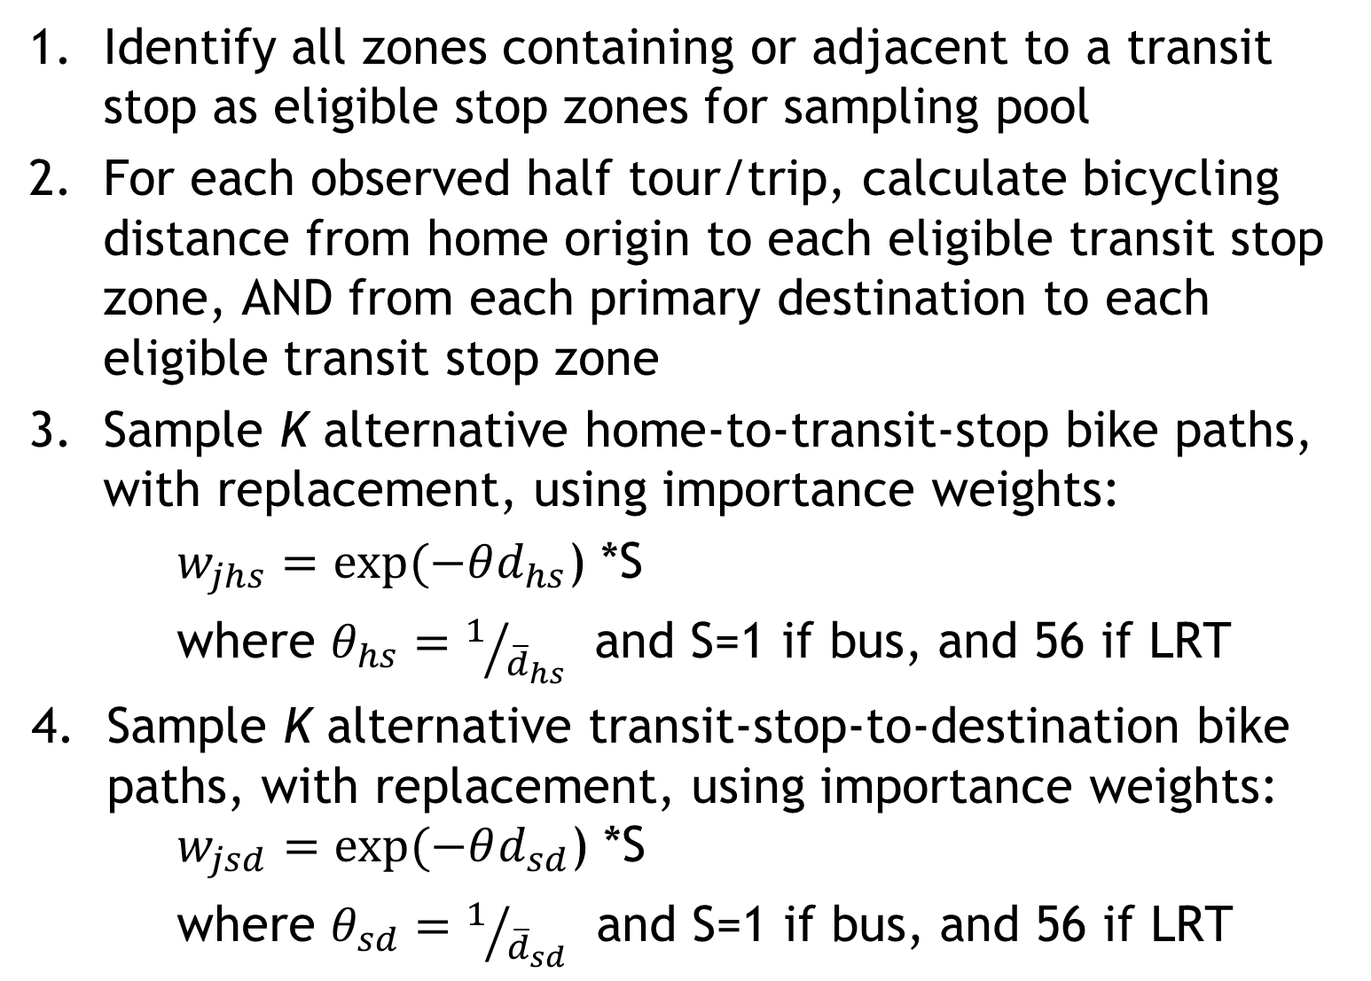
Sampling Bike-Transit Path Alternatives
Identify all zones containing or adjacent to a transit stop as eligible stop zones for sampling pool
For each observed half tour/trip, calculate bicycling distance from home origin to each eligible transit stop zone, AND from each primary destination to each eligible transit stop zone
Sample K alternative home-to-transit-stop bike paths, with replacement, using importance weights:
$w_{jhs}=exp(−θd_{hs}$) *S
where $θ_{hs}=1/{{\overline{d}}_{hs}}$ and S=1 if bus, and 56 if LRT
Sample K alternative transit-stop-to-destination bike paths, with replacement, using importance weights: $w_{jsd}=exp(−θd_{sd}$) *S
where $θ_{sd}=1/{{\overline{d}}_{sd}}$ and S=1 if bus, and 56 if LRT

Slide 26
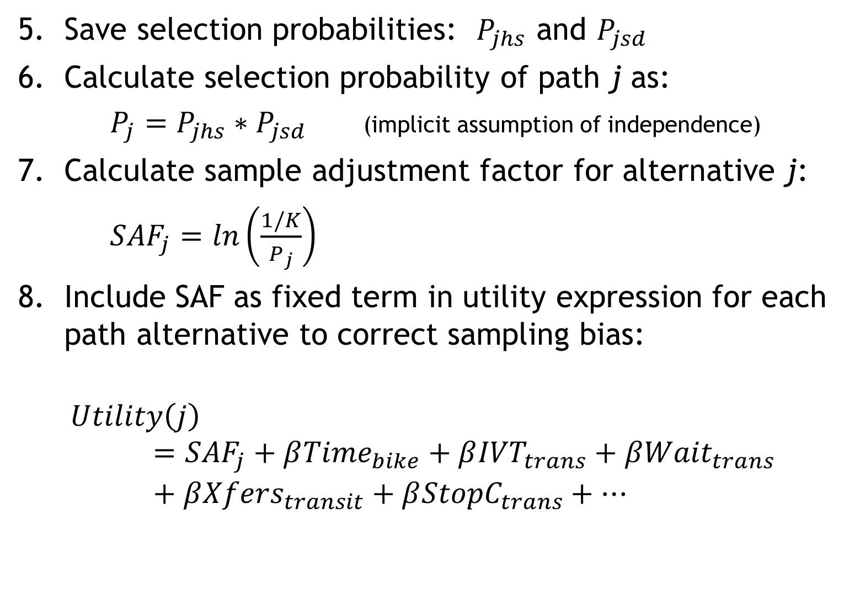
Specifying Bike-Transit Path Alternatives
Save selection probabilities: $P_{jhs}$ and $P_{jsd}$
Calculate selection probability of path j as:
$P_{j}=P_{jhs}∗P_{jsd}$ (implicit assumption of independence)
Calculate sample adjustment factor for alternative j:
${SAF}_{j}=ln\left(\frac{1/K}{P_{j}}\right)$
Include SAF as fixed term in utility expression for each path alternative to correct sampling bias:
$$Utility\left(j\right)={SAF}_{j}+β{Time}_{bike}+β{IVT}_{trans}+β{Wait}_{trans}+β{Xfers}_{transit}+β{StopC}_{trans}+…$$

Slide 27
Status
Tour mode choice model now under development
Cross-nested structure
Incorporates similar path choices for Park-and-Ride stop choice and Kiss-and-Ride drop off and pickup locations
Incorporates household driver choices for drop-offs and pick-ups

Slide 28
Potential Research and Development
Bike-Park-and-Ride not represented
  Insufficient survey sample (n=9)
  Want to consider bike storage lockers and racks at station areas
Additional observations may come from…
  On-board transit survey (future)
  Stated preference survey (future)… bicyclists may have different preferences for vehicle and station types
  Potential to use observations from other OHAS locations?
    Lane Council of Governments (Eugene) also has adopted the Portland bike model
Transit vehicle capacity constraints for bikes
  Needs to be done together with general passenger volume/capacity modeling
  Microscopic simulation approach would be ideal
  Approximation approaches may be possible (i.e., dynamic accounting of boardings and alightings)

Slide 29
Questions and Answers
For more information:
John Gliebe, RSG 802-295-4999

