Slide 1

Environmental Justice Analysis of
Goods Movement in Southern California
Jung Seo, Frank Wen, Simon Choi, Sungbin Cho
Research & Analysis
Southern California Association of Governments
14th TRB National Transportation Planning Applications Conference
May 5-9, 2013, Columbus, Ohio
Notes:
Good morning, I’m Jung Seo, a Senior Regional Planner in Research & Analysis Department at SCAG (Southern California Association of Governments).
The title of my presentation is “Goods Movement Environmental Justice Analysis in Southern California”
My co-authors are Frank Wen, Simon Choi, and Sungbin Cho.

Slide 2
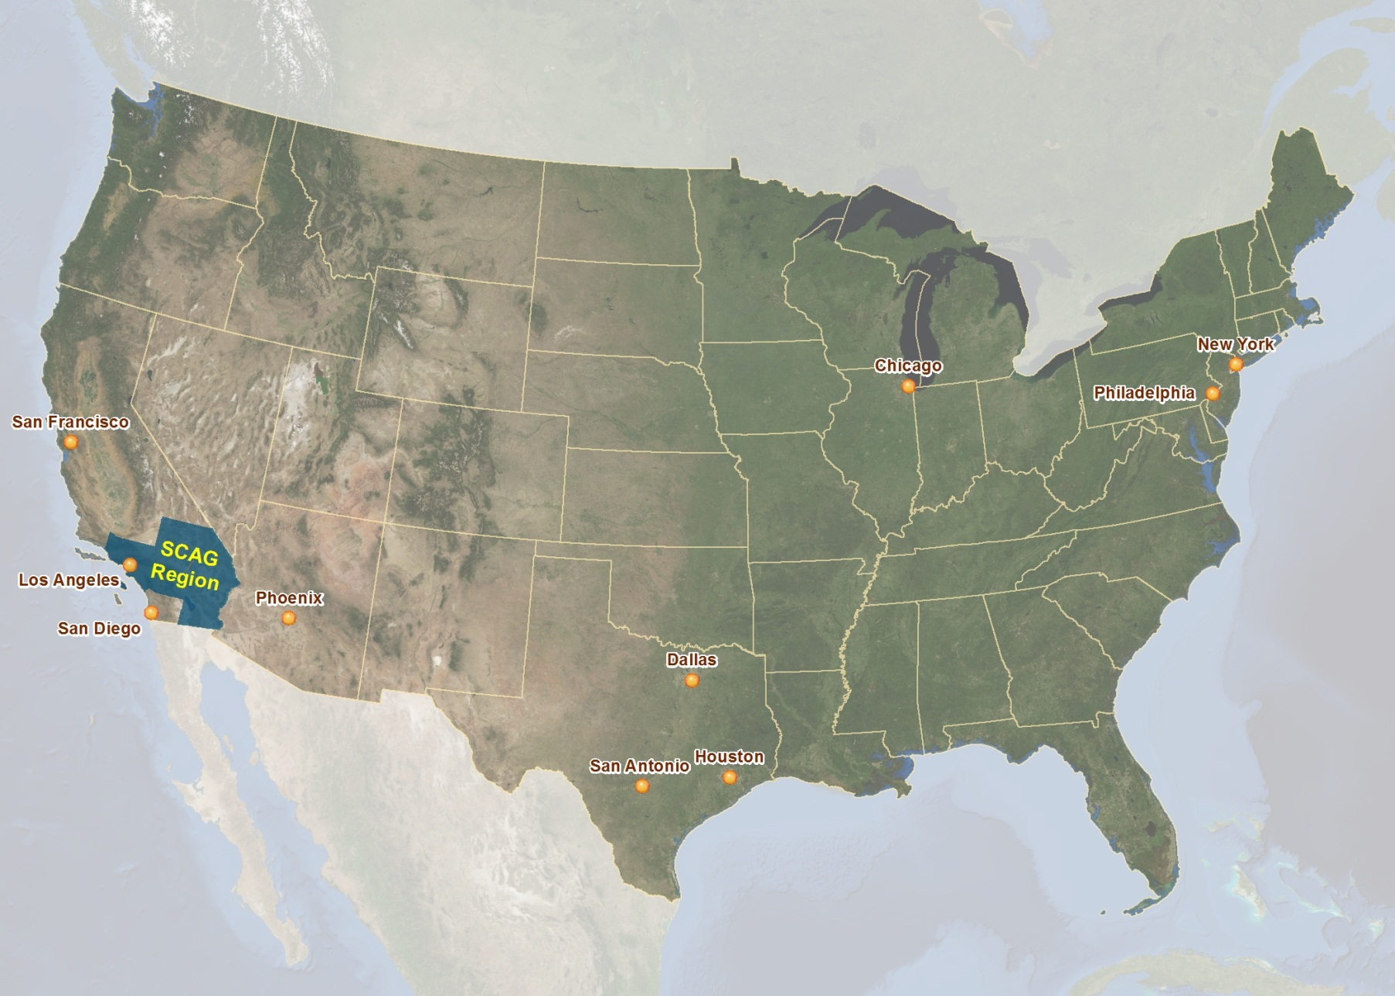
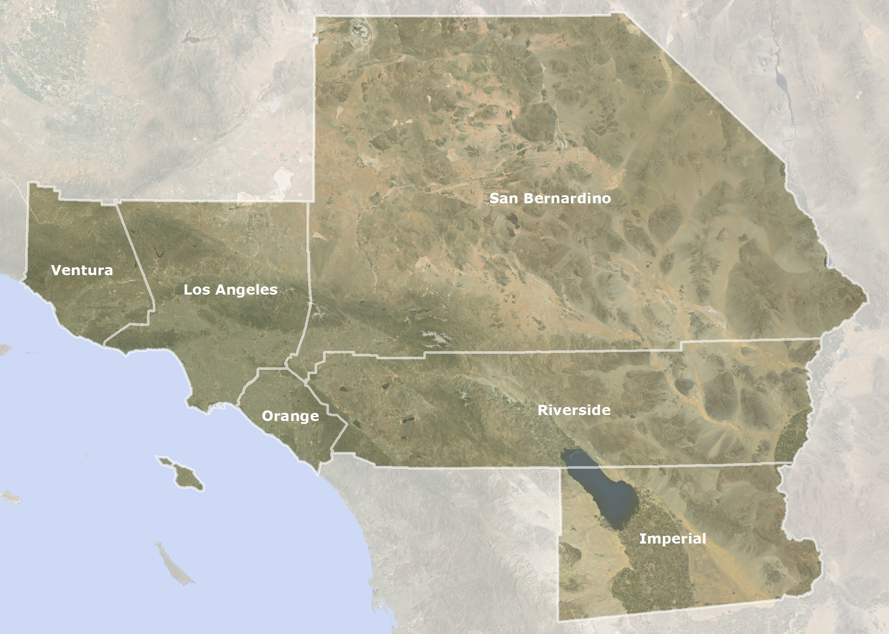
Southern California Association of Governments (SCAG)
Notes:
First, let me briefly explain about SCAG.
SCAG stands for Southern California Association of Governments.
SCAG is an MPO (Metropolitan Planning Organization), and it is also an association of local governments and agencies.
This map shows the general location of the SCAG region.

Slide 3

SCAG Quick Facts
Nation’s largest Metropolitan Planning Organization (MPO)
6 counties and 191 cities
18 million people within 38,000+ square miles
GDP in 2012: $890 Billion, 16th largest economy in the world
Notes:
The SCAG region includes 6 counties.
Counties of Imperial, Los Angeles, Orange, Riverside, San Bernardino and Ventura.
SCAG is the largest MPO in the nation.
Representing 6 counties and 191 cities.
It is a region of 18 million people within 38,000 square miles.
Its population is about 6% of US population and slightly less than half of California population.
Its regional GDP in 2012 is about $890 billion, which put SCAG on 16th largest economy in the world.

Slide 4
Overview
Background
Objectives
Methodology
Results
Conclusions
Notes:
In this presentation, I’ll briefly discuss about the backgrounds of Environmental Justice and SCAG’s long-range Regional Transportation Plan.
Then, I’ll explain about the objectives, methodology and results of this study; and then, conclude with the implications of the results.

Slide 5
SCAG’s 2012-2035 RTP/SCS
Regional Transportation Plan (RTP)
SB 375 - Nation’s first law to control greenhouse gas (GHG)
Sustainable Communities Strategy (SCS)
2012-2035 RTP/SCS adopted on April 4, 2012
Notes:
Under federal mandates, SCAG is responsible for developing and adopting a long-range RTP (Regional Transportation Plan).
Also, pursuant to SB 375, which is the nation’s first law to control GHG emissions, SCAG is also responsible for developing an SCS (Sustainable Communities Strategy) to address greenhouse gas emission.
SCAG adopted the 2012-2035 RTP/SCS on April 4, 2012.

Slide 6
SCAG and Environmental Justice
Title VI of the Civil Right Act of 1964
  “No person in the United States shall, on the ground of race, color, or national origin, be excluded from participation in, be denied the benefits of, or be subjected to discrimination under any program or activity receiving Federal financial assistance.”
Notes:
As an MPO, SCAG is responsible for implementing Title VI of the Civil Right Act of 1964.
Title VI states that “no person in the United States shall, on the ground of race, color, or national origin, be excluded from participation in, be denied the benefits of, or be subjected to discrimination under any program or activity receiving Federal financial assistance.”

Slide 7
SCAG and Environmental Justice
Title VI of the Civil Right Act of 1964
Executive Order 12898
DOT and FHWA Orders on EJ
Other nondiscrimination requirements and guidance in support of Title VI
Notes:
And, Title VI was further amplified by the Executive Order 12898.
which provide that “each Federal agency shall make achieving environmental justice part of its mission by identifying and addressing, as appropriate, disproportionately high and adverse human health or environmental effects of its programs, policies, and activities on minority populations and low-income populations.”
And, there are Orders on Environment Justice by U.S. DOT and Federal Highway Administration (FHWA).
And, there are other nondiscrimination requirements and guidance in support of the Title VI and Environmental Justice.

Slide 8
2012-2035 RTP/SCS and Environmental Justice
Integration of the principles of Title VI into RTPs to address EJ
EJ analysis to assess the impacts of RTP programs and projects on minority and low-income populations
Notes:
SCAG is determined and committed to developing long range plans that will improve, correct or mitigate any disproportionate impacts to our minority and low-income populations.
So, SCAG has been integrating the principles of Title VI into its RTPs in order to address Environmental Justice.
In preparation for the RTP/SCS, SCAG conducted EJ analyses to assess the impacts of RTP programs and projects on minority and low-income populations.
SCAG identified the performance measures to analyze existing social and environmental equity in the region:
RTP/SCS Revenue Sources In Terms of Tax Burdens
Share of Transportation System Usage
RTP/SCS Investments
Impacts of Proposed VMT Fees
Distribution of Travel Time Savings and Travel Distance Reductions
Jobs-Housing Imbalance or Jobs-Housing Mismatch
Accessibility to Employment and Services
Accessibility to Parks
Gentrification and Displacement
Environmental Impact Analyses (Air, Health, Noise)
Rail-related Impacts

Slide 9
Goods Movement in the SCAG Region
Goods movement system development
➔ one of the key RTP strategies
Largest international trade gateway in U.S.
Domestic, regional and local goods movement activity
Economic growth and expansion of international trade ➔ GM to serve market demand and to facilitate economic growth
Notes:
One of the key strategies of the RTP is development of goods movement system.
SCAG Region is the largest international trade gateway in the U.S.
But, a dominant goods movement activity generated in this region is the local, regional and domestic trade system.
The intra-regional goods movement takes more than 85 percent of truck trips.
Given the expected growth in international trade and domestic goods movement in the future, significant growth in truck volumes are anticipated in this region to facilitate reliable goods movement and to support economic growth.

Slide 10
Environmental Concerns and Strategies
Continuing increases in truck volumes
➔ Increasing environmental concerns in the region
Strategies to reduce the impacts of the regional goods movement system on the environment and public health
Strategies to improve or mitigate any disproportionate impacts to minority and low-income populations
Notes:
As goods movement is a major contributor to local and regional environmental issues, such as air pollution and health risk, it is a regional priority not only to mitigate health risk and environmental impacts of the goods movement system, but also to ensure that there is equity in distribution of environmental benefits and burdens.
In order to achieve this goal, the 2012-2035 RTP/SCS includes strategies to address public health concerns and environmental issues.
It includes a near term approach supporting the deployment of commercially available lower-emission freight system and the long term approach implementing zero- and near-zero emission freight system.
Please visit SCAG website (http://www.scag.ca.gov) for more details.
SCAG also analyzed the impacts of programs and projects of the 2012-2035 RTP/SCS on Environmental Justice population groups.
And it has also developed a toolbox of potential mitigation measures to address potential impacts to EJ communities, such as:
Potential mitigation for noise impacts
Potential mitigation for air quality impacts along freeways and heavily traveled corridors
Potential mitigation for rail-related impacts
Please visit SCAG website (http://www.scag.ca.gov) for more details.

Slide 11
Research Objectives
Spatial distributions of the minority and low-income populations (“EJ population groups”) adjacent to major truck corridors
Estimate of truck emission intensity for areas near major truck corridors
EJ concerns and issues from the goods movement system in the SCAG Region
Notes:
As a part of SCAG’s EJ analyses, the focus of this research is:
To examine spatial distributions of each EJ population group living adjacent to major truck corridors
To estimate truck emission intensity for areas near major truck corridors
To discuss the EJ concerns and issues from the goods movement system in the SCAG Region.

Slide 12
Methodology

Slide 13
Methodology
Identifying EJ Population Group
Determining Buffer Distance Criteria
Spatial Distribution of EJ Population Groups
& Emission Intensity Estimates
Notes:
The methodology of this research consists of the following steps:
First, we identified the EJ population groups
Second, in order to examine the concentration of EJ population groups, we determined an appropriate buffer distance from major truck corridors.
Then, the spatial analysis of EJ population distribution was conducted by using a GIS-based residential area-weighted interpolation method.
Also, this study estimated a truck emission intensity to understand the truck-related environmental impacts on areas adjacent to major truck corridors.

Slide 14
Identifying EJ Population Groups
Minority:
Low-Income:
A person who is Black, Hispanic or Latino, Asian American, American Indian, Alaskan Native, Native Hawaiian and Other Pacific Islander
A person whose median household income is at or below the Department of Health and Human Services (HHS) poverty guidelines
Notes:
First of all, in order to assess the potential disproportionate distribution of environmental impacts on EJ population groups, it is necessary to identify minority and low-income populations.
Executive Order 12898 and the Orders on Environmental Justice by DOT and FHWA define “minority” as a person who is Black, Hispanic or Latino, Asian American, American Indian, Alaskan Native, Native Hawaiian and Other Pacific Islander.
Minority – Social demographic indicators were selected based on the Environmental Justice Strategic Enforcement Assessment Tool (EJSEAT), a tool for the EPA Office of Enforcement and Compliance Assurance (OECA) to identify areas with potentially disproportionately high and adverse environmental and public health burdens.
‘Low-income’ population was defined as a person whose median household income is at or below the Department of Health and Human Services (HHS) poverty guidelines.
The poverty threshold for the SCAG Region is based on regional average household size for the census year.
For example, for a regional mean of 2.98 persons (rounded to 3) per household, the threshold would consist of the sum of the value for the first person plus two additional people.
The household counts in each income range are then used to determine the number and percentage of households in each census tract below the poverty level which is a family of three earning less than $17,374 in 2010.

Slide 15
Socioeconomic Indicators of
EJ Population Groups
Ethnic/Racial/Other Indicators:
Income Indicators:
White (NH), Hispanic (Latino), African-American, American Indian, Asian/Pacific Islander, Others
Below Poverty Level
Disabled, Age 65 and Above, Age 5 and Below
Income Quintile
Notes:
The following is the list of the socioeconomic indicators SCAG used as a reference to EJ population group.
In addition to ethnic/racial indicators, we also included elderly, young children and the disabled populations as FHWA recommended.
According to FHWA EJ website, “Within the framework provided by Executive Order 12898 on Environmental Justice, the U.S. DOT Order addresses only minority populations and low-income populations, and does not provide for separate consideration of elderly, children, disabled, and other populations. However, concentrations of the elderly, children, disabled, and other populations protected by Title VI and related nondiscrimination statutes in a specific area or any low-income group ought to be discussed…”
In addition, SCAG analyzed income quintile.
SCAG analyzed the socioeconomic indicators by TAZ (transportation analysis zones) (11,000+ zones equivalent to census block groups), based on the SCAG’s growth forecast.

Slide 16
Concentration of EJ Population Groups
Minority and low-income population is concentrated if the percentage of minority and low-income population of the affected area is “meaningfully greater” than the percentage of minority and low-income population in the general population. (EPA EJ Guidance)
Comparative analysis between the share of EJ population groups near major truck corridors and the share in the regional level.
Notes:
The EPA EJ guidance explains that minority and low-income population is concentrated if the percentage of the minority and the low-income population of the affected area is “meaningfully greater” than the percentage of the minority and low-income population in the general population.
In order to assess the concentration of the EJ population groups, a comparative analysis was conducted between the percentage of the EJ population groups living adjacent to major truck corridors and the percentage of the EJ population groups in the SCAG Region.

Slide 17
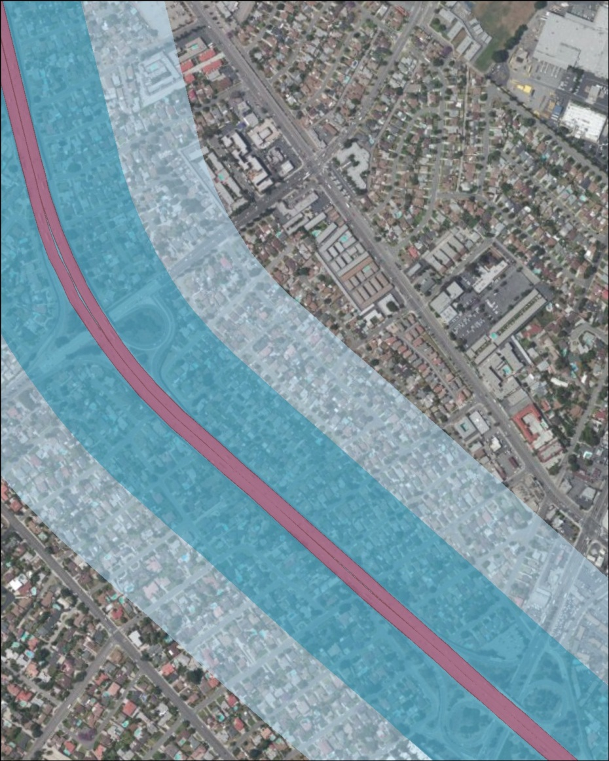
Determining Distance Criteria
Buffer distance criteria
Guidance and recommendations from various organizations
500 ft vs. 1,000 ft
No significant difference between the two buffers
500ft
1,000ft
Notes:
For this assessment, it is necessary to determine appropriate distance criteria for the environmental impacts extent.
For this, SCAG referred to several guidance and recommendations from various organizations,
such as the California Air Resources Board (CARB), Southern California Air Quality Management District (SCAQMD), and California Office of Environmental Health Hazard Assessment (OEHHA).
Based on these guidance and recommendations, SCAG used 500 foot and 1,000 foot buffers to test if there is a significant difference between two buffers in assessing the spatial distribution of the EJ population groups.
But, we couldn’t find significant difference between the results of two buffers.
Based on the results, SCAG determined to use 500 foot buffer only to assess the spatial distribution of the EJ population groups for this research.

Slide 18
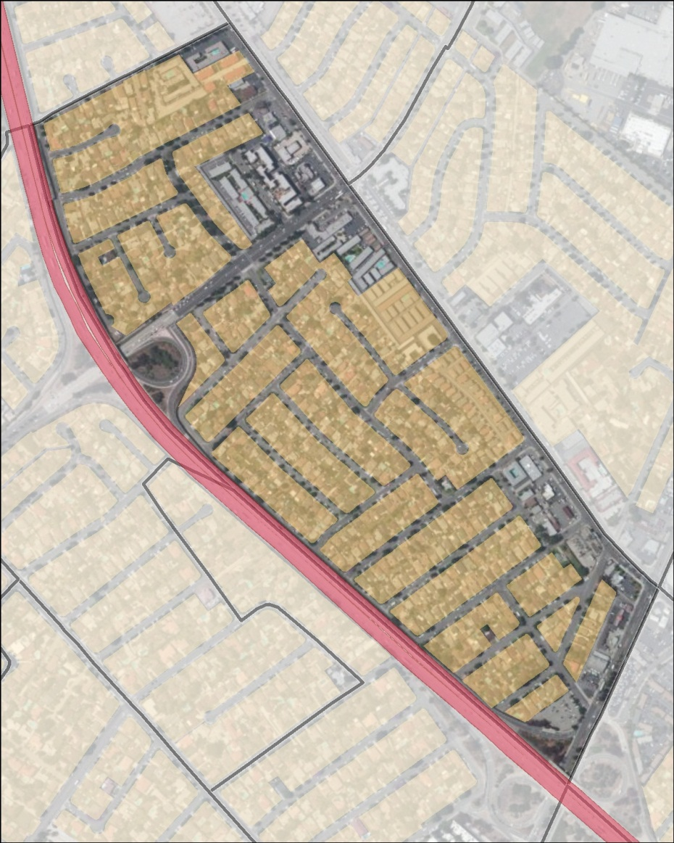
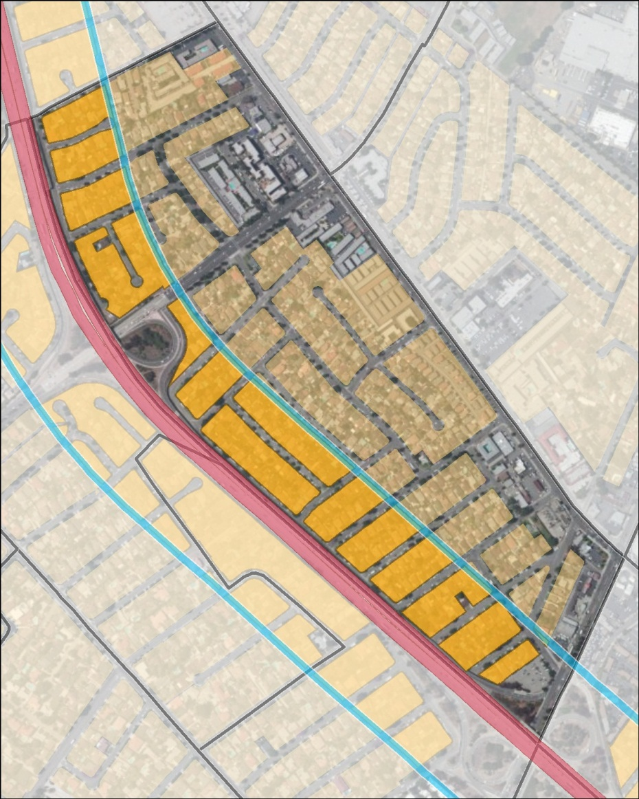
Residential Area-Weighted Interpolation
Population estimates based on ratio of res. area in 500ft buffer to res. area in entire TAZ
where:
= total population in buffer (2008)
= total population in TAZ (2008)
= total residential area in buffer (2008)
= total residential area in TAZ (2008)
Notes:
To analyze the spatial distribution of EJ population groups, SCAG used a GIS-based residential area-weighted interpolation method.
This method assumes that the population is distributed equally within residential areas of a TAZ, and it estimates population based on the ratio of the residential areas interested with 500 foot buffer to the entire residential areas of a TAZ.
To evaluate the concentration of EJ population groups near major truck corridors, we estimated the percentage of each socioeconomic indicator within 500 foot buffer and then compared it with the regional average.

Slide 19
Emission Intensity Estimates
SCAG Emission Impact Study
Running emission estimates for air pollutants (ROG, CO, CO₂, NO_{X}, SO₂, PM_{2.5}) for the year 2008 at TAZ level
SCAG Model
(4 veh. types / 5 time periods)
Emfac
2007
(13 veh. types / 24 time periods)
Results to Network Link
Assigned to TAZ level
Notes:
In addition, we conducted air pollutant emission intensity analysis in order to assess environmental impacts of truck operations on the EJ population groups near major truck corridors.
Emission intensity analysis is based on SCAG Emission Impact Study.
This diagram generally explains the emission estimates process.
SCAG model’s 4 vehicle types and 5 time periods were translated to Emfac’s 13 vehicle types and 24 time periods.
Then, the emission results at network link were assigned to nearest TAZ.
The model estimated running emission for air pollutants, including reactive organic gases (ROG), carbon monoxide (CO), carbon dioxide (CO₂), oxides of nitrogen (NO_{X}), sulfur dioxide (SO₂), particulate matter (PM_{2.5}).
Emissions were estimated for the year 2008.

Slide 20
Emission Intensity Estimates (cont.)
Total emissions of TAZ located within 500 feet from major truck corridors, normalized by total acreage of TAZ
The emission data includes emissions from heavy-duty vehicles (LHDT1, LHDT2, MHDT, HHDT).
Estimation of truck VMT share to better assess the impacts of truck movement
Notes:
Truck emission intensity was estimated by total truck emission of each TAZ located within 500 feet from major truck corridors, normalized by total acreage of the TAZ.
For comparison purpose, we also estimated emission intensity of TAZs adjacent to other freeways and entire freeways in the region, using the same methodology.
Truck emission data includes emissions from:
LHDT1 - Class 2b Heavy-Duty Gasoline/Diesel Vehicles (8501-10,000 lbs. GVWR)
LHDT2 - Class 3 Heavy-Duty Gasoline/Diesel Vehicles (10,001-14,000 lbs. GVWR)
MHDT - Class 4,5,6,7 Heavy-Duty Gasoline/Diesel Vehicles (14,001-33,000 lbs. GVWR)
HHDT - Class 8a Heavy-Duty Gasoline/Diesel Vehicles (33,001-60,000 lbs. GVWR) and Class 8b Heavy-Duty Diesel Vehicles (>60,000 lbs. GVWR)
In addition, to better understand how much truck movements are generated on major truck corridors, we estimated the vehicle-miles traveled (VMT) for truck movement on the major truck corridors.

Slide 21
Results

Slide 22
Distribution of EJ Population Groups
( Major Truck Corridors vs. SCAG Region )
Ethnic/Racial /Other Indicators | 500 ft from Major Truck Corridors |  | SCAG Region
 | 2008 | 2035 | 2008 | 2035
Hispanic | 56.2% | 64.8% | 44.8% | 55.4%
NH White | 23.2% | 15.5% | 34.4% | 23.5%
NH Black | 7.3% | 6.3% | 6.9% | 6.1%
NH NA | 0.5% | 0.5% | 0.4% | 0.5%
NH Asian | 11.2% | 11.1% | 11.6% | 12.3%
NH Others | 1.7% | 1.7% | 1.9% | 2.1%
Age 65 & Above | 9.2% | 15.1% | 10.4% | 16.7%
Age 5 & Below | 9.4% | 8.9% | 8.7% | 8.2%
Disabled | 9.2% | 10.0% | 8.6% | 9.3%
Notes:
This table shows the distribution of minority populations indicators within 500 feet from major truck corridors for 2008 and 2035 .
As shown in the table, the share of most minority variables is higher than regional average, with some exceptions.
Especially, the table shows a high share of Hispanic population and low share of non-Hispanic White population in the areas within 500 feet from major truck corridors.

Slide 23
Distribution of EJ Population Groups
( Major Truck Corridors vs. SCAG Region )
Income Indicators | 500 ft from Major Truck Corridors |  | SCAG Region
 | 2008 | 2035 | 2008 | 2035
Poverty 1* | 15.7% | 15.7% | 13.8% | 14.5%
Poverty 2* | 9.9% | 10.0% | 8.7% | 9.0%
Poverty 3* | 9.4% | 9.4% | 8.3% | 8.5%
Quintile 1 | 21.5% | 21.3% | 20% | 20%
Quintile 2 | 22.5% | 22.0% | 20% | 20%
Quintile 3 | 21.8% | 21.4% | 20% | 20%
Quintile 4 | 19.6% | 20.0% | 20% | 20%
Quintile 5 | 14.7% | 15.3% | 20% | 20%
Notes:
And the next table shows the indicators of low-income populations within 500 feet from major truck corridors and freight railroads in 2008 and 2035.
As shown in the table, the share of low-income variables is higher than regional average both in 2008 and 2035.

Slide 24
Distribution of EJ Population Groups
( Major Truck Corridors vs. SCAG Region )
Higher share of most EJ population groups within 500 feet from major truck corridors than regional average
High concentration of EJ population groups living nearby major truck corridors
Notes:
From both tables, we observed higher share of EJ population groups within 500 feet from major truck corridors than regional average.
This may imply high concentration of EJ population groups living nearby major truck corridors.
However, further analysis is needed to verify this observation.

Slide 25
Truck Emission Intensity
( 2008 )
Emission Factors | Truck Emission Intensity (gram/year/acre) |  |  | Truck Emission Intensity Comp.
 | Major Truck Corridors | Other Freeways | Entire Freeways
ROG | 1.70 (34%) | 0.66 (24%) | 1.11 (30%) | 52.9%
CO | 11.29 (12%) | 5.17 (9%) | 7.82 (11%) | 44.3%
CO₂ | 2,808.29 (24%) | 1,187.55 (16%) | 1,890.11 (20%) | 48.6%
NO_{X} | 22.49 (75%) | 8.52 (64%) | 14.58 (71%) | 54.3%
SO₂ | 0.03 (23%) | 0.01 (16%) | 0.02 (20%) | 48.2%
PM_{2.5} | 0.84 (75%) | 0.29 (61%) | 0.53 (70%) | 59.8%
(Numbers in parenthesis indicate percentage out of total emission intensity.)
Notes:
This table summarizes truck emission intensity estimates for 2008.
It compares the truck emission intensity between 500ft buffer areas from major truck corridors and buffer areas from other freeways and entire freeways in the SCAG Region.
The last column of the table shows how much more emission intensity are estimated in the areas near major truck corridors, compared with the regional level.
It was estimated that areas in proximity to major truck corridors show approximately 60 percent of PM_{2.5} emission intensity and over 54 percent of NO_{x} emission intensity more than the regional level.
Numbers in parenthesis indicate percentage out of total emission intensity.
Among emission factors, PM_{2.5} and NO_{x} from truck movement take higher share than other emission factors.
It indicates that truck movements are major sources of NO_{X}, and PM_{2.5} emissions, which contribute to community health risks, including respiratory illnesses and asthma.
The goods movement system is also a major source of CO₂ emissions, the most significant GHG which causes global climate change.

Slide 26
Share of Truck VMT
( 2008 )
 | Length (mi.) | Total VMT (thousands) | Truck VMT (thousands) | Share of Truck VMT
Major Truck Corridors | 1,810 | 124,940 | 15,693 | 12.6%
 | (26%) | (49%) | (63%)
Other Freeways | 5,210 | 131,240 | 9,207 | 7.0%
 | (74%) | (51%) | (37%)
Entire Freeways | 7,020 | 256,180 | 24,901 | 9.7%
Notes:
And, we estimated the truck VMT for the major truck corridors and for other freeways in the region in order to understand how much more truck movements would be generated on major truck corridors.
As shown in the table, it is estimated that 12.6% of total VMT for major truck corridors is truck VMT; on the other hand, only 7% of total VMT is truck VMT for other freeways in the region.
And, it is also estimated that truck VMT for major truck corridors accounts for approximately 63% of total truck VMT of the SCAG Region while the length of major truck corridors accounts for 26% of total length of freeways in the SCAG Region.
These observations suggest that there is a high truck movements on major truck corridors, compared with other freeways in the region.

Slide 27
Truck Emission Intensity
( Major Truck Corridors vs. Region )
Higher emission intensity within 500ft buffer from major truck corridors than regional level
High truck movements on major truck corridors than regional level
More adverse truck-related environmental impacts on areas adjacent to truck corridors
Notes:
Based on emission intensity analysis,
Higher truck emission intensity is expected within areas along major truck corridors than the regional level, especially PM_{2.5} and NO_{x}.
This implies more adverse truck-related environmental impacts on areas adjacent to major truck corridors.

Slide 28
Conclusions

Slide 29
Conclusions
High concentration of the EJ pop. groups living near major truck corridors
High truck emission intensity within areas adjacent to major truck corridors
EJ population groups highly exposed to high and adverse human health/environmental effects from goods movement system
Potential disproportionately high and adverse human health or environmental effects on the EJ population groups from the goods movement system
Further analysis is needed.
Notes:
We observed high concentration of EJ population groups living near major truck corridors, compared to the regional level.
Also, we observed higher truck emission intensity within areas near major truck corridors, compared to the regional level.
These observations show that the EJ population groups could be highly exposed to health risks and environmental impacts from goods movement system than the regional level.
And, these observation may imply that potential disproportionately high and adverse human health or environmental effects on the EJ population groups from the goods movement system.
However, as this kind of study at regional plan level is the first level assessment, further analysis is needed to verify this observation given there may be other potential influencing factors.

Slide 30
Areas for Future Research
Racial/ethnic majority in the SCAG Region
Additional data and analysis is needed to understand the future environmental jus­tice impacts of other goods movement system such as rail and ports
EJ impacts on policy, e.g. shifting portions of truck traffic to rail
Notes:
Currently there is no racial/ethnic majority in the SCAG region, but the sum of all minority groups comprises over 50 percent of the total population in the region. Around 2025, the Hispanic population is projected to obtain a population majority in SCAG region
In addition to estimation of truck-related emission intensity along major truck corridors, similar analysis is needed to estimate freight rail-related emission analysis from EJ perspective.
Also, further analysis is necessary to examine the environmental impacts of facilities in connection with ports and major rail yards in the region, given the expected growth in international trade and domestic goods movement in the future.
Also, the analysis framework could be further extended to assess EJ impacts on policy to shift portions of truck traffic to rail and through trade off of passenger car increase and truck emission reductions compared with emissions increase in rail and associated impacts on EJ population groups.

Slide 31

Thank you!
Jung H. Seo
Southern California Association of Governments
seo@scag.ca.gov
www.scag.ca.gov

