Slide 1
Identifying and Prioritizing Biking and Walking Needs
The 2012 Utah Bicycle and Pedestrian Barriers Survey
TRB Planning Applications Conference
RSG, Inc
Chloe Ritter
Elizabeth Greene
James Kerrigan

Slide 2


Overview
Survey Context and Purpose
Survey Methods
  Recruitment
  Administration
  Design
Survey Responses
  Attitudes
  Behaviors
  Barrier Locations
Conclusion
  Applications
  Next steps

Slide 3
Survey Context and Purpose
Survey context: Utah Statewide Transportation Study
Attitude Survey
College Travel Diary
Residential Choice Survey
Bike and Walk Survey Purposes
  Collect additional walking and biking details
  Identify specific problem locations for bikers and walkers
Main Household Travel Diary
On-Board Transit Survey (Dixie MPO)
Long Distance Travel Survey
Bicycle and Pedestrian Survey
Bicycle and Pedestrian Survey
Notes:
Larger context – Statewide Diary to update models,
Mon May 6, 10:30 AM – survey/data collection session – Elizabeth’s presentation on college diaries
Wed May 8, 10:30 AM – Land Use Planning session – Asa’s presentation on home location choices

Slide 4
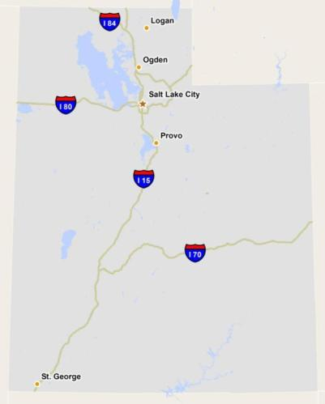
Survey Administration
Surveys collected September – November 2012
Incentive offered
  Raffle for Apple iPadTM
Electronic administration
  Online survey
  Email communication
Urban recruitment focus
  Household diary participants
  Snowball sampling
Notes:
- Open weblink, word of mouth, open to all residents
- Advantage of “snowball” sample method: cost effective, enables real-time planning, more feedback from people with experience/interest (while only a experienced bikers/walkers would be found in a random sample)
- Focused recruitment efforts in urban regions (more bike/walk interest)
- 2000 HH diary respondents invited

Slide 5
Survey Recruitment
Assistance from 150 interest groups
Notes:
- Agencies also conducted outreach

Slide 6
Questionnaire Design
Introduction
Behavior
Optional:
Repeat for both Walk and Bike
Attitudes
Barrier Locations
Demographics
Notes:
Separate walk/bike question sections allowed respondents to focus on their area of interest, but most people (~60%) responded to both (~25% bike only, ~15% walk only)
Behavior: Frequency, purposes
Attitudes: preferred infrastructure, funding priorities
Barrier locations

Slide 7
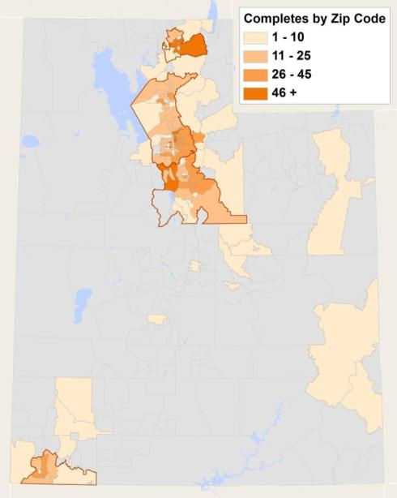
Sample Profile
Notes:
1,987 completed surveys - ~half in SLC region
1477 total walk surveys; 1708 total bike surveys; (1987 total surveys combined)
~15% walk only; ~25% bike only; ~60% both bike and walk surveys
WFRC – 1206 total (910 walk, 1026 bike)
MAG – 366 total (267 walk, 311 bike)
Cache – 208 total (151 walk, 188 bike)
Dixie – 105 total (72 walk, 85 bike)

Slide 8
Sample Profile
Notes:
1477 total walk surveys; 1708 total bike surveys; (1987 total surveys combined)
~15% walk only; ~25% bike only; ~60% both bike and walk surveys
WFRC – 1206 total (910 walk, 1026 bike)
MAG – 366 total (267 walk, 311 bike)
Cache – 208 total (151 walk, 188 bike)
Dixie – 105 total (72 walk, 85 bike)

Slide 9
Preferred infrastructure
Notes:
Example of the attitude info collected –
Preferred infrastructure could inform the barrier locations (e.g. “what kind of improvements does this area need?”);
also informs who is describing a problem (e.g. if someone is comfortable on shared streets, they may report different problems from someone uncomfortable on shared street)
Another indicator of the types of respondents –high proportion of respondents comfortable on shared low-traffic or basic bike lane (NOT just trails)

Slide 10
Preferred infrastructure
Notes:
Example of the attitude info collected –
Preferred infrastructure could inform the barrier locations (e.g. “what kind of improvements does this area need?”);
also informs who is describing a problem (e.g. if someone is comfortable on shared streets, they may report different problems from someone uncomfortable on shared street)
Another indicator of the types of respondents –high proportion of respondents comfortable on shared low-traffic or basic bike lane (NOT just trails)

Slide 11
Typical Behaviors and Barrier Reporting
Notes:
Say what it means to “walk 3-4 times/week”: 10+ minutes…
1477 total walk surveys; 1708 total bike surveys; 1987 total surveys (1198 both topics)
~10% walked 0 times or never walk; ~25% biked 0 times or never bike

Slide 12
Typical Behaviors and Barrier Reporting
Notes:
Say what it means to “walk 3-4 times/week”: 10+ minutes…
1477 total walk surveys; 1708 total bike surveys; 1987 total surveys (1198 both topics)
~10% walked 0 times or never walk; ~25% biked 0 times or never bike

Slide 13
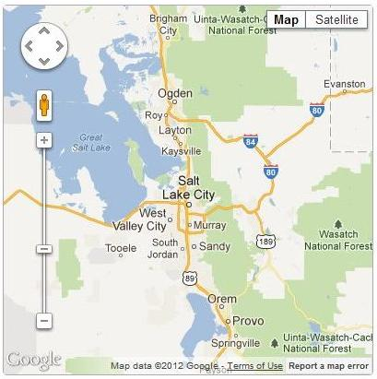
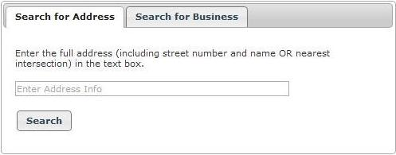
Barrier Locations: Question Design
Notes:
Explain how the barrier roster is functionally similar to a trip roster in a diary (list it, locate it, describe it)

Slide 14
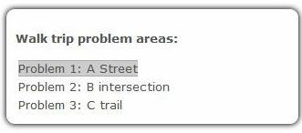
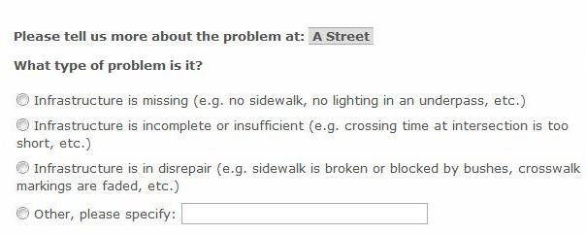
Barrier Locations: Question Design

Slide 15
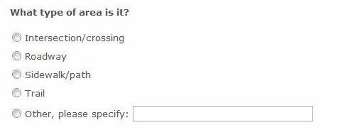
Barrier Locations: Question Design

Slide 16
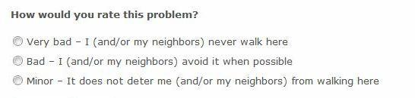
Barrier Locations: Question Design

Slide 17
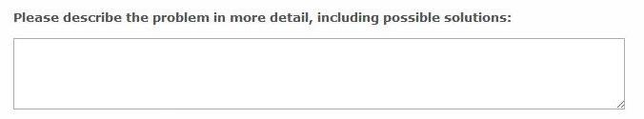
Barrier Locations: Question Design

Slide 18
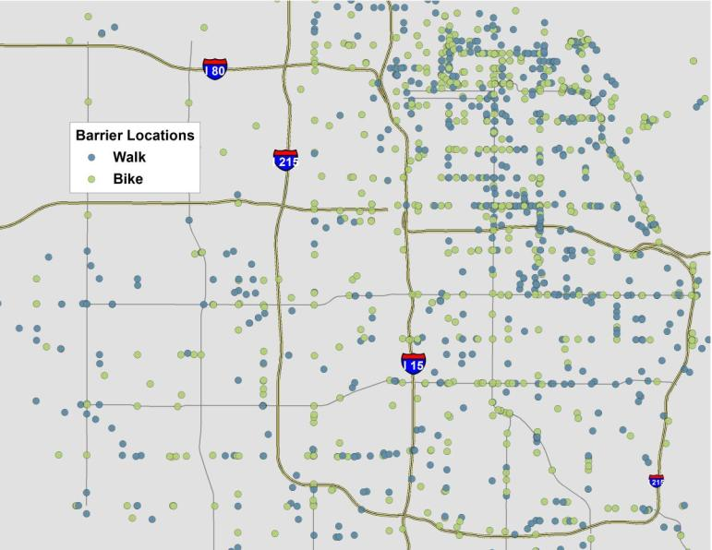
Walk and Bike Barrier Locations
Example: Salt Lake City Barriers
Notes:
4200 locations
Most barrier locations in urban regions
Most barrier locations are “missing infrastructure” (e.g. road with no bike lane, intersection with no sidewalk)
Most barrier locations are along roadway segments (e.g. long sections of road with no b/w facilities)

Slide 19
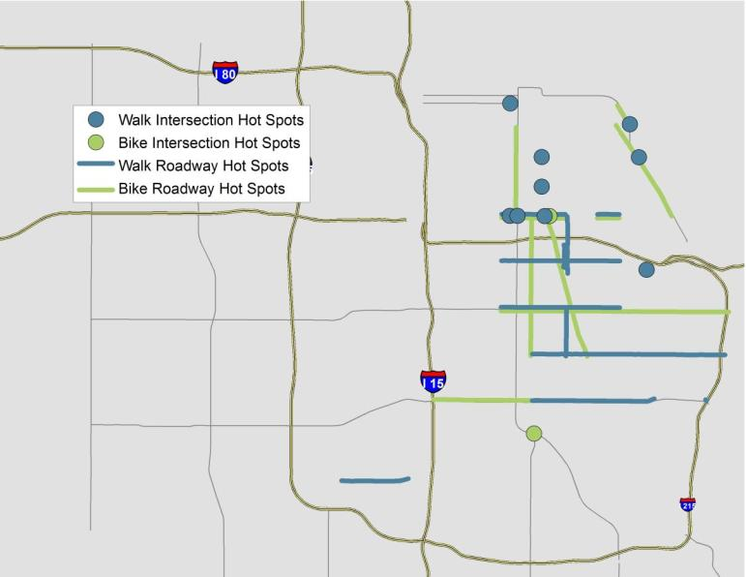
Walk and Bike Barrier Hot Spots
Example: Salt Lake City Barrier “Hot Spots”
Notes:
Analysis to focus in on areas (intersections or road segments) where many people flagged a problem.
(Example of “real-time” planning application?)
Hot spots = areas with at least three, up to 20+ flags
– analyzed by mode and area type within 100 feet
SLC example of “hot spot” analysis
3+ barrier data points within 100 feet of unique intersection or roadway segment

Slide 20
Applications
Salt Lake area agencies collaborate and are sharing the dataset
  City of Salt Lake: Data is informing update of Bicycle and Pedestrian Master Plan
  Study team members and agencies plan to use data for Utah Collaborative Active Transportation Study (UCATS)
  WFRC planners identifying “hot spots” for disabled travelers
  UTA reviewing for transit access issues
  Potential use for the newly launched SLC Bike Share
Engage & share results with residents
  Cache MPO sharing results on website
  WFRC considering ways to share results
Notes:
Master plan – maybe this will help with project identification
UCATS – part of WFRC Choices for 2040 (and RTP?) – identify gaps/analyze active transport challenges
Mobility issues – esp for people with limited mobility (e.g. where missing sidewalks=no mobility)
Mobility issues also related to transit access? (What is UTA’s take…)
Engage and inform residents – discuss Cache’s website on next page
SLC Bike Share – this is unrelated to our study (?), but indicates the increased interest and attention to biking; the study COULD relate to bike safety and demand

Slide 21
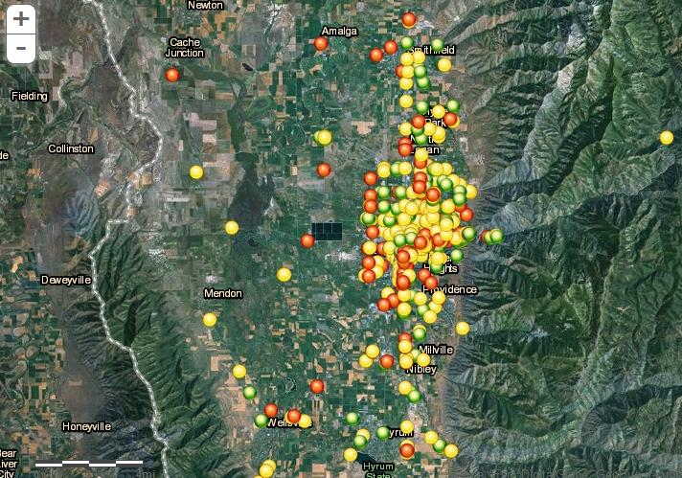
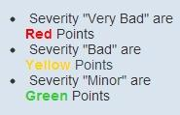
Applications
Notes:
Example of informing residents:
This is the map shared with the bike ped community in Cache MPO, anyone can go to the website and look at these described problem locations

Slide 22
Closing Thoughts
Good method for “real-time” data for planning
  Improved targeting of limited dollars
  Insight into demand for walk and bike infrastructure
Potential to adapt the survey to support ongoing data collection
  Continuous collection of “hot spots” across several seasons
  Allow for longer survey administration period to encourage more word of mouth/response
Assess trends in barrier data and improve future survey design
  Identifying and locating problems along roadways
  Categorization of problem types
  Coordination with safety and health needs

Slide 23
Thank You!
Questions?
Contact information:
  Chloe Ritter
  RSG, Inc.
  critter@rsginc.com
Acknowledgements:
  Wasatch Front Regional Council (WFRC)
  Mountainland Association of Governments (MAG)
  Cache MPO
  Dixie MPO
  Utah Transit Authority (UTA)
  Utah DOT

