Slide 1
An Economic and Life Cycle Analysis of Regional Land Use and Transportation Plans
Caroline Rodier
Research Associate
Mineta Transportation Institute
14th TRB National Transportation Planning Applications Conference
Columbus, Ohio
May 5-9, 2013

Slide 2
Acknowledgements
  Co-Authors:
    Elliot Martin, Doug Hunt, John Abraham, Margot Spiller & Brenda Dix
  Technical Assistance:
    Gordon Garry & Bruce Griesenbeck, SACOG
Financial Support:
  Mineta Transportation Institute
  California Department of Transportation
  University of California

Slide 3
Introduction
Spatial-economic model (PECAS) in Sacramento, California, to examine policy 2 questions:
  What are the economic dis/incentives for local jurisdictions to support regional land use & transport plans?
  What is the net change in GHGs from regional plans, if upstream lifecycle emissions are considered?
Notes:
+ that reduce GHG emissions a regulatory framework that relies only on incentives
+more specifically, what are the trade-offs between upstream effects of change in economic activities and construction

Slide 4
Overview
Legislative Background
Sacramento Case Study
Sacramento PECAS Model
Lifecycle Analysis
Economic Incentives & Disincentives
Conclusions

Slide 5
Legislative Background
Climate Change in California

Slide 6
California’s Climate Change Laws
Dramatic Reductions in GHGs
New Vehicle & Fuel Technology Necessary But Not Sufficient to Meet Transportation GHG Goals
  Need Demand Management Measures
Notes:
(AB 32)
1990 levels by 2020
80 below 1990 levels by 2050
It is widely

Slide 7


Sustainable Communities and Climate Protection Act—2008 (SB 375)
MPOs Develop Regional Land Use & Transportation Plans (SCSs) to Reduce Percent Growth in Per Capita VMT
Notes:
Legislative answer to the “3rd leg of the stool”:
From 2005
Regional governments (or MPOs) lead the coordination, development, and evaluation of state, regional, and local governments’ policies.
Regional GHG targets for SB 375 policies set by the California Air Board (ARB) with MPOs.
MPOs must develop a Sustainable Communities Strategy (SCS) as part of their regional transportation plan that demonstrates how the region will meet their GHG target.

Slide 8
Implementation: Local Rule, Public Participation & Incentives
Local governments retain authority over development decisions & final implementation of SCSs.
Implementation relies on
  Bottom-up public participation processes
  Incentives: streamlined environmental review (CEQA) for SCS consistent projects & transportation funding.
Notes:
Bottom line is that implementation is a real problems for SB.
Although the bill requires such a strategy, it does not compel local governments to conform to this strategy. Because their general plans do not have to be consistent with the regional plan and they retain authority over development decisions in their jurisdiction, local governments have the final word over how the provisions of SB 375 are ultimately implemented.
SB 375 does not require local governments to adopt general plans that are consistent with land use-transport plans in SCSs
Places emphasis on “bottom up” public participation processes to enable the development of and support for plans
Also relies on transportation funding and CEQA streamlining.

Slide 9
Case Study
The Sacramento, California, Region
Sacramento Area Council of Governments (SACOG)

Slide 10
SACOG’s 2035 MTP (2008)
Blueprint (or PRB) Plan
  Compact, Mixed-Use Development & Transit.
Business-As-Usual (BAU)
  Low Density Auto-Oriented Development
Notes:
PRB compared to BAU—PRB is SCS proxy in this study

Slide 11
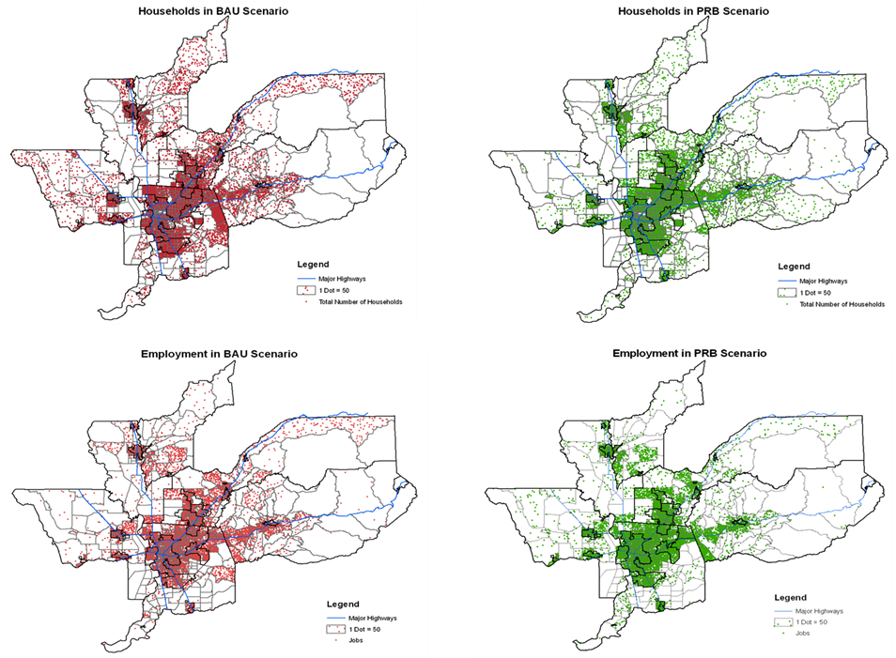
Notes:
--In this next slide, the maps in red illustrate the business as usual scenario for 2035 and maps in green illustrate the PRB scenario
--In general, it is possible to see a greater concentration of employment locations in urban centers in the PRB relative to BAU
--Significant housing development is located near existing employment centers near downtown Sacramento, Rancho Cordova, and Roseville to improve the overall jobs to housing balance and concentrate growth near high quality transit service.

Slide 12
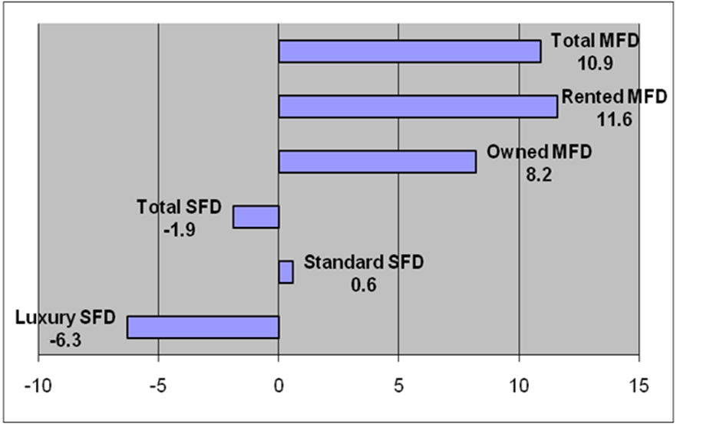
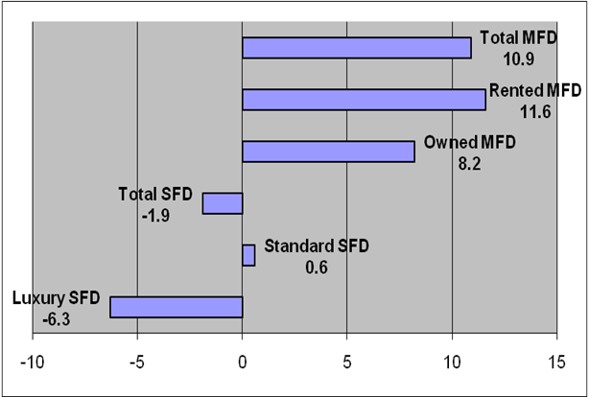
Percentage Change in Dwelling Units by Type between BAU & PRB
Notes:
This slide shows the shift in dwelling unit types from the BAU to the PRB.
It can be seen that there is a relatively small percentage reduction in total SFD, which is derived from luxury SFD
There is a relatively larger increase in MF units
In 2035, the region is forecasted to grow by an additional 535,000 jobs and 433,000 housing units in both scenarios

Slide 13
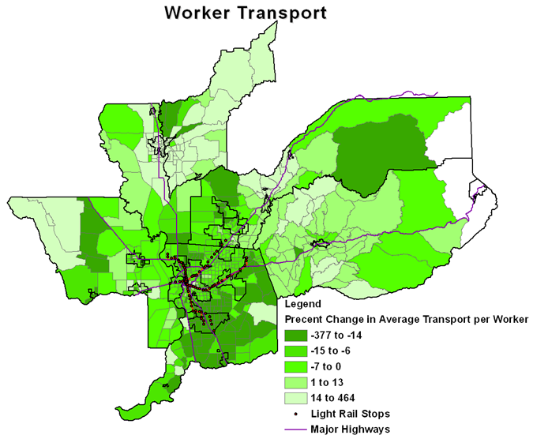
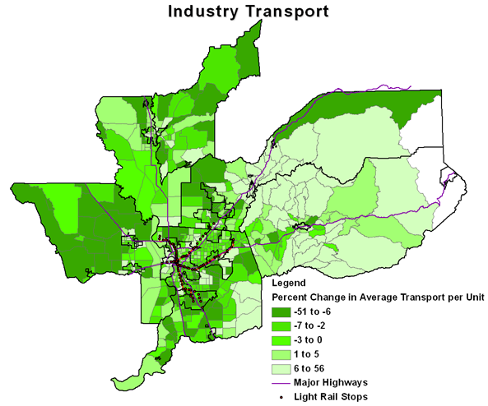
Percentage Change in Worker & Industry Transport Costs BAU to PRB
Notes:
The figure on the right shows the travel time and cost of commuting to work from a home zone.
The figure on the left shows the travel time and cost of conducting business from the zone in which the business is located.
It can be seen that the PRB scenario provides relatively large reductions in overall travel cost over the BAU scenario, but not all zones have reduced travel costs.

Slide 14
Model Application
The Sacramento PECAS Model

Slide 15
AA Module of PECAS
Notes:
This study uses the AA module of the PECAS model, which uses
an aggregate, equilibrium structure
a 3-level nested logit model as shown here.
Activities are located in LUZs (land use zones that represent the study area).
Activities produce commodities and then transport and sell these commodities.
Activities also consume commodities after buying them and transporting them.
There are different types of activities, including industrial sectors, government and households.
Commodities flow at specific rates
from where they are produced to where they are exchanged (from seller to buyer)
and then from where they are exchanged to where they are consumed.
they are grouped into categories, such as different types of goods & services, labor & space.
It is the travel conditions – the distances, costs, times or (dis)utilities – for the movement of commodities that results in the influence of the transportation system on the interactions among activities & the attractiveness of locations for activities.

Slide 16
AA Allocates Households & Employment in 2035 BAU & PRB
Inputs | BAU | PRB
Land Use | 2035 BAU Floorspace | 2035 PRB Floorspace
Travel: zone to zone by mode, purpose & time | 2035 travel time/cost SACSIM BAU | 2035 travel time/cost SACSIM PRB
Notes:
For this study, SACOG provided the build-form or floorspace inputs for the BAU and PRB scenarios in the year 2035.
Built-form is an input, but the AA module allocates the location of employment and households.
SACOG’s ABM model provided the zone-to-zone travel time and cost (or logsums) for all modes by trip purpose by time of day.
These travel times were consistent for the built form in each land use.
Total economic growth by activity category was assumed to remain constant for both scenarios simulated with AA model.

Slide 17
Regional Land Use and Transportation Plans
Reduce Travel, Wage & Housing Costs due to Better Accessibility
Increase Net Benefits (i.e., More Economic Consumption & Production)
Reduce Net Benefits for High Income Household
  Preference for Luxury Housing & More Affected by Change in Wage
Notes:
This study shows that a more compact urban form designed around transit stations can reduce travel costs, wages, and housing costs by increasing accessibility.
These can lead to substantial net benefits for industry categories and for lower income households.
Higher income households may be net losers, since their incomes are more dependent on reduced wages, they are less willing to switch to higher density dwellings, and they are more likely to own their own home.

Slide 18
Life-Cycle Analysis
Comparing PRB and BAU Economic Outputs

Slide 19
Lifecycle GHG Impacts of Sacramento’s Regional Plan
Sacramento’s regional plan (relative to the BAU) is expected to have the following GHG impacts:
  Reduced vehicle travel.
  Reduced manufactured construction materials (shift from larger to smaller housing units).
  Increased regional production & consumption (PECAS analysis).
The net effect of these opposing GHG impacts is not well understood.
Notes:
Travel and emissions models are commonly applied to evaluate the change in passenger and commercial travel and associated GHG emissions from land use and transportation plans. Analyses conducted by the Sacramento Area Council of Governments (SACOG) predict a decline in such travel and emissions in the PRB relative to the BAU scenario. However, the life cycle GHG effects due to changes in production and consumption associated with transportation and land use plans are rarely, if ever, conducted.
As described above, lower labor, transport, and rental costs in the PRB scenario increase producer and consumer surpluses, and production and consumption relative to the BAU. As a result, life cycle GHG emissions from these upstream economic activities may increase. At the same time, life cycle GHG emissions associated with the manufacture of construction materials for housing may decline due to a shift from larger luxury homes to smaller multi-family homes. The net impact of these opposing GHG impacts is not well understood.
Sacramento Area Council of Governments (SACOG), Metropolitan Transportation Plan (Sacramento, CA: SACOG, 2008).

Slide 20
Lifecycle Analysis
The Economic Input-Output Life Cycle Assessment model (EIOLCA) is applied to evaluate effects of changes in economic production and consumption as well as housing construction using the results of the PECAS simulation.
Notes:
Just described
The EIOLCA model is a publicly available lifecycle assessment model of upstream emissions impacts resulting from economic activity within a particular sector. The model is produced and maintained by Carnegie Mellon University’s Green Design Institute.

Slide 21
Lifecycle Results
Total CO2e increases by 1,037,864 metric tons from increased economic activity in the plan over 25 years.
However, a shift in construction from larger to smaller homes reduces GHGs by 2,165,959 metric tons.
Upstream construction effects appear to more than offset those of increased economic activity in the plan.
Notes:
(carbon dioxide equivalent)
Changes in economic activities may be underestimated in the PRB scenario because of the assumption of constant total economic size. However, to put the relative impacts in perspective, the difference between economic activities (from the BAU to the PRB) would have to at least double to offset the reductions in GHG emissions from housing construction.
It is important to note that the analysis of life cycle GHG emissions includes production, but not the use of goods and services demanded by consumers or purchasers in each scenario. GHG emissions from the distribution and use of the transportation system is estimated to decline in the PRB relative to the BAU, as discussed above; however, it is unclear how use of products and services might impact the results of this study.

Slide 22
Economic Incentives & Disincentives for Local Governments to Implement Regional Land Use and Transportation Plans

Slide 23
AA Allocates 2035 Households & Employment
Inputs | Partial Conformity: 150 Scenarios
BAU Floorspace | Jurisdictions & Percentage Randomly Assigned
PRB Floorspace | Remainder
Travel | SACSIM PRB
Notes:
Partial Conformity:
A set of non-compliance scenarios are developed in which multiple jurisdictions partially pursue the BAU at differing rates that are randomly allocated.
The focus is on how non-conformity may influence the supply of housing by type, and holding other factors constant, the geographic and income distribution of rents, wages, commute costs, and consumer surplus.

Slide 24
Partial Jurisdictional Compliance
Each jurisdiction in the region randomly designated as “complying” or not.
Each land use type in zones that comprise non-complying jurisdictions was randomly assigned percentage of BAU development.
  5, 10, 15 & 20 percent
Notes:
In each scenario, each jurisdiction in the region is randomly designated as either “complying” or “non-complying.” Within the non-complying jurisdictions, each land use type (e.g., retail space, luxury single-family housing) within each LUZ was randomly assigned a percentage for which it would develop according to the BAU scenario. The assigned percentages of non-compliance were limited to 5 percent, 10 percent, 15 percent, and 20 percent.
One hundred and fifty (150) randomly generated scenarios were created and simulated with the Sacramento PECAS model. In each scenario, total amount of industrial floorspace by sector and number of total dwelling units in the region is held constant at the levels established for the PRB scenario, while the number of dwelling units by type is allowed to vary based on demand. This scenario configuration is not a feature of the PECAS model, but was instead a choice made in the study design in order to keep the analysis more tractable. In order to hold the regional amount of different land uses at a constant level, the changes in land use in the non-complying jurisdictions are allocated to zones in the region’s jurisdictions that complied with the PRB development plan. Because allocation is weighted by relative share of zonal dwelling units and industry by sector in the PRB plan, zones with the more total land use supply obtain a larger share of the change in supply resulting from the BAU development in the non-complying jurisdictions.
The results of the scenarios provide insight into how changes in the relative supply of the four housing types represented in the model (luxury single-family dwelling units, standard single-family dwelling units, owned multi-family dwelling units, and rented multi-family dwelling units), and holding other factors constant, might influence housing values, rents, wages, commute costs, and consumer surplus (total and by-income class) across the region, and in conforming and non-conforming jurisdictions.

Slide 25
Partial Implementation
An increase in the supply of larger, luxury single family housing in non-conforming jurisdictions increases household benefits at the expense of households in conforming jurisdictions.
Notes:
On average, when non-conformity increases the supply of larger, luxury single-family homes in non-complying jurisdictions, the average household in those jurisdictions experiences increased economic benefits, while the average household elsewhere experiences economic losses. The total net benefits in the non-complying jurisdictions are large enough to offset the losses in complying jurisdictions to produce net benefits for the average regional household.
However, when non-conformity increases in both luxury and standard single-family housing, then economic benefits decline for the average household in all jurisdictions. At this point, the more heavily weighted gains of the higher income households are not great enough to offset the less heavily weighted losses of the lower income classes.
Maintaining fixed total industry size between scenarios impacts the consumer surplus measures. The PECAS AA model represents how increased accessibility benefits industry directly and indirectly (for example through lower wages), but it does not represent how industry may grow faster in the region because of this benefit. If a separate model of region-wide economic size were to respond to AA’s producer surplus measures, industry would grow faster, and some of the benefit currently ascribed to industry would be transferred to households through less wage reductions.
Another actor that is outside of the consistent AA evaluation system is the land developer. The SD module of PECAS could be used to calculate a measure of developer profits, but since this study did not use the SD module it is important to point out that developers may not win in the PRB scenario. Hence developers may not want to build the built-form assumed in the PRB scenario without additional incentives, which could be costly to taxpayers and hence households.

Slide 26
Partial Implementation
When non-conformity increases both luxury & standard single-family
  Economic benefits decline for average households in all jurisdictions.
  The gains of high income households do not offset losses of lower income households.
Notes:
However, when non-conformity increases in both luxury and standard single-family housing, then economic benefits decline for the average household in all jurisdictions. At this point, the more heavily weighted gains of the higher income households are not great enough to offset the less heavily weighted losses of the lower income classes.
Maintaining fixed total industry size between scenarios impacts the consumer surplus measures. The PECAS AA model represents how increased accessibility benefits industry directly and indirectly (for example through lower wages), but it does not represent how industry may grow faster in the region because of this benefit. If a separate model of region-wide economic size were to respond to AA’s producer surplus measures, industry would grow faster, and some of the benefit currently ascribed to industry would be transferred to households through less wage reductions.
Another actor that is outside of the consistent AA evaluation system is the land developer. The SD module of PECAS could be used to calculate a measure of developer profits, but since this study did not use the SD module it is important to point out that developers may not win in the PRB scenario. Hence developers may not want to build the built-form assumed in the PRB scenario without additional incentives, which could be costly to taxpayers and hence households.

Slide 27
Conclusions

Slide 28
Conclusions
Unless housing preferences have significantly changed since the calibration of the Sacramento PECAS model (pre-economic downturn), market forces may not favor local jurisdictions’ implementation of regional land use & transportation plans.

Slide 29
Conclusions
In fact, as California’s housing market recovered in early 2013, SB 375’s Achilles’ Heel—no sanctions & weak incentives for local implementation—exposed.
  City of Fresno sues northern counties over suburban development (homes for 10K people).
  Sacramento County approves a 2.7K acre development with 8K homes outside of regional plan’s specified growth areas.
Notes:
The City of Fresno filed suit against Fresno and Madera County for approving a northern suburban housing development (100,000 people) contending it is “irresponsible sprawl” that threatens downtown revitalization.
Sacramento County approved a 2,700 acre development with 8,000 homes outside of the regional plan’s specified growth areas.

Slide 30
Conclusions
The overall reduction in home size implicit in regional plans that integrate compact development with transportation investments more than offset lifecycle GHGs from expanded regional economic activities.

Slide 31
Thank You! http://transweb.sjsu.edu/project/1008.html

