Slide 1
The Use of Multiple Data Sources in Development of a Statewide Freight Model
Prepared for:
The 14th TRB National Transportation Planning Applications Conference
May 5-9, 2013
Columbus, Ohio
Phillip J. Mescher, AICP, Iowa Department of Transportation
Vincent Bernardin Jr., Ph.D., RSG
Paul Hershkowitz, CDM Smith
Mary Lupa, Parsons Brinkerhoff
Daniel Szekeres, Michael Baker Corp.

Slide 2
The Iowa Travel Analysis Model
What iTRAM is now
What iTRAM is adding
Rail Network
Passenger Model
  New Passenger Rail Model
  Other Improvements & Data
Freight Model
  Iowa Freight Context
  Available Freight Data
  Freight Model Architecture

Slide 3

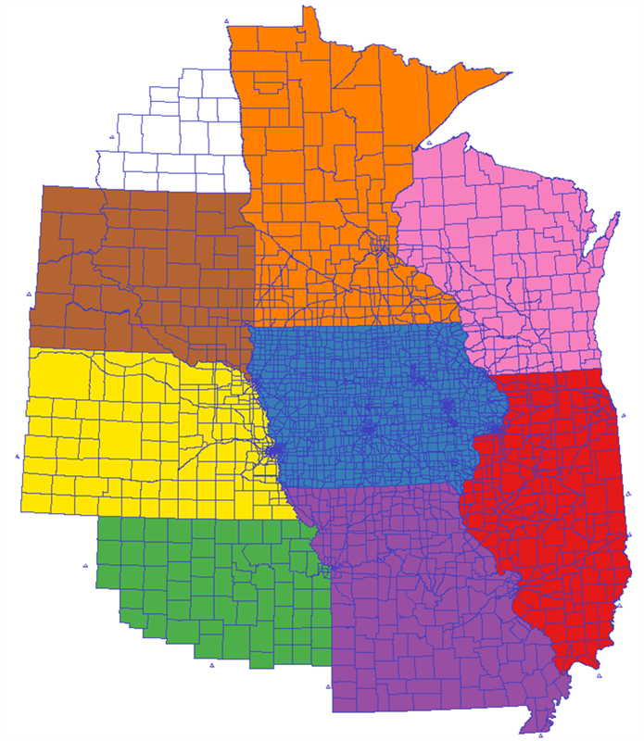
iTRAM Now
Passenger Car & Truck
3-step model
Gravity Model
Truck Sub Model
Airport Vehicle Sub Model
3,144 Zones
National in Scope
Focus on Midwest
Interfaces with MPO Models

Slide 4
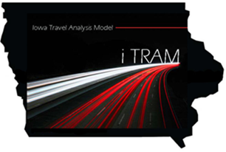
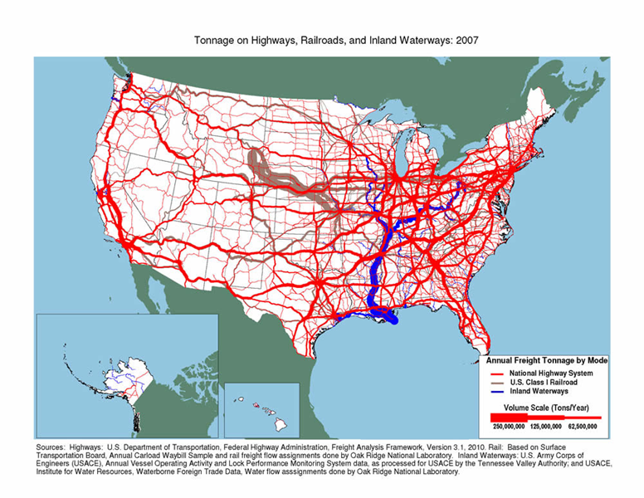
iTRAM Phase II
Original Architecture Included Future Rail Addition
FRA Grant to Expand Model
Support Iowa DOT Rail Planning Efforts
Passenger Rail
  Support Chicago to Omaha Passenger Rail Study
Freight Rail
  Supports grant program
  & other efforts

Slide 5

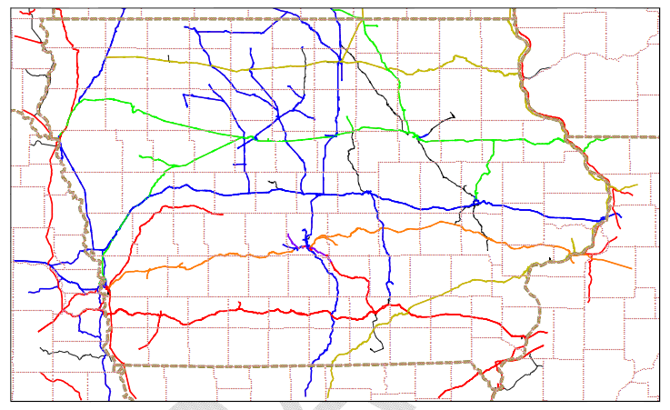
Rail Network
New GIS Rail Network
Assignable Network
Various Attributes
Linkages to Highway Network

Slide 6
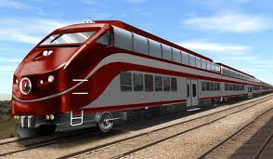
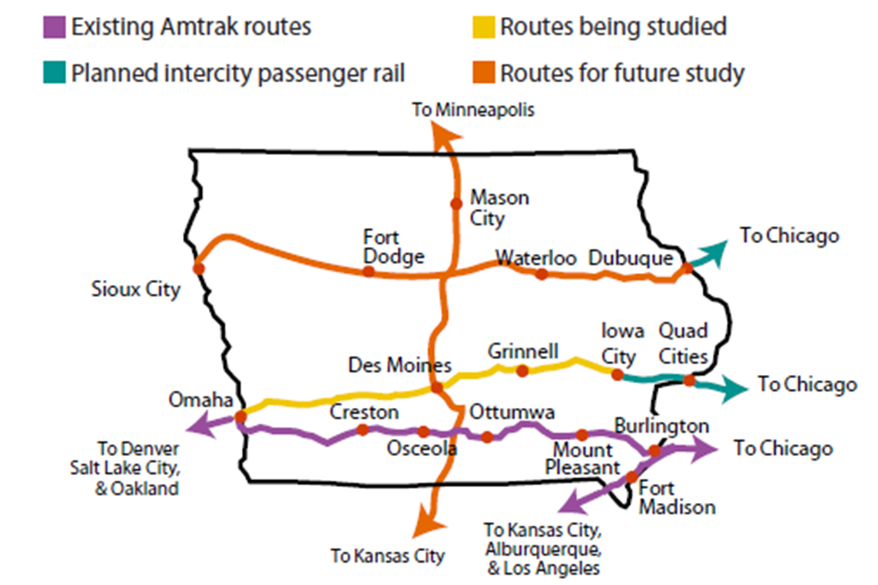
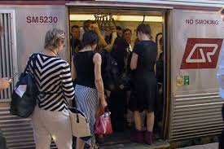
Passenger Rail Model

Slide 7
Passenger Rail Model
Parallel and independent model
Nested Logit Mode Choice model
Ridership forecasts between Iowa Urban Areas
Also between Iowa and Major Metro Areas
  Chicago
  Omaha
  Kansas City
  Minneapolis
Terminal Based O/D
Sensitivity to travel time and fares

Slide 8
Passenger Model Update
New Trip Generation
New Destination Choice Models in place of Gravity
Multiple passenger data sources:
  National Household Travel Survey (NHTS) Add-On
  Census Transportation Planning Package (CTPP)
  Census Longitudinal Employer Household Dynamics (LEHD)

Slide 9
Iowa Add-on Sample in 2009
Focuses more on rural travel
2,000 Usable Surveys
Trip Rate Development
Destination Choice Model Estimation
  Trip Length Validation
  O/D Patterns

Slide 10

ACS Based Commuter Flow Data
Commuting Data to Supplement the NHTS
Validating Work Trip Patterns
County to County Worker Flows
Validation of Mode Choice and Trip Lengths
5-year Data Available Summer 2013

Slide 11
Census LEHD O/D Employment
Additional data source for block level employment data
Available for each year between 2002-2010
Employer and employee tax records
Noise incorporated to protect confidentiality
Will serve as check on InfoGroup derived employment
Additional source of Commuter Flow estimates to validate work destination choice

Slide 12

Freight Rail Model
Iowa Freight to Increase 53% by 2040
Truck handles 80% of Freight in Iowa
Rail handles 43% of total freight movements
Main Union Pacific Line Runs Through Iowa
  Coal, Grain, Ethanol, Chemicals
  Union Pacific main carrier
18 Railroads total
3,945 miles of track
Began with review of data
sources to support model

Slide 13

Transearch
3-digit County to County Commodity Flows by Mode
Data Available below the FAF/CFS level
Deficiencies Exist (Agricultural Commodities)
Most recent Iowa DOT version circa 2001
High cost and High Level of Data Cleansing
Higher B/C to invest in other datasets
  IMPLAN
  ATRI

Slide 14
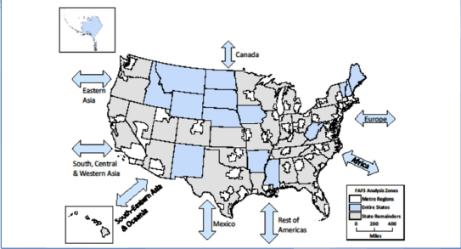
FAF3
No Cost FHWA Product
Commodity Flow Data by mode
Forecasts to year 2040
Based on BTS’s Commodity Flow Survey
Limitation: Iowa is ONE FAF zone
No explicit through traffic O/D

Slide 15
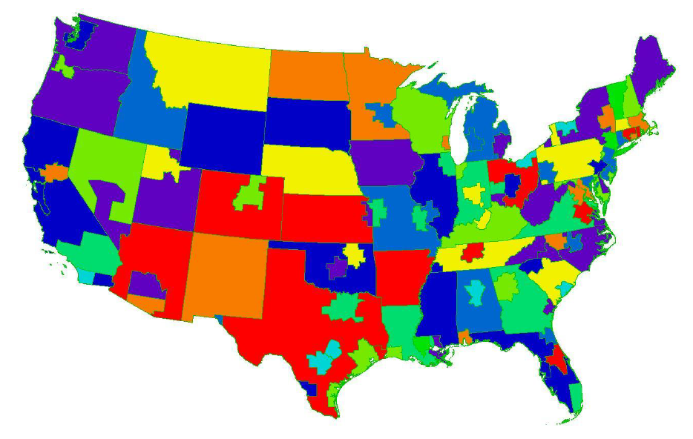
FAF3 Zones
Iowa is One FAF Zone

Slide 16

Carload Waybill Sample
Obtained confidential Carload Waybill sample from STB
Large stratified sample of carload waybills for all U.S. rail traffic from carriers with more than 4,500 annual carloads
Rail Inc. Rail Station Database
  GIS Database of National and Iowa Rail Stations
  Necessary to process Carload Waybill Sample

Slide 17

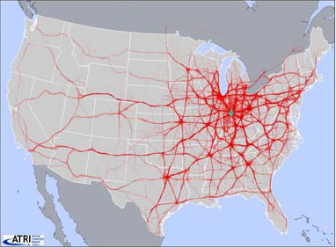
One Week of GPS Truck Flows Passing Through Indiana

Slide 18
American Transportation Research Institute (ATRI)
Non-Profit Research Arm of American Trucking Association
GPS Trace Database (several billion truck positions annually)
Resource to develop Truck Origins and Destinations
Used successfully in the Indiana Statewide Model
Aid in Disaggregating FAF3 Data and for developing static pivot point ODs for truck model

Slide 19

IMPLAN – Economic Dataset
County level Commodity Production and Consumption
No data forecasts
Help to disaggregate FAF3 Commodity Flows
Supplement ATRI and Carload Waybill Sample
Independent Estimate of Iowa Commodity Flows

Slide 20
Special Generators
FleetSeek Trucking Database
  Private Fleet and Owner Operator Data
Leonard’s Guide
  National Warehouse and Distribution Directory
  Trucking Special Generation Locations
National Motor Freight Traffic Association
  Standard Point Location Code Data

Slide 21
Special Iowa Data
On commodity productions and consumption
  USDA Agricultural Production data
  Iowa River Barge Terminal Directory
  Iowa Grain Elevator Database
  Iowa Ethanol Plant Locations
On commodity flows
  Iowa Grain and Biofuel
  Flow Survey
  Iowa Coal Trends Data

Slide 22
Freight Model Architecture
Still being finalized, debating pivot point vs. dynamic disaggregation for commodity flows
Rail freight directly from commodity flows
Trucks pivot off of ATRI trip table based on truck model with three parts
  Commodity flows by truck (long distance)
  Commodity flows by truck to/from rail/barge
  Local trucks (distribution, service)
Will use and integrate most data sources

Slide 23
Freight Model Architecture
Approach: Disaggregate FAF3 commodity flows
### | ### | ### | ### | ### |  |  | FAF3 Flows
### | ### | ### | ### | ###
### | ### | ### | ### | ###
### | ### | ### | ### | ###
### | ### | ### | ### | ###
### | ### | ### | ### | ###
### | ### | ### | ### | ### | ### | ### | ### |  | IMPLAN
### | ### | ### | ### | ### | ### | ### | ###
 | Rail Flows |  | ### | ### | ### | ### | ### |  | ###
 |  |  | ### | ### | ### | ### | ### |  | ###
Carload Waybill |  |  | ### | ### | ### | ### | ### |  | ###
 |  |  | ### | ### | ### | ### | ### |  | ###
 |  |  | ### | ### | ### | ### | ### |  | ###
 |  |  | ### | ### | ### | ### | ### |  | ###
 | ATRI |  |  | Truck Flows |  |  |  |  | ###
 |  |  |  |  |  |  |  |  | ###
 |  |  |  | ### | ### | ### | ### | ###

Slide 24
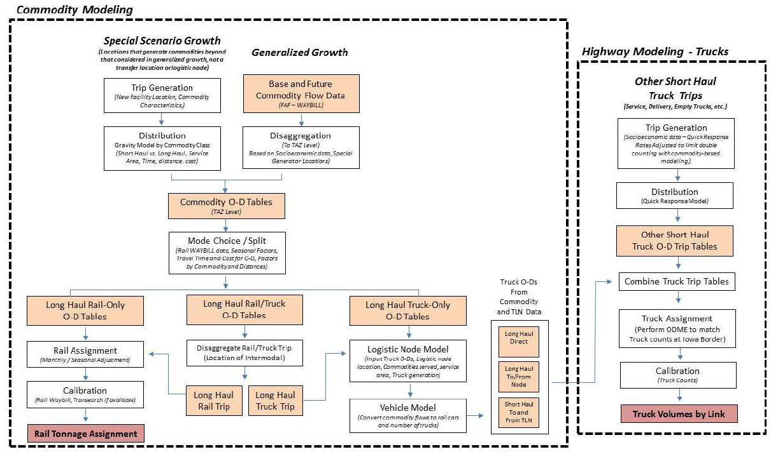
Freight Model Architecture, Option A: Pivot Point Approach

Slide 25





Contact Information
Phillip J. Mescher, AICP
phil.mescher@dot.iowa.gov
(515) 239-1629
Vincent Bernardin Jr., Ph.D
Vince.bernardin@rsginc.com
(812) 459-3500
Paul Hershkowitz
hershkowitzp@cdmsmith.com
(517) 622-2500
Mary Lupa
lupa@pbworld.com
(312) 803-6662
Daniel Szekeres
dszekeres@mbakercorp.com
(717) 221-2019

