Slide 1
Necessary or Nice?
Mapping the Perceptual Distance between Current & Ideal Location Attributes in Utah
TRB Planning Applications Conference
RSG, Inc
Åsa Bergman
Elizabeth Greene
WFRC
Jon Larsen

Slide 2
Alternative Title
“Necessary or nice? Exploring Utah Residential Preference Data with Multidimensional Scaling”

Slide 3

Overview
The Utah Residential Choice Stated Preference Survey
  Study overview
  Our research questions
What is MDS?
  Multi-dimensional scaling
MDS results
Lessons learned
Next analysis steps

Slide 4
Survey Context: Utah Residential Choice Stated Preference Survey
2012 Utah Statewide Household Travel Diary
  9,100 households
  1 HH member from 2,800 households ALSO completed the Residential Choice Stated Preference Survey
2012 Utah Residential Choice Stated Preference Survey
  Survey design inputs:
      TCRP H-31 (How Individuals Make Travel & Location Decisions)
      Community Preference Survey (National Association of Realtors)
      Growth & Transportation Survey for National Association of Realtors & SmartGrowth America
Residential Choice Survey Resulting Data:
  Current & ideal home location (transit, shopping, parks, etc.)
    Area type (downtown, city residential, suburban, small town, rural)
  Ideal home location stated preference experiments
  Household & individual demographics

Slide 5
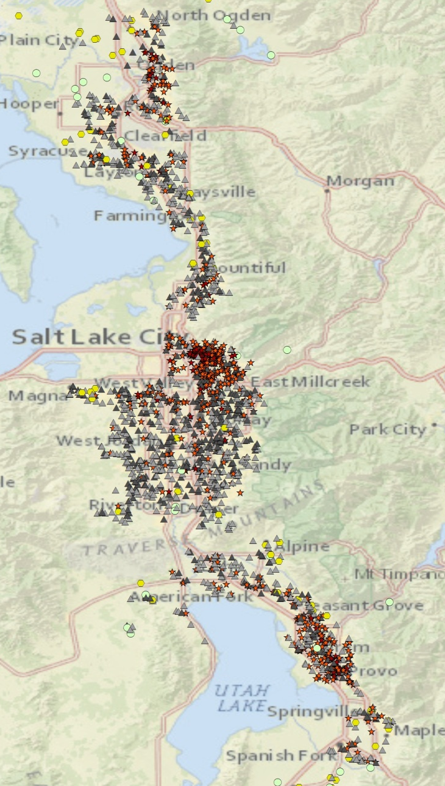
Our Segmentation Variable
Self-Reported Home Area “Type”
Home Location | HH Diary | Res Choice | This Study: Res Choice Wasatch Front
City downtown | 4% | 5% | 6%
City residential | 27% | 26% | 27%
Suburban mixed | 18% | 21% | 25%
Suburban residential | 31% | 33% | 36%
Small town | 15% | 10% | 4%
Rural area | 6% | 4% | 1%
 | 9,155 HHs | 2,795 respondents | 1,972 respondents
Focus greater Salt Lake City region, more comparable and relevant from planning perspective
Notes:
Location descriptions in survey: City, downtown, with a mix of offices, apartments, and shops. City, residential neighborhood. Suburban neighborhood, with a mix of houses, shops, and businesses. Suburban neighborhood, with houses only. Small town. Rural area. WF (n=1972) results were compared against analysis on full dataset (n=2795). Results were similar, though rural area stood apart more.

Slide 6
Research Objectives
Evaluate Multi-Dimensional Scaling (MDS) as analysis technique to answer our research questions…
Our Research Questions: Compare “ideals” to “current” for residents of different area types:
  What location attributes do residents of different area types (downtown, suburban, et c) prioritize?
  How do the area types differ from one another in terms of priorities/values of residents?
  How well do existing amenities associated with the area types align with the preferences of residents?
  How do reported distances to services (e.g. grocery store) compare to stated ideals?
  How do walk, bike, & transit offerings compare to stated ideals?

Slide 7
What is Multi-Dimensional Scaling (MDS)?
An exploratory data reduction technique to visualize differences between a set of objects where the difference between each pair of objects can be thought of as a distance
  Origin in psychometrics, commonly used in market research

Slide 8
Why Try Multi-Dimensional Scaling (MDS)?
Cross-tabulations are a good start to answer research questions
But it can be difficult to simultaneously visualize all differences
Ideal Home Location
 | City downtown | City residential | Suburban mixed | Suburban residential | Small town | Rural area | Row Total
City downtown | 44% | 18% | 18% | 4% | 7% | 10% | 100%
City residential | 10% | 33% | 24% | 15% | 12% | 7% | 100%
Suburban mixed | 6% | 10% | 50% | 16% | 11% | 6% | 100%
Suburban residential | 5% | 5% | 31% | 35% | 13% | 10% | 100%
Small town | 3% | 1% | 12% | 14% | 38% | 32% | 100%
Rural area | 0% | 4% | 15% | 11% | 4% | 67% | 100%
Current
Home
Location
(Small town n=73, rural area n=27)

Slide 9
The MDS Components
Simplified, MDS is a 3-step process:
  Input, iteration, & output
Step 1: Formatting matrix input
  Distances, frequencies, means, ratings, rankings, proportions, correlations
  Matrix with differences between pairs of objects (e.g. area types)
Columns = Variables
Rows =
Objects to map
MDS input:
Difference between objects
(Euclidean)

Slide 10
The MDS Components
Step 2: Iterate to find arrangement of objects in space
  Closely matching distances in matrix & preserving rank order (non-metric MDS)
Step 3: Plot and interpret output
Use input matrix and output map to interpret locations of points relative to each other. Points closer = More similar
Clusters
Notes:
Non-metric MDS: Monotonic/isotonic regression. This study used R function ‘isoMDS’ in library MASS. MDS also available in SPSS, SAS.

Slide 11
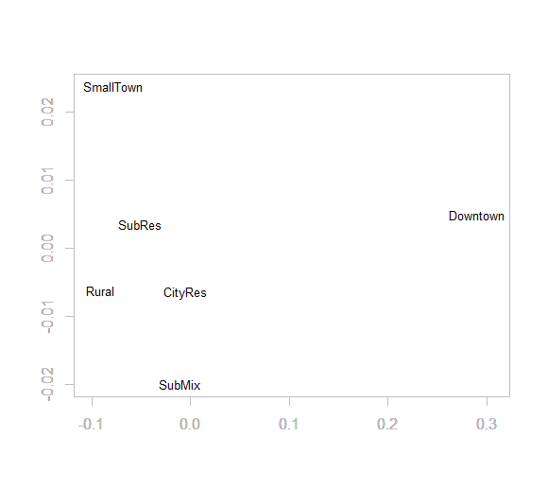
Simple Example: Ideal Residence Type by Current Location Type
Overwhelming preference for single family houses.
Cross-tab tells the story:
  MDS does not add value
Notes:
Interpreting non-metric MDS output: The axes values and object score values have no meaning, and the orientation of the plot is arbitrary

Slide 12
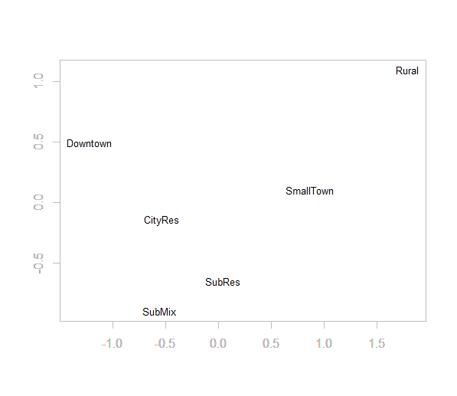
Simple Example: Current vs Ideal Location Type
As expected, differences in preferences match differences in area type
  People largely live in the area type they want to live
Most satisfied:
Rural (67%)
Suburban mixed (50%)
City downtown (44%)
Small town (38%)
Suburban residential (35%)
City residential (33%)
Notes:
Presented results have stress <0.05. Top ‘ideal’ home area types:
Suburban mixed (32%)
Suburban residential (21%)
City residential (15%)
Small town (13%)
Rural (10%)
City Downtown (9%)

Slide 13
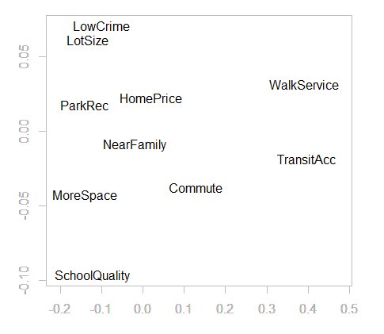
Primary Reason Chose Current Home
‘Flip’ the matrix; Map ideal location attributes
  Glean location types from the attributes
  Dimensions emerge
  Rural residents are fundamentally different (46% chose “Other reason”)
Notes:
Categories excluded (few observations): Community with sidewalks and bike lanes, Close to cultural activities, Close to church or other place of worship, Lower property taxes. ‘Other, please specify’ excluded as it is not one category. Note: Price reflects other attributes, should ideally not be answer option.

Slide 14
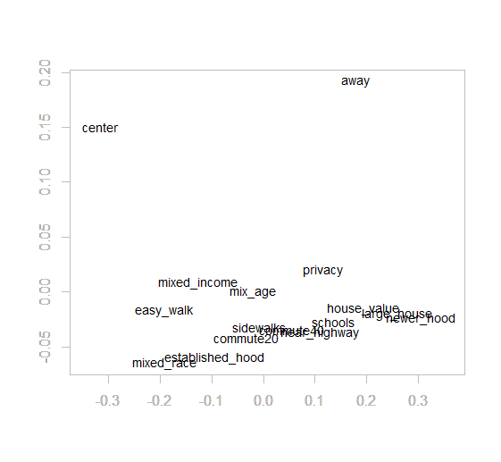
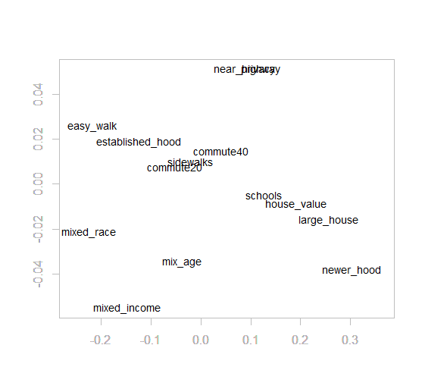
“Very Important” Reasons for Choosing Current Home
Notes:
"How important were each of the following to you when it came to deciding to live in your current home?" . Statements were shown in randomized order. ‘Center of it all’ and ‘away from it all’ stand out in respondents’ judgments of the home location attributes. ‘away’ and ‘center’ removed.

Slide 15
“Very Important” Reasons for Choosing Current Home
Now, having removed the extremes:
  Glean location types from the attributes
Notes:
"How important were each of the following to you when it came to deciding to live in your current home?" . Statements were shown in randomized order. Compare with matrix. ‘away’ and ‘center’ removed. Small town and rural stand apart from lower ratings for commute, sidewalks and places to walk and established neighborhood. Downtown stands out from lower ratings for quality public schools and higher rating for mixed race/diverse neighborhood. Top rated:
Commute distance
Sidewalks
High quality public schools
Places to walk
Easy highway access
Established neighborhood

Slide 16
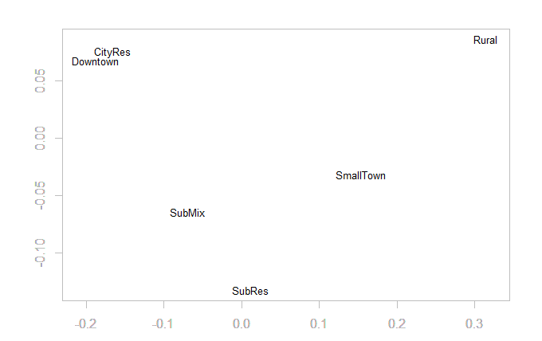
Current Commute Distance
Commute distance primary reason chose home:
Downtown 27%
City residential 27%
Suburban mixed 16%
Suburban residential 17%
Small town 6%
Rural area 4%
  Caution: Small town, rural, small sample size
Notes:
Commute < 5miles: 50% of city downtown, 47% of city residential, 26% of suburban mixed, 15% of suburban residential, 16% of small town, 5% of rural area.

Slide 17
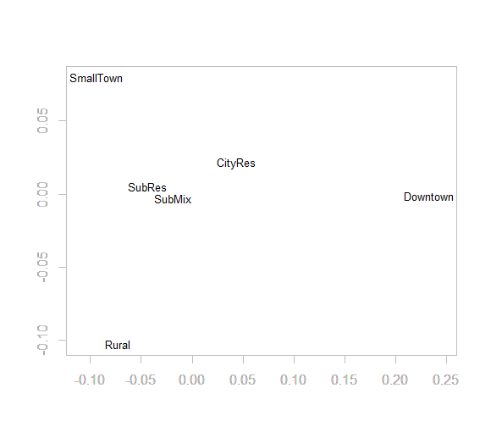
Desire to Walk More by Location Type
Downtown residents wish to walk more, or expressing their values in the survey?

Slide 18
Did MDS help Answer Our Research Questions?
Not all of them, and not exhaustively, but we learned something.
  What location attributes do residents of different area types (downtown, suburban, et c) prioritize?
  How do the area types differ from one another in terms of priorities/values of residents?
  How well do existing amenities associated with the area types align with the preferences of residents?
  How do reported distances to services (e.g. grocery store) compare to stated ideals?
  How do walk, bike, & transit offerings compare to stated ideals?
  MDS useful
  MDS useful
  Want land-use and secondary data to really get at this.
  Better done with more disaggregate and secondary actual distance (miles) data.
  Want to quantify this, MDS is not sufficient. But learned something about the survey question (‘desire to walk more’).
Notes:
Non-metric MDS.

Slide 19
Considerations for Using MDS
Strengths
Excellent for exploring ordinal data (e.g., attitude/opinion/judgment) for groups/objects/segments of interest before further analysis
Flexible: Any difference measure accepted
  Compare to e.g. factor analysis (requires correlations)
  Does well with ranking or rating or single choice data
Quickly reveals clusters and extremes
Evaluate not only the answers, but the question itself
  Useful to evaluate answer options in a pilot survey
Challenges, Limitations
Want ~10 or more objects to map, sufficiently large matrix for MDS to really add value
Exploratory technique ≠ simple:
  Are differences shown statistically significant?
To control for other variables:
  Regression analysis better suited
To answer questions about relative priorities, trade-offs:
  Choice modeling better suited (but requires stated preference experiments)

Slide 20
Next Analysis Steps
Involve land-use and secondary access variables to verify and supplement the self-reported;
  More refined area type variables than the six included here
  Population density
  Walk score
  Transit and other access measures
Introduce socio-economic variables;
  Education, income, age group, presence of children
Perform analysis on larger dataset, but geographically focused
  Allows for more segmentation while still comparing ‘apples to apples’
Move beyond MDS (it is an exploratory technique, after all)
  Regression analysis

Slide 21
Thank You
Acknowledgements
  Wasatch Front Regional Council
  Mountainland Association of Govermnents
  Dixie Metropolitan Planning Organization
  Cache Metropolitan Planning Organization
  Utah Department of Transportation
  Utah Transit Authority

Slide 22
MDS References
Kruskal & Wish (1978)
Borg & Groenen (2005)
Takane (2007)
Borgatti (1997)
isoMDS() from R library MASS
Examples:
  Psychometrics: Judge similarity between facial expressions
  Marketing research: Map differences between car brands from subjects’ ratings
  Communication studies: Create organizational chart from the flows of email between staff
  Animal studies: How genetically close are populations of turtles relative to their spatial locations?

Slide 23
Contact
For more information:
  Åsa Bergman, Analyst, RSG, Inc.
  asa.bergman@rsginc.com

