Slide 1
Integrating Dedicated Bicycle Modeling Tools into a Regional Modeling Framework: Case Studies
14th TRB National Transportation Planning Applications Conference
May 6, 2013

Slide 2
Development History
Overview of Tools
Pilot Project
First Project Application

Slide 3
Development History
Data Collection & Analysis
Portland State University (Broach, Dill, Gliebe)
revealed preference survey (GPS)
  routing
  trip purpose
route choice model estimation (logit-based)
  distance
  facility type
  traffic volume
  uphill slope
  bridge crossings
  turn frequency
  intersection control
stand-alone implementation (Python, ArcGIS)

Slide 4
Development History
Implementation within Regional Transportation Model (trip-based)
Network
  base network refinement
  attribute derivation
  ArcGIS to VISUM conversion
Model Integration
  programming
  validation
  sensitivity testing
  horizon year network coding
  application

Slide 5
Essentials
Temporal Basis
average weekday
model years: 2010, 2035
spring/early fall conditions
Trip Purposes
commute vs. non-commute
non-utilitarian, exercise-only trips excluded
Network
entirety of 4-county, bi-state region
TAZ as basis for origins and destinations
all streets (paths, trails, etc.)

Slide 6
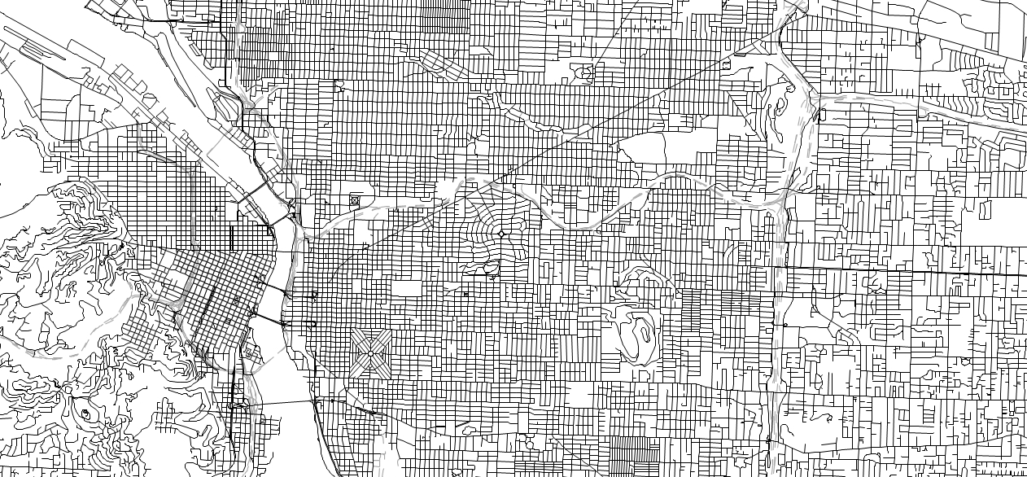
Essentials

Slide 7
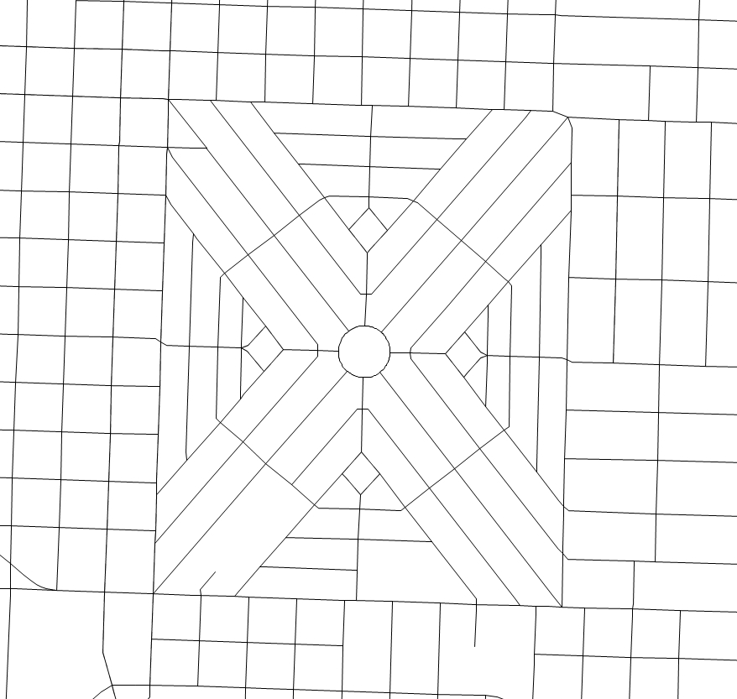
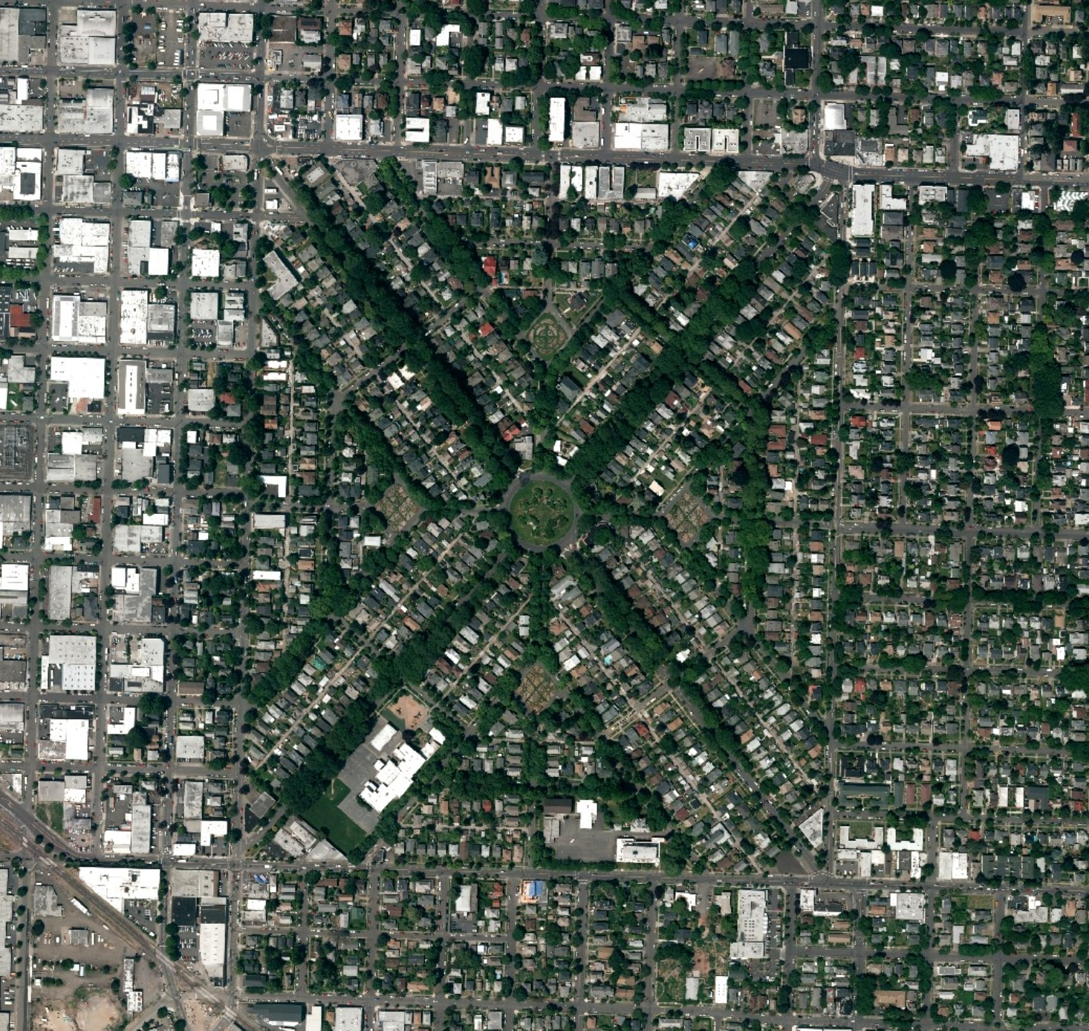
Essentials

Slide 8
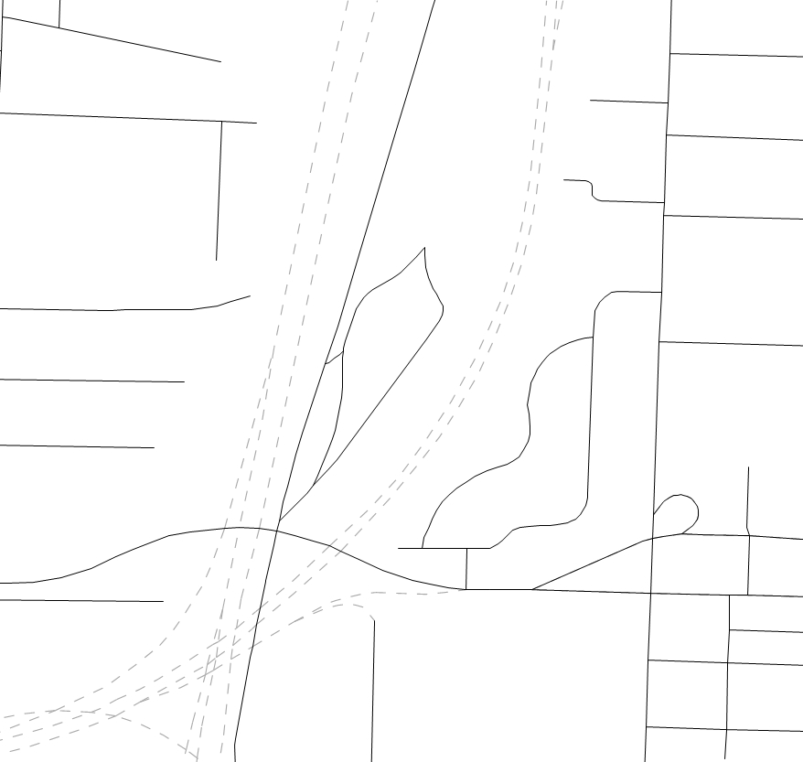
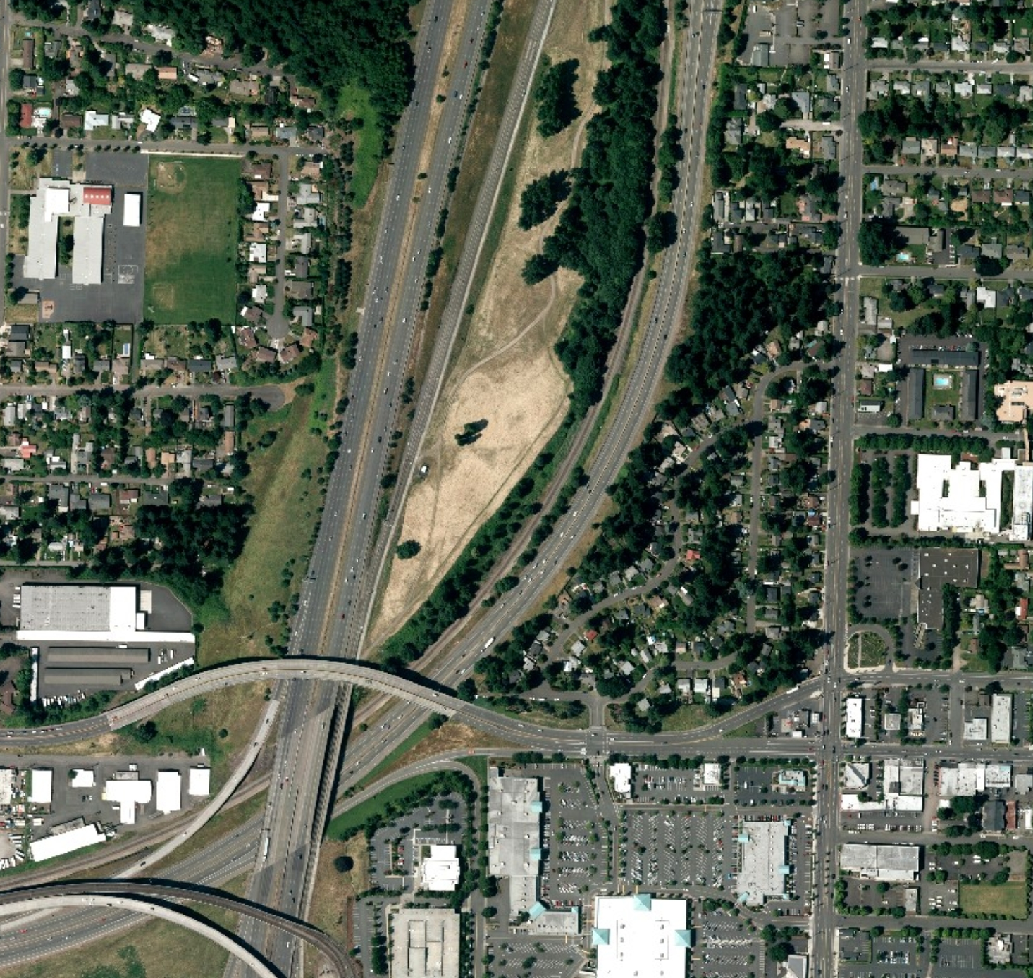
Essentials

Slide 9
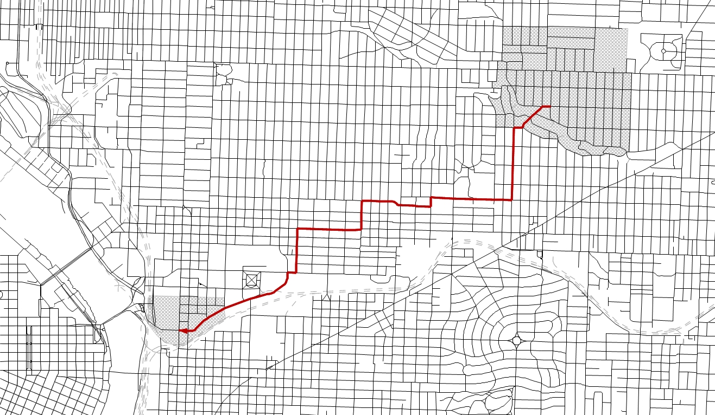
Application Steps
Most attractive zone-to-zone paths determined

Slide 10
Application Steps
Route experience measure calculated for chosen paths
Links
-1.81 * Bridge w/no Bike Facility +
-1.30 * Bridge w/no Separated Bike Facility +
-1.03 * Proportion on Bike Blvd +
-1.57 * Proportion on Bike Path +
-2.85 * Proportion with 2-4 % upslope +
-7.11 * Proportion with 4-6 % upslope +
-13.0 * Proportion with 6plus % upslope +
[-2.82(C) | -1.05(NC)] * Proportion on AADT 10 - 20,000 +
[-7.88(C) | -4.51(NC)] * Proportion on AADT 20 - 30,000 +
[-18.89(C) | -10.3(NC)] * Proportion on AADT 30,000plus +
[-8.98(C) | -5.22(NC)] * Ln(Distance + 1)
Turns
-.782 * Left Unsignalized AADT 10 - 20,000 per mile +
-1.87 * Left Unsignalized 20,000plus per mile +
-.186 * Left or Through at Signal per mile +
-.0483 * Stop Signs per mile +
-.371 * Left or Right Turns per mile +
-.338 * Right Unsignalized Cross AADT 10,000plus per mile +
-.363 * Left or Through Unsignalized AADT 5-10,000 per mile +
-.516 * Left or Through Unsignalized AADT 10-20,000 per mile +
-2.51 * Left or Through Unsignalized AADT 20,000plus per mile

Slide 11
Application Steps
Route experience measure passed into demand model
Households
size, income, age of head
Number of Workers
Trip Generation
# person trips produced by TAZ
Employment
9 industry sectors
Multimodal Accessibility
Destination Choice
productions linked to attractions
Auto Utilities (3)
time
operating cost
parking cost
household attributes
urban form
Transit Utilities (2)
time
fare
# transfers
household attributes
urban form
Walk Utility
distance
household attributes
urban form
Bike Utility
route experience
household attributes
urban form
Mode Choice
demand apportioned to modes

Slide 12
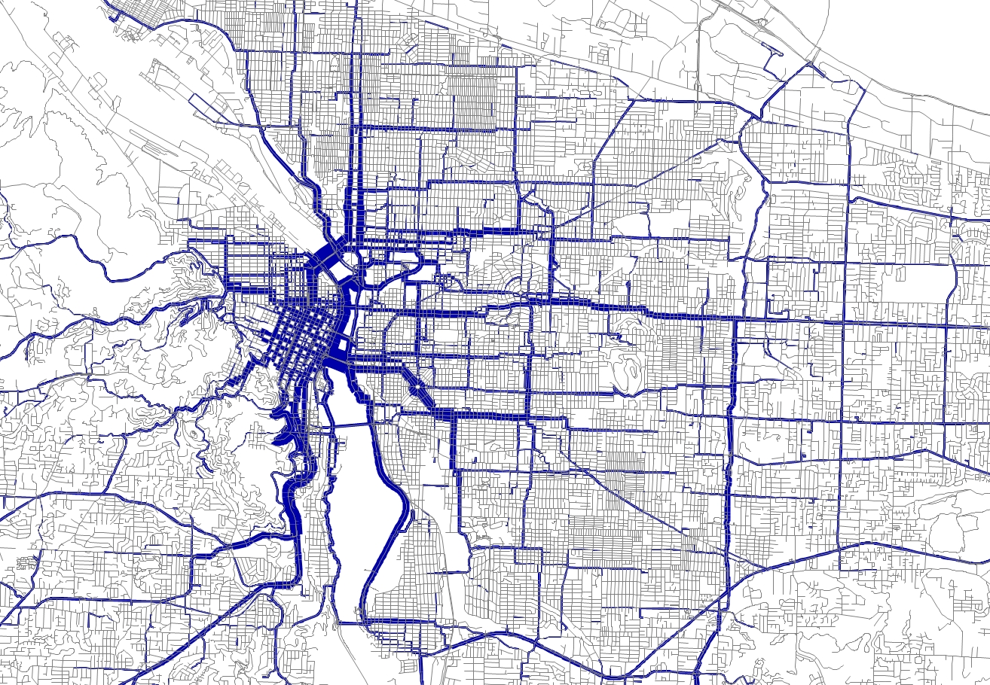
Application Steps
Assign daily demand to network

Slide 13
Validation
2010 Targets
Household Travel Survey
  bike mode share by purpose
  average bike trip length by purpose
  bike trip length frequency distribution
  Census (ACS): City of Portland journey to work bike mode share
City of Portland Willamette Bridge Counts
* notes:
(1) counts taken in July-September, model results reflect May/October conditions
(2) counts capture all cyclists, model results exclude purely recreational bike trips
Bridge | 2010 count | 2010 model | difference
Broadway | 5,291 | 4,909 | -382 | -7.2%
Steel | 3,287 | 3,149 | -138 | -4.2%
Burnside | 1,865 | 1,307 | -558 | -29.9%
Hawthorne | 7,133 | 5,060 | -2,073 | -29.1%
sum | 17,576 | 14,424 | -3,152 | -17.9%

Slide 14
Sullivan’s Gulch Trail
Metro Pilot Study
sensitivity testing only, not associated with concept planning effort
base-year (2010) evaluation
Project Overview
Parallel to I-84
Eastbank Esplanade to I-205 multi-use path, 5.5 miles
18 neighborhood access points
Pilot Results
600 daily trips shifted from other modes to bike
4,000 daily riders at peak load point

Slide 15
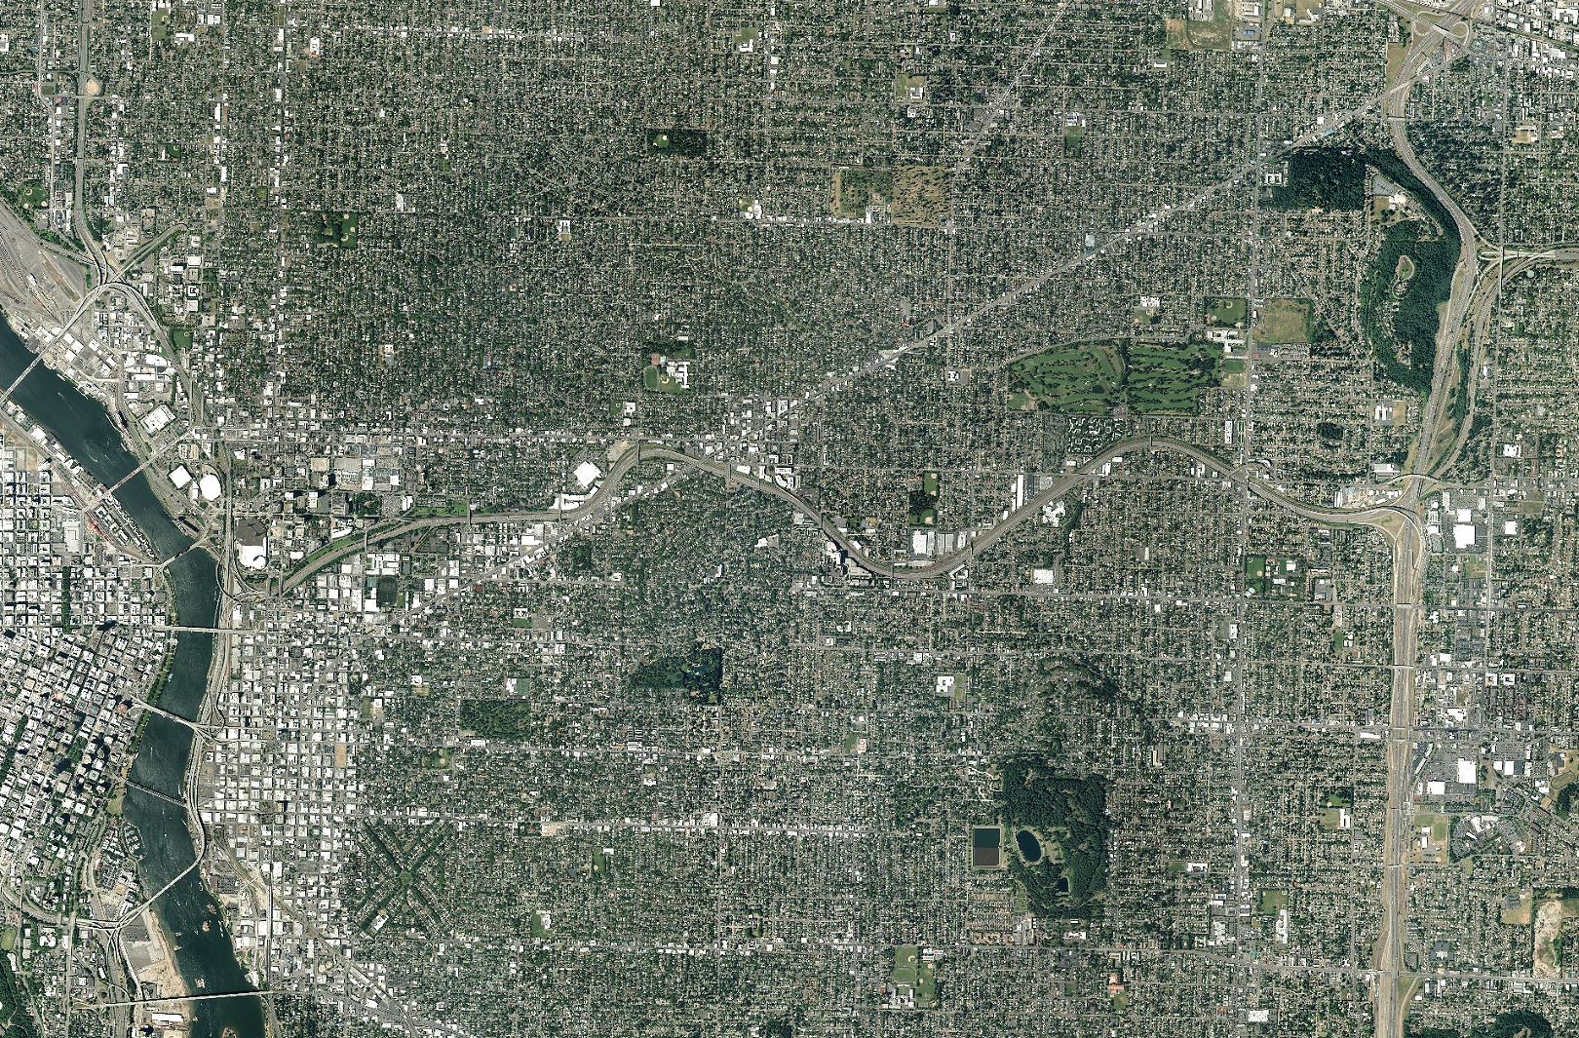
Sullivan’s Gulch Trail

Slide 16
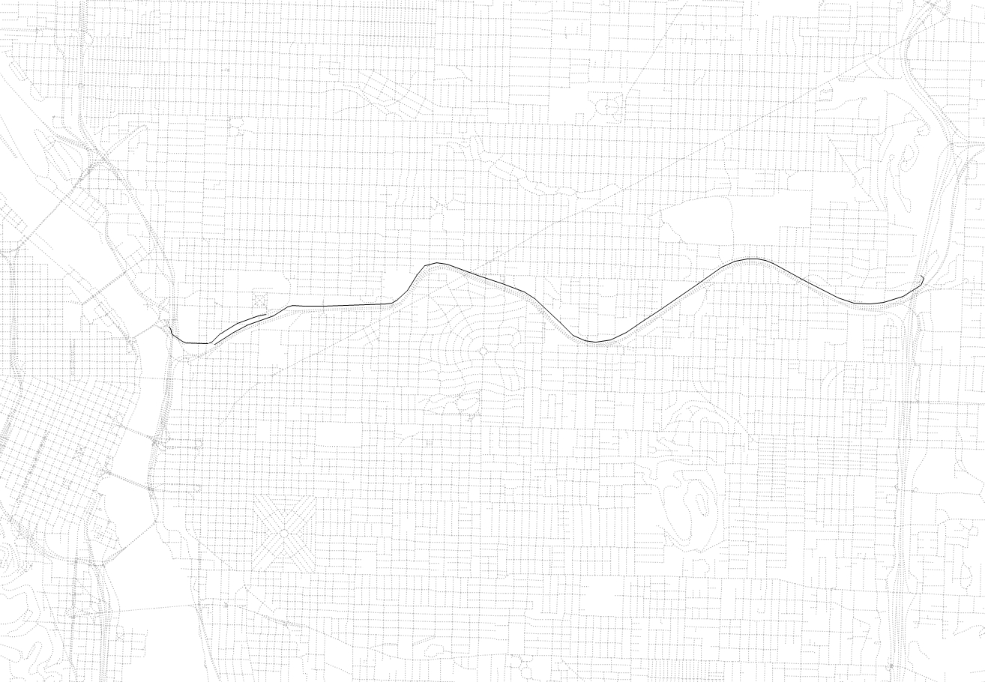
Sullivan’s Gulch Trail

Slide 17
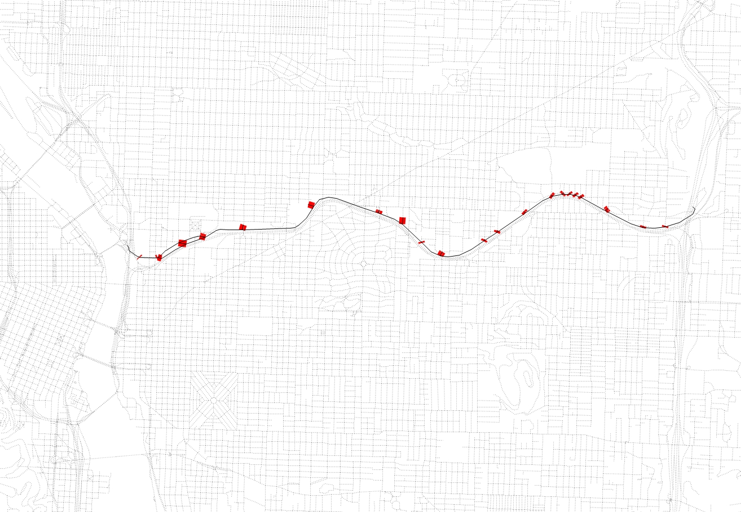
Sullivan’s Gulch Trail

Slide 18
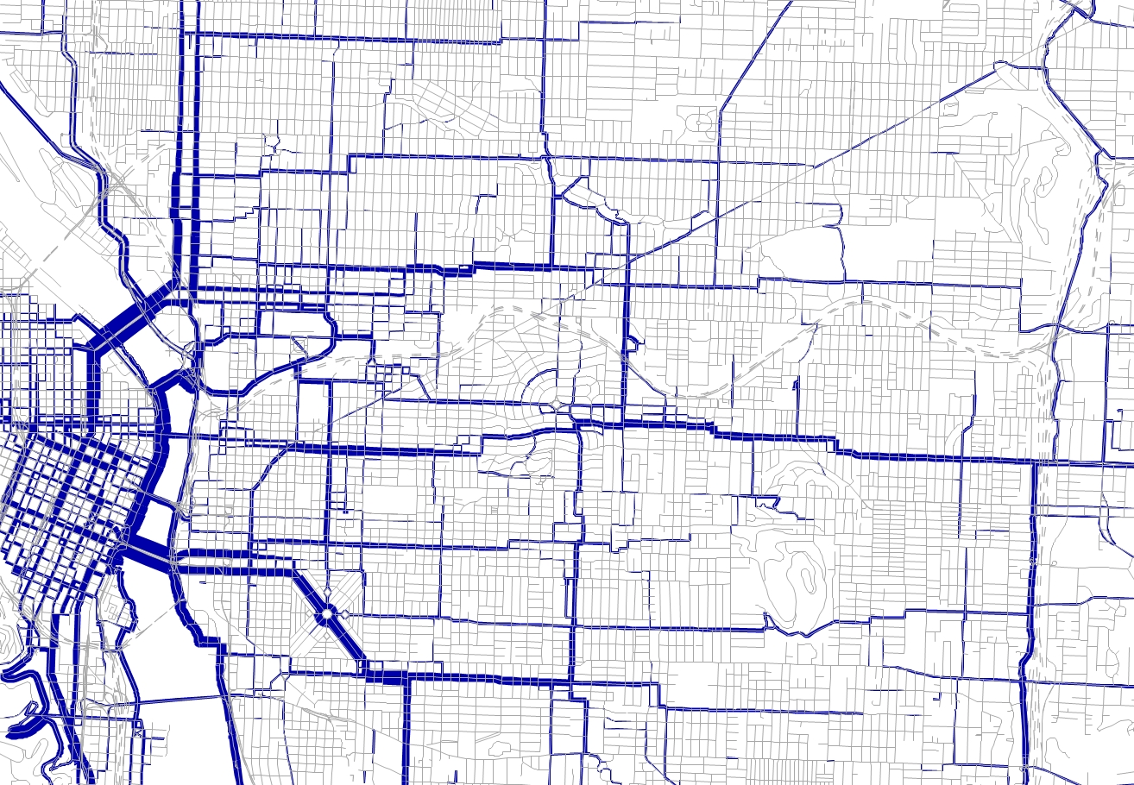
Sullivan’s Gulch Trail
2010 Base Scenario Volumes

Slide 19
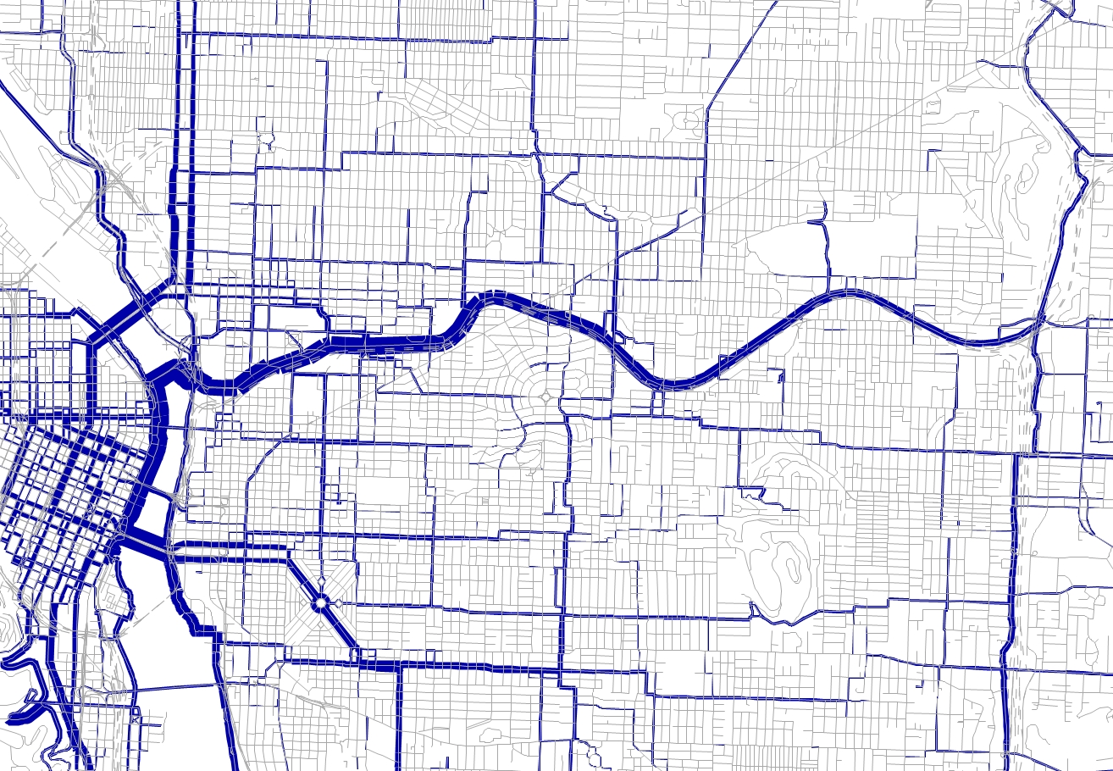
Sullivan’s Gulch Trail
2010 Build Scenario Volumes

Slide 20
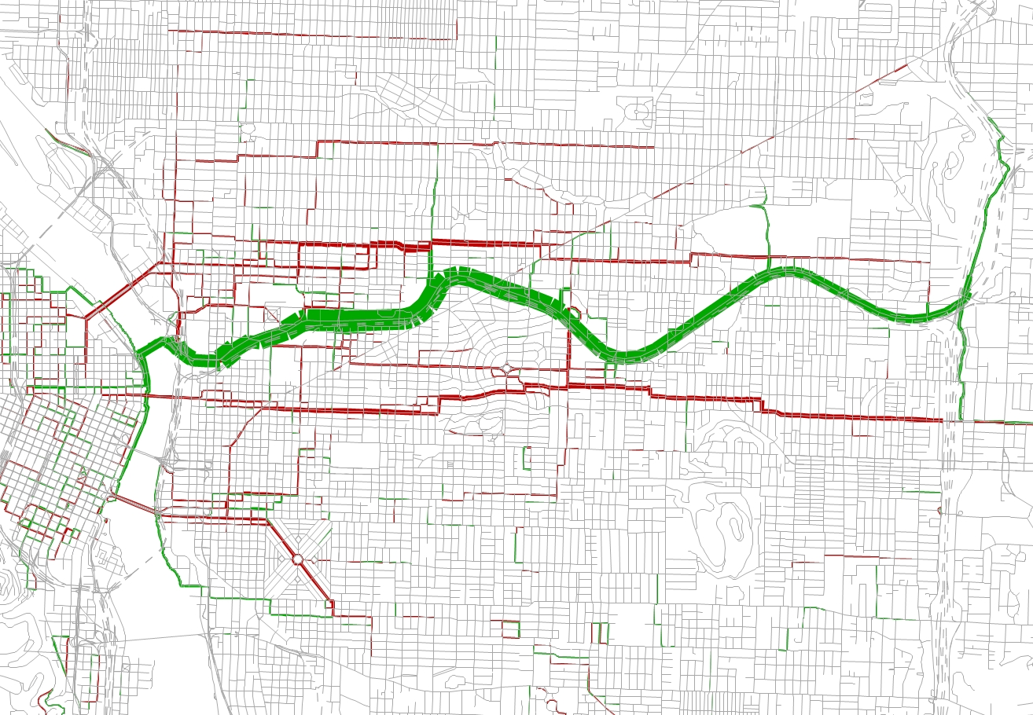
Sullivan’s Gulch Trail
Volume Difference from 2010 Base

Slide 21
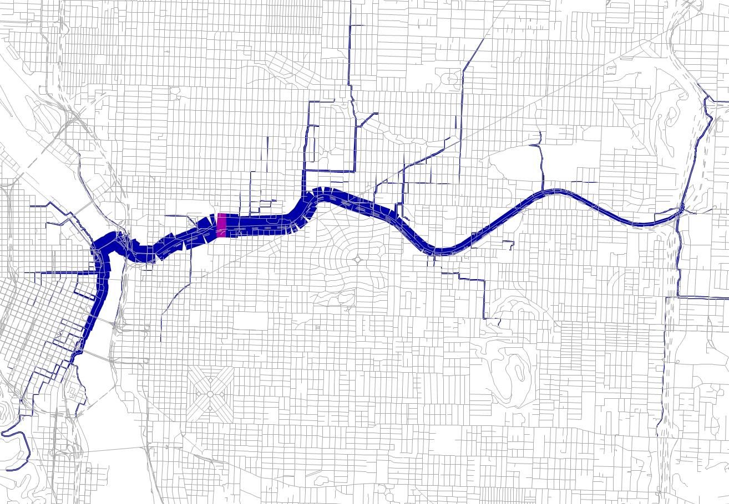
Sullivan’s Gulch Trail
Select Link at Peak Load Point

Slide 22
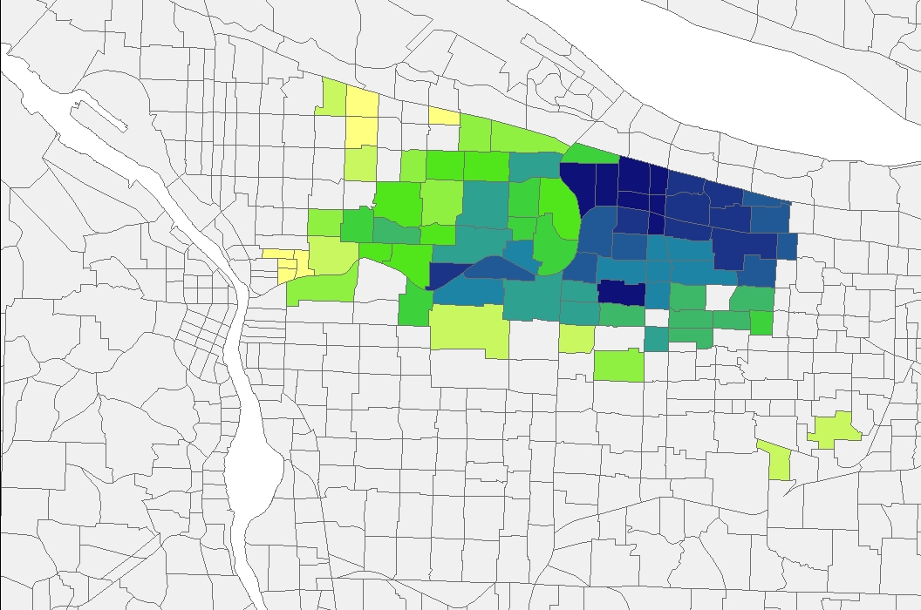
Sullivan’s Gulch Trail
Route Experience Benefit - to CBD

Slide 23
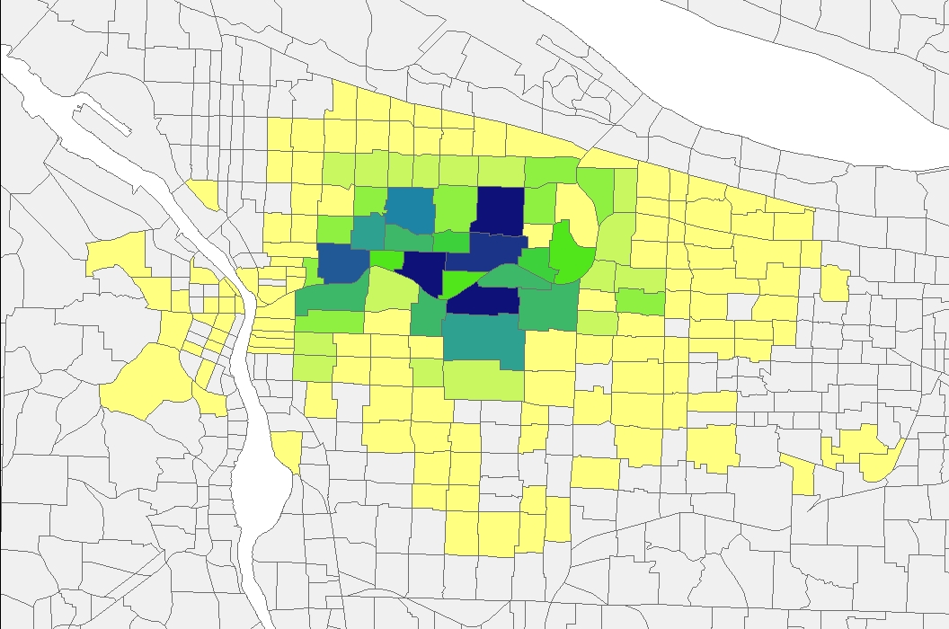
Sullivan’s Gulch Trail
New Riders - productions

Slide 24
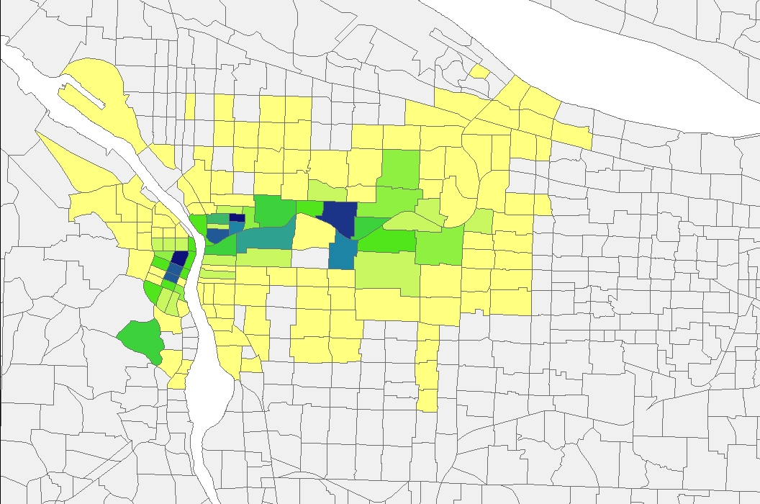
Sullivan’s Gulch Trail
New Riders - attractions

Slide 25
Foster Road Study
Foster Streetscape Plan
current City of Portland effort
bicycle travel one of multiple elements
Project Context
SE Foster Road
52nd to 92nd Ave, 2.2 miles
4 lanes, no bike facility
Modeling Assumptions
4 → 3 lanes
add bike lanes
base (2010) and future-year (2035) evaluation

Slide 26
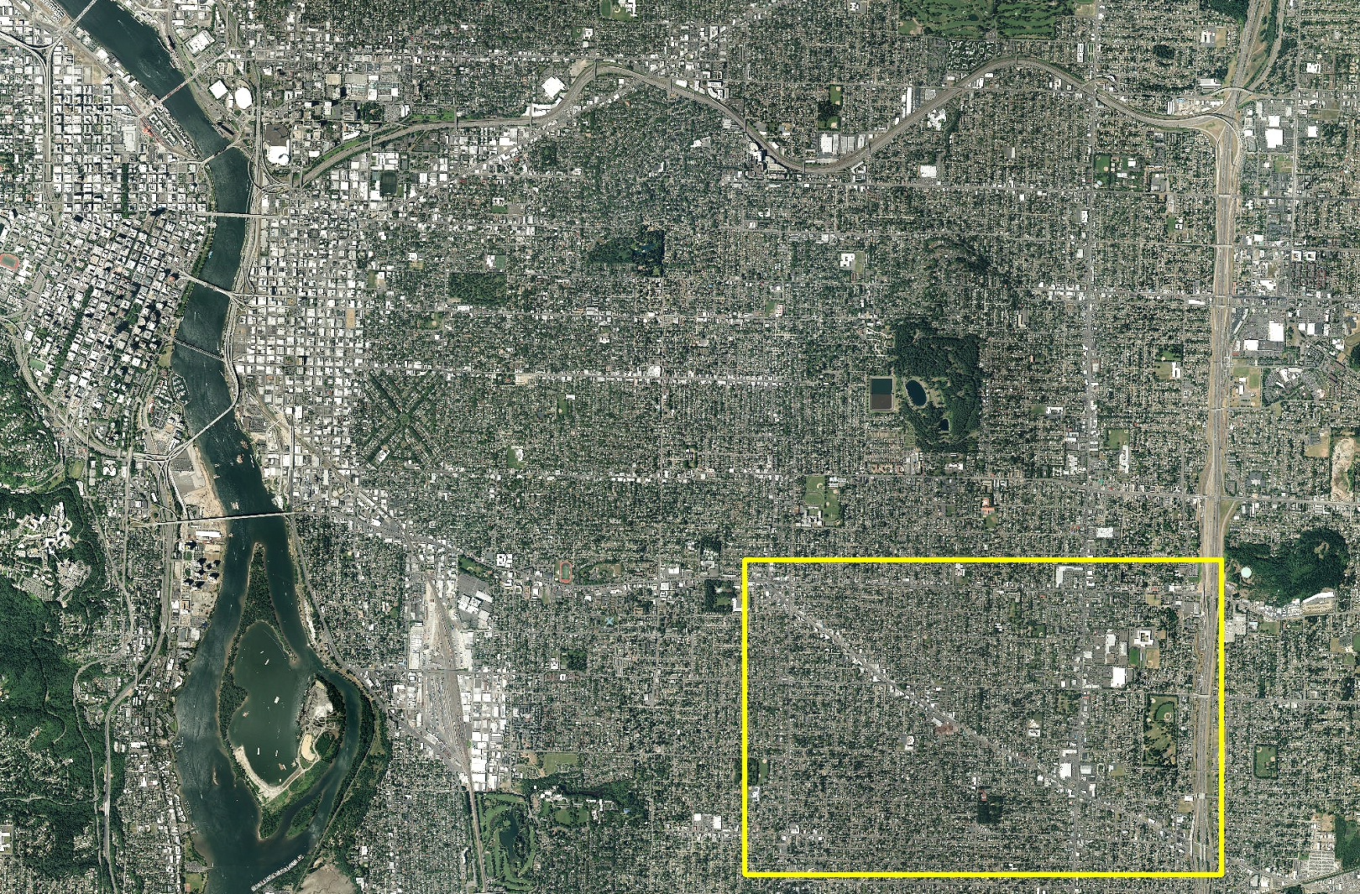
Foster Road Study

Slide 27
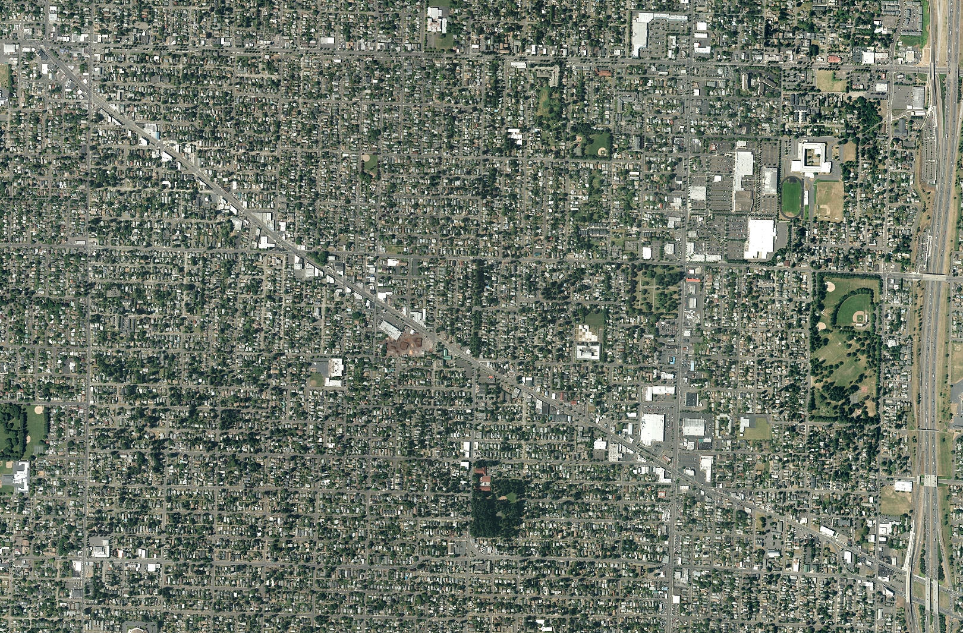
Foster Road Study

Slide 28
Foster Road Study
BMT
modest overall increase in study area
shift from other facilities to Foster
DAILY BIKE MILES TRAVELED
 |  | 2010 | 2035
Study Area | base | 10,786 | 16,391
 | build | 11,052 | 16,782
 | delta | 266 | 391
 |  | 2.5% | 2.4%
Foster Road | base | 592 | 704
 | build | 1,388 | 2,023
 | delta | 796 | 1,319
 |  | 134.4% | 187.4%
Other Facilities | base | 10,194 | 15,687
 | build | 9,664 | 14,758
 | delta | -530 | -928
 |  | -5.2% | -5.9%

Slide 29
Foster Road Study
Facility Use
59% increase in users
17% increase in average trip length
DAILY FOSTER ROAD CYCLISTS
 |  | 2010 | 2035
Project Extent | base | 1,193 | 1,879
 | build | 1,888 | 2,986
 | delta | 695 | 1,107
 |  | 58.3% | 58.9%
FOSTER ROAD AVERAGE BIKE TRIP LENGTH
 |  | 2010 | 2035
All Purposes | base | 3.30 | 3.30
 | build | 3.90 | 3.85
 | delta | 0.59 | 0.55
 |  | 17.9% | 16.5%

Slide 30
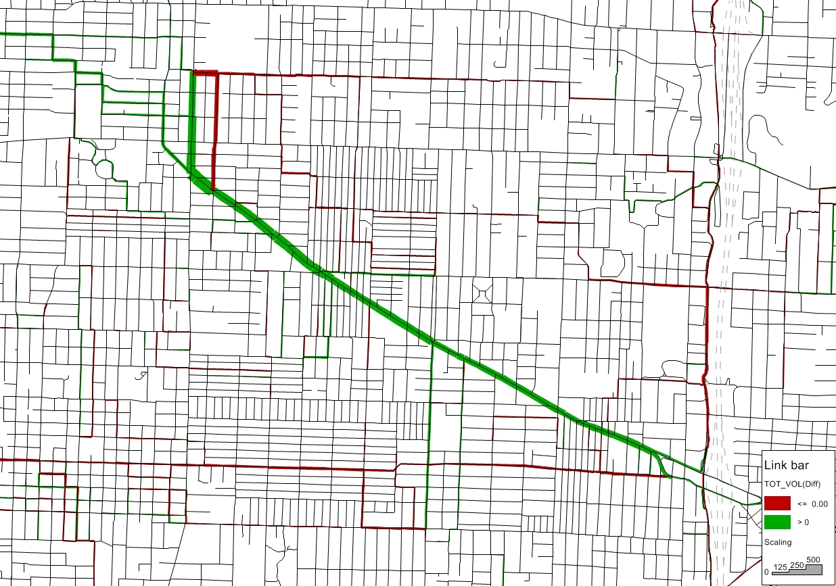
Foster Road Study
2010 Volume Differences

Slide 31
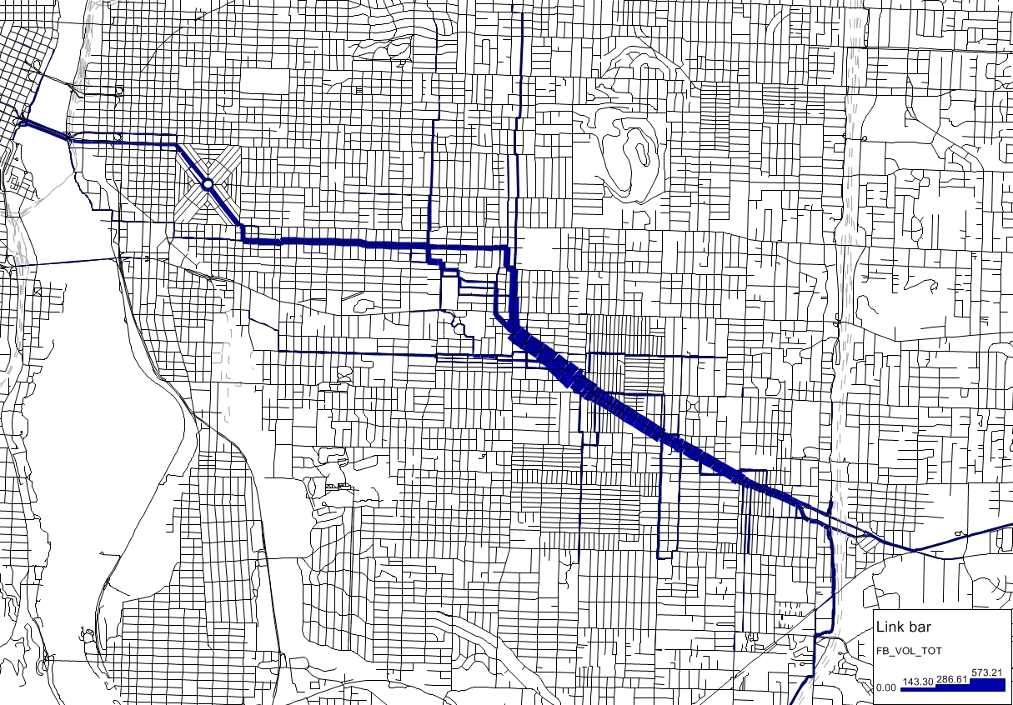
Foster Road Study
2010 Select Link for Entire Project

Slide 32
Considerations
Rethinking performance metrics, MOEs
shift in focus
safety, user experience, …
Data challenges
counts
research
Going forward…
revisit route choice variable set
explore alternative routing framework
agent-based application

Slide 33
Metro – Transportation Research & Modeling Services
Aaron Breakstone
aaron.breakstone@oregonmetro.gov
503-797-1823
Bud Reiff
Dick Walker

