Slide 1
Hell’s Kitchen
Neighborhood Transportation Study
Goal: Improve mobility, safety and quality of life for all street users
Pedestrians
Cyclists
Transit Users
Deliveries
Motorists
Commissioner Janette Sadik-Khan New York City Department of Transportation
TRB Presentation May 6, 2013

Slide 2
Study Area
NEW
JERSEY
MANHATTAN
Hudson R
LINCOLN
TUN
QUEENS
East R
BKLYN
2

Slide 3
Study Area
0.8 square miles
142 signalized intersections
Trip generators within study area:
Port Authority Bus terminal
Javits Convention Center
Manhattan Cruise Terminal
USS Intrepid Museum
Theater Row
Restaurant Row
Hudson River Greenway Bike Path
Caemmerer Rail Yards
Quill Bus Depot
US Postal Service Complex
Distribution Centers for 3 major parcel delivery companies
37,000 residents
96,000 workers
3

Slide 4
Study Area
Adjacent to the study area to the east:
Theater District
Times Square
Garment District
Penn Station
Madison Square Garden
To the north:
Lincoln Center
Upper West Side neighborhood
To the south:
Chelsea neighborhood
4

Slide 5
Study Area
5

Slide 6
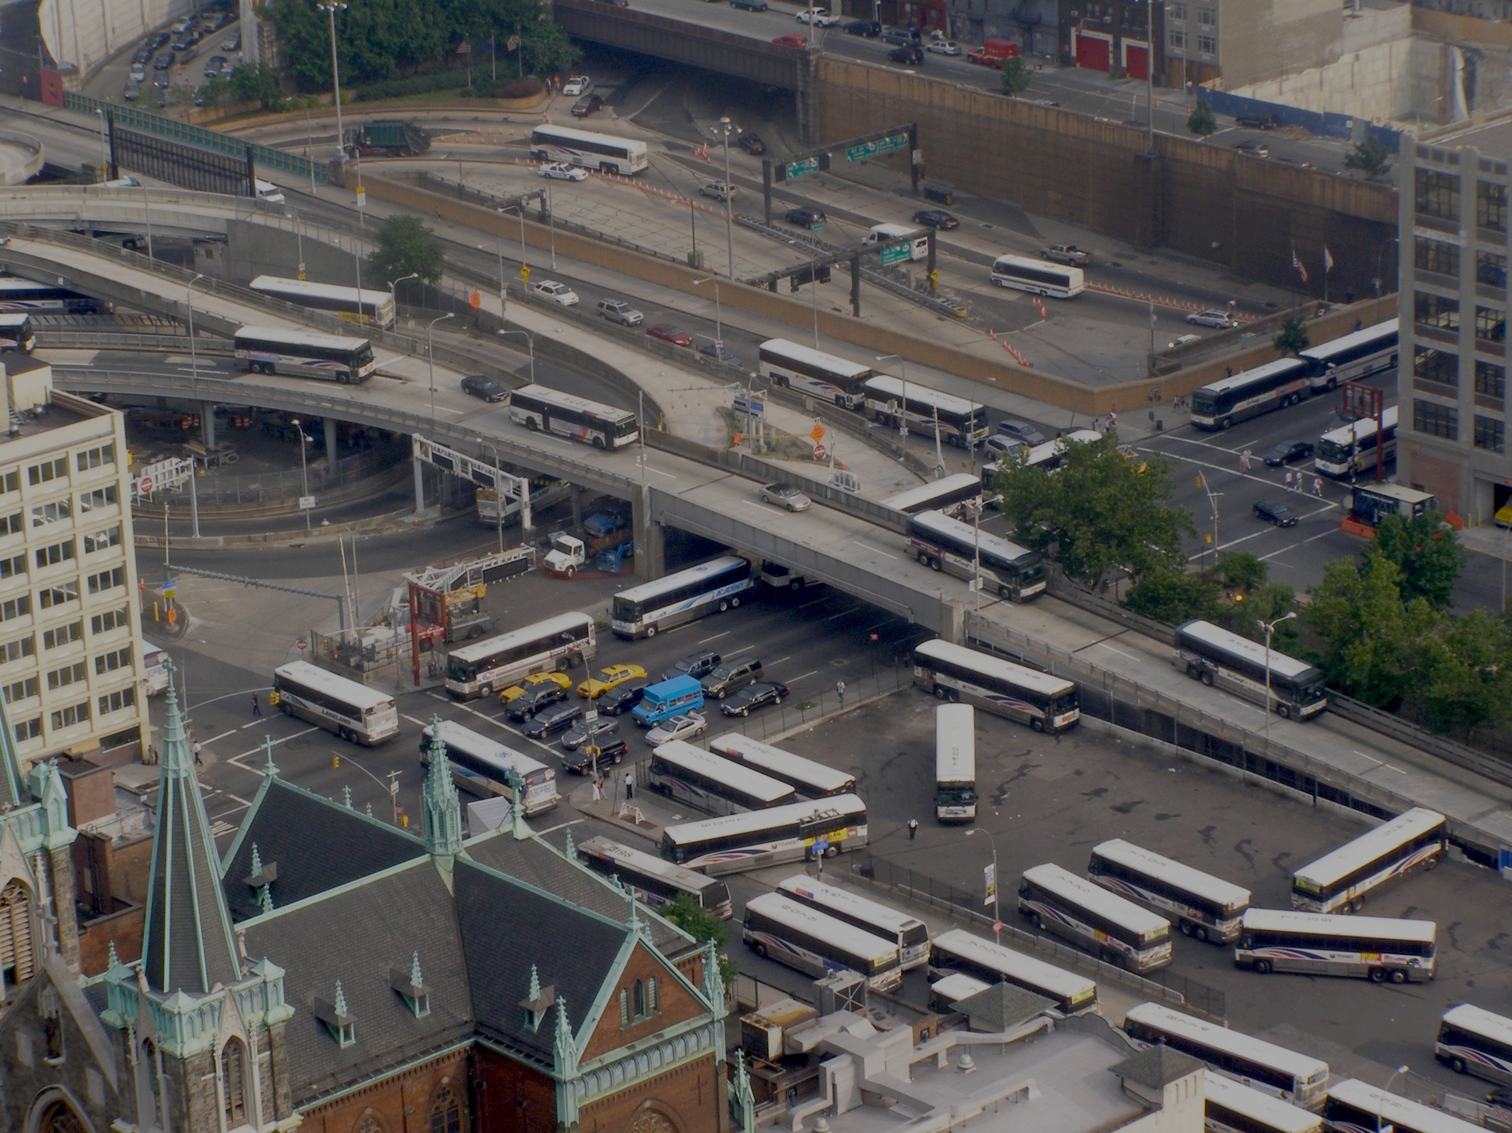
Effects of Lincoln Tunnel
Biggest cause of congestion in the neighborhood
6 lanes of traffic in 3 tubes
Reversible middle tube
AM peak: 4 lanes inbound, 2 lanes outbound
PM peak: 2 lanes inbound, 4 lanes outbound
AOT: 3 lanes inbound, 3 lanes outbound
120,000 vpd ADT
Traffic worst during PM peak
Outbound capacity is 5200 vph
Excess demand at least another 2000 vph
6

Slide 7
Neighborhood Concerns
7

Slide 8
Neighborhood Vision
8

Slide 9
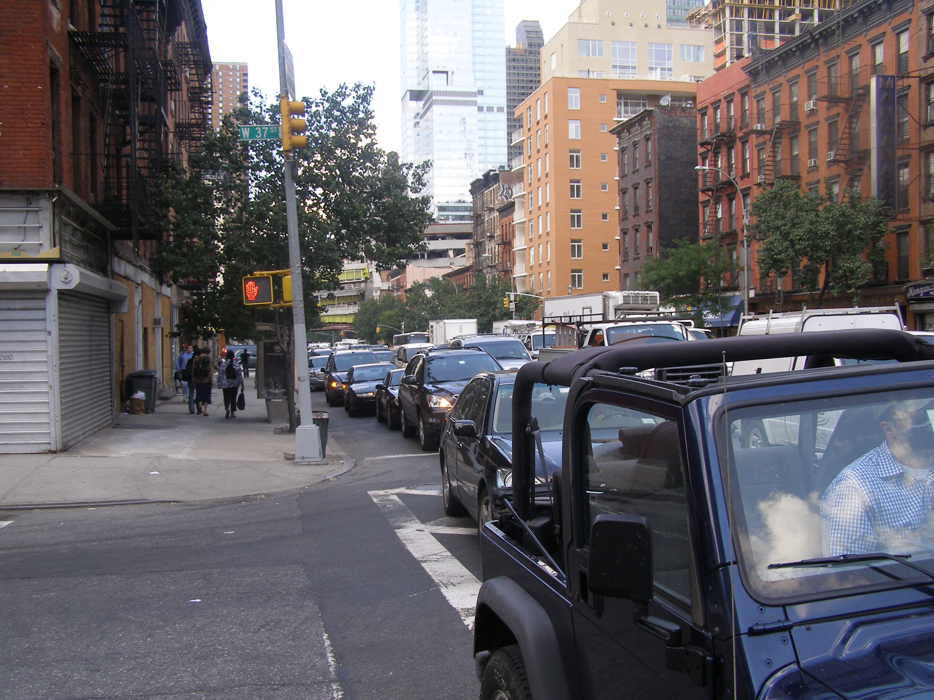
Reality of Traffic Congestion
Goal: Improve mobility, safety and quality of life for all street users
Pedestrians
Cyclists
Transit Users
Deliveries
Motorists
9

Slide 10
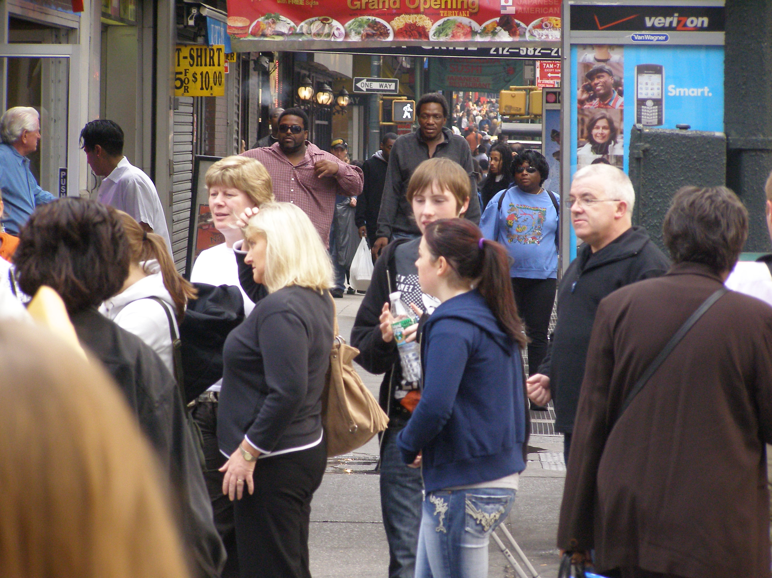
Data Collection
Traffic and pedestrian data
Used data from 7 different EIS’s
Supplemental Turning Movement Counts
Supplemental ATRs
MioVision Counts in some locations
Speed Data
From EIS’s
Supplemented with Taxi GPS
10

Slide 11
Modeled Using SimTraffic
Network must extend to bottleneck of Lincoln Tunnel
To account for downstream congestion, must use demand volume, not processed volume
Limitations of model
Max allowable crosswalk volume 1700 ped/hr
Aggressive driving
Merging
Finding Gaps
Getting into proper lane at the last second
Turning onto a congested link
11

Slide 12
Baseline Condition Average Travel Speeds
12

Slide 13
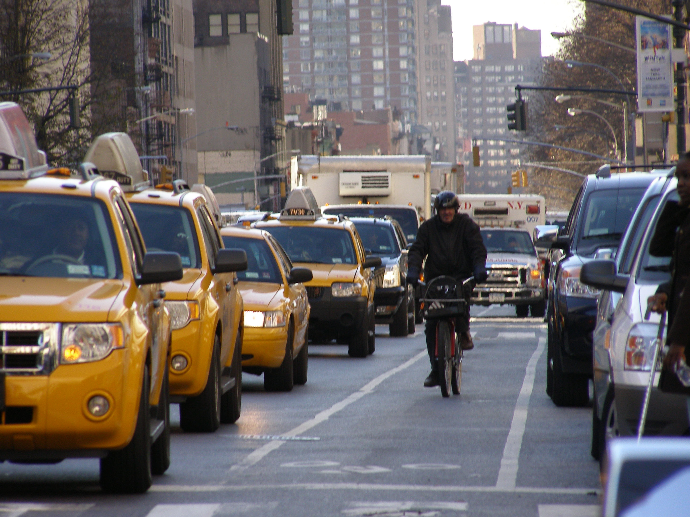
4 Improvements
Signal Timing adjustments to protect pedestrians
Bike Lanes on 8th & 9th Avenues
36th & 9th Canoe Project
Turn ban at 37th & 9th
Show Incremental Effect and Cumulative Effect
13

Slide 14
Improvement 1:Signal Timing to Protect Pedestrians
NO IMPROVEMENT
LPI
SPLIT PHASE
Conflict between pedestrians and turning vehicles
Pedestrians get a 7 sec head start before conflict with turning vehicles
Less crossing time but conflict free
Less time for turning vehicles
Need to remove parking
High rate of non-compliance (peds and vehicles)

Slide 15
Effect of 2012 Signal Timing Improvements
15

Slide 16
Improvement 2: Bike Lanes on 8th & 9th Avenues
Parking protected bike lane on left side, with floating parking lanes
Left turn bays every other block
Retains same number of travel lanes, but narrower from 12’ to 10’ or 11’
Concrete pedestrian islands effectively reduces crossing distance
Removal of 76 parking spaces each on 8th & 9th Avenues
Outreach effort to merchants assures sufficient loading zones provided
16

Slide 17
Effect of Bike Lanes on Traffic
17

Slide 18
Discontinuous Sidewalk on 9th Ave
9 Av
To Lincoln Tunnel
W 36 St
18

Slide 19
Discontinuous Sidewalk on 9th Ave
19

Slide 20
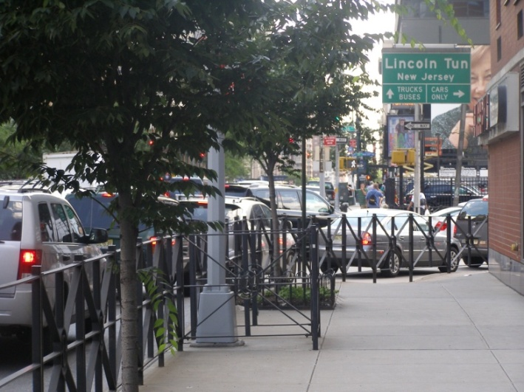
Discontinuous Sidewalk on 9th Ave
20

Slide 21
Imp 3:“Canoe” Design with New Signalized Crosswalk
EXISTING
PROPOSED
21

Slide 22
Effect of “Canoe”
22

Slide 23
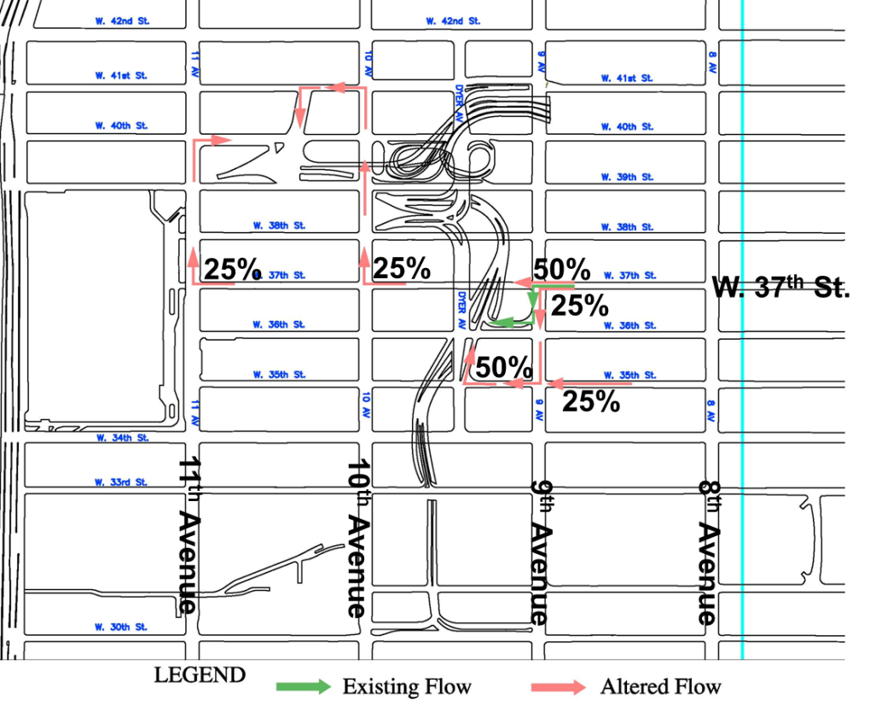
Improvement 4: Turn Ban from W 37th St to Ramp
Diverted Flow
23

Slide 24
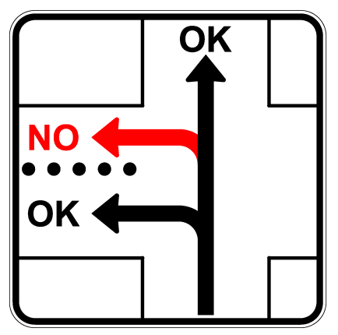
Sign for Turn Ban at WB Approach 37th & 9th
Diverted Flow
24

Slide 25
Effect of Turn Ban at 37th & 9th
25

Slide 26
Thank
You
Questions?
Gregory Haas ghaas@dot.nyc.gov (212) 839-7759

