Slide 1
Accessibility Approach to Estimating Bicycle and Pedestrian Demand
NCHRP 08-78
Renaissance Planning Group
Rich Kuzmyak
Chris Sinclair
Alex Bell
TRB National Transportation Planning
Applications Conference
May 6, 2013
Columbus, Ohio

Slide 2
Outline
Research context
Basics of the accessibility approach
Summary of research findings
Application
Next steps

Slide 3
Research Context
NCHRP 8-78: Estimating Bicycle and Pedestrian Demand
Create new methods – sensitive to land use and facilities
Product: Practitioner Guidebook of scalable techniques
  Tour-based models (Seattle – Bradley & Bowman)
  Enhanced 4-step (Seattle – Kockelman & Kahn)
  Accessibility approach (Arlington VA)

Slide 4
Basics of the Accessibility Approach
Travel behavior is responsive to “accessibility”
Mode choice can be linked to:
  Amount of activity reachable from an origin over corresponding modal network
  Account for impedance unique to mode (directness, slope, facility type, etc.)

Slide 5
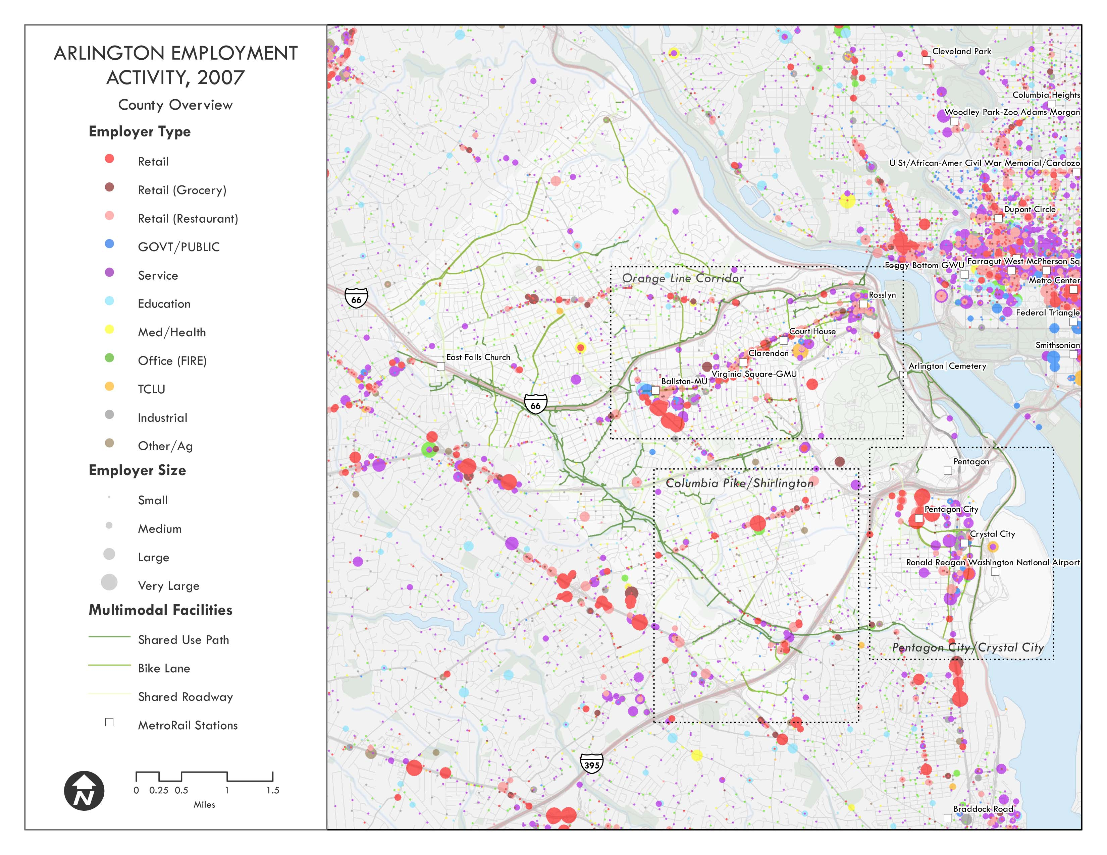
Study Area: Arlington County, VA – Activity and Networks

Slide 6
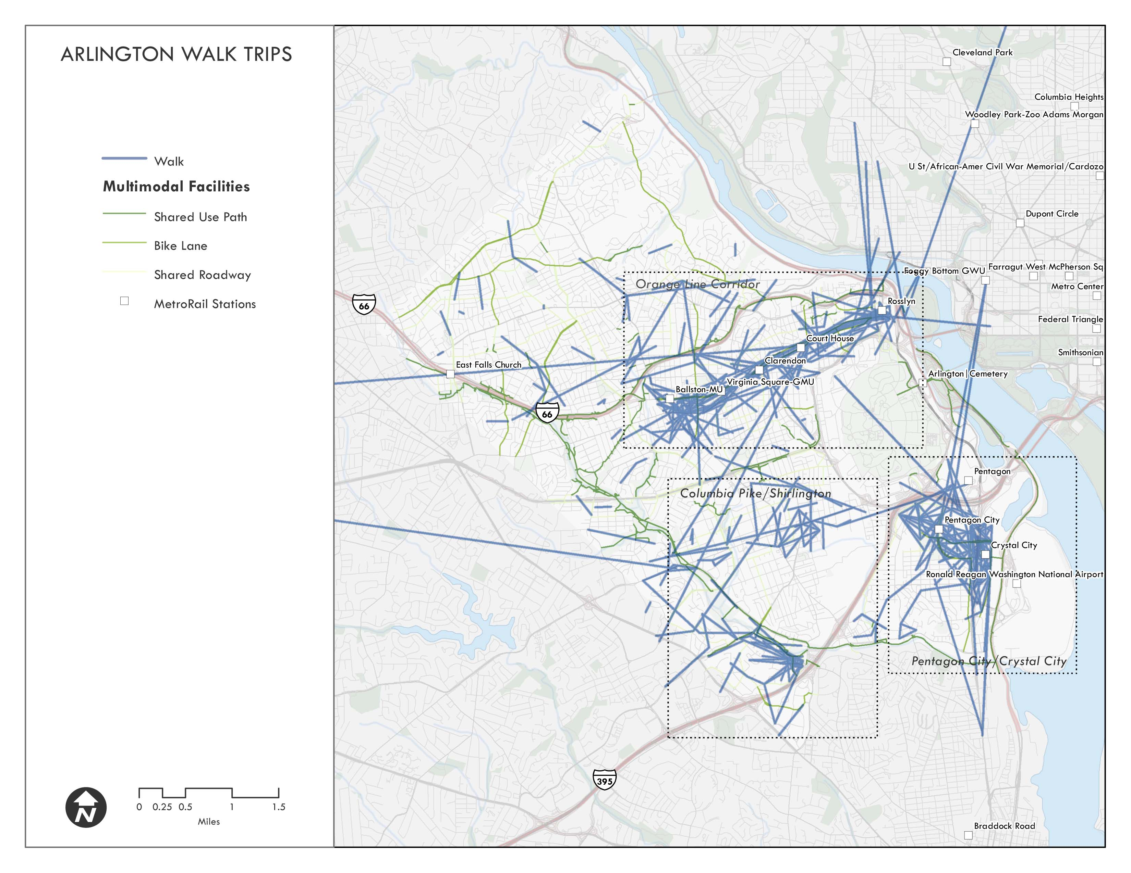
Study Area: Arlington County, VA – Survey Data

Slide 7
Basics of the Accessibility Approach
Use detailed travel networks to model travel times from a given origin to all accessible destinations (by mode):
  Walk
  Bike
  Transit
  Auto
NAVTEQ streets, GTFS transit schedules, bicycle facilities and trails

Slide 8
Comparative Accessiblities

Slide 9
Comparative Accessiblities

Slide 10
Summary of Research Findings
Non-motorized trip making is associated with high accessibility scores, regardless of mode
Modal competiveness (in terms of accessibility) influences mode choice
  More transit trips are made to destinations that have high walk and transit accessibility scores
  Discretionary walk trips are highly sensitive to walk accessibility at the trip origin
  Walk to work a unique/limited opportunity

Slide 11
Summary of Research Findings
Number of Establishments Accessible from Origin
Chosen Mode | Auto | Transit | Walk | Bike
Transit | 1367 | 129 | 109 | 1162
Drive Alone | 1195 | 69 | 60 | 868
Auto Pax | 1177 | 66 | 57 | 840
Walk | 1345 | 124 | 98 | 998
Bicycle | 1506 | 120 | 91 | 1191
Number of Employees Accessible from Origin
Chosen Mode | Auto | Transit | Walk | Bike
Transit | 18110 | 1650 | 1457 | 13986
Drive Alone | 15092 | 984 | 797 | 10783
Auto Pax | 13658 | 840 | 673 | 9254
Walk | 23583 | 2962 | 2329 | 15778
Bicycle | 19516 | 1470 | 1237 | 14845

Slide 12
Summary of Research Findings
Walk accessibility alone influences mode choice

Slide 13
Spreadsheet Application

Slide 14
Spreadsheet Application
Spreadsheet tool (beta version and template for additional tools)

Slide 15
Application
Models effects of…
  Land use changes
    Development master plans
    Disaggregated TAZ forecasts
    Future land use scenarios
  Network enhancements
    Accessibility benefits of improving street connectivity
    Non-motorized facilities

Slide 16
Application
Data and process
  Microzone residential and employment activity
    Person trip generation
  Zone to zone walk skims (microzones)
    Walk accessibility score
Output
  Microzone walk trip generation
  Matrix of walk microzone to microzone walk trip interchange

Slide 17
Next Steps
Develop native GIS tool
  Community Viz or other scenario planning platform
  Enable dynamic spatial analysis
Evaluate and operationalize relationships among modal accessibilities and socio-demographics
  High local walk access, low regional transit access vs. High local walk access, high regional transit access
  Household and individual characteristics

Slide 18
Next Steps
Incorporate into NCHRP Guidebook
Integrate with regional travel demand model
Incorporate EPA’s Smart Location Database modal accessibilities and add geoprocessing services to support rapid deployment of the tool

Slide 19
Questions
Thanks!

