Slide 1
Adapting the DRCOG Focus Model for Use in FTA New Starts Analysis

Slide 2
Overview
Focus Model Application to Colfax Ave
Initial Contact with FTA
Evaluation Process and Results
Next Steps

Slide 3
Focus Model Application to Colfax Ave

Slide 4
Focus Activity-Based Model
TransCAD for Skims & Assignment
SQL Server Databases
C# Choice Modules
DaySim DAP Model
7 Tour Purposes
Up to 8 Modes
30 Distinct Steps

Slide 5
Colfax Corridor Connections
2 Parallel Studies
AA/EA
MODEL ASSESSMENT
Urban Corridor
Transit Alternatives
ENHANCED BUS
BRT
MODERN STREETCAR
Common Elements
Parallel Routes Screened Out

Slide 6
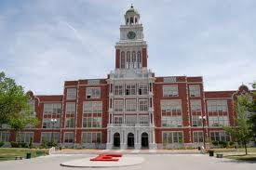
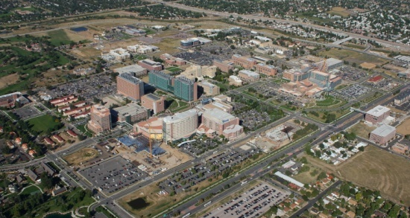
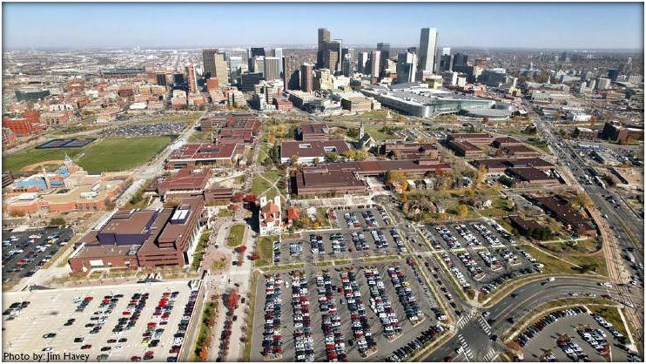
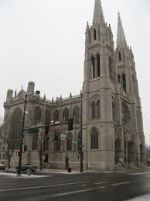
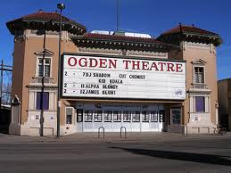
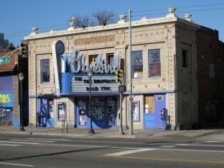
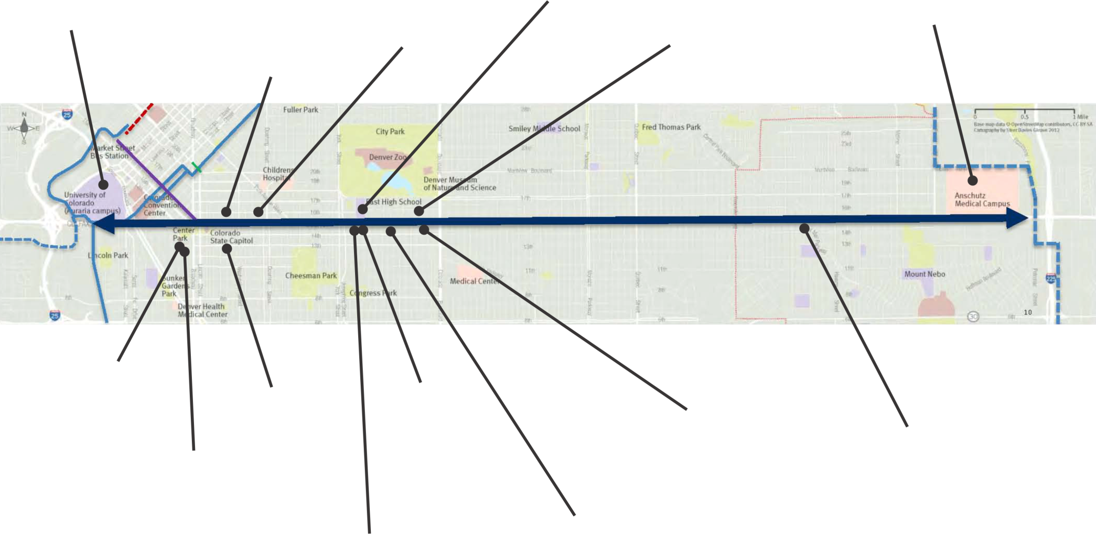
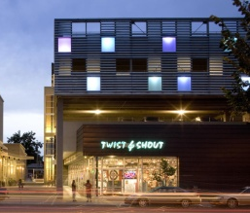
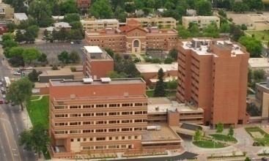
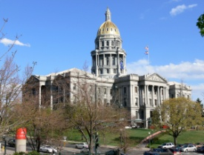
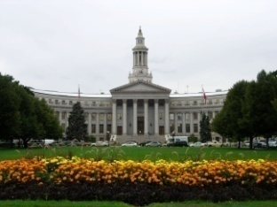
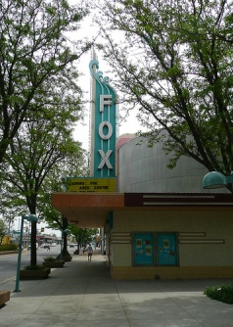
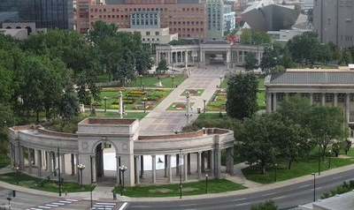
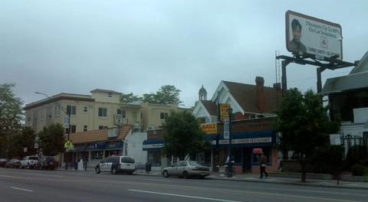
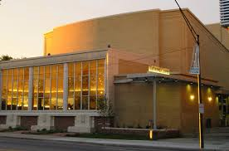
Colfax Ave
East High School/
Esplanade
Anschutz Campus
Auraria Campus
Basilica
Ogden
Theatre
Blue Bird
Theatre
State
Capitol
National Jewish
Hospital
Lowenstein
Theatre
Civic Center Park/
City & County Building
Aurora Fox
Arts Center
Greektown
Tattered Cover
Notes:
Original Aurora

Slide 7
Study Team
Funding Agency
Grantee
Grant Recipient
Planning Partner
Prime Consultant
Subconsultants
Notes:
Cover quickly

Slide 8
Initial Contact with FTA

Slide 9
Dec. 2011 FTA Meeting
Hold Tours Constant for SUMMIT
Explicit Amenity Attributes
Consistency Across the Board
PATH BUILDING
MODE CHOICE
Variable Specifications
Return to Same PnR
Research
PARK-N-RIDE CHOICE MODEL
KISS-N-RIDE MODE
Notes:
CAB issues: VOTs, time ratios
Variable specifications: wait = f(headway); xxx/IVT variables
Constrain drive-to-transit tours to return to the same PnR
P-A v O-D assignment
P-A better for understanding HBW
O-D better for comparing to counts

Slide 10
IVT Fractions
Ex. Local Bus IVT/Total IVT
Alt. A: 10 min Local Bus, 30 min Rail
Alt. B: 20 min Local Bus, 20 min Rail
All Else Equal, Denverites Prefer Alt. A
Suppose Speed Up Rail
Overall IVT Improves
Local Bus IVT/Total IVT Worsens
Which One Prevails?
Similar Issue for Drive Access Time

Slide 11
Evaluation Process and Results

Slide 12
Data Available
Traffic Counts
Transit Ridership Counts
2008 Transit On-Board Survey
2010 Front Range Travel Counts Household Survey
2012 Free Mall Ride Survey
Ongoing Transit Satisfaction Surveys
Notes:
Sampling methodologies

Slide 13
Evaluation Process
Forecast Volumes v. Counts
Travel Time Comparisons
Trip Table Comparisons
DISTRICT INTERCHANGES
TRIP LENGTH DISTRIBUTIONS
Transit Path Comparisons
Notes:
Have we made any transit path comparisons?

Slide 14
2010 Transit Volumes - EB

Slide 15
2010 Transit Volumes - WB

Slide 16
2010 Boardings by Transit Mode
MODE | OBSERVED | MODELED | PCT DIFF
MALLRIDE | 46,600 | 38,600 | -17%
DEN LOCAL | 135,600 | 150,600 | +11%
DEN LTD | 24,200 | 19,000 | -21%
EXPRESS | 7,700 | 7,300 | -6%
REGIONAL | 12,500 | 6,200 | -50%
RAIL | 64,400 | 74,100 | +15%
SKYRIDE | 5,700 | 3,900 | -30%
BOULDER | 21,100 | 20,800 | -1%
TOTAL | 317,600 | 320,600 | +1%
Notes:
Boulder local includes Longmont local

Slide 17
Transit Trip Distance
Notes:
WT trips are 2 mi too short; DT trips 9 mi too short
Not enough xfers

Slide 18
District Interchanges
Notes:
241k transit PTs in Focus mtx, 206k in On-Board survey factored from 2008 to 2010.

Slide 19
Bus Speed Comparisons
2010 AM Peak Period (mph)
RT & DIR | SCHEDULED | OBSERVED | MODELED
10 EB | 12.0 | 11.6 | 11.1
10 WB | 10.8 | 11.0 | 11.0
15 EB | 11.4 | 10.6 | 14.2
15 WB | 11.3 | 10.8 | 12.8
15 LTD EB | 14.1 | 13.4 | 19.2
15 LTD WB | 13.3 | 12.9 | 15.9
20 EB | 13.6 | 13.0 | 16.8
20 WB | 13.6 | 12.9 | 14.7
Notes:
Generally too fast, except for Rt 10, which is coded with a more meandering path because the streets it actually uses sometimes aren’t in the network.

Slide 20
Next Steps

Slide 21
Next Steps
New Mode Codes for BRT, Streetcar
Mode- and Stop-Based Dwells
Determine IVT “Discount”
Consistency Across the Board
New Link Codes for Part-Time Bus-Only Facilities
Destination Choice Adjustments
Mode Choice Adjustments
Notes:
Does this do enough?

Slide 22
Credits

Slide 23
Photo Credits
Steer Davies Gleave
Mike Torres, DRCOG

Slide 24
Questions & Answers

Slide 25
Backup Slides to Respond to Specific Questions

Slide 26
Background Overview
Compass Trip-Based Model [cut]
Focus Activity-Based Model
Timeline [cut]
Colfax Corridor Connections

Slide 27
Compass Trip-Based Model
4-Step
Trip Purposes:
HBW FOR 3 INCOME GROUPS
HBO
NHB
COMMERCIAL VEHICLE
INTERNAL EXTERNAL
Mode Choices Varied by Purpose
TransCAD GISDK Script

Slide 28
Timeline
1996-98 Travel Behavior Inventory
2001-04 Compass
2005 Selected IRM Contractor
2008 Region-Wide Transit Survey
2010 Compass 4.0
ZONAL FARES
VALUE OF TIME
2011 Focus RTP Update
2008-13 Front Range Travel Counts
Notes:
Compass 4.0
Updates to highway elements of the model:
Revised k-factors
Revised highway assignment procedures
Revised value of time parameters
Updates to transit and mode choice elements of the model:
Analysis of network parameters and transit networks using Before and After on-board surveys
Implementation of zone based fare structure
Update to mode to mode transfer penalty
Revision to drive access to transit connectors
Updates to bus dwell time at rail stations
Update to premium transit preference
Updates to mode choice model
Removal of bifurcated transit wait times
Updates to value of time coefficients
Model re-calibrated to spring 2008 on-board survey
Update to time of day split factors for transit assignment
Base year 2007 model validation

Slide 29
Amenity Attributes
Light Rail IVT Currently Has 30% Discount
Vehicle Amenities
SEAT TYPE
READING LIGHT
WI-FI
Stop Amenities
COVERED SHELTER
OFF-BOARD TICKETING
REAL-TIME INFORMATION
Notes:
Other vehicle amenities: bike/luggage rack,
Other station/stop amenities: parking security guard, bench, route information

Slide 30
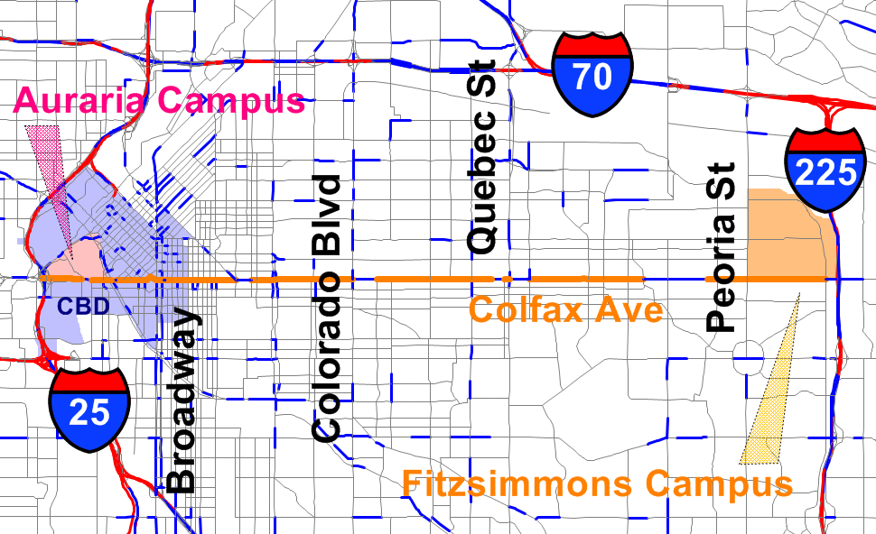
Traffic Count Locations
Notes:
cut

Slide 31
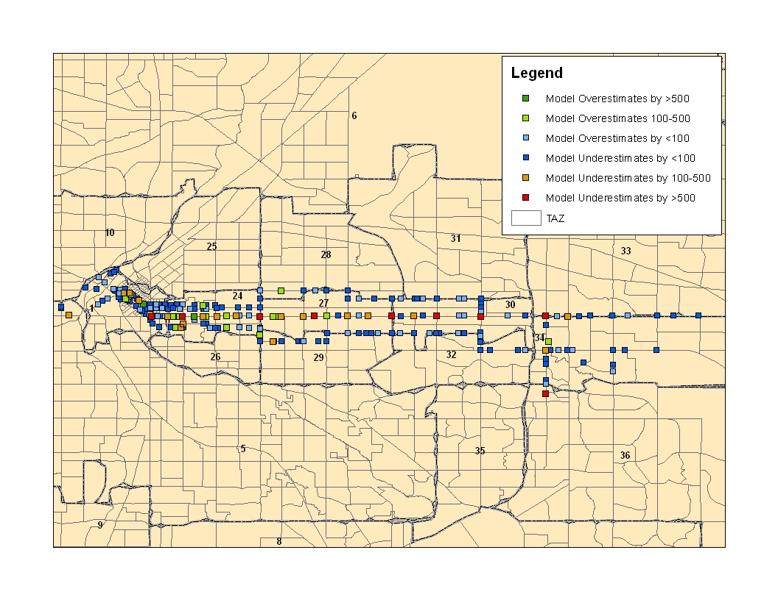
Transit Boarding Comparison
Notes:
Greens – model overestimates; Red/orange – model underestimates – tend to be major intersections not directly connected to centroids.
cut

Slide 32
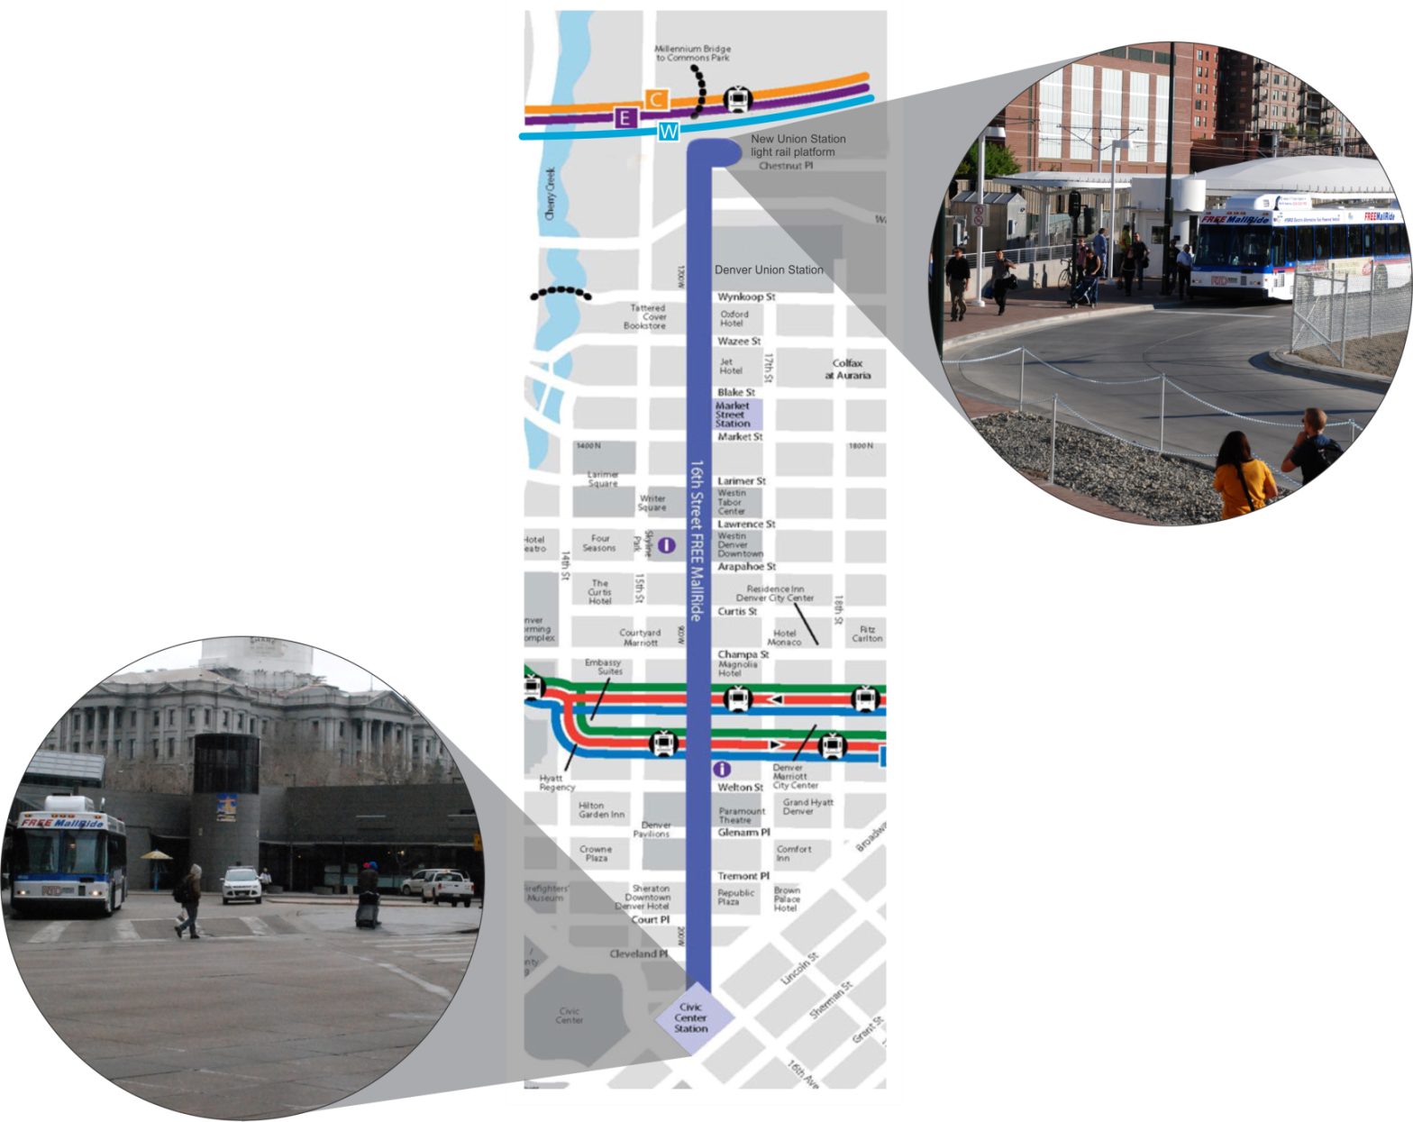
RTD Free MallRide
CIVIC CENTER STATION
DENVER UNION STATION (LRT)
Notes:
As many as 14 D, F, and H trains/h
As many as 12 C, E, and W trains/h to DUS
Signals on 90s cycles – as freq as every signal during peak
CCS and MSS have about 10 bays each
cut

Slide 33
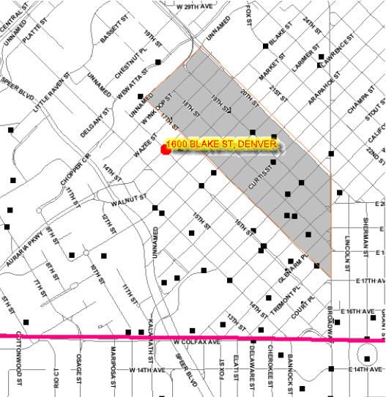
Mall Ride Survey
Notes:
cut

