Slide 1
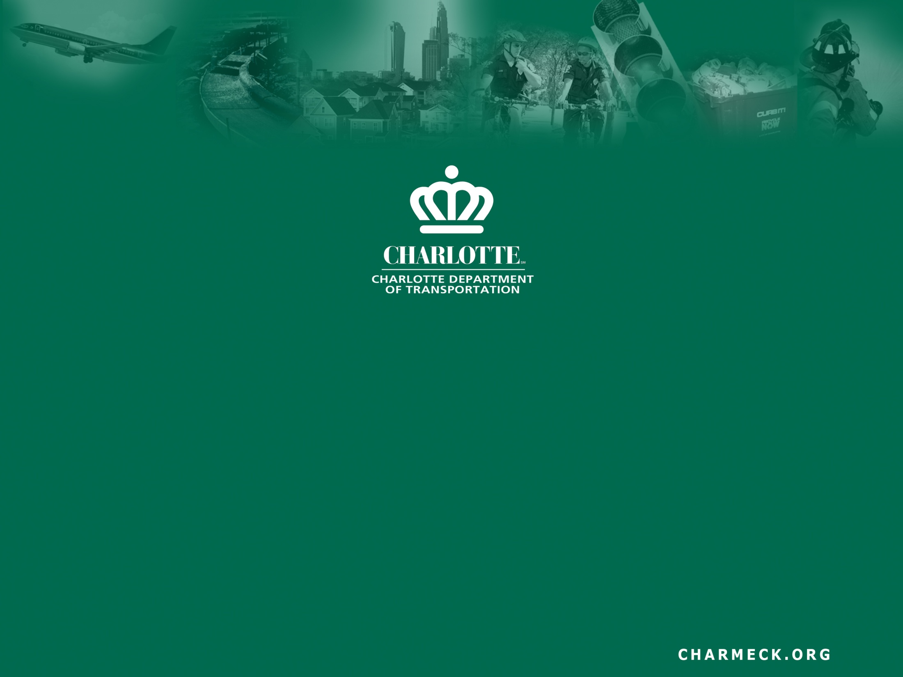
Effective Public Involvement in
Street Connectivity Capital Projects
Matt Magnasco, P.E.
Street Connectivity Program Manager
May 9, 2013

Slide 2
Co-Authors
Tom Sorrentino, P.E.
Senior Engineering Project Manager
Charlotte Dept. of Transportation (CDOT)
Dan Leaver, P.E.
Senior Engineer
Charlotte Engineering & Property Mgmt.

Slide 3
Outline
About Charlotte’s Street Connectivity Program
Successful Public Involvement Case Studies
  Lawing School Road
  Shamrock Gardens
Unsuccessful Public Involvement Case Study
  Harburn Forest Drive Extension
Lessons Learned
In the essence of time, the case studies have been abbreviated.

Slide 4
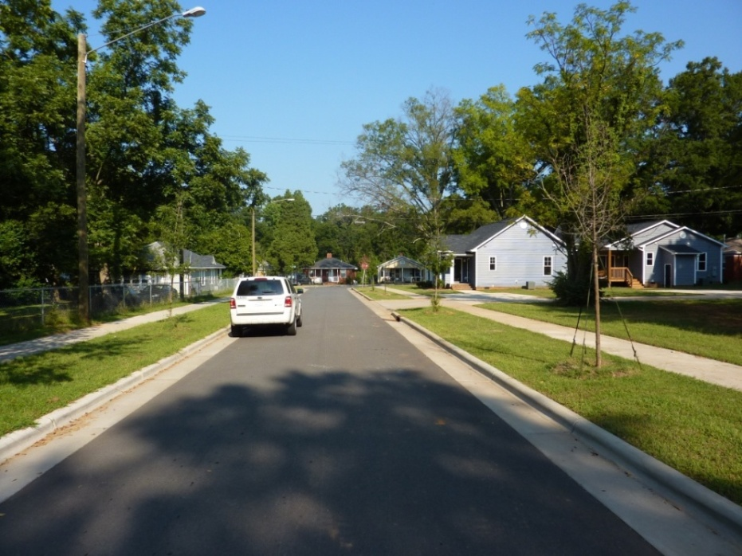
About Charlotte’s
Street Connectivity Program
A capital program started in 2007
Purpose: connect local streets
$2M per year funding (bonds)
Project implementation
  City-initiated capital projects
  Private development leverage
McVay Street (2008)

Slide 5
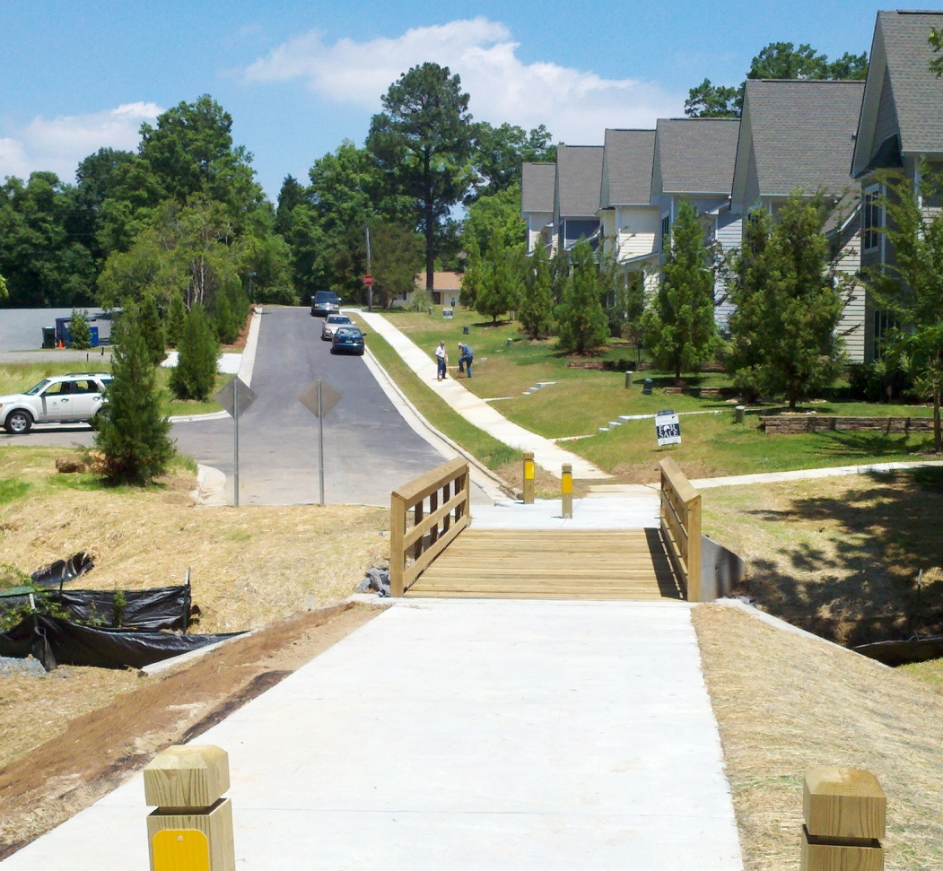
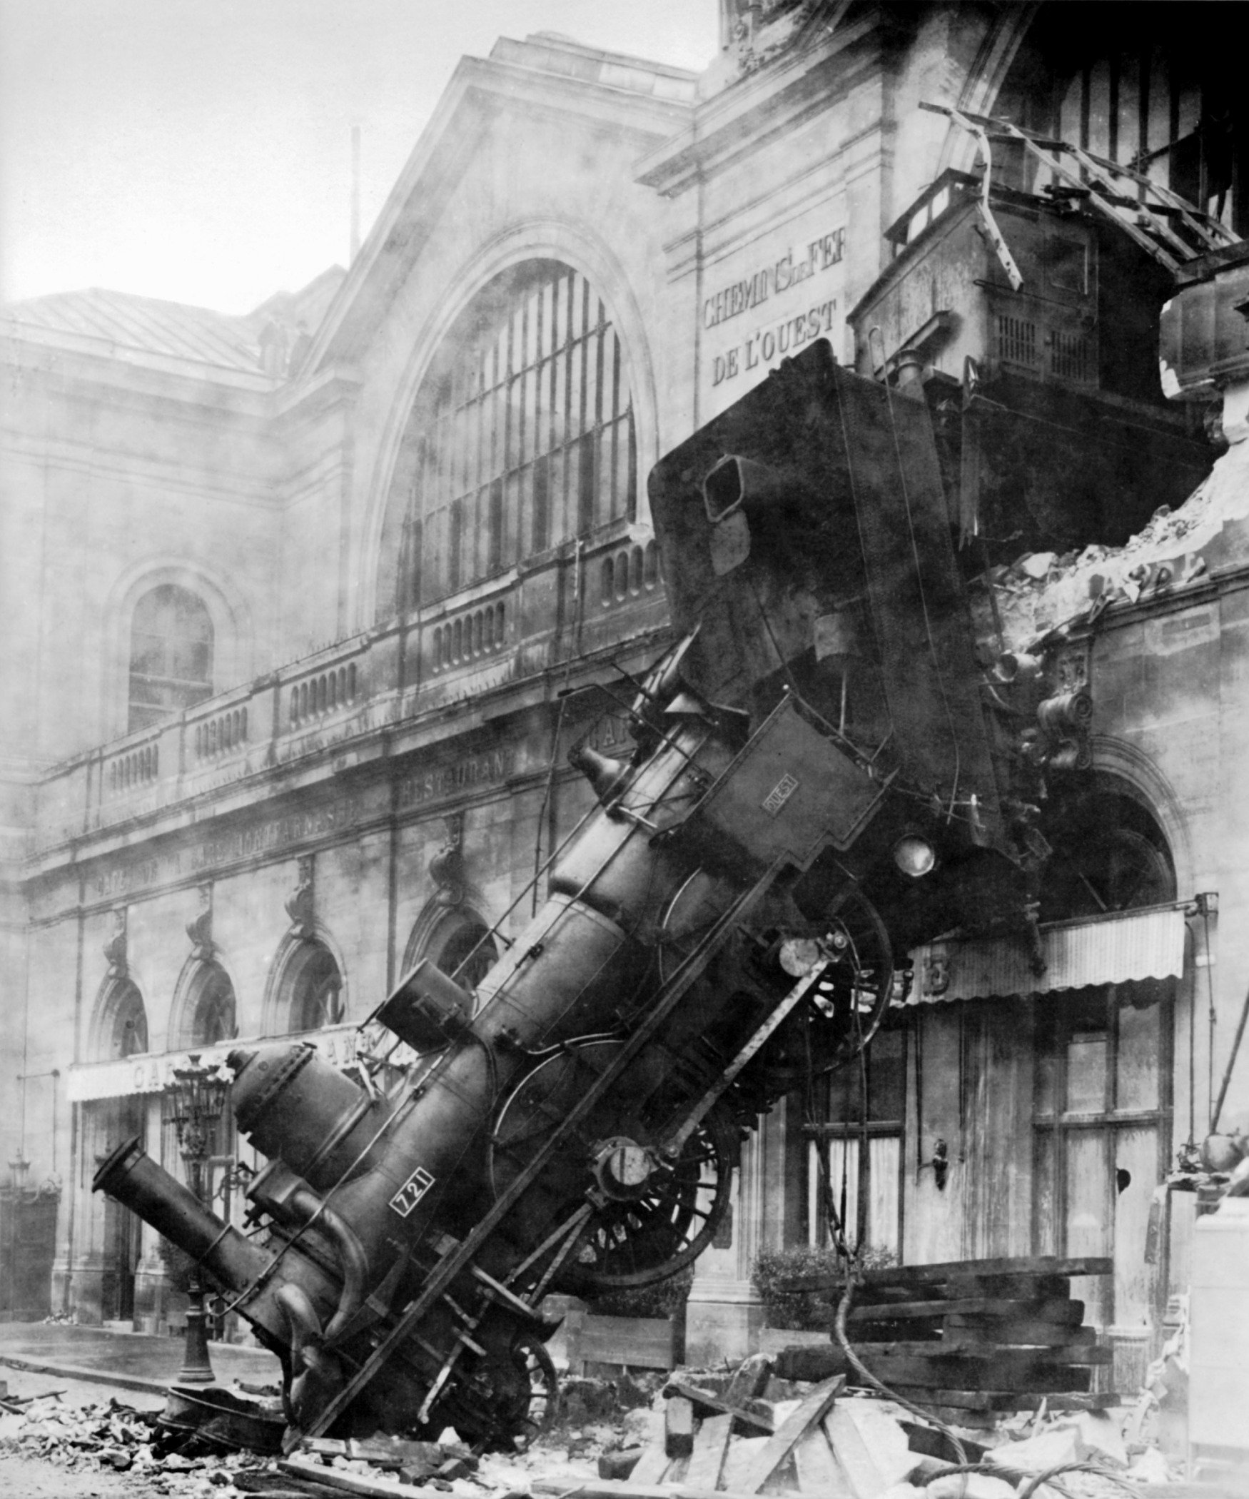
Why Connectivity Projects Need
Effective Public Involvement
Effective public involvement can lead to:
Ineffective public involvement can lead to:
Wright Ave., phases I and II (2011)

Slide 6
What Makes Public Involvement on Connectivity Projects Difficult?
Connectivity projects different from thoroughfare projects
  Public involvement needs to be different too!
Need to overcome Fear, Uncertainty, & Doubt
  Fear of the unknown
  Fear of connecting “us” to “them”
  Fear of no benefits, just impacts
Effective Public Involvement (PI) can overcome these fears

Slide 7
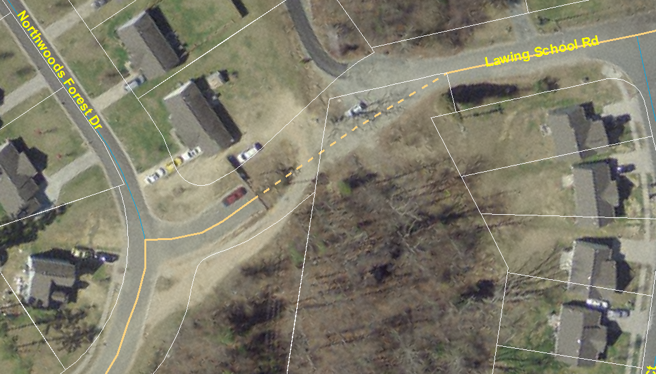
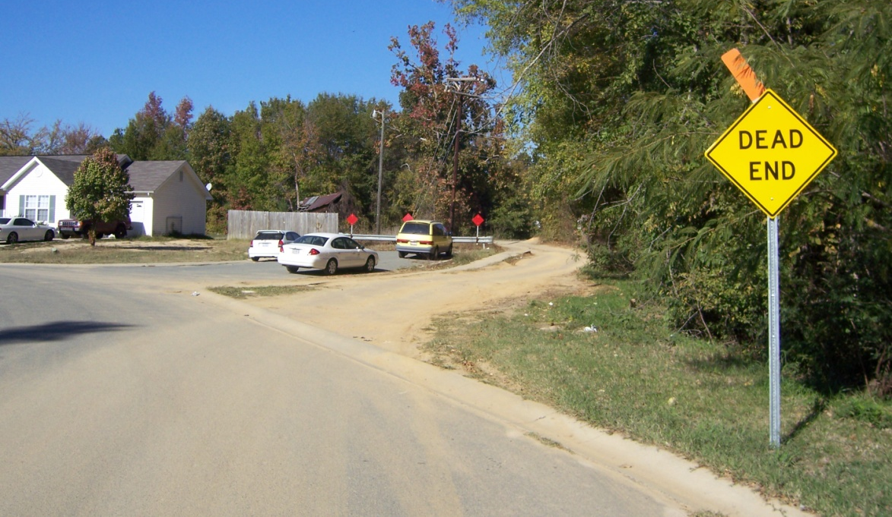
Successful Case Study #1:
Lawing School Road (2008)
300’ gap in Lawing School Rd. b/w 2 separate neighborhoods
Project justification
  Obvious need
  Neighborhood requests
  Traffic >300 veh/day

Slide 8
Get Councilmember’s Support First
In same city council district as cancelled Auten Rd. thoroughfare
  Negative public involvement: project was cancelled
  Lawing School Rd. <1 year after Auten Rd.
Met with councilmember 3 times during planning
  Be honest about the pros & cons
  Get ahead of any possible issues
Councilmember strongly supported the project

Slide 9
1st Public Meeting:
Propose the Project & Get Feedback
Identify purpose, need, benefits of connection
Ask residents for comments
  Neighborhood A: strong support
  Neighborhood B: strong opposition
4 main comments received from Neighborhood B
  Crime
  Inadequate infrastructure
  Existing speeding problem
  Benefits to Neighborhood A, impacts to Neighborhood B
Staff felt that issues could be overcome

Slide 10
2nd Public Meeting:
Address Comments, Move Forward
Described all stakeholders’ issues
  Neighborhood A
  Neighborhood B
  Charlotte Fire Department / MEDIC
  Charlotte-Mecklenburg Police Department
  Charlotte-Mecklenburg Schools
  Councilmember
Specifically answered comments from 1st meeting
  Expanded project scope as mitigation
  Show benefits of project to both neighborhoods

Slide 11
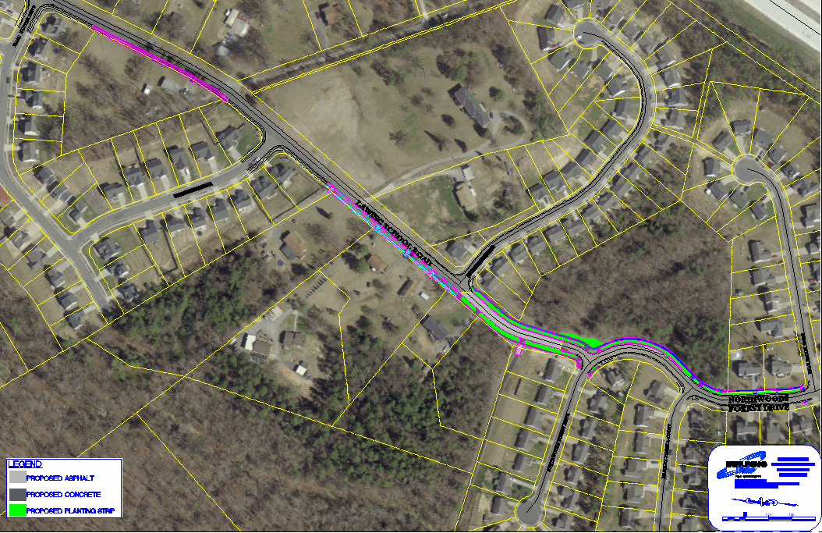
Original Scope vs.
Expanded Mitigation Scope
`
B
A
Add Sidewalk,
Curb & Gutter, Speed humps
NORTH
300’ Connection
Ancillary improvements

Slide 12
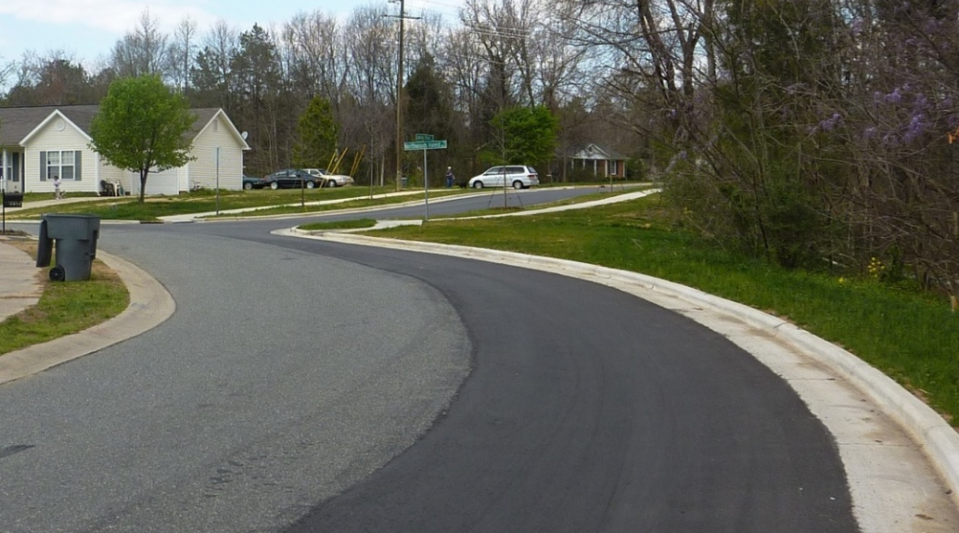
Lawing School Road:
What Made the PI Successful?
Project need was obvious
People felt involved & that we listened
  Explained ALL stakeholders’ issues
  Specifically addressed Neighborhood B’s concerns
  Added mitigation to project scope
Had councilmember’s support
Spring 2011

Slide 13
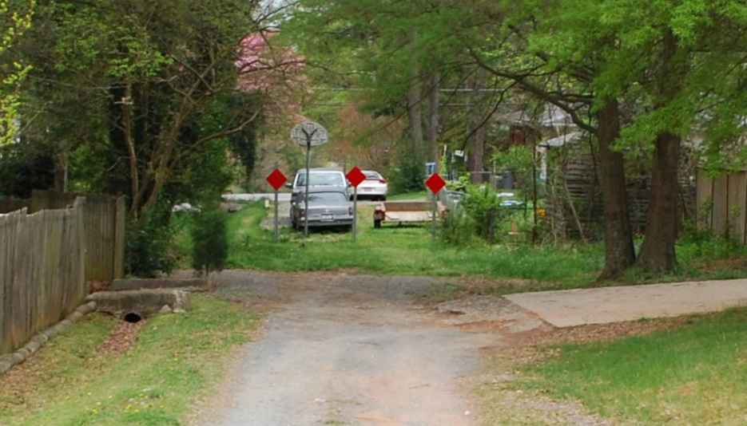
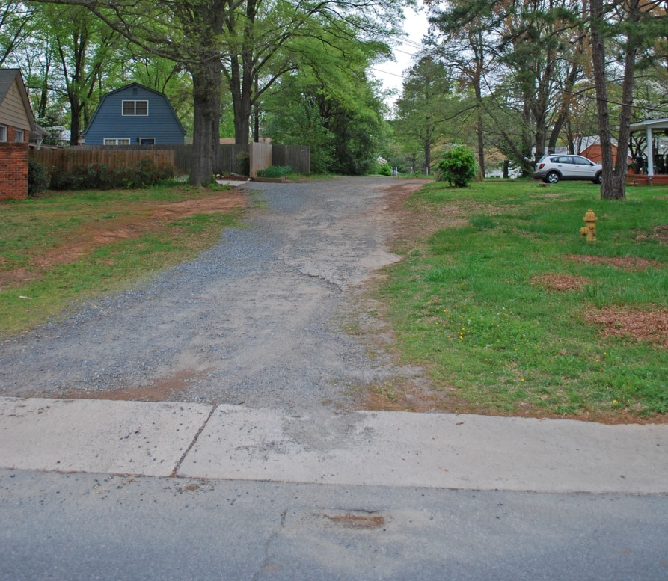
Successful Case Study #2:
Shamrock Gardens
Neighborhood infrastructure project begun in 2009
  Connections not part of project
Residents spoke up at 1st public meeting
  4 unopened ROW’s
  ROW’s perceived to be nuisances (trash, crime, trespassing, etc.)
  Wanted the nuisances addressed
Connecticut Ave.
Cardiff Ave.

Slide 14
Developing & Vetting a Solution
Staff: building streets would solve nuisance
  Needed agreement from neighborhood
Received district councilmember’s support
Abutting owners = major stakeholders
  Door-to-door interviews
  Special invitations to 2nd public meeting
  Brochure/postcard summarizing options
  Online survey

Slide 15
2nd & 3rd Public Meetings
2nd public meeting: What Do You Think of This?
  Proposed initial designs for 3 blocks
  Sought feedback from residents
  Show renderings & photos of connections
3rd public meeting: We’re Building The Streets
  To confirm support for connections
  Final scope: only build 2 blocks

Slide 16
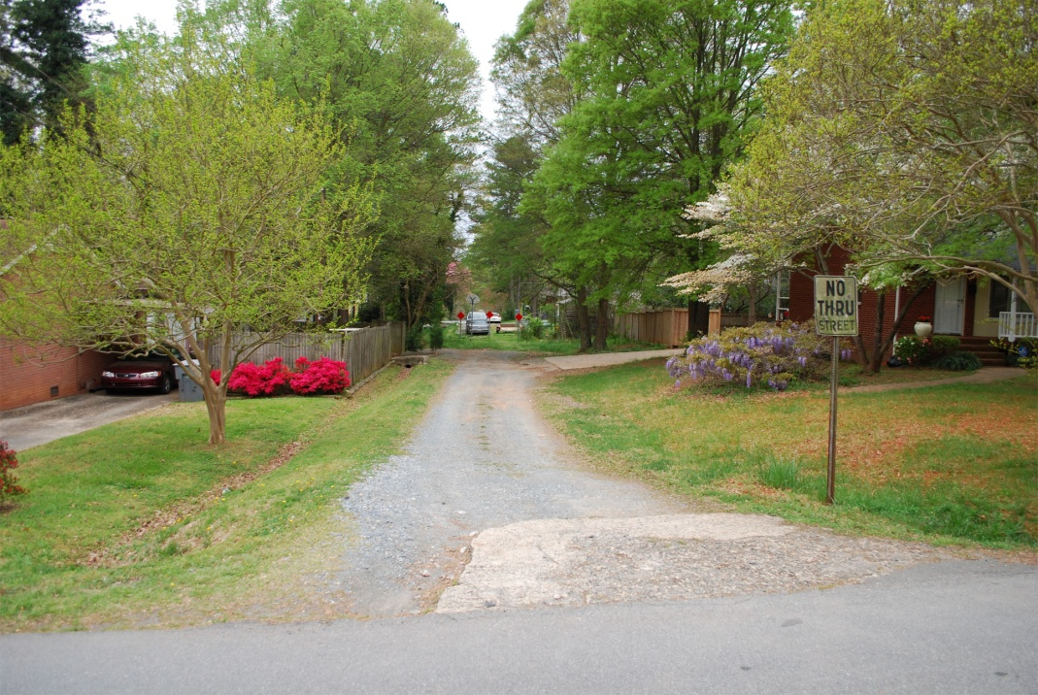
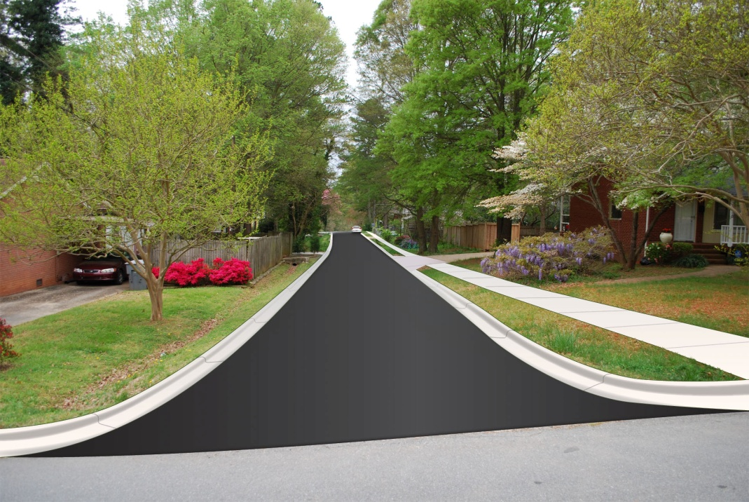
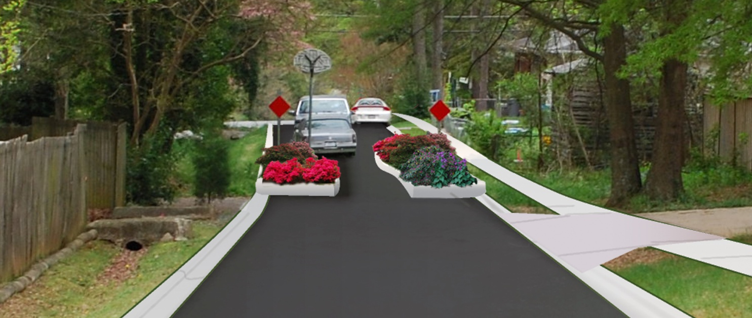
Concepts for Connecticut Ave. Shown at 2nd & 3rd Meetings
Existing
Rendering
Rejected “Dogbone” Alternative

Slide 17
Shamrock Gardens:
What Made the PI Successful?
Project was initiated by the neighborhood
Had district councilmember’s support
Clear directions for public at meetings
Iterative, interactive process
Construction begins Fall 2013

Slide 18
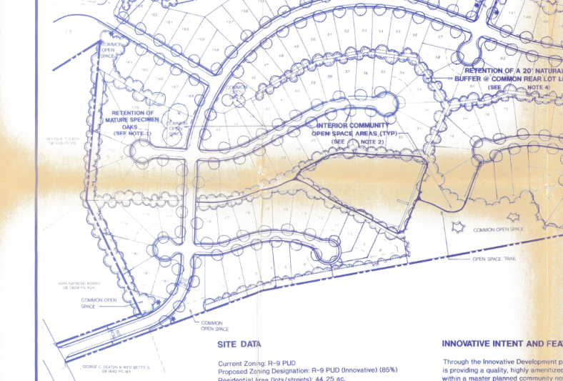
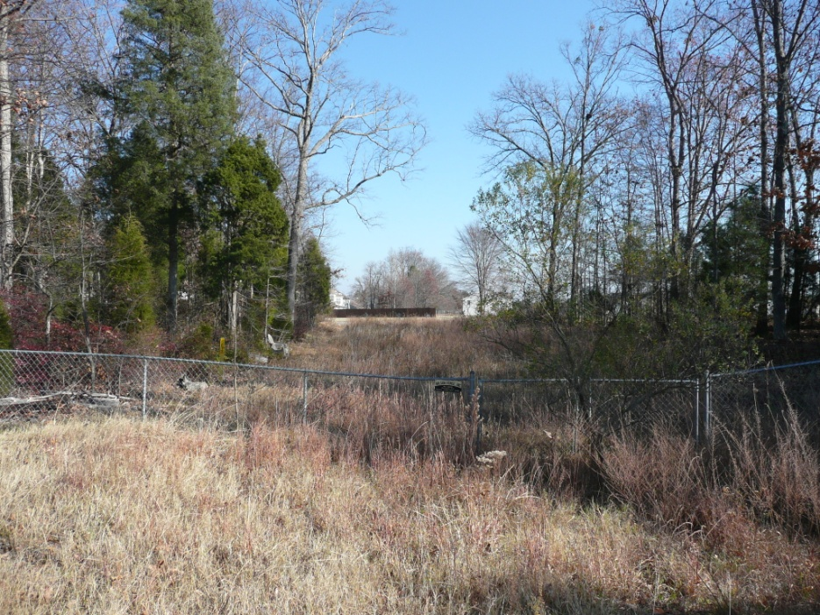
Unsuccessful Case Study:
Harburn Forest Drive (2010)
Unbuilt 3rd entrance to 650-home subdivision
  Connection shown on 3 plans
  Sight distance problem → access permit denied
  Developer built what he could
Staff opinion: it’s inevitable
  Connection is a benefit
  Supposed to be here already
  Future development required to build it
What could possibly go wrong?
Notes:
Snapshot from 1994 Administrative Approval Plan
Ways Harburn Forest could be connected:
By private developer if/when adjacent land is redeveloped (R-3 zoning)
By the City

Slide 19
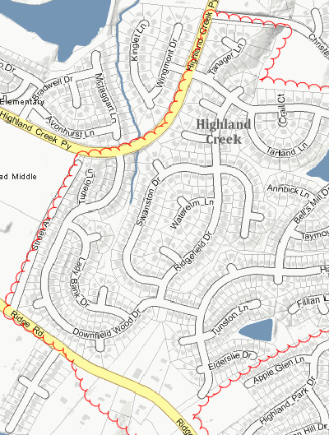
Staff Expected Controversy
From the Start
4 main concerns
  Traffic patterns will change
  2000-3000 ADT expected
  Neighborhood playground 2 blocks from extension
  City-initiated project
Minimization plan
  Work through Highland Creek HOA
  Show videos of ____ ADT
  Propose mitigation for playground and traffic
  Get councilmember’s support
    I’ll support you until…

Slide 20
Sequence of Public Involvement
Early 2010: Staff begins project planning
July 2011: HOA Board of Directors
  No answer to “is this project inevitable?”
  Online survey posted – leading questions?
August 2011: Full HOA
October 2011: Public meeting
November 2011: Project cancelled
Project implodes in only 4 months!

Slide 21
Presentation to the Full HOA
Placed last on the agenda
  After 90 min. contentious election
  Rushed through presentation, got off-message
Q&A
  Erroneous information provided by residents
  Complaints about leading questions on survey
  Many concerns about traffic, playground, etc.
No perceived need for project

Slide 22
The (Only) Public Meeting
Emphasized the previous plans, benefits
  Street is supposed to be here
  Reduced fuel consumption
  Reduced travel time/distance
  Improved fire response time
Still did not identify a need for project
Q&A comments almost exclusively “no”
2nd survey/vote afterward: 5:1 “no”

Slide 23
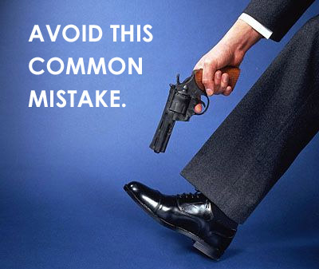
What Made the PI Unsuccessful
Not controlling the message
  Arrogance: “It’s supposed to be here already”
  Project benefits ≠ project justification or need
  Misinformation by residents
Not controlling the venue
  HOA meeting agenda
Not building trust
  Leading questions on survey
  Not answering question of inevitability
  District councilmember wasn’t fully on-board

Slide 24
Comprehensive Review of City’s Public Involvement Process
Howard-Stein-Hudson (HSH) hired in 2011 to:
  Evaluate current City policies, procedures for PI
  Develop toolbox of recommendations for effective PI
  Provide case studies of other agencies
2 key recommendations
  Need clear vision of project goal and need
  Clearly articulate what the public is supposed to do

Slide 25
Suggested PI to DO for Street Connectivity Projects
Need neighborhood support/champion
Make sure area’s elected official is on board
Make the project tangible (as appropriate)
  Show benefits of connection – make it personal
  Provide visual examples
  Expand project scope to offer mitigation

Slide 26
Conclusions
Street connectivity projects are unique
Implementing street connectivity requires overcoming fears
Having neighborhood support is critical
Bad public involvement will doom a project

Slide 27
Questions?
mmagnasco@charlottenc.gov
704-336-3368
“Planning street networks isn’t rocket science.
It’s much harder.”

