Slide 1
Who’s Employed?
An in Depth Comparison of Employment Data Sources
Gregory Giaimo, PE
Samuel Granato, PE
Andrew Hurst
The Ohio Department of Transportation
Division of Planning
Presented at
The 14th Transportation Planning Applications Conference
May 6, 2013

Slide 2
Overview
Motivation
Macro View-QCEW vs. BEA Control Totals for Data Expansion
Micro View-QCEW vs. Purchased Data for Possible Replacement

Slide 3
Motivation
For Travel Modeling Want Employment Data With:
Accuracy (correct employment/employers)
Completeness (all employment/employers)
Spatial Precision (geocodable address of individual employers at actual place of business activity)
Temporal Consistency (no defunct businesses, contain new businesses extant on the supposed date of the dataset)
Categorization (correct NAICS or similar)
Disaggregate (individual employer records allows data checking, finer TAZ disaggregation and future travel demand models (particularly freight) will include disaggregate attraction end modeling including business synthesizers similar to current household synthesizers)
There Area a Number of Potential Employment Data Sources

Slide 4
Motivation
QCEW (Quarterly Census of Employment and Wages)
Regulatory dataset for Federal unemployment insurance
Pros: cheap, regulatory basis implies it is complete and temporally consistent for covered sectors
Cons: confidentiality restrictions, uncovered sectors for those exempt from Federal unemployment insurance laws (sole proprietors, small farms, railroads, military, small non-profits, student workers, elected officials etc.), sub-county location must be geocoded by user from mailing addresses (regulations only require correct county and ability to mail a bill), single site reporting for multi-site businesses, government particularly poor
BEA (Bureau of Economic Analysis)
Dataset maintained by Federal Government for Macro-Economic Analysis
Pros: based on QCEW but enhanced with other administrative sources such as income tax data to provide complete and temporally consistent data
Cons: Only aggregate county level data available

Slide 5
Motivation
LEHD (Longitudinal Employer-Household Dynamics)
Census Bureau product based on QCEW and linked with ACS data
Pros: Same pros as other QCEW based sources, no confidentiality restrictions or costs, in addition dataset provides linkages between employee residences and employer locations
Cons: Same pros as other QCEW based sources, plus no employer records only aggregate employment, Census Bureau masking, a PUMS-like product for employment would alleviate some of this constraint
Private Sources (InfoGroup’s InfoUSA/ReferenceUSA, Dun & Bradstreet’s Global Commercial Database etc.)
Several firms assemble employment data, primarily for resale for business marketing purposes, they use phone directories and other publicly available sources and then enhance and verify it with their staff
Pros: Good spatial precision, few of the multi-site problems in QCEW, reasonably complete
Cons: Cost, lack of regulatory basis means incompleteness is ill-defined, temporal consistency is poor because primary purpose of dataset makes it more likely that defunct businesses are retained

Slide 6
Motivation
Since 2000 ODOT has utilized QCEW as its primary source of employment data, confidentiality requirements mean model employment data can’t be given out freely creating some logistical issues with the models and consultant contracts, also the latest confidentiality agreement includes stricter personal liability making some hesitant to sign
Ohio library system has a license for Infogroups’s ReferenceUSA, allowing state agencies to query 50 records at a time, based on this data, ODOT also received a small area sample of their InfoUSA database for this study
ODOT Economic Development and Planning Offices also recently purchased two separate version of the Dun and Bradstreet database for their own purposes (largely due to QCEW confidentiality limits)
Taken with the public availability of LEHD and BEA data this provided an opportunity and need for ODOT to compare and contrast data sources

Slide 7
Macro-View
Macro-View will focus on QCEW vs. BEA
Expand QCEW to BEA to account for:
Ungeocoded QCEW (records do travel modelers no good if not located)
Uncovered employment sectors
Sole proprietors (most important)
Difference between 1st Qtr. QCEW and annual average BEA
Important to expand by county and industry as will be shown
Total Employment
 | Employees | Percent
QCEW Geocoded | 4765940 | 74%
QCEW Total | 4909538 | 76%
BEA Wage | 5199216 | 81%
BEA Total | 6451236 | 100%

Slide 8
QCEW vs. BEA

Slide 9
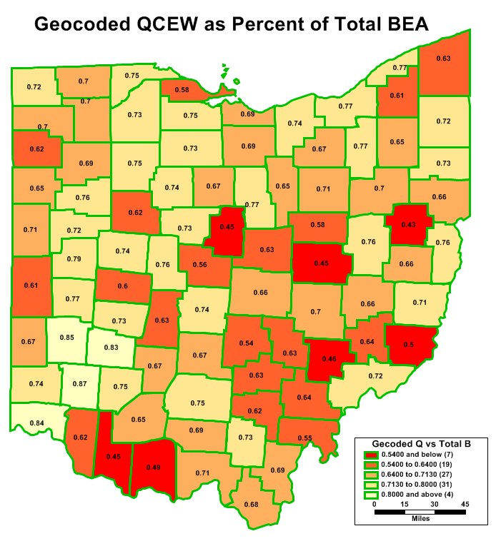
QCEW vs. BEA
There are significant differences so it’s worth delving a bit deeper

Slide 10
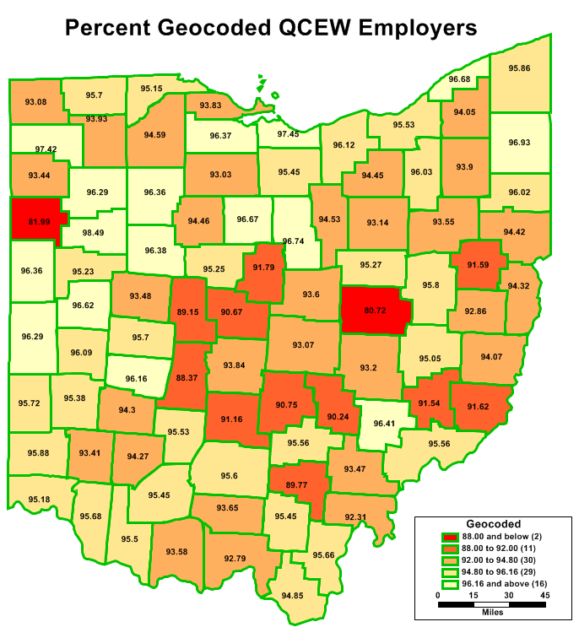
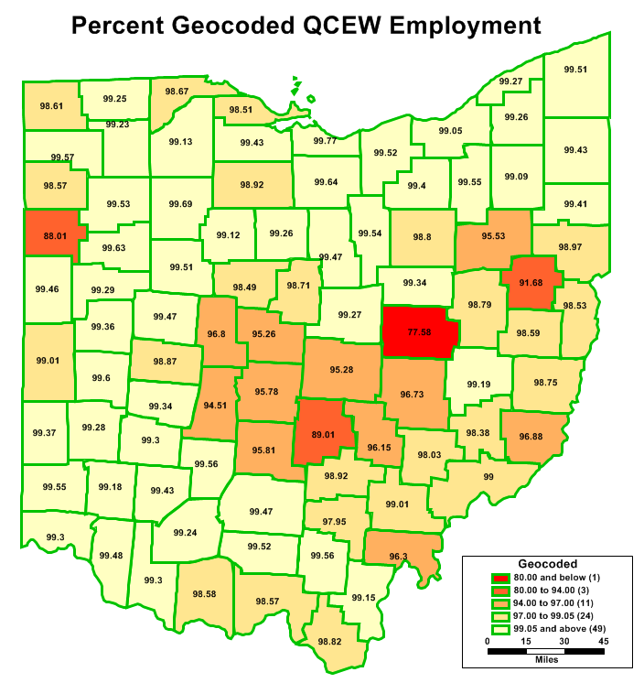
QCEW Geocoding
Mostly automated but manual passes on large employers (hence while only 90% of employers geocoded, 97% of employment)
Geocoding not even across industry categories or counties
ODOT spent a lot of time fixing multi-site employers, especially school districts which now appear in Ohio’s official file

Slide 11
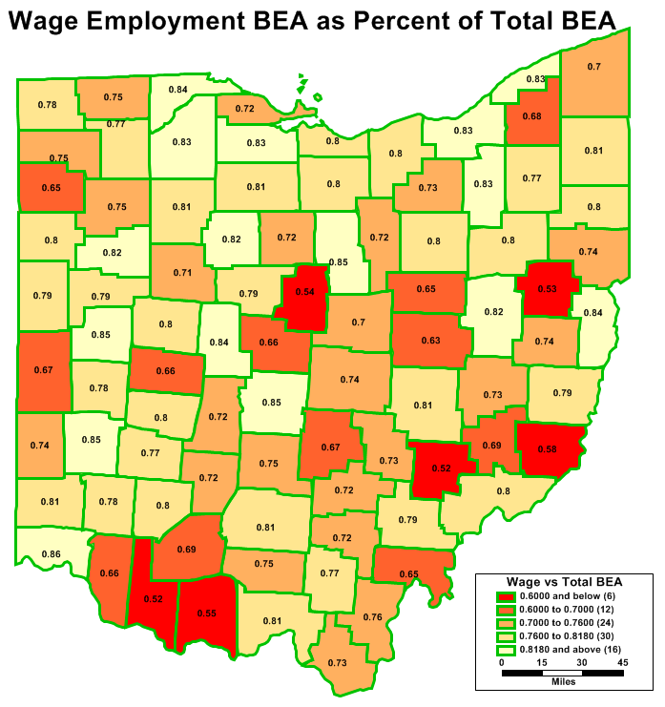
BEA Characteristics
BEA Proprietor Rates
Farm | 83%
Private | 21%
Government | 0%
While BEA industry and county marginal totals add up, the joint distribution values do not due to limitations in the sources BEA uses to fill in QCEW gaps
Hence if you are expanding to industry/county totals you need to use an Iterative Proportional Fitting routine (i.e. Fratar) to account for the unallocated employment (not all industries/counties equal in this regard)
BEA data has different (and much higher) sole proprietor rate for farm than other types

Slide 12
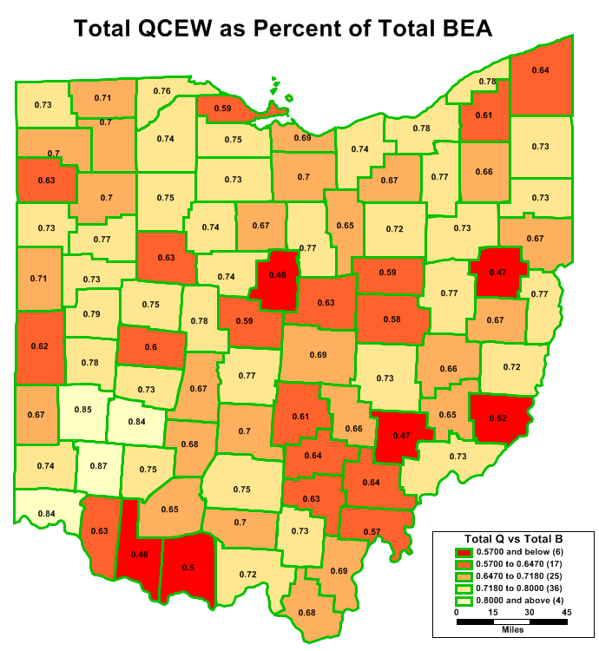
Comparing QCEW/BEA
BEA adds many commission only employees in NAICS 50 categories, particularly real estate so you should expect high expansion factors here
ODOT uses Q1 QCEW so we get high expansion factors in seasonal industries (construction and arts/recreation)
Note similarity to previous map

Slide 13
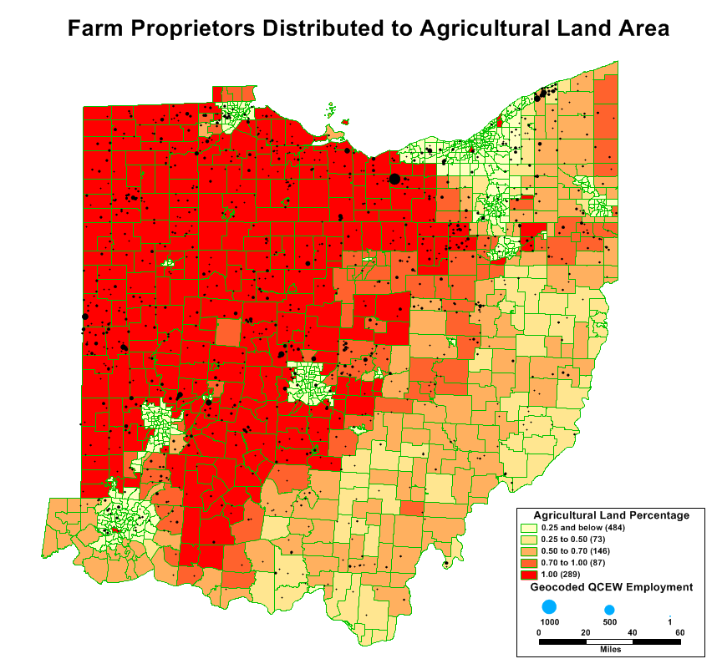
Comparing QCEW/BEA
Tiny representation of agriculture in QCEW renders direct expansion sub-optimal
ODOT allocates the BEA farm proprietors based on agricultural acreage instead

Slide 14
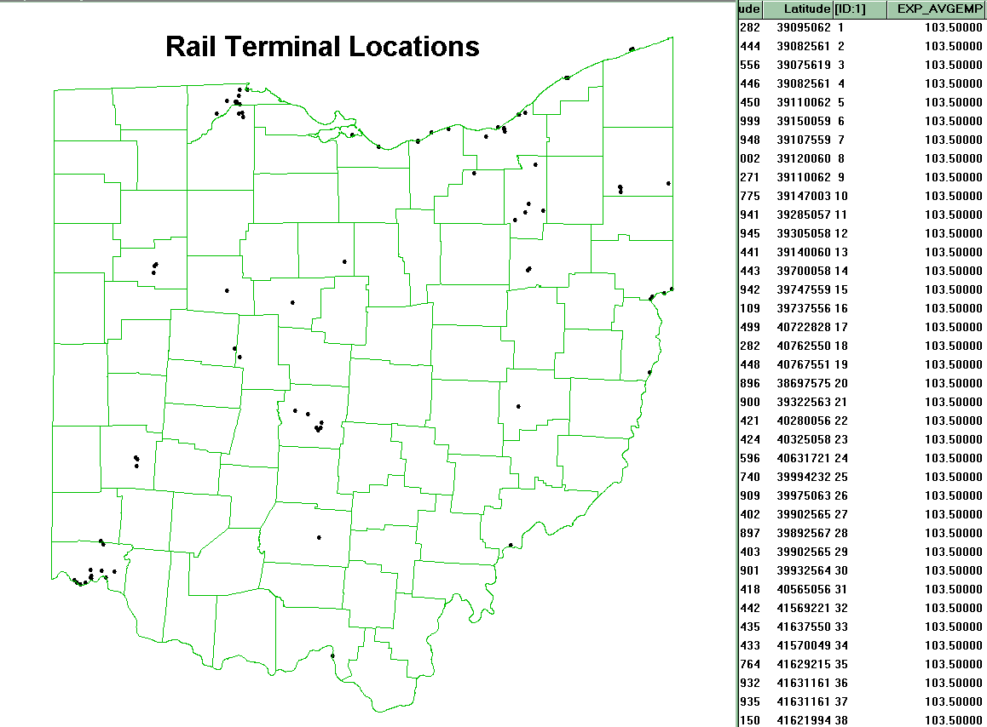
Comparing QCEW/BEA
While of minor importance, we decided to allocate some of the missing transportation employment to rail terminals prior to expansion

Slide 15
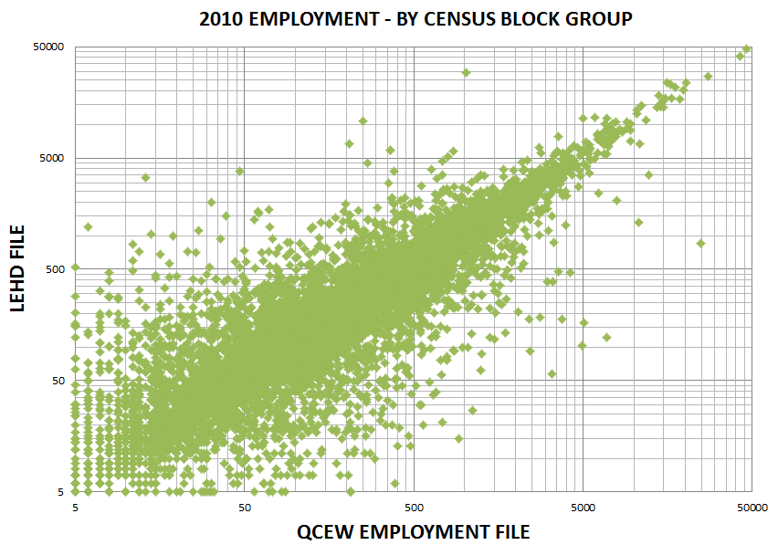
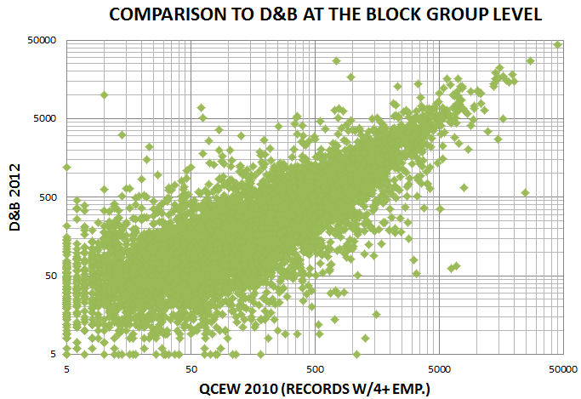
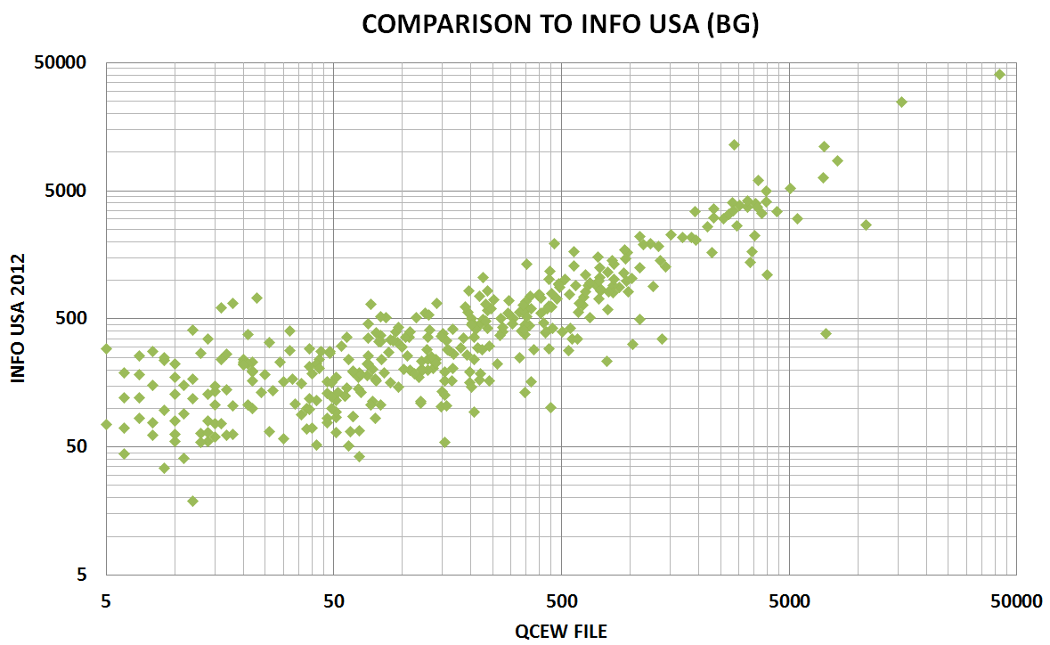
Macro-View Wrap Up
As mentioned previous, ODOT evaluated other sources beyond QCEW
At a macro level, there are significant differences
These are more difficult to understand at this level, so ODOT conducted some micro analysis at several locations

Slide 16
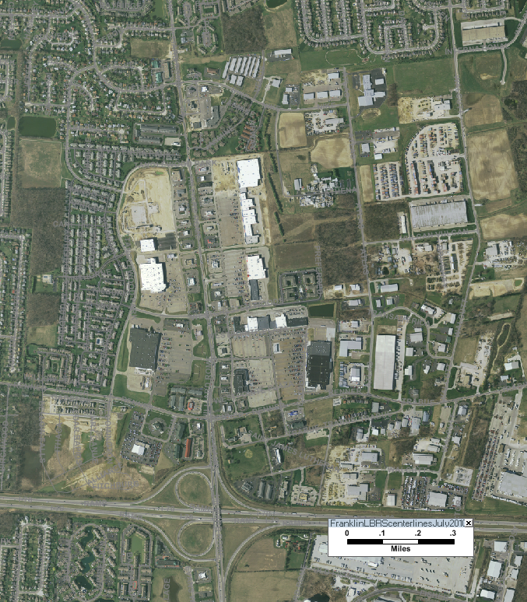
Micro-View
This presentation will focus on one location for clarity
A relatively recent and growing commercial/ industrial area in the western suburbs of Columbus
Contains diverse mix of employment types
However, due to small study area, results shown here should not be generalized, consider them as illustrative only

Slide 17
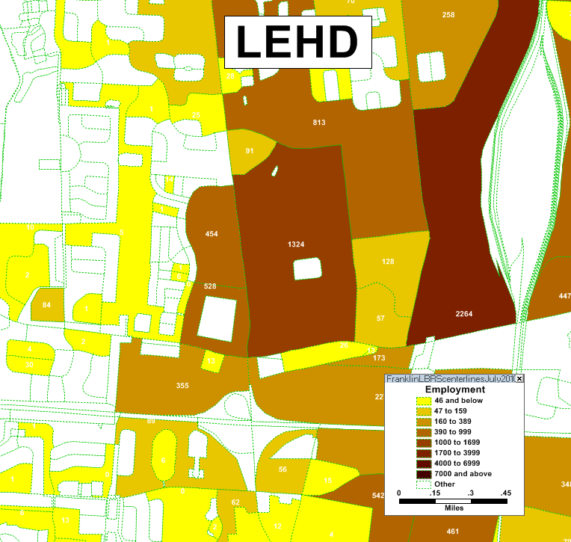
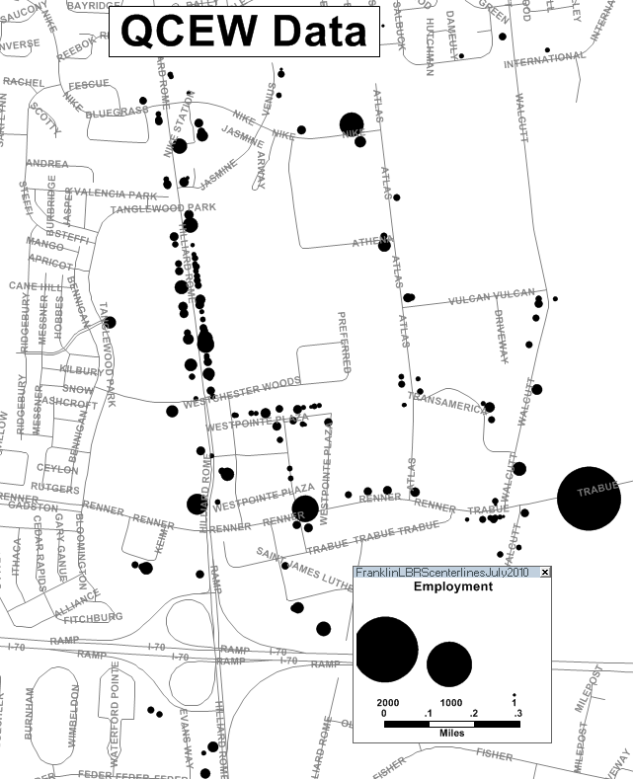
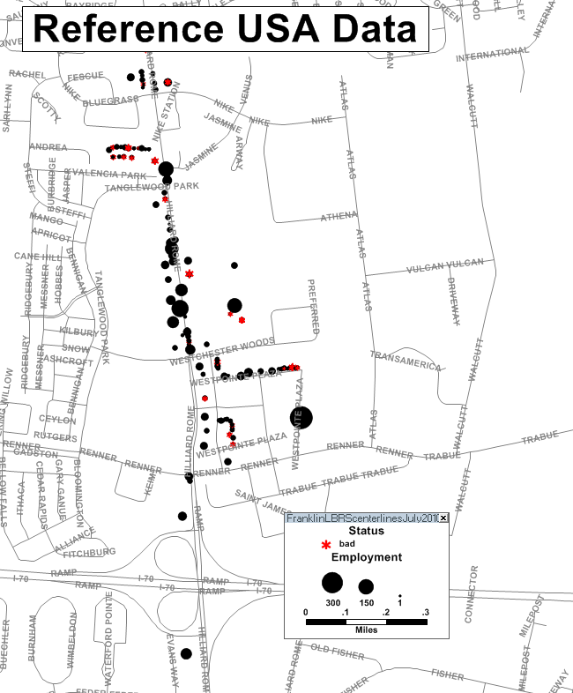
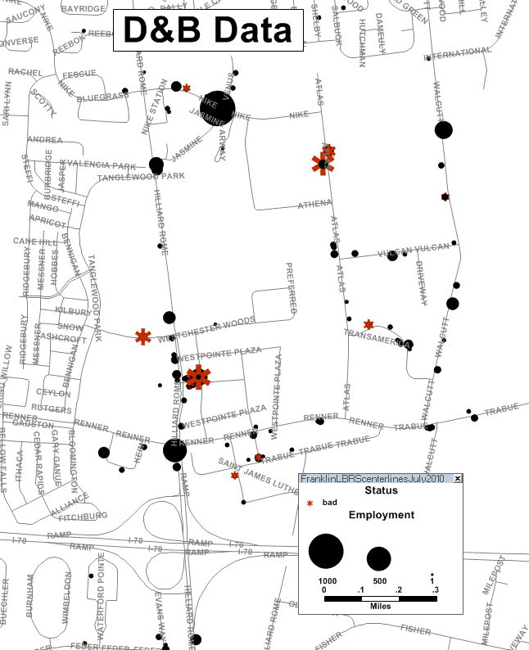
Micro-View
The same area looks a bit different depending on the source
RefUSA data only obtained for a subarea
D&B data only obtained for 4+ employee employers

Slide 18
Comparison Methodology
Obtained data for (mostly) the same area
Compared the employment records by address since no other common unique identifier
Combined this with detailed local knowledge and aerial imagery (study areas were selected based on analyst knowledge)
Necessary to determine when duplicate addresses are valid (office parks, suite’s, corporate vs. franchise and subsidiaries often have employee’s at same address) or when multiple occupants from different year’s are in data
Theoretical maximum employment for an address taken as the maximum valid employment from any of the sources (this is not necessarily the true value since that source may have over-stated the number)
LEHD not included in most comparison’s since it is aggregate data

Slide 19
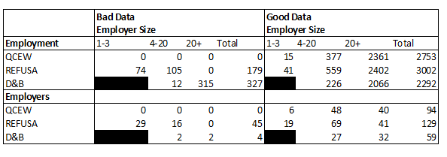
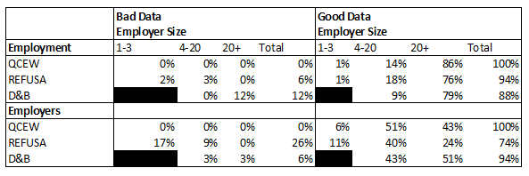
Comparison Methodology
Purchased data sources contain many duplicate businesses which need removed prior to comparison
More problematic for smaller employers

Slide 20
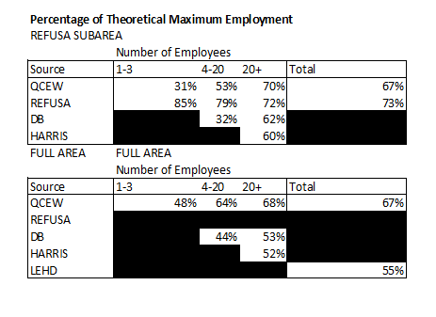
Comparisons
After removal of duplicates, REFUSA and QCEW performed similarly for large employers, REFUSA had better coverage of small employers (includes some sole proprietors and commission employee’s not in QCEW)
D&B didn’t perform as well in this study area
Harris one of the two versions of the D&B data purchased by ODOT, only had 20+ employee employers

Slide 21
Combining Datasets
Employers included in purchased data and QCEW were nearly statistically independent
Given the 75% and 92% employer coverage in QCEW and Reference USA, one would expect 98% coverage by combining the sources (analyst could not identify any missing employers which implies 100% was obtained but there is certainly some margin of error)

Slide 22
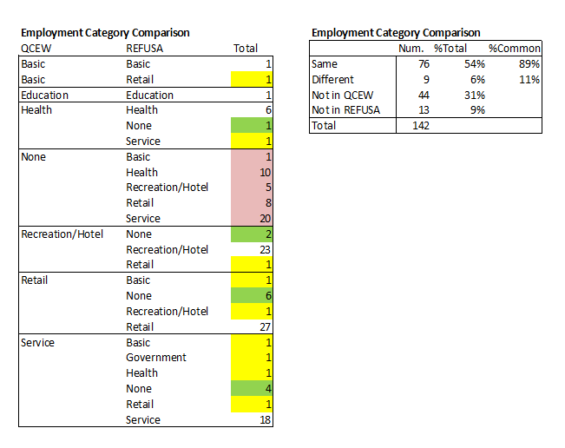
Categorization
Categorization by industry was similar (89% same for same employers)

Slide 23
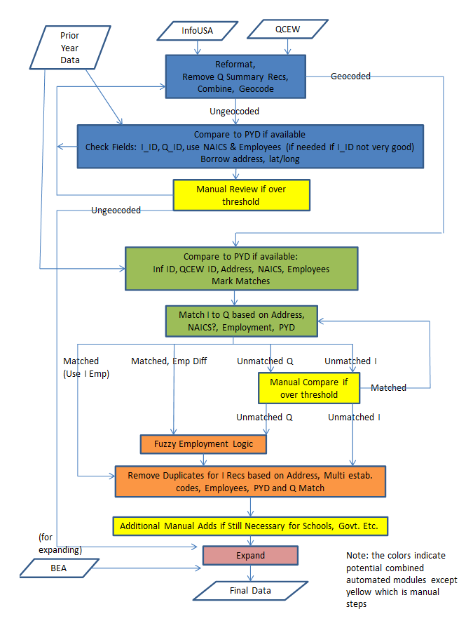
Future Direction
Given these results and the desire to produce model datasets not subject to confidentiality constraints ODOT will purchase employment data and develop a process to:
Geocode
Remove duplicates
Cross match with previous year’s data
Cross match with QCEW
Develop an employment estimate for employer’s identified by QCEW rather than using value directly

