Slide 1

Improving Project Level Traffic Forecasts by Attacking the Problem from all Sides
Gregory Giaimo, PE
Mark Byram, PE
The Ohio Department of Transportation
Division of Planning
Presented at
The 14th Transportation Planning Applications Conference
May 7, 2013

Slide 2
Motivation
Project level traffic forecasts are the most challenging to provide due to the need to provide highly detailed spatial (such as individual turning movements) and temporal (such as 15 minutes) resolution.
The Ohio Department of Transportation (ODOT) in attempting to address this need has found no single source of inaccuracy but rather a web of potential analytical and procedural pit falls. These are being addressed by many efforts including the ten initiatives shown here, these have the potential to produce better fine resolution traffic forecasts in the future.
Notes:
ODOT’s Administration identified accuracy of traffic forecasts for roadway planning and design as an issue. This largely stemmed from a lack of post construction studies that compare forecasts with counts. Since designers had not been provided with accuracy comparisons, they could not assess the viability of minor design changes which might result in great cost reduction if the forecast were slightly lower.
As a result ODOT formed a task force to identify potential process improvements. Staff had already taken on initiatives to address perceived shortcomings as well as departmental desire to become more efficient. So these combined to form the ten initiatives.

Slide 3
Ten Initiatives
Forecast accuracy assessment
Develop automated forecasting tool for simple projects
Changes to request form and count requirements
Update post-model (NCHRP255) adjustment process
NCHRP 8-83 project participation
Increase modeler participation with project forecasting
Update guidelines and training
Travel demand model enhancements
Improve land use forecasts
Enhance traffic counting program

Slide 4
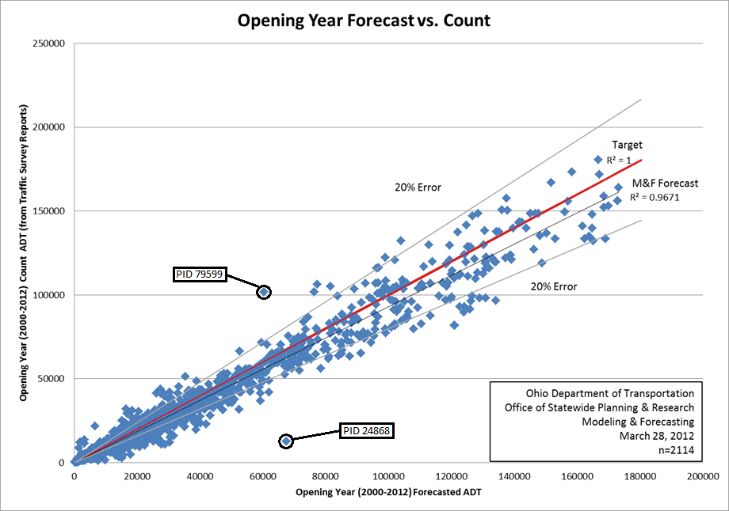
Historical Forecast Accuracy
ODOT provides forecasts for some 250 projects a year
Receive occasional complaints when the forecasts don’t pan out
Began tracking opening and design year forecasts vs. realized counts
Since our record retention period is 10 years and design is usually for 20 years, can only compare opening year values thus far

Slide 5
Historical Forecast Accuracy
Discrepancies were caused by the following:
  Location mismatch between actual project/forecast location and automatically populated count from ODOT’s Traffic Survey Report
  Open year of project different from that projected (including projects that were never actually built)
  Projected developed did not occur on projected time line (or at all)
  Bad traffic counts, including counts taken during construction activities
  The great recession
  ODOT policy to not forecast declines
  Forecaster error
On average ODOT forecasts slightly high, but well within the standard error of the counts themselves (items 5 and 6 cause the high-side bias)
Other than item 6, no systematic problems in process found, most mismatches were actually caused by the automated data processing to create the study (item 1) or due to planned developments and roadway construction simply not occurring as planned (items 2 and 3)

Slide 6
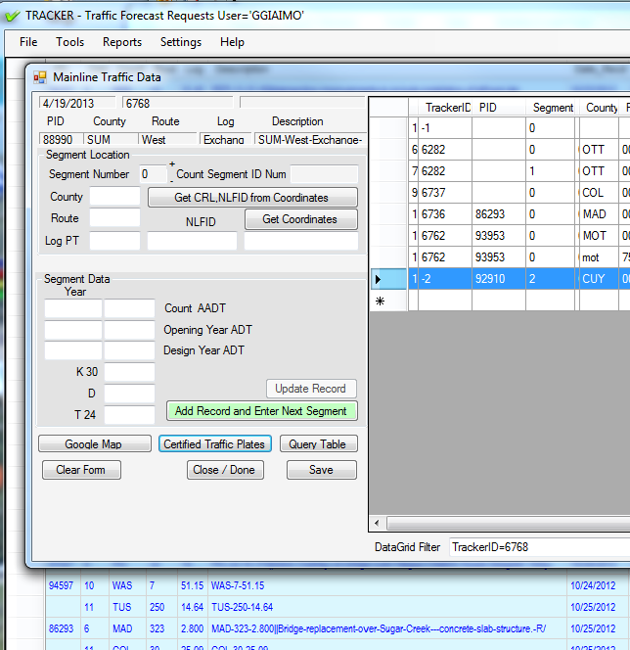
Historical Forecast Accuracy
ODOT has updated its project forecasting tracking system to archive relevant information to make accuracy tracking easier in the future
Could reconsider the “no decline” policy (probably won’t)
Additional training and other process changes as detailed in other initiatives to follow

Slide 7
Automated Forecasting Tool: SHIFT
Automated forecasting tool for “low risk” projects called SHIFT (Simplified Highway Forecasting Tool)
Process has these steps:
  Regression analysis of ODOT historical count database
  Bulk NCHRP 255 adjustment of statewide model of record results
  Combining of these two sources
  Development of design hour parameters (K, D, T)
Access database macro provides user interface
Database generated once a year from latest count/model data and also serves as basis of statewide congestion management process and other statewide planning analysis not requiring alternatives analysis (volumes are static)

Slide 8
SHIFT Methodology
  Regression analysis of ODOT historical count database
For each traffic count segment, a regression equation is fit through historic counts and a forecast volume for the model forecast year is determined using 6 methods
    1.Use all counts
    2.Drop count with highest residual
    3.Drop oldest count
    4.As 3 AND drop highest residual count
    5.Drop 2 oldest counts
    6.As 5 AND drop highest residual count
This vaguely mirrors the sorts of things analysts end up doing when producing forecasts manually

Slide 9
SHIFT Methodology
Well behaved trend gives tight pattern regardless of points chosen
Other trends can produce quite disparate results

Slide 10
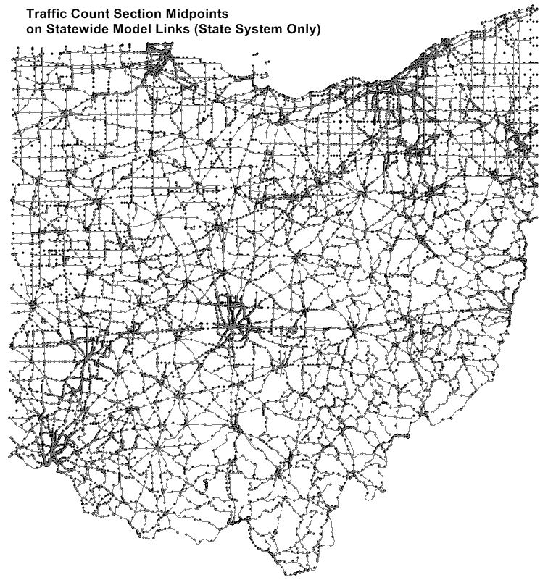
SHIFT Methodology
  Bulk NCHRP 255 adjustment of statewide model of record results
Raw model results for both a forecast and base year are joined to the ODOT historic counts file in GIS
The ODOT modified NCHRP255 adjustment process (see initiative 4) is applied to raw model volumes to adjust model to most recent counts

Slide 11
SHIFT Methodology
Combine Regression and Model Estimates (read on your own)
Regression forecasts were first adjusted so that the regression slope applied from the latest count year produced the forecast
Regression forecasts deemed “well behaved” if don’t change direction more than once (subject to a 10% buffer)
Linear growth rates for each regression line and model forecast were computed, if the model forecast was within 75%-130% of any of the regression forecast trends, the model was used.
If not, a regression forecast was selected base on its coefficient of variation (CV) as follows:
  Use method 2 if its CV<0.3
  Else use method 4 if its CV<0.3
  Else use method 1
  Selected adjusted regression forecast then averaged with the model forecast if well behaved (use model if not well behaved, if no model forecast available regression used alone).
GROWTH RATE FLOOR OF 0% PER YEAR APPLIED IN ALL CASES
GROWTH RATE CEILING OF 3% PER YEAR FOR CARS, 4% FOR TRUCKS APPLIED UNLESS BOTH MODEL AND REGRESSION OVER AND REGRESSION WELL BEHAVED

Slide 12
SHIFT Methodology
  Development of design hour parameters (K, D, T)
Directional peak Hour car and truck volumes from the Statewide Travel Model compared to ATR counts are the basis
K multiplied by the statewide average of 1.25 to translate from average to design hour day
Factors of 0.80 and 0.85 were necessary to translate model directional and peak hour %Truck numbers to design hour

Slide 13
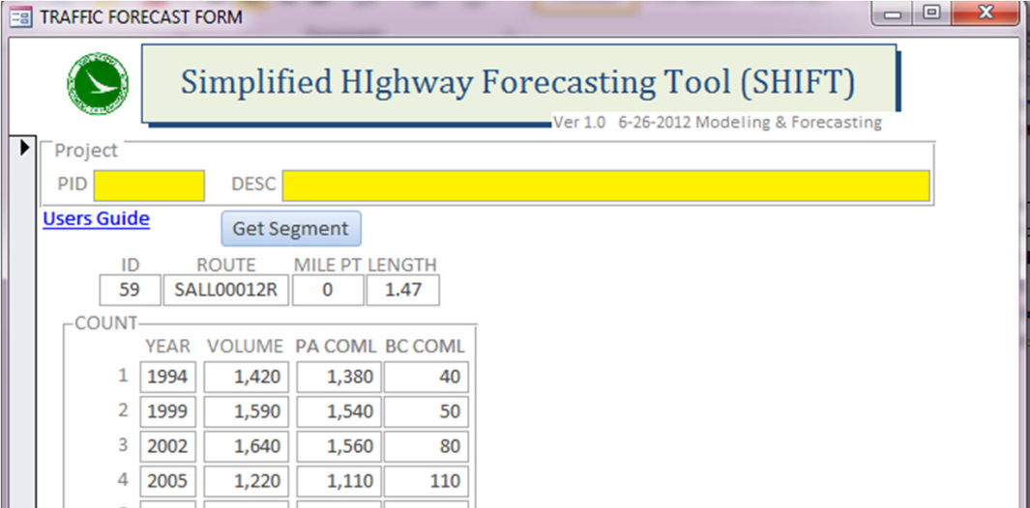
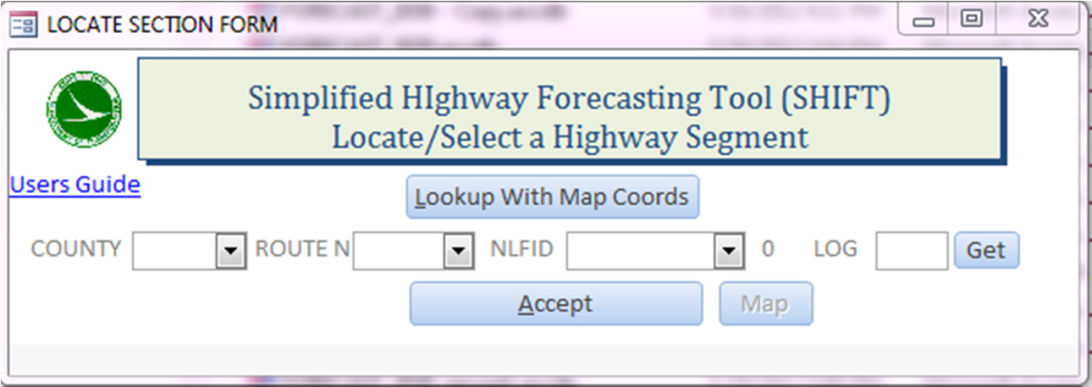
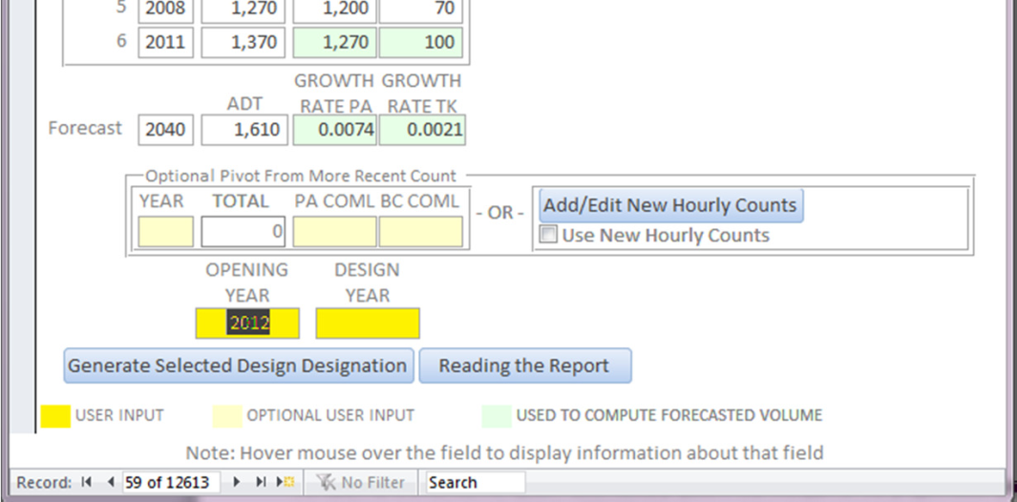
SHIFT User Interface
Methodology is applied annually when traffic count database updated resulting in an access database
Database resides on a shared server and access macro provides the user interface
ODOT District personal run to generate forecasts for minor projects*
*ODOT delineates all projects into 5 paths, the lowest 2 paths (encompassing the vast majority of projects) are minor projects not expected to cause traffic diversion and are suitable for SHIFT

Slide 14
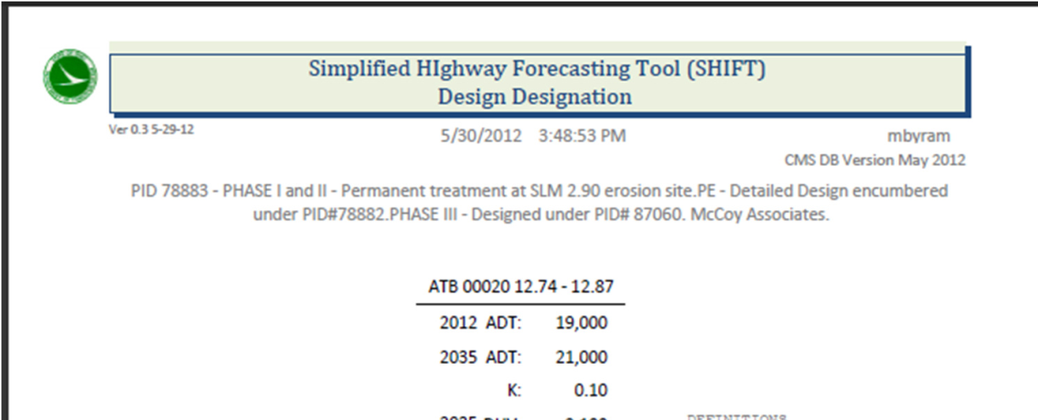
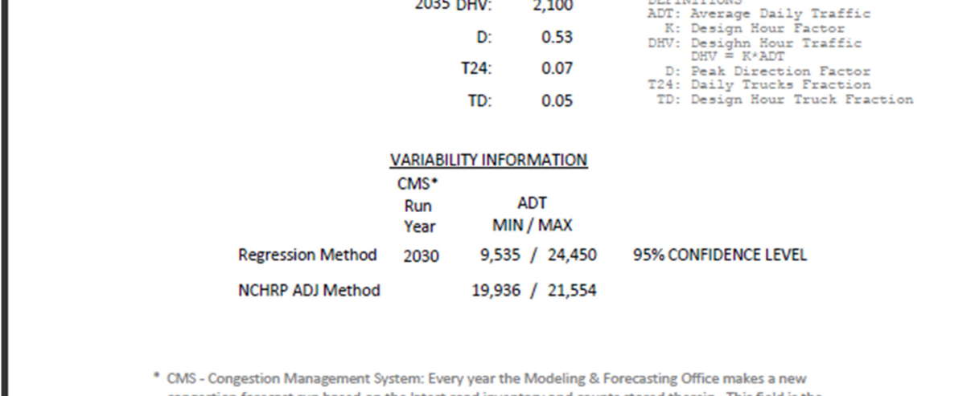
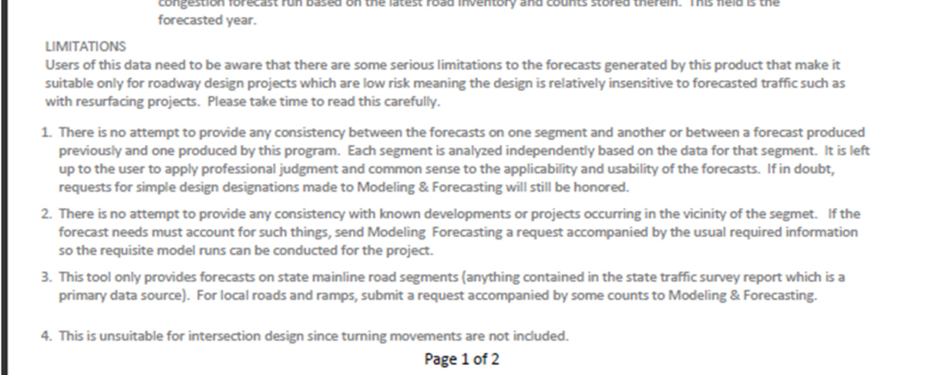
SHIFT Output
Standard report is generated with single segment design parameters
Email is auto-generated and logged into ODOT project forecasting tracker
SHIFT only generates forecasts for mainline State Highways (no ramps, local roads or turn movements)

Slide 15
Revised Project Design Traffic Request Form
Much of the problems with generating design traffic forecasts deal with miscommunication between project manager and forecasting team
While a manual exists, the day to day reality is that the best way to make sure the appropriate information is communicated is via the standard traffic forecast request form
When communication issues arise, the form is amended

Slide 16
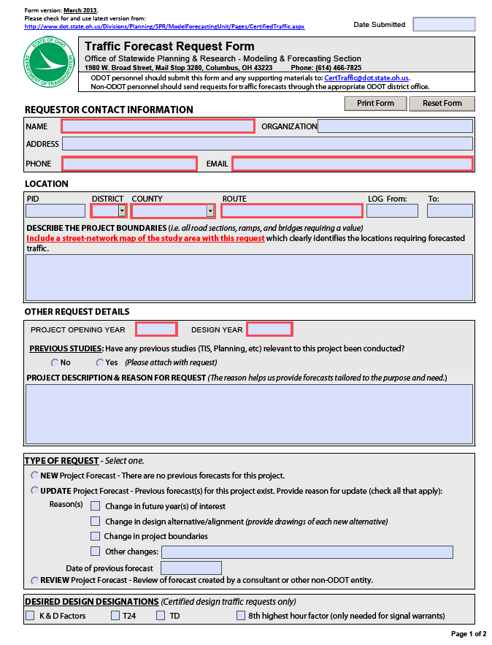
Revised Project Design Traffic Request Form
Some recent additions
Explicit referencing of past studies

Slide 17
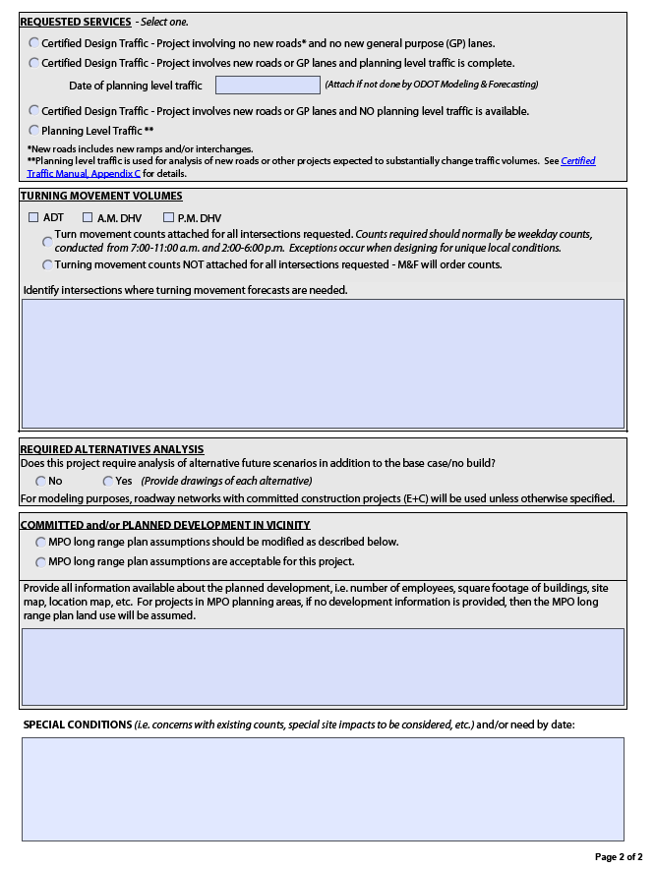
Revised Project Design Traffic Request Form
…and on the back
Designation of different forecast type requests including simple vs. complex and planning level traffic
Explicit delineation of alternatives requested
Check off that standard MPO SE forecasts are acceptable (or not)

Slide 18
Updated NCHRP255 Procedures
Despite Initiatives to improve models (see later initiatives), model based forecasts still need adjusting
The biggest issues are:
  Temporal-models traditionally calibrated/validated on average daily volumes but design traffic needs hourly/15 minute design hour values
  Spatial-models traditionally calibrated at link level only but design traffic often needs turning movements
  Class-models traditionally calibrated on total average daily traffic but design traffic needs truck percentages
  Year-models typically only exist for certain analysis years but design traffic needs year’s specific to the project opening and design year
NCHRP255 provided a variety of such methods

Slide 19
Updated NCHRP255 Procedures
ODOT has a spreadsheet that applies these procedures (based on one originally developed by consultant’s years ago)
Old spreadsheet required users to short-circuit functionality to address various special circumstances- this is more prone to error
Recently updated to address a number of issues:
  Addition of opening year data to fix interpolation issues
  Revisions of ratio/difference method for better consistency
  Revision of screen-line capacity procedure
  Ability to enter model turn movements
  Ability to fix select volumes to match at adjacent intersection
  Ability to handle 5 and 6 leg intersections
  Ability to deal with missing links and new intersections

Slide 20
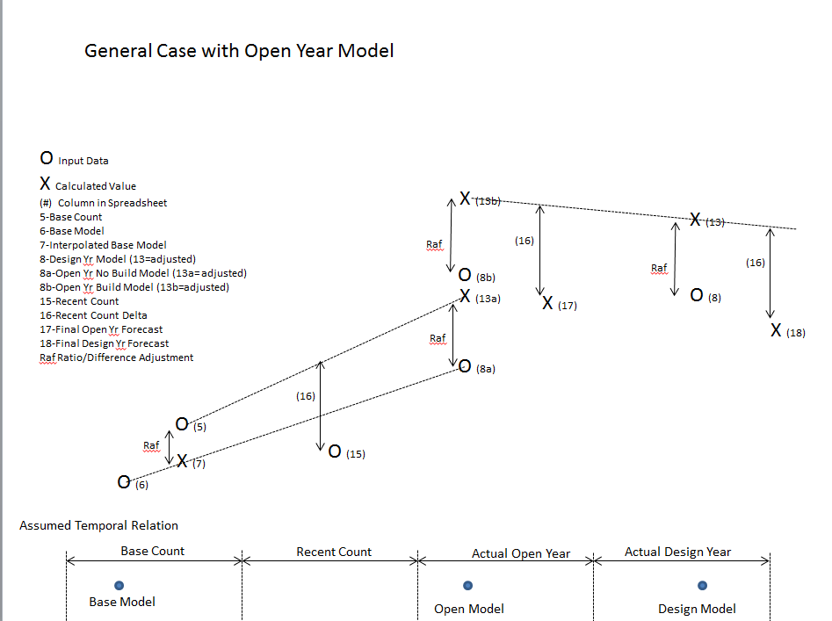
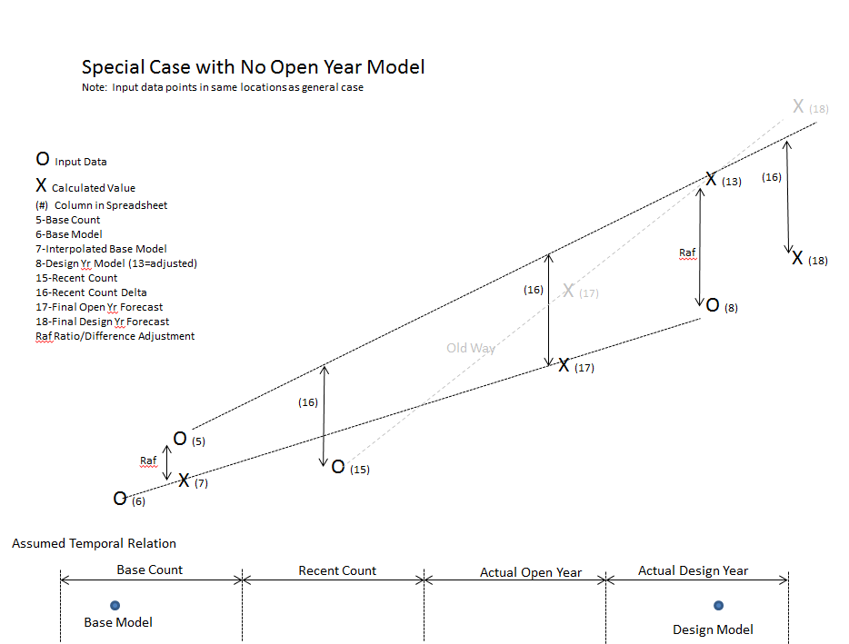
Updated NCHRP255 Procedures
Reconciliation of model to design years requires interpolations, opening year added to process to resolve potential difficulties caused by project diversion
Old Interpolation
New Interpolation

Slide 21
Updated NCHRP255 Procedures
NCHRP255 provided a method using ratios and difference of base year model to counts for adjusting forecasts
  Ratio only for Ratio<0.5 (usually avoids negatives)
  Difference only for Ratio>2 (usually avoids result blowing up)
  Average the two in between
Unfortunately, this method could yield poor results when the forecast model results were significantly different
  Example: count=1000, base model=100, forecast model=10,000, ratio method adjusts to 100,000
Additionally, the method was inconsistent at the boundaries between application of the ratio, the difference or the average

Slide 22
Updated NCHRP255 Procedures
New method is somewhat more complex but alleviates these issues (read on your own):
  Linearly interpolate model base year volume to latest count year (MBVI)
  Calculate Ratio of CNT/MBVI (R)
  Calculate Difference of CNT-MBVI (D)
  Calculate Ratio of Model Forecast to MBVI (MR)
  Calculate Adjusted Model Forecast Volume (MFVA) 4 ways:
    Ratio: MFVA=R*MFV
    Diff: MFVA=D+MFV
    Mod Rat: if MR<1 MFVA=R*MFV
    else MFVA=((MR-1)*(D+MFV)+R*MFV)/MR
    RAF: (Diff Meth+ Mod Rat Meth)/2
  Select Method
    If 1<R<2 and MR<=1: RAF
    If R<=1 and MR<=1: Ratio
    If 0.5<R<2 and MR>1: RAF
    If R<=0.5 and MR>1: Mod Rat
    If R>=2: Diff
Key difference is to account for ratio of forecast model to base model

Slide 23
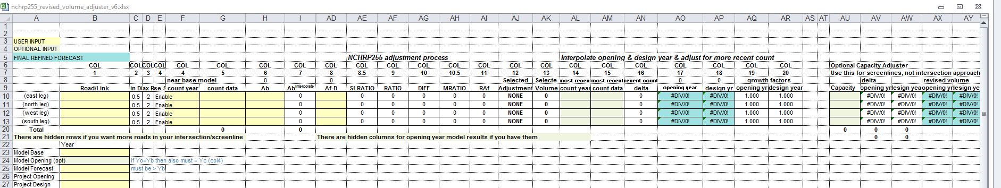
Updated NCHRP255 Procedures
Old screen line procedure allocated forecast in proportion to capacity
Fine if near saturation but in reality there are many factors besides capacity that determine route allocation
New method pivots from independent route estimates, only reallocating over-capacity volumes to under-capacity routes (at saturation will match the old method)
Also added ability to apply link-wise adjustments to links with no base count (such as new roads) using the screen-line values

Slide 24
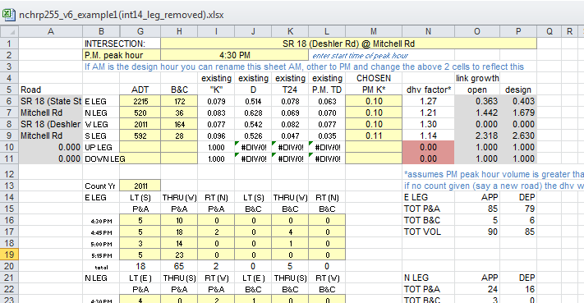
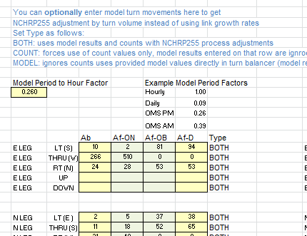
Updated NCHRP255 Procedures
Turn Movement procedure heavily modified
  Allows input of model turn movements
  Allows forcing to adjacent intersection or other exogenous number by turn movement
Count input (similar to old)
Model input

Slide 25
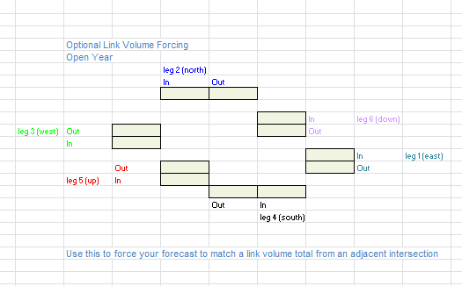
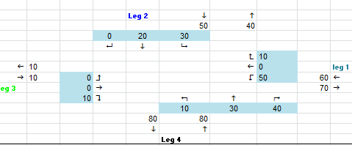
Updated NCHRP255 Procedures
Volume forcing
Final results

Slide 26
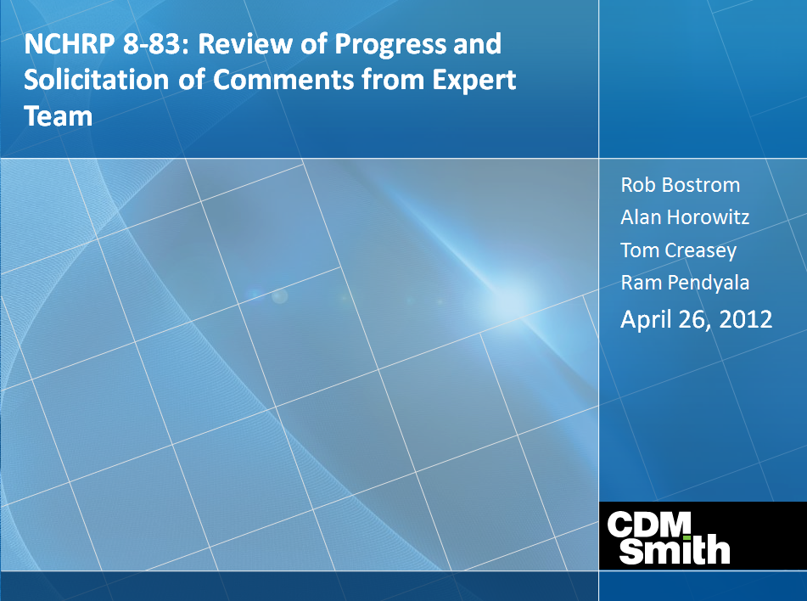
NCHRP 8-83 Project
While ODOT has updated methods internally, these updates tend to be ad hoc
More carefully researched methods are needed so ODOT participates in the NCHRP 8-83 project Technical Advisory Panel
Will cover technical methods and policy issues that did not exist in 1982
Phase 1 research complete and guidebook being produced

Slide 27
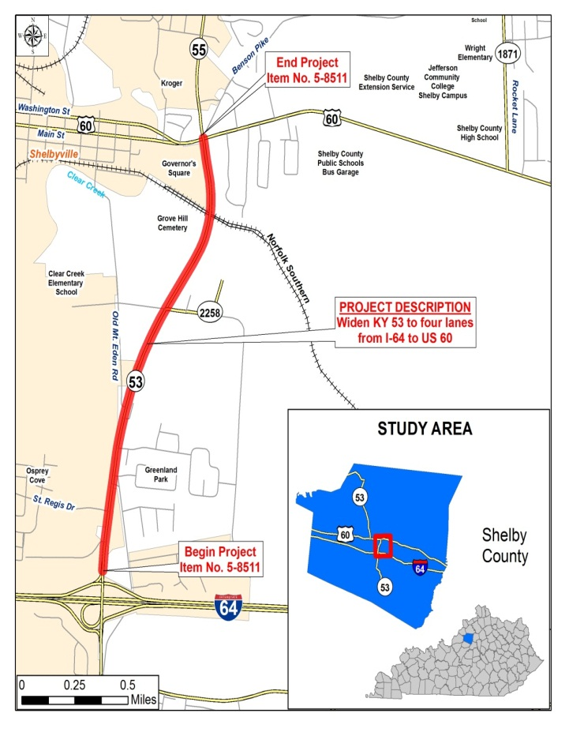
NCHRP 8-83 Project
Guidebook Chapters:
1.0 Introduction
2.0 Fundamental Concept Overview
3.0 State of the Practice
4.0 Traffic Forecasting Tools & Methodologies
5.0 Steps in project level forecasting
6.0 Work with a travel model
7.0 Model Output Refinements
8.0 Increasing spatial detail of traffic models
9.0 Improving temporal accuracy of traffic forecasts
10.0 Traffic forecasting methods for special purpose applications
11.0 Tools outside of Travel Models
12.0 Integrated Case Studies

Slide 28
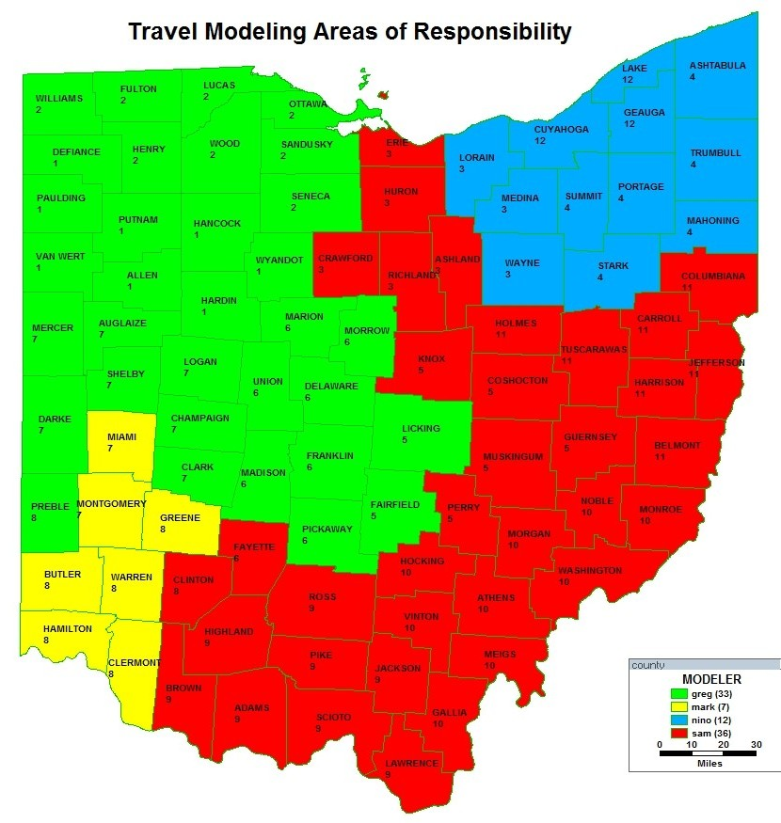
More Involvement of Modelers
with Project Forecasts
Large volume of project forecast requests means ODOT needs staff dedicated to this
Historically modeling staff and project forecasting staff were in separate sections
Merged over 15 years ago
Took some time to overcome inertia (from modelers) and get modelers more involved with the project forecasts

Slide 29
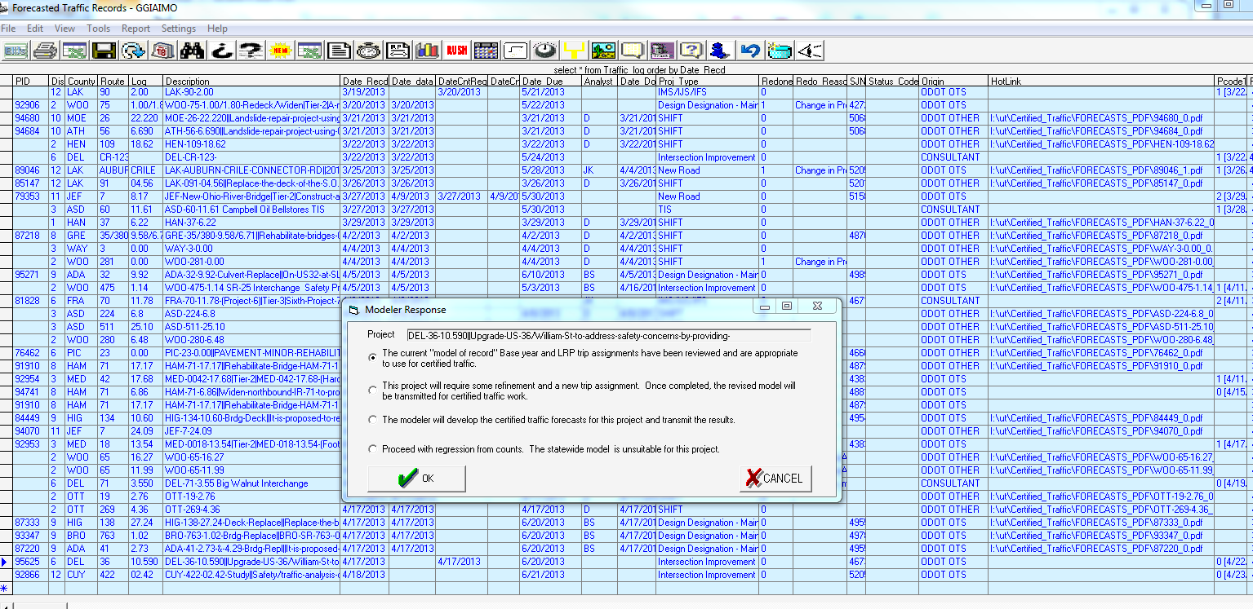
More Involvement of Modelers
with Project Forecasts
Established procedure in project forecasts tracking application to manage modeler review for complex projects

Slide 30

More Involvement of Modelers
with Project Forecasts
When project specific modeling needed, established technical memoranda and archiving/tracking procedures

Slide 31
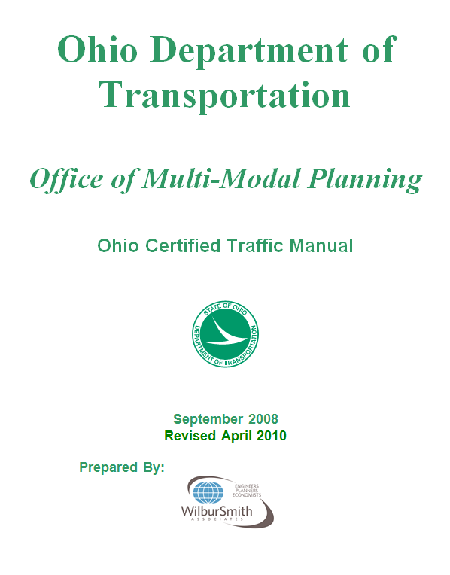

Improved Training and Documentation
High staff turn over and lack of consistency from consultant and MPO developed work
Developed a Design Traffic Manual and Training

Slide 32

Improved Training and Documentation
Includes an Appendix with full guidelines on using travel demand models for project level forecasts
This is coordinated with the ODOT Project Development Process and Federal NEPA guidelines

Slide 33
Improve Travel Demand Models
Improved spatial/temporal resolution and more realistic representation of traffic operations are the primary means (besides making sure your input data is correct) by which modeling for most highway projects are improved
ODOT’s before/after study of the MORPC agent based micro-simulation demand model confirms this
Besides their role in providing policy sensitivity to some emerging but rarely deployed policies, ABM’s do provide some secondary benefits to typical project forecasting since they CAN allow greater spatial/temporal resolution and market segmentation than can be obtained with matrix based methods

Slide 34
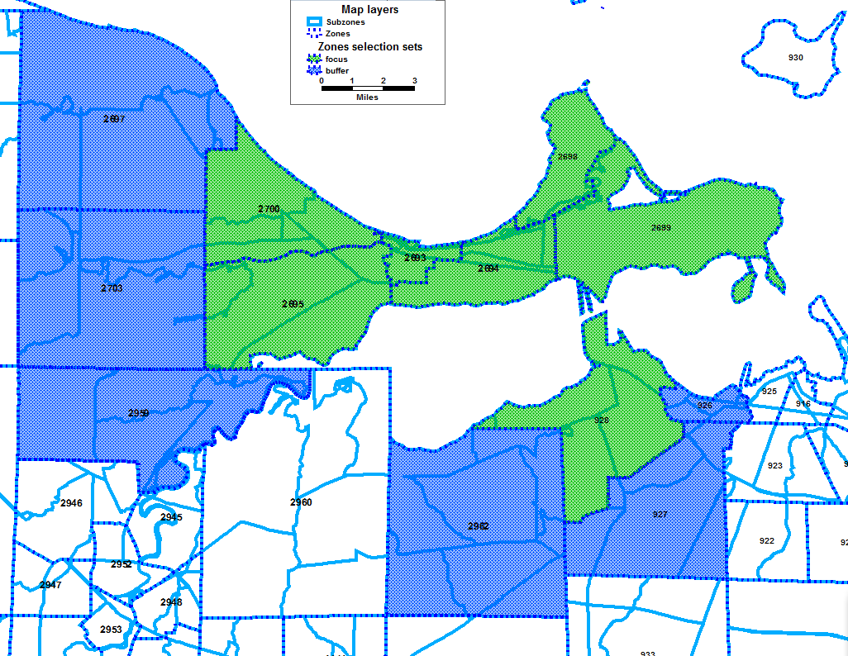
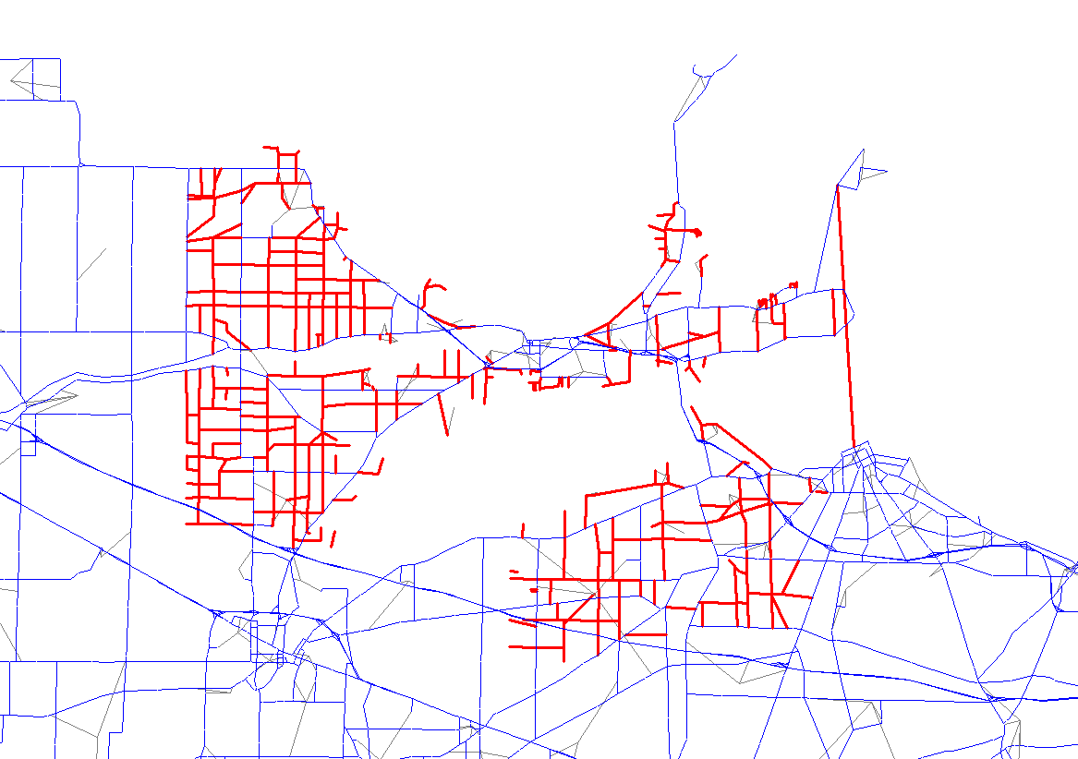
Improve Travel Demand Models
Spatial Resolution
First ADD ZONES
Statewide model can’t tolerate as many as needed (have over 5000, need 20000 minimum) so developed the focusing model which extracts additional zone/network detail for the project area
Added Focus TAZ’s
Added Focus Network

Slide 35
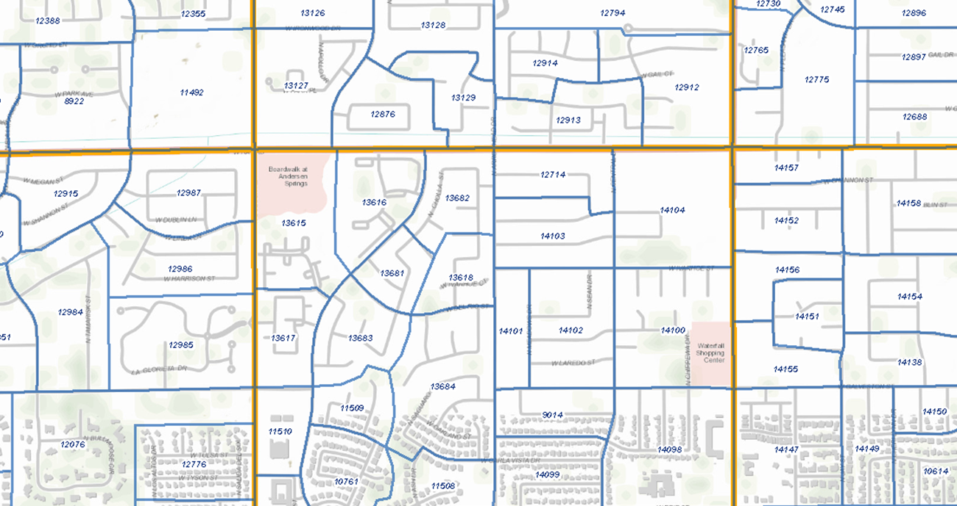
Improve Travel Demand Models
For 3C model, adding micro-analysis zones (MAZ) for better transit representation (we think parcel level adds too much overhead in the travel demand model at this point)

Slide 36
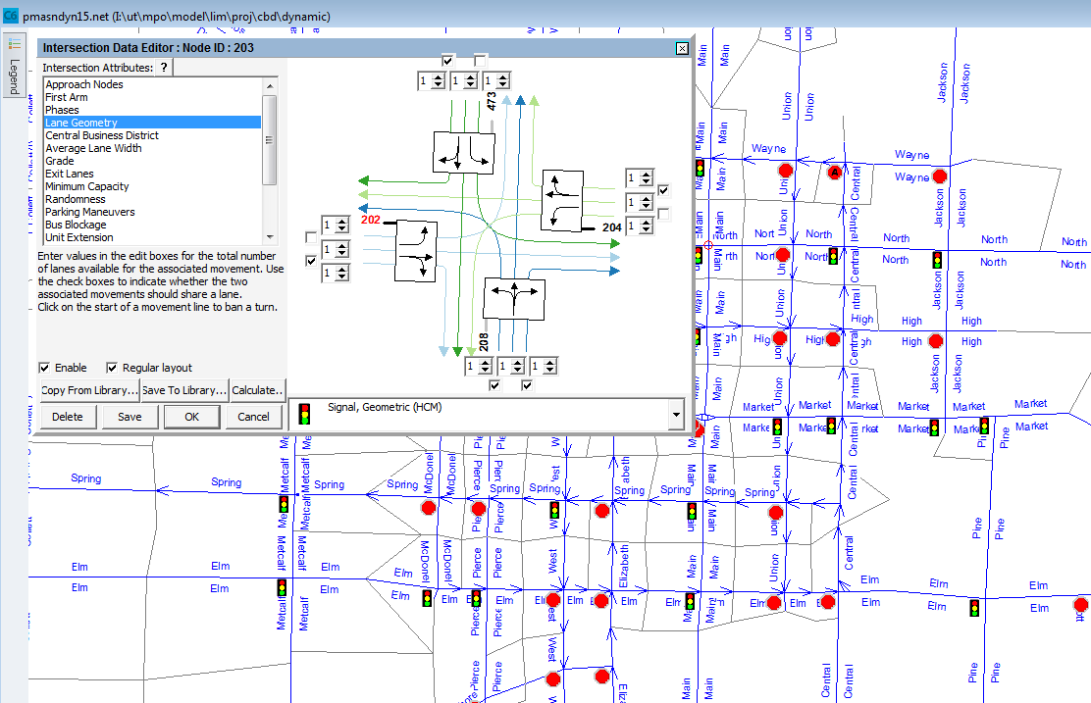
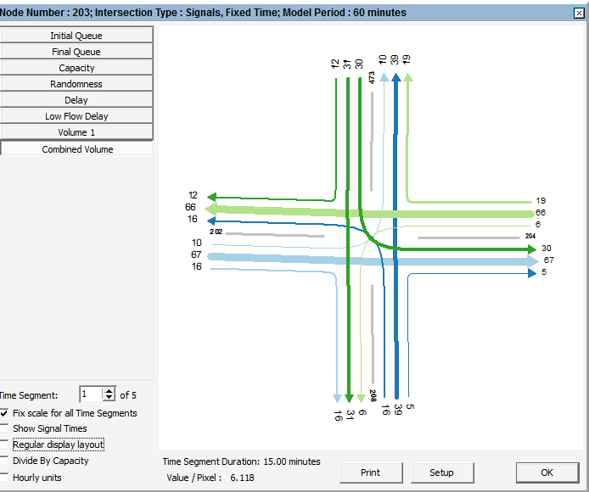
Improve Travel Demand Models
Improved Traffic Operations Modeling
Better traffic operations models achieved with explicit intersection delay models
Required coding 2 new link attributes: turn lanes and control type
ODOT procedure creates Cube junction file on the fly
Also coding new system-wide speed data to networks for speed validation
This added coding eased the transition to more advanced traffic operations models

Slide 37
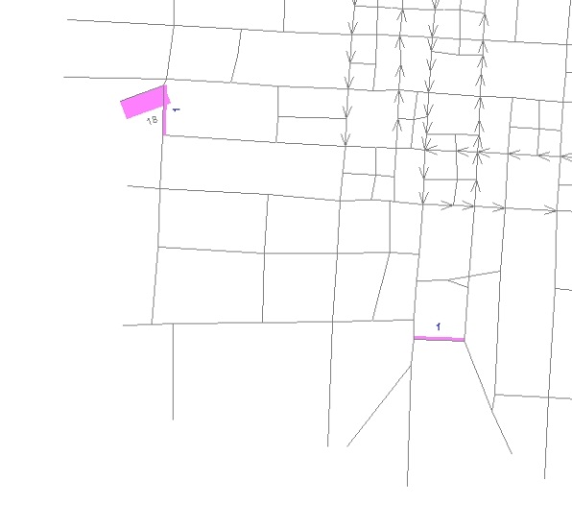
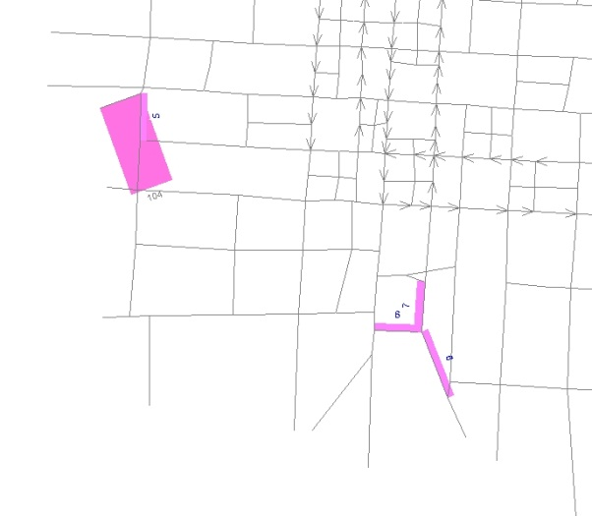
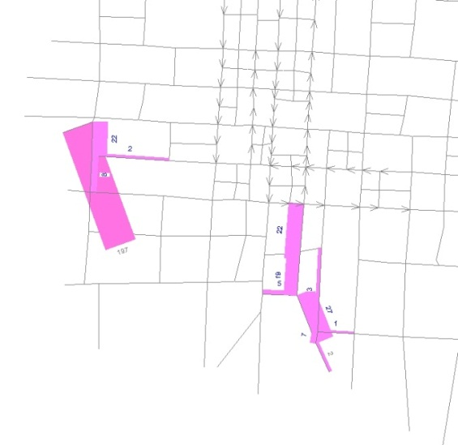
Improve Travel Demand Models
Temporal Resolution
Temporal resolution primarily added by converting all models from daily to period models
For 2010 validation, large effort to code period level car/truck counts and validate to all periods as well as daily
Also running meso level DTA for some projects
Queue Formation at Failed Intersections
Parameters
1 hour model
5 time slices of 15 min
15 min warm up
Period 1
Period 3
Period 5

Slide 38
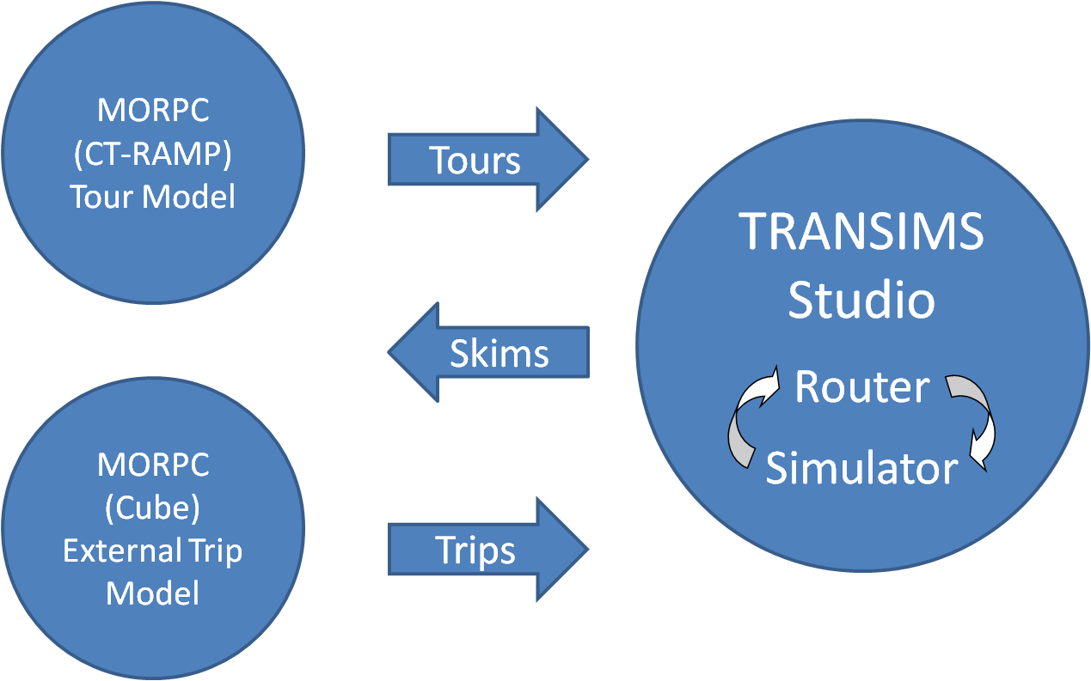
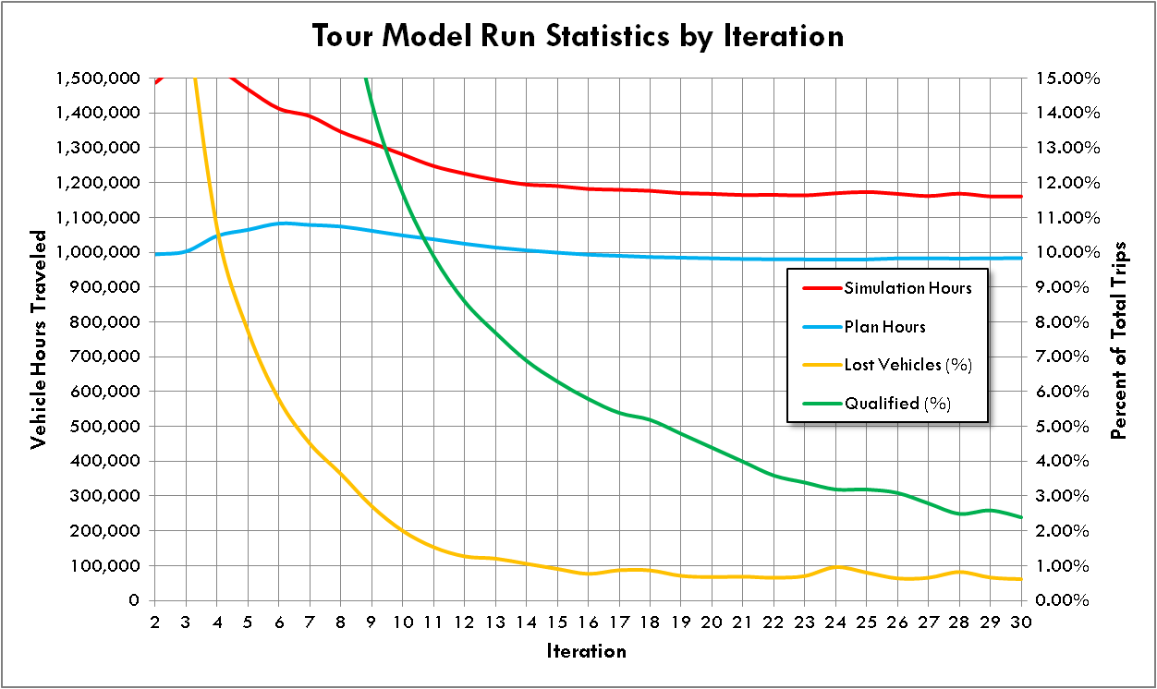
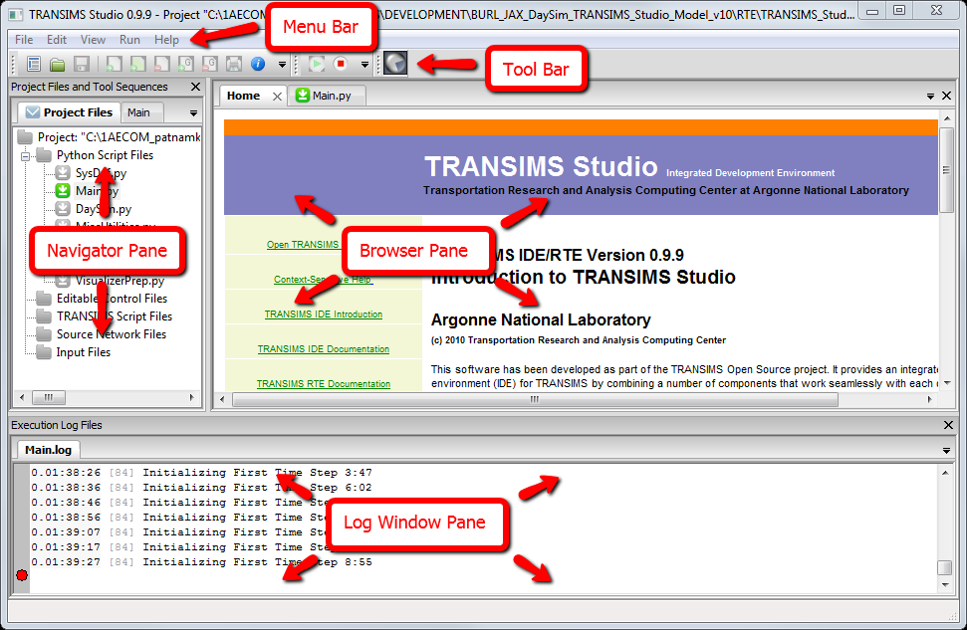
Improve Travel Demand Models
Integrated supply/demand models are the eventual goal
Piloted addition of Transims to the MORPC ABM with two way feedback (implementation is very similar to the SHRP C10A project)

Slide 39
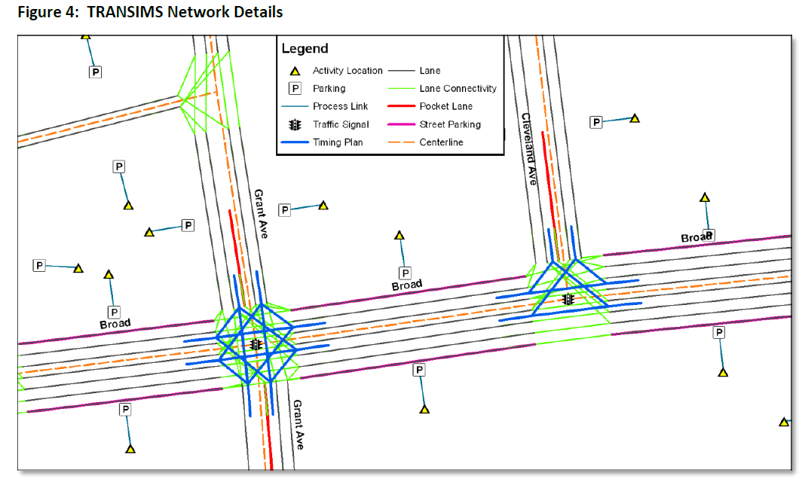
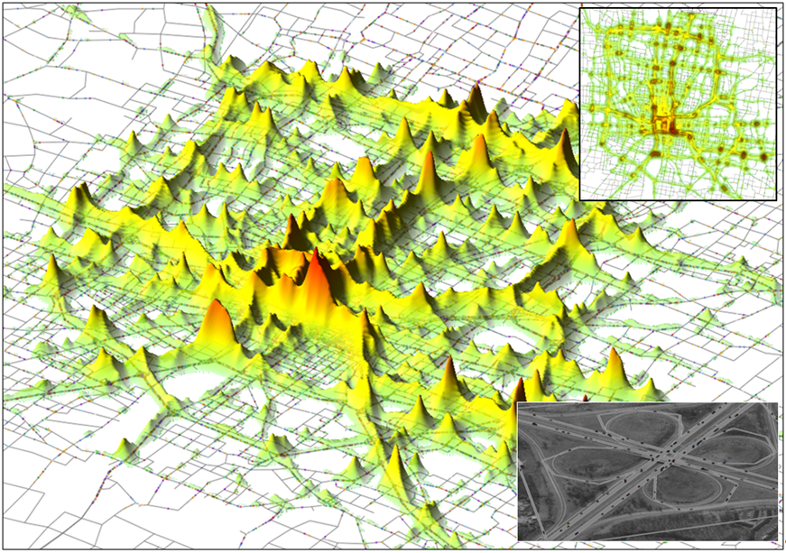
Improve Travel Demand Models
Many useful lessons learned about how the demand model needed to be updated to serve the fine grained supply model:
  Finer temporal resolution
  Keep track of vehicles
  Keep track of who is together/when
  Better info on tour stops, locations/duration/type etc.
  Network needs true shape and signal progression
  You CAN’T synthesis traffic operations details and expect to match real world conditions

Slide 40
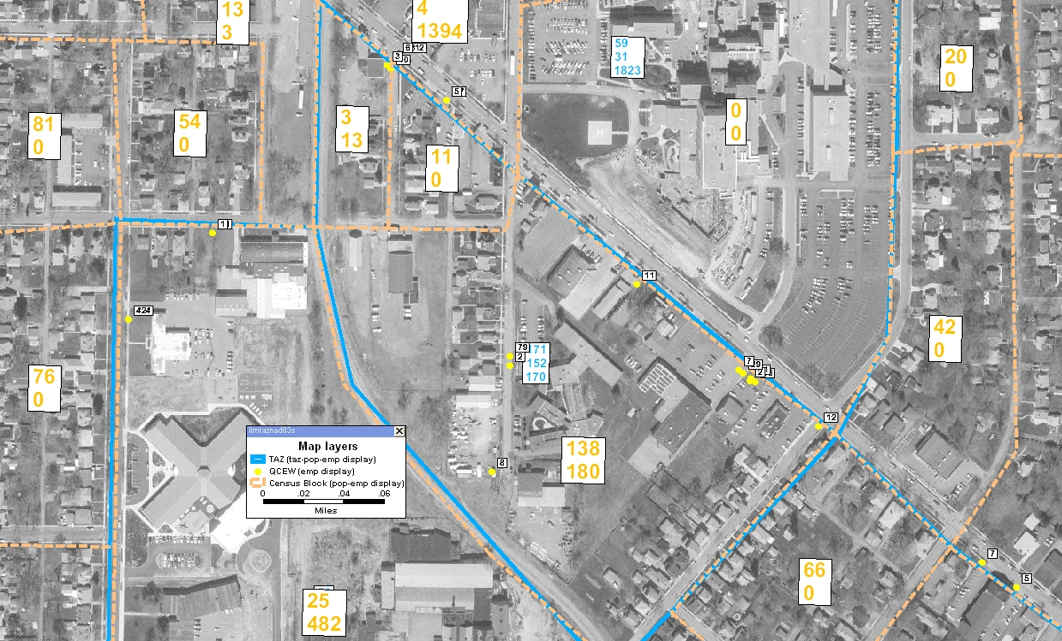
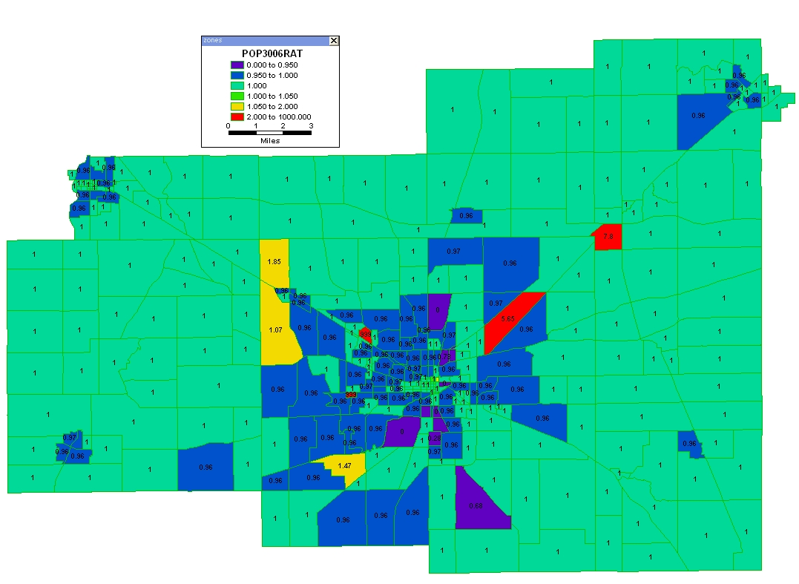
Improved Socio-Economic Model Inputs
The biggest source of inaccuracy in travel demand models is the SE inputs
Most are still developed manually so training is the key
ODOT and the OTDMUG have a rotating series of 4 courses:
  Developing Base and Forecast SE Inputs
  Project Level Modeling
  Turning Model Results Into Information
  Network Coding

Slide 41
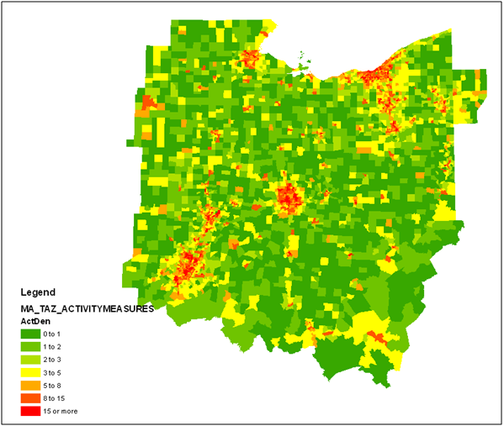
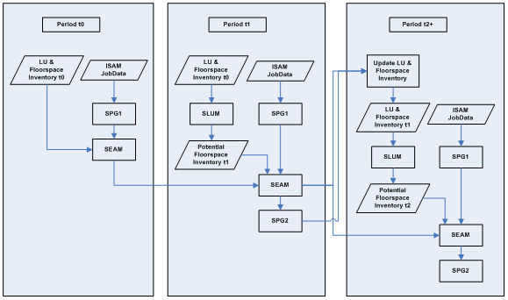
Improved Socio-Economic Model Inputs
Land Use Models
Due mainly to the impossibility of ODOT staff performing the manual SE forecasting process the MPOs use, statewide model has a simple land use model
This has recently been modularized and extracted with the freight model for use by MPOs to generate external and truck trip tables
Another research effort with OSU is expanding upon the MORPC land-use modeling process providing another potential tool for MPO use

Slide 42
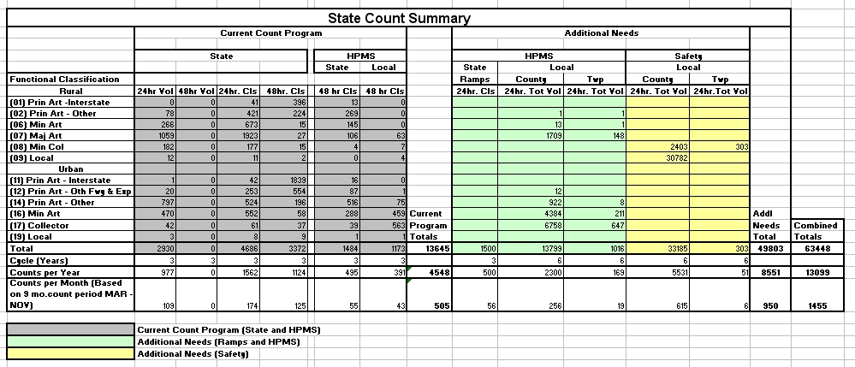
Traffic Count Improvements
Improvements to the traffic count databases from the old ADT on state system only paradigm, allows sub-daily/vehicle class model validation on more refined networks
ODOT has additional requirements (besides modeling/forecasting) driving improvements to its count program
  HPMS requiring full coverage counts
  Safety program requirement for calculation of crash rates on all public roads implies need for volume estimates

Slide 43
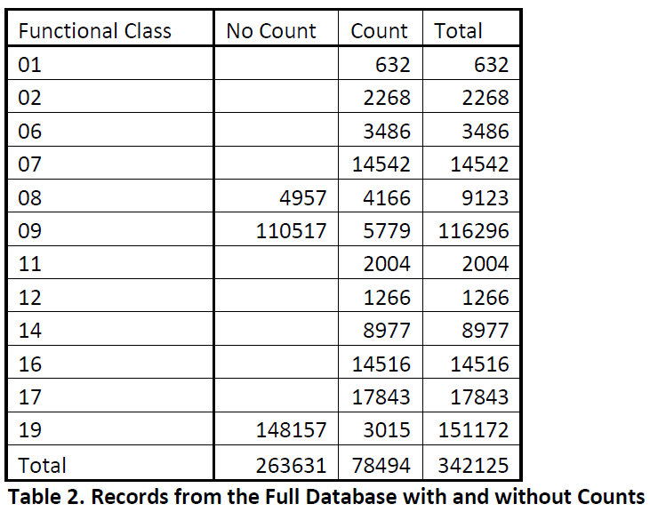
Traffic Count Improvements
Changing database structures to keep more of the raw count information, eventually will move to a “per vehicle record” format
Beyond this, the main challenge is increasing spatial coverage
Recently outsourced all traffic counting to private firms which enables us to collect far more counts
Count stations ODOT cycles through went from 15K to 30K (doesn’t include project specific counts)
But still not enough

Slide 44
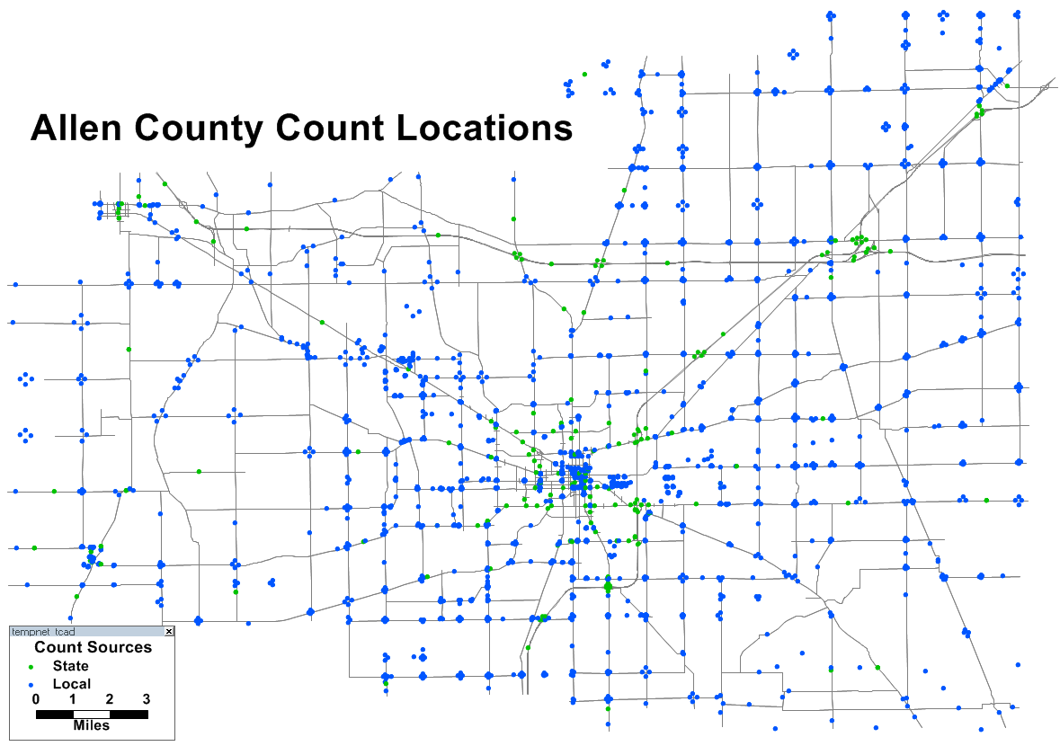
Traffic Count Improvements
The first part of the solution is to obtain local data

Slide 45
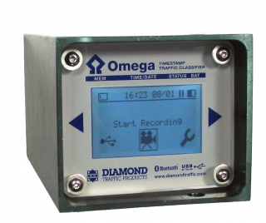
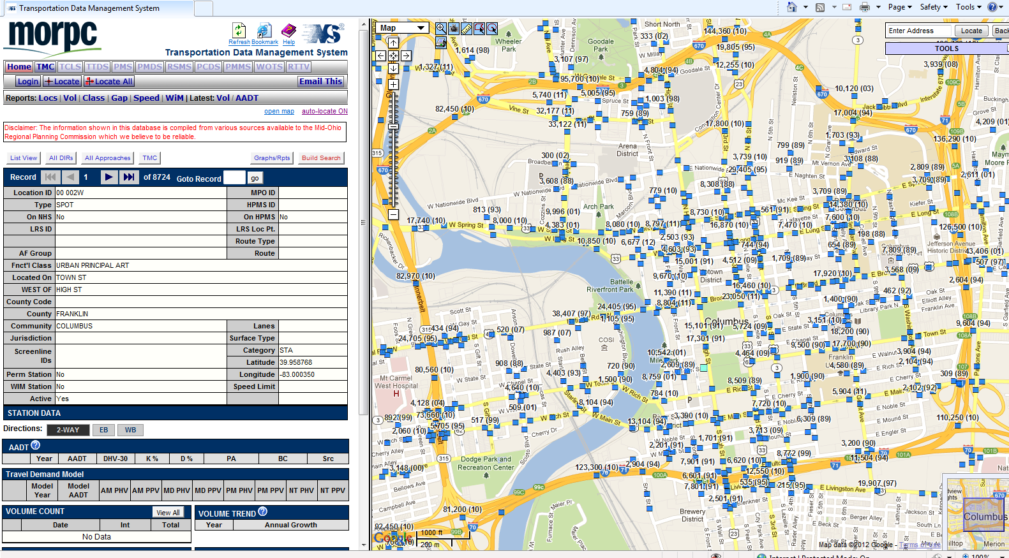
Traffic Count Improvements
Primary out reach is with MPOs and county engineers
Provided 150 traffic counters and training to MPOs
While this effort obtained many counts, very manually intensive and ad hoc
Next phase of the effort is to develop and field a system that will allow ODOT and local agencies to share count data on an on going basis
Looking at purchasing a vendor solution

Slide 46
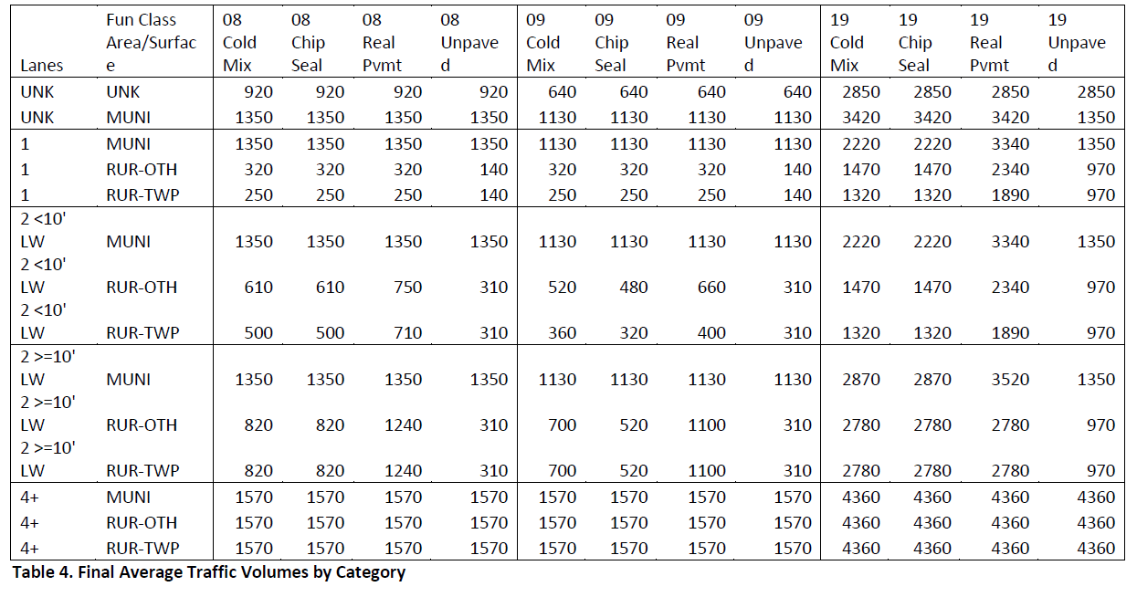
Traffic Count Improvements
Combined resources of local agencies and ODOT still cannot provide a volume estimate for every segment of public road
Solution is to estimate volumes on remaining system
Categorical analysis using the following dimensions found to be the best estimators:
  Functional Class
  Jurisdiction
  Number of Lanes
  Lane Width
  Pavement Type

