Slide 1
Collection of Travel Data on University Populations:
A Tale of 3 Colleges
Prepared for:
TRB Planning Applications Conference
RSG, Inc.
Elizabeth Greene
James Kerrigan
ASU
Ram Pendyala
TTI
Stacey Bricka
Ed Hard
Chris Simek

Slide 2
Outline
Background
General Survey Techniques
3 Case Studies
Comparisons
Conclusions
Notes:
Methodology presentation. Currently discussion with Ram Pendyala (and Chad?) about interest in future presentations on applications/results. Ram wants a “series” of papers

Slide 3
BACKGROUND :: Overview of Work
Authors conducted 3 separate university travel diary surveys in 2012-2013:
Tempe (Phoenix), AZ
16,000 respondents
Utah: 8 colleges/universities
Part of statewide travel study 8,000 respondents
Bryan/College Station, TX
Texas A&M + Blinn Junior College (Still underway) ~2,800 respondents

Slide 4
BACKGROUND :: University Travel Diary Studies
Why conduct university travel diary studies?
Colleges are example “special generators”
Often underrepresented in HH diaries
Often major contributors to a region’s travel demand
Are facilities or institutions that generate atypical trip characteristics
Time of day, day of week, irregularity, use of public transit
Travel demand models typically use trip rates stratified by demographic variables that may not accurately characterize the university population:
HH income, HH size, auto ownership, etc.

Slide 5
BACKGROUND :: What are Differences from a HH Travel Diary?
University populations are fundamentally different in some ways
Trip definition: Include all trips? Only off-campus ones? Set a minimum length?
Coverage:
On-campus & off-campus students are very hard to reach with traditional sampling methods (RDD, ABS)
Generationally:
Motivations for participation
Attention span or tolerance for long surveys
Reliance on technology
In this way, are university populations a good “leading indicator” of needed future changes to transportation surveys?

Slide 6
Outline
Background
General Survey Techniques
3 Case Studies
Comparisons
Conclusions

Slide 7
GENERAL SURVEY TECHNIQUES :: Questionnaire Design

Slide 8
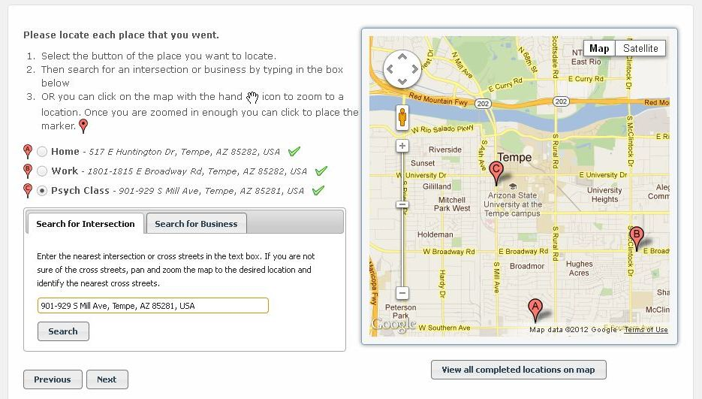
GENERAL SURVEY TECHNIQUES :: Questionnaire Design

Slide 9
GENERAL SURVEY TECHNIQUES :: Administration
What administration techniques improve response?
Assigned Travel Date: Be Flexible:
If completing survey on Tues-Sat: Report travel from “Yesterday”
If completing survey on Sun or Mon: Report travel from “Friday” (most recent weekday)
The basics:
Length (keep it short): supplement with other data sources, e.g. class schedules
Simplicity: ask of just student (not household). Only if live off-campus obtain household demographic info
Mindfulness of semester schedule:
Conduct the survey at “mid-semester”
Avoid exam, add/drop class, and spring/fall break periods

Slide 10
GENERAL SURVEY TECHNIQUES :: Questionnaire Design
What survey characteristics help response (rate and data quality)?
Use a web-based instrument because university populations are tech-savvy and have extremely high rates of Internet access
Maximize tablet/smartphone compatibility as well
Partner with university to give the survey good exposure
Methods of communicating with student population
Number of reminders communication with student population
Incentives offered
Share data back to university where possible
Combine these techniques for a cost-effective survey effort
Notes:
Not only a web-based instrument, but also a tablet/smartphone based instrument
Bulletin boards
Write-ups in campus newspaper
Leverage existing technology systems (e.g. MyASU)
Other advertising (flyers, etc.)

Slide 11
Outline
Background
General Survey Techniques
3 Case Studies
Comparisons
Conclusions

Slide 12
3 CASE STUDIES :: ASU Overview
One of the largest universities in North America
70,440 students
56,562 undergraduate students
13,878 graduate students
12,000 faculty/staff
Four campuses (all within Maricopa Association of Govt boundaries)
Tempe
West
Polytechnic
Downtown

Slide 13
3 CASE STUDIES :: ASU, survey administration
March-April 2012 Recruitment:
Email invitation to entire ASU population
Staggered to spread out reported travel date (“yesterday”)
Email follow-ups in subsequent weeks
Added to “To-Do” list in “MyASU”
Banner advertisements and flyers
Results
Segment | Response rate
Undergraduate | 17%
Graduate student | 13%
Faculty | 20%
Staff | 24%
Overall | 18%
Travel Day | Percent
Monday | 10%
Tuesday | 39%
Wednesday | 11%
Thursday | 14%
Friday | 27%
Total | 100%

Slide 14
3 CASE STUDIES :: ASU, project update
Data use: Enhance transportation modeling/forecasting
ASU = special generator in the current TDM by MAG
Survey data used to update special generator model:
Trip rates
Trip length distributions
Mode specific constants for ASU community
Will use this survey data in activity-based microsimulation model development context, still as an ASU specific model
Project status
Data collection complete: spring 2012
Data analyzed, trip rates calculated: 2012-2013
To be incorporated into MAG’s regional model in 2013
Notes:
With very accurate information about the geographic locations of respondents and their origins and destinations, it is possible to use the ASU travel survey data in an activity-based travel microsimulation model development context. The MAG activity-based travel demand model framework includes an ASU-specific model that requires the synthesis of the ASU student population in the region with the simulation of the students’ activity-travel patterns. The microsimulation model that is specific to ASU is being estimated, calibrated, and validated using the data collected in the web-based survey.

Slide 15
3 CASE STUDIES :: Utah, overview
8 colleges/universities in Utah
6 along the Wasatch Front
Dixie State College (Dixie MPO)
Weber State Univ (Cache MPO)
College survey effort pivoted off the statewide travel diary
Identical survey where possible
Customization of 5-10 upfront questions per college
College | Resp. Rate | College | Resp. Rate
Dixie State College | 5% | Utah State Univ. | 8%
LDS Business College | 11% | Utah Valley Univ. | 5%
Salt Lake City CC | 2% | Weber State Univ. | 5%
University of Utah | 10% | Westminster College | 2%
Notes:
Dixie State College
LDS Business College
Salt Lake Community College
Utah State University
Utah Valley University
University of Utah
Weber State University
Westminster College

Slide 16
3 CASE STUDIES :: Utah, project update
Data collection: March-April 2012
Data weighting/processing: Summer/Fall 2012
Expanded dataset based on student demographic category:
Full-time, living on campus
Full-time, living off campus
Part-time, living off campus
Wasatch Front Regional Council (WFRC) model updates: Spring 2013
Improve college trip generation based on college physical location head count
Improve mode choice (some colleges have strong transit ridership, others do not)
Improve time of day students travel (students have a strong morning peak, but return scattered through the day)
Differentiate better by individual college in trip making (previously aggregated together)

Slide 17
3 CASE STUDIES :: Texas A&M, overview and administration
Conducted as part of the regional travel survey in Bryan/College Station Texas (BCS)
Combined student population: 65,000
Recruitment
In-person intercepts on campus: tablet computers or online (later)
Household survey is screening for college students
Web surveys: two student-wide email invitations (latest was mid-April) – 90% of response
Data use:
Develop student trip rates by various stratifications:
On-campus vs. off-campus residents
Undergraduate vs. graduate students
Full-time vs. part-time
Non-resident student travel to be modeled separately from resident travel

Slide 18
Outline
Background
General Survey Techniques
3 Case Studies
Comparisons
Conclusions

Slide 19
Comparison: ASU Time of Day Distribution of All Trips

Slide 20
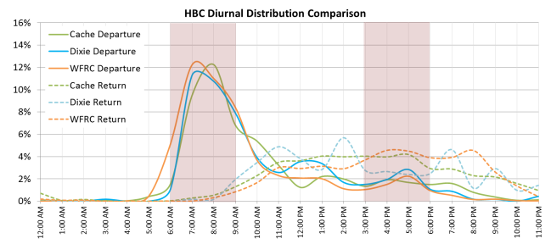
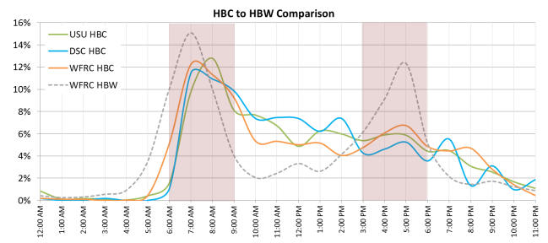
Comparison: Utah Colleges Diurnal Distribution
Colleges have similar HBC diurnal distributions
Students come back from campus throughout the day without a PM return peak
Current models assume HBC has a similar diurnal distribution with HBW

Slide 21
Outline
Background
General Survey Techniques
3 Case Studies
Comparisons
Conclusions

Slide 22
CONCLUSIONS
What is our most general takeaway?
Travel diary surveys at special generators, especially large universities…
SHOULD NOT BE FEARED
ARE COST-EFFECTIVE
What are the most successful techniques?
Web-based instrument
Design an efficient and user-friendly survey instrument
Hinge off design of household diary design, where possible
Use “yesterday” as assigned travel date
Partner with the university
Carefully consider administrative methods and schedule to maximize response and data quality
Day of week, time of day, staggered invitations, incentives, etc.
Defining the trip: always complicated, but especially at universities, where on-campus movements are hard to classify
Application (4-step vs. activity-based) helps inform definition
Notes:
Given advances in web-retrieval software and the technologically savvy nature of campus populations, data can be obtained in a relatively cost-effective manner

Slide 23
THANK YOU!
Acknowledgements
Arizona State University (staff and grad students)
Maricopa Association of Governments
Wasatch Front Regional Council
Mountainland Association of Governments
Dixie Metropolitan Planning Organization
Cache Metropolitan Planning Organization
Utah Department of Transportation
Utah Transit Authority
Texas Transportation Institute
…and of course, all the survey participants!

Slide 24
THANK YOU!
Questions?
For more information about the projects…
Utah Colleges/Universities Study:
Elizabeth Greene: Senior Consultant, RSG, Inc.
Elizabeth.greene@rsginc.com
ASU Travel Study:
Ram Pendyala: Professor, Arizona State University
ram.pendyala@asu.edu
Texas A&M/Blinn Junior College:
Stacey Bricka: Program Manager, Texas A&M Transportation Institute
s-bricka@ttimail.tamu.edu

