Slide 1

How much convergence is enough for traffic assignments used in feedback?
John Gibb
DKS Associates
For the 14th TRB National Transportation Planning Applications Conference
*Annotated version* - see notes.
Notes:
Annotated, with things I said and meant to say. Thanks for the interest many have expressed after the talk, so here I try to clarify and expand on it.
I sometimes wonder why we have so many conference presentations and papers on model convergence. From an engineering background, I have a little bit of envy to modelers of structures, water, etc. Many of their models are from well-understood physics, and use algorithms the mathematicians have been optimizing for centuries. Some just push a “calculate” button, and take for granted that their iterations are converged well, or get a clear report when they don’t.
Not so with transportation planning models. It’s up to us both to configure the method and specify the degree of a model’s convergence, and verify it actually converged properly.
The overall purpose is to figure out how to best achieve equilibrium of the combined travel-demand and network performance problem, using feedback methods generally known to be capable of such a solution for practical travel models – while minimizing runtimes.

Slide 2
Partners, Sources, Assistance
Sacramento Area Council of Governments
Puget Sound Regional Council
John Bowman, Mark Bradley, RSG
Carson Area Metropolitan Planning Organization
Spokane Regional Transportation Council
Citilabs
PTV America
Caliper
Inro Consultants
Notes:
My major impetus is two large activity-based models, for SACOG and PSRC.
Also developing and/or improving three trip-based models.
The agencies, team members, and I have been bringing tough questions and frank complaints to our software vendors, and we appreciate their responsiveness.

Slide 3
Convergence of traffic assignments: How much is enough?
David Boyce
Biljana Ralevic-Dekic
Hillel Bar-Gera
ASCE Journal of Transportation Engineering 130, 49-55 (2004)
Link flow stability – avoid random noise
Relative gap → 0.0001
Notes:
This presentation’s title is based on this. Recommended reading for model practitioners. Much of this paper’s content is also in Dr. Boyce’s course notes (in http://www.civil.northwestern.edu/people/profiles/boyce.html).
We can thank them for making it clear that random noise and spurious flow changes are not an inevitable “feature” of models, but arise from inadequate convergence of assignments (although other causes can contribute).
And that we’ve needed considerably finer convergence than previously thought, or easy to get with the Frank-Wolfe algorithm.
We can also thank Dr. Bar-Gera for starting a revolution in making fine convergence possible and practical, beginning with his Origin-Based Assignment.
I think “how much is enough” depends on the questions being asked of a model, and is hard to pin down to a single criterion. I also think such facts that we are modeling people rather than physics, that traffic varies from day to day, that equilibrium is an idealism, and that models are seldom accurate compared to ground counts, are *not* reasons to settle for poor convergence. Dr. Boyce, in his presentation preceding mine on another topic, quoted Box and Draper, “all models are wrong, but some are useful.” One use of a travel model is to estimate the impact of a project to a region; spurious flow differences far from a project seriously impair a model’s usefulness and credibility for this purpose, and are not necessary.
Dr. Boyce and I agreed there isn’t a suitable journal or professional society for modeling practitioners to read or publish papers like this. These Applications Conferences are our best exchange. (Software user conferences may contend for this role, but are less expected to include presentations and papers such as this Boyce paper, which didn’t make any product look good at the time.)
(According to http://en.wikiquote.org/wiki/George_E._P._Box, this quote is correct, from a different page of the same book which also states “Remember that all models are wrong; the practical question is how wrong do they have to be to not be useful.” George Box and N. R. Draper, Empirical Model-Building and Response Surfaces, 1987. Dr. Box very recently passed away in March 2013 at 93.)

Slide 4
The rest of the assignments
Skims
Skims
Skims
Skims
Demand model
Demand model
Demand model
Demand model
Assignment
Assignment
Assignment
Assignment
Link times
Link times
Link times
Link volumes
Notes:
I’m examining the assignments nobody looks at – which is most of them in a modern model.
Modern demand models are iterative. We seek consistency between travel times entering the demand model, and those resulting from assigning the demand.
Feedback assignments are mainly used for their link times (but some successive-average schemes use link volumes).
Link times determine the next skims, which determine the next iteration of the demand model.
(Here I consider an iteration to begin with skims, and end with assignments.)
The skims are changing from one iteration to the next, normally less each time as the model converges.
Assignments are themselves iterative. How much do we need to converge them, so we don’t overwhelm the skims with noise, and limit convergence?
Flip side: despite recent advances, assignments take a long time – with more stringent convergence requirements, more time periods, user-classes, and zones. Can we cut short those early assignments (between which, travel times are fluctuating anyway) to speed up runtimes, and not impair convergence?

Slide 5
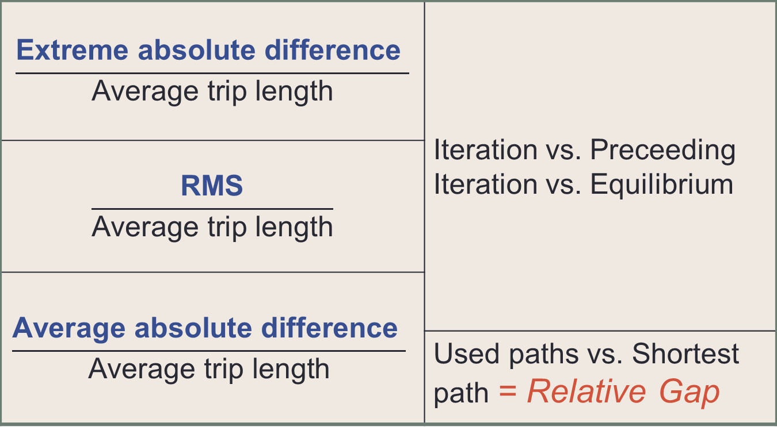
Skim comparison statistics
$$\frac{\text{Extreme} \text{absolute} \text{difference} }{\text{Average} \text{trip} \text{length}}$$ | Iteration vs. Preceeding Iteration vs. Equilibrium
$$\frac{\text{RMS}}{\text{Average} \text{trip} \text{length}}$$
$$\frac{\text{Average} \text{absolute} \text{difference} }{\text{Average} \text{trip} \text{length}}$$
 | Used paths vs. Shortest path = Relative Gap
Notes:
These are statistical measures of how much two skim tables differ from one another. Every feedback model should report successive-difference statistics such as these, and others such as displaced trips, and traffic volume changes, to monitor its convergence. (I’m usually in catch-up mode trying to find opportunities to insert more of them into models in my charge. It often requires adding some extra data file management schemes to be able to compare an iteration’s data to the previous iteration’s before it gets overwritten.)
Relative measures are chosen so they are dimensionless, as is the relative gap.
Mostly studied *weighted* averages (average absolute and RMS), weighted by the trips assigned. (Unweighted average results are not as consistent between areas.)
While not usually presented as such, the relative gap is also a relative weighted-average difference between skims, between OD’s average of the paths used, and shortest-path. (Used-paths skim matrices are not a usual feature of model software, but at least one, Visum, offers them as an option.)
I was in a conversation with a colleague about equilibrium and consistency among the model’s components, and was asked why we are using shortest-path skims; wouldn’t it be more consistent to use the times on the paths actually taken? In practical terms, one is much easier to get in most software. But the deeper reason is that if the assignments are converged to equilibrium, then the two are equal anyway.

Slide 6
Convergence Progress of a Trip-Based Model – AM Skim Change
Notes:
Sacramento (unofficial) trip-based model runs, all same except RG setting in all assignments of any given run.
Demand matrix successive-averaging is constant-weight = 0.6
Rapid convergence until stagnation. Notice that a small relative gap does not buy us a faster demand-model convergence; it only determines when the progress stops.
Stagnation level seems to correlate with RG setting.

Slide 7
Convergence Progress of a Trip-Based Model – AM Displaced Trips
Notes:
Successive displaced trips show similar stagnation pattern as skims, but an iteration or two later.
Relative displaced trips = sum across trip matrix of absolute values of flow change / sum of trips assigned

Slide 8
Convergence Progress of draft Sacramento Activity-Based Model
Notes:
I have already been doing some models with larger RG in early demand-model iterations, then ramping it down.
Doing this saves considerable runtime: FW assignments in first 8 iterations take less combined time than the last two.
This RG schedule was determined by trial-and-error, trying to minimize runtime and final skim-delta measures.
But does RG tighten enough? Or too much? Trial-and-error tests take a long time, and have numerous degrees of freedom.
You can’t tell from this graph – although it draws RG and skim-deltas together, they might be apples-and-oranges.
I want a rational way to assess this relative gap schedule in relation to its convergence progress. Stagnation tests take a long time.

Slide 9
Skim error study
Trip Table & Network
Well-converged assignment
Less-converged assignment
Poorly-converged assignment
Skim
Skim
Skim
Comparison statistics
Comparison statistics
Notes:
I haven’t found any studies on the relationship between the convergence level of an assignment, with the error level of the resulting skim matrix. So I did one.
How can we compare assignment convergence with skim error?
Assign a trip table to best practical convergence
Build its skims (using this assignment’s link times) for reference
Run less-converged assignments
Build their skims for comparison
Generate comparison statistics

Slide 10
Skim comparison: unconverged vs. best equilibrium
Notes:
A sample of 4000 randomly-selected O-D cells in a matrix.
Finer convergence comes tighter to the y=x line.
Shows tendency of shortest-path skims to be biased low.
It might be tempting to guess that the equilibrium skims are in between the shortest-path skims, and the average times on the used paths. They are not necessarily - for the same reason that the equilibrium VHT is not the minimum.

Slide 11
Skim Error v. Relative Gap: Sacramento AM (F-W)
Extreme
RMS
convergence
Notes:
“Swarm plots.” Here begin a series of slides showing three summary statistics of skim error (relative to the best converged available), versus relative gap of the preceding assignment.
This should appear as three prominent series, in front of faded-out superset of more data (to be highlighted in turn in next slides). I will flip through the series fairly quickly, just to identify the variety of models contributing to these results.
Three different ways to measure difference between skim following assignment at the given relative gap, and skim from best-converged assignment.
RMS and Avg-Absolute differences are trip-weighted averages of all O-D pairs, relative to trip length. Extreme is largest absolute difference relative to trip length. 1 sec is roughly 0.001 in both axes.
Highlighted is Sacramento trip-based model, AM peak period. Cube Voyager Frank-Wolfe. Conical congestion functions.
“Skim error” in this presentation refers to the difference between skims of an assignment to skims of a well-converged assignment of the same trips on the same network. This is not a comparison to real-world or field measurements – which is itself a worthy and timely topic of study.
“Posterior” relative gap here means it is the relative difference in vehicle-hours on the assignment’s actual flows and travel times, and the shortest paths skimmed *after* the assignment. Usually, assignment programs report the relative gap of the iteration *before.*
I obtained so many data points from the Frank-Wolfe assignments in Cube Voyager by coding the matrix calculation within the assignments themselves, yielding a point for each assignment-iteration – a capability not seen in the other prevailing software packages.

Slide 12
Skim Error v. Relative Gap: Sacramento Mid-Day
Extreme
RMS
convergence
Average-Absolute
Notes:
Highlighted is Sacramento trip-based model, Mid-Day period. Cube Voyager Frank-Wolfe.

Slide 13
Skim Error v. Relative Gap: Reduced congestion (AM)
Extreme
RMS
convergence
Average-Absolute
Notes:
Highlighted is Sacramento trip-based model, AM demand proportionally reduced for low congestion. Cube Voyager Frank-Wolfe.

Slide 14
Skim Error v. Relative Gap: Increased congestion (AM)
Extreme
RMS
convergence
Average-Absolute
Notes:
Highlighted is Sacramento trip-based model, AM demand proportionally increased for higher congestion. Cube Voyager Frank-Wolfe.

Slide 15
Skim Error v. Relative Gap: BPR^8(AM)
Extreme
RMS
convergence
Average-Absolute
Notes:
Highlighted is Sacramento trip-based model, AM base demand, but with BPR 1 + (v/c)^8 congestion curve. Cube Voyager Frank-Wolfe.
Individual comparison curves shift around some, but all stay in the same neighborhood.

Slide 16
Skim Error v. Relative Gap: Visum (Spokane)
Extreme
RMS
convergence
Average-Absolute
Notes:
Highlighted is Spokane model, AM period, Visum path-based assignment.
Solid compares shortest-path skim; dashed lines compares used-paths skim, an option only available in Visum, to my knowledge.
As expected, the average difference between used-path and shortest-path skims reasonably duplicated the relative gaps reported for the next iteration.
This is with Visum’s standard path-based equilibrium assignment on version 12.0, not the newer LUCE algorithm, with which I could not obtain appropriate results. As of this writing, Visum 12.5 was recently released with significant revisions to the LUCE application, but I did not have the opportunity to re-make these tests with it.

Slide 17
Skim Error v. Relative Gap: TransCAD (Carson City)
Extreme
RMS
convergence
Average-Absolute
Notes:
Highlighted is Carson City model, PM and Mid-Day assignments using TransCAD Origin-Based User Equilibrium.
Solid is PM; dashed is Mid-Day.
Only weighted is RMS available presently for this model.
All results, across different time periods of the day, congestion level, flow-delay curves, area size, and software & algorithm, “swarm” around the same neighborhood for each measure. I welcome explanations (or counter-indications) from theory, and more data points from others (corroborating or not).
Some particular tests roughly track a direct proportion between skim error and RG, while others have slightly flatter slope across most or all of their ranges. That is, skim errors sometimes converge proportionately slower than relative gap. Why? Does anyone want to study that?
TransCAD has an easy-to-apply function “MatrixRMSE,” but this gives an unweighted relative RMSE. Caliper tech-support provided a weighted-RMSE calculation in the script language, into which average-absolute and extreme differences should be easily added.
The “swarm plots” of unweighted RMSE varied quite a bit more between cities. A probable reason for this is that the unweighted difference is more sensitive to how many O-D pairs exist between fringe-area zones with few trips and little congestion between them.
Sorry, no EMME results. PSRC is doing a large and good job building feedback-equilibration around ABM, but that model’s convergence-measures calculations have not been developed yet.

Slide 18
Convergence Progress of a Trip-Based Model – AM Average Skim Change
Notes:
Repeat of Sacramento trip-based model stagnation, AM skim deltas.
Color-bands roughly around stagnation range.
Model has some lingering round-off errors likely contributing to flattening stagnation range.
Now, imagine the RG as a depth dimension, the higher RGs farther back. Next, imagine we rotate this chart to look at those stagnation bands end-on from the right. Those will be the colored circles on the following plot…

Slide 19
Skim Error, AM changes v. Relative Gap
Extreme
RMS
Average-Absolute
Notes:
Color-bands projected from stagnation range of model’s Abs-Avg skim-deltas.
Circles on the respective model’s RG, and stagnation range.
Stagnation is not quite proportional, tracking the top of the skim-error range. Flattening, rather than exact tracking of the skim-errors, might be due to round-off and similar errors that I suppressed from that trip-based demand model but have not entirely eliminated. (Further study…)

Slide 20
Convergence Progress of a Trip-Based Model – Mid-Day Avg. Skim Change
AM
Mid-Day
Notes:
The same Sacramento trip-based model stagnation, now for off-peak skim deltas.
The AM plots from before are shown dimmed, for comparison.
So much lower, for the same RG!
Out-of-order, too!
Can we really infer that the skims are an order-of-magnitude more accurate?
Didn’t I just show in the swarm plots that the skim errors due to relative gap are much more consistent than that, across wide variations in congestion levels?
Next, the same rotation of the color-bands onto the error swarm-plot as before…

Slide 21
Skim Error, MD changes v. Relative Gap
Extreme
RMS
Average-Absolute
Notes:
Color-bands projected from stagnation range of model’s off-peak Abs-Avg skim-deltas.
Circles on the respective model’s RG, and stagnation range.
For worst-converged, successive skim differences are much less than from better-converged.
Conjecture: Same paths chosen in early assignments iterations, but different paths chosen later.
- Some supporting evidence: assignment iteration progress reports look similar in first iterations but break step later.
- Further study indicated.
* Caution when relying on successive-difference measures alone as convergence measures! *
It appears that if the congestion level is low, and the assignment gap tolerance is large, then successive skim differences may be quite lower than actual skim errors.
The demand model could actually “converge” to very small successive-skim differences – and not be in equilibrium!

Slide 22
Conclusions
Relative Gap seems to imply relative skim errors.
Successive skim differences can be misleading – less than skim error implied by RG – esp. in low congestion.
Choose Relative Gaps to create small skim errors compared to skim changes.
  Low RGs don’t seem to accelerate demand convergence, but high RGs limit it.
  Doing so should avoid the misleading-differences problem.
This is a small study of a few models. Test your own!
Notes:
Relation between RG and Relative Skim Errors is fairly consistent across a range of congestion levels & curves, software & algorithms, area sizes.
You can skimp on the convergence, to a limit, on the assignments nobody will look at – and save a lot of runtime. This study helps identify that limit, although it remains somewhat “soft.” But just to be clear: Don’t use inadequately converged assignments for anything – except to continue further convergence of the model!
More studies are wanted, especially with better-converging assigners. The more are amassed, the better a paper to publish, with contributors gratefully acknowledged. And the better we can firm up those soft skim-error limits, if the relation shown holds up among more studies.
Further study:
An “endgame strategy” – what RG to apply to next-to-last assignments is enough for the final demand model iteration?
I plan to start adding link-volume change measures, in addition to skim and displaced-trip measures. These may help inform the “endgame strategy.”
Gain experience using these results to improve equilibrium and minimize runtimes.

Slide 23
Convergence Progress of draft Sacramento Activity-Based Model
Notes:
The same skims-change progress chart as before for the draft Sacramento ABM.
The expected error estimate due to assignment is added, from a rough eyeballed relation Rel Abs Error ≈ Rel Gap ^ 0.8
The skim-change curves are the farthest below the estimated error for iterations 4, 5, and 6. This might account for the slower progress of demand-iterations 5, 6, and 7 compared to the first 4.
My advice to myself is to tighten up the assignments in demand-model iterations 4-7. (And reduce the RG criteria afterwards enough to continue their ramping down.)
The final decision to do so will weigh increased runtime in those iterations against improved and/or hastened final convergence. There’s still some trial-and-error, but with so many degrees of freedom to decide among, it helps to have a new basis to decide what to try next.
As with the trip-based model, the low-congestion periods (evening ev2 and overnight ni9) are doubted to be any more equilibrated than the rest. (Not that it would matter: demand for all the time periods is calculated together.)

Slide 24

Contact
John Gibb
jag (at) dksassociates (dot) com
Notes:
Inquiries are welcome for further details, comments, and results from other models that add to or challenge my findings.

Slide 26
Extra slides
Notes:
Extra slides prepared but left out of the presentation

Slide 27
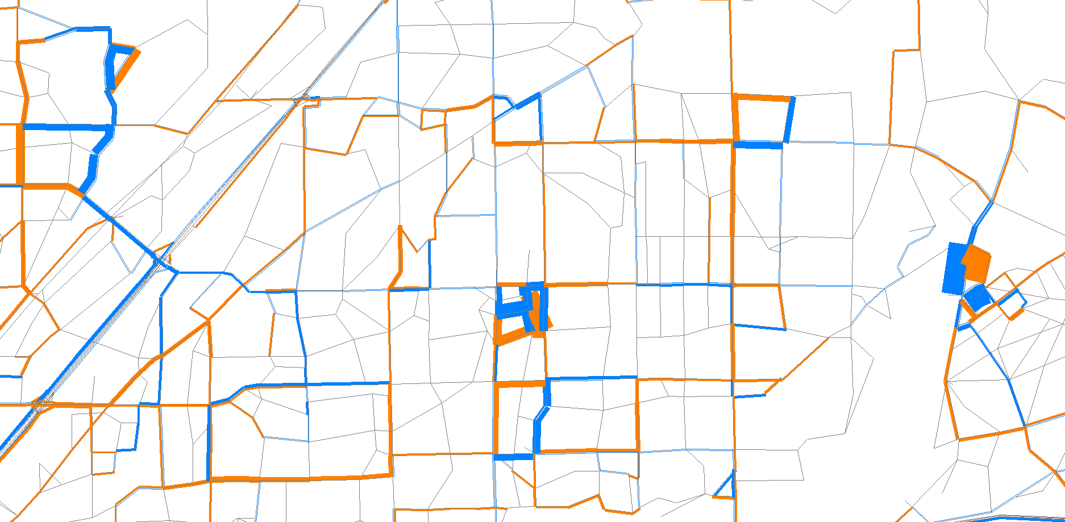
Example of spurious flow change
Notes:
Ever have to explain how you get such volume differences 5 miles away? The only input change is zone connectors near the center.
This is the difference between two not-so-converged assignments (RG=0.02) of the same trip table.

Slide 28
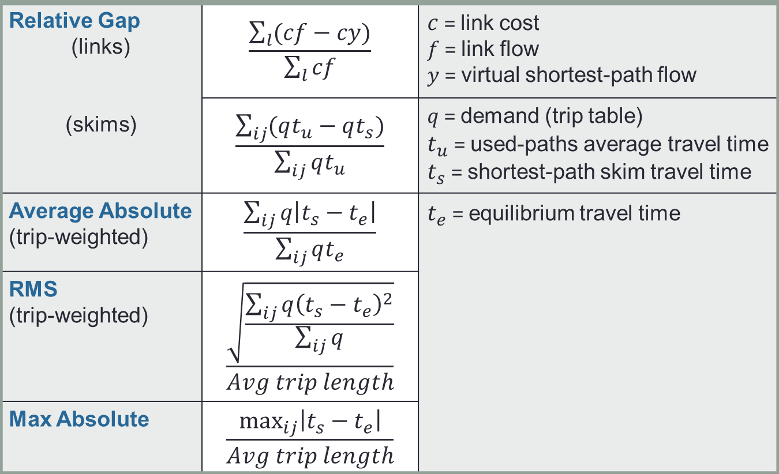
Skim comparison statistics
Relative Gap (links) (skims) | $$\frac{\sum_{l}{(cf−cy)}}{\sum_{l}{cf}}$$ | $c$ = link cost $f$ = link flow $y$ = virtual shortest-path flow
 | $$\frac{\sum_{ij}{(qt_{u}−qt_{s})}}{\sum_{ij}{qt_{u}}}$$ | $q$ = demand (trip table) $t_{u}$ = used-paths average travel time $t_{s}$ = shortest-path skim travel time
Average Absolute (trip-weighted) | $$\frac{\sum_{ij}{q\left|{t_{s}−t}_{e}\right|}}{\sum_{ij}{qt_{e}}}$$ | $t_{e}$ = equilibrium travel time
RMS (trip-weighted) | $$\frac{\sqrt{\frac{\sum_{ij}{q{\left({t_{s}−t}_{e}\right)}^{2}}}{\sum_{ij}{q}}}}{Avg trip length}$$
Max Absolute | $$\frac{\max_{ij}⁡\left|{t_{s}−t}_{e}\right|}{Avg trip length}$$
Notes:
Here are the actual formulas.
The link-based and skim-based expressions for RG aggregate the same quantities.
RG resembles Avg-Absolute skim difference, but there’s no firm relationship.

