Slide 1

Application of an Activity-Based Model for Highway Pricing Studies in Chicago
Notes:
This presentation covers the initial development of the CMAP activity-based model and its application for studying highway pricing.

Slide 2
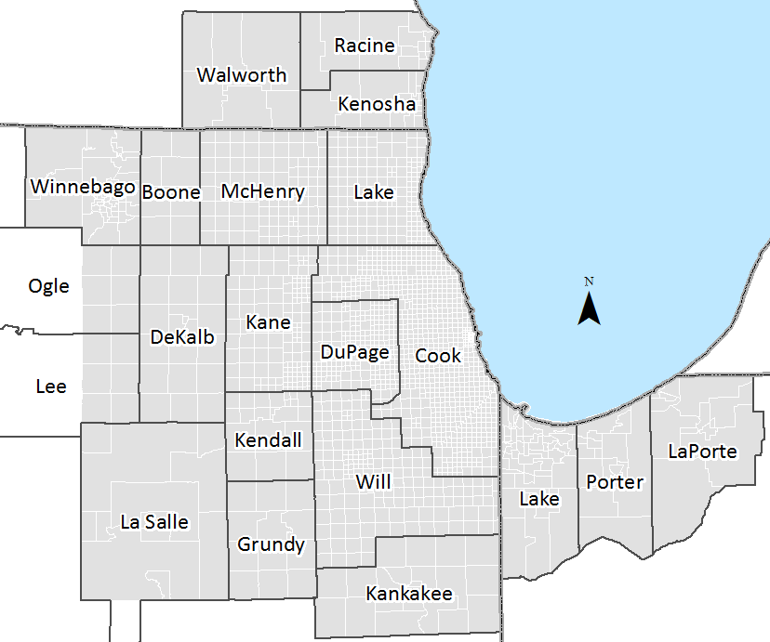
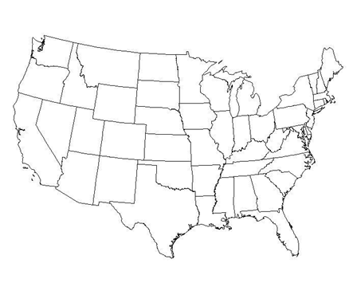
CMAP Region
Population: 10.5m
21 counties
2K TAZs
17K MAZs
Notes:
- CMAP’s jurisdiction includes the Illinois counties of Cook, DuPage, Kane, Kendall, Lake, McHenry, and Will.
- Our latest HH travel survey from 2007-08 covered CMAP jurisdiction & Indiana counties of Lake, Porter, and LaPorte.
- No survey for remaining counties in IL and SE Wisconsin.

Slide 3
Regional Comprehensive Plan
GO TO 2040, adopted in 2010
Notorious traffic congestion
Pricing queries lead to ABM development
Notes:
Congestion problem
Among nation’s most congested auto networks
Currently, toll rates are very modest
Tollways have time of day pricing for trucks in the form of overnight discounts.
Unfortunately placed toll facilities (suburban counties rather than urban center)
Hostility toward modest toll increases on existing toll roads
GO TO 2040
Regional plan from 2010
Very limited list of major capital projects with funding identified
Key transportation recommendations are congestion pricing, parking pricing, and more commitment to public transit (which are mostly demand management strategies)
Pricing Queries
Difficulty answering pricing queries with 4-step model

Slide 4
Why Pricing?
Theoretical
  Turn external costs inward
Practical
  Cannot build our way out of congestion
Notes:
Theoretical
- Drivers impose costs on one another and the rest of society by driving during peak periods
- Pricing internalizes those social costs and discourages driving during peak periods
Practical
- Congestion is the major cost that commuters face
- Reducing congestion by adding capacity temporarily reduces travel costs in peak periods
- Reduced travel cost encourages more people to drive during peak times, increasing congestion again

Slide 5
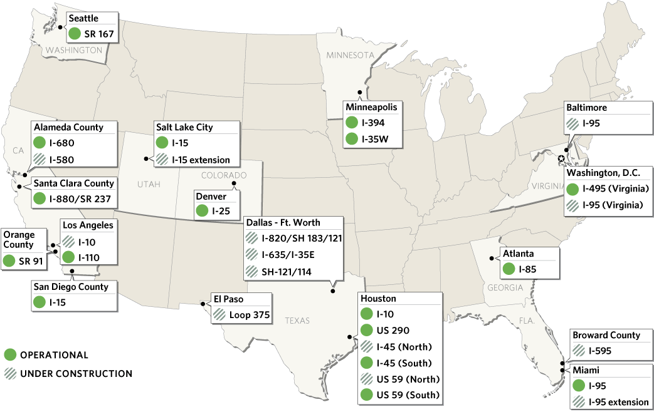
Express or HOT lanes in the US (2012)
Notes:
Success of congestion pricing schemes in US and internationally has created momentum and support for the idea in Chicago’s planning community.

Slide 6
Why Develop ABM?
  Advanced Model Work Plan
    Pricing ABM
    Transit ABM
    ABM-DTA Integration
  Benefits
    User segmentation
    Continuous value of time

Slide 7
Integrated Model System
CT-RAMP demand model
  Coordinated Travel Regional Activity-based Modeling Platform
Highway Assignments & Skimming
  Handles route choice for trucks, externals, & airport traffic
Notes:
CT-RAMP
Microsimulation of demand
Java application developed by PB
Intra-household interactions and Coordinated Daily Activity Patterns
Temporal resolution (30 minutes)
Highway Assignment and Skimming
EMME Macro
Handles route choice (toll/non-toll) for non-ABM generated traffic handled by this skimming macro

Slide 8
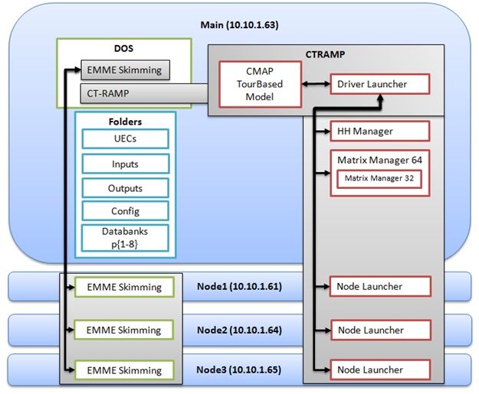
Distributed Model System
Notes:
This shows are distributed model system
It works on 4 Windows servers (1 master, 3 workers)
EMME and Java work is distributed across all 4 machines

Slide 9
Model Flow
Model Re-estimated for CMAP Pricing ABM
Auto ownership model
Destination choice models
Time-of-day choice models
Mode choice models
Notes:
This is a flow chart of our model system.
Beginning at population synthesis and ending with network assignments.
The highlighted models were re-estimated for the CMAP development

Slide 10
CT-RAMP Person Types
PERSON-TYPE | AGE | WORK STATUS | SCHOOL STATUS
Full-time worker | 18+ | Full-time | None
Part-time worker | 18+ | Part-time | None
Non-working adult | 18 – 64 | Unemployed | None
Non-working senior | 65+ | Unemployed | None
College student | 18+ | Any | College +
Driving age student | 16 – 17 | Any | Pre-college
Non-driving student | 6 – 16 | None | Pre-college
Pre-school | 0 – 5 | None | None
Notes:
The ABM has very rich population characteristics. Each person’s type restricts their eligibility to participate in activities.

Slide 11
CT-RAMP Activity Types
PURPOSE | DESCRIPTION | CLASSIFICATION | ELIGIBILITY
Work | Working at regular workplace or work-related activities outside the home. | Mandatory | Workers and students
University | College + | Mandatory | Age 18+
High School | Grades 9-12 | Mandatory | Age 14-17
Grade School | Grades K-8 | Mandatory | Age 5-13
Escorting | Pick-up/drop-off passengers (auto trips only). | Maintenance | Age 16+
Shopping | Shopping away from home. | Maintenance | Age 5+
Other Maintenance | Personal business/services, and medical appointments. | Maintenance | Age 5+
Social/Recreational | Recreation, visiting friends/family. | Discretionary | Age 5+
Eat Out | Eating outside of home. | Discretionary | Age 5+
Other Discretionary | Volunteer work, religious activities. | Discretionary | Age 5+
Notes:
And here’s a list of the unique activity types in the ABM, along with rules for activity eligibility

Slide 12
Road Pricing Essentials
Variation in Value of Time
  ABM - continuous VOT distribution
  EMME - discrete VOT classes (high & low)
Vehicle occupancy
  ABM & EMME - 3 discrete classes
    SOV, HOV2, HOV3+
Route type choice
  ABM & EMME explicitly treat toll & non-toll users for each segment

Slide 13
Value of Time
VOT by travel purpose & person type
Car occupancy accounts for cost sharing
  VOT(HOV2) = 1.6 * max(individual VOT)
  VOT(HOV3+) = 2.3 * max(individual VOT)
Static assignment & VOT
Notes:
VOT is segmented by person and trip purpose
Situational variation of VOT applied for each person based on lognormal distribution
VOT for an HOV trip was based off of the highest individual VOT
Restricted a bit by static assignments which required aggregation into a limited number of assignable classes. High and Low VOT by vehicle occupancy and toll/non-toll
For static assignments VOT has to be aggregated across individuals into discrete vehicle classes

Slide 14
Example of VOT Distribution

Slide 15
EMME Macro
Notes:
This is a flow chart of our EMME macro that handles the network assignments and skimming.
Initializes matrices before demand model
12 class assignment
Skimming
Utility Calculations
Route Type Choice Model
Binary choice (toll vs. non-toll)
Accounts for negative toll bias
Update demand matrices (MSA)
Iterate

Slide 16
Route Type Choice
Currently implemented as binary choice
  Toll vs. non-toll
Explicit modeling of toll users at OD level
Accounts for toll bias
Allows for VOT variation/segmentation beyond 12 assignable classes
Notes:
Route type choice can be extended to distinguish between managed lanes (toll vs. non-toll) and general purpose lanes (toll vs. non-toll)

Slide 17
Assignable Trip Tables
Total of 44
  12 for passenger auto (from ABM)
  8 for trucks (EMME route type choice model)
  12 for externals (EMME route type choice model)
  12 for airports (EMME route type choice model)

Slide 18
Initial Demand Segmentation
Vehicle Type & Value-Of-Time | Non-toll SOV | Non-toll HOV2 | Non-toll HOV3+ | Toll SOV | Toll HOV2 | Toll HOV3+
Auto low VOT | 1 | 3 | 5 | 2 | 4 | 6
Auto high VOT | 7 | 9 | 11 | 8 | 10 | 12
Commercial | 13 |  |  | 14
Light truck | 15 |  |  | 16
Medium truck | 17 |  |  | 18
Heavy truck | 19 |  |  | 20
External low | 21 | 23 | 25 | 22 | 24 | 26
External high | 27 | 29 | 31 | 28 | 30 | 32
Airport low | 33 | 35 | 37 | 34 | 36 | 38
Airport high | 39 | 41 | 43 | 40 | 42 | 44

Slide 19
Desired Multi-Class Assignment
Vehicle Type & Value-Of-Time | Non-toll SOV | Non-toll HOV2 | Non-toll HOV3+ | Toll SOV | Toll HOV2 | Toll HOV3+
Auto + external + airport low VOT | 1 | 3 | 5 | 2 | 4 | 6
Auto + external + airport high VOT | 7 | 9 | 11 | 8 | 10 | 12
Commercial | 13 |  |  | 14
Light truck | 15 |  |  | 16
Medium truck | 17 |  |  | 18
Heavy truck | 19 |  |  | 20
Notes:
Now possible with EMME 4

Slide 20
Multi-Class Assignment
Vehicle Type & Value-Of-Time | Non-toll SOV | Non-toll HOV2 | Non-toll HOV3+ | Toll SOV | Toll HOV2 | Toll HOV3+
Auto + external + airport low & high VOT | 1 | 3 | 5 | 2 | 4 | 6
Commercial + light truck | 7 |  |  | 8
Medium truck | 9 |  |  | 10
Heavy truck | 11 |  |  | 12
Notes:
EMME 4 now allows 30 vehicle classes.
This project was completed prior to EMME 4.
Would be nice to assign more than just high and low VOT.
Alternative would have been to pre-assign trucks (assuming they keep fixed routes), and then assign passenger traffic

Slide 21
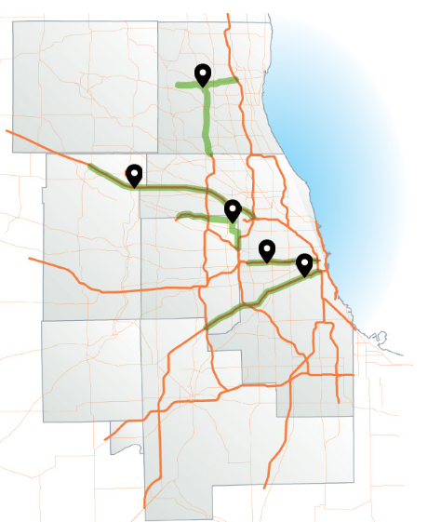
Projects
IL 53/120
New highways
  IL 53/120
  Elgin O’Hare West
  Bypass
Add lanes
  I-90
  I-290
  I-55
I-90
EOWB
I-290
I-55
Notes:
The new highways:
- IL 53/120, known as the Central Lake County Corridor, a tolled parkway in heavily congested Lake County, IL
- Elgin O’Hare West Bypass, an eastward extension of an existing highway relieving traffic near O’Hare Airport
Add lanes projects:
I-90 is an existing toll road west of O’Hare Airport
I-290 and I-55 are freeways
Other Key Info:
Toll rates set to maintain free flow speeds for all time of day periods
No discounts for HOV’s
Limited access for express lanes (for add lanes projects only)
Base Year Validation Completed

Slide 22
Setting Toll Rates
Current
  Set to recover construction & operating costs
Congestion pricing
  Set to achieve performance objectives
    Maintain free flow speed
    Maximize revenue
    Maximize throughput

Slide 23
Setting Toll Rates
Set toll based on modeled delay
Toll Rate = (Hrs of Delay * VOT per Hr) / Miles
Notes:
In order to set tolls, we started with a model run where we added capacity but did not price it. Then we calculated the modeled delay for predefined segments on each project facility. Then we used this simple equation to covert the initial model delay into a toll rate representing the value of time savings.

Slide 24
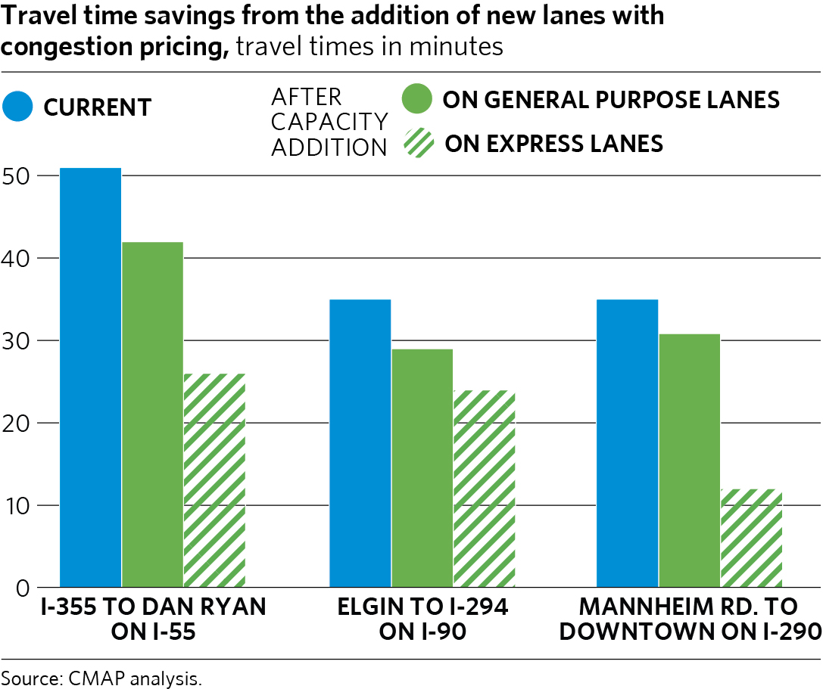
Travel Times (AM Peak)
$0.00
$1.30
$0.00
Minutes
$2.76
$2.53
$3.41
Notes:
This shows the AM peak travel times for 3 of the projects before and after pricing. These 3 projects are the roads where we add an express tolled lane. On each facility, the general purpose lanes saw significant travel time savings due to the pricing of the express lanes. However, many much of the time savings in the general purpose lanes is attributable to the fact that the express lanes are new capacity.

Slide 25
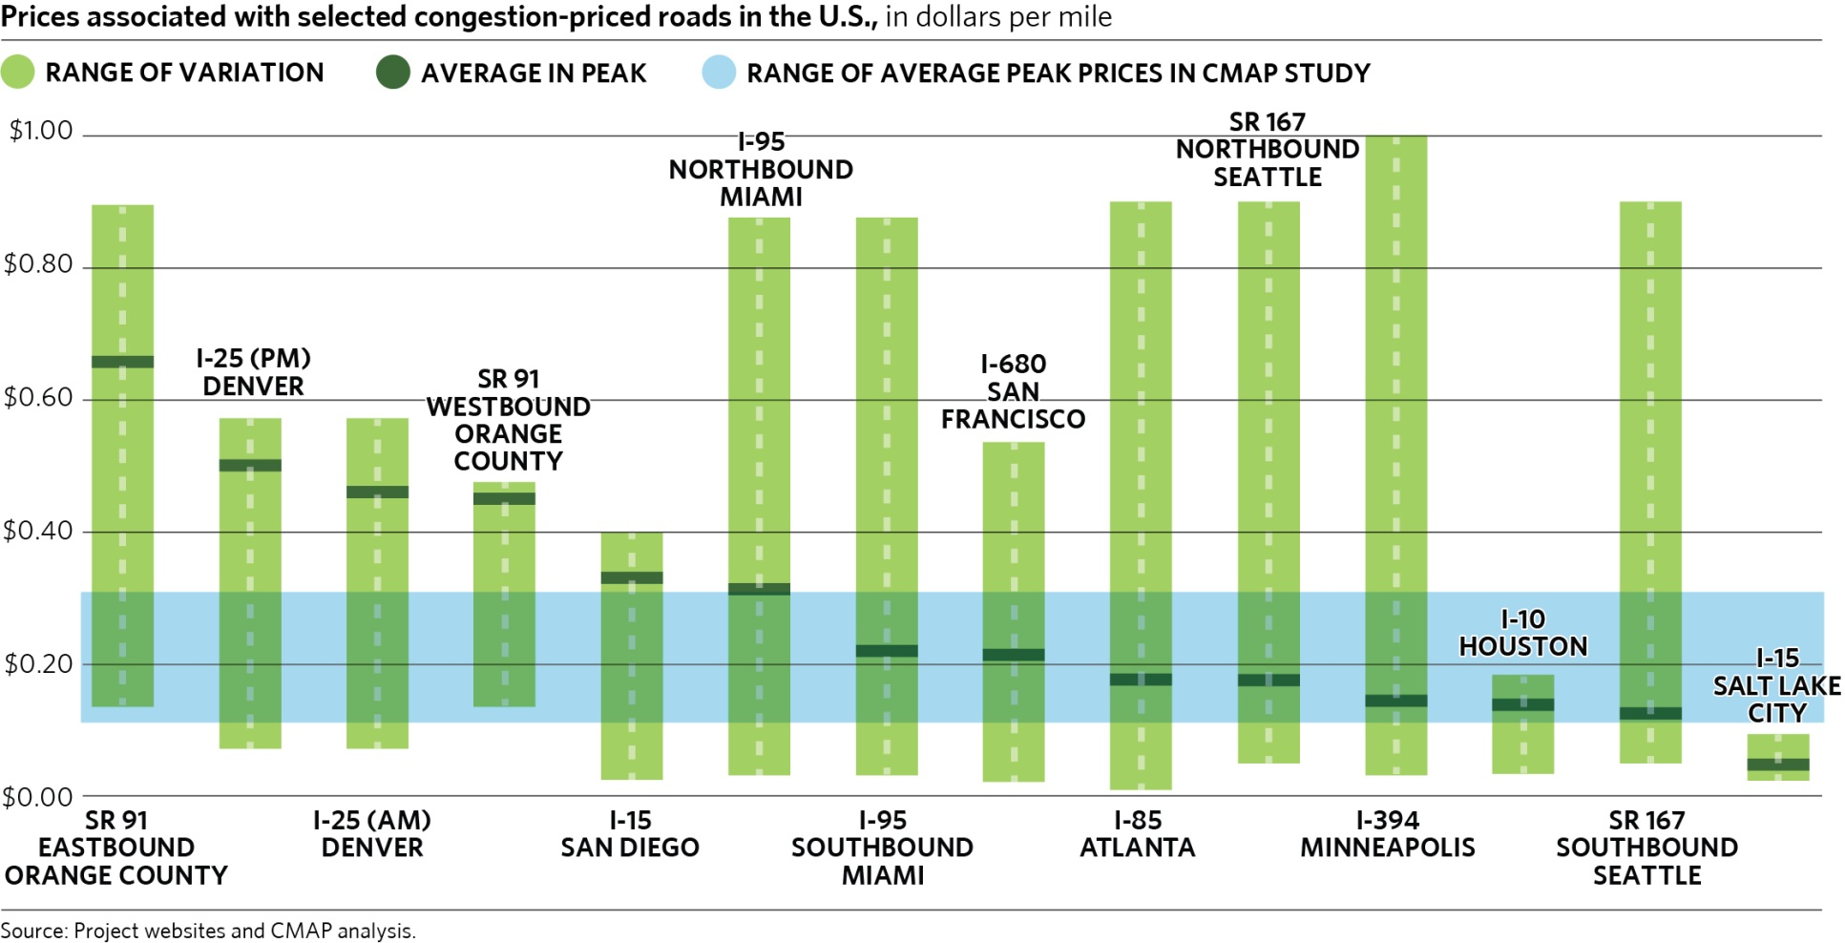
Toll Rate Comparisons
Toll rate ($/mile)
Notes:
This slide shows how our proposed toll rates compare to current congestion priced facilities in the US. The shaded blue area shows the range of peak prices in the CMAP study.

Slide 26
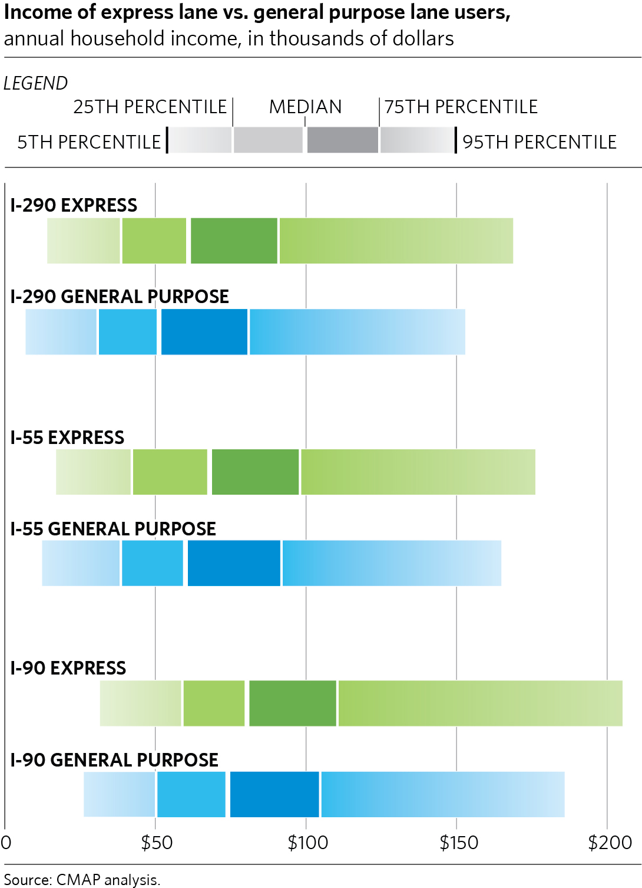
Notes:
This slide addressed some of the equity concerns regarding congestion pricing.
Who would use express lanes?
Express lane user median HH incomes 13 – 19% higher than general purpose lane users
Overall income distributions similar for the express and general purpose groups
Conclusion: drivers at almost any income would see these priced express lanes as a reasonable alternative to the general purpose lanes
Mitigation of Equity Concerns
Reinvest revenues in transit; low-income toll transponders; state tax deductions; “lifeline” credits

Slide 27
Other Findings
Mode Share
  Small HOV increase & SOV decrease
Traffic Spillover
  Arterials & General Purpose Lanes
    Decreased congestion
Notes:
Mode Share
Almost no shift to transit or non-motorized
Minor shift from SOV to HOV
Traffic Spillover
Benefits are mostly due to increased capacity. Without extra capacity, arterials and general purpose lanes would suffer.

Slide 28
Other CMAP Efforts
Outreach
Further study
Notes:
Outreach
Campaign to build public support
Public website
Direct appeals to business community, partner agencies, local municipalities, news media
Further study
Pricing on existing highway capacity
Diversion of revenues to transit system improvement

Slide 29

Questions?
Matt Stratton, mstratton@cmap.illinois.gov
Kermit Wies, kwies@cmap.illinois.gov
Peter Vovsha, vovsha@pbworld.com
Ben Stabler, stabler@pbworld.com

