Slide 1

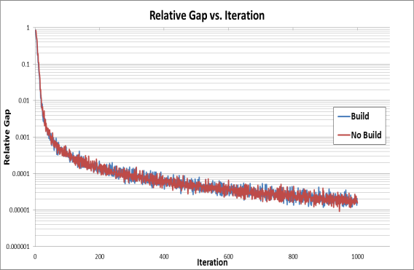
Assignment Convergence: Big Model, Small Projects; Improving Assignment Convergence in Ohio for Estimating Project Impacts
TRB Planning Applications Conference
Statewide Modeling Workshop
May 5, 2013
Aaron Keegan, Bernardin, Lochmueller & Associates
Vince Bernardin Jr., Resource Systems Group
Gregory Giaimo, Ohio Department of Transportation
Sam Granato, Ohio Department of Transportation

Slide 2
Motivation
Project Cost/Benefit Analysis For Economic Impact Model
  No Build vs. Build Highway Assignments
Highly Converged Assignment Solutions Crucial to Analysis
Minimize Assignment Runtime

Slide 3
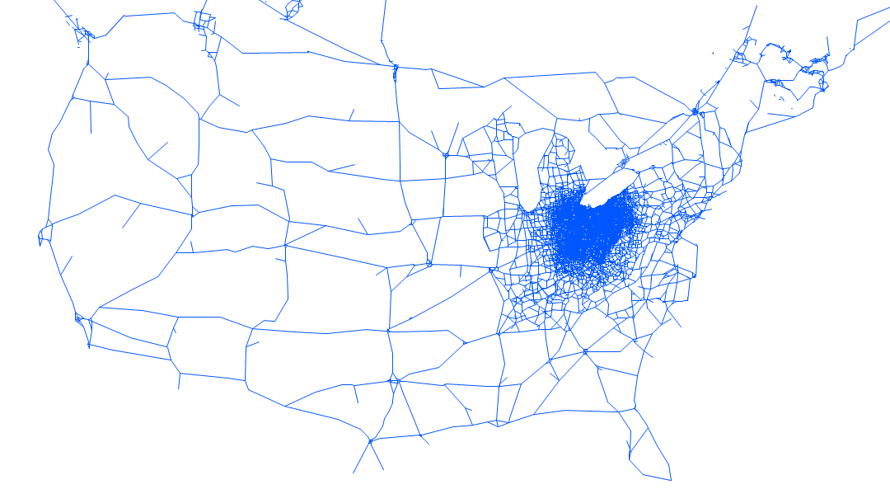
Ohio Statewide Model = Big Network
285,000 One Way Links
5,116 Zones

Slide 4
Starting Point
Project impacts are tiny compared to full model, even for large projects thus need very tight convergence
Highway Assignments on Full Statewide Model Network to 500 iterations.
Project Subarea Network Assignments to 500 and occasionally 1000 iterations.
User Equilibrium or MSA Algorithms

Slide 5
Statewide Network Example
No-Build & Build MSA Assignments to 500 Iterations
Steady VHT with Respect to Iteration, But Slow to Converge
80 Hours of Runtime

Slide 6
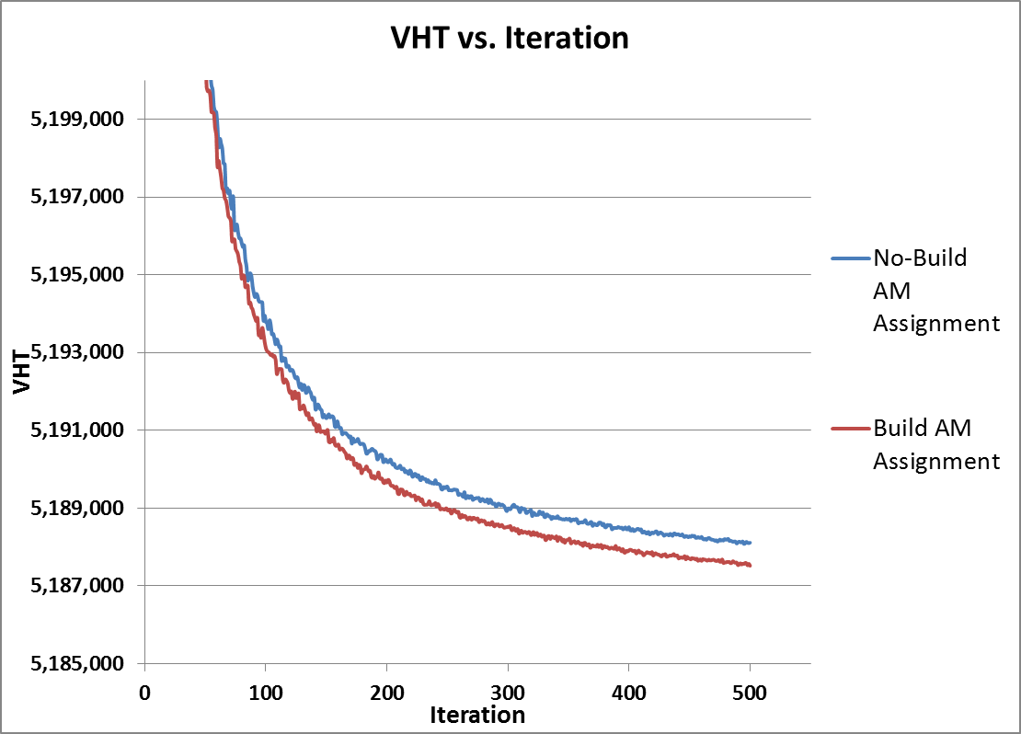
Statewide Network Example

Slide 7
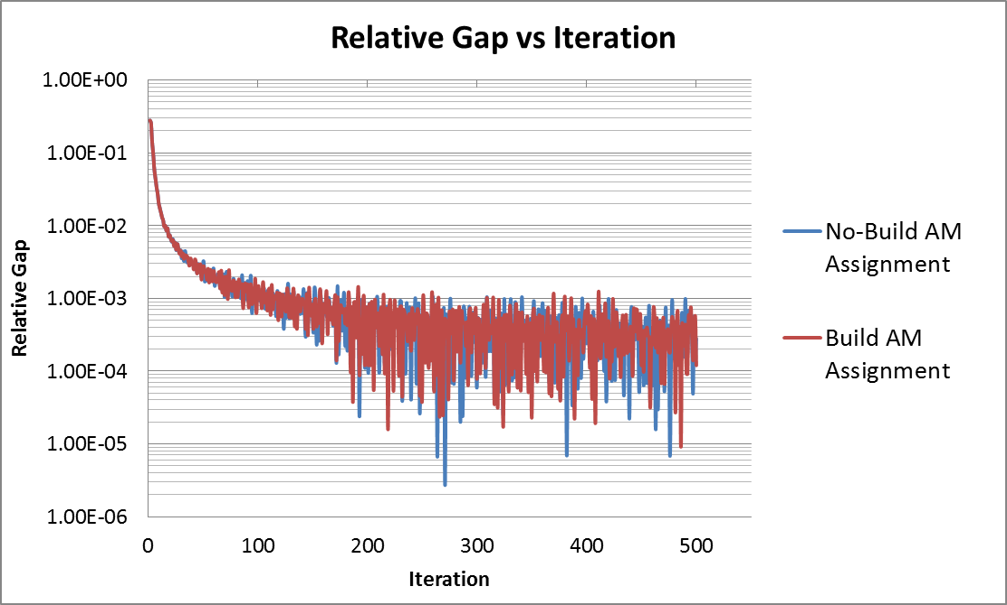
Statewide Network Example
Relative Gap Unstable and Poor Predictor of Convergence

Slide 8
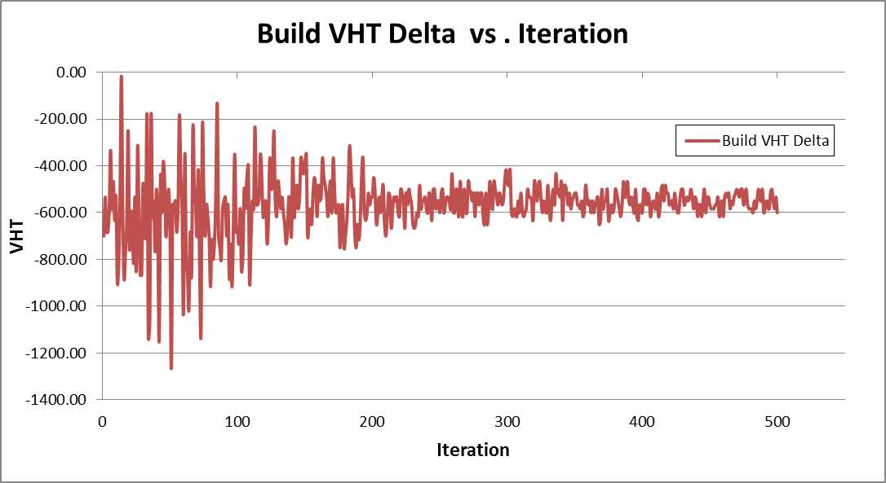
Statewide Network Example
The VHT Delta Tapers But the Variability is Still About 100 VHT
Notes:
Note: VHT delta seems stable around 200 iterations, yet from 2 graphs back, VHT continues settling far more than this delta beyond iteration 200, from 1 slide back, relative gap isn’t very tight, becomes less stable with more iterations and in general seems uninformative in terms of a good stopping point.

Slide 9
Subarea Network Example
Influence Area Around Project Cut to Subarea
User Equilibrium to 500 Iterations and Occasionally 1000.

Slide 10
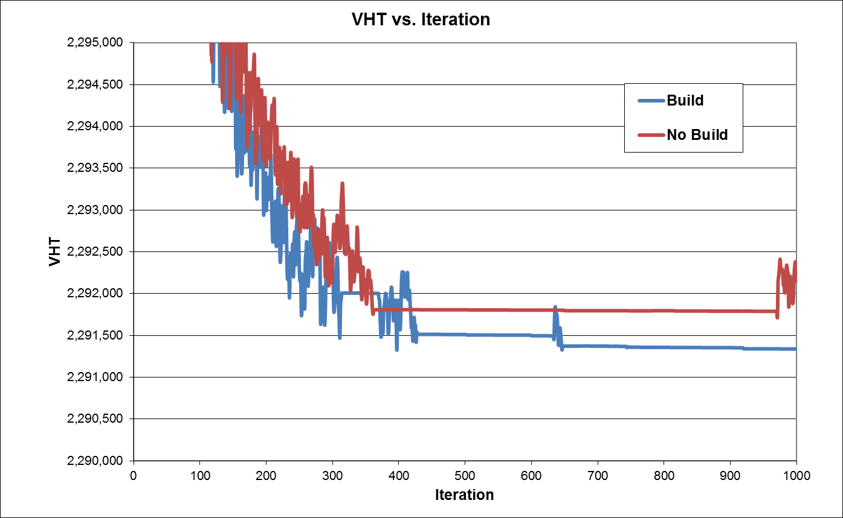
Subarea Network Example
VHT For Some Projects Would Not Stabilize

Slide 11
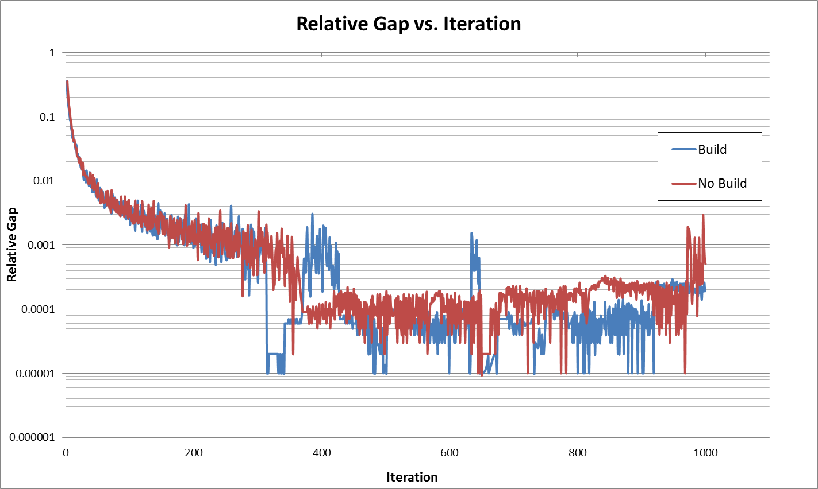
Subarea Network Example
Relative Gap Highly Unstable

Slide 12
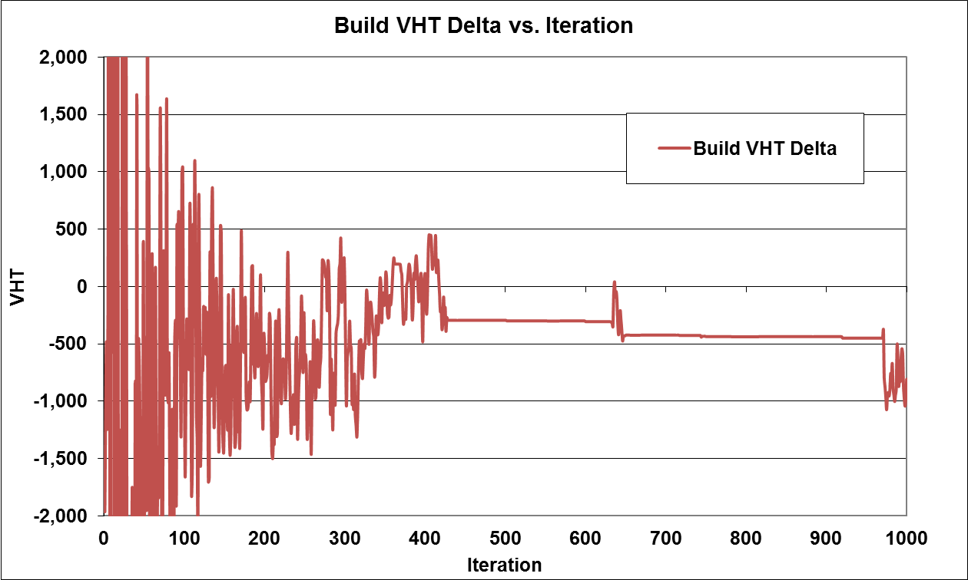
Subarea Network Example
Highly Variable Project Delta

Slide 13
Initial Adjustments
Switch from Vehicle Time to Weighted Average of Assignment Class Generalized Costs for Convergence Cost Calculation
VDF Function Constraint Removal
  Congested Travel Time Had Been Limited to 10 Times Free-Flow Time
See Before and After Assignment Scripts on Your Flash Drive!

Slide 14
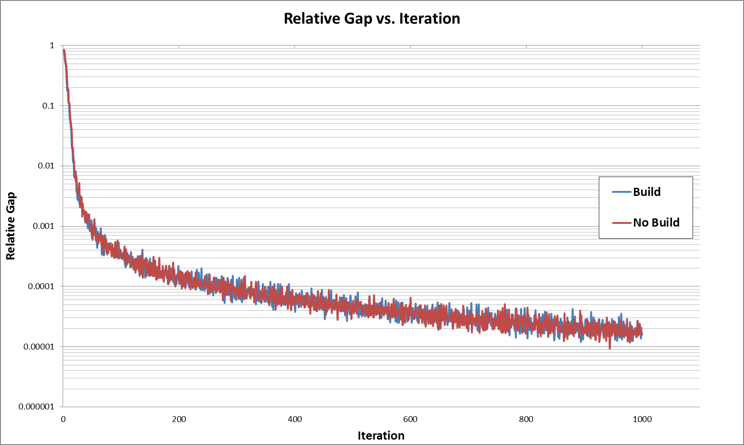
Subarea with VDF Constraint Removed
Marked Difference in Relative Gap Behavior

Slide 15
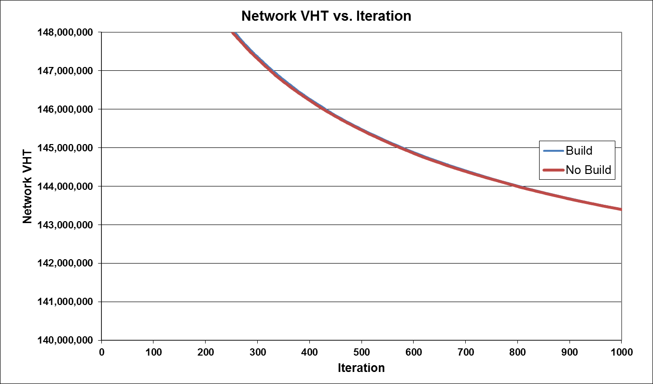
Subarea with VDF Constraint Removed
VHT Stable, but Suddenly Very High

Slide 16
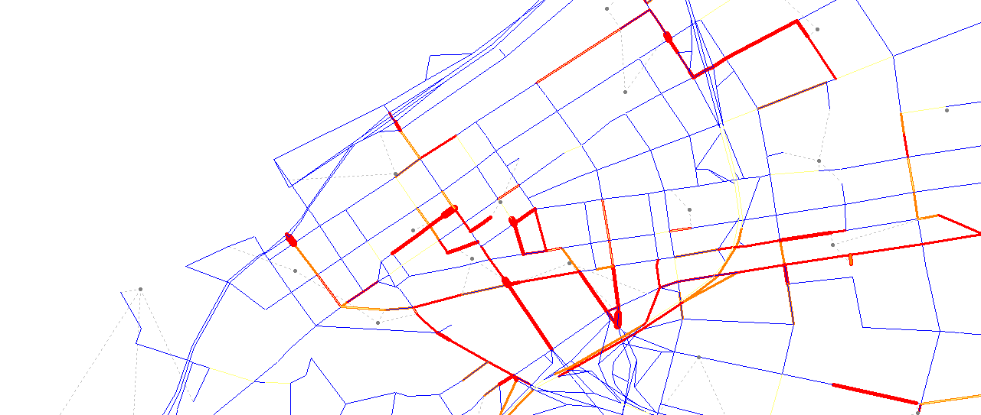
Initial Adjustment Results
Relative Gap Behavior Smoothed by Lifting VDF Constraint, but VHT Went up by Factor of 60.
In One Result 3%, of The Network Links Accounted for 98% of the VHT, Slowing and Destabilizing Convergence.
Red=VC>1

Slide 17
Network Editing
Several Iterations of Network Link Edits to Fix Problematic Loading Points & Overloaded Links. VERY HELPFUL!
Edits Were Prioritized by Link VHT
Other Issues Caught in the Process
  Link Import Errors From Shapefile
  Zero Distance Links

Slide 18
Assignment Algorithm
Bi-Conjugate Frank-Wolfe Speeds Arrival to Low Relative Gaps But has “Jumpy” Behavior. Oscillation of Relative Gap Apparent At High Iterations
May Oscillate More With Distributed Processing of Assignment

Slide 19
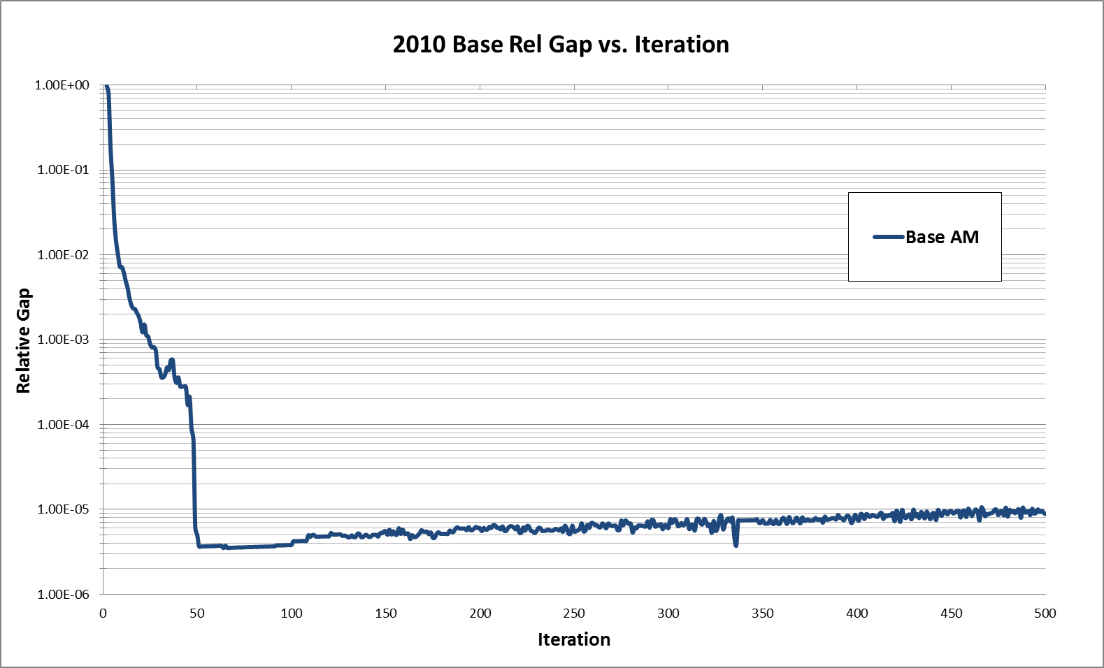
2010 Base Network
Quick Descent to Low Rel. Gap Then Drift

Slide 20
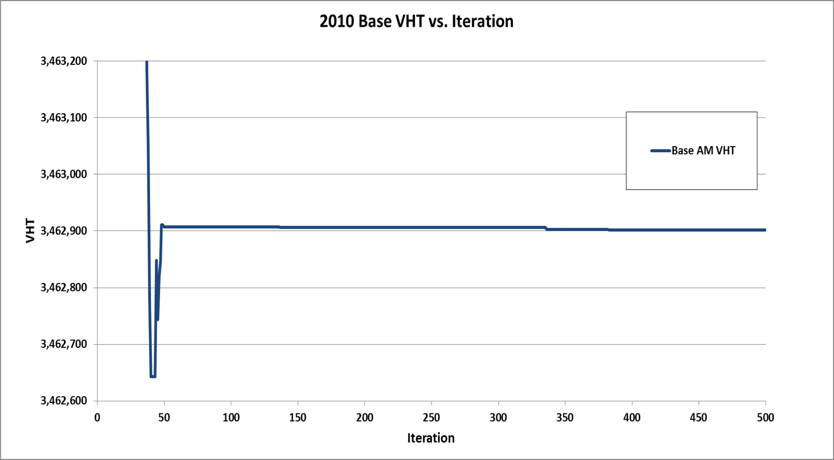
2010 Base Network
Network Cost and VHT More Stable than Relative Gap, But Still Some Cost Change at High Iterations.

Slide 21
2010 Base Network
Base Network Changed 5 VHT in Final 450 Iterations.
How Significant Is This in Absolute Terms to No Build vs. Build VHT Deltas?

Slide 22
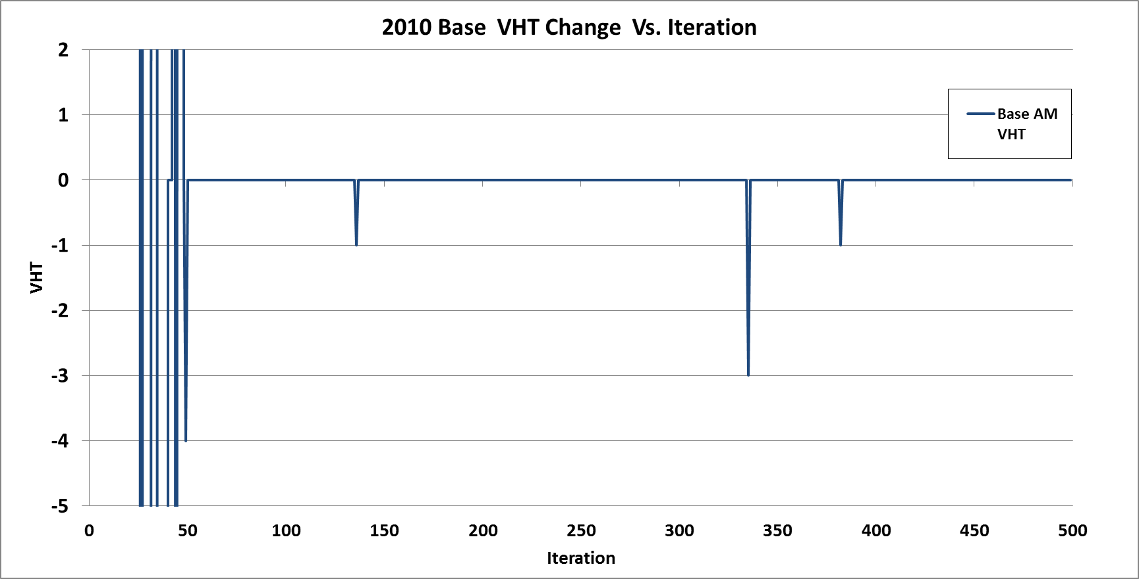
2010 Base Network
VHT Rate of Change Slows But Does Not Stop

Slide 23
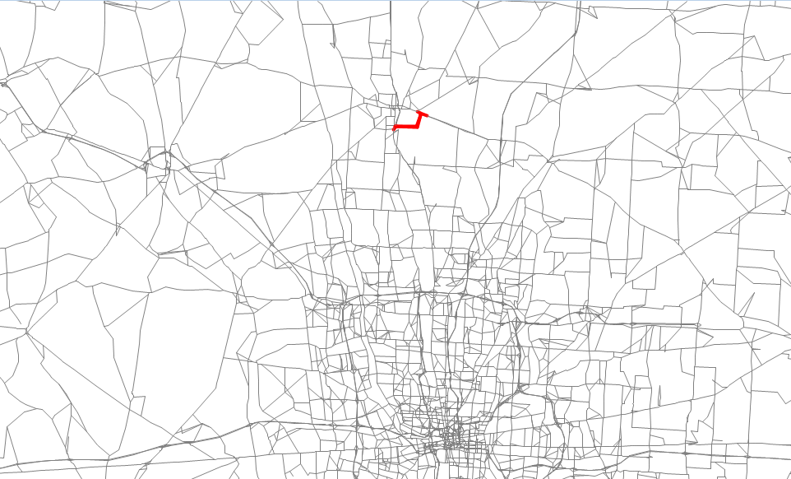
Small Project Test
AM Assignment Build vs. No-Build

Slide 24
Convergence Criteria Choices
High Iteration such as 500
Relative Gap 1E-4 to 1E-5
Code A Custom Criteria. Monitor the Absolute Change in Network Generalized Cost For Flattening Once Rel. Gap Below 1E-4 .
Run Time Implications.

Slide 25
Small Project Test Results
Algorithm | Convergence Criteria | Build VHT | No-Build VHT | Build Delta VHT | Time
Bi-Conj. UE | 500ite | 3,462,801 | 3,462,902 | -101 | 58 hours
Bi-Conj. UE | 1E-5 Relative Gap | 3,462,800 | 3,462,911 | -111 | 5 hours 10 mins
Bi-Conj. UE | Custom Criteria | 3,462,800 | 3,462,907 | -107 | 5 hours 40 mins
Origin Based UE | 1E-5 Relative Gap | 3,460,431 | 3,460,510 | -79 | 3 hours 20 mins
See Assignment Graphs on Your Flash Drive!

Slide 26
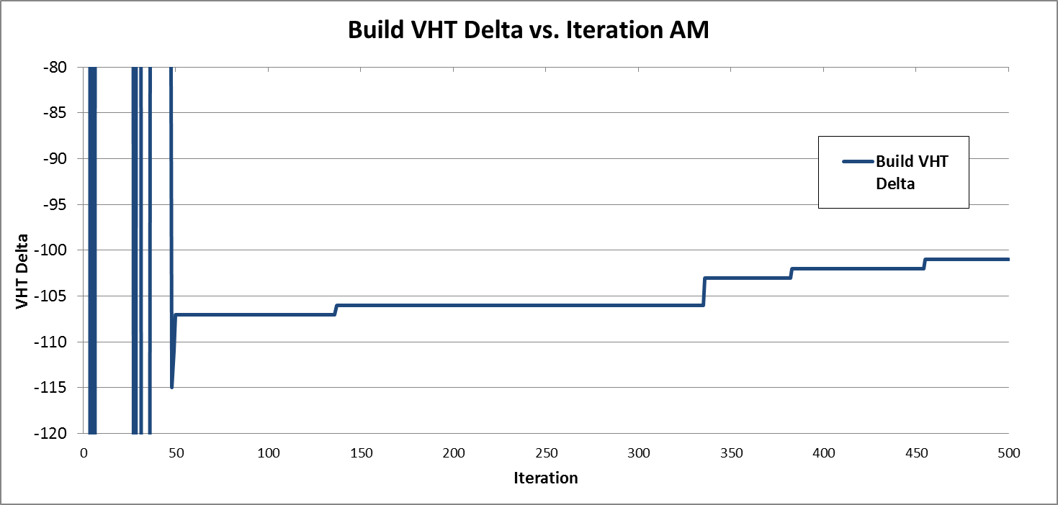
Small Project Test
VHT Delta Varies by less than 10 for last 450 ite.

Slide 27
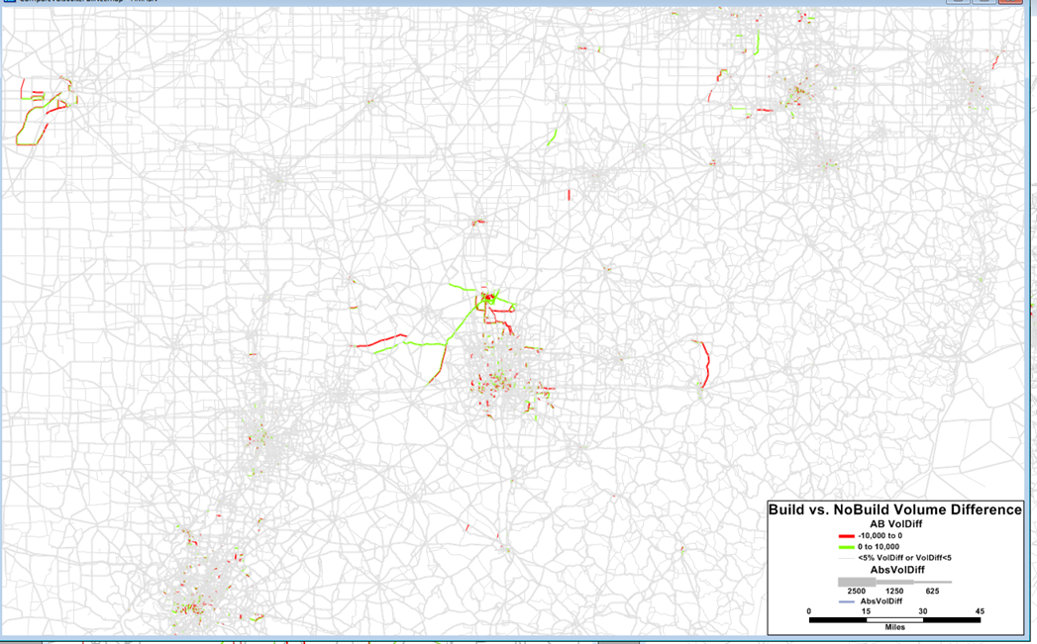
Check Solution Localization

Slide 28
Summary
VDF Constraint Removal and Edits to Overloaded Links Made the Biggest Improvements to Performance.
Comparable Solutions to High Iteration Assignments achievable in 6 hours vs 80 previously.
Variability of Project VHT Delta has been reduced.

Slide 29
Next Steps
New Smoothing Feature for Bi-Conjugate U.E. Released in Software
Beta Testing of New Algorithm

Slide 30
Further Assignment Updates
New Generalized Cost Equation with More Explanatory Variables Calibrated with A Genetic Algorithm
New Definition of Classes and Values of Time for Economic Assignment
Optional Toll Choice Logit Model Before Assignment
Interfacing with updated UCOST Tool

