Slide 1
TRB National Transportation Planning Applications Conference
Columbus, OH May 2013
Estimating Bus and Rail
Travel Times
For Transit Corridor Studies
Presented by:
James Baker, Vice President
Connetics Transportation Group

Slide 2

“Baking” Transit Ridership Forecasts
Ingredients
Alignment
Station Locations
Demographics
Service Plans
Auto Travel Times
Transit Travel Times

Slide 3
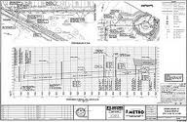
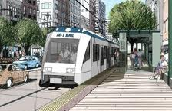
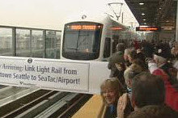
Travel Time Estimates in Relation to Project Development
Idea
Concept
Feasibility
Alternatives
Analysis
Preliminary
Engineering
Final
Design
Construction
Opening
Day!
Average Speed
Assumptions
Spreadsheet
Applications
Rail Simulation
Programs
Travel Time Detail Increases with Project Development

Slide 4
Travel Time Estimates in Relation to Project Development
Idea
Concept
Feasibility
Alternatives
Analysis
Preliminary
Engineering
Final
Design
Construction
Opening
Day!
Average Speed
Assumptions
Spreadsheet
Applications
Rail Simulation
Programs
Travel Time Detail Increases with Project Development

Slide 5
Travel Time Estimates Used for…
Ridership Forecasts
Operating Schedules
Vehicle Requirements
Operating & Maintenance Cost Estimates
Speed Profiles
Single Track Analysis
Power/Substation Requirements
Noise Impact Analysis

Slide 6
Travel Time Components
Vehicle Speeds
Alignment
Station Dwells
Traffic Congestion and Signal Delays
Objective:
Build a Travel Time Estimate With Reasonable
Planning Level Assumptions for Each Component

Slide 7
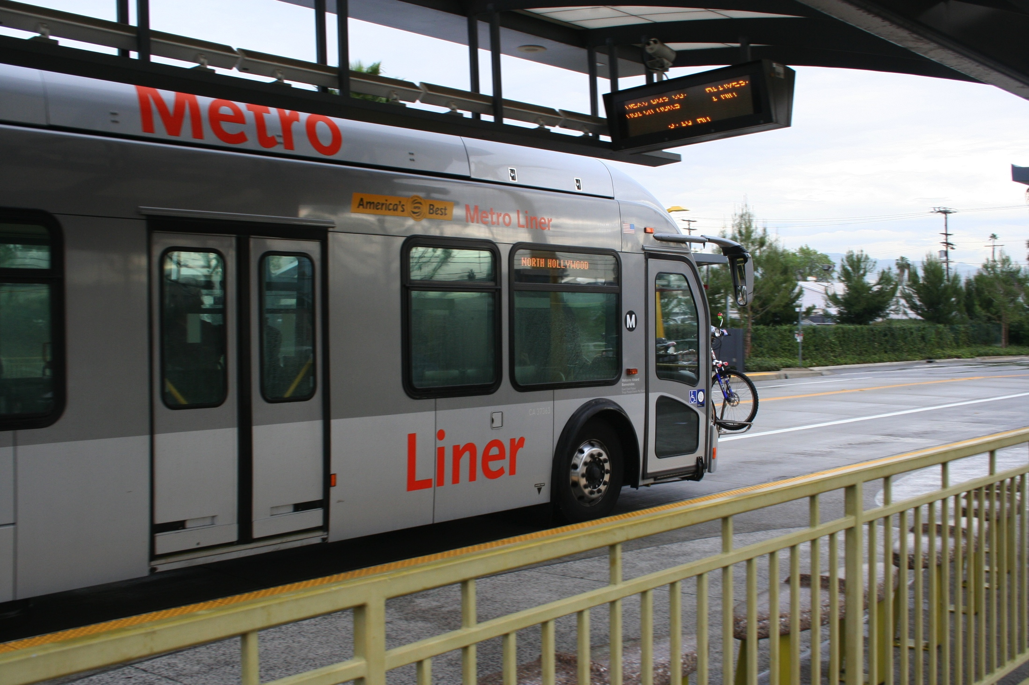
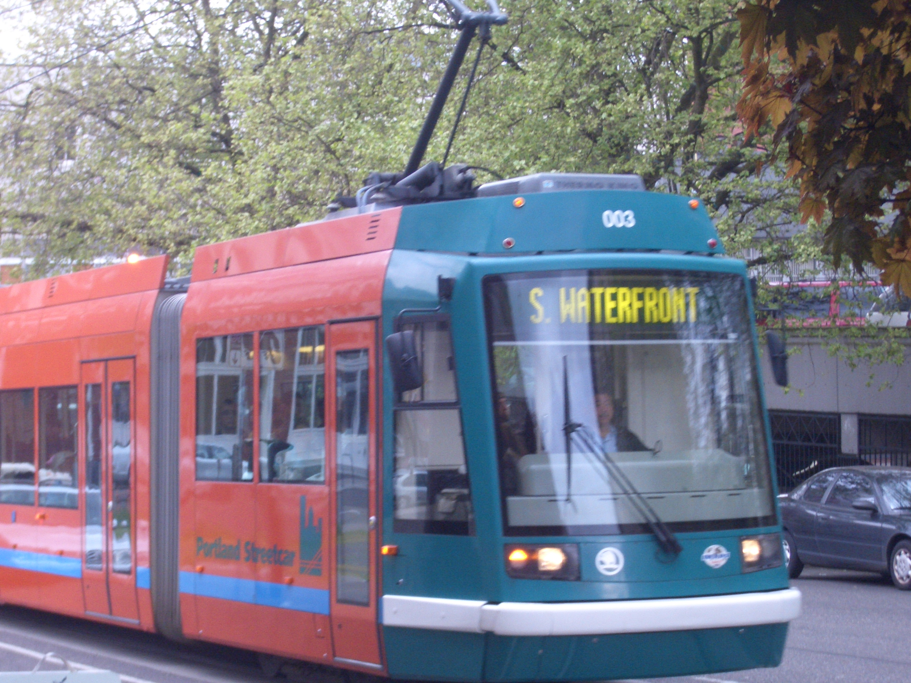
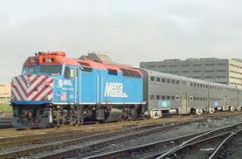
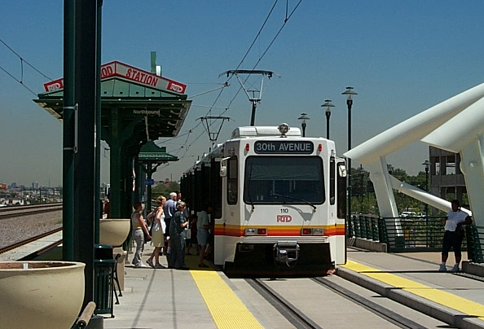
Vehicle Speeds
Typical Maximum Vehicle Speeds &
Range of Acceleration and Deceleration Rates
Mode | Typical Max. Speed | Range of Rates
Bus | 65-70 mph | 1.5 to 2.0 mphps
Streetcar | 40-45 mph | 2.0 to 2.5 mphps
Light Rail | 55-65 mph | 2.5 to 3.0 mphps
Heavy Rail | 65-75 mph | 2.5 to 3.0 mphps
Commuter Rail | 70-80 mph | 1.0 to 1.5 mphps
Diesel Multiple Unit | 70-80 mph | 1.5 to 2.5 mphps

Slide 8
Vehicle Speeds
Acceleration Time:
(Final Velocity/100)/acceleration rate/60
Deceleration Time:
(Initiial Velocity/deceleration rate/60

Slide 9
Vehicle Speeds

Slide 10
Alignment
Plan and Profile Drawings Identify:
Station/Stop Locations
Start and End of Horizontal Curves
Maximum Speeds Through Curves
Vertical Grades

Slide 11
Station Dwell Times
Factors that Impact Station Dwell Times
Passenger Boarding & Alighting Volumes
Payment Method
Passenger Volume Inside Vehicle
Number of Doors on Vehicle
Level vs. Step Boarding & Alighting
ADA Boardings/Alightings
Bicycle Loadings

Slide 12
Station Dwell Times:
Fare Collection Service Times
TCRP Report 90 Passenger Boarding and Alighting Rates
(Seconds per Passenger)
Situation | Observed Range | Suggested Default
 | BOARDING | (sec. per pass.)
Prepayment | 2.25-2.75 | 2.5
Single ticket or token | 3.4-3.6 | 3.5
Smart card | 3.0-3.7 | 3.5
Exact change | 3.6-4.3 | 4.0
Swipe or dip card | 4.2 | 4.2
 | ALIGHTING | (sec. per pass.)
Front door | 3.3 | 3.3
Rear door | 2.1 | 2.1
Note: Rates can vary depending on # of standees and type of bus (low floor)

Slide 13
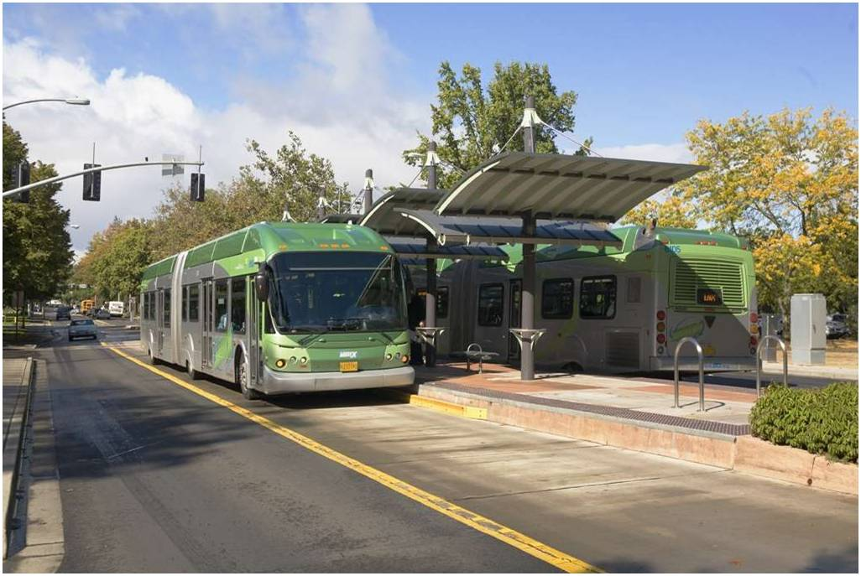
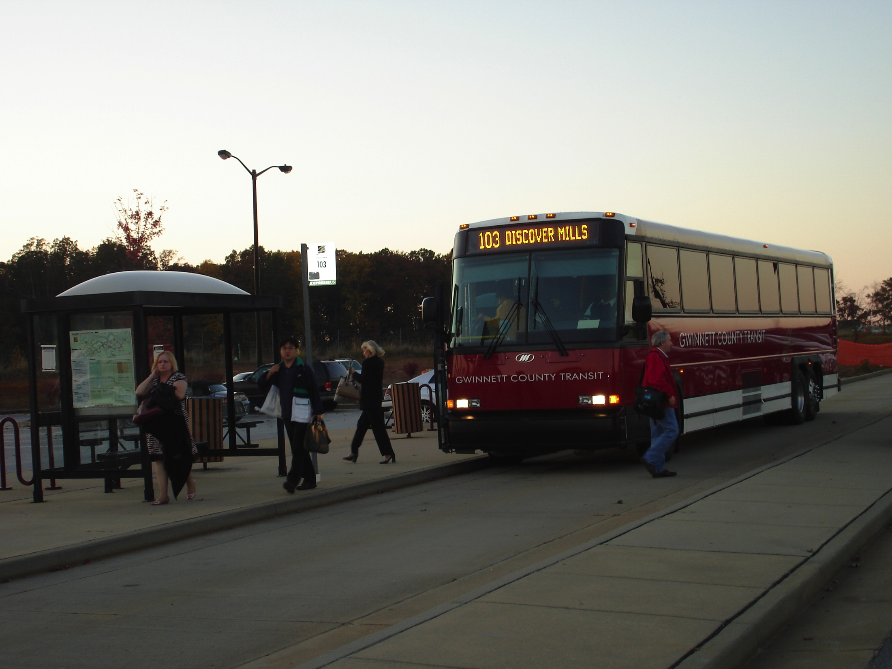
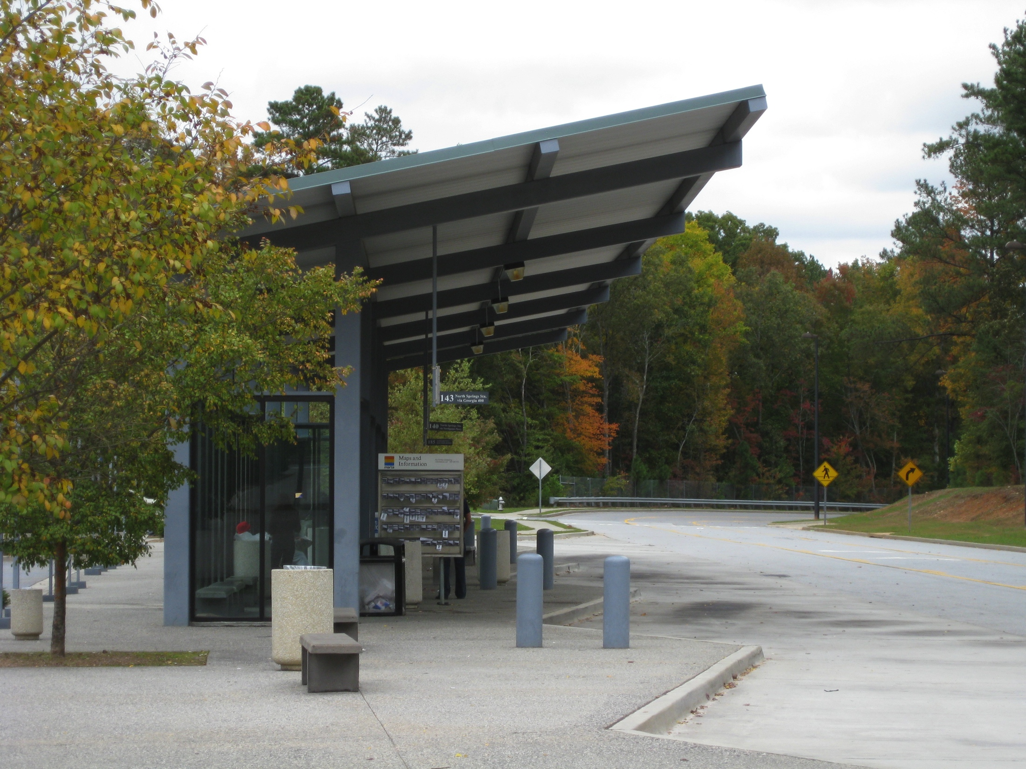
Station Dwell Times:
Suggested Rates
Suggested Dwell Times
BRT: 10-30 seconds
HRT, LRT and Streetcar: 15-30 seconds
Commuter Rail and DMU: 30-60 seconds

Slide 14
Traffic Congestion & Signal Delays
Roadway Congestion Impacts
  Maximum Speed Adjustments Based on Road LOS
  Intersection Delay Impacts
  Cycle Length
  Green time/cycle time (g/c) ratio
  Volume/capacity (v/c) ratio
  Bus Priority Treatments (TSP, queue jumpers)

Slide 15
Traffic Congestion & Signal Delays
Intersection Delay Curves in TCRP Report 118
  60, 90 and 120 second cycle length curves
  Curves for g/c ratios of 0.40, 0.50 and 0.60
TCRP Report 118 Delay curves for 120 second traffic signal cycles

Slide 16
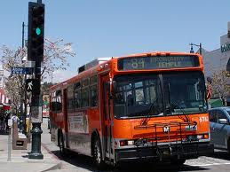
Traffic Congestion & Signal Delays
  Transit Signal Priority
  Improves g/c ratio (e.g., from 0.40 to 0.50 g/c)
  Queue Jumper Lanes
  Reduces v/c ratio (e.g., from 0.70 to 0.40)
Reductions Calculated with TCRP Report 118 Traffic Signal Delay Curves

Slide 17
Example Calculation of
Traffic Signal Delay
Intersection Characteristic | No Treatment | With TSP | With Queue Jumper
Signal Cycle Length | 120 seconds | 120 seconds | 120 seconds
g/c Ratio | 0.40 | 0.50 | 0.40
v/c Ratio | 0.70 | 0.70 | 0.40
Estimated Delay | 36 seconds | 28 seconds | 28 seconds
Existing Travel Time Observations Should Be Used to Validate Assumptions

Slide 18
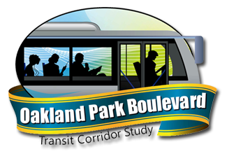
Example Application #1
Oakland Park Blvd. Alternatives Analysis
  Major East/West Arterial Road in Broward County, FL
  Potential Modes are BRT and Streetcar
  Alignment Options include Mixed Traffic, Business Access and Transit (BAT) Lane, and Exclusive Lane

Slide 19
Example Application #1
Oakland Park Blvd. Alternatives Analysis
Modes/Vehicles Being Considered
Bus Rapid Transit (2.0 mphps accel/decel rates)
Streetcar (2.5 mphps accel/decel rates)
Alignment
15.4 miles
16 Stops
Stop Dwell Times
15-20 seconds

Slide 20
Example Application #1
Oakland Park Blvd. Alternatives Analysis
Signalized Intersection Delays
Roadway Congestion
Factors to Posted Speed Limits

Slide 21
Example Application #1
Oakland Park Blvd. Alternatives Analysis
Example Portion of Travel Time Worksheet

Slide 22
Example Application #1
Oakland Park Blvd. Alternatives Analysis
Eastbound Travel Time Summary

Slide 23
Example Application #1
Oakland Park Blvd. Alternatives Analysis
Eastbound Travel Time Summary

Slide 24
Example Application #1
Oakland Park Blvd. Alternatives Analysis
Eastbound Cumulative Travel Times

Slide 25

Example Application #2
Cotton Belt Corridor Regional Rail Project
  Proposed Crosstown Corridor Rail Project in North Dallas Suburbs – from Dallas/Fort Worth Airport to Plano
  Proposed Mode: Diesel Multiple Units
  Shared Track with Freight Operations
  Some Single Track Segments

Slide 26
Example Application #2
Cotton Belt Corridor Regional Rail Project
  Mode/Vehicle
  Stadler GTW DMU 2-2/6 Low Floor Vehicle
  2.2 mphps acceleration/2.5 mphps deceleration
  Alignment
  26.7 to 27.5 miles
  9 to 12 stations
  Up to 5 segments with single track operations
  Station Dwell Times
  30 to 60 seconds
  Roadway Congestion and Intersection Delay
  Not Applicable

Slide 27
Example Application #2
Cotton Belt Corridor Regional Rail Project
  Cotton Belt String Line Diagram

Slide 28
Example Application #2
Cotton Belt Corridor Regional Rail Project
  Cotton Belt Speed Profile (Both Directions)

Slide 29
For More Information
  James Baker
  678-461-0969, Ext. 13
  jbaker@ctgconsult.com
Thank You!

