Slide 1

Challenge 2: Spatial Aggregation Level
Multi-tier Modeling in Ohio Attempts to Balance Run Time and Forecast Granularity
Gregory Giaimo, PE
The Ohio Department of Transportation
Division of Planning
Presented at
The 14th Transportation Planning Applications Conference
May 5, 2013

Slide 2
Overview
Motivation
Focus Model
Quick Run Model
Comparisons

Slide 3
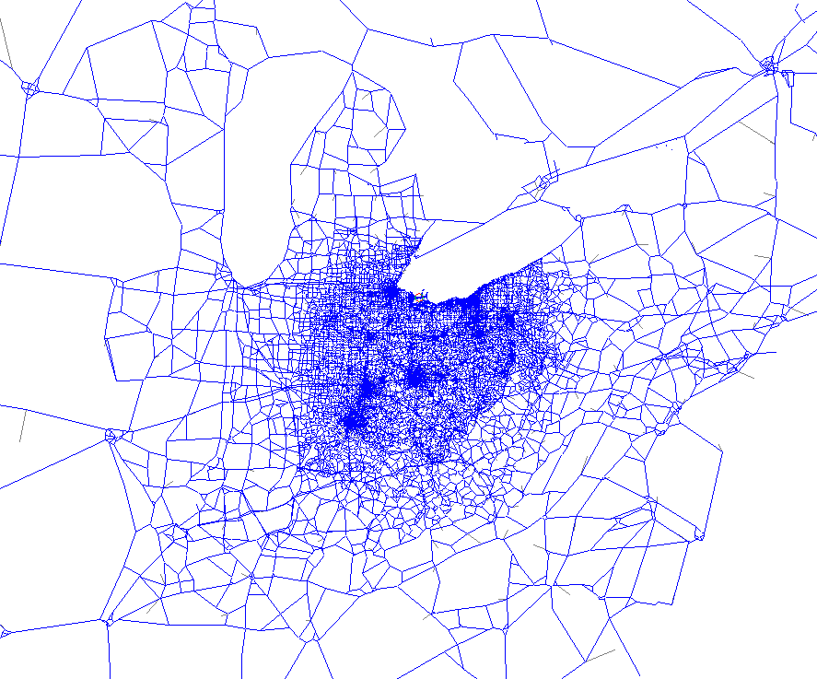
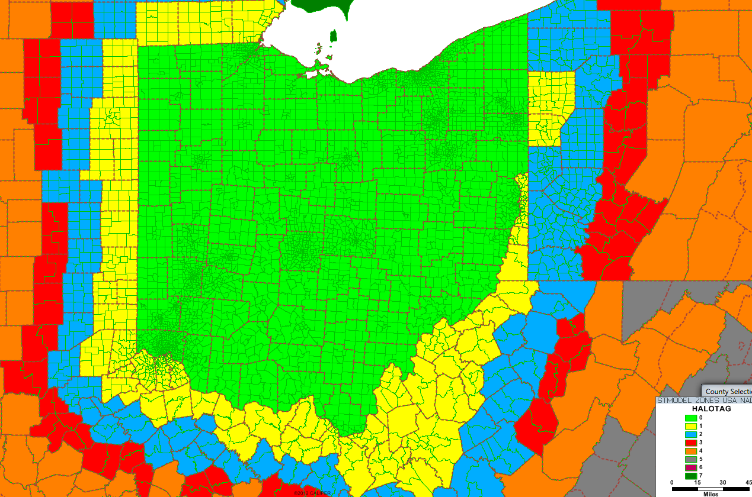
Motivation
Statewide models are big
  Ohio has 5000+ zones (3600+ state)
  Model takes about 14 hrs. on dedicated cluster (makes model difficult to update)

Slide 4
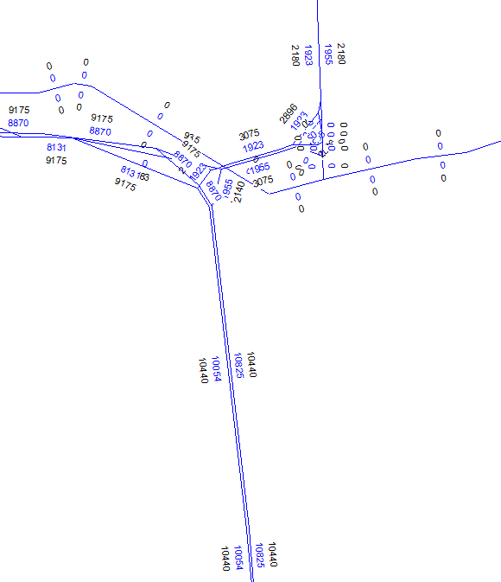
Motivation
Ick!
Good
Spatial aggregation is still too great to get good volumes on arterial streets
OK
Bleah!
Good
Black=Count
Blue=Model

Slide 5
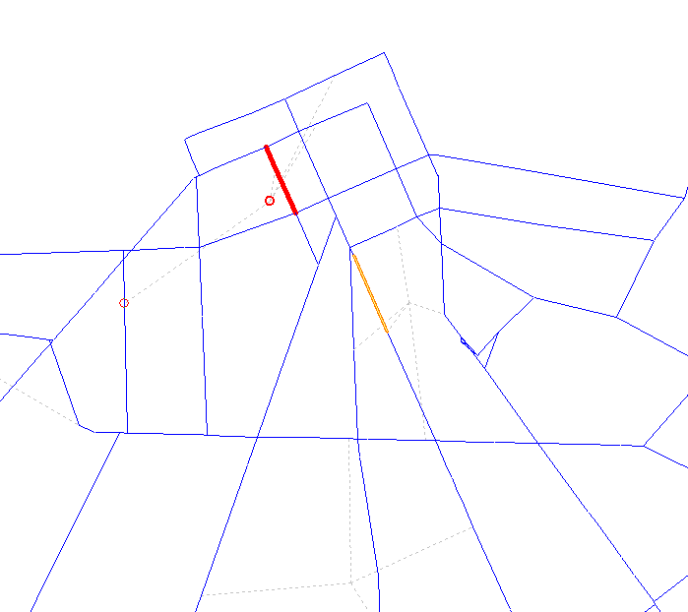
Motivation
Fictitious congestion near centroids makes assignment convergence unstable (challenge 7 presentation will address)
Red=VC>1
Yellow=VC>0.9

Slide 6
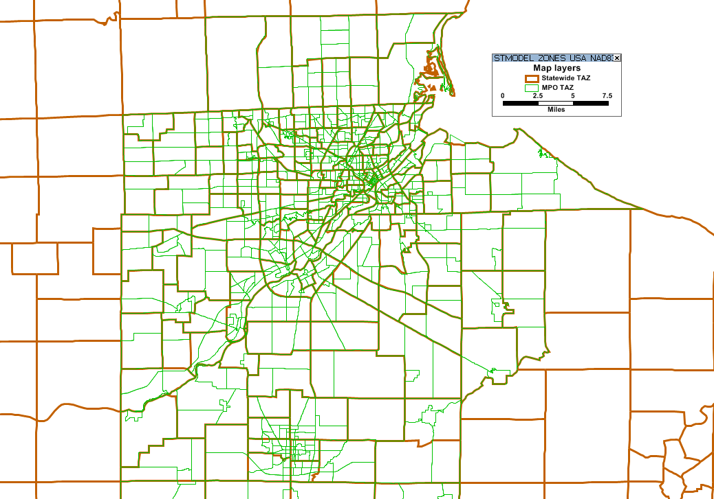
Motivation
Need closer to 20,000 zones to have the correct balance to achieve reasonable loadings on arterial system (similar to MPO model TAZ density)

Slide 7
Motivation
Two Part Solution
  Focus Model: provides finer spatial detail in a small area
  Quick Run Model: less spatial detail to make model run quicker

Slide 8
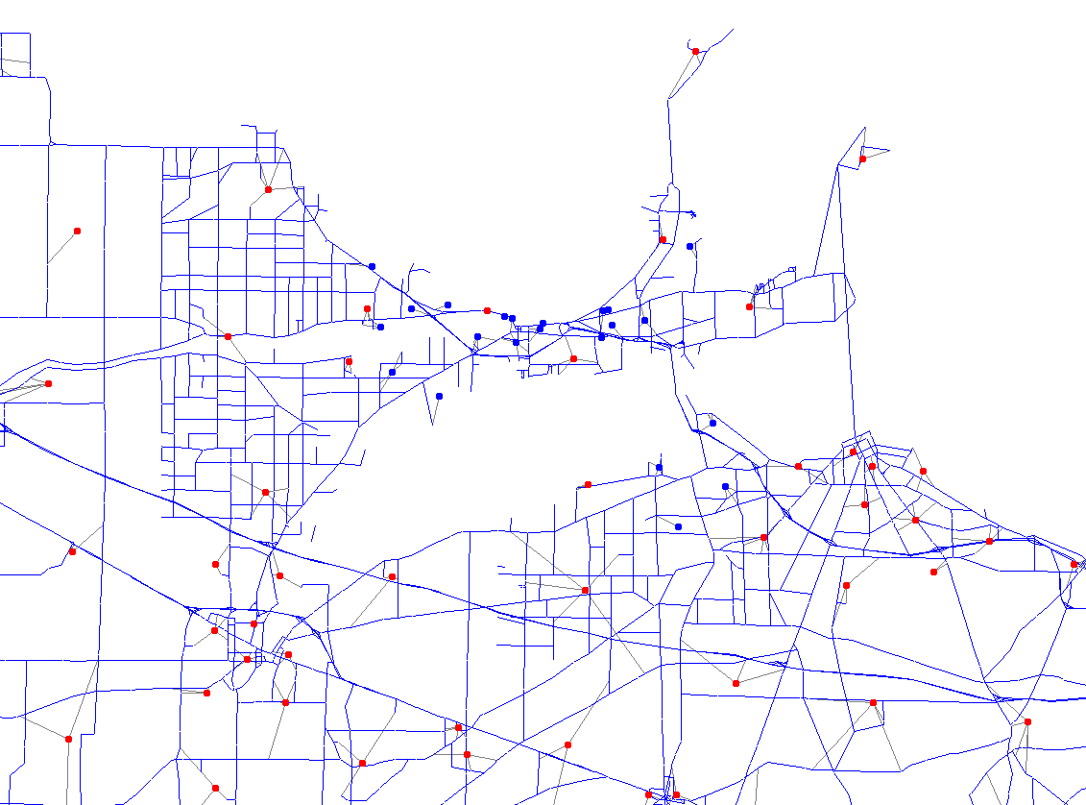
Focus Model
The key to the focus model is data
ODOT maintains a master network for the statewide model containing far more detail than is used in a normal model run
Focus Network
Blue centroids=focus
Red centroids=normal
Focus Area
Buffer Area

Slide 9
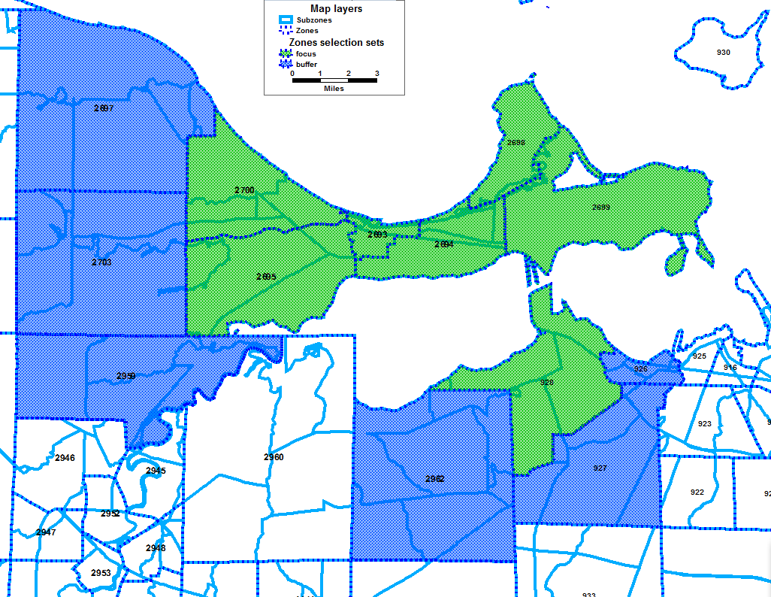
Focus Model
Also maintain a set of 14000 more refined zones

Slide 10
Focus Model
Focus model combines these data sets with static trip tables from a full model run
Application has 5 steps
  Add network detail
  Split trip tables
  Create Cube junctions in focus area
  Select junctions
  Assignment trip tables
Optional 6th step for performing ODME
Check out focus.zip on your flash drive to see it in detail!

Slide 11
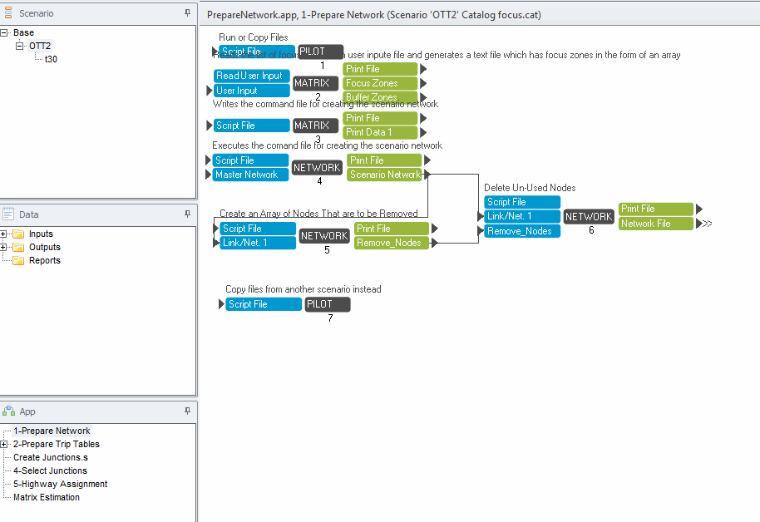
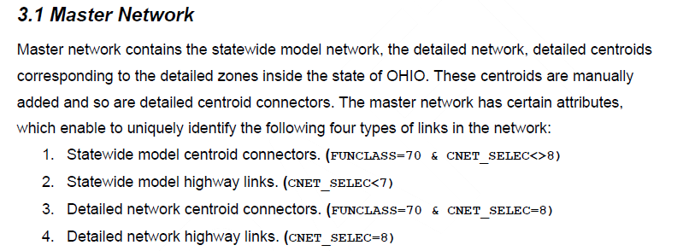
Focus Model
Add network detail
Links selected from master network
Additional network detail is added in a buffer area as well as focus area to prevent discontinuities in area of interest
Focus model centroid connectors were generated automatically (full model CC’s had much more human interaction

Slide 12
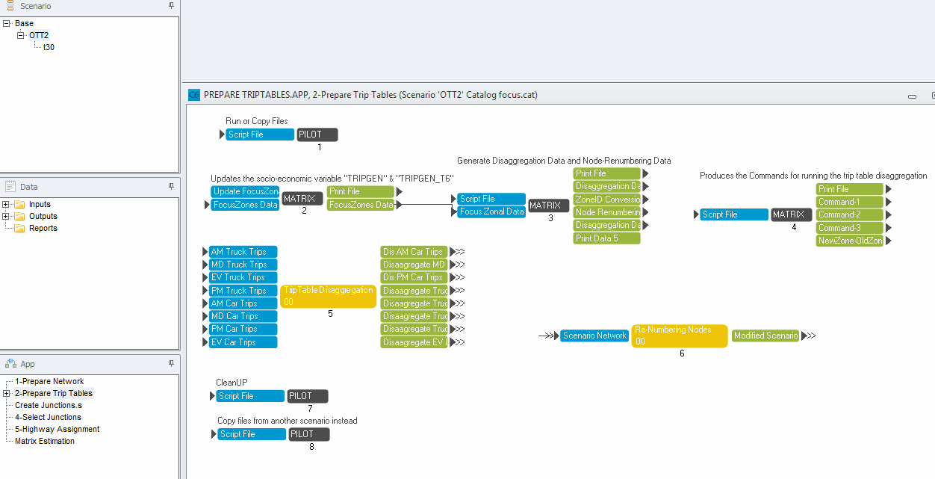
Focus Model
Static trip tables (by user class, focus model has capability to deal with trips tables with various market segmentation) are split within the focus area
Uses zonal data at the focus zone level to parse trip tables using simple generation intensity functions

Slide 13
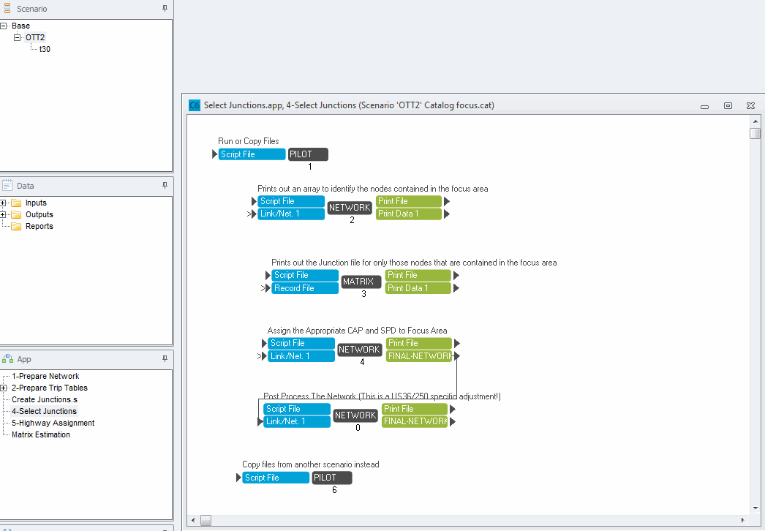
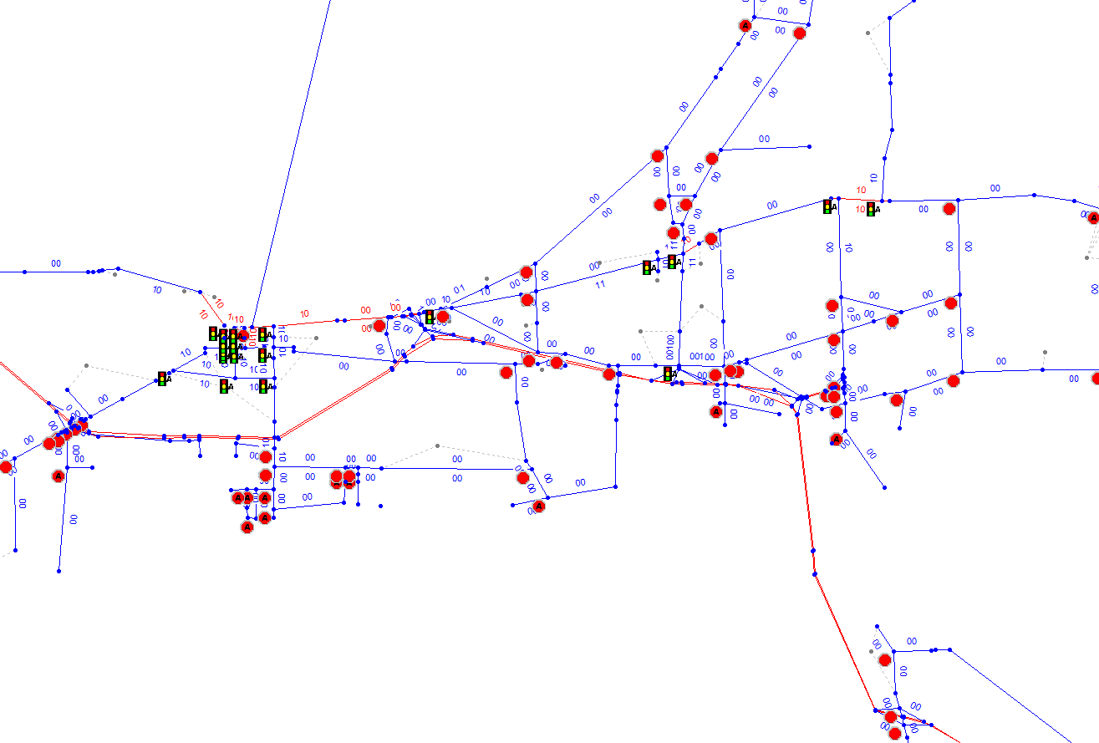
Focus Model
We prefers dynamic intersection delay modeling (aka Junction Modeling), however does not work for full model due to computer memory limitations
Steps 3 and 4 of the focus model create the detailed intersection control information in the focus area (we codes the necessary information on the all state and MPO model links)

Slide 14
Focus Model
Step 5 is simply the assign the trip tables to the network
Recent updates to the tool include:
  Ability to accept different market segmentations in trip tables (we use different types for different purposes such as user benefit analysis, tolling, HOV or standard highway projects)
  Ability to bring in forecast networks (previously the master network was maintained for base conditions only, now code future projects to this as well)

Slide 15
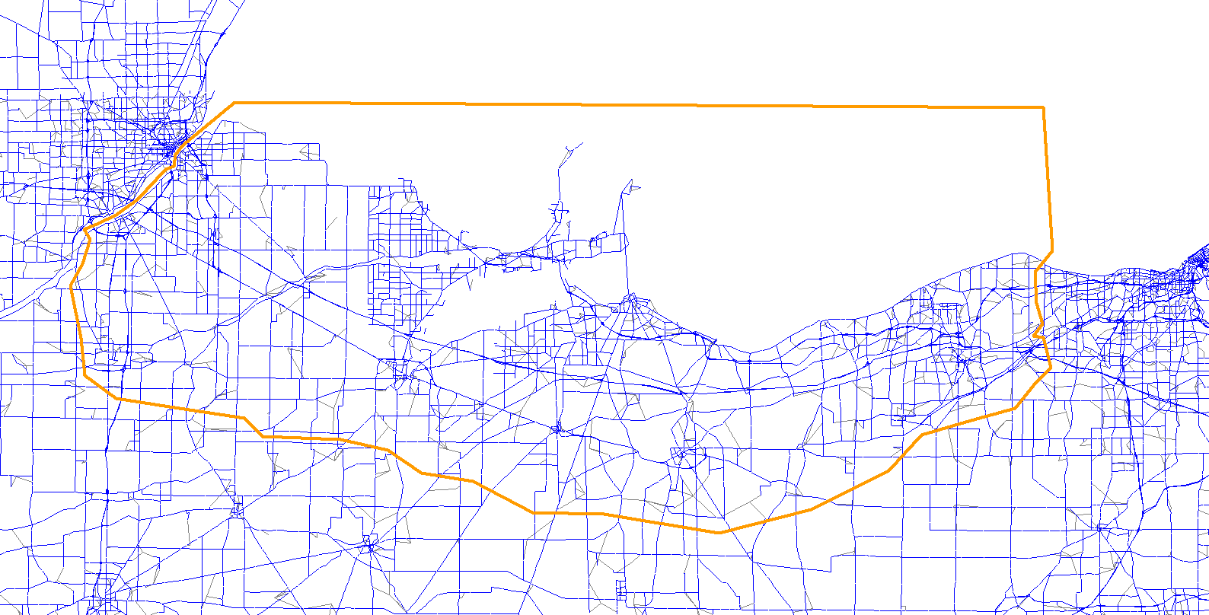
Focus Model
Even with focus model, it is often necessary to perform additional project level updates*
For this we generally use built in software tools for subarea extraction and then refine the subarea
Subarea Extracted
*following ODOT guidelines for project level modeling, see file Guidelines for ….. .pdf on your flash drive to learn more!

Slide 16
Quick Run Model
Quick Run Model is at the opposite end of the spectrum and solves a different problem: long run times
Each Full Model scenario year takes 8 hours to run
A full scenario runs from year t0 to t40 (total of 9 scenario years per full scenario)
9 scenario years * 8 hours per year = 72 hour run time per scenario for Full Model
Quick Run Model runs much faster (1.5 hours per scenario year at 1 in 10 sampling, much faster for 1 in 1000)

Slide 17
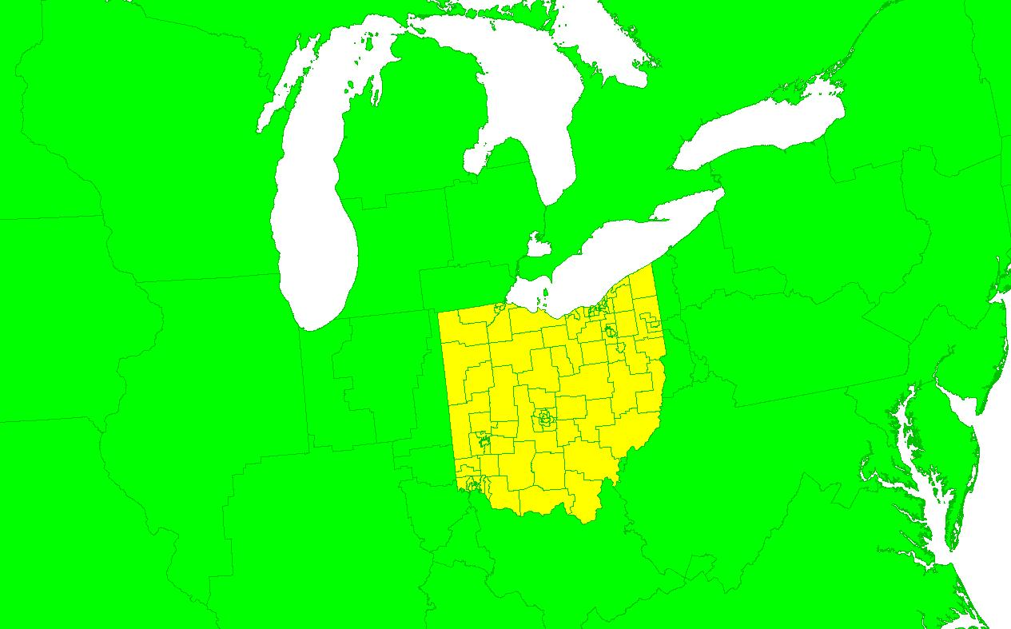
Quick Run Model
Achieved with 2 changes:
  Sampling in micro-simulation models reduced from 1 in 3 HH in a standard run to 1 in 1000 or less
  Zones aggregated (PUMA’s in state, larger out of state)
Quick Run Zones

Slide 18
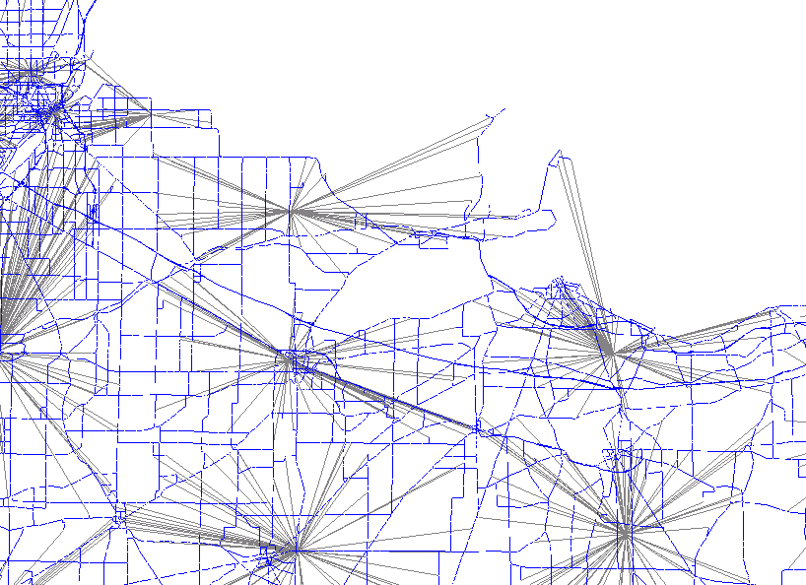
Quick Run Model
No aggregation occurs at network level, rather quick run centroids are simply connected everywhere one of its child TAZ’s connects

Slide 19
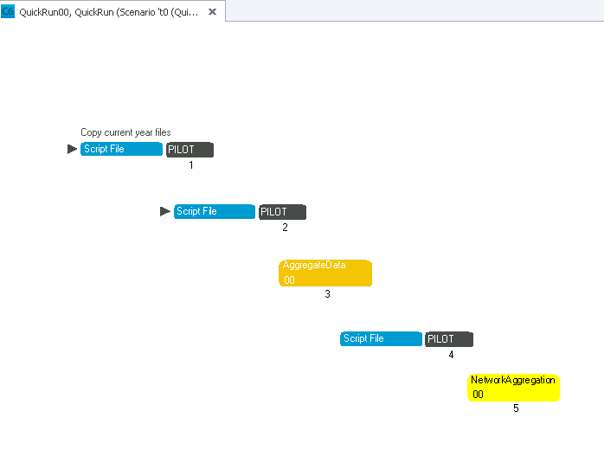
Quick Run Model
Application has 2 steps
  Various SE/land use files are aggregated
  Centroid connectors changed
Once data is processed, the full model is run on these datasets with a quick run toggle switched
Thus QRM is a simpler application than FM but must operate on many more files and then results in data for a full run of the model

Slide 20
Quick Run Model
Results themselves are not suitable for analysis
Large zone size causes problems in distribution (high intrazonal trips) resulting in less network traffic
Thus need to be careful when calibrating model components related to congestion levels
Some more detailed preliminary comparison results are contained in spreadsheet QuickRunValidation_t0.xlsx on your flash drive!

Slide 21
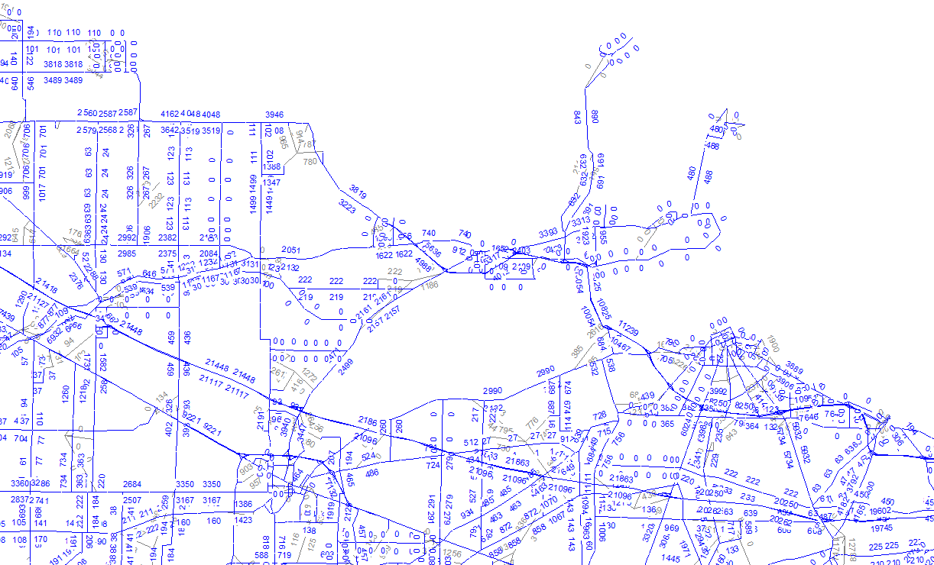
Comparisons
You can find these maps on your flash drive to compare yourself!
Regular Model Run
2015 daily volume

Slide 22
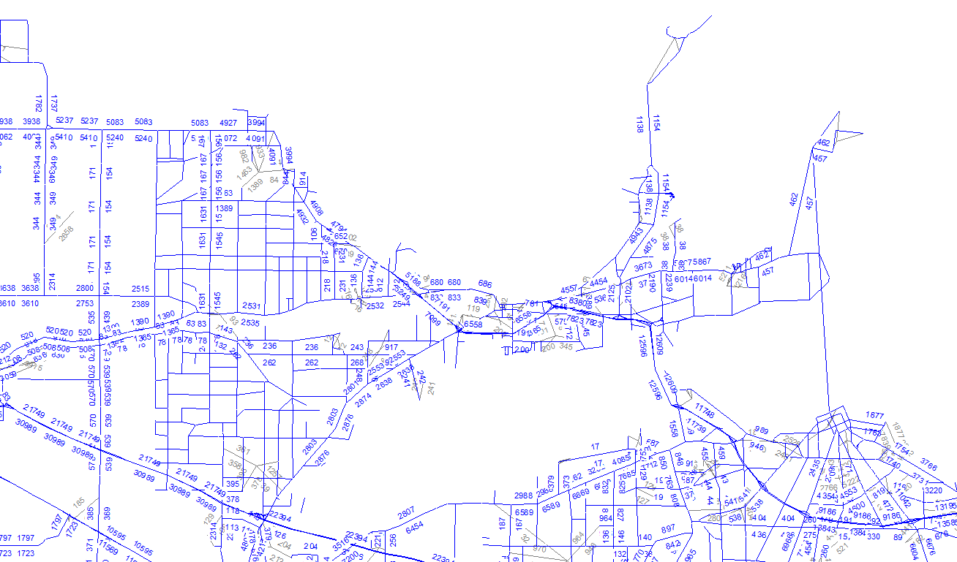
Comparisons
You can find these maps on your flash drive to compare yourself!
Raw Focus Model Run
2015 daily volume

Slide 23
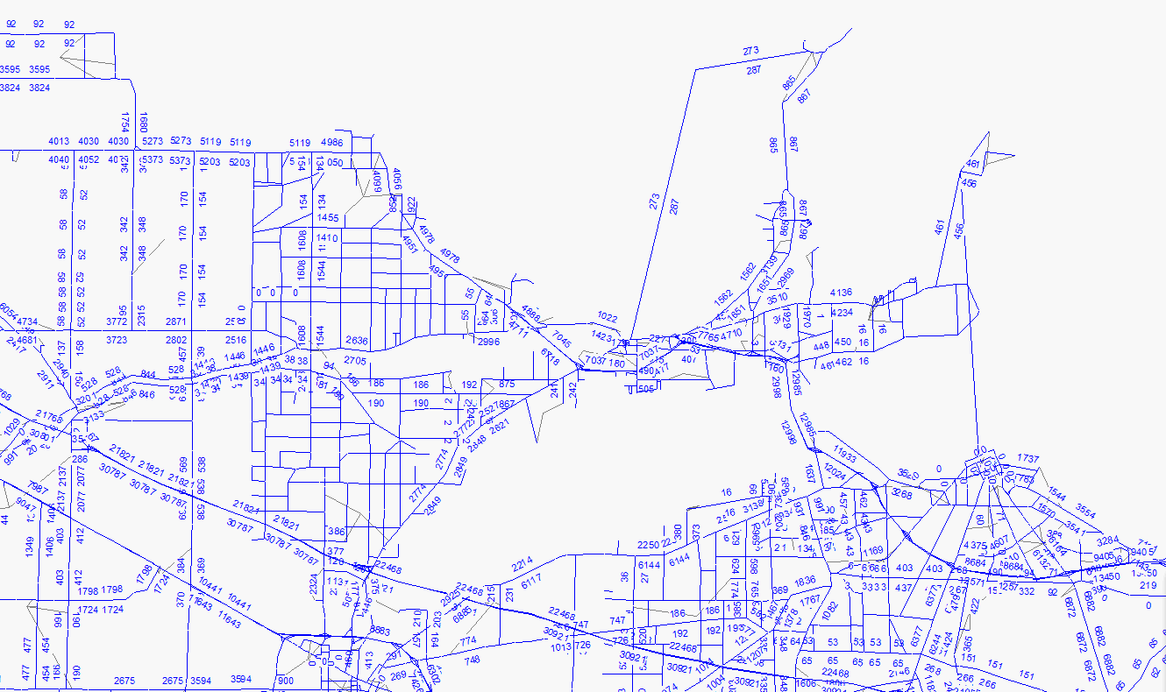
Comparisons
You can find these maps on your flash drive to compare yourself!
Refined Focus Model Run
2015 daily volume

Slide 24
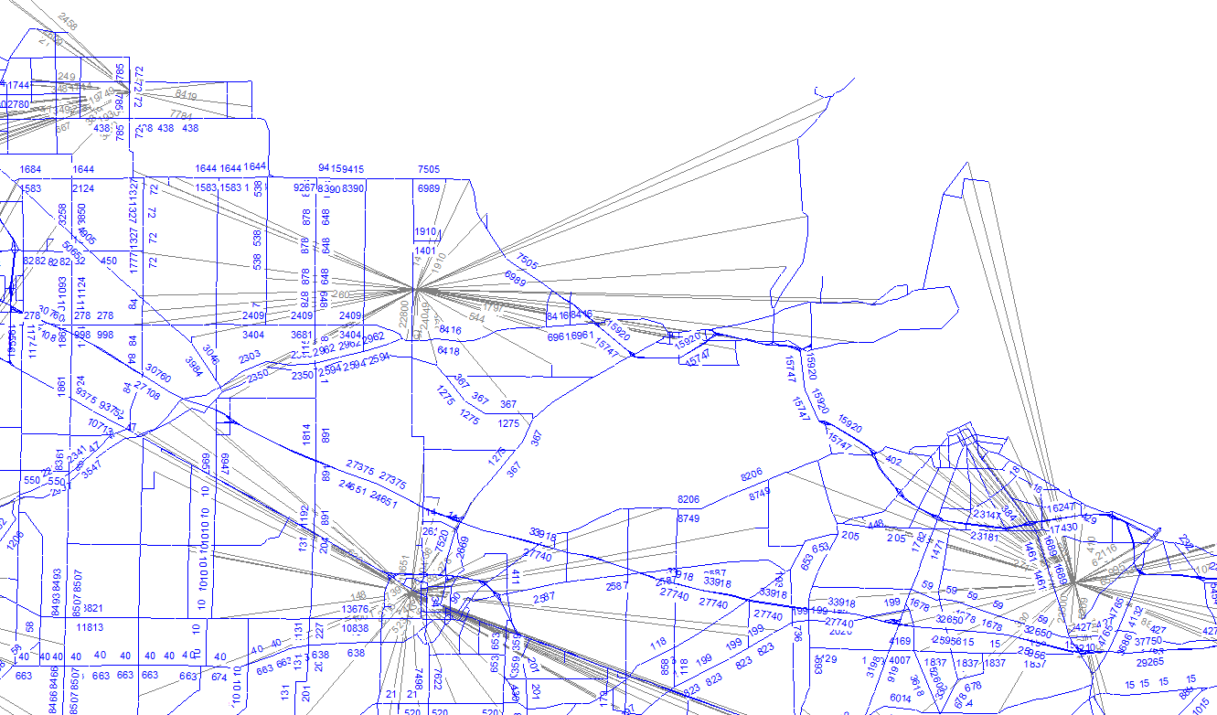
Comparisons
You can find these maps on your flash drive to compare yourself!
Quick Run Model Run
2000 daily volume

