Slide 1
Developing a 24-Hr Regional DTA Model for Use in Operations Planning
Lili (Leo) Luo, P.E., ITS & Safety Engineer
Sarath Joshua, P.E., Ph.D., ITS & Safety Program Manager

Slide 2
Project Background
Internal Testing of DynusT and Multi-Resolution Modeling Two Years Ago
Develop a 24 hr Regional DynusT DTA Model

Slide 3
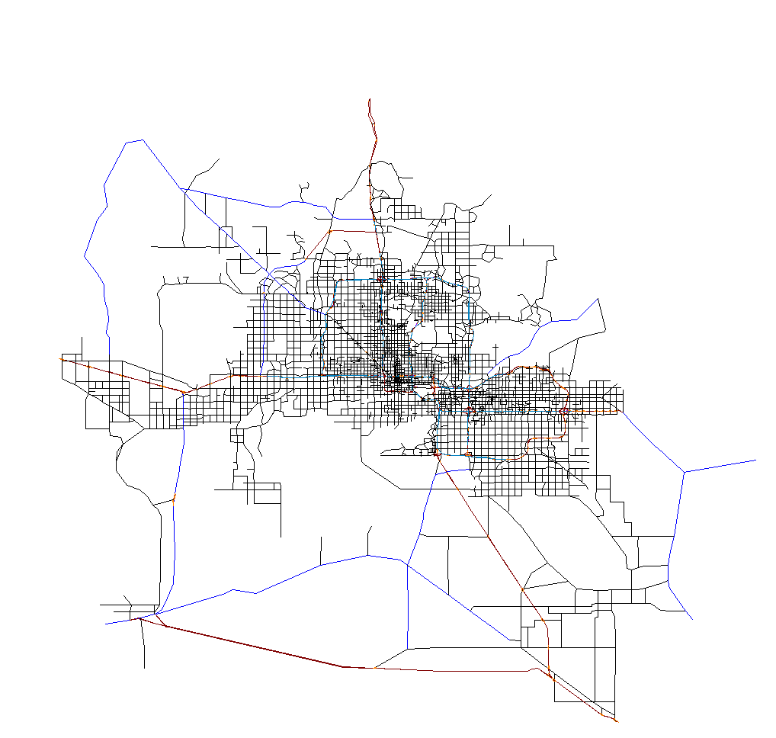
MAG DynusT Model Network
11,200 Sq Miles
# of links: 24869
# of nodes: 11550
# of signalized intersections: 2933
# of zones: 2006
10+ Million Trips

Slide 4
Initial Demand
Original Travel Demand Tables
NHTS Directional Departure Time Distribution by Trip Purpose

Slide 5
Traffic Flow Models
Traffic Flow Models
  Freeway
  Major Arterial
  Minor Road

Slide 6
Count Calibration

Slide 7
Convergence
Relative Gaps (20 iterations)
  AM
    5.5%
  PM
    8.1%

Slide 8
Count Validation
Notes:
Count data not used in Calibration, have to assume the percentage of SOV, HOV and Truck (no classification count with TMCs)
Spot Check
Network coding issues may still exist on arterials.
With the calibration tools provided and data, it is expected to improve.

Slide 9
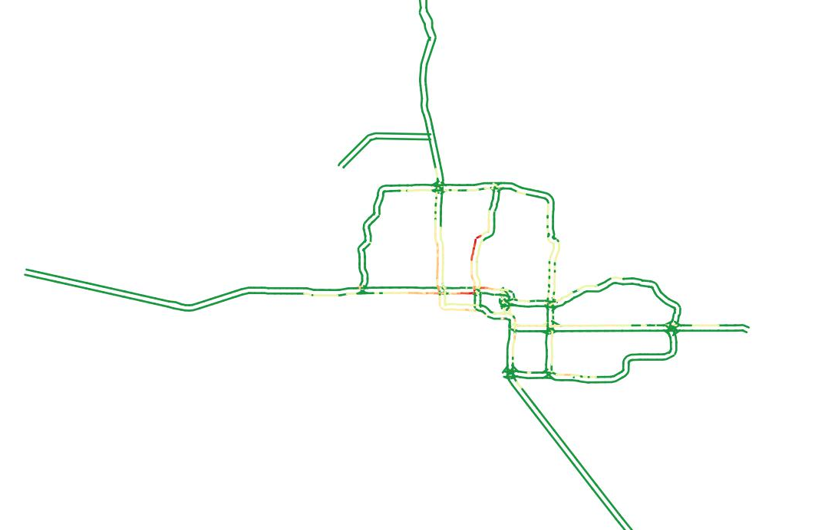
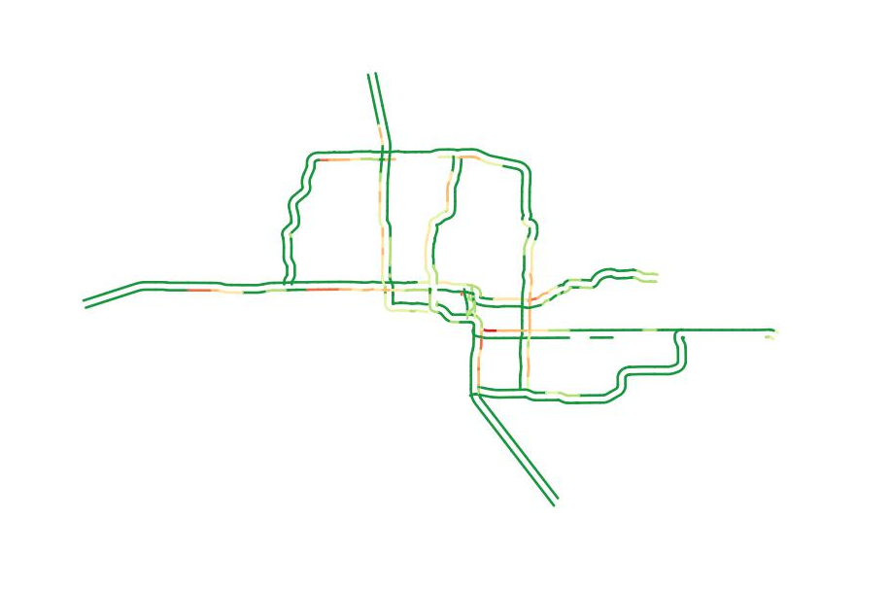
Bottleneck Validation
  AM
DynusT Bottleneck from 7:00AM-7:30AM
MAG Bottleneck Study 2003 from 7:00AM-7:30AM

Slide 10
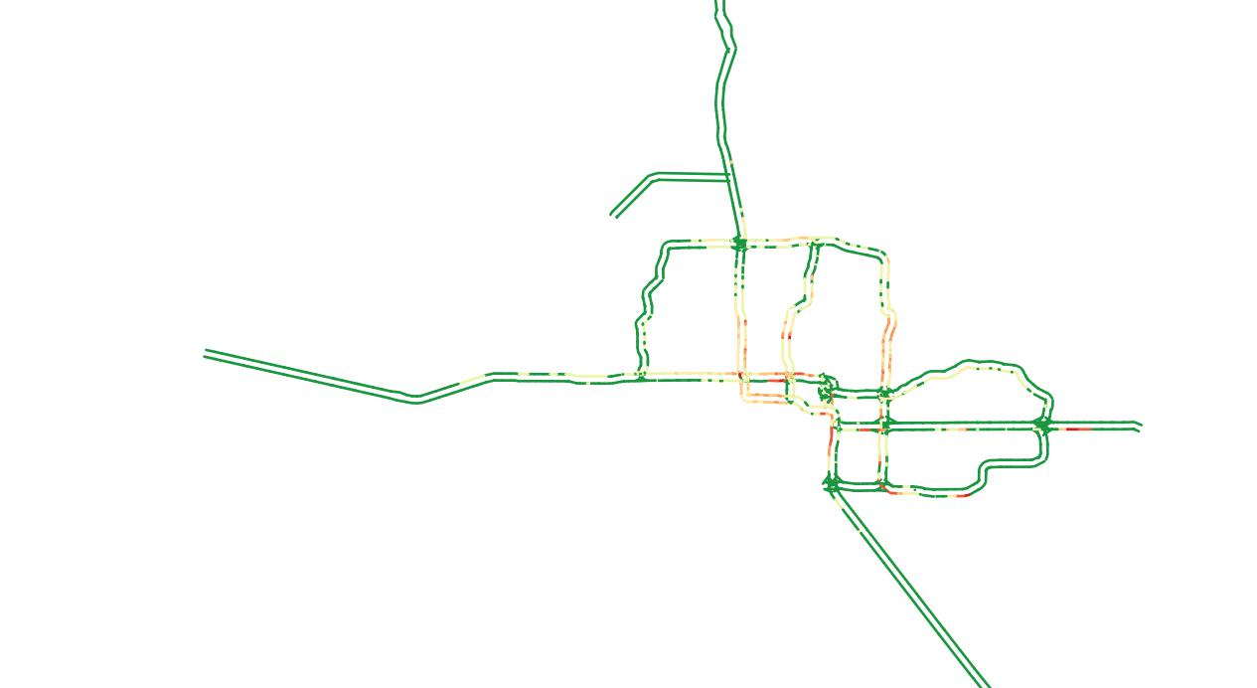
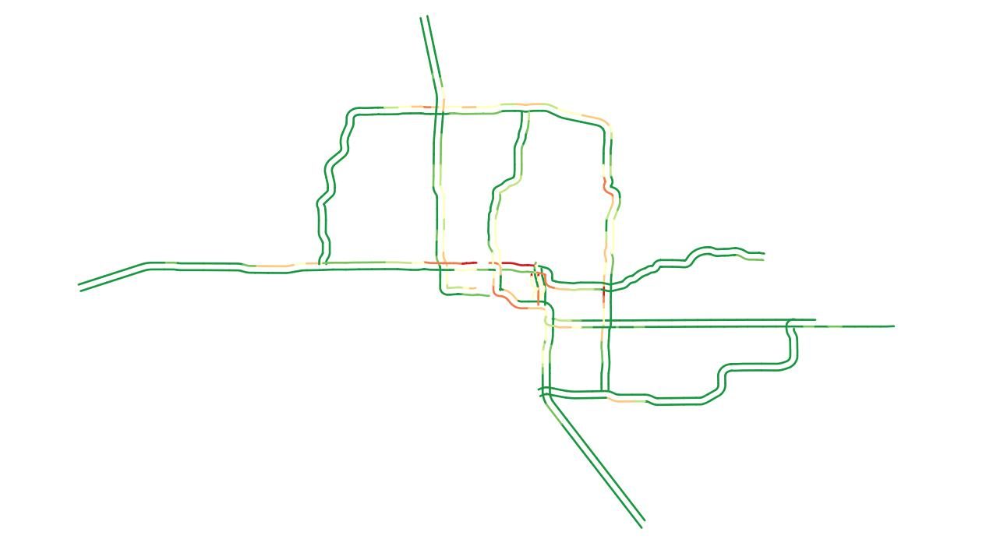
Bottleneck Validation
  PM
DynusT Bottleneck from 5:00PM-5:30PM
MAG Bottleneck Study 2003 from 5:00PM-5:30PM

Slide 11
Travel Time Comparison

Slide 12
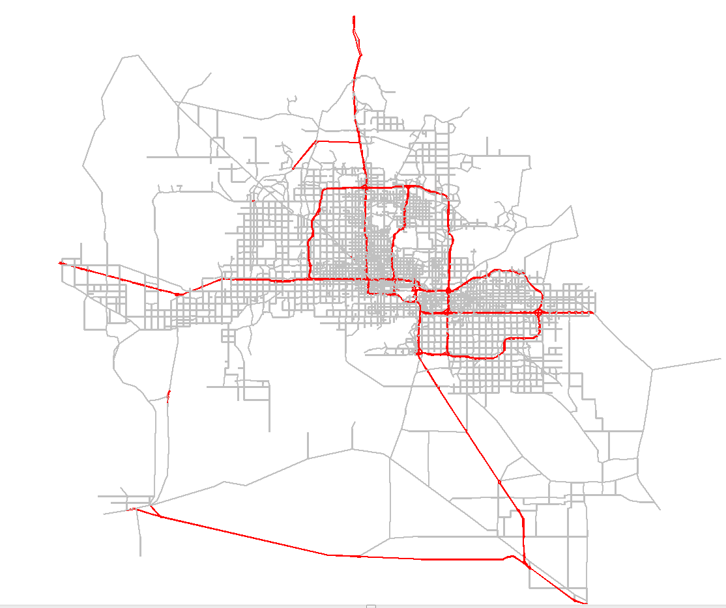
Application of the Model
Loop 101 Integrated Corridor Management
City of Scottsdale
Loop 101
Notes:
Need to know where traffic is going in the event of freeway crashes
Focus resources on arterials that are heavily impacted
Coordinate among agencies to reduce congestion, improve safety

Slide 13
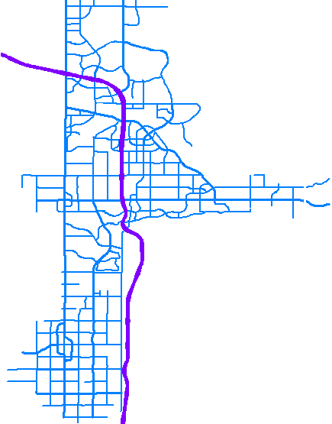

The Original Plan
PINNACLE PEAK
PIMA FWY / LOOP 101
SECTOR 3
LOCAL INCIDENT DETOUR PLAN
101 FREEWAY
THOMPSON PEAK
D.M.S.
BELL
GREENWAY
THUNDERBIRD
SECTOR 2
CACTUS
D.M.S.
D.M.S.
FRANK LLOYD WRIGHT
STRATEGIC SECTOR #
SHEA
D.M.S.
D.M.S.
92nd
124th
DOUBLETREE
96th
136th
SAMPLE INCIDENT LOCATION
McCORMICK
VIA DE VENTURA
D.M.S.
INDIAN BEND
POSSIBLE DETOUR ROUTES
D.M.S.
McDONALD
D.M.S.
CHAPARRAL
D.M.S.
LOCAL DYNAMIC MESSAGE SIGN
D.M.S.
SECTOR 1
D.M.S.
D.M.S.
D.M.S.
D.M.S.
INDIAN SCHOOL
D.M.S.
D.M.S.
THOMAS
64th
D.M.S.
McDOWELL
Note: Scottsdale does not control any of the freeway interchange signals south of Indian Bend. In order to have better remote control of traffic exiting the freeway during an incident we would need communications to those signals.
PIMA
McKELLIPS
HAYDEN
SCOTTSDALE

Slide 14
Performance
12 scenarios
  Each scenario includes the entire region
  8 hr simulation period
  30 minutes of model run
  30 minutes of result loading

Slide 15
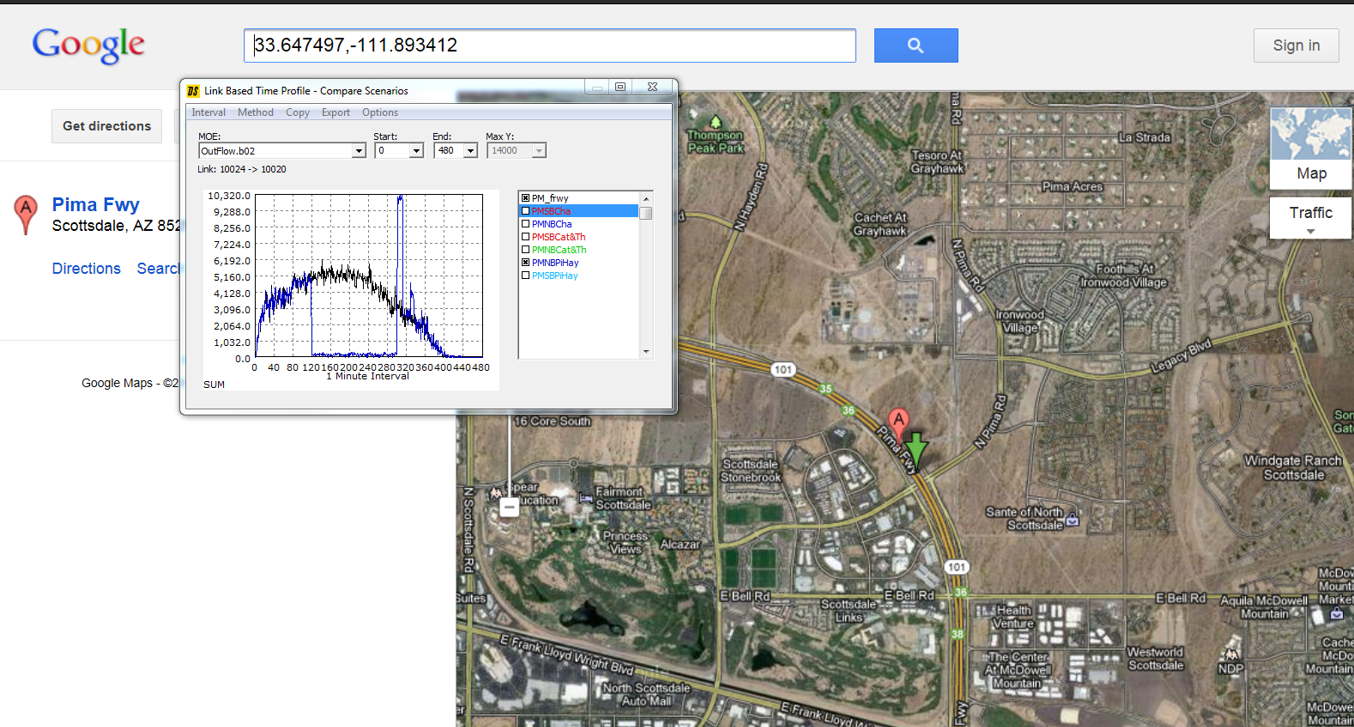
Freeway Statistics
Upstream Flow

Slide 16
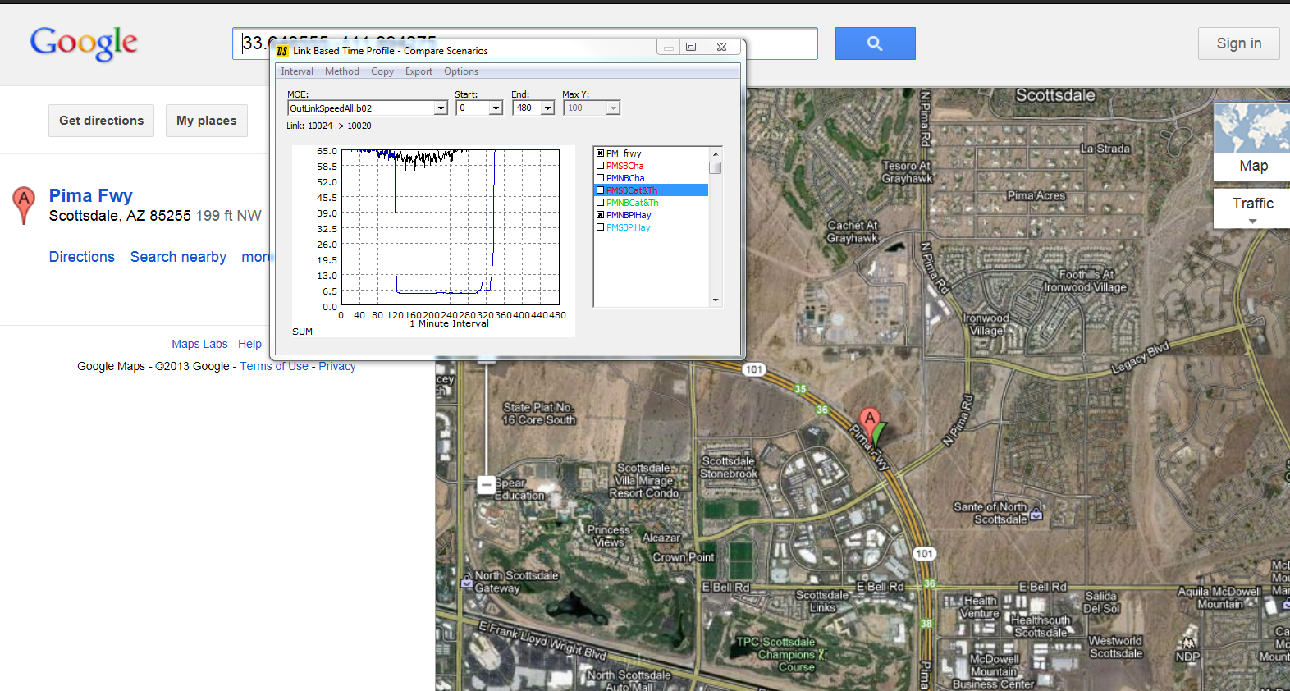
Freeway Statistics
Upstream Speed

Slide 17

Freeway Statistics
Upstream Travel Time

Slide 18
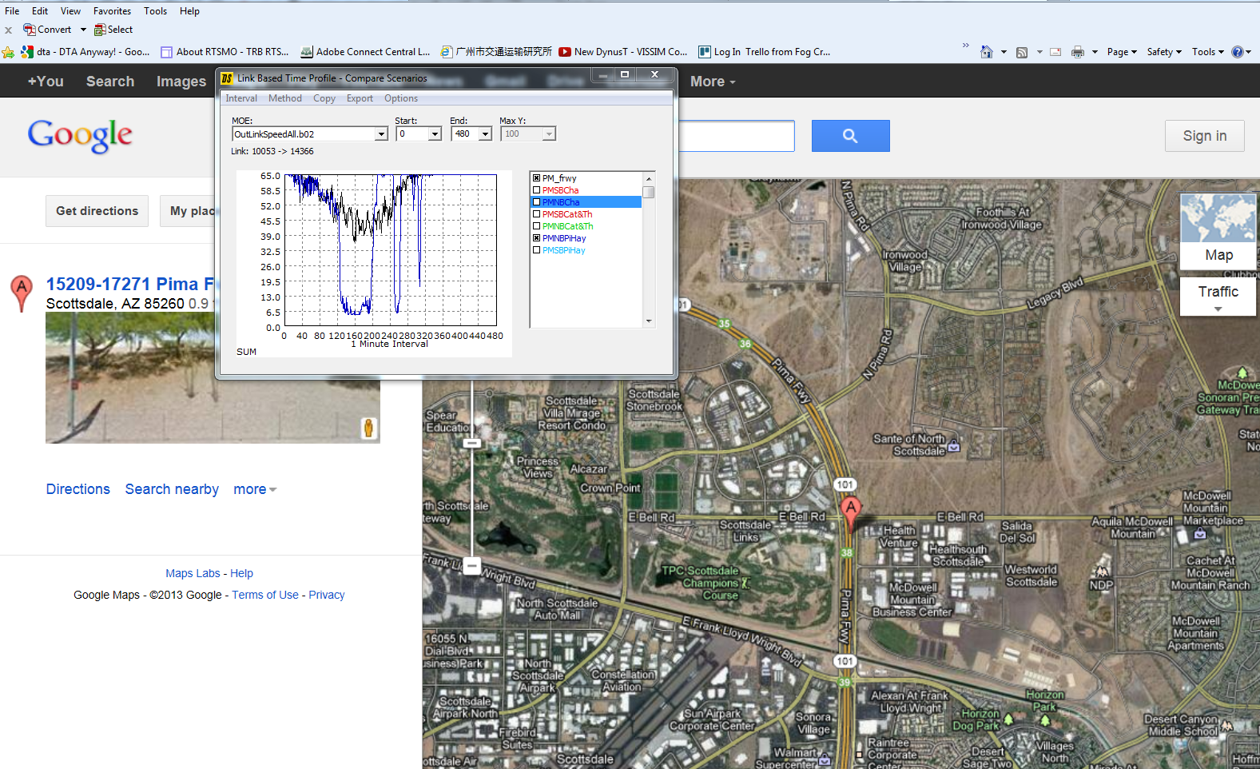
Freeway Statistics
Unstable Speed Further Upstream

Slide 19
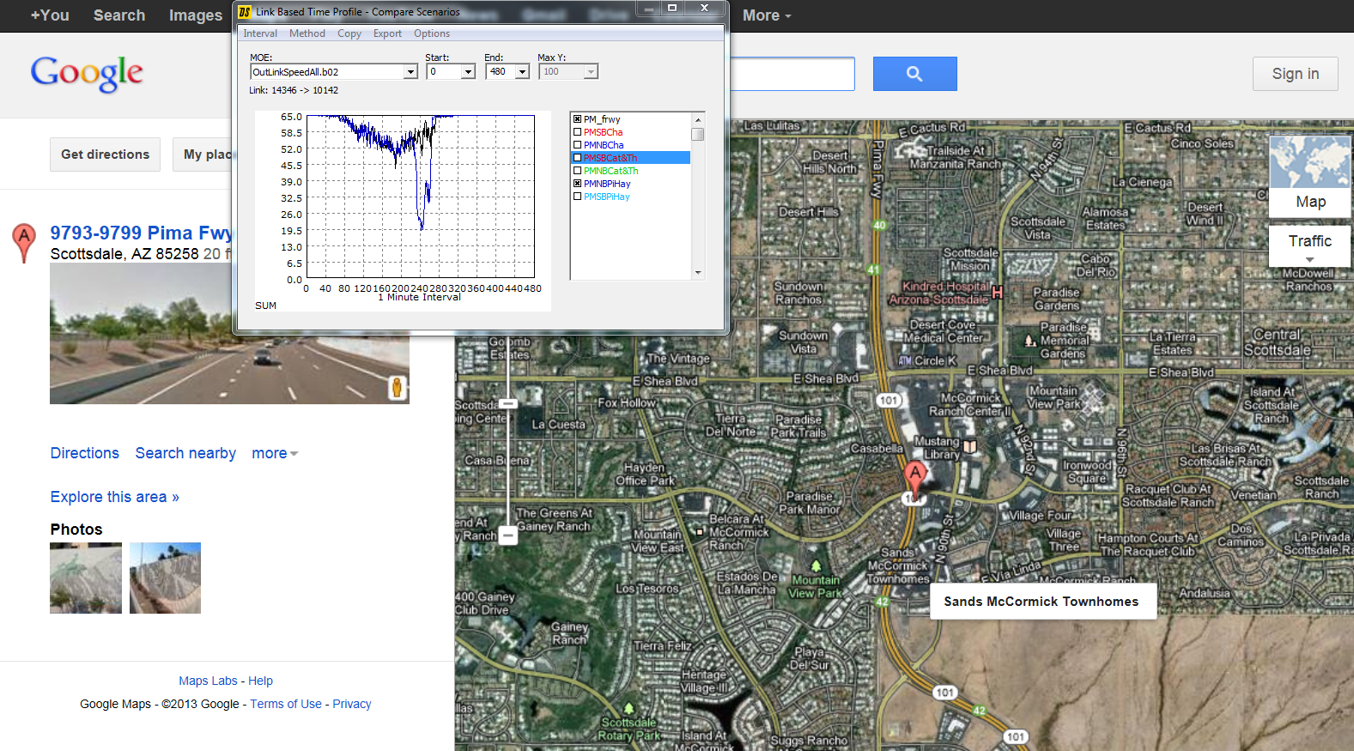
Freeway Statistics
6 Miles Upstream

Slide 20
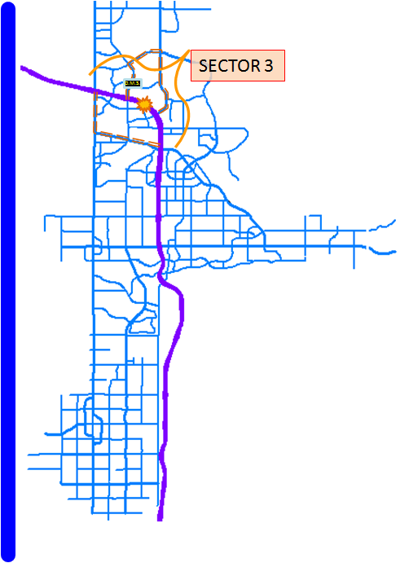
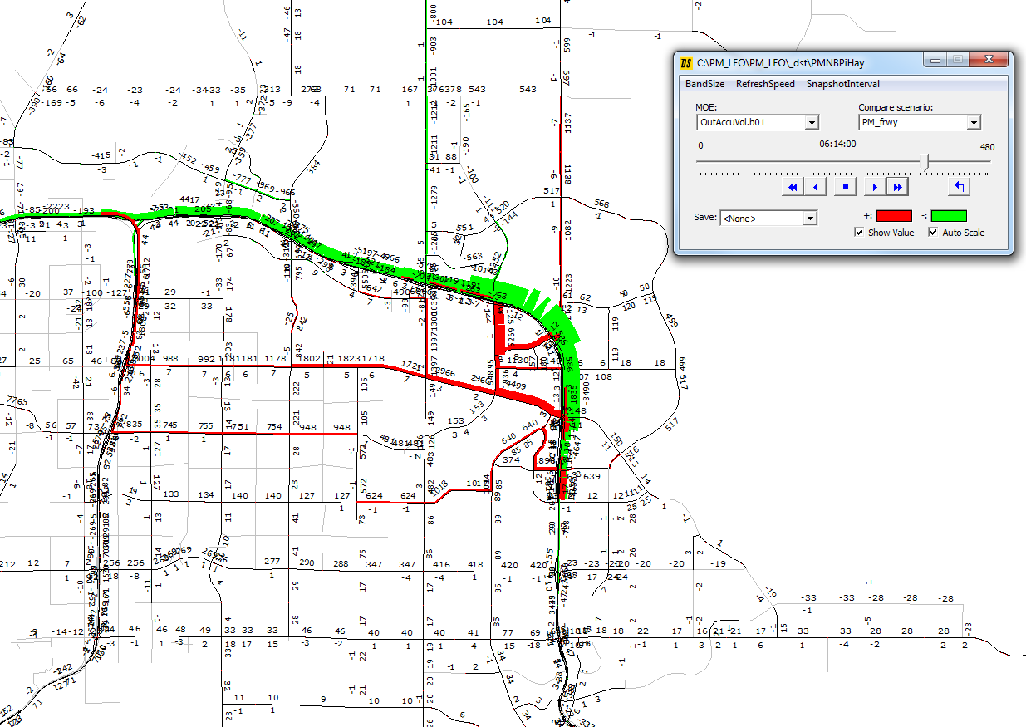
Arterial Statistics
Suggested Diversion Routes

Slide 21
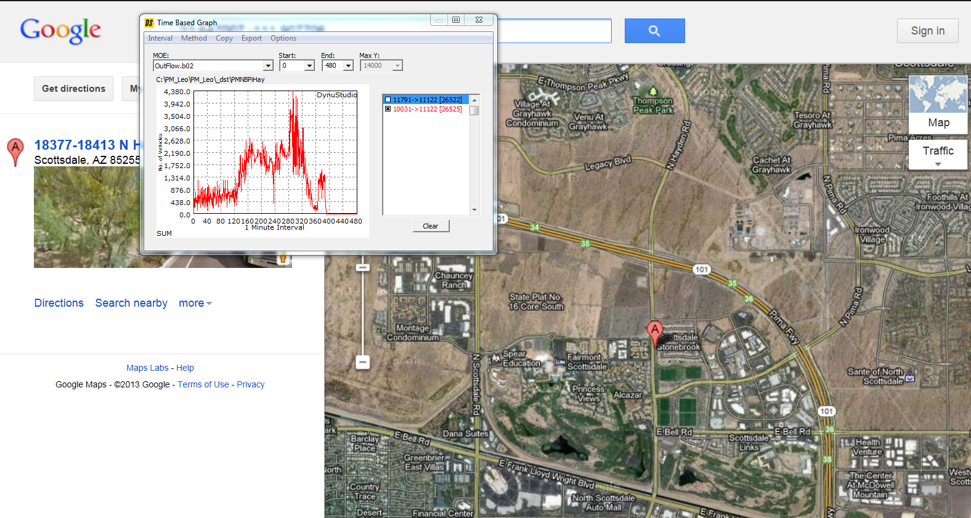
Arterial Statistics
Hayden NB Traffic Flow

Slide 22
Arterial statistics
Volume
Time | Volume
3:15 | 160
3:30 | 167
3:45 | 172
4:00 | 155
4:15 | 220
4:30 | 377
4:45 | 494
5:00 | 540
5:15 | 520
………………. | ……………………….
Street | Hayden
Direction | NB
Location | Between Princess Drive and Loop 101
Link# | 26525
FromNode | 10031
ToNode | 11122

Slide 23
Arterial Statistics
Turning Movement Counts
Intersection | Dir | Movement | 6:30 | 6:45 | 7:00 | 7:15 | 7:30 | 7:45 | 8:00 | 8:15 | 8:30 | 8:45 | 9:00
Pima&McDowell | SB | right | 18 | 22 | 27 | 37 | 54 | 77 | 89 | 124 | 157 | 193 | 237
 | SB | left | 37 | 54 | 62 | 79 | 91 | 114 | 133 | 161 | 197 | 244 | 287
 | EB | left | 56 | 79 | 87 | 129 | 179 | 241 | 301 | 392 | 500 | 632 | 777
 | EB | through | 150 | 220 | 269 | 355 | 462 | 567 | 680 | 834 | 1014 | 1180 | 1328
 | WB | right | 42 | 64 | 92 | 111 | 151 | 209 | 255 | 334 | 409 | 491 | 608
 | WB | through | 84 | 128 | 168 | 217 | 280 | 364 | 447 | 534 | 647 | 775 | 922

Slide 24

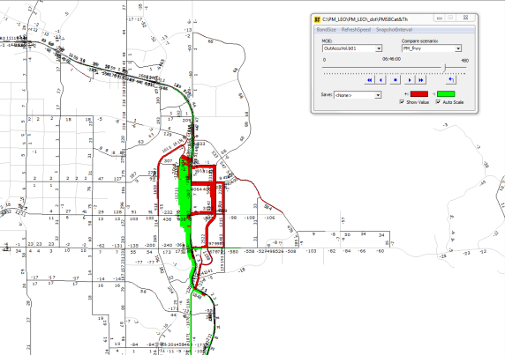
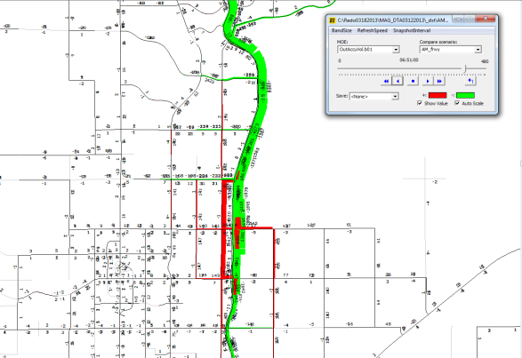
Recommendations
PINNACLE PEAK
SECTOR 3
THOMPSON PEAK
101 FREEWAY
D.M.S.
BELL
GREENWAY
THUNDERBIRD
SECTOR 2
CACTUS
D.M.S.
FRANK LLOYD WRIGHT
D.M.S.
SHEA
D.M.S.
D.M.S.
92nd
124th
96th
136th
DOUBLETREE
McCORMICK
VIA DE VENTURA
D.M.S.
INDIAN BEND
D.M.S.
McDONALD
D.M.S.
CHAPARRAL
SECTOR 1
D.M.S.
D.M.S.
INDIAN SCHOOL
D.M.S.
D.M.S.
D.M.S.
D.M.S.
D.M.S.
THOMAS
64th
McDOWELL
D.M.S.
McKELLIPS
HAYDEN
PIMA
SCOTTSDALE

Slide 25
Questions
Email: lluo@azmag.gov
Tel: 602-452-5072
Email: sjoshua@azmag.gov
Tel: 602-452-5031
Notes:
The MAG project webpage is being updated. More detail information will be made available once update is completed.

