Slide 1
Population Movements from Anonymous Mobile Signaling Data
An Alternative or Complement to Large-Scale Episodic Travel Surveys?

Slide 2
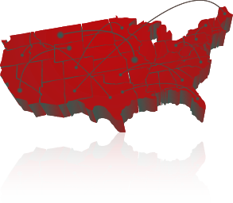
AirSage Company Overview
Patented Population Analytics
15 billion location data points per day
100 million mobile devices
Consumer privacy protection
Notes:
AirSage anonymously collects and analyzes wireless signaling data – processing more than 15 billion phone locations every day – and turns it into meaningful and actionable information, conveniently time- and date-stamped.
Our Population Analytics Data Products that provide powerful information and insights about how and when people travel, where people are, and how often they go there.

Slide 3
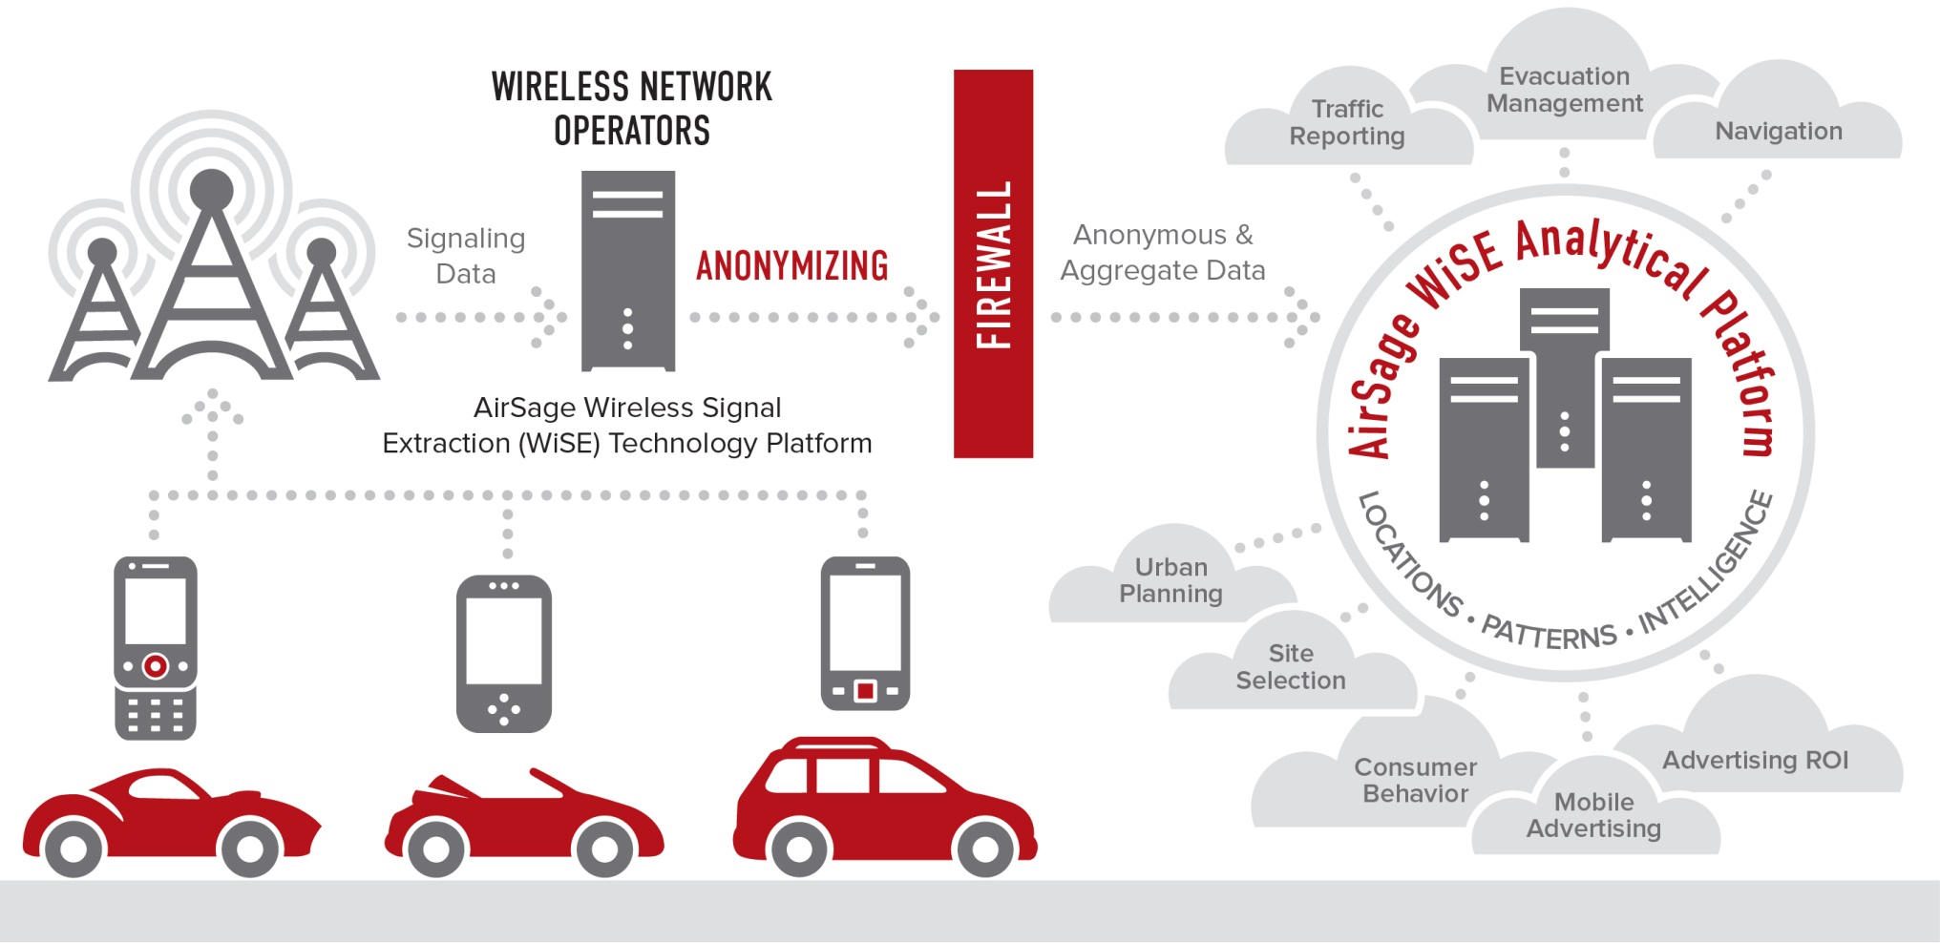
AirSage WiSE Platform

Slide 4
IBM and MIT Research
Research Concludes AirSage Data
Allows for lower collection cost, a larger sample size, higher update frequency, and a broader spatial and temporal coverage
Generates detailed traces that can be used to construct path histories with high fidelity across long periods of time
Produces audience measurements that are more credible than current static measurements, thus providing rich information to support transportation planning and operation

Slide 5
Data Validation
“The estimation of traffic flows using the AirSage data compares within 3% of the average daily machine counts for the same period. This is within range of counter error and provides very good correlation with the origin and destination data.”
Tom Hiles, HDR

Slide 6
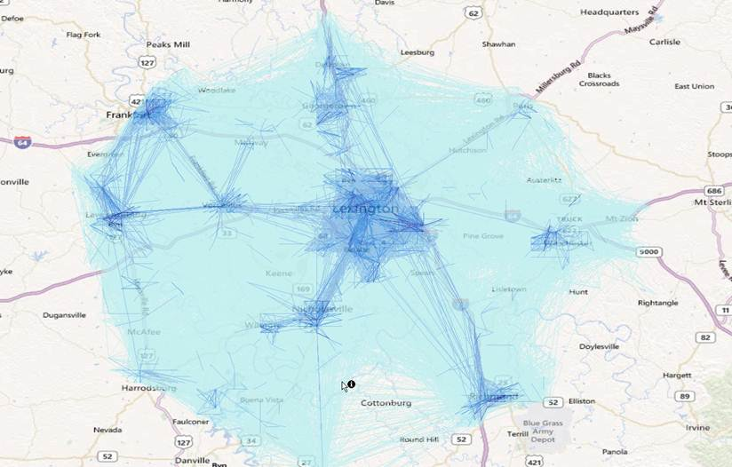
Trip Matrix: Lexington, Kentucky
Includes:
Day part segmentation
Trip purpose segmentation
Residence class segmentation
Resident Worker
Home Worker
Inbound Commuter
Outbound Commuter
Long-term Visitor
Short-term Visitor
24 hour trips in the Lexington, KY metro area
Notes:
For this project in Lexington, Kentucky, the client needed to understand not only urban travel – they wanted data that included trips from and to satellite communities in the surrounding metro area. With this broader Trip Matrix we can see travel passing through external to internal areas as well as return trips from internal to external.
A vehicle intercept study could be used to solve the data need but there are inherent challenges with this method. While it can be inexpensive by comparison to use interns to record license plates on the side of the road, capturing the data this way only yields a very small sample (which could be biased based on where the survey takes place). We had a call recently from an MPO who does just that… he takes license plates at external areas and then maps the data to vehicle registration information. This is OK because clearly he can get the home location from this process but it’s impossible for him to know where the trip originated and where the driver went after they past that external point. Vehicle intercept surveys can yield good information but in both cases AirSage can provide a more comprehensive solution.

Slide 7
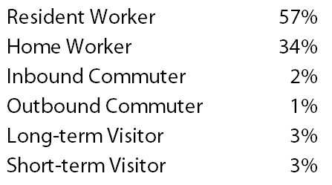
Resident Classification
Devices classified using statistical clustering of activity:
Home Locations – assumed to be primary nighttime cluster
Work Location – assumed to be primary daytime cluster
Weekday Sample Trips – September 19, 2012

Slide 8
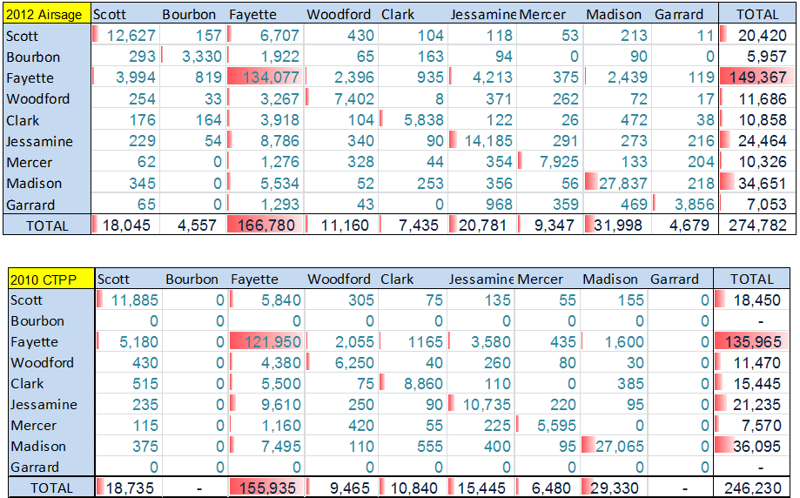
Home-Work Matrix

Slide 9
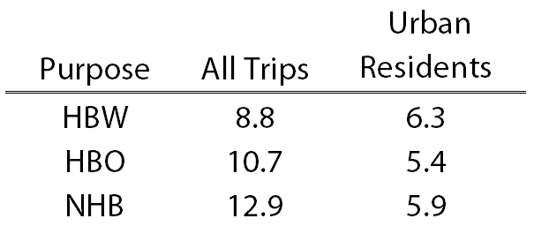
Data Validation: Trip Lengths
Average Trip Lengths in miles
Explained by consideration of
Long Distance Commuters
Non-Resident Travelers

Slide 10
Data Validation: Trip Rates
Number of Person Trips by Purpose
Explained by consideration of
Long Distance Commuters
Non-Resident Travelers

Slide 11
What’s Next?
“The average person doesn’t visit more than 13 unique locations per month” – Marta Gonzalez, MIT
Activity Patterns:
Top 20 location clusters for every device
Cluster frequency summarized
Cluster schedule summarized
Cluster purpose research
If you have activity pattern information every day for 30% to 40% of your population, how are those patterns summarized and understood over time?

Slide 12
www.airsage.com ● 404-809-2499

