Slide 1
SERPM 6.7
Development, Calibration & Results
Shi-Chiang Li, AICP
Scott Seeburger
David Schmitt, AICP
Ashutosh Kumar
February 17, 2012

Slide 2
Topics
Model objectives & schedule
Transit survey findings
Transit model development activities and results
Transit model calibration/validation process and results
FTA reaction
Summary

Slide 3
SERPM 6.7 Objectives
The new transit model should:
  Be a solid technical tool for multi-modal planning analysis, long-range transit planning and New/Small Starts analysis
  Understand key transit travel patterns and behaviors
  Include changes and adjustments that resolve non-transit issues identified since the release of SERPM 6.5
  Reflect all major findings of recent transit on-board surveys
  Utilize PT throughout transit model, removing any use of TRNBUILD
  Be reviewed and discussed with Federal Transit Administration staff

Slide 4
Schedule
Activities | 2010 |  | 2011 |  |  |  | 2012+
 | Q3 | Q4 | Q1 | Q2 | Q3 | Q4 | Q1+
Transit Survey Processing & Analysis | √ | √
Transit Model Development |  |  | √ | √
Transit Model Calibration / Validation |  |  |  |  | √ | √
FTA Coordination / Meeting | √ | √ |  | √ |  | √
Application |  |  |  |  |  |  | √
Transit survey fieldwork in 2008, 2009, & 2010

Slide 5
Transit Survey Findings

Slide 6
Southeast Florida Transit Survey Overview
(in chronological order)
First ever comprehensive picture of transit patterns & behavior in Southeast Florida!
System / Survey Year | Weekday Boardings during Survey | Sample Rate (Expandable Surveys) | Sample Rate (Geocodable Surveys)
Metrobus 2004 | 229,164 | 4.3% | 1.4%
Tri-Rail 2008 | 15,358 | 40% | 18%
Metrorail 2009 | 58,908 | 18% | 13%
I-95 Express Bus 2010 | 2,990 | 39% | n/a *
Broward County Transit 2010 | 119,624 | 6.5% | 6.5%
Palm Tran 2010 | 34,019 | 9.9% | 9.8%
An expandable survey has been reviewed for reasonableness (e.g., does not reflect home-to-home trip, etc.) contains a minimum amount of basic information (e.g., auto ownership, trip purpose, boarding location)
A geocodable survey is a subset of the expandable surveys that have at least a geocodable origin and destination.
* The I-95 Express Bus survey did not request detailed origin and destination information

Slide 7
Key Survey Findings – Overview
There are two major types of transit markets in the South Florida region:
  Mobility-dependent market using local services for all trip-making
  Commuter market utilizing premium transit service for longer work trips

Slide 8
Summary of Differences between Mobility-Dependent & Commuter Markets

Slide 9
Key Survey Findings – Overview
While work trips from car-owning households comprise the commuter market, the market itself consists of three distinct sub-markets:
  Traditional commuter market utilizing urban rail to distribute Miami-Dade workers to jobs in and around the Miami CBD
  Second traditional commuter market utilizing express bus service to connect Broward County workers to jobs in and around the Miami CBD
  Non-traditional inter-county market utilizing commuter rail to connect workers with jobs throughout the 3-county region, with these trips beginning and ending in different counties with no dominant destination

Slide 10
Summary of Differences among Commuter Sub-Markets

Slide 11
Tri-Rail Overview
72-mile commuter rail system
18 stations across 3 counties
1:45 traveling time
50 trains/day service
13,500 daily riders (12,200 in 2010)
Not easily accessible to any major attraction by walking
Survey conducted in October 2008
Counts collected Oct/Nov 2008

Slide 12
Tri-Rail
Key Ridership Patterns/Findings (1 of 2)
Tri-Rail is used for long, inter-county trips by choice riders accessing by auto
  80% of non-school/college trips travel between stations in different counties
  87% of all trips travel more than 2 stations (at least ~8 miles)
  Mean travel distance on Tri-Rail: 30 miles for non-school/college trips and 23 miles for school/college (28.7 miles overall)
  95% of riders are from 1- or 2+-car households
  70% auto-access (all trips)
Riders have very dispersed travel patterns, even for work trips
  No station produces more than 8% of all trips
  Only 2 attraction stations receive over 10% of trips
  Metrorail station – 17%, Boca Raton – 11%, All other stations <=9%
  NB/SB travel direction evenly split
  54% southbound with college/school trips
  58% southbound without college/school trips
  23% of park-ride trips transfer to Metrorail via Metrorail Transfer station (with the Miami CBD as a likely final destination)

Slide 13
Tri-Rail
Key Ridership Patterns/Findings (2 of 2)
Most riders (73%) access and egress Tri-Rail through non-walk modes
  79% of all trips require a non-walk mode to reach their final destination
Tri-Rail is used primarily for work trips, with higher non-work usage than traditional commuter rail systems
  66% work trips
  18% trips are college- or school-related
  12% home-based non-work; 4% non-home-based
Major markets are strongly peaked and access Tri-Rail by auto, other markets occur mostly in off-peak
  Work, school and college trips (85% of total) have 70%/30% peak/off-peak split
  All other trips, HBNW and NHB (15% of total) have 40%/60% peak/off-peak split

Slide 14
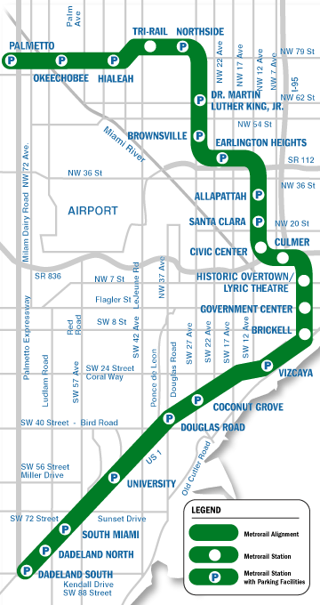
Metrorail Overview
22.5 miles within Miami-Dade County
22 stations
10-min pk/15-min op service
63,000 boardings/weekday (58,908 during survey)
5 “core” stations serving downtown Miami and adjacent activity centers
Survey conducted Spring 2009
Station-to-station flows from Fall 2009

Slide 15
Metrorail
Key Ridership Patterns/Findings
Metrorail is primarily used by choice riders traveling to/from the Miami core, which has connections to other transit services and a high concentration of jobs
  76% work trips to/from core
  66% non-work trips to/from core
  81% of riders are from 1- or 2+-car households
  92% of work park-ride trips to/from core
Metrorail is used more south of the core than north of the core
  67% of all trips use one station south of the core
  50% of all work trips are between the core and the stations south of the core
  The 3 southernmost stations produce 37% of all trips and 46% of work trips

Slide 16
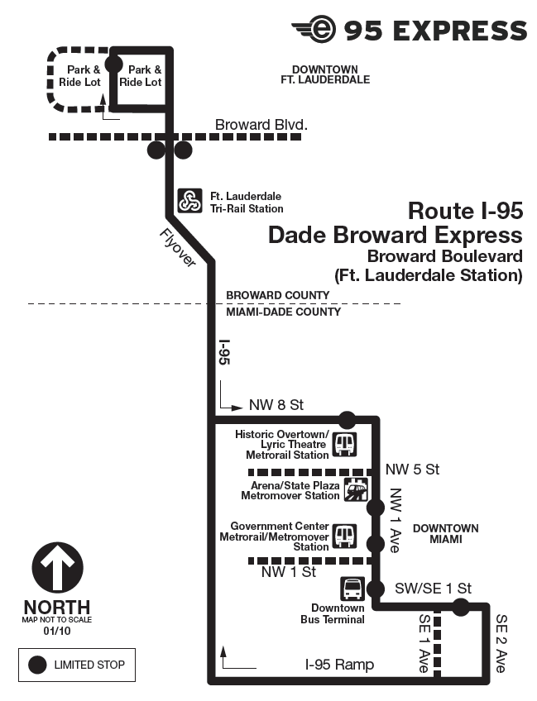
I-95 Express Bus Overview
95 Express (95E)
4 limited-stop bus routes between Broward County and downtown Miami
  Broward Boulevard
  Sheridan Street
  Pembrooke Pines
  Miramar (initiated January 2011)
15-30 min service during peak periods, provided by both BCT and MDT
~1,100 daily boardings
95X
2 routes between Golden Glades and downtown Miami/Earlington Heights
<15-min combined headways during peak periods provided by MDT
~1,900 daily boardings
Survey conducted May 2010

Slide 17
I-95 Express Bus
Key Ridership Patterns/Findings
Both I-95 Express and 95X services are used largely by choice riders accessing by car
  <5% riders are from zero-car households
  70+% have car available for trip
  74-77% access by auto (either PNR or KNR)
I-95 Express riders make more extensive use of Metrorail, Metromover & other bus services when they egress in downtown Miami than 95X riders, even though both sets of riders are destined for the same location
  35% of I-95 Express riders egress by Metrorail (18%), Metromover (12%) and bus (5%)
  11% of 95X riders egress by Metrorail (2%), Metromover (2%) and bus (7%)
52% of I-95 Express riders previously used other transit services, compared to 15% of 95X riders
Overall, I-95 Express and 95X riders have similar characteristics

Slide 18
BCT, Palm Tran and MDT Overview
Broward County Transit (BCT)
Palm Tran
40 routes servicing Broward County
~120,000 daily boardings in 2010
Survey conducted in March-May 2010
35 routes servicing Palm Beach County
~34,000 boardings in 2010
Survey conducted in February-March 2010
Miami-Dade Transit
88 routes servicing Miami-Dade County
~217,000 boardings in 2010
Survey conducted in March-June, 2004

Slide 19
Broward County Transit
Key Ridership Patterns/Findings
Local bus riders are mobility dependent
  Heavily walk-dependent for access/egress (~90% for both access and egress)
  High transfer rate (59%) reflecting BCT’s grid system
  49% of riders are from 0-car households; 71% either are from 0-car households or do not have a valid driver’s license
Dispersed travel patterns, with Ft. Lauderdale CBD attracting <10% trips
  Limited-stop bus riders are slightly less dependent for mobility, are more work-oriented & travel longer distances
  5-30% fewer riders from 0-car households; 8-30% more riders from household with cars
  60-70% work trips (cf. 46-50% for underlying local bus)
  Travel 30-50% longer than riders on underlying local bus service

Slide 20
Palm Tran
Key Ridership Patterns/Findings
Palm Tran bus riders are mobility dependent
  45% of riders are from 0-car households; 70% either are from 0-car households or do not have a valid driver’s license
  Heavily walk-dependent for access/egress (Over 90% for both access/ egress)
  32% transfer rate seems low but is consistent with Palm Tran staff supposition
Dispersed travel patterns, with most trips occurring between West Palm Beach and Delray Beach (east central Palm Beach County)
  ~80% of productions and attractions in this area
  Only 3% of trips travel to West Palm Beach CBD

Slide 21
Metrobus
Key Ridership Patterns/Findings
Survey questionnaire provides limited information, so definitive conclusions are challenging
  Limited address information
  No route listing of entire trip
  No time-of-day information available on survey records
Results show that Metrobus riders generally appear to be similar to BCT and Palm Tran riders but with a higher participation of “choice” riders
  Walk is dominant access modes
  Dispersed travel patterns
Survey not able to be used for model calibration/validation → used estimated trips from SERPM 6.5 where necessary

Slide 22
Survey Findings – Summary
Strong differences in ridership patterns between “local” and “premium” transit riders
  Local transit riders have dispersed travel patterns, high level of mobility dependents
  Metrorail and express bus riders have work travel patterns oriented towards downtown Miami
  Tri-Rail riders have characteristics similar to Metrorail and express bus riders with destinations to downtown Miami and suburban employment centers
Further analysis indicated minute competition among transit modes, even rail transit modes
  0.3% of unique zonal interchanges have viable competitive option (18k)
  0.6% of linked survey trips have viable option (182k)
  Metrorail and Tri-Rail are used together more often than they are in direct competition

Slide 23
Transit Model Development Activities and Results

Slide 24
Major Model Development Activities
Transition to 2010 base year
Distribution refinements
Path and mode choice structure
Mode choice coefficients and constants
Many other changes and updates have been made, but are not discussed in this presentation

Slide 25
Transition to 2010 Base Year
Model Component | Development Process
Population | Interpolated 2005 and 2035 values and scaled to 2010 Census counts for each county
Employment | Interpolated 2005 and 2035 values and scaled to 2009 BEBR control totals for each county
External trips | Interpolated 2005 and 2035 values
Airport trips | Scaled to enplanement figures
Highway and transit networks | Updated to 2010 conditions
Parking costs | Updated based on 2008 regional parking survey

Slide 26
Distribution Refinements
Work trip purposes
  Model’s estimates of HBW P’s and A’s fratared using CTPP journey-to-work data as seed table; this is performed separately for 0-car and 1+-car households
  Zones with very high growth uses distribution patterns from a nearby similar zone (similarity defined in terms of land use)
Non-work trip purposes
  Peak period distribution is based on 6-iteration feedback process (2 iteration feedback in SERPM 6.5)
  Off-peak period distribution is based on a 2-iteration feedback process (rather than free-flow speeds in prior SERPM versions)

Slide 27
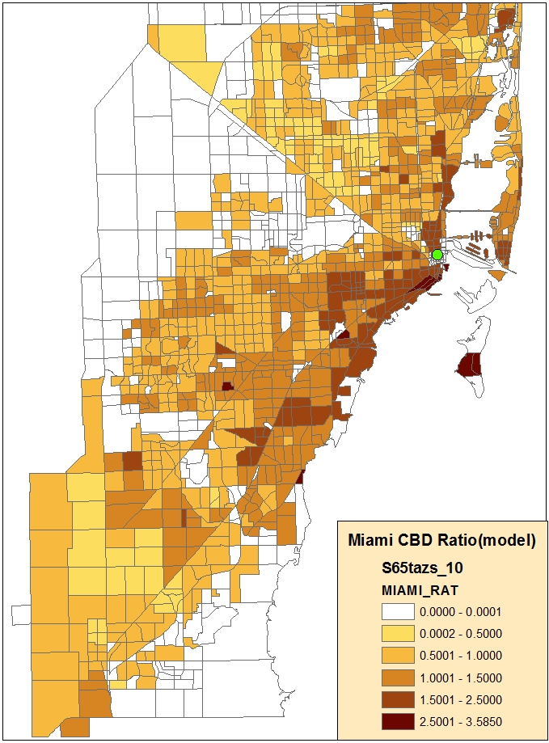
Using CTPP Journeys for Work Distribution
Results – Journeys to downtown Miami
CTPP
SERPM 6.5
SERPM 6.7

Slide 28
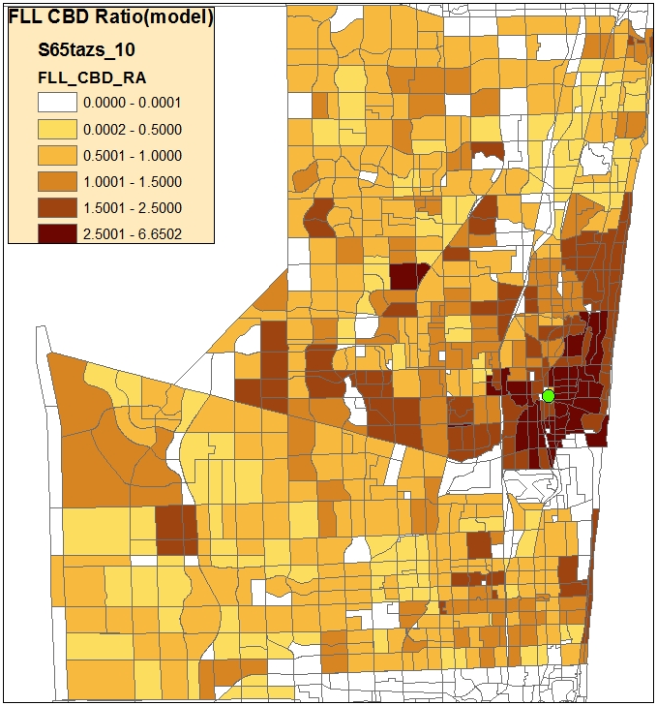
Using CTPP Journeys for Work Distribution
Results – Journeys to downtown Ft. Lauderdale
CTPP
SERPM 6.5
SERPM 6.7

Slide 29
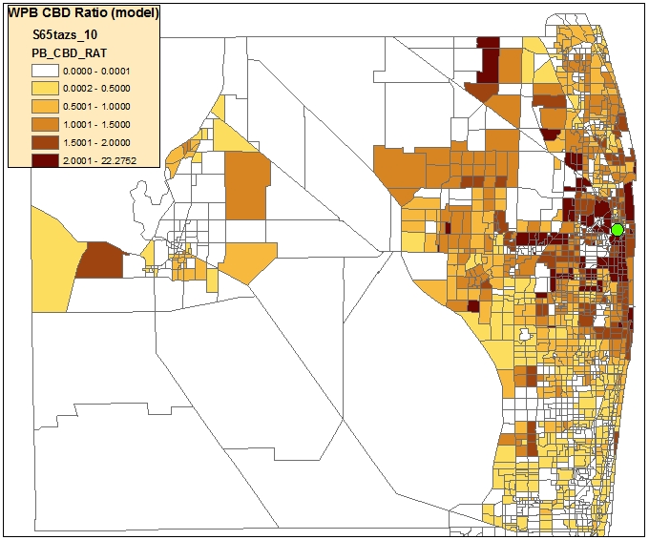
Using CTPP Journeys for Work Distribution
Results – Journeys to downtown West Palm Beach
CTPP
SERPM 6.5
SERPM 6.7

Slide 30
Path Structure
Survey results indicated that there is minimal competition between rail modes and, in fact, rail modes are used in combination more than in competition → new path structure needed to reflect this observation
Applied innovative method to develop and validate new path/mode choice structure
  Performing a preliminary check on observed line-haul path competition (via the surveys),
  Proposing the simplest structure based on the line-haul path competition check,
  Assigning of the survey trips to the network using the proposed structure,
  Reporting the path/boarding results and comparing them to observed values,
  Making refinements to the structure and travel component weights to improve path/boarding results,
  Repeating steps 3-5 until assigned trips match generally survey results, and
  Transferring structure and weights directly to mode choice and begin calibrating/validating mode choice model.

Slide 31
Initial Path/Mode Choice Structure (6-path)

Slide 32
Evaluating the Structure
Two key metrics used to evaluate new path structure
  Line-haul path accuracy – if survey trip were to use modeled path, does model correctly pick the surveyed line-haul mode?
  Transfer/assignment accuracy – when survey trips are assigned to network, do the aggregate number of boardings match observed values?
Initial results for the 6-path structure were acceptable, but in some cases the model tended to favor local bus paths over the premium transit survey path ← long access times
Proposed 9-path structure to account for differences between paths using both local and premium transit and premium-only paths

Slide 33
Proposed Path/Mode Choice Structure (9-path)
Premium services – not generally subject to auto signals and/or traffic delays (95 Express, 95X, Metrorail, Tri-Rail)
Local services – generally subject to auto signals and/or traffic delays (Metrobus, BCT, Palm Tran)
Mixed-mode – path utilizing both local and premium services

Slide 34
Path Structure Evaluation (Validation) Tests
9-path structure performs better overall, and is being used in SERPM 6.7

Slide 35
Mode Choice Coefficients / Constants
Relative coefficients taken directly from travel component weights in path-builder
Market segmentation switched to auto availability rather than auto ownership
  CTPP data → large percentages of “zero-car” households driving to work
  Identification that driver’s license has huge impact on transit ridership, more so than auto ownership
  Zero-car market fairly small in size

Slide 36
Mode Choice Coefficients
Actual Transit Path Building Weights (relative to IVTT coefficient)
Variable | Peak |  |  | Off-Peak
 | HBW | HBO | NHB | HBW | HBO | NHB
Transit run time, highway run time | 1.00 | 1.00 | 1.00 | 1.00 | 1.00 | 1.00
Transit walk time, highway terminal time | 2.00 | 2.00 | 2.00 | 2.00 | 2.00 | 2.00
Pre-weighted* transit auto access/egress time | 1.00 | 1.00 | 1.00 | 1.00 | 1.00 | 1.00
Transit first wait (<=7 minutes) | 2.00 | 2.00 | 2.00 | 2.00 | 2.00 | 2.00
Transit first wait (>7 minutes) | 1.00 | 1.00 | 1.00 | 1.00 | 1.00 | 1.00
Transit transfer wait time | 2.00 | 2.00 | 2.00 | 2.00 | 2.00 | 2.00
Transit number of transfers (Walk access) | 5.00 | 5.00 | 5.00 | 5.00 | 5.00 | 5.00
Transit number of transfers (Park-ride access) | 20.00 | 20.00 | 20.00 | 20.00 | 20.00 | 20.00
Transit number of transfers (Kiss-ride access) | 10.00 | 10.00 | 10.00 | 10.00 | 10.00 | 10.00
Transit fare (Value of time in $/hr) | $ 8.13 | $ 6.94 | $ 7.49 | $ 8.13 | $ 6.94 | $ 7.49
Highway auto operating costs (Value of time in $/hr) | $ 8.13 | $ 6.94 | $ 7.49 | $ 8.13 | $ 6.94 | $ 7.49
Highway parking costs (Value of time in $/hr) | $ 8.13 | $ 6.94 | $ 7.49 | $ 8.13 | $ 6.94 | $ 7.49
HOV time difference | 0.72 | 1.00 | 1.00 | 0.90 | 1.00 | 1.00
Variables not used in transit path building process but used in mode choice utility calculations

Slide 37
Other Major Model Development Activities
(Not Presented Here)
  Travel generation is now balanced by auto availability category:
    0-car
    Cars < Workers (People)
    Cars >= Workers (People)
  Non-work distribution is stratified by auto availability market segments
  Non-work zero-car HH travel distribution is now based on auto impedances rather than transit impedances.
  Transit mode and operator numbers have been revised to avoid awkward and potentially confusing modal definitions
  Transit fares have been revised to “best daily pass” rather than full cash fare
  Both the highway and transit networks have been updated to a 2010 base year
  The parking costs have been updated to reflect the values proposed by recent CS report
  Pathbuilding and assignment processes now performed in PT (rather than TRNBUILD)
  Incorporated fare into pathbuilding weights
  Transit access and egress connectors have been simplified to avoid cliffs
  Percent walk procedures have been removed to take advantage of the relatively small zones in SERPM
  Mode choice is now stratified by auto availability segment

Slide 38
Transit Model Calibration and Validation

Slide 39
SERPM 6.0-6.6 Transit Model Shortcomings
Limited transit survey data available during model development
  Limited knowledge on transit → insufficient model calibration/validation
“Over-specified” mode choice model
  Alternate-specific constants were much larger (~20-70 min) than FTA allows
  Model relied too heavily on constants and layers of constants, rather than on behavior
  Large constants overwhelm transit variables may result in illogical results
Bus speed methodology does not easily provide for high accuracy of regional bus speeds
  Accurate bus speeds are needed to accurate reflect project benefits
  Easier system needed for improved maintenance and accuracy
Existing model calibration/validation not sufficiently rigorous for FTA New/Small Starts planning
  Used traditional model calibration → adjusting constant to match linked trip totals
  Used traditional model validation → matching aggregate boardings

Slide 40
Key Calibration/Validation Issue
Previous attempts at mode choice calibration and transit validation replicated the appropriate numbers, but the model did not capture transit ridership patterns and did not properly react to changes

Slide 41
Solution for SERPM 6.7:
A More Robust Calibration/Validation Process
Ensure that the key behaviors are right:
  Mode usage by access mode, time of day, market segment
  Transit travel patterns by mode (O/D or station-to-station) by access mode, time of day, market segment
  Transit trip lengths
  Rail/bus vs. rail-only (or bus-only)
  Boardings
  Tri-Rail sensitivity to recent fuel and service changes
Simplify path/mode choice model to the extent possible
Review/address expanded range of model attributes
Analyze model’s sensitivity of Tri-Rail boardings to key transportation variables

Slide 42
Solution for SERPM 6.7:
A More Robust Calibration/Validation Process
Review/address expanded range of model attributes
  Work trip distribution (already done via CTPP-based distribution)
  Auto speeds (AM peak, midday)
  Transit speeds (AM peak, midday)
  Transit trips by mode, O/D or S2S, access mode, trip purpose and time of day
  Transit boardings by mode and route/station
Analyze model’s sensitivity of Tri-Rail boardings to key transportation variables
  Introduction of I-95E inter-county bus service
  Tri-Rail and Tri-Rail shuttle service changes
  Higher fuel prices

Slide 43
Auto & Transit Speeds
Auto speeds: Improved relationship between volumes and speeds and improved consistency between free-flow and congested speeds
  Removed free-flow speed adjustment factors
  Introduced 2-iteration feedback loop for off-peak speeds
Bus speeds: functions now based on auto speed and dwell time per transit stop → estimated speeds much improved
  Local bus dwell times 0.46-0.70 min/stop
  Limited-stop and express bus dwell times 1.20 min/stop

Slide 44
Auto Speed Results
Off-Peak Period

Slide 45
Auto Speed Results
Peak Period
2009
2010

Slide 46
Transit Speed Results
AM Peak Period | SERPM 6.5 |  | SERPM 6.7
 | % Avg. Difference | % RMSE | % Avg. Difference | % RMSE
Palm Tran Routes | 23% | 54% | 2% | 12%
BCT Routes | 0% | 16% | 1% | 10%
MDT Routes | 9% | 28% | 4% | 15%
Off-Peak Period | SERPM 6.5 |  | SERPM 6.7
 | % Avg. Difference | % RMSE | % Avg. Difference | % RMSE
Palm Tran Routes | 11% | 43% | 0% | 13%
BCT Routes | -5% | 20% | 0% | 11%
MDT Routes | -13% | 30% | -3% | 16%

Slide 47
Mode Choice Calibration Process
3-step innovative calibration process
  Compare modeled transit trip tables to survey trip tables by line-haul path, access and egress mode, O/D district and time period
  Resolve significant differences by making mode-neutral adjustments to the utility equations that are directly tied to a proposed behavior
  Repeat steps 1-2 until there are no significant differences by the four trip dimensions

Slide 48
Behavioral Enhancements (1 of 2)
Observed Behavior | Original Issue | Solution
Transit is a competitive modal option for longer distance work trips, especially Tri-Rail | Model originally under-stated transit attract-iveness for long trips | Weight auto time in excess of 45 minutes by OVT coefficient; Discount Metrorail (15%) and Tri-Rail (20%) IVTT in path/mode choice
Park-riders do not use premium transit for short trips | Model originally produced large amounts of short Tri-Rail trips | Add time penalty for very short premium transit trips

Slide 49
Behavioral Enhancements (2 of 2)
Observed Behavior | Original Issue | Solution
Transit is more accessible in higher-density areas with easier walk environments | Model originally did not adequately reflect differences in walk-accessibility | Add time penalty for lower-density zones
Transit riders do take fare into account in their path/modal decision | Mode choice accounted for transit fare, but the pathbuilder did not | Incorporate fares in transit pathbuilder

Slide 50
Alternative-Specific Constants
Observed Behavior | Original Issue | Solution
Riders do take modal characteristics into account in their path/modal decision | Earlier SERPM versions had ASCs as high as 70 IVTT minutes (FTA normally accepts 10-15 minutes) | Metrorail = up to 10 min Tri-Rail = up to 15 min BRT systems with advanced attributes = up to 7 min
In the utility expression, constants represent the cumulative effects of un-included (or non-quantitative) attributes:
        Y = k + ax₁ + bx₂ + cx₃
  where Y is the utility of some transit mode, k is the constant; x₁, x_{2,} x₃ are times, costs, and other measure attributes, and a, b, and c are the coefficients

Slide 51
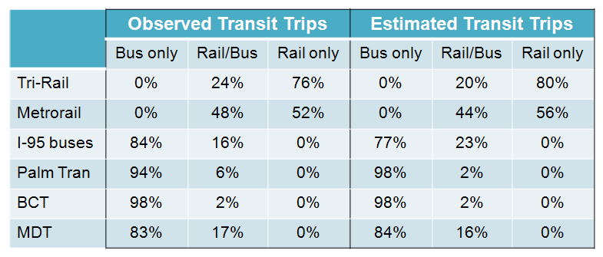
Transit Path Consistency Check
Strong consistency in representation of transit paths by mode is important to ensure that the model fully reflects transit travel patterns
These results show that SERPM 6.7 is replicating the observed transit modes used by riders

Slide 52
Tri-Rail Activity by Station
Average Daily Boardings
Station | Observed | Estimated | Difference
1-Mangonia Park | 828 | 579 | -248
2-West Palm Beach | 895 | 921 | 26
3-Lake Worth | 622 | 792 | 170
4-Boynton Beach | 617 | 654 | 37
5-Delray Beach | 462 | 625 | 163
6-Boca Raton | 1,125 | 1,108 | -17
7-Deerfield Beach | 633 | 830 | 197
8-Pompano Beach | 569 | 896 | 327
9-Cypress Creek | 913 | 1,087 | 174
10-Fort Lauderdale | 794 | 900 | 105
11-Fort Lauderdale Airport | 647 | 748 | 101
12-Sheridan Street | 593 | 493 | -100
13-Hollywood | 533 | 311 | -222
14-Golden Glades | 441 | 477 | 36
15-Opa-locka | 195 | 448 | 253
16-Metrorail | 1,362 | 1,229 | -133
17-Hialeah Market | 210 | 154 | -56
18-Miami Airport | 762 | 729 | -33
Total | 12,200 | 12,980 | 780

Slide 53
Tri-Rail Trip Length: Survey vs. Estimated
Much improved representation of Tri-Rail trip lengths and station-to-station patterns!
SERPM 6.5
SERPM 6.7
Average Trip Length (On-board survey): 30.0 miles

Slide 54
Metrorail Activity by Station
Average Daily Boardings
Station | Observed | Estimated | Difference
1-Palmetto | 1,388 | 1,744 | 356
2-Okeechobee | 1,128 | 1,239 | 112
3-Hialeah | 1,375 | 1,047 | -328
4-Tri-Rail | 1,747 | 1,310 | -437
5-Northside | 1,783 | 815 | -968
6-Dr.MLK Jr. | 1,173 | 800 | -373
7-Brownsville | 878 | 516 | -362
8-Earlington Heights | 1,178 | 978 | -200
9-Allapattah | 1,265 | 1,336 | 72
10-Santa Clara | 514 | 492 | -22
11-Civic Center | 7,024 | 6,612 | -412
12-Culmer | 938 | 657 | -281
13-Overtown | 1,385 | 2,020 | 635
14-Government Center | 10,405 | 7,564 | -2,841
15-Brickell | 2,783 | 3,265 | 482
16-Vizcaya | 1,077 | 695 | -382
17-Coconut Grove | 1,465 | 1,815 | 350
18-Douglas Road | 3,348 | 2,804 | -544
19-University | 2,899 | 3,579 | 680
20-South Miami | 2,956 | 2,059 | -897
21-Dadeland North | 5,117 | 5,664 | 547
22-Dadeland South | 6,057 | 10,449 | 4,392
Total | 57,884 | 57,463 | -421

Slide 55
Metrorail trip length: Survey v/s Estimated
Much improved representation of Metrorail trip lengths and station-to-station patterns!
SERPM 6.5
SERPM 6.7

Slide 56
I-95 Express Bus Boardings
I-95X boardings
95X | Observed | Estimated | Difference
Biscayne Blvd. | 1,078 | 2,043 | 965
Civic Center | 471 | 1,021 | 550
Brickell | 357 | 296 | -61
Total | 1,906 | 3,360 | 1,454
I-95E boardings
Express bus boardings are over-estimated, but well within reasonable aggregate limits
95E | Observed | Estimated | Difference
Sheridan St. | 377 | 517 | 140
Fort Lauderdale | 470 | 853 | 383
Pines Blvd. | 218 | 774 | 556
Total | 1,065 | 2,144 | 1,079

Slide 57
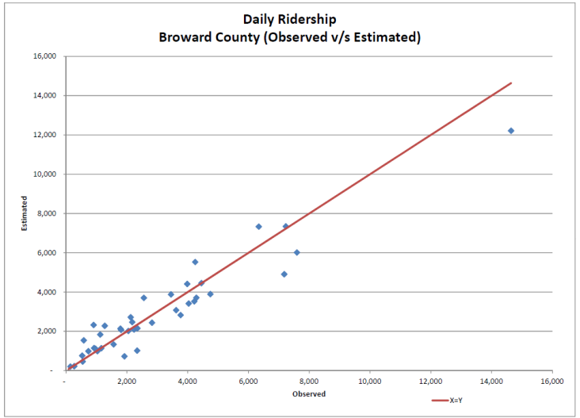
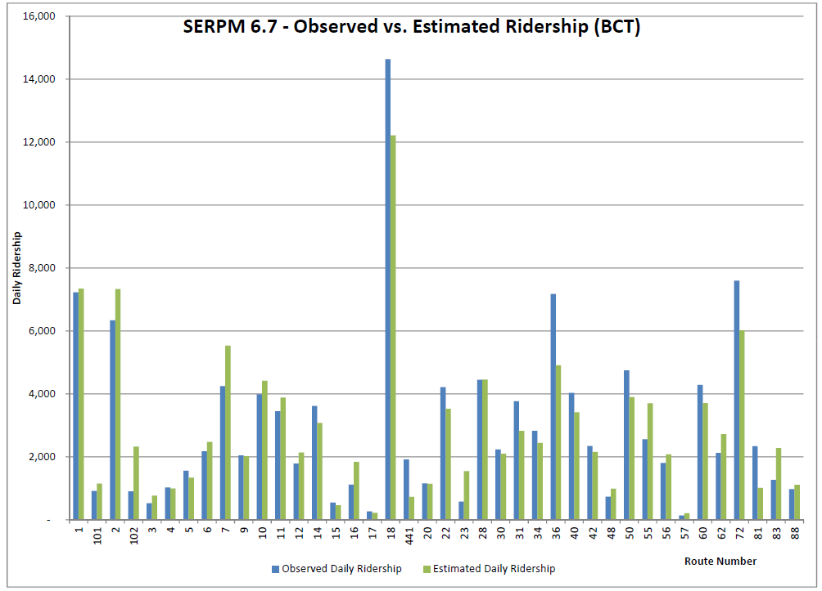
BCT Boardings
Assignments compare well to each route
Daily Boardings
  116,494 estimated
  119,624 observed

Slide 58
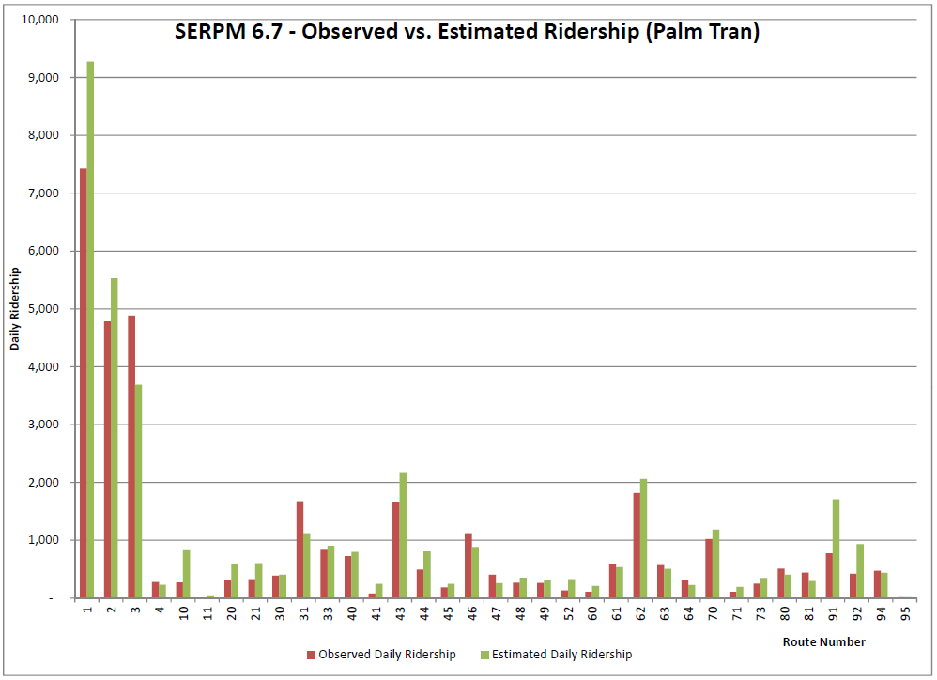
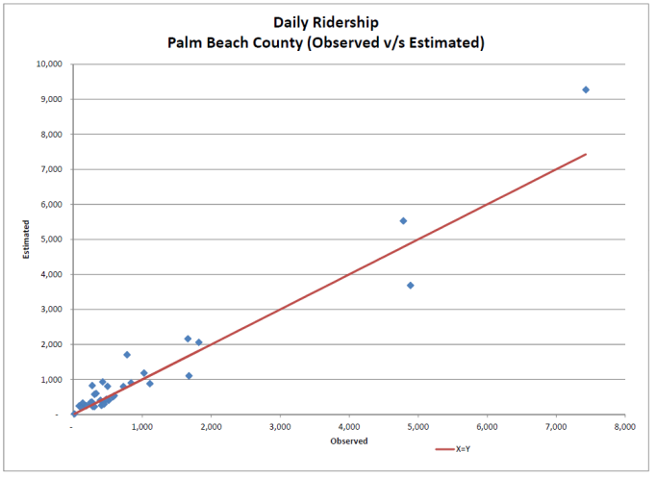
Palm Tran Boardings
Assignments compare well to each route
Daily Boardings
  38,663 estimated
  33,939 observed

Slide 59
Longitudinal Validation Tests
Longitudinal tests are correlational comparisons across periods of time
Powerful tests because they validate model’s ability to forecast
  Robust model validation → does model replicate existing patterns?
  Longitudinal tests → does model correctly react to key variables?
For SERPM 6.7, verify the model’s sensitivity of Tri-Rail boardings to:
  Introduction of 95E inter-county bus service
  Higher fuel prices
  Tri-Rail and Tri-Rail shuttle service changes

Slide 60
Longitudinal Validation Tests
Introduction of 95E Service
Inter-county bus service introduced in early 2010 in conjunction with opening of 95 Express lanes
Tri-Rail survey used for calibration conducted in 2008
95E bus surveys showed that 434 trips previously used “other transit” before switching to 95E service
New transit model → introduction of 95E service decreases Tri-Rail boardings by 603 boardings per weekday
Conclusion: model effectively replicates impact of 95E bus service on Tri-Rail ridership

Slide 61
Longitudinal Validation Tests
Higher Fuel Prices
Fuel prices experienced strong increases in 2008, which impacted Tri-Rail ridership
  March 2008 $3.34 monthly average
  June 2008 $4.16 monthly average
  June 2010 $2.72 monthly average
Test: adjust auto operating cost to reflect higher fuel prices and assess impact on Tri-Rail ridership
  Observed elasticities → +0.43-0.48
  Estimated elasticities → +0.17-0.21
Conclusion: model results are consistent with other research, observed elasticities heavily influenced by macroeconomic impacts

Slide 62
Longitudinal Validation Tests
Tri-Rail Service Changes
Tri-Rail service increased from 32 trains/day in 2005 to 50 trains/day in 2010
Tri-Rail shuttle service, which provides distribution service for Tri-Rail riders, increased nearly 300% in 2005-2010
Test: compare impacts of service increases on Tri-Rail boardings
  Observed elasticities → +0.61
  Estimated elasticities → +0.57
Conclusion: model effectively replicates ridership changes from service increases

Slide 63
Model Calibration / Validation Summary
Performing a robust validation is extremely helpful in preparing model for forecasting!
Model is validated across wide range of model attributes
  Work trip distribution
  Auto and transit speeds
  Transit trips by mode, O/D or S2S, access mode, trip purpose and time of day
  Transit boardings by mode and route/station
Model’s forecast-ability is validated across 3 variables
  Introduction of I-95E inter-county bus service
  Tri-Rail and Tri-Rail shuttle service changes
  Higher fuel prices

Slide 64
FTA Reaction and Summary

Slide 65
FTA Coordination and Reaction
4 face-to-face meetings with FTA Planning staff in Washington DC
  2010 July: reviewed SERPM 6.5 attributes, discussed model improvement strategy
  2010 December: reviewed transit survey findings and model development process
  2011 July: reviewed model development activities, discussed calibration/validation process
  2011 October: reviewed calibration/validation results
Very positive reaction to development and calibration/validation process
  Development based on transit survey data, not pre-conceived ideas
  Calibration meant adding previously unknown travel behaviors,not adjusting constants
  Validation based on replicating key behaviors, not “number matching”
  Longitudinal checks extremely helpful in assessing model’s forecasting abilities before planning analysis begins
FTA agrees that SERPM 6.7 can be used for multi-modal planning and New/Small Starts analysis

Slide 66
Summary
Seven successful SERPM “1st’s”
  1st ever comprehensive picture of transit patterns & behavior
  1st robust calibration/validation based on replicating key behaviors
  1st validation of pathbuilding structure
  1st calibration/validation based on detailed transit survey data
  1st use of longitudinal tests to assess forecastability
  1st transit model fully reviewed by FTA
  1st transit model with very positive reaction from FTA
SERPM 6.7 represents a significant improvement over previous SERPM transit models

Slide 67
Summary
SERPM 6.7’s transit model:
  Meets all stated objectives
  Captures key transit travel behaviors
  Reasonably reacts to changes to transportation variables
FTA has reviewed SERPM 6.7 and agrees its use for New/Small Starts analysis
SERPM 6.7 is currently being used for multi-modal projects:
  South Florida East Coast Corridor Study, Phase 3 (FEC)
  Central Broward Transit Study
  Oakland Park Boulevard AA
  Broward Boulevard AA
Findings from new transit surveys will be incorporated as those results and findings become available

Slide 68
Thank You!
Shi-Chiang.Li@dot.state.fl.us
Scott.Seeburger@dot.state.fl.us
David.Schmitt@aecom.com
Ashutosh.Kumar@aecom.com

