Slide 1


Use of Establishment Surveys to Estimate Non Resident Travel in Urban Areas
Chris Simek
Ed Hard
David Pearson
Stacey Bricka
Stella Nepal
Columbus, Ohio
May 7, 2013

Slide 2
Purpose
Collect information on the destination or attraction end of trip
  Resident and non-resident
Develop attraction rates for trip generation
  Attraction rate = attractions per employee
  Stratified by area type (6) and employment type (4)

Slide 3

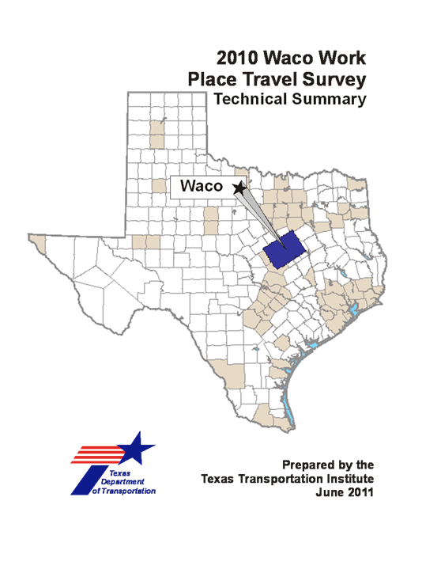

Design Considerations
Sampling
Data collection process
Fielding
Processing

Slide 4
Sample Development
Drawn from list of WPs
Possible sources
  State employment data
  Dun & Bradstreet
  infoUSA
Sorted by Basic, Service, Retail and Education employment types
  Based on NAICS code
Type* | NAICS | Industry Group
Basic | 11 | Agriculture, Forestry, Fishing and Hunting
 | 21 | Mining, Quarrying, and Oil and Gas Extraction
 | 22 | Utilities
 | 23 | Construction
 | 31-33 | Manufacturing
 | 42 | Wholesale Trade
 | 48-49 | Transportation and Warehousing (except 491)
 | 5111 | Newspaper Publishers/Book Publishers/Directory Publishers
 | 5112 | Software Publishers
 | 512 | Motion Picture and Sound Recording (except 51213)
 | 5151 | Radio and TV Broadcasting
 | 5152 | TW Cable
 | 5173 | Telecommunications Resellers
 | 5174 | Satellite Network
 | 5175 | Cable and Other Program Distribution
Retail | 44-45 | Retail
 | 51213 | Motion Picture Theaters
 | 71 | Arts, Entertainment, and Recreation
 | 722 | Food Service and Drinking Places
 | 491 | Post Offices
* Service and Education not included

Slide 5
Sample Size and Stratification
Sample size = what you can afford
  Small to medium MPOs (100-300 surveys)
  Large MPOs (400-600 surveys)
Stratification
  By employment type for small/medium areas
  By employment and/or area type, WP size in larger areas
Ratio of full to partial surveys varies
  Generally 1/3 to 2/3
Example Workplace Sample Matrix
Employment Type | Full Survey | Partial Survey
Basic | 20 | 30
Retail | 30 | 70
Service | 30 | 70
Education | 20 | 30
Totals | 100 | 200

Slide 6
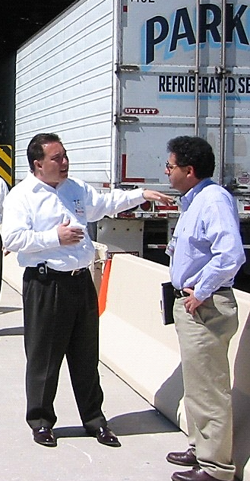
Data Collection Process
Randomized list of WPs contacted for recruitment
General survey of participating WPs
Pre survey site assessment
CAPI of visitors and employees
  Collect information regarding travel to/from WP
Vehicle or person counts

Slide 7

Fielding
Survey team comprised of surveyors and counters
  Size of team dependent on size of establishment, number of access points, etc.
Interviews and counts conducted on same day

Slide 8
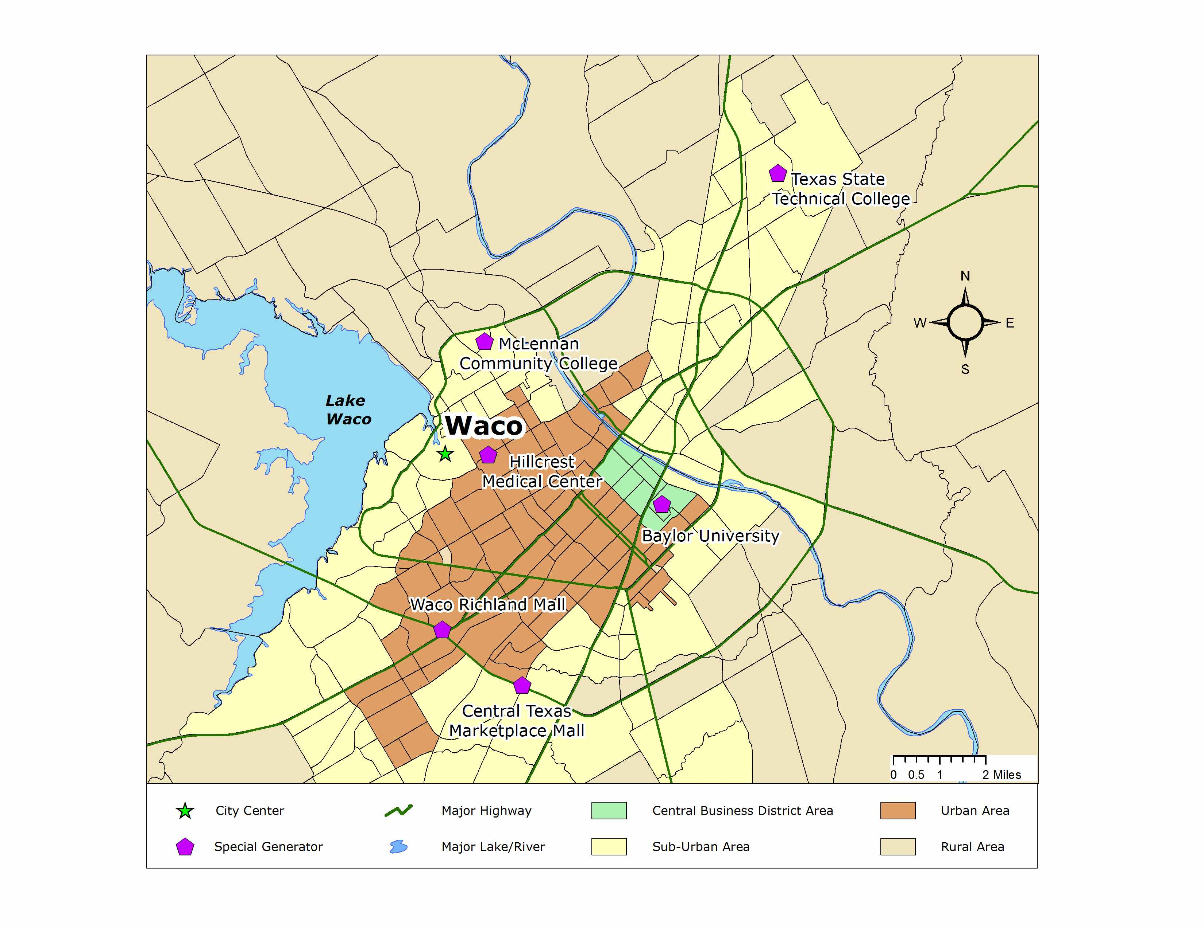
Data Processing
Geocoded data assigned to study area TAZs and area types
  Texas MPO area types based on pop. & employment densities
  CBD, CBD Fringe, Urban, Sub-Urban, Sub-Urban Fringe, Rural
Data processed and expanded at each site to vehicle or person control total
  Visitor and employee data expanded separately
  Trips assessed by trip purpose

Slide 9

Development of WP Attraction Rates
Attraction rates developed by trip purpose
  HBW; HBNW-Retail; HBNW-Education; HBNW-Other; NHB; EXT; NON-RES
  Person and auto driver trips per employee
CV attraction rates also developed
  CV trips per employee
Results compiled by employment and area type

Slide 10

Comparing Productions and Attractions
Attraction rates applied to total employment to estimate total attractions
  Compared to total productions from HHTS
  Compared to total CV trips from CVS
Texas Practice: Modelers have latitude to use estimate they consider most appropriate in model calibration
  WPS Attractions balanced to HH productions
  WPS CV attractions balanced to CVS CV productions

Slide 11
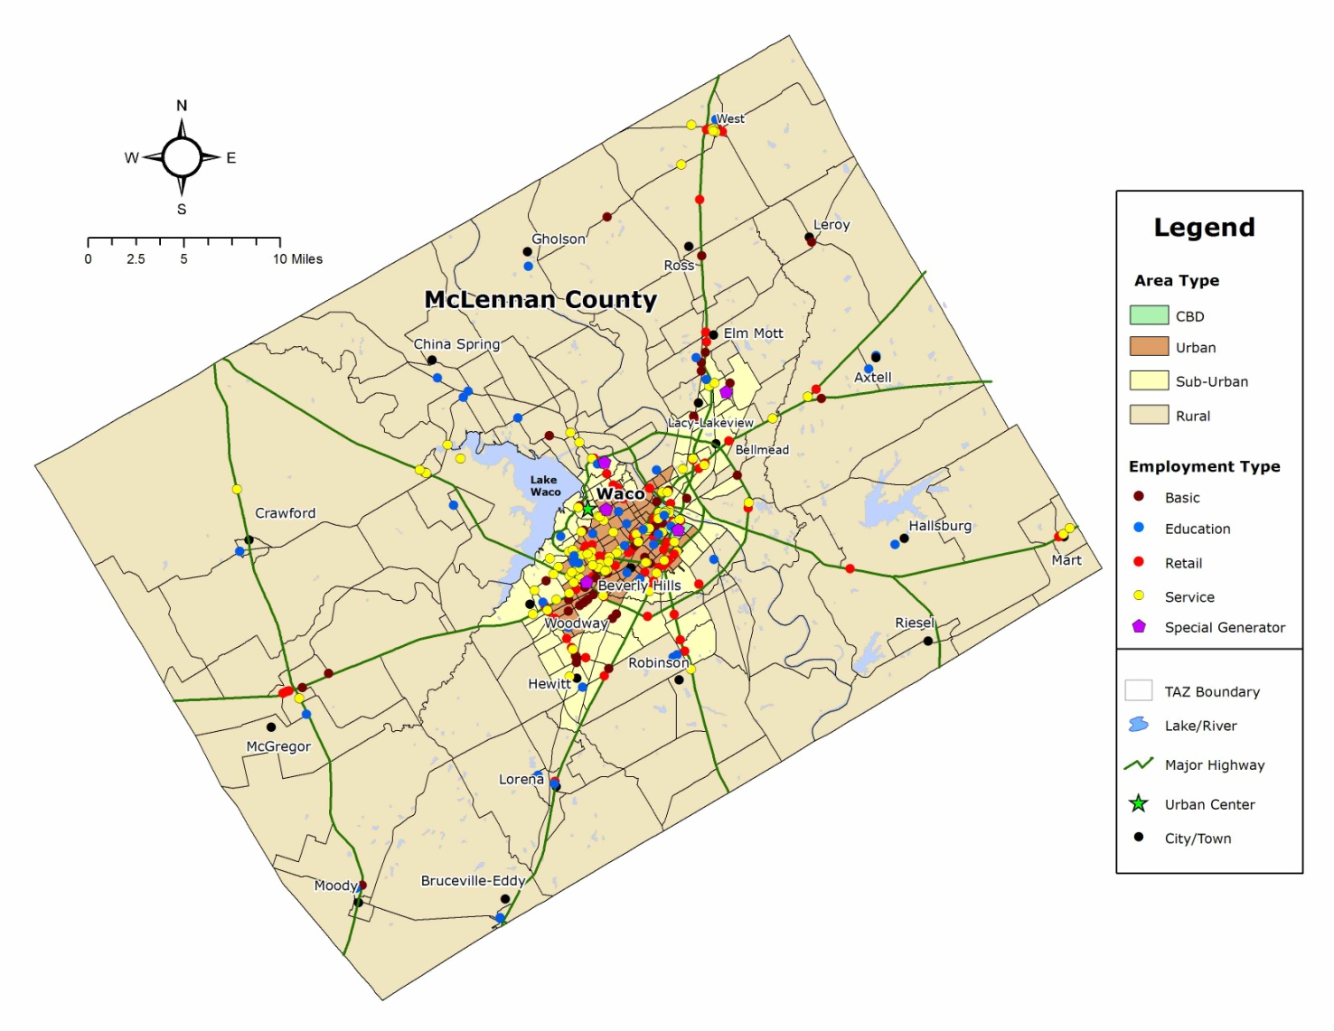
Waco MPO
- 1,042 Miles²
- 239k persons
- 89k households
- 14th largest TX MSA
- 5,000 establishments
- 99,000 employees

Slide 12
Waco MPO
Trip Purpose | WP Attractions |  | Household Productions |  | External Productions |  | CV Productions
 | Person | Vehicle | Person | Vehicle | Person | Vehicle | Vehicle
HBW | 165,562 | 158,841 | 125,778 | 103,769
HBNW-Retail | 587,311 | 489,398 | 135,099 | 88,329
HBNW-Other | 220,756 | 184,583 | 189,631 | 111,546
HBNW-School | 166,285 | 133,398 | 132,945 | 46,708
NHB-D | 126,316 | 106,581 | 246,479 | 161,761
NHB-O | 181,659 | 153,984
EXT-D | 3,766 | 3,169 |  |  | 63,951 | 52,419
EXT-O | 7,172 | 6,044 |  |  | 63,951 | 52,419
NON-RES | 53,512 | 45,520
CV |  | 50,586 |  |  |  | 21,730 | 111,658

Slide 13
Waco MPO
Trip Purpose | WP Attractions | HH Productions | External Productions | CV Productions
 | Vehicle | Vehicle | Vehicle | Vehicle
HBW | 158,841 | 103,769 | N/A | N/A
HBNW | 807,379 | 246,583 | N/A | N/A
NHB | 260,565 | 161,761 | N/A | N/A
EXT | 9,213 | N/A | 104,838 | N/A
NON-RES | 45,520 | N/A | N/A | N/A
CV | 50,586 | N/A | 21,730 | 111,658
TOTAL | 1,332,104 | 512,113 | 126,568 | 111,658

Slide 14
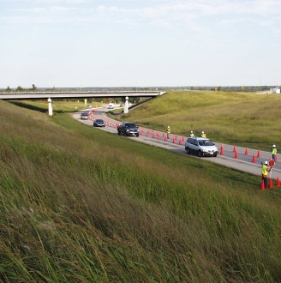
Non Resident Travel
Captured in external survey and work place survey
  Most of the time not captured in HHTS
WP best estimate of internal NON-RES travel
  Person and vehicle counts provide control totals
External survey best estimate of external NON-RES travel
Missing link in NON-RES travel
  Internal NON-RES residential travel (Traveling salesman example)
Rule of Thumb → WPS estimates of NON-RES trips are about 5-10% of total HHTS productions
  45,520 NON-RES attractions/ 512,113 total productions = .088 ≈ 8.8%

Slide 15
Questions?
Chris Simek
(512) 467-0946
C-simek@tamu.edu
Ed Hard
(979) 845-8539
e-hard@tamu.edu

