Slide 1
The Future of Travel Surveys
Chris Simek
Stacey Bricka
Columbus, Ohio
May 6, 2013

Slide 2
Symposium Overview
Funded by SWUTC and TTI
November 8-9, 2012 in Dallas Texas
75 Attendees
Oversight Panel
Source: dfwfreeways.info

Slide 3
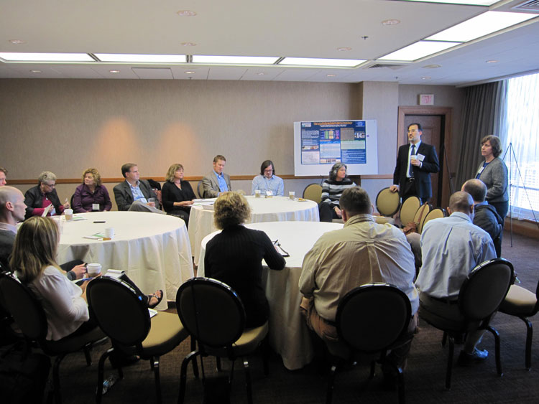
Symposium Structure
Opening Poster Session
Opening Plenary Session
Three Parts
Lessons Learned
Future Surveys
Moving into Practice
Focus: Discussion
Source: Texas A&M Transportation Institute

Slide 4
Ready to Implement
Outreach
Explicit in Scope and Budget
Respondents, Sponsors, and General Public
Meeting Society’s Expectations w/Technology
Source: http://20102165.blogspot.com/2010_05_01_archive.html

Slide 5
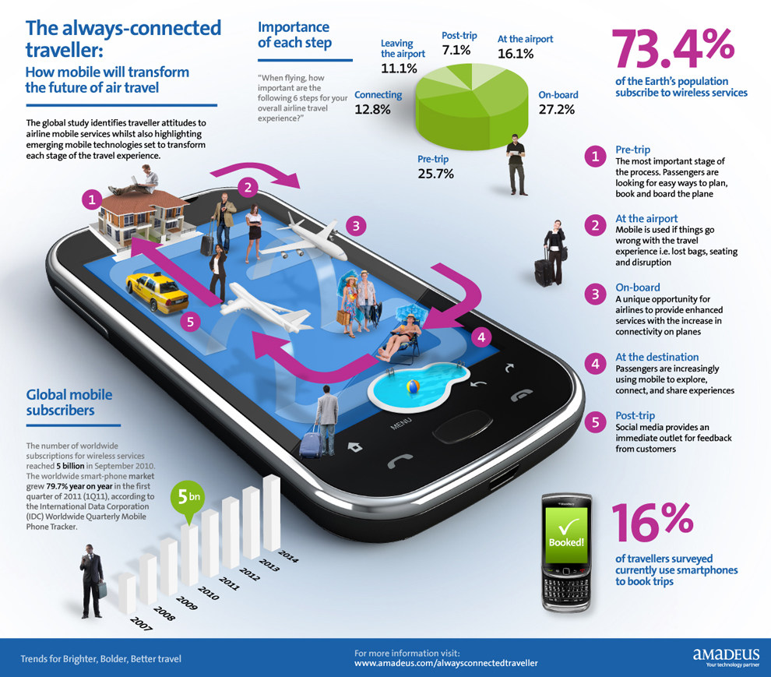
Ready to Implement
Multi-Mode surveys
Traditional
Web
GPS
Need to confirm we achieve similar results across modes
Source: http://www.zdnet.com/airlines-cant-justify-roi-for-mobile-apps-1339317061/

Slide 6
Ready to Implement
Multi-Frame samples
Address-based
Cell Phones
Target Problem Cells from the Start
Focus on Hard to Reach
Convenience/Snowball Samples
Incentives
THEN
NOW
Sources: http://www.impactcommunicationsinc.com/telephone-communication-skills/defending-yourself-against-the-mad-caller/ and http://youngamericanwisdom.com/2013/02/06/dont-answer-the-phone-its-embarrassing/

Slide 7
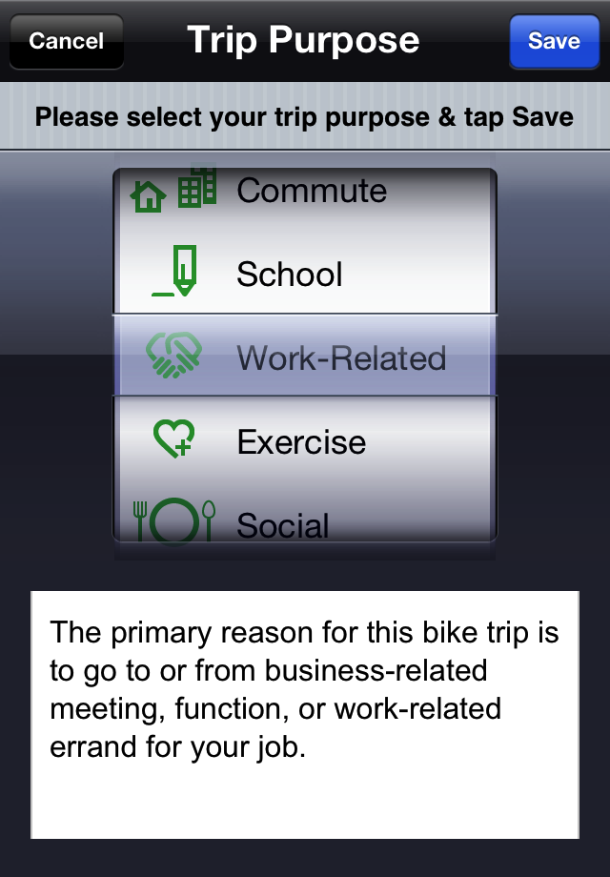
Ready to Implement
Capture all Trips
Trip Purposes
Long Distance, Non-Motorized, Overnight Trips
Source: http://cycleatlanta.org/instructions/

Slide 8
Ready to Implement
Community of Practice
Share RFPs
Share Lesson’s Learned
Share Data???
Source: https://community.qualys.com/blogs/qualys-tech/2011/10

Slide 9
Ready to Implement
Multi-jurisdictional Survey Efforts
Core/non-core approach
Synthesis: Hard to Reach Populations
Source: Regional Coordination in Travel Surveys. Bricka and Knudson.

Slide 10
Ready to Implement
RFPs
Allow at Least 30 days to Respond
Avoid Holidays in the 30 day Period ☺
Prioritize Data Needs PRIOR to Issuing RFP
Provide Budget or Indicate Enough Detail to all for Proposal to be “In Range”
Announce RFP on TMIP List Serve

Slide 11
Research Needs
Effects of Multi-Mode Surveys on Trip Data
Interviewer Mediated vs. Self-Reported Data
Unit of Analysis: HH or Person?
How to Improve the Respondent Experience
Research Tiered/Stacked Survey Approach
Planned vs. Actual Travel
Source: http://www.memegenerator.net

Slide 12
Research Needs
Effects of Emerging Technologies on Participation
How to Process and Integrate Multiple Data Streams
Viability of and How to Harmonize Data
NHTS and Regional Data
Secondary OD Data (B07)
Cell phone, GPS, alternative OD
Credit Reporting Data
Social Media Data

Slide 13
HH Survey Subcommittee Priorities
Synthesis Statements
Examine efficacy of survey methods used by various agencies
Document cost/benefit
Quick Response
Examine efficacy of multi-day data
Examine relationship between sample size and model accuracy/precision
Examine alternative sampling approaches
NCHRP
Update of Report 571
Workshop
Partnering on Travel Surveys
Pooled Fund to Research Panel/Continuous Surveys and Survey Programs

Slide 14
Questions?
Chris Simek
(512) 467-0946
C-simek@tamu.edu
Stacey Bricka
(512) 467-0946
s-bricka@ttimail.tamu.edu
Source: http://consumer.discoverohio.com/downloads/freeohioimages/columbus.jpg
SWTUC Website: http://tti.tamu.edu/conferences/tss12/

