Slide 1
Use of Technology for Public Involvement for the
Illiana Corridor Study
May 6, 2013

Slide 2


Presentation Agenda
Project Overview
Technology Uses
Question and Answers

Slide 3
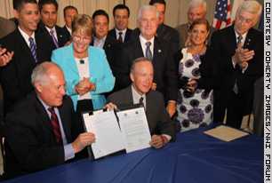
Bi-State Partnership
Indiana & Illinois Governors signed MOA in June 2010
Both states passed P3 legislation for Illiana in 2010
Joint INDOT & IDOT Illiana Corridor Study initiated in April 2011
Notes:
This study is being conducted jointly by the Illinois and Indiana Departments of Transportation. In June 2010, a memorandum of understanding was signed by both Governors that formalized the partnership between the two states for planning a potential new transportation linkage.
In addition, legislation was enacted in 2010 in both states allowing “public private partnerships” or “P3s”, which allows for private sector financing for constructing or operating a transportation facility.

Slide 4
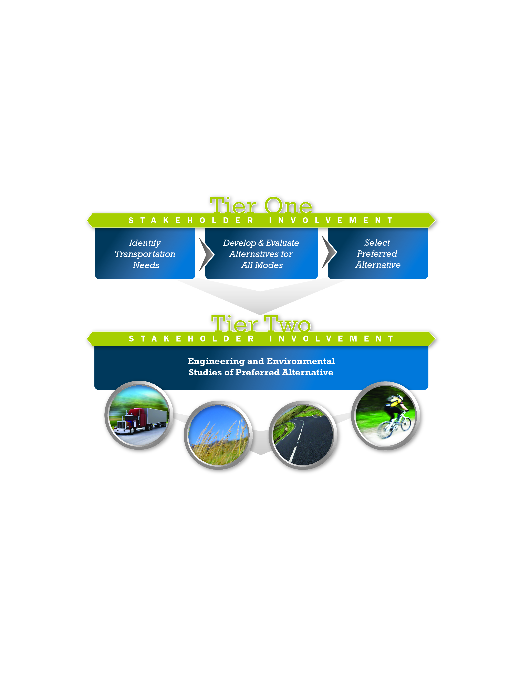

Tiered Environmental Process
COMPLETION WINTER 2013/EARLY SPRING 2014
Notes:
Due to the study area size (956 sq. miles) and complexity, this project has been broken up into two parts or “tiers” following a federal process.
Tier One involved the identification of transportation needs, the development and evaluation of alternatives, and the selection of a preferred corridor at a conceptual level of detail. Tier One, was completed in January 2013; at which time Tier Two activities kicked off.
In Tier Two a more in-depth discussion and analysis of the preferred alternative, Corridor B3, from Tier One. This will involve additional detailed studies, including defining a design and footprint for the project, interchange locations, drainage studies, and detail financing options and road closure analysis.

Slide 5
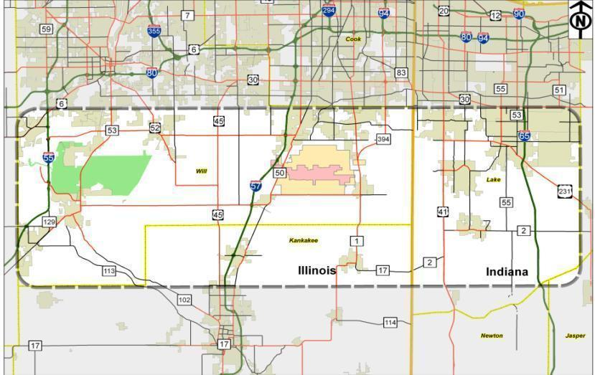
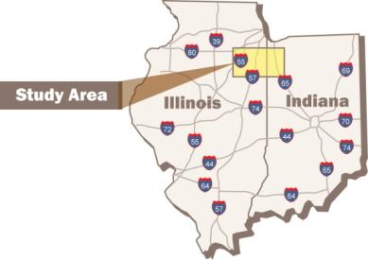
Study Area
950 square miles – about the size of Rhode Island
Parts of Will and Kankakee (IL) and Lake (IN) counties
Notes:
The study area is located in southern Lake County in Indiana and southern Will County and northern Kankakee County in Illinois. The area is generally located between I-65 on the east, I-55 on the west and bordered by U.S. 30 to the north and northern Kankakee County to the south.

Slide 6
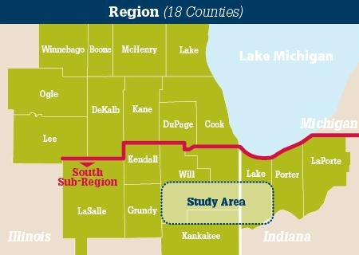



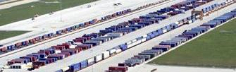
Why does this Region need a new facility?
VITAL NATIONAL LINK
KEY INTERMODAL LOGISTICS AREA
Notes:
Given the central location in the nation, the northwest Indiana and northeastern Illinois region is essentially the crossroads of America and is therefore heavily utilized by three sectors of travel, roadways, rail and air. Due to this fact, our region is a national link to transportation and commerce which creates heavy use of our highways.
The concept of an Illiana Expressway goes as far back as Daniel Burnham’s 1909 Plan for Chicago, but the idea really started to gain momentum in the last few decades as the south suburban region emerged as a multi-modal transportation hub, causing tremendous growth in population and traffic.
The existing transportation network, including I-80, has been unable to support the travel demand, resulting in increased congestion and the need to provide better access to jobs. This demand will only increase and expand to the south, as the population is expected to grow 175 % in the study area by 2040, and traffic at the intermodal centers will increase to over 45,000 trucks per day.

Slide 7
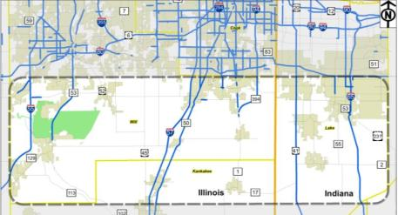
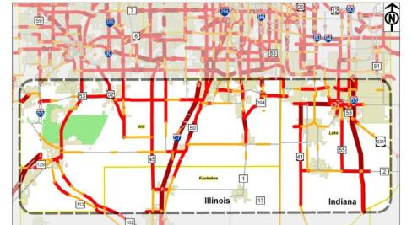
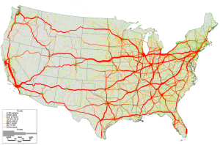
Why Does this Region Need a New East-West Facility?
Lack of continuous & multi-lane east-west roads
Population & employment growth by 2040
Vehicle trips will increase by 126% by 2040 resulting in increased congestion
I-80 congested & assumed at full build out
National truck freight increasing
47,000 daily intermodal truck trips by 2040
Truck trips will increase by 193% by 2040
Notes:
The many alternatives that were generated by stakeholders were grouped into a set of initial alternatives. This included 8 initial limited access highways shown on the map, as well as two arterial alternatives.

Slide 8
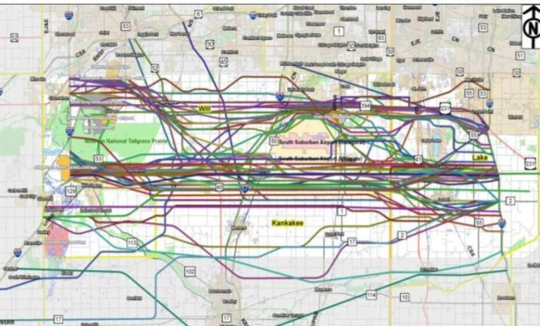
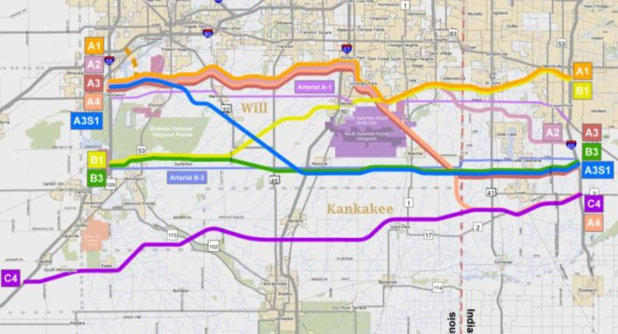
Tier One Corridor Alternatives
Alternatives Workshop Ideas
Initial Alternatives
Tier One DEIS Alternatives
Notes:
The many alternatives that were generated by stakeholders were grouped into a set of initial alternatives. This included 8 initial limited access highways shown on the map, as well as two arterial alternatives.

Slide 9
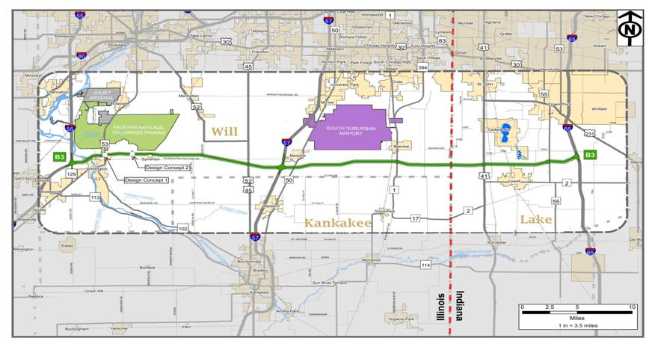
Single Document (Combined Final EIS/ROD):
B3 and No-Action
☑
Less environmental impacts
Higher travel performance
Greater stakeholder support
Lower construction costs
Alternatives Carried Forward to Tier Two
B3 and No-Action
Notes:
Based on the extensive technical analysis and stakeholder input after the Tier One public hearing; Corridor B3 and the No-Action alternatives were carried forward into Tier Two.
Corridor B3 has the best balance of fewer impacts to the natural environment, travel performance, stakeholder support, constructability factors, and better design flexibility for avoidance and minimization of impacts as the study proceeds.
The No-Action alternative means the only improvements in the study area would be to the existing local and state roads that are forecasted to be constructed by the year 2040.

Slide 10
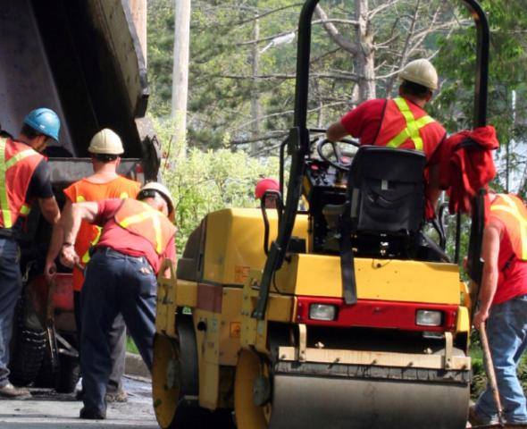
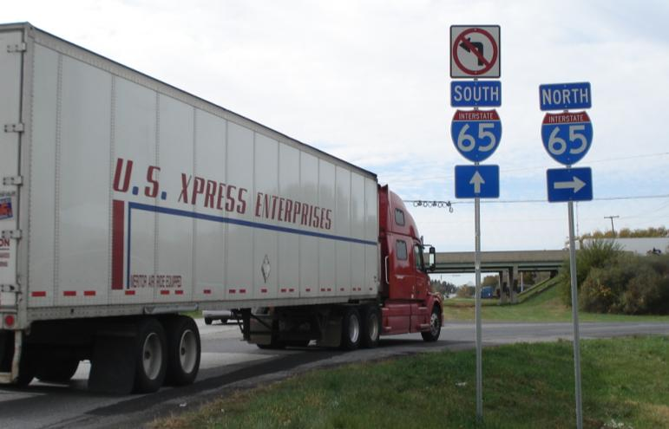
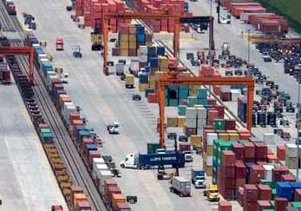
Benefits: Regional & Local
  9,000 construction jobs
  30,000 long term jobs
  $1.4 billion short-term economic output
  $4 billion long-term economic output
JOBS/
ECONOMIC GROWTH
Notes:
If built, the Illiana Corridor will benefit the local and regional economy.
The Illiana is projected to create 9,000 immediate construction jobs and 25,000 long-term construction jobs (in Indiana, Illinois and throughout the region) ; contracting opportunities with local and regional companies; and $3.9 billion dollars invested in the local economy along the corridor – a direct benefit to residents and businesses in Lake County Indiana, and Will County, Illinois.
It will improve accessibility to one of the largest intermodal freight and port areas in the country. The Illiana will reduce the strain of truck traffic on local roads, improving safety, cutting commuting times and reducing congestion.

Slide 11
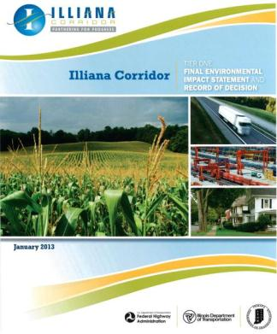
Tier One FEIS/ROD
Tier One “Single Document” Final EIS/ROD approved January 17, 2013
First “single document” in country approved under new MAP-21 streamlining provisions
Notes:
Financing strategies for alternatives, including toll financing/public-private partnership is a consideration.

Slide 12
How Can Technology Help?

Slide 13
Technology Applications
Convey Impacts of multiple alternatives
  Fly through videos of impacts
Show the stakeholders meaningful data that relates to their individual properties
  Interactive Mapping
Capture public Input for long term use
  Comprehensive comment data Management

Slide 14
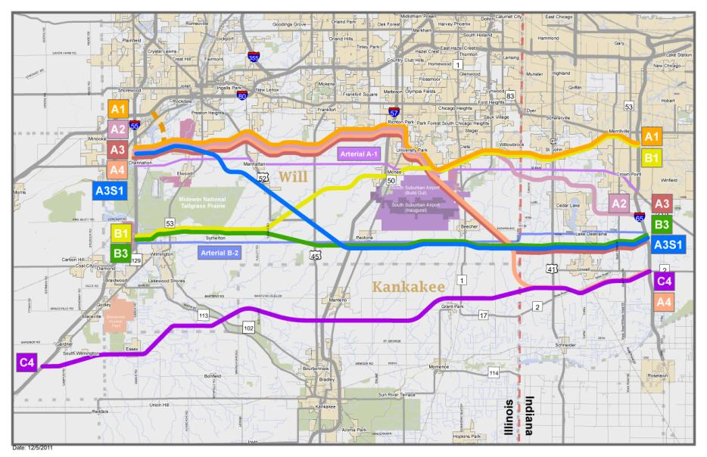
Representative Alternatives
Eight Limited Access Alternatives
Two Arterial Alternatives (widening existing roads)
Notes:
We then grouped these initial ideas and concepts into a set of initial alternatives. This included 8 initial limited access highways shown on the map, as well as two arterial alternatives.

Slide 15
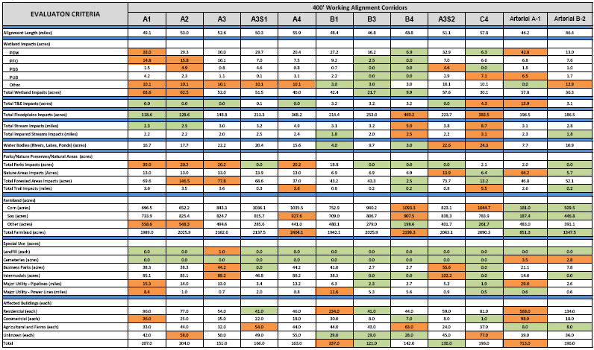
Simplify the Impact Table
Message
Notes:
Screening tables were used to assist the study team in evaluating the impacts however the reviewing agencies and public found it difficult to relate alternatives to the tables. PB utilized Google earth as a quick way to prepare fly through demonstrations of multiple alternatives and used shading, text notes and presenter commentary to convey the message.

Slide 16
Sample Impact Summary Video
Demo Video

Slide 17
Relate to the Stakeholder Impacts
A 950 square mile study area presents challenges with displaying level of detail
ArcGIS online mapping used to allow the team to zoom in on the stakeholder area of interest while using larger maps for project wide issues

Slide 18
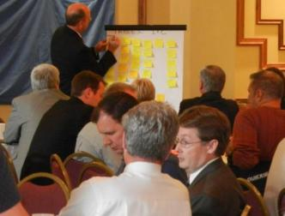
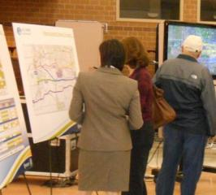
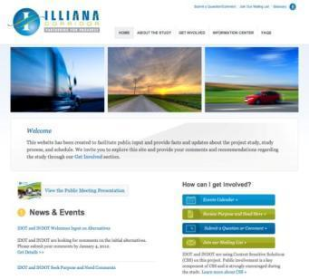
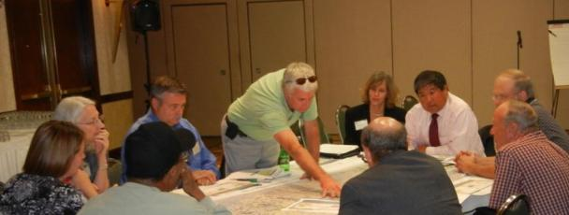
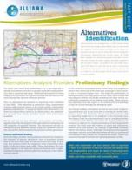
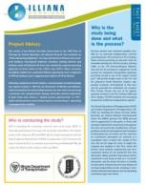
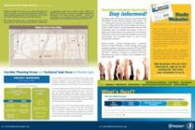

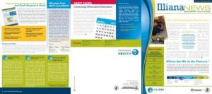
Tier One Public Involvement
Project Website
9 CPG/TTF Meetings
3 Rounds of Public Meetings
Formal Public Hearings
130+ Stakeholder Meetings
5 Newsletters/Fact Sheets
Notes:
A key component of the study process included bringing together stakeholders and transportation providers who have interests in improved transportation in the Illiana Corridor Area.
Over 130 small group meetings were conducted
6 public meetings attended by 2,400 people
2 public hearings attended by 1,800 people
10 Corridor Planning Group Meetings and,
Over 9,000 newsletters being distributed to stakeholders.
This is a significant milestone in the development of the Illiana Corridor, and the selection of Corridor B3 could not have been made without the input from residents, communities, local officials, agencies, and other stakeholders who greatly assisted IDOT and INDOT every step of the way.
The Tier One Record of Decision was the authorization to proceed with advancing the 2000 foot B3 Corridor with detailed engineering studies, and the no-action alternative forward into Tier Two.

Slide 19
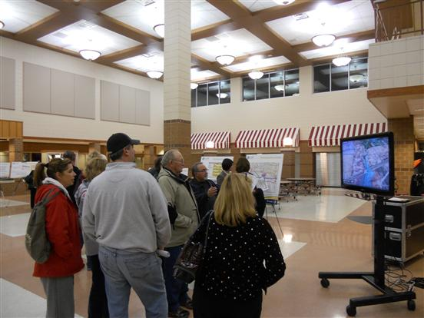
Video Stations
Google Earth fly-through demonstrations used at the public meetings

Slide 20
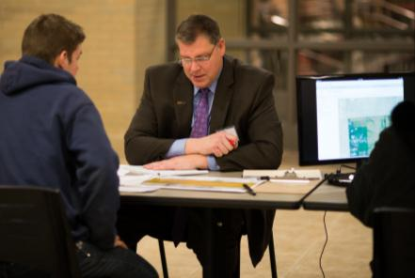

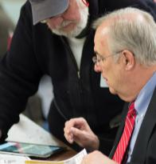

Tier Two Public Involvement
  45 one-on-one stakeholder meetings
  Five landowner meetings in February with 850 attendees
  Two Corridor Planning Group meetings
  Land Use Task Force Meetings on April 10 & 30
  Tier Two Public Meetings on April 16 & 18 with 700 attendees

Slide 21
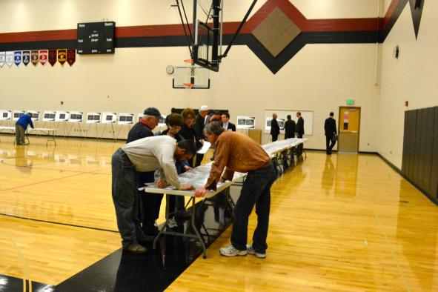
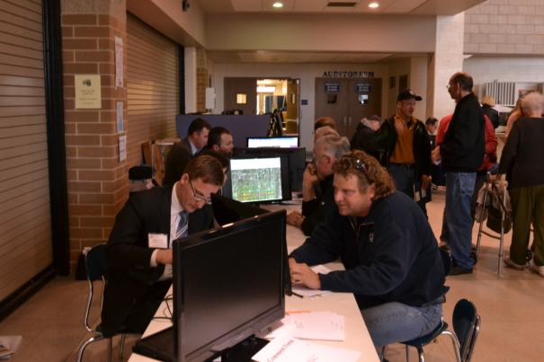
From Maps to the Digital Tablet
The 47-mile corridor required a 41’ long exhibit to show meaningful level of detail
Study team members answer land owner questions while referencing maps on IPads
Multiple stations are setup at every meeting to accommodate the large groups

Slide 22
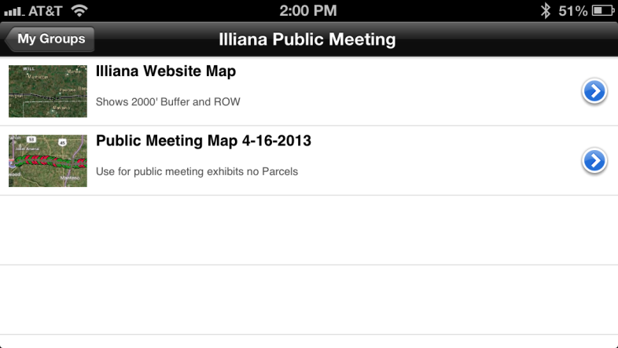
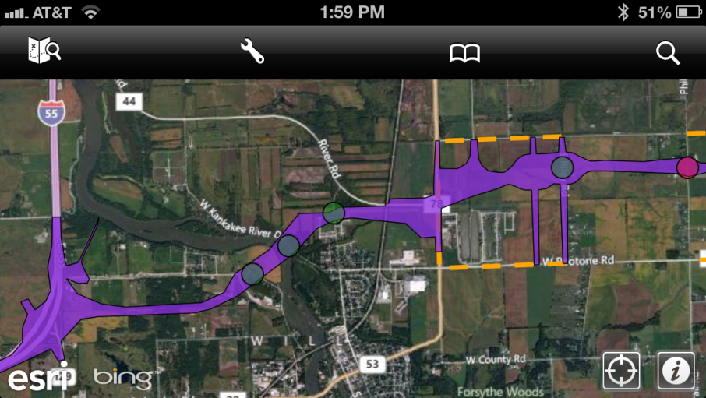
Hand Held Devices & Tablets
The corridor can be displayed on mobile devices that run the ESRI app
Allows users to quickly locate areas of interest and with GPS enabled devices, locate themselves relative to the corridor

Slide 23
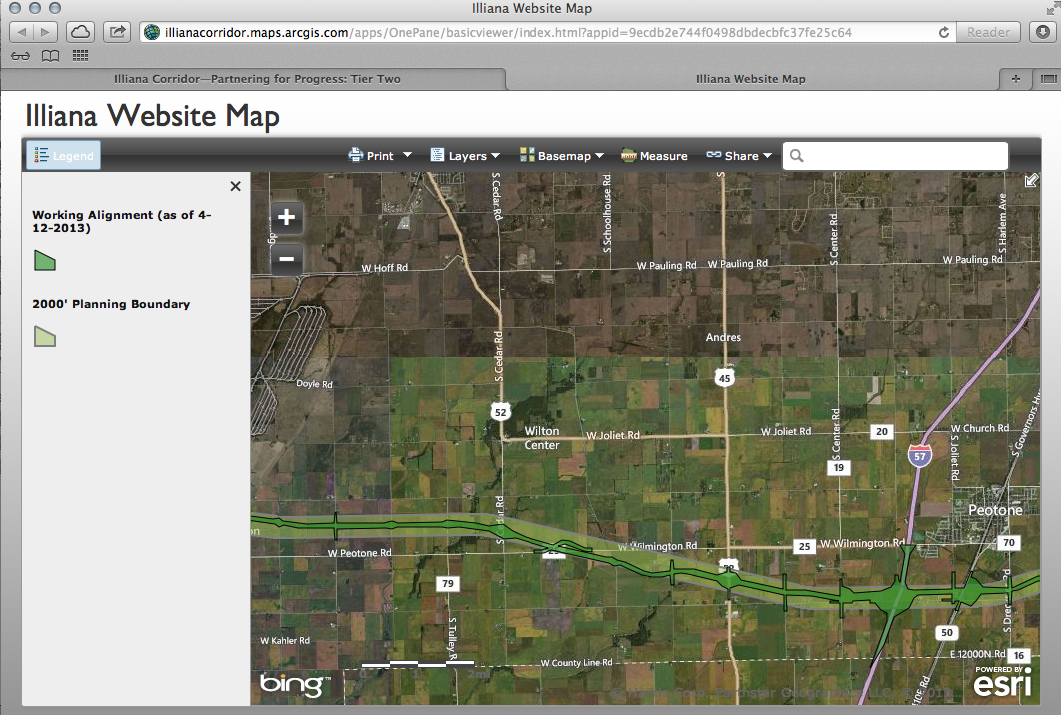
Public GIS Mapping
Stakeholders can view an online version of the corridor map
Search for addresses
Print scaled images
Web site www.illianacorridor.org

Slide 24
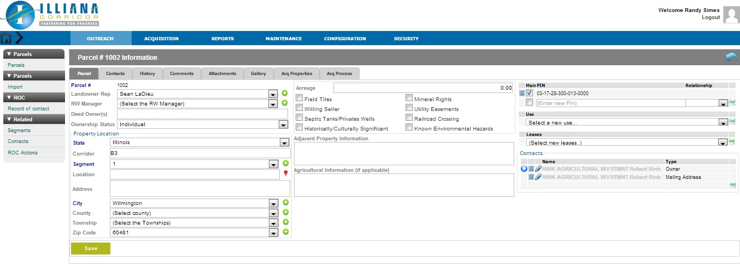
Stakeholder Database
Each affected property owner has a unique entry by parcel
All interaction is tracked including comment history and property details

Slide 25
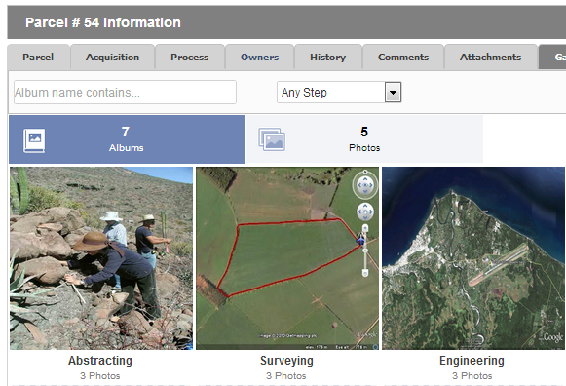
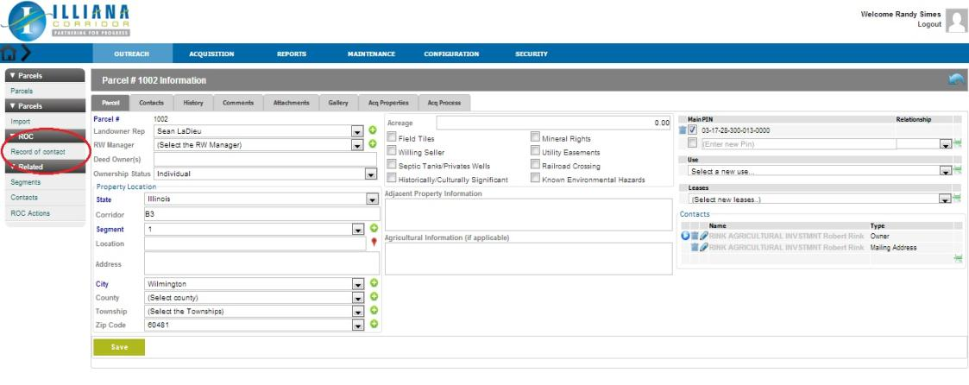
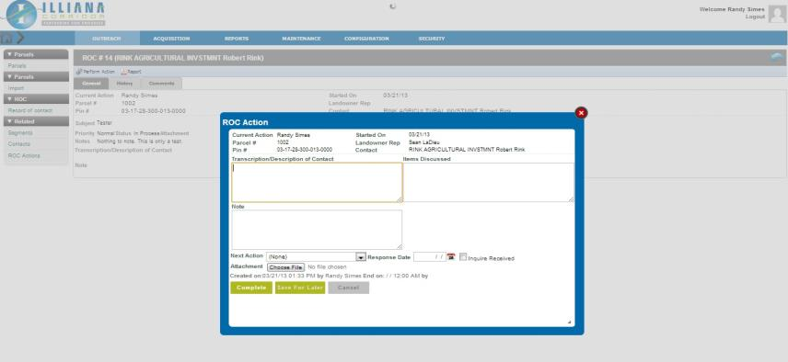
Information Logged for Future Use
Records of Conversation
Property details
Photographs
Responses to comments

Slide 26
Questions?

