Slide 1
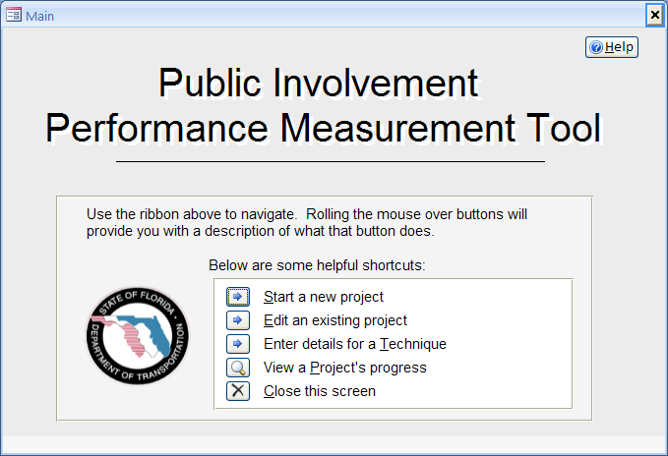
Performance Measures for Public Involvement Center for Urban Transportation Research University of south Florida Jeff Kramer, AICP Domenico Pontoriero Melissa McCarville Kristine Williams
May 7, 2013
Transportation Research Board
Planning Applications Conference

Slide 2
Assessment of FL Public Involvement Practices in 2006
Found few, if any, formal methods to measure effectiveness
Several interviewees requested formal evaluation methods
Recommended development of systematic performance measures:
Focusing on desired outcomes
Advancing FDOT strategic objectives and business plan
Notes:
Went to every district, talked to at least a dozen people in all phases, anyone who “touches” the public
We asked about personal knowledge of pm, district attitudes, how they do their job, how they perceive the needs for pm, what they need from us
This gave us a baseline assessment
Several specifically requested help on evaluating their techniques which became one of the recommendations

Slide 3
Development of Performance Measures
Document current performance measure practices
Generally
Specific to public involvement
Develop systematic methodology to evaluate public involvement practices
Based on defined performance measures
Outcomes versus outputs
Coordinate with established FDOT performance management process
Notes:
Outcomes versus outputs – talk about that - number of meeting notices are outputs. Satisfaction levels are outcomes, such as people felt they had opportunity to participate or provide comment or have their opinions considered (and I’ll mention that again in a few minutes)

Slide 4
Project Team
Rusty Ennemoser, Project Manager
George Ballo, Contract Manager
CUTR Project Faculty
Jeff Kramer, AICP
Kristine Williams, AICP
Christina Hopes
Alex Bond, AICP
Technical Working Group
Kris Carson, District 7 - PIO
Larry Ferguson, Central Office – Performance Management
Lee Ann Jacobs, Federal Highway Administration
Phil Matson, Indian River County MPO
Kathy Neill, Central Office - Policy Planning
Cathy Owen, District 6 - EMO
Gus Schmidt, District 4 - PLEMO
Kelly Teague, METROPLAN Orlando
Notes:
Point out the experience and expertise of the team, real mix of people with diverse knowledge

Slide 5
Literature Review and National Scan
Comprehensive literature review to identify related efforts for performance measures
Scanning survey of state transportation agencies and MPOs
Distributed electronically through AMPO, NARC, and 200 individuals at federal and state DOTs
Notes:
AMPO -- Association of Metropolitan Planning Organizations
NARC -- National Association of Regional Councils
The literature review attempted to identify other states or MPOs using performance measures for related subjects. Results were limited for social considerations or public policy related to socioeconomics and virtually nothing about public involvement except for measurement of inputs and outputs – how many meetings were held, how many postcards sent out. These kinds of measures don’t get at outcomes – did we achieve an objective, were people satisfied? The literature suggests that performance measures are most successful when they are tied to specific and spelled out goals and objectives.
Survey said: nobody is doing anything but everyone sees the need.

Slide 6
Public Involvement Framework
Goal – overarching agency purpose for activity
Objectives – subcomponents of agency goal
Indicators – variables used to measure progress toward an objective
Targets – specified, measurable criteria for evaluating the performance indicator
Notes:
The technical group developed a framework to define goals, objectives, indicators, targets. You need to define what it is you want to evaluate. We recognize FDOT didn’t have specific goals/objectives for PI. So we created them. We recognize that these are not “official” goals/objectives. We needed something to be working toward, so this gave us a framework.

Slide 7
Public Involvement Framework
Goal
Objective
Objective
Indicator
Indicator
Target
Target
Indicator
Indicator
Target
Target
Notes:
This is how the framework appears graphically.

Slide 8
Public Involvement Framework
Goal Objectives Indicators Targets
Goal Objectives Indicators Targets
Goal: Ensure that all interested parties have an opportunity to participate fully in the transportation decision-making process and that public input is carefully considered

Slide 9
Public Involvement Framework
Goal Objectives Indicators Targets
Objectives
Equity - Provide equitable access to transportation-decision making
Information - Inform the public early, clearly and continuously
Methods - Use a variety of methods to involve and engage the public
Responsiveness - Carefully consider public input in transportation decisions

Slide 10
Equity – Provide Equitable Access to Transportation Decision-Making
Indicator E-2 – Convenience of meetings and events to public transportation, where available
Target : [xx%] of public involvement events are within [xx-mile] of a transit stop
Target : [xx%] of public involvement events are within paratransit service areas
Data and Measurement: Tracking number of public involvement events in relation to transit stops, where available

Slide 11
Information – Inform the public early, clearly and continuously
Indicator I-1 – Clarity and adequacy of project information
Target : At least [xx%] agree that the information provided by the department was clear
Target : At least [xx%] agree that the information provided by the department was adequate
Data and Measurement: Questionnaires at meetings, via web, through mail
Notes:
People need to be able to understand the information to be able to engage. So did they feel like they do understand and get it? Is there enough information or too much?

Slide 12
Developing A Data Collection and Analysis Tool
A comprehensive tool for FDOT
Facilitates data collection and analysis during environmental assessment public involvement
Low security risks
Not web-based
Easy to install and use
Robust and versatile
Microsoft Access
VBA, XML, SQL

Slide 13
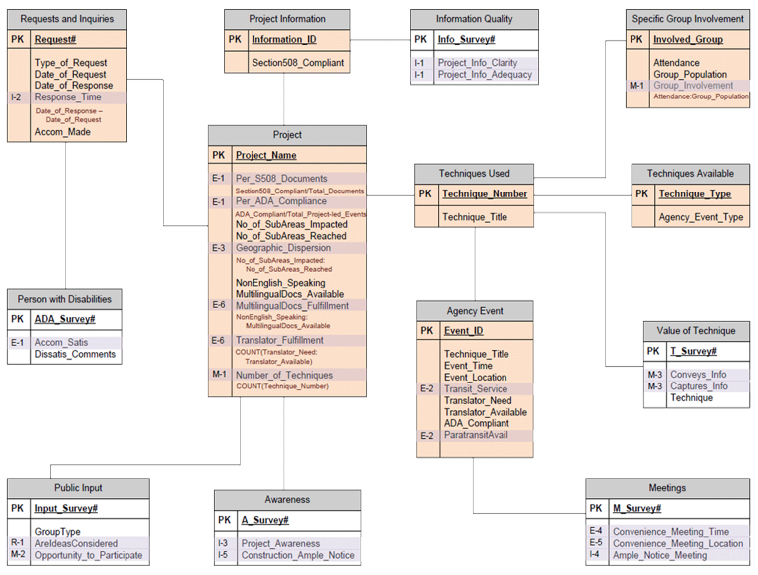
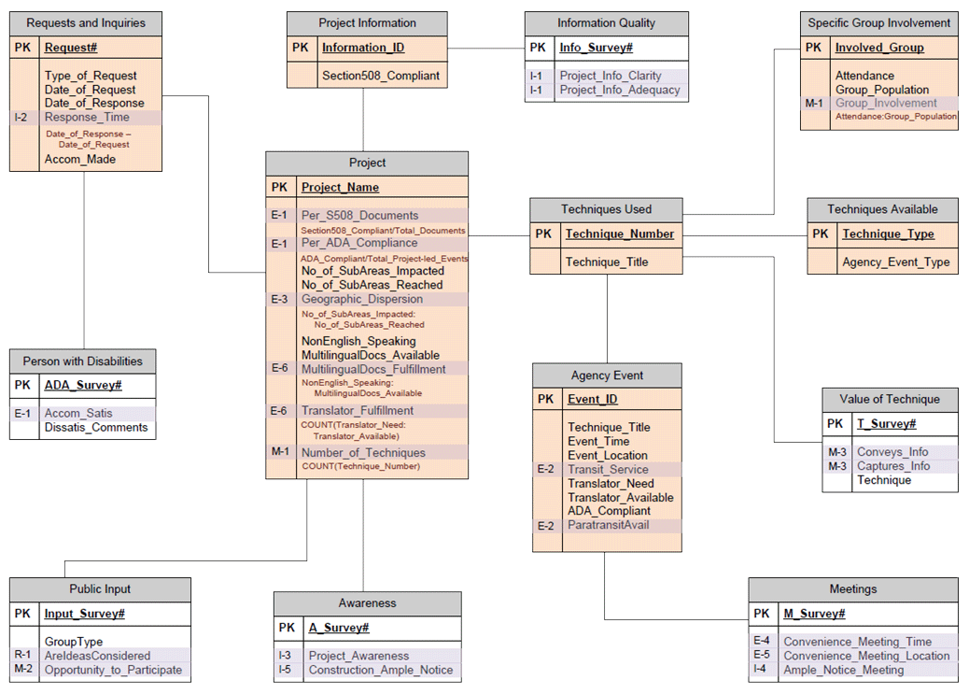
Entity Relationship Diagram (ERD)
Notes:
The underlying architecture of a relational database like Microsoft Office Access required intricate planning. An entity relationship diagram (ERD), which focuses on the relationships between data, was therefore a necessary step in development planning.
The final ERD, although not completely true to the database’s full complexity, exhibited the primary organizational structure of the PIPM Tool.

Slide 14
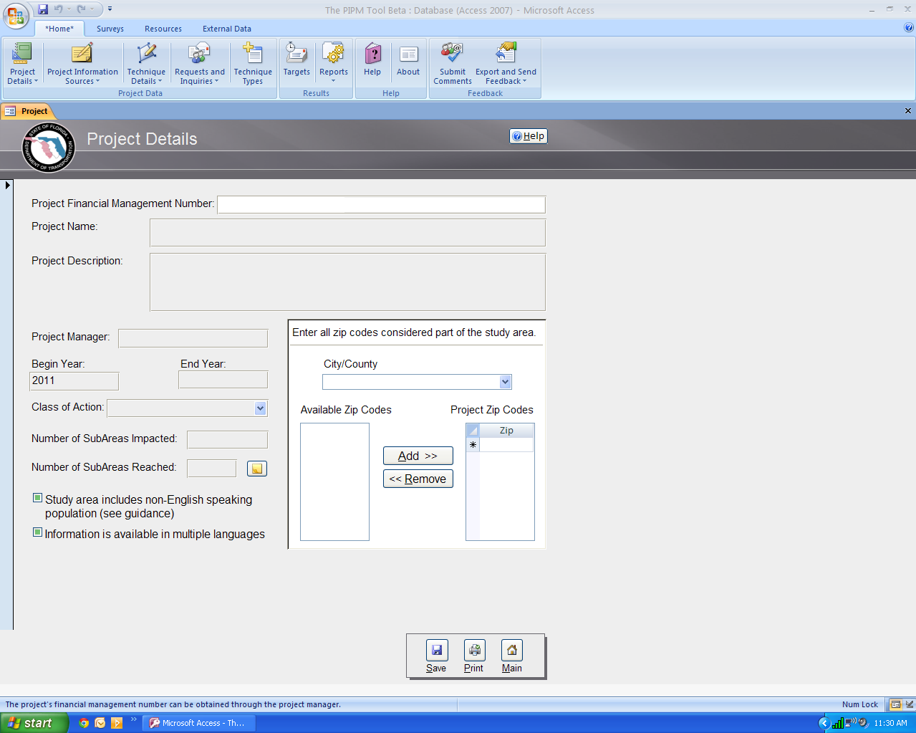
PIPM Tool Functions
collect and store data (surveys)
store and organize data collected outside the tool
quantify public involvement activities and compare results to predetermined targets in an easy to use report format
technical support through an interactive user and reference guide
Notes:
Upon completion, the PIPM Tool amassed:
65 forms (accessible to the user)
33 tables (plus 27 additional system tables)
45+ global macros
Hundreds of queries

Slide 16
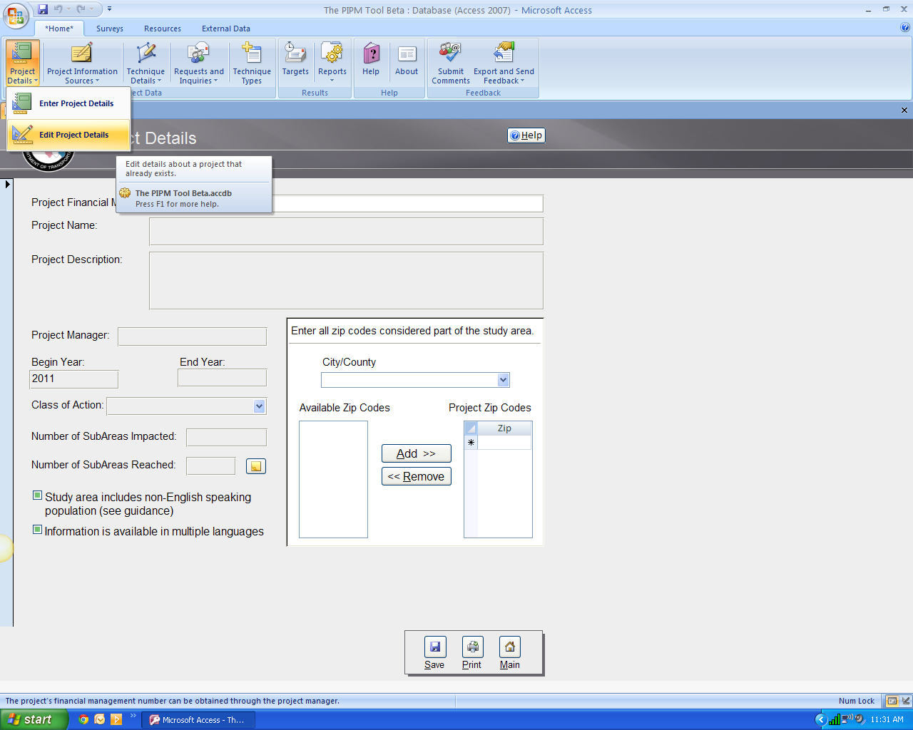

Slide 17
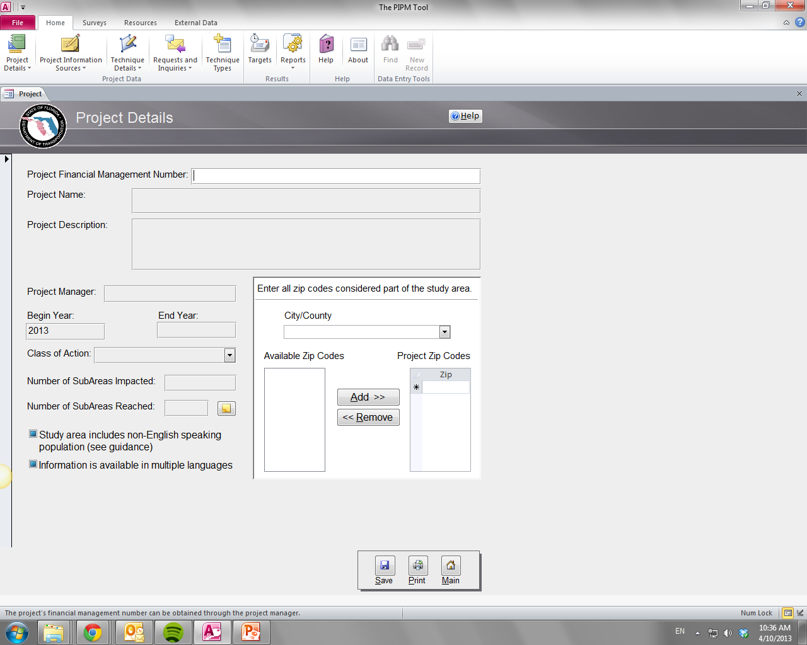
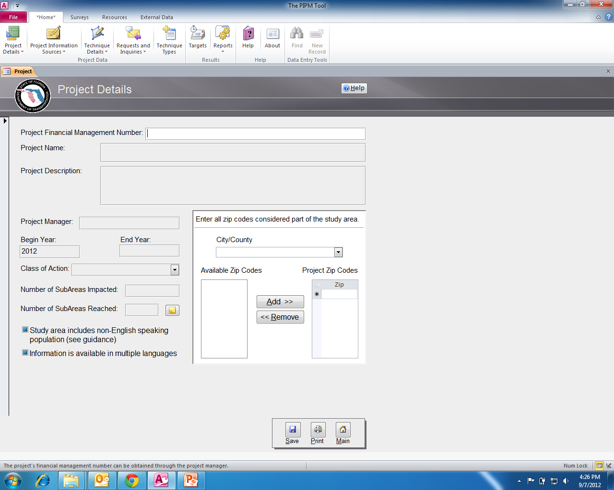

Slide 18
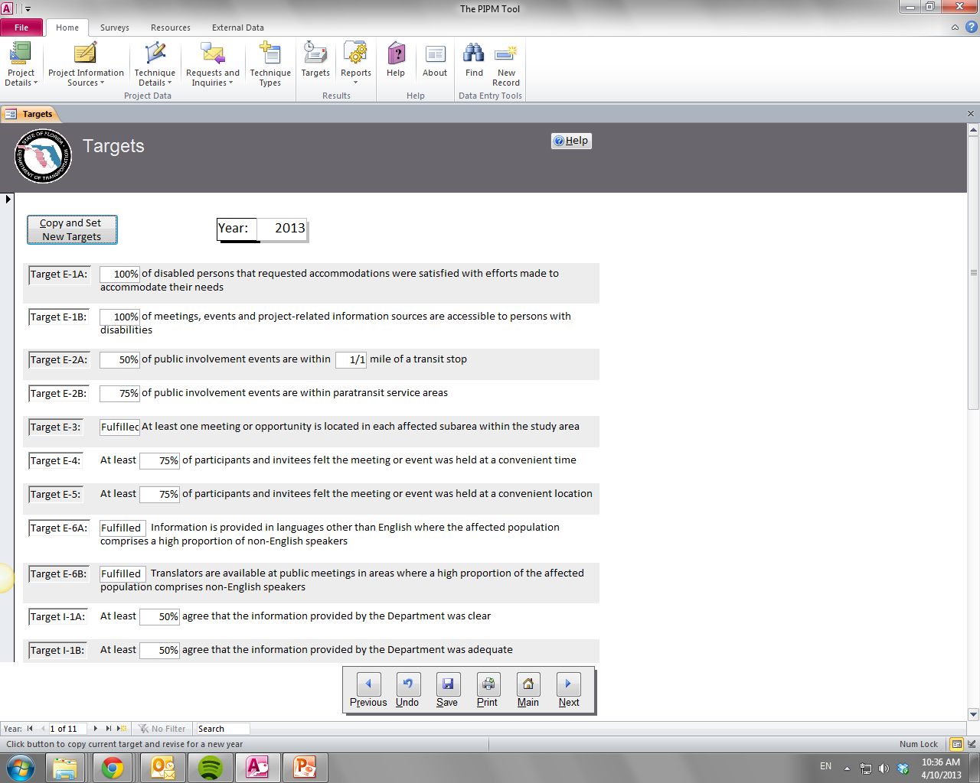
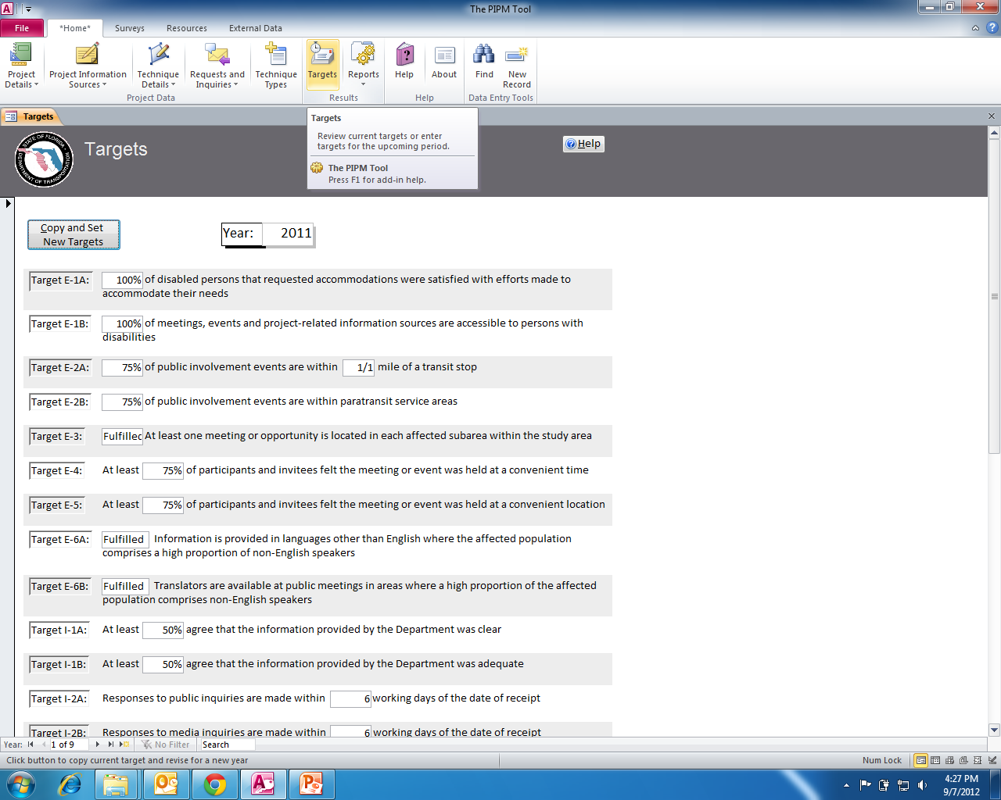

Slide 19
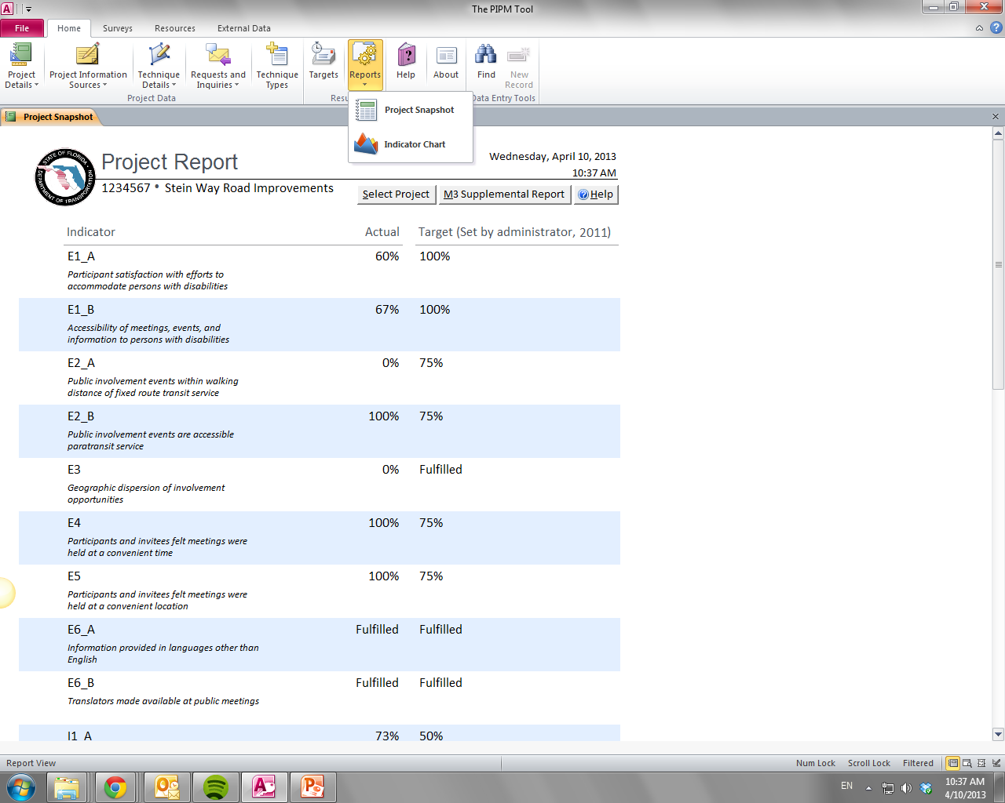
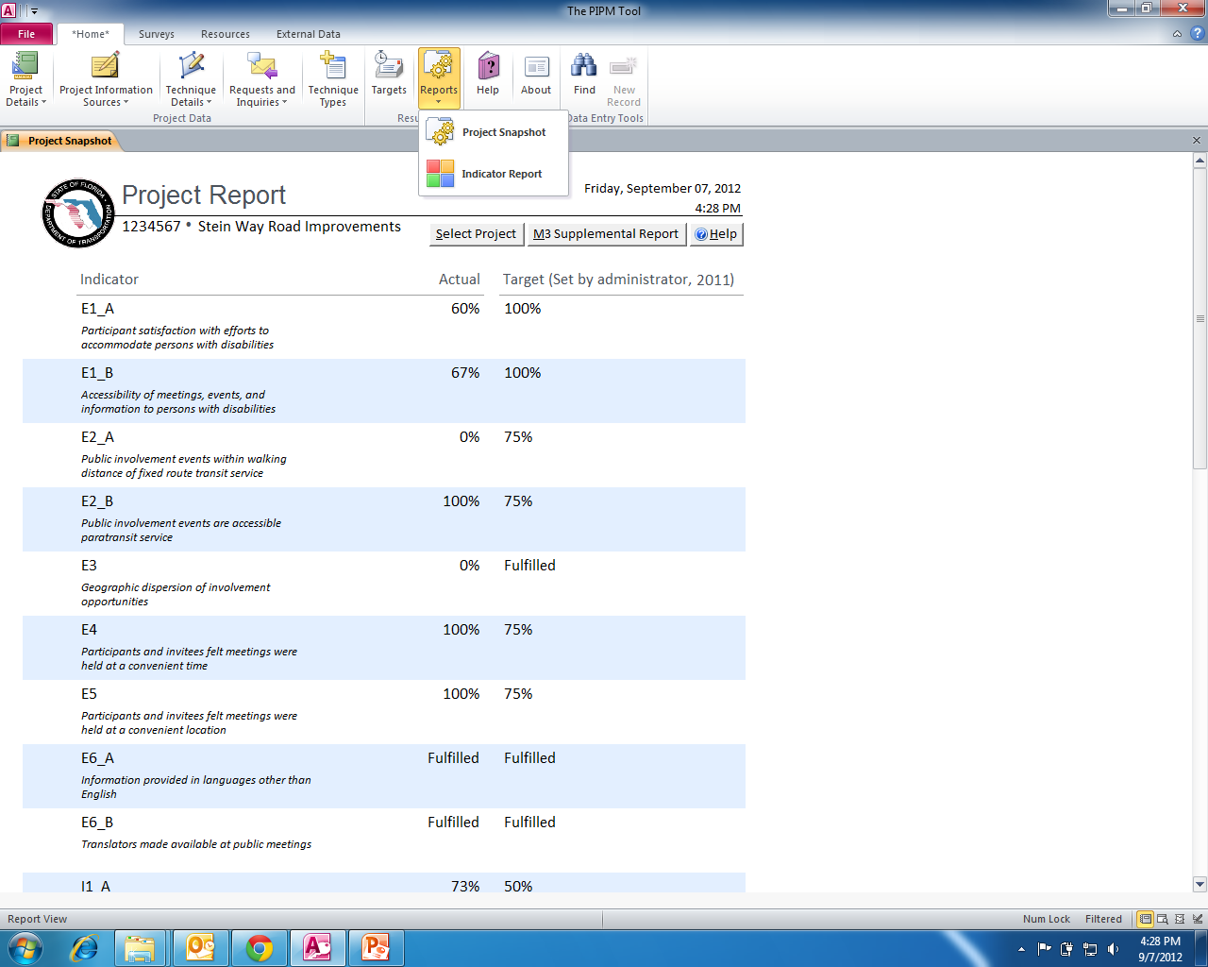

Slide 20
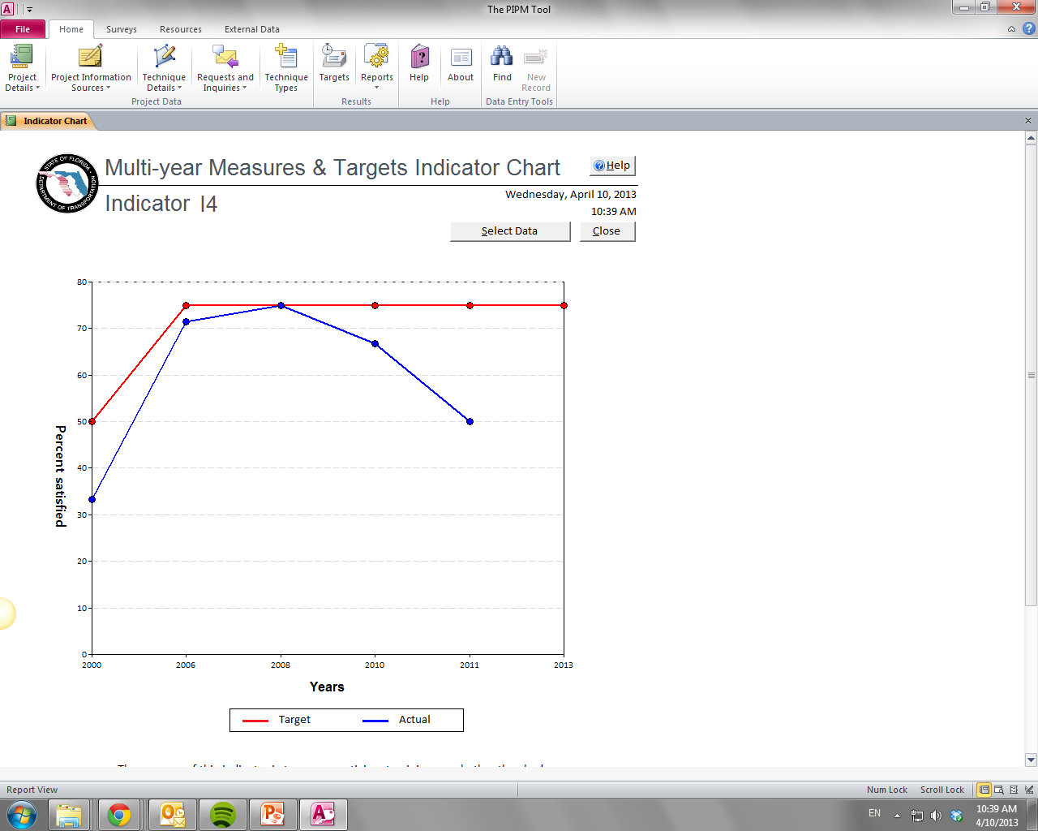
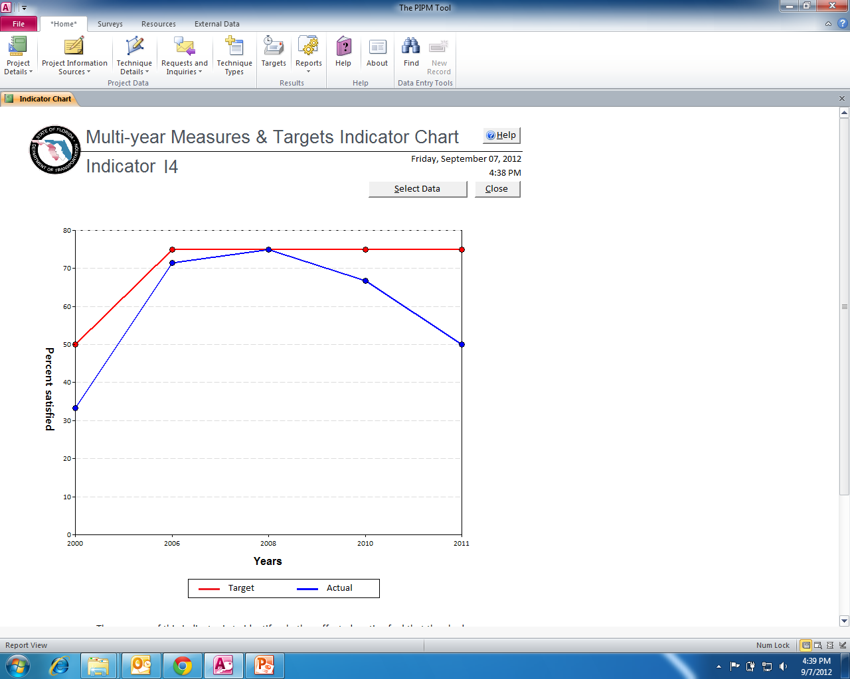

Slide 21
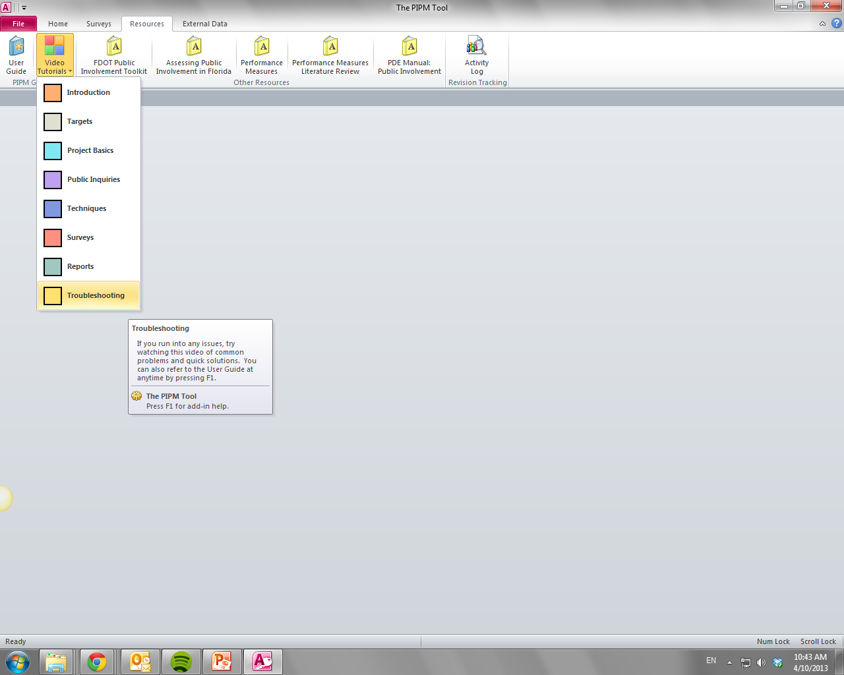
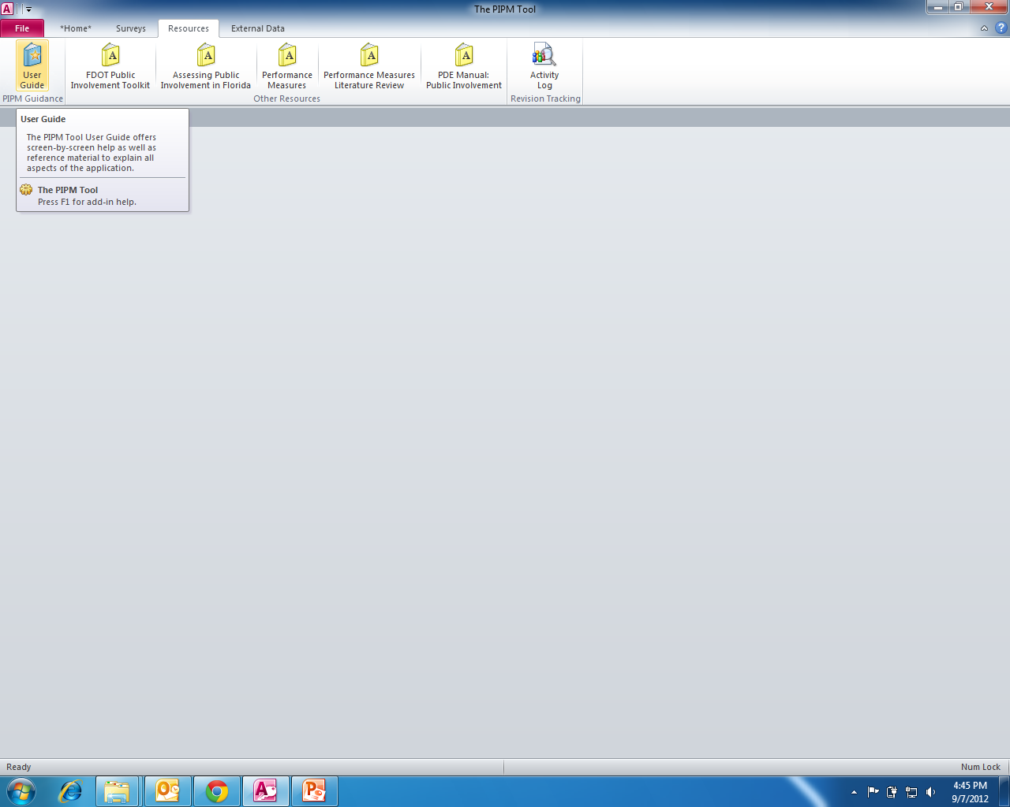

Slide 22
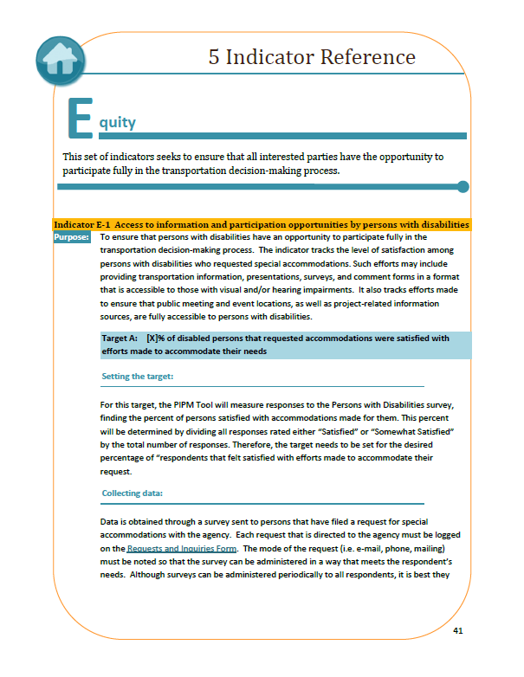
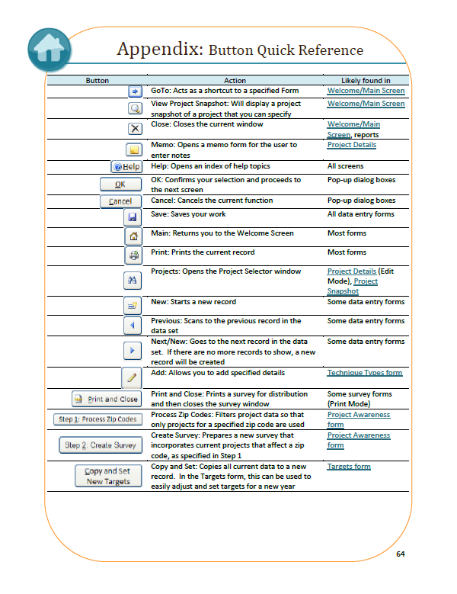
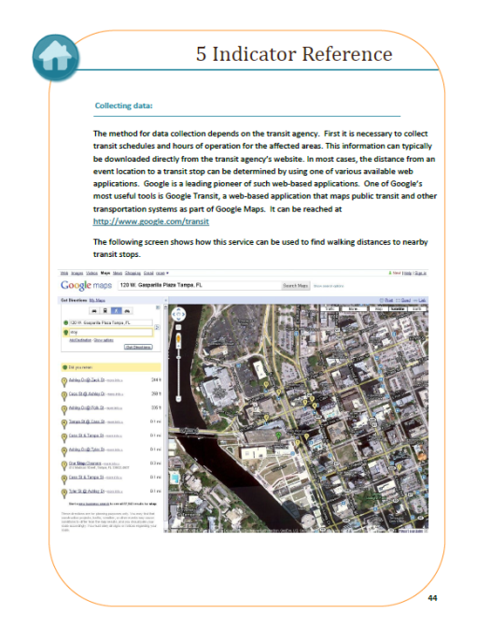
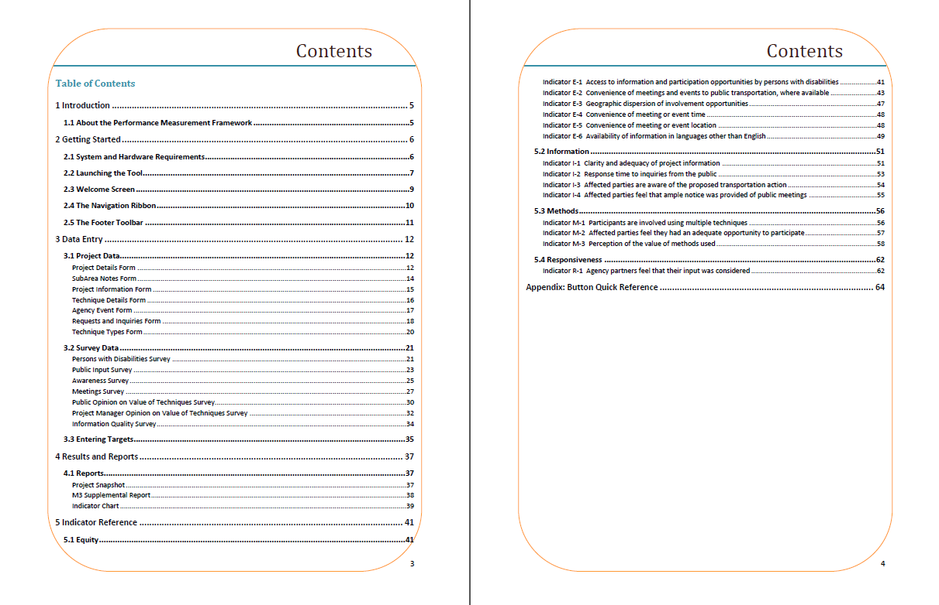

Slide 23
Status
OIS reviewed and approved tool implementation.
Field tested in two districts and conducted evaluations in other districts.
Almost finished refining tool and developing CBTs.
Revised Ch. 10 in Public Involvement Handbook.

Slide 24
Performance Measures for Public Involvement Florida Department of Transportation Center For Urban transportation Research
http://www.dot.state.fl.us/emo/pubinvolvement.shtm
Rusty Ennemoser Rusty.ennemoser@dot.state.fl.us
Jeff Kramer kramer@cutr.usf.edu

