Slide 1
Innovative Ridership Estimation Modeling for an Automated People Mover in a Mixed-Use Development
Transportation Research Board Applications Conference
June 5, 2019

Slide 2
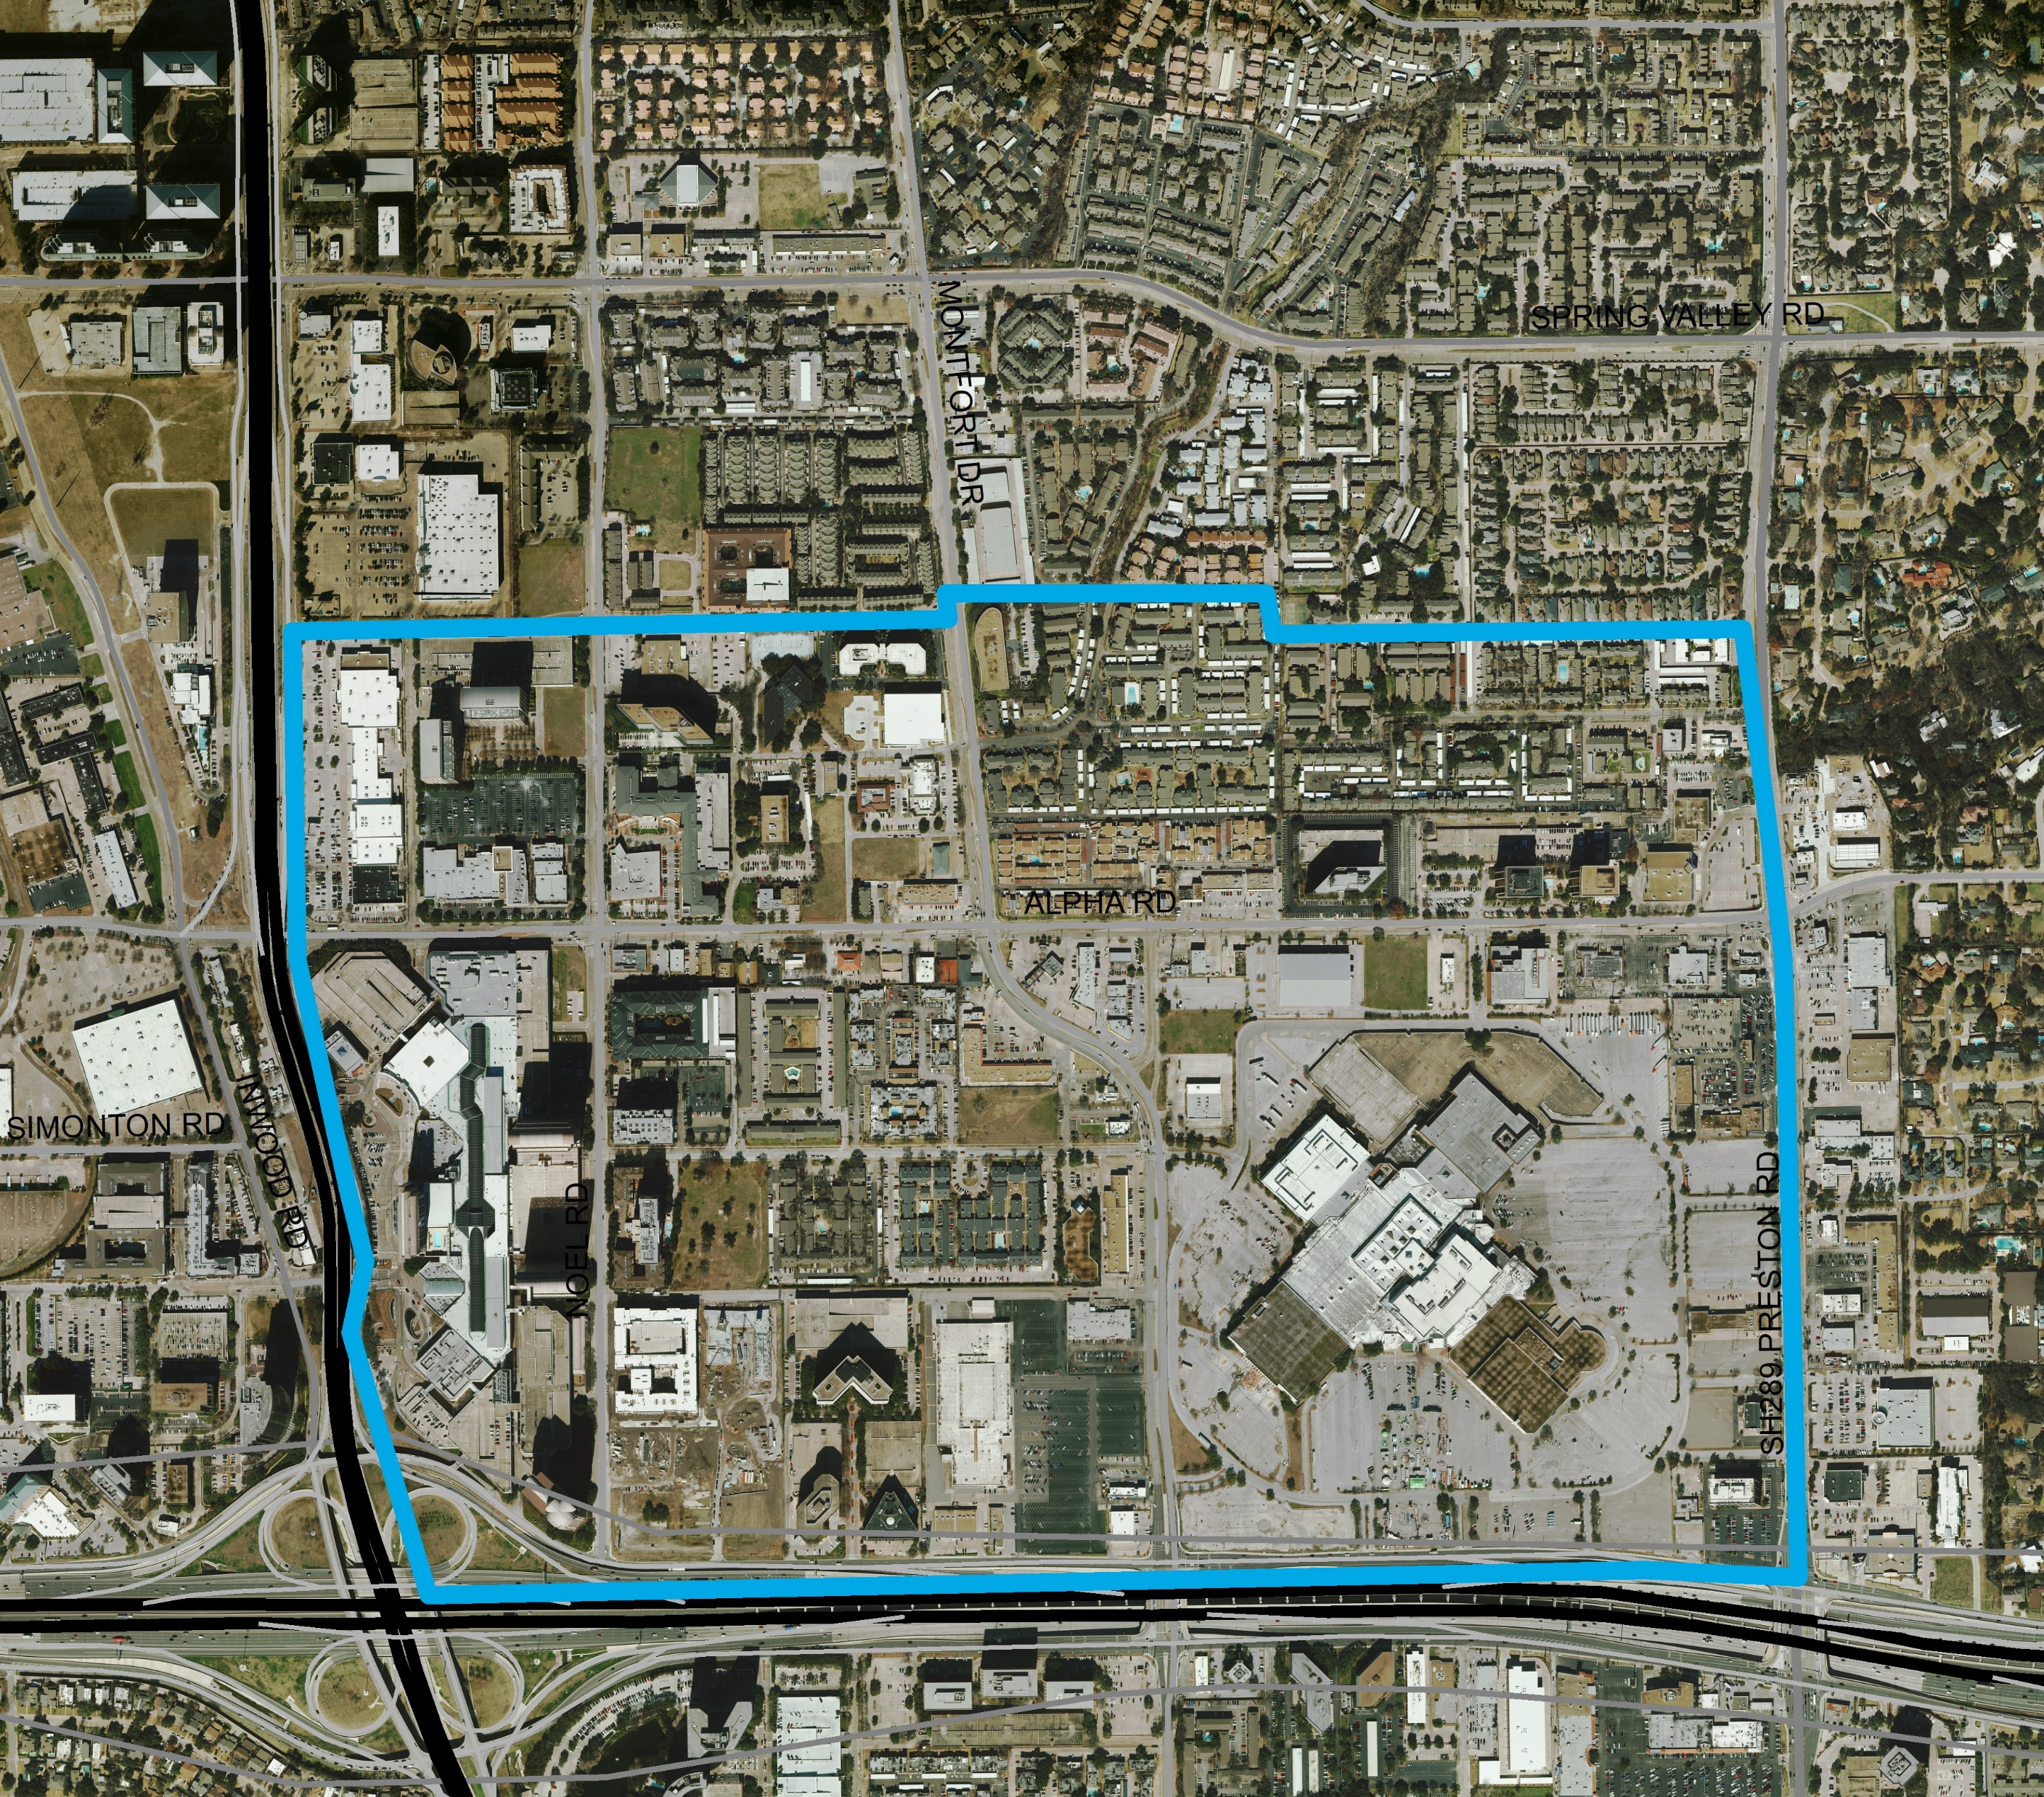
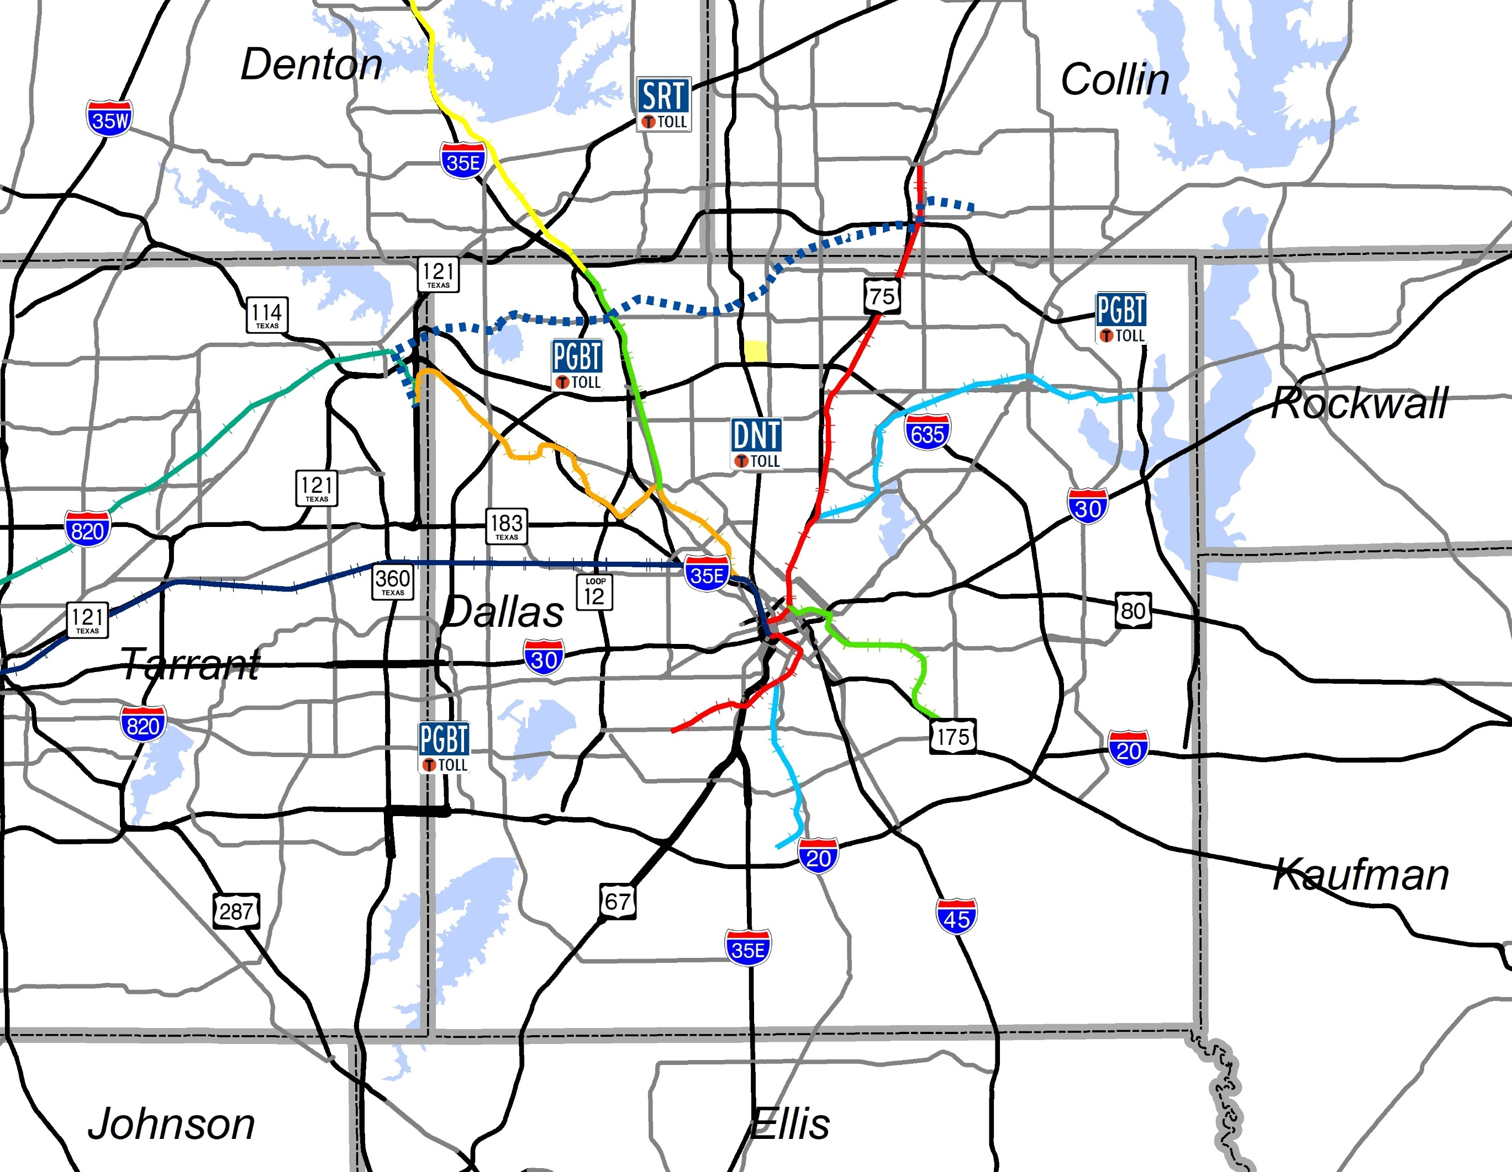
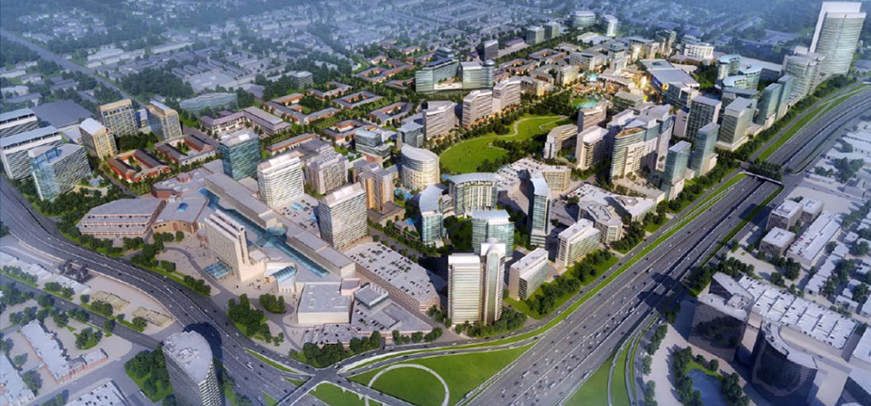
Dallas Midtown
Study Area

Slide 3
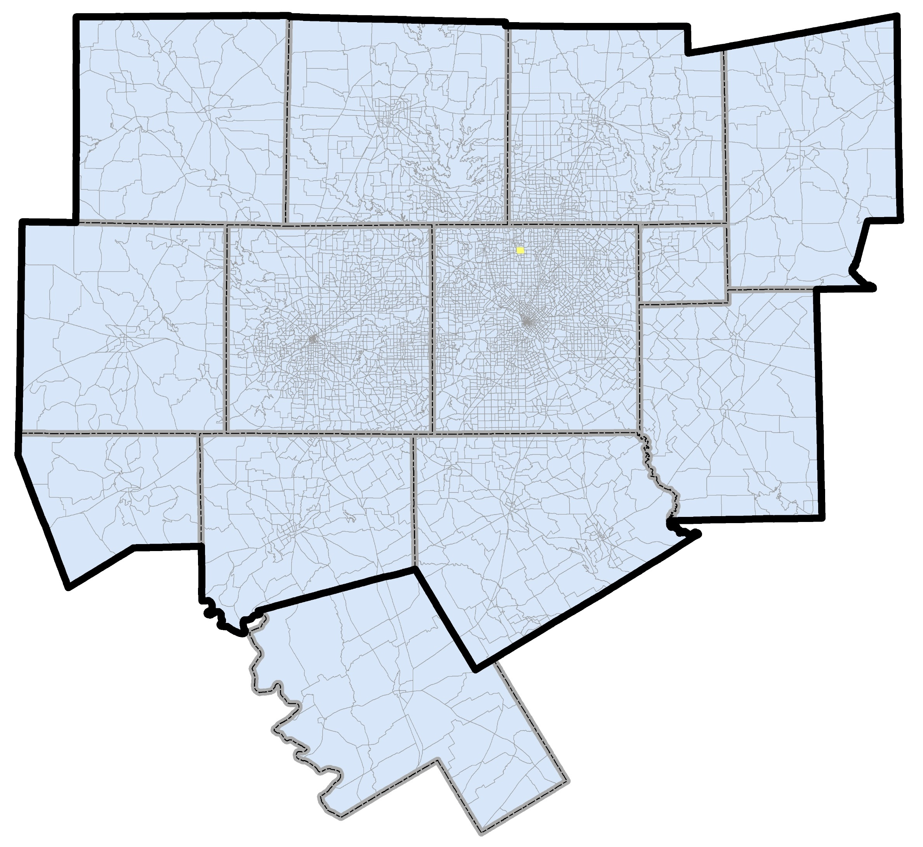
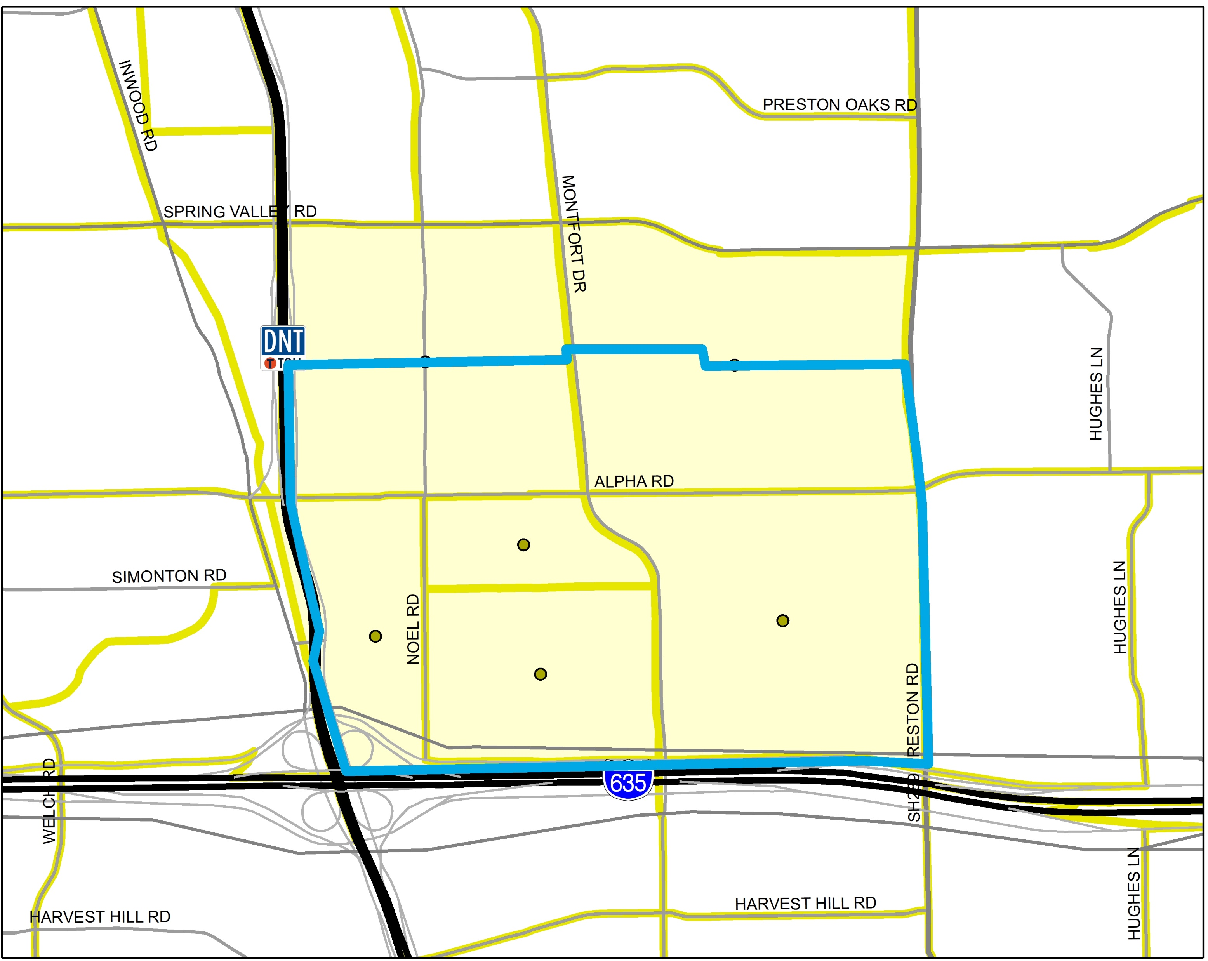
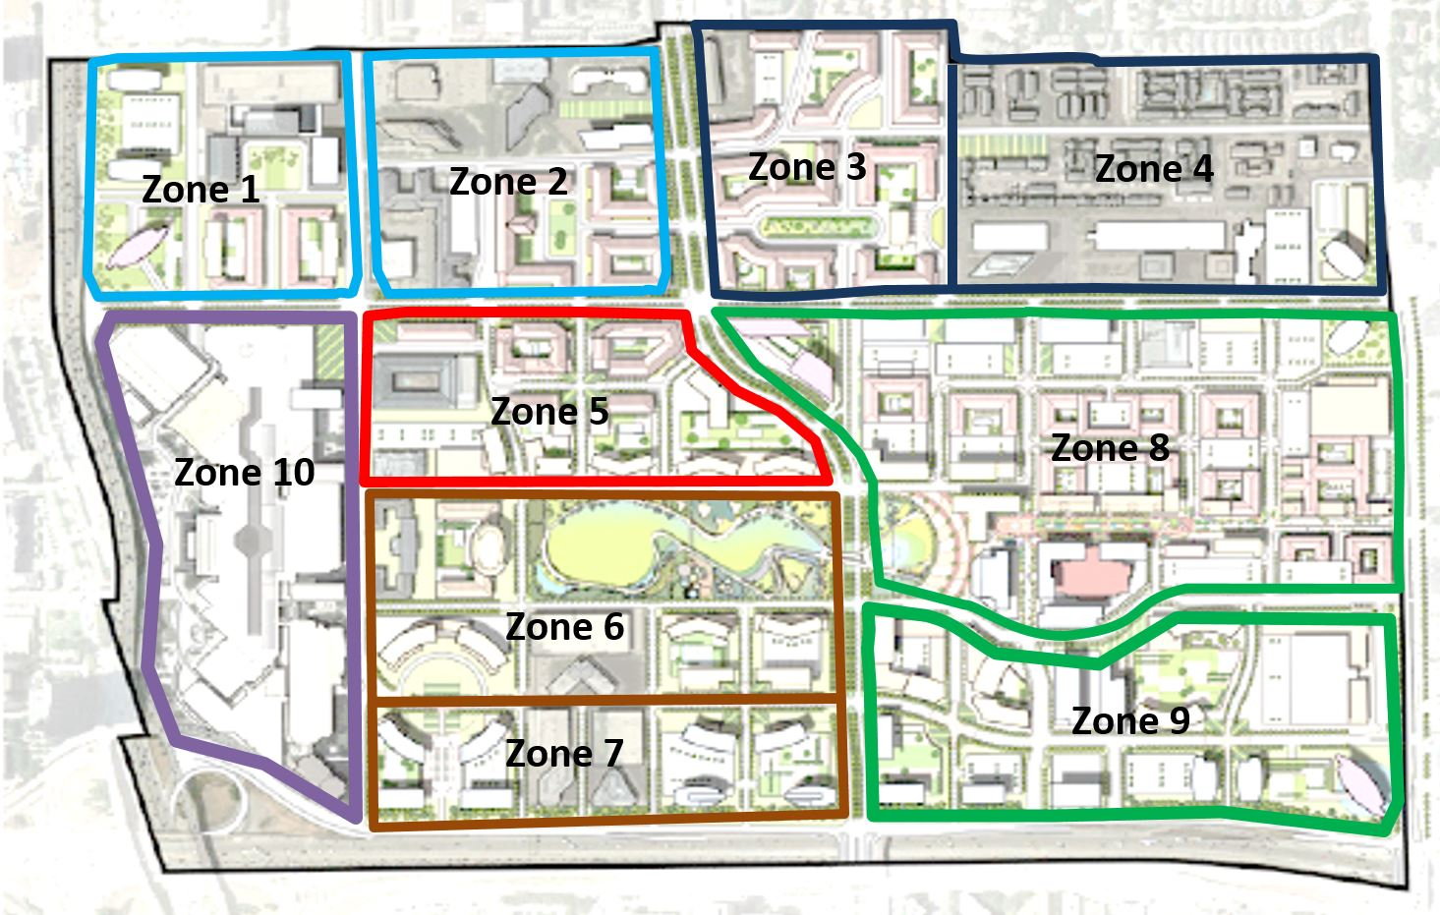
Issue 1: Regional Connectivity vs. Small-Area Resolution

Slide 4
Issue 2: Reuse and Adaptability

Slide 5
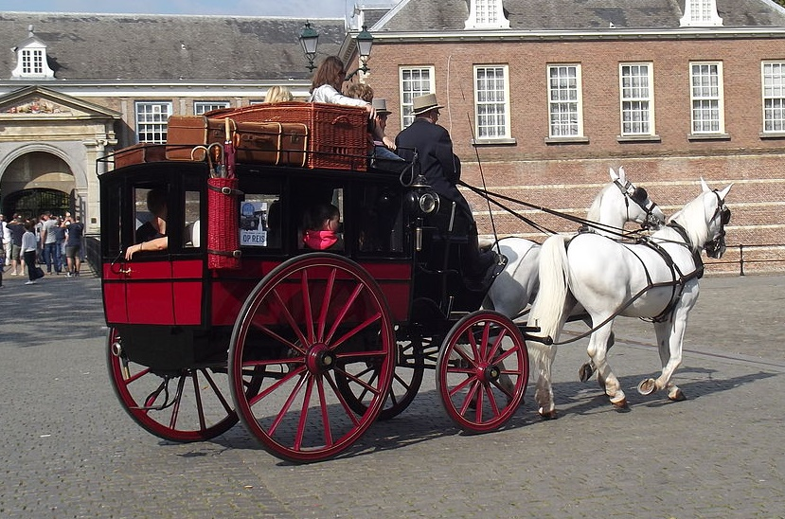
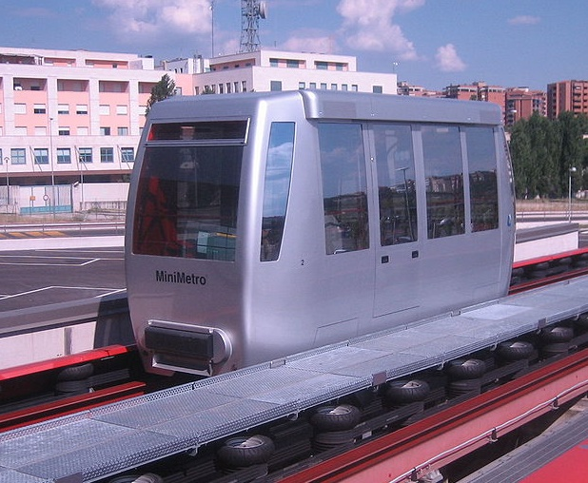
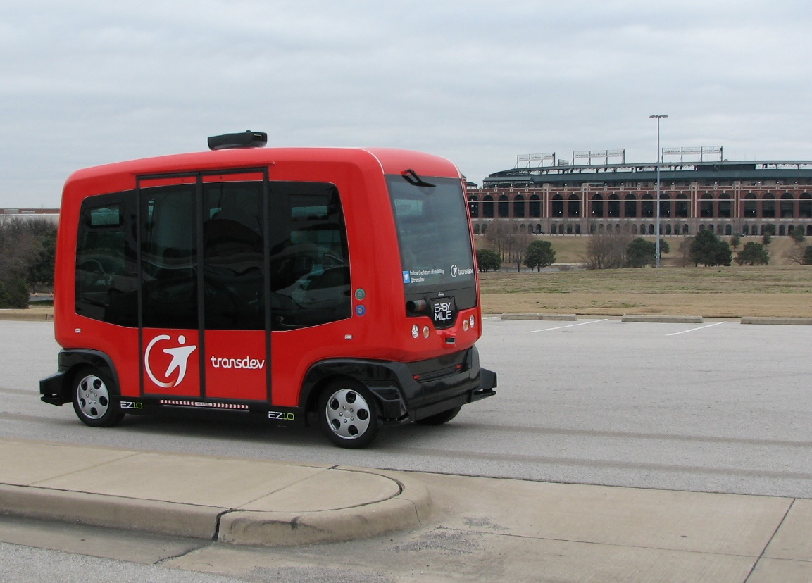
Issue 3: What is a “People Mover”?
Source: Smiley.toerist, via Wikipedia
Source: Pava, via Wikipedia
Source: NCTCOG

Slide 6
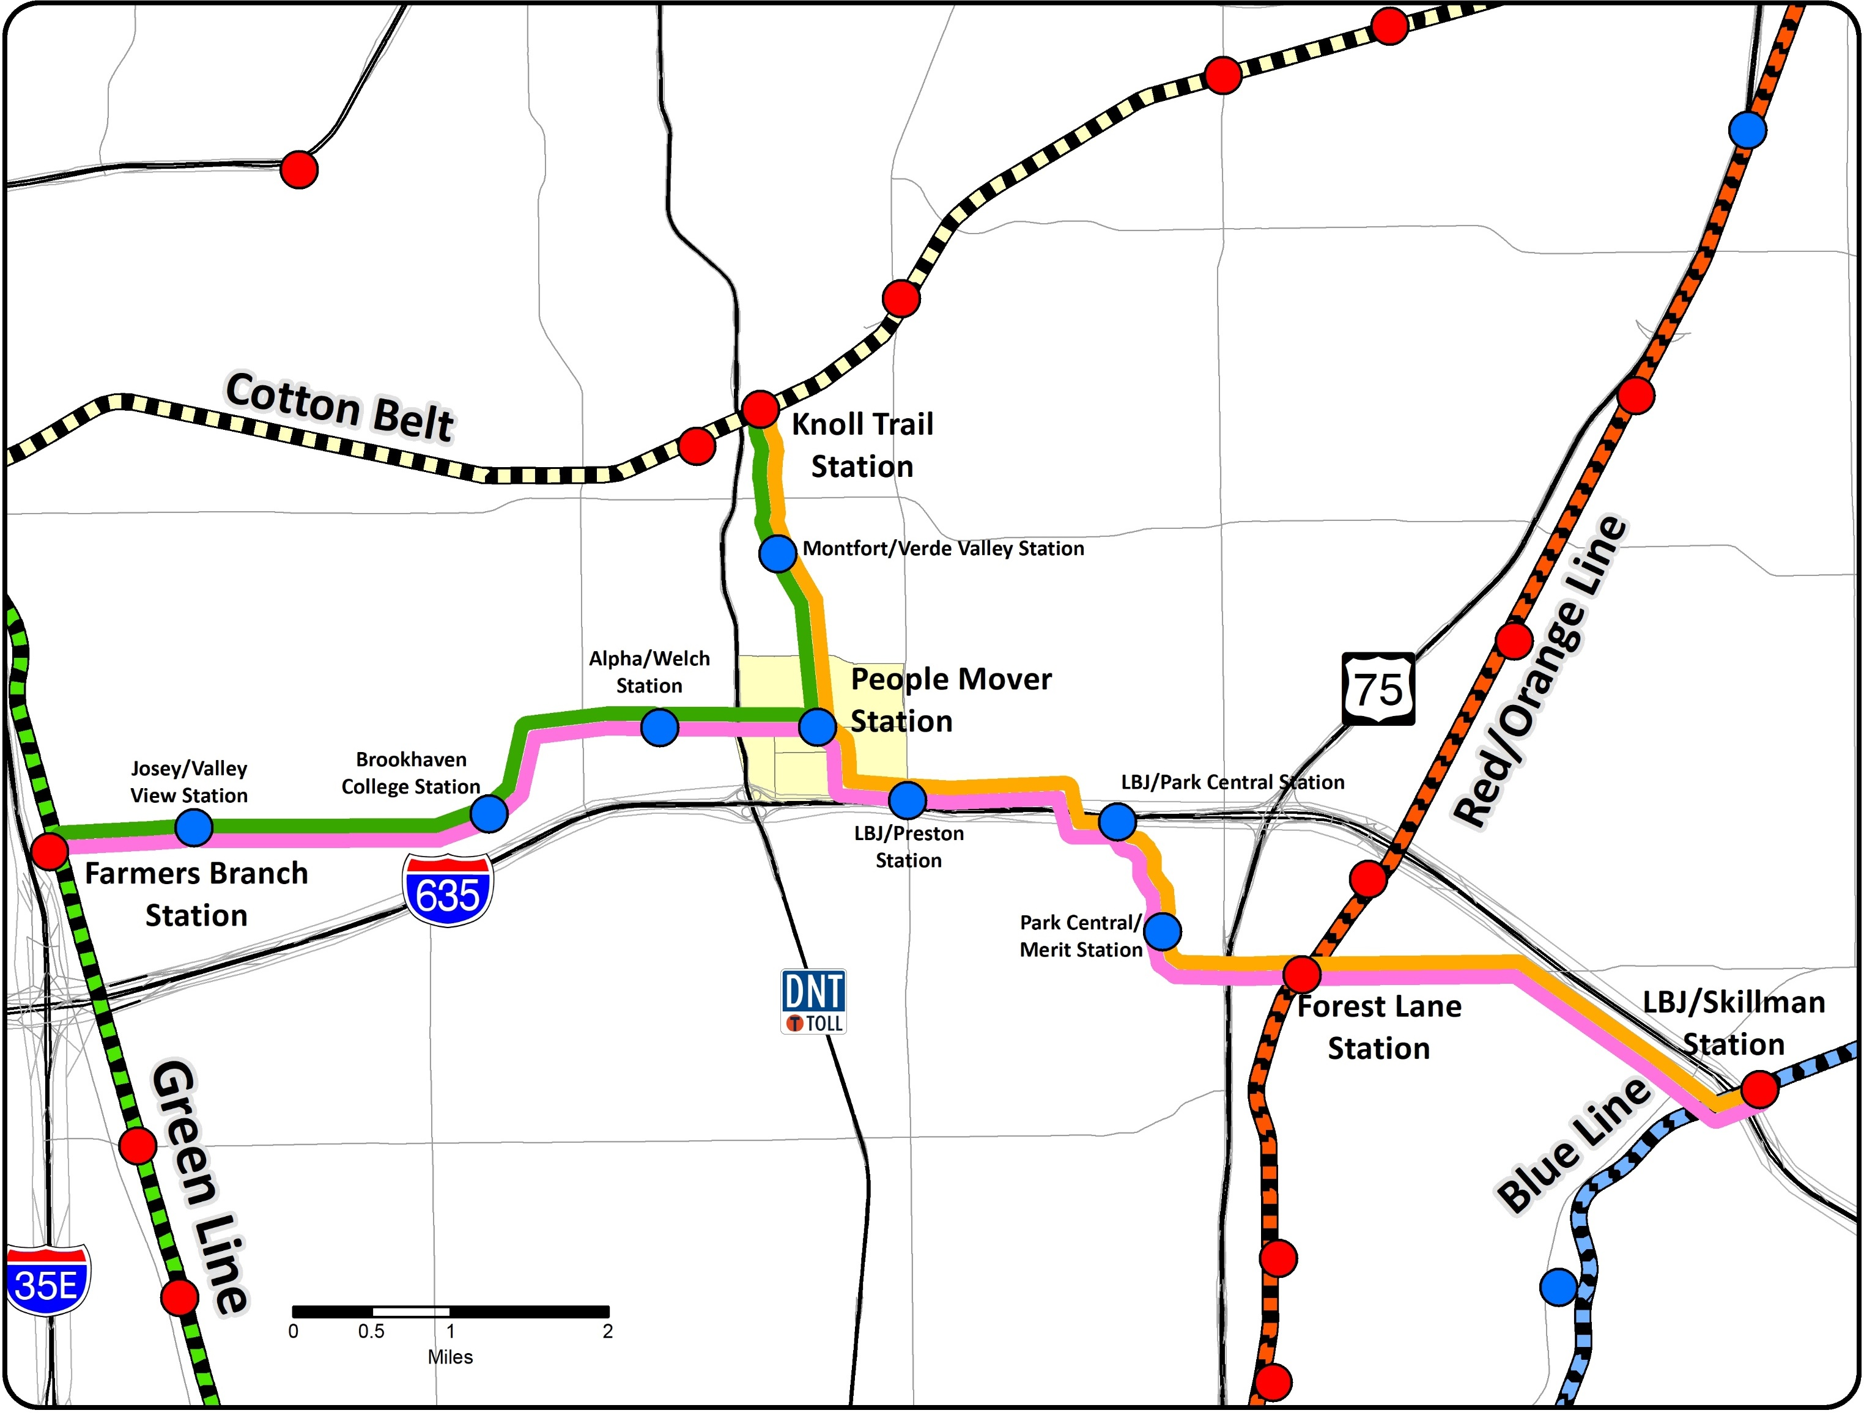
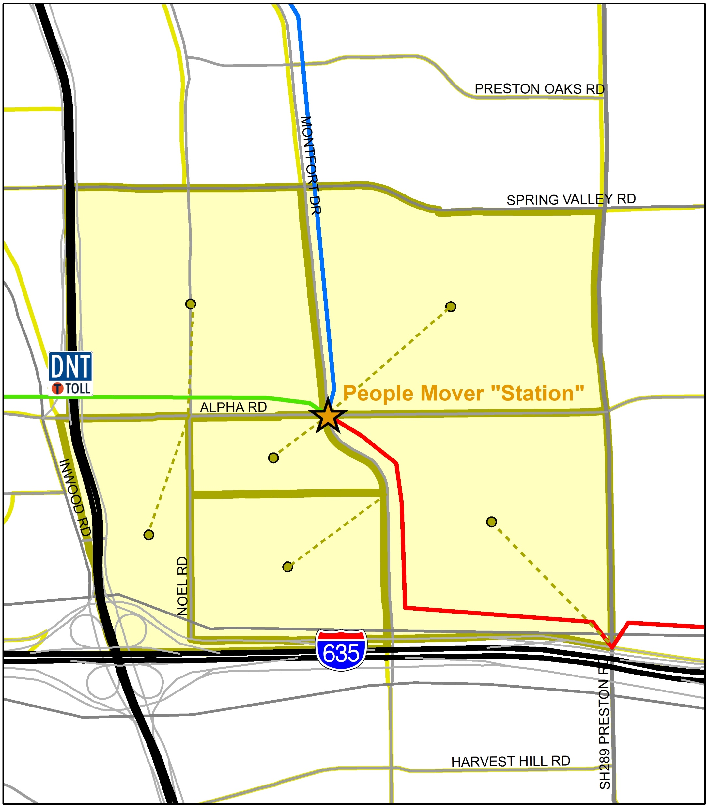
Two-Step Solution—Regional Movement

Slide 7
Two-Step Solution—Local Movement
ITE Trip
Generation Rates
ATS Network Coding
Inputs
ATS Ridership Estimation Tool
TransCAD
Land Uses
ATS Network Characteristics
Site Capture
Trip Generation
User Assumptions
ATS Trip Assignment
Trip Distribution
ATS Origins/ Destinations
Roadway Characteristics
ATS Network Characteristics
Mode Split
Link Ridership

Slide 8
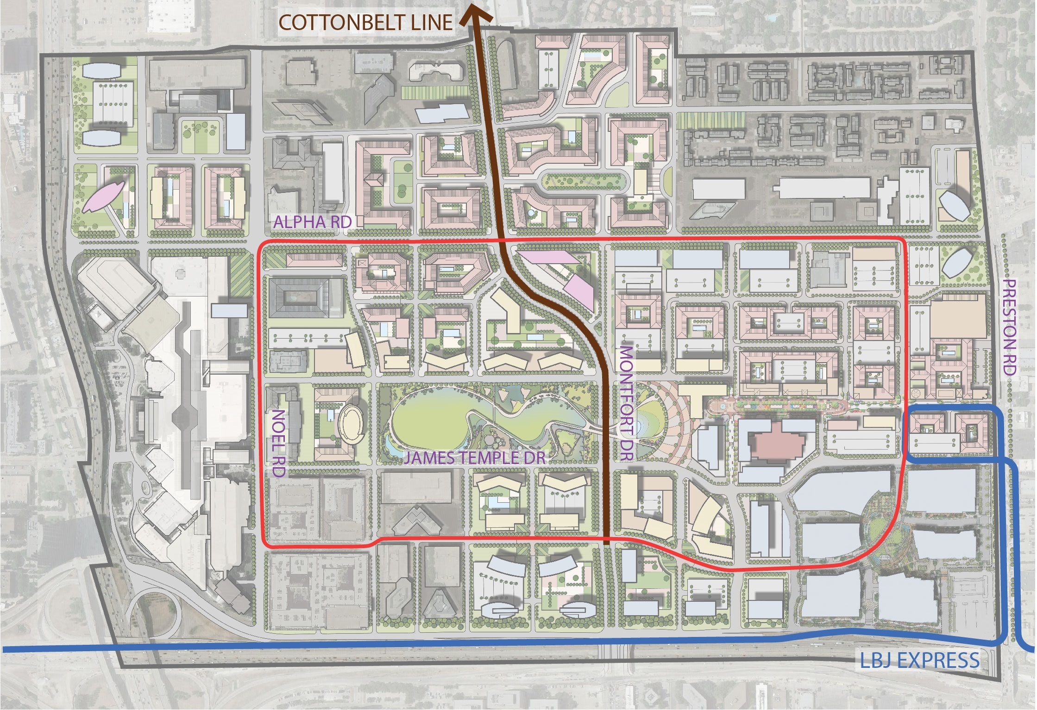
Outputs
Local
Link volumes on ATS, by period
Ridership at each ATS station
Regional
Link volumes on regional system
Ridership at stations
Ridership to/from local Automated Transit System
“Through” traffic
How to integrate?
To Cotton Belt CRT
To Green Line LRT
To Red/Blue Line LRT

Slide 9
Questions?
Donald Parker
Email: dparker@nctcog.org
Phone: 817-608-2380

