Slide 1


Hourly Volume Estimation
Methodology for Calculating
Annual Hours of
Peak Hour Excessive Delay
TRB AppCon 2019
June 4, 2019

Slide 2
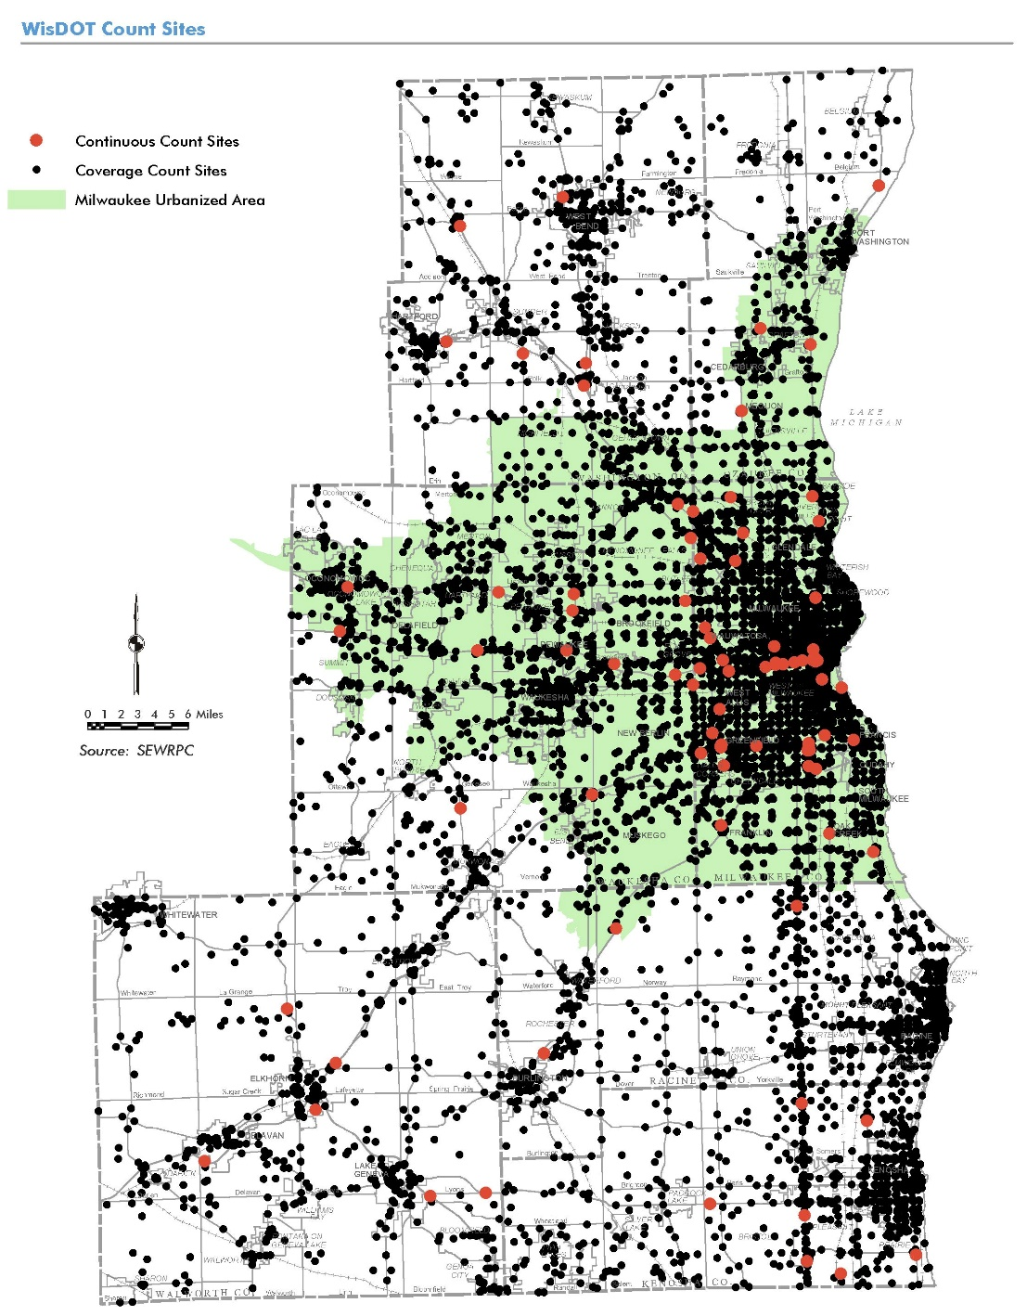
ODME

Slide 3
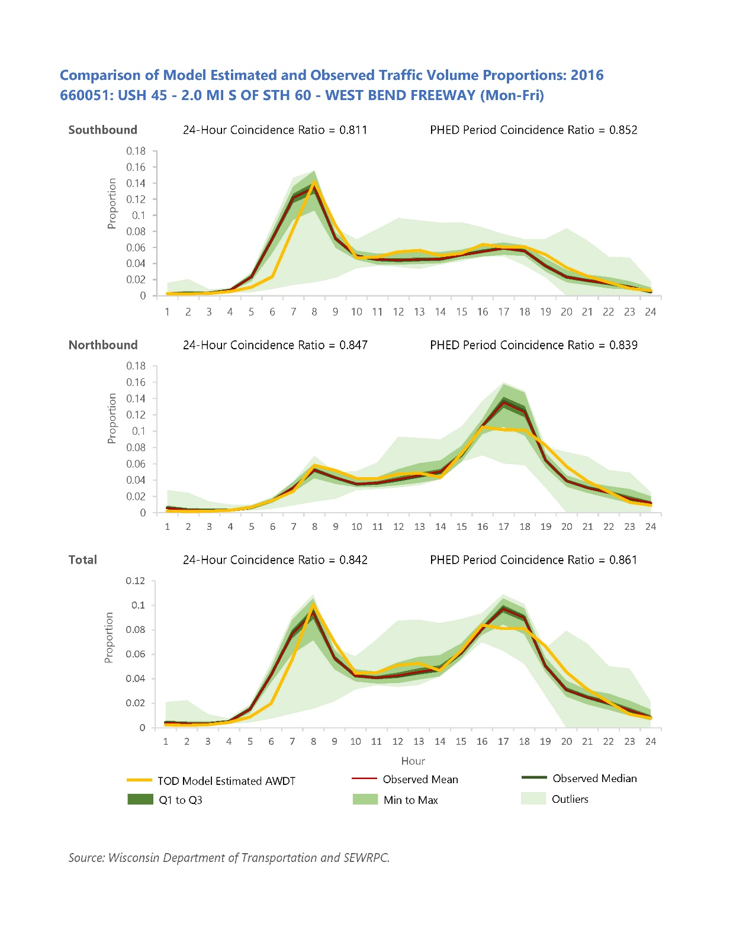
Estimate Hourly Distribution
ODME
Auto & Truck (LD, MD, HD) Trip Tables
Congested Travel Time
Disaggregate
Trip Tables
Schedule
Trip Start
Iterate
48 periods
E-E
Preload
Feedback Volumes and Congested Travel Times
I-I, I-E, E-I
Assignment
Final TOD
Assignment

Slide 4
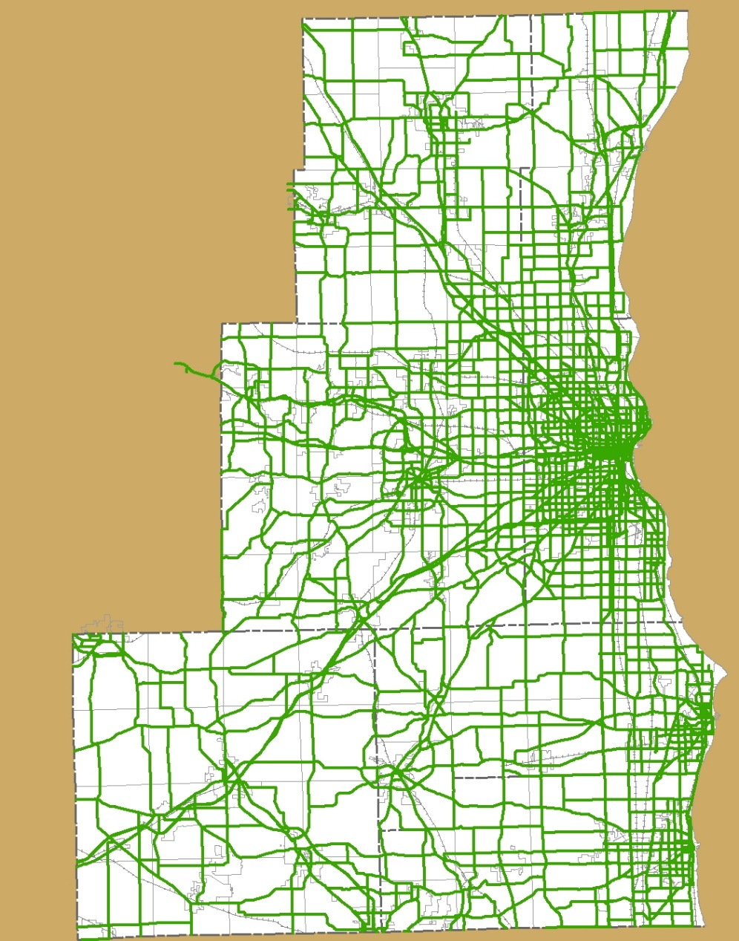
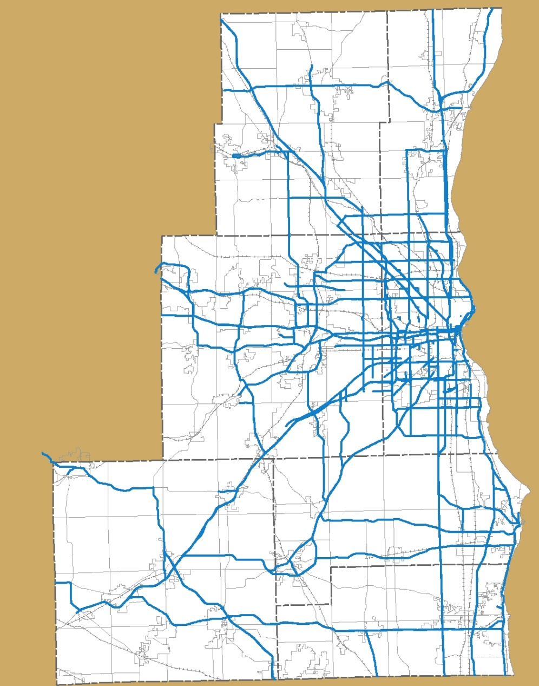
Joining Data
Model
NPMRDS
TMC_ID | TMC_AB_Prop | AB | AB_TMC_Prop
10001 | 1 | 1109305563 | 0.01
10002 | 1 | 556311091 | 1
10003 | 0.64 | 1036005560 | 1
10003 | 0.11 | 1036110360 | 1
10003 | 0.25 | 1108710361 | 1
10004 | 1 | 555905557 | 1
10005 | 0.27 | 563505555 | 0.79
10005 | 0.19 | 562505635 | 1
10005 | 0.51 | 555605625 | 1
10006 | 0.95 | 555411069 | 0.91
10007 | 1 | 555211040 | 0.74
10008 | 1 | 1104011039 | 1
10009 | 0.48 | 3080230823 | 1
10009 | 0.46 | 3211030802 | 0.89
10010 | 1 | 2518105351 | 0.8

Slide 5
Annual Seasonalization Factors
Notes:
Temporal Distribution of Trips by Vehicle Type by 30-minute period of Arrival.

Slide 6
Thank You
Christopher Hiebert, P.E. chiebert@sewrpc.org
SEWRPC.ORG
/sewrpc sewrpc.org @sew_rpc

