Slide 1
HCM CAV CAFs
Capacity Adjustment Factors for Connected and Autonomous Vehicles in the Highway Capacity Manual
June 2019
1

Slide 2
Introductions
Technical Advisory Committee (TAC)
Brian Dunn, Oregon DOT
Tony Knudson, Oregon DOT
Peter Calcaterra, Connecticut DOT
Grant Farnsworth, Utah DOT
Joe Hummer, NCDOT
Jessie Jones, Arkansas DOT
Jim Mahugh, Washington State DOT
Bill Knowles, TXDOT
Subrat Mahapatra, MDOT SHA
Maria Overton, Florida DOT
Brad Steckler, Indiana DOT
Research Team
Kittelson and Associates
Bastian Schroeder (PI)
Abby Morgan
Paul Ryus
Burak Cesme
Anxi Jia
Lake Trask
Alicia Hunter
University of Cincinnati
Jiaqi Ma
Notes:
This pooled fund study was initiated by the Oregon Department of Transportation in 2017.
There are 10 DOT’s involved in the study.
Kittelson and Associates and the University of Cincinatti are heading up the research effort.

Slide 3
Project Overview
Objectives:
Develop highway capacity adjustments for CAVs at different levels of volume and market penetration
Agent-Based Approach:
Vehicle and driver behavior will be fully customizable for simulation scenarios
Focused on CAVs (not CV or AV separately)
HCQS Committee Touch Points
Annual meetings January 2019/2020
Mid-year meetings 2019/2020
Notes:
We have all been getting a lot of questions about the affect that automated vehicles will have on the transportation system.
There are demand related questions and capacity related questions. This project is focused on the capacity related questions.
The objective is to develop a range of capacity adjustment factors that can be used in planning.
The analysis is using an Agent Based scenario simulation framework where CAV and non-CAV behavior are coded differently.
In this effort we are looking at vehicles that are both fully automated and connected.
The expected product from this effort is a set of capacity adjustment lookup tables and figures.
This effort is being coordinated with the HCQS committee that is responsible for the HCM.

Slide 4
What factors impact capacity?
Geometry
Vehicle Composition
Truck Percentage
Driver Behavior
Other Factors Impacting Capacity
Notes:
As you can see here, there are a lot of factors that affect the capacity impact of CAV’s.
The modeling approach allows us to look at many different factors where vehicles and driver behavior are fully customizable.
We are evaluating a lot of scenarios using a range of assumptions and facility types.

Slide 5
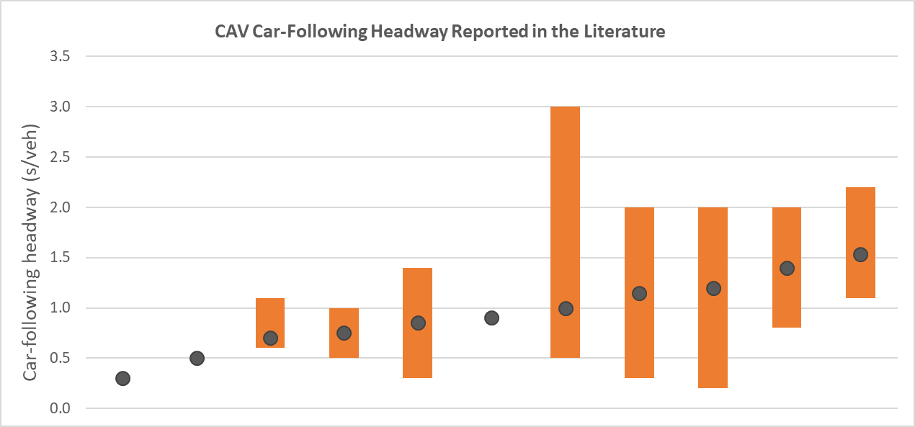
CAV Headways in the Literature
To date, most CAV research assumed a single-lane freeway “pipe” facility, without ramps!!
2,400 pc/h/ln
3,600 pc/h/ln
7,200 pc/h/ln
Notes:
We have all heard people say that automated vehicles will double, triple, maybe even quadruple capacity.
As we looked into the work that shows these increases, we found out most of them are not real world applications.
In this example you can see that according the HCM, an ideal freeway segment has a capacity of 2,400 PC/H/ln based on a 1.5 sec headway. You would have to get down to something like a 0.5 sec headway to triple the capacity. Note that headway is typically measured from front bumper to front bumper.
They also rely on some pretty unrealistic assumptions – such as no merge and diverge activity and a single lane freeway where no lane changing activity occurs.
In this project, we plan to evaluate a range of possible headways and associated capacities. That will allow an analyst to test a range of possible outcomes.

Slide 6
CAV Adoption Rates
Source: Litman, Todd, 2018. Autonomous Vehicle Implementation Predictions. https://www.vtpi.org/avip.pdf
Notes:
In addition to headway, vehicle adoption rates and fleet composistion will be a significant factor on capacity.
As you can see here, there are a range of possible CAV adoption rates. If you look at the year 2040 in the graph, you can see an optimistic sales projection of around ound 40%. However, they would only make up about 25% of the overall fleet.
Since we do not know exactly how CAV’s will be incorporated into the fleet, we intend to look at a range of scenarios that have varying CAV adoption rates.

Slide 7
Tiered Modeling Approach
Tier I (Spring 2019)
- Basic Freeway Segments
Tier II (Fall 2019)
Tier III (Spring 2020)
- Urban Street Segments
- Freeway Merge Bottlenecks
- Freeway Weaving Segments
- Roundabouts
- TWSC Intersections
- Two-Lane Highways
- Special Modeling*
* May include weather, work zone, and incident effects
- Freeway Managed Lanes
- Signalized Intersections
Notes:
We are using a tiered approach for this effort, looking at freeways followed by intersection and the urban streets and Two lane highways.
As you can see we have completed most of the freeway effort, those results will be reviewed by the Pooled Fund TAC and the HCQS later this month.

Slide 8
Early Sensitivity Tests of Parameters
Freeway Capacity in Vehicles per Hour per Lane (veh/h/ln) as a Function of Market Penetration Rate with VISSIM 11’s Pre-Defined “AV Cautious”, “AV Normal”, and “AV All-Knowing” Driving Behaviors
Notes:
We do not have the official freeway numbers at this point, but I wanted to share an example of what we hope to have for a final product.
We hope to have something that can easily be used to facilitate a conversation and analysis of CAV’s. For example, as shown here, we could have a range of possible capacities that vary based on assumptions that are being made.
In this example, we can see how the capacity varies for 3 CAV scenarios that could be tested at various penetration rates

Slide 9
Key Findings (To Date)
CAVs may increase freeway capacities by 30-40% at 100% penetration rate
Capacities will NOT double, much less triple!
100% Penetration of CAVs across the entire vehicle fleet will happen post 2070 (best case)
Devil is in the details – capacities are function of assumptions on vehicle technology, legislation, public acceptance, etc.
Notes:
Early findings suggest CAVs will probably not double or tripe capacity.
When we have full penetration of CAVs we could see a 30 to 40% increase
However, full penetration wont happen in the near future.
Finally, the devil is in the details ….
At the end of this project, we hope information that we develop will be useful for planning and policy conversations.

Slide 10
Questions and Discussion

