Slide 1

Pseudo Dynamic Traffic Assignment
Planning Applications Conference
June 4, 2019

Slide 2
Background
Commission had a tabular TOD model for freeways developed as part of the Freeway Reconstruction Study.
Initially implemented around 2011 as part of the Zoo interchange design work
  Significant Interchange >300,000 vehicles a day
Would allow for diversion modeling and forecasts by time-of-day
Based on tools and techniques already in use by others

Slide 3
Current Model Structure
AM
Trip
Distribution
Mode
Choice
Assignment
Congested Travel Time
Trip
Distribution
Mode
Choice
Assignment
Midday
Trip
Generation
Final
Assigned
Volumes
Congested Travel Time
Trip
Distribution
Mode
Choice
Assignment
PM
Congested Travel Time
Night
Trip
Distribution
Mode
Choice
Assignment
Congested Travel Time
TOD
Assignment
Congested Travel Time & Trips
(AM, MD, PM, NT)

Slide 4
TOD DTA Structure
Four-Step
Model
Auto & Truck (LD, MD, HD) Trip Tables
(AM, Midday, PM, Night)
Congested Travel Time
(AM, Midday, PM, Night)
Generalized Arrival Time
Distribution
Disaggregate
Trip Tables
Schedule
Trip Start
Iterate
48 periods
E-E
Preload
Feedback Volumes and Congested Travel Times
I-I, I-E, E-I
Assignment
Final TOD
Assignment

Slide 5
Scheduler: Desired Arrival Time (Regional)
Notes:
Temporal Distribution of Trips by Vehicle Type by 30-minute period of Arrival.

Slide 6
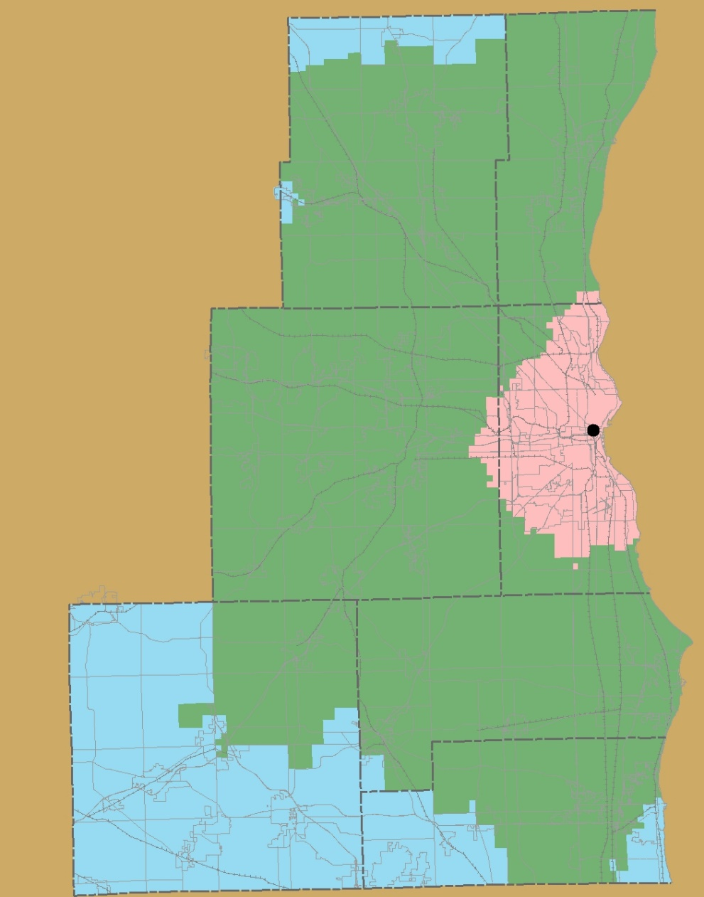
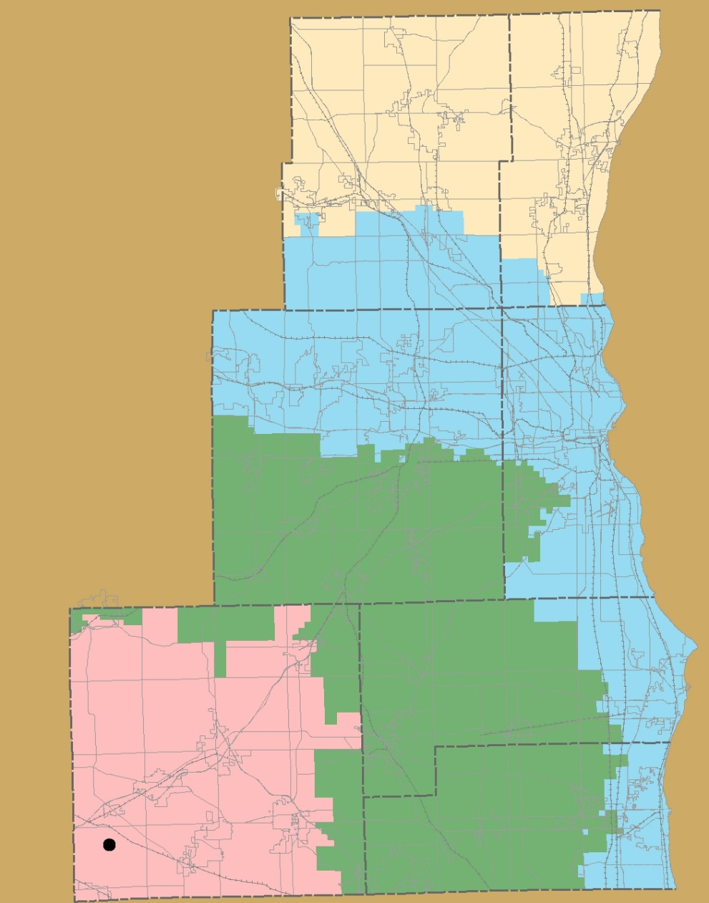
Scheduler: Localized Start Time
P_{n-3}
P_{n-2}
P_{n}
P_{n-1}
P_{n-1}
P_{n}
P_{n-2}
AM=P₁₃₋₁₈, MD=P₁₉₋₂₉, PM=P₃₀₋₃₆, NT=P_{1-12, 37-48}
Notes:
If the resulting period is a negative number. Those trips get moved to the end of the day.

Slide 7
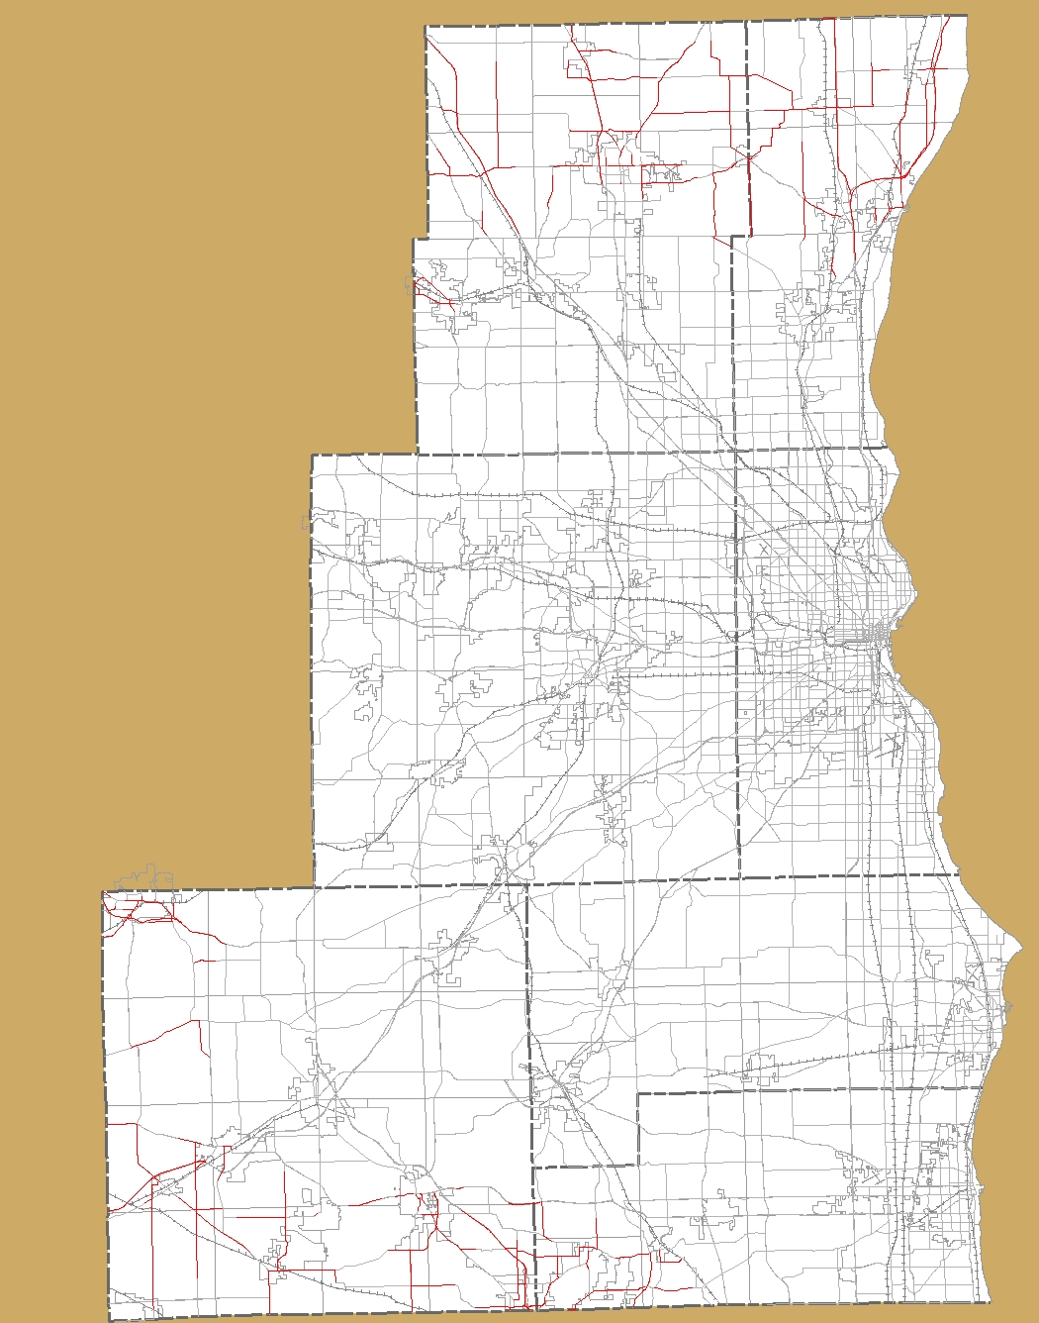
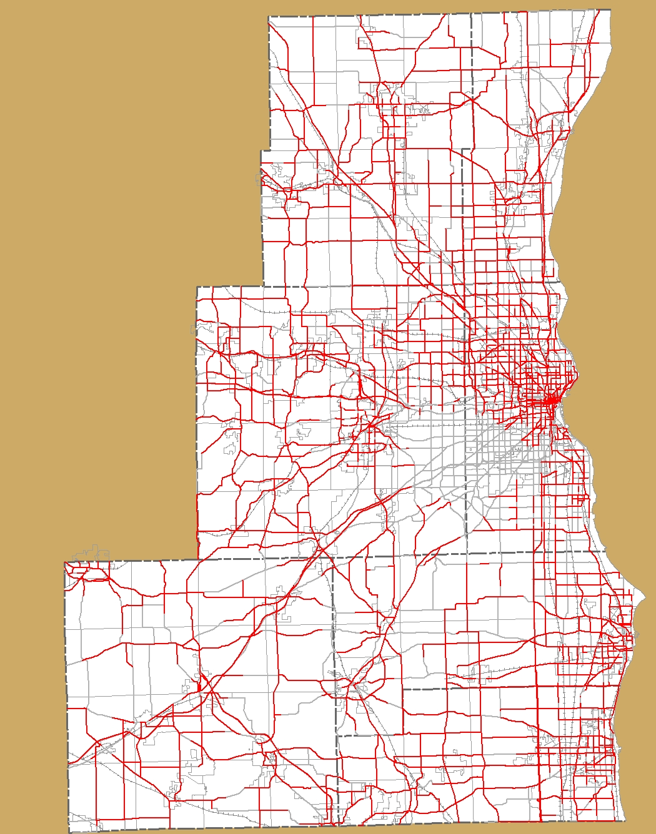
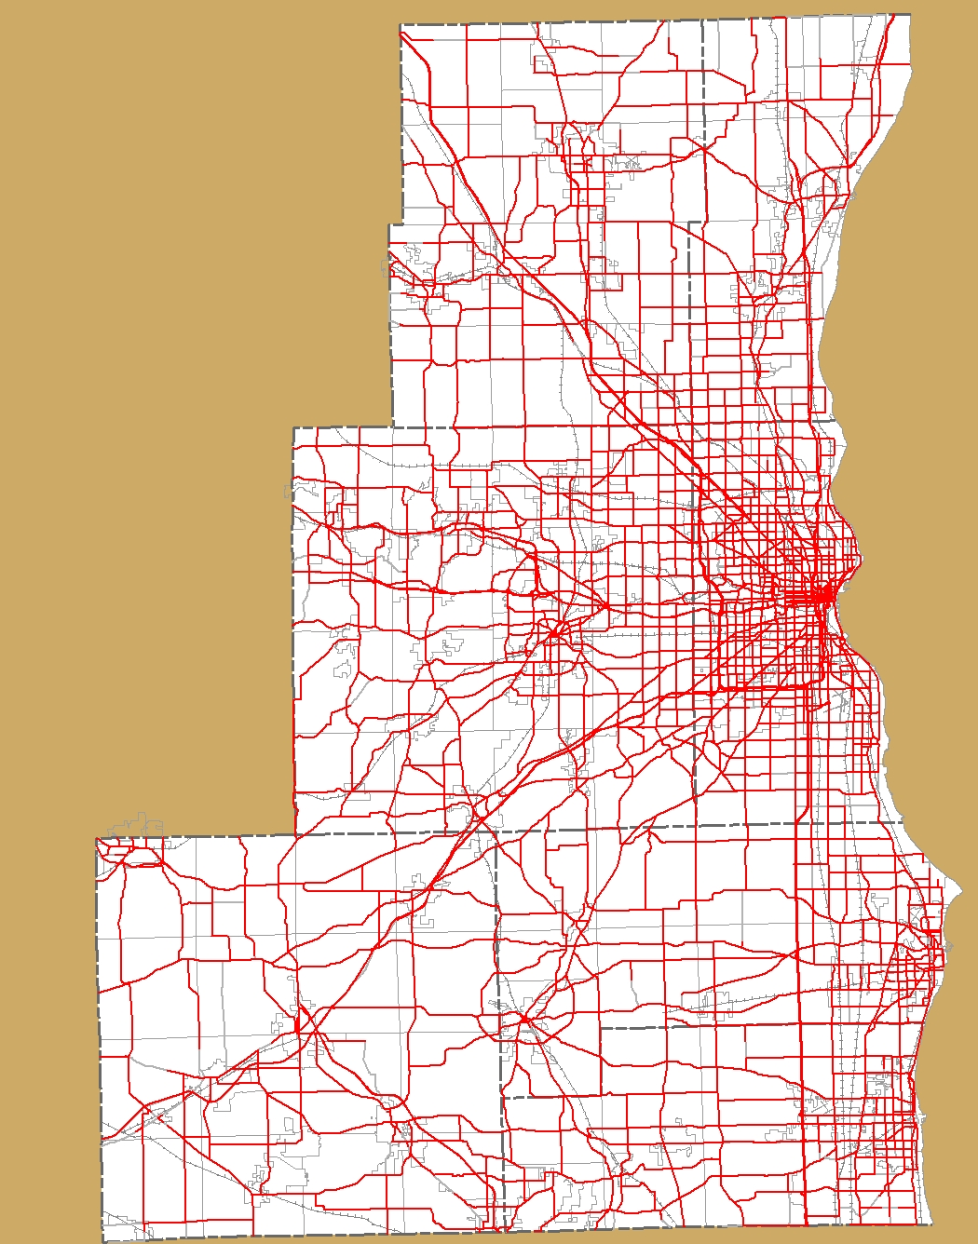
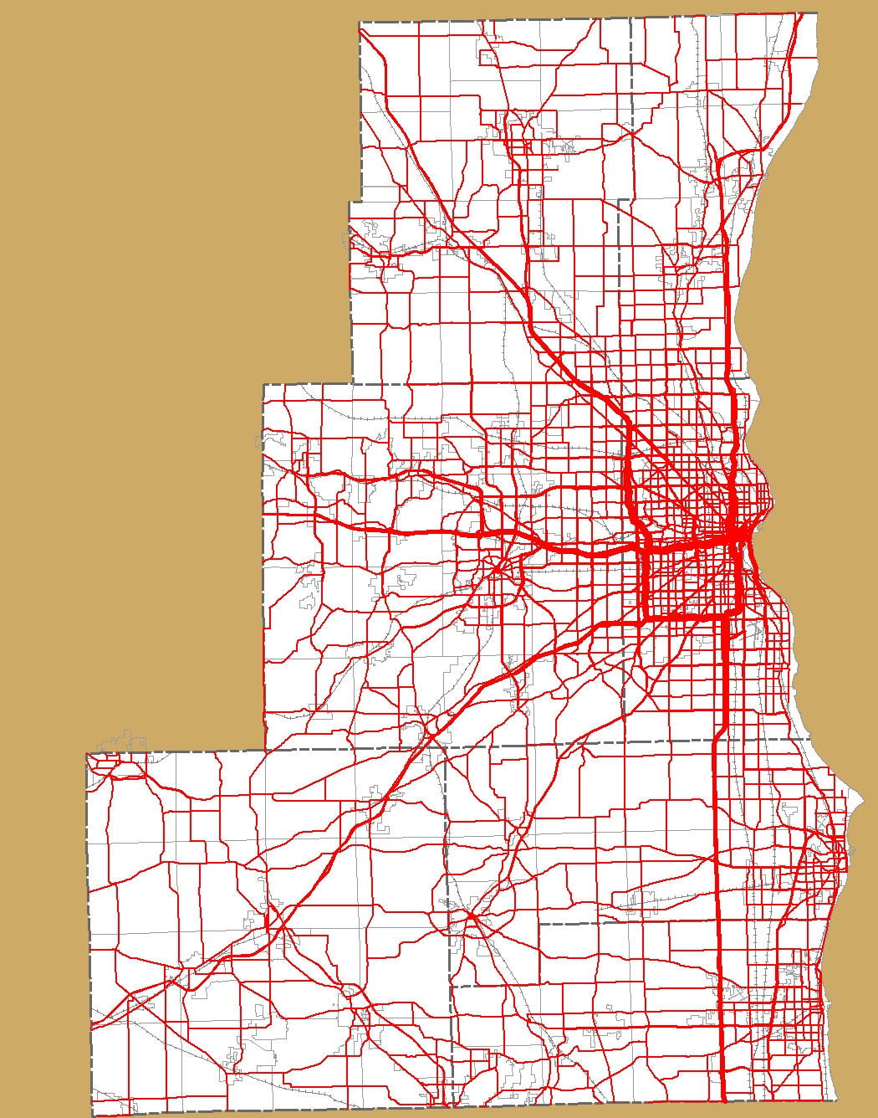
Path Building
D_{1-n}
Vol_{>90}
Vol₆₀₋₉₀
Vol₃₀₋₆₀
Vol₀₋₃₀
O_{1-n}

Slide 8
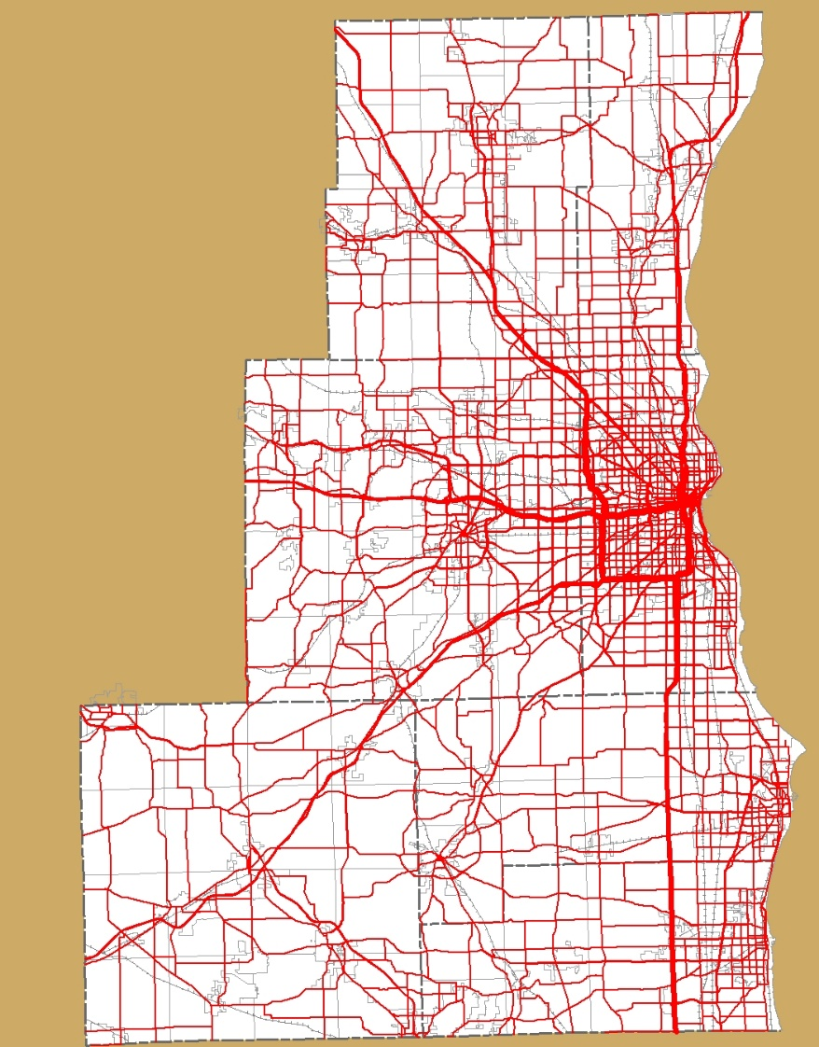
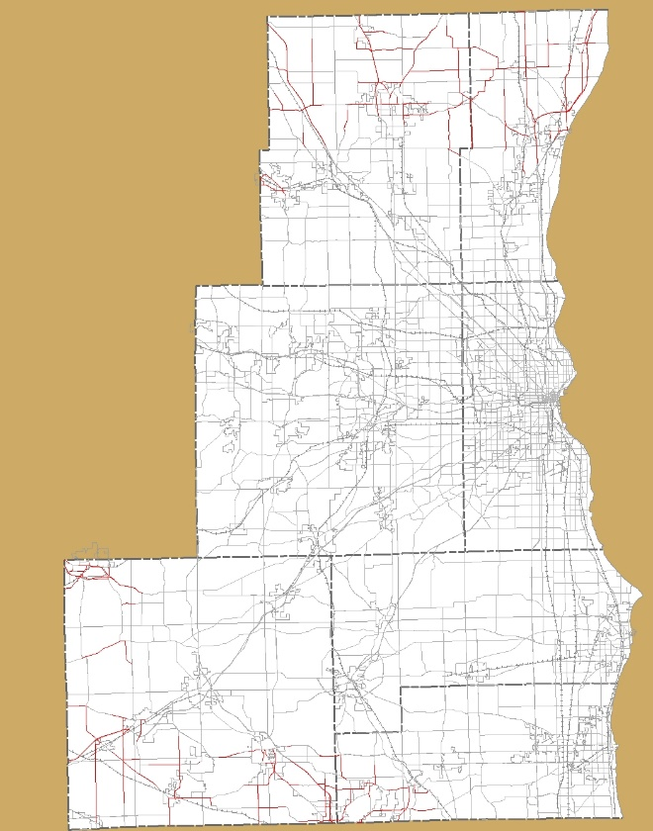
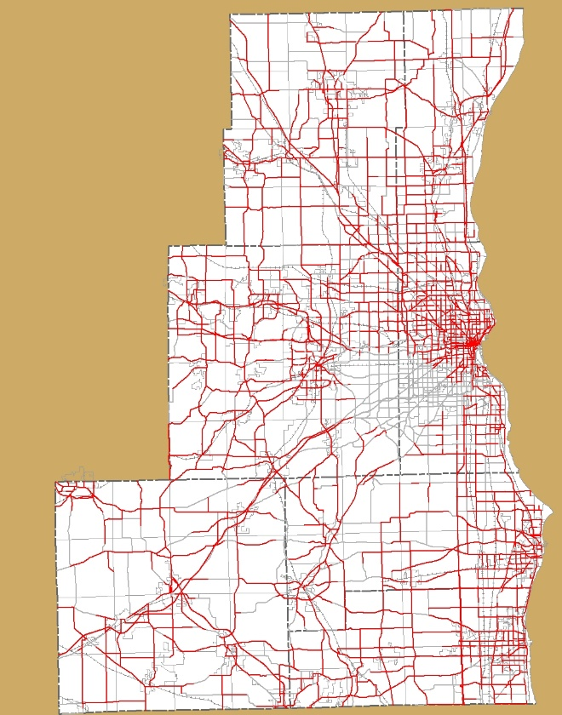
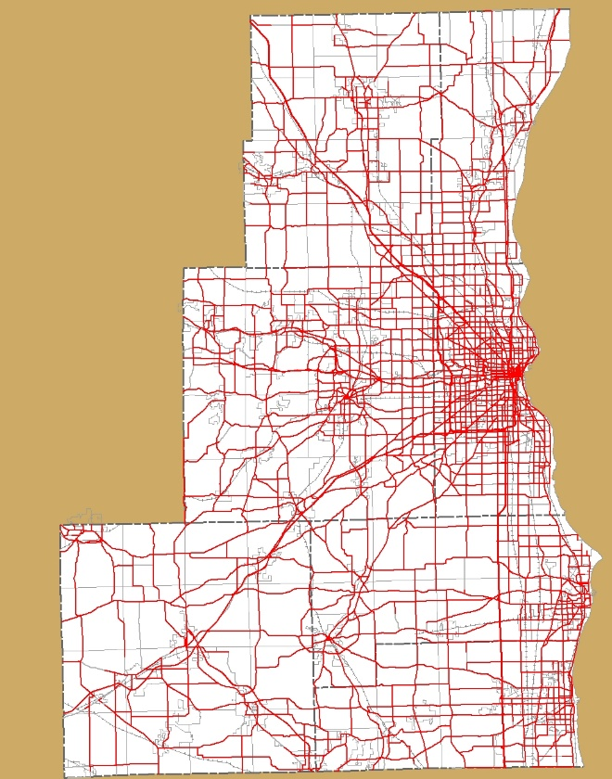

Layering of Travel
=
+
+
+
Vol_{n} = Vol_{n0-30} + Vol_{(n-1)30-60}+ Vol_{(n-2)60-90}+ Vol_{(n-3)>90}

Slide 9
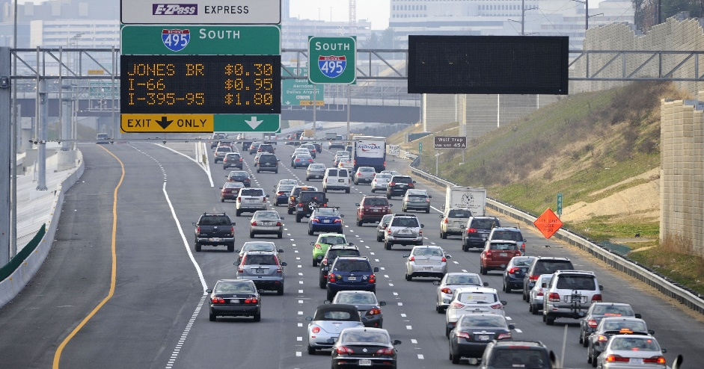
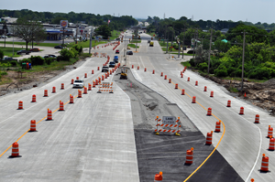
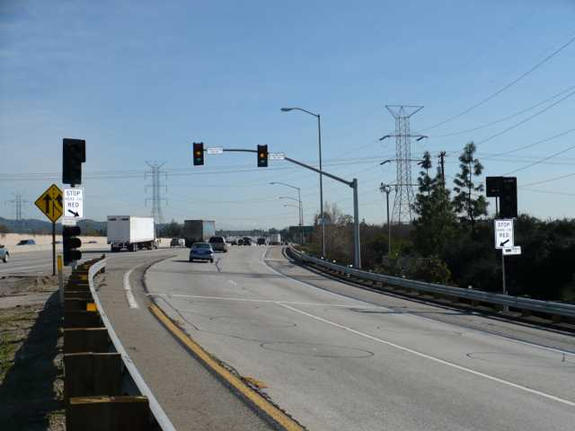
Temporal Variability in Capacity
Capacity_{avail} = Capacity_{n} – (Queue_{n-1})
Construction Capacity_{n} can be varied by period
Capacity_{n} varied to account for ramp metering
Notes:
Queue or “over-assignment” treated as a shadow.
Queue recalculated after each iteration

Slide 10
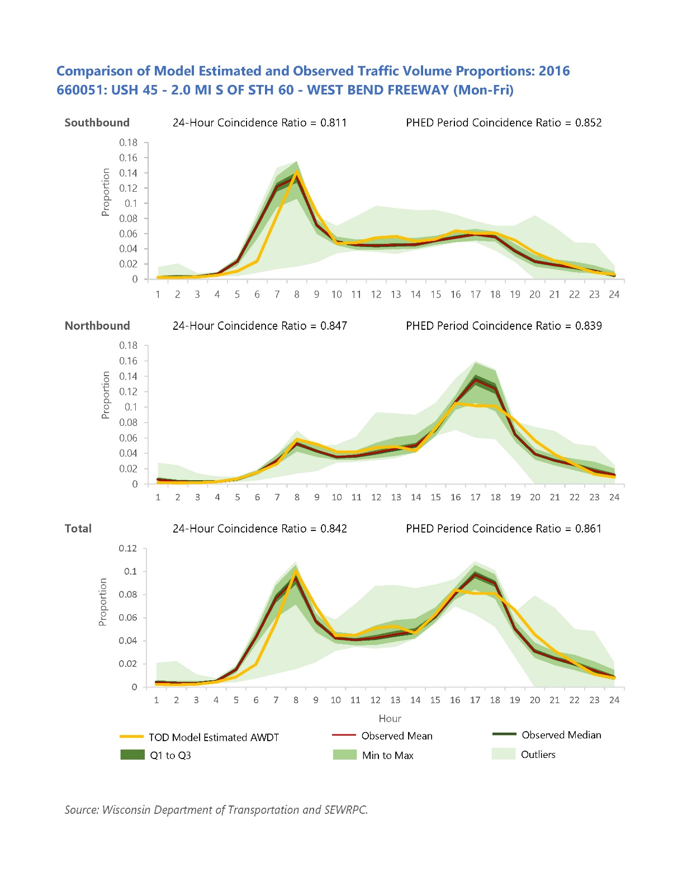

Validation
24-Hour
Model vs
Count
Model Error
vs Target

Slide 11
Applications
Period Modeling
Operational Modeling
PHED
Variable Lane Closures by Time of Day

Slide 12
Thank You
Christopher Hiebert, P.E. chiebert@sewrpc.org
SEWRPC.ORG
/sewrpc sewrpc.org @sew_rpc

