Slide 1
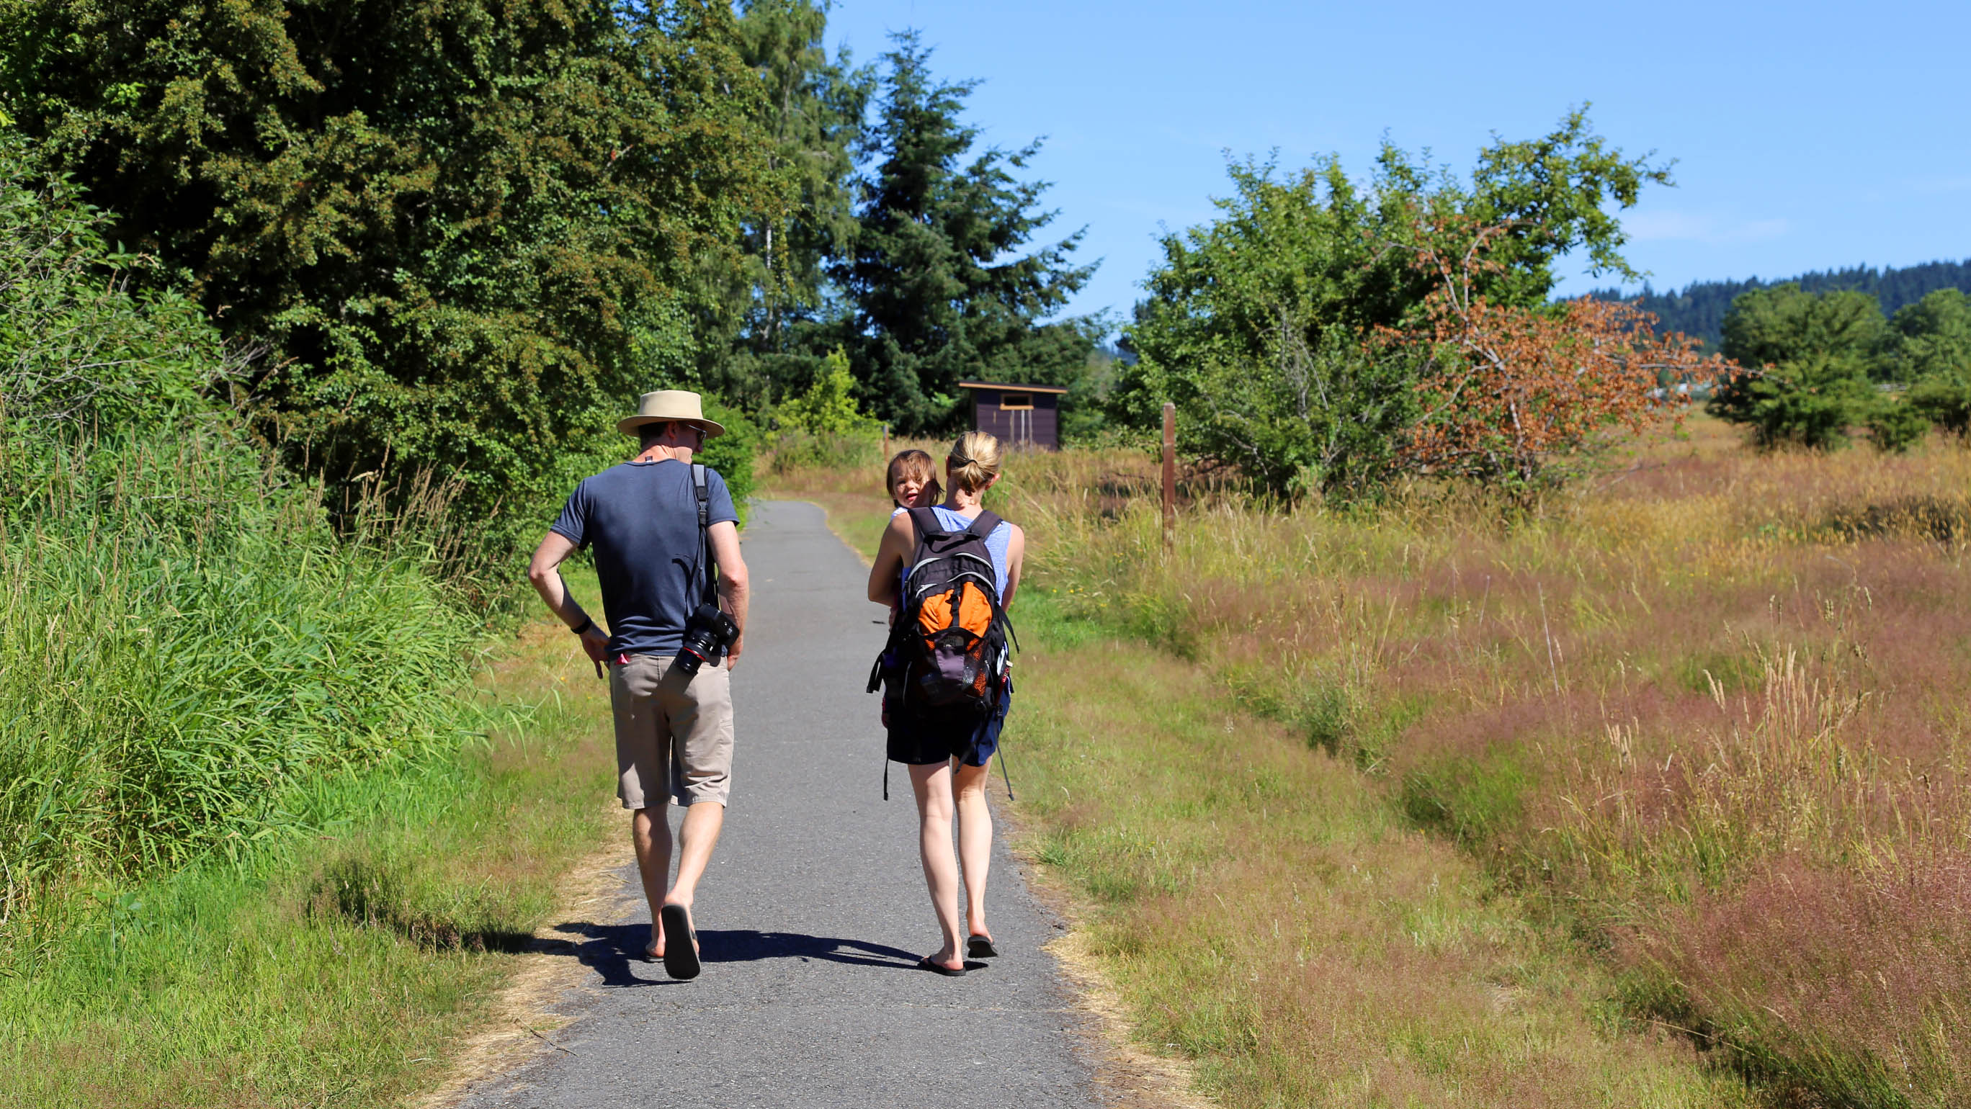
Towards human-scale transport metrics
Transportation Planning Applications Suzanne Childress, Principal Data Scientist
Puget Sound Regional Council
June 5, 2019

Slide 2
The volume of data to create the first image of a black hole was four petabytes.

Slide 3
Human-scale

Slide 4
From the 2010 Regional Transportation Plan
“As illustrated in Figure 13, as a result of the plan’s projects and actions, the region’s households and businesses would realize over $6 billion in annual travel time savings in the year 2040.”
Notes:
Too much abstraction, too many assumptions. Avoidance of translation steps such as converting time into money, “Despite their importance in public discourse, numbers in the range of 1 million to 1 trillion are notoriously difficult to understand.”
https://onlinelibrary.wiley.com/doi/full/10.1111/cogs.12028

Slide 5
Other typical metrics
Vehicle Miles Traveled by Facility Type
Daily Shared Ride Auto Mode Share
Vehicle Hours of Delay by Time of Day
Notes:
Jargon ridden. inaccessible

Slide 6
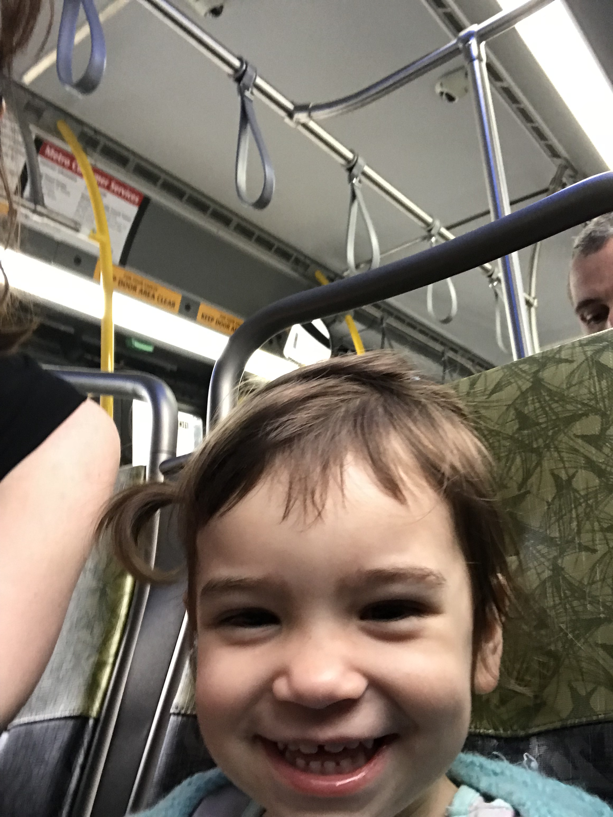
Traffic engineering metrics are about optimizing the system.
New planning metrics are about describing people’s experiences.
Notes:
Easier from an abm, but can be done with other models.

Slide 7
Household Out-of-Pocket Travel Costs
How much do households pay in travel costs each year (gas, fees, tolls, parking, fares)?
Notes:
Ensuring the timescale makes the measure meaningful, such as daily or annually
Use of simple bar charts where appropriate, use animations carefully

Slide 8
How much time do people spend sitting in traffic annually?
Notes:
Avoiding jargon

Slide 9
What percent of people close to frequent transit service?

Slide 10
Percent of People Walking and Biking
Today
2040
Notes:
Aggregation of geographic metrics to home locations as opposed to trip ends, about where people live. Maps also help understanding

Slide 11
Percent of People Walking and Biking-
Describing Equity Groups
Notes:
Analysis of how low-income people are impacted differently

Slide 12
Handy Principles for Better Metrics
1. Keep it simple :
- Relatable to regular life
- No indices or translation steps
- A few metrics instead of everything possible
2. About people:
- Consider planning populations of interest
- Aggregate to home locations instead of trip ends
Notes:
Selection of a few measures that tell a story, instead of every possible measure
Use of measures that correlate with human happiness and health such as short commutes
Avoidance of indices or measures that have several interlocking layers and weights
Aggregation of geographic metrics to home locations as opposed to trip ends
Ensuring the timescale makes the measure meaningful, such as daily or annually
Analysis of how low-income people are impacted differently
Avoidance of translation steps such as converting time into money
Use of simple bar charts where appropriate, as opposed to complex animations

Slide 13
How do we best combine the metrics about the individual human experience with societal benefits and costs?

Slide 14
thank you
Suzanne Childress
Schildress@psrc.org

