Slide 1
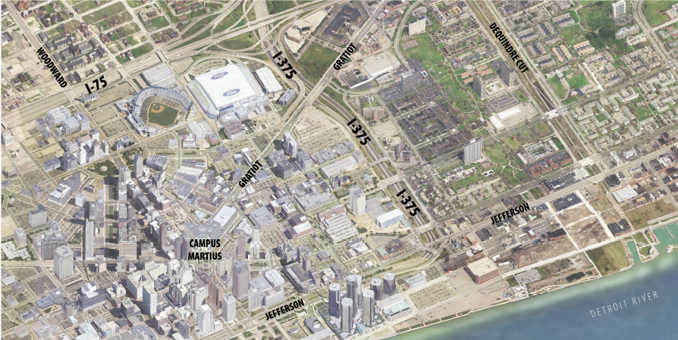
I-375 Improvement Project
The conversion of a Freeway to a surface street

Slide 2
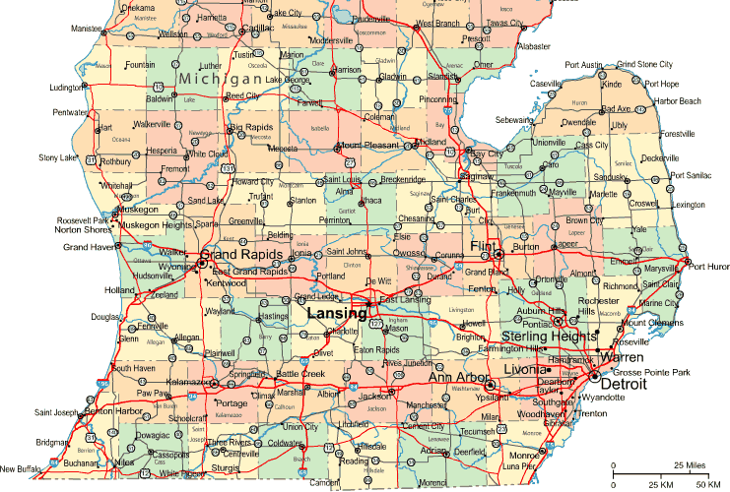
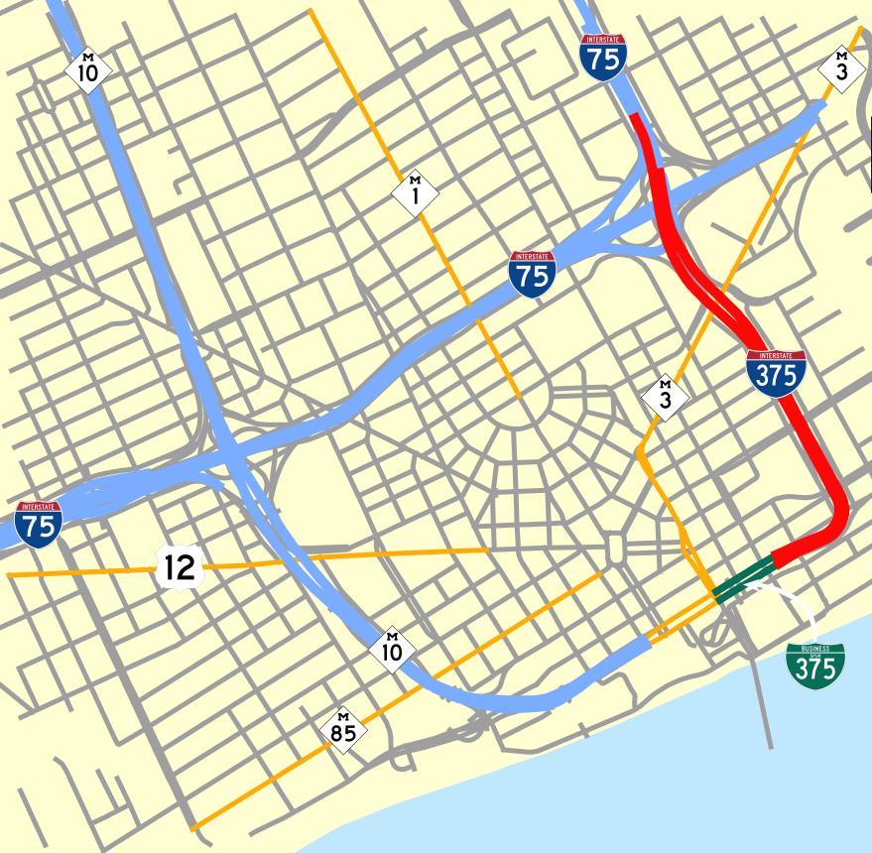
Project Location and Partners

Slide 3
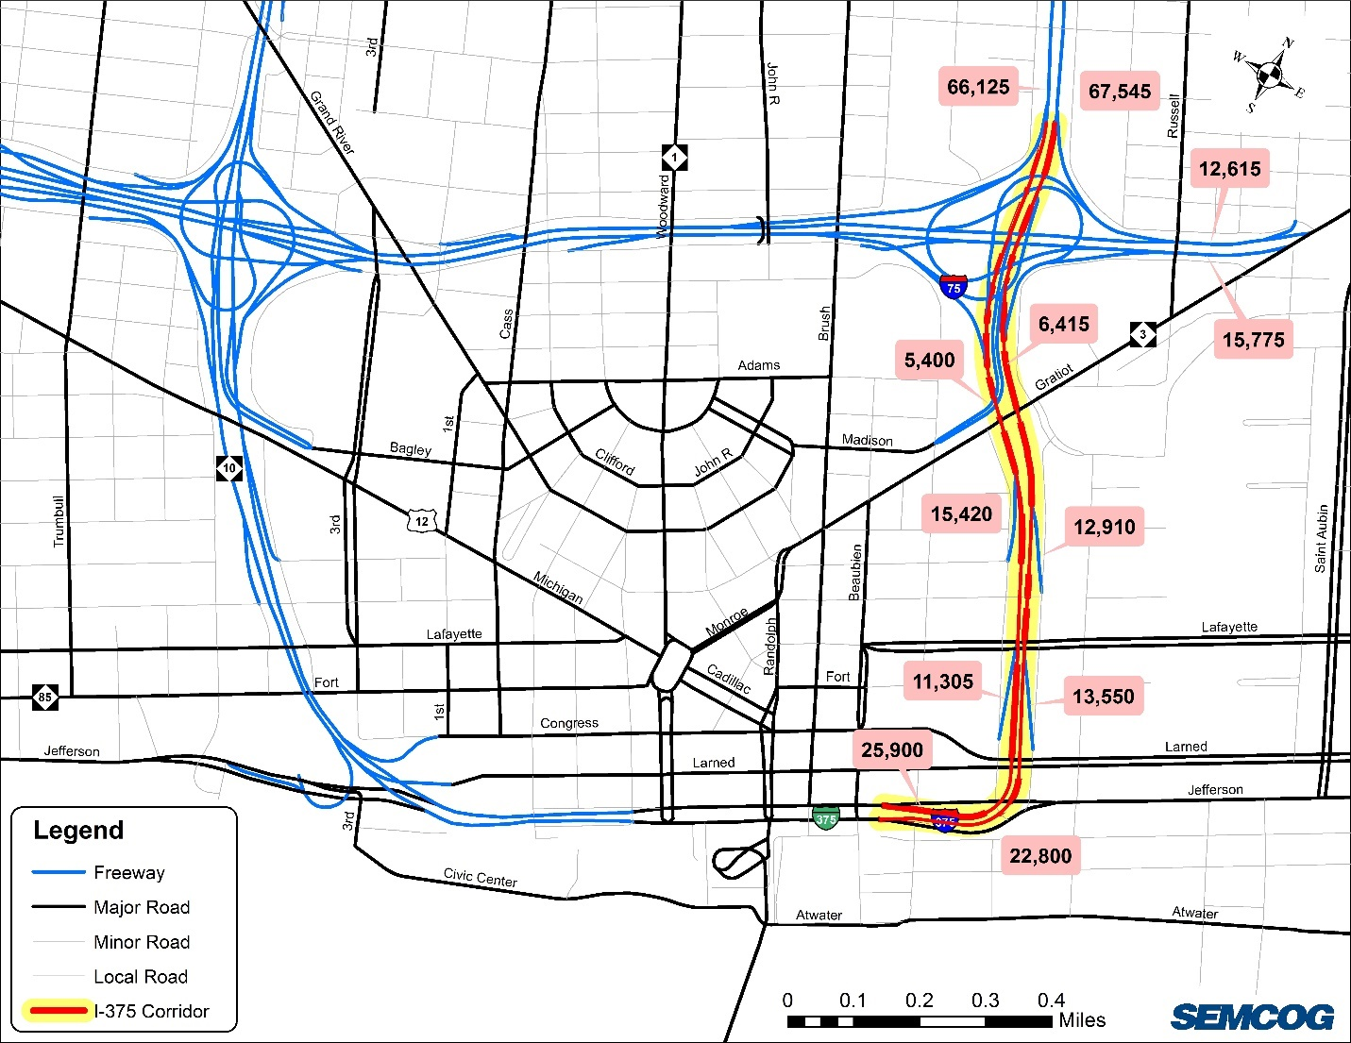
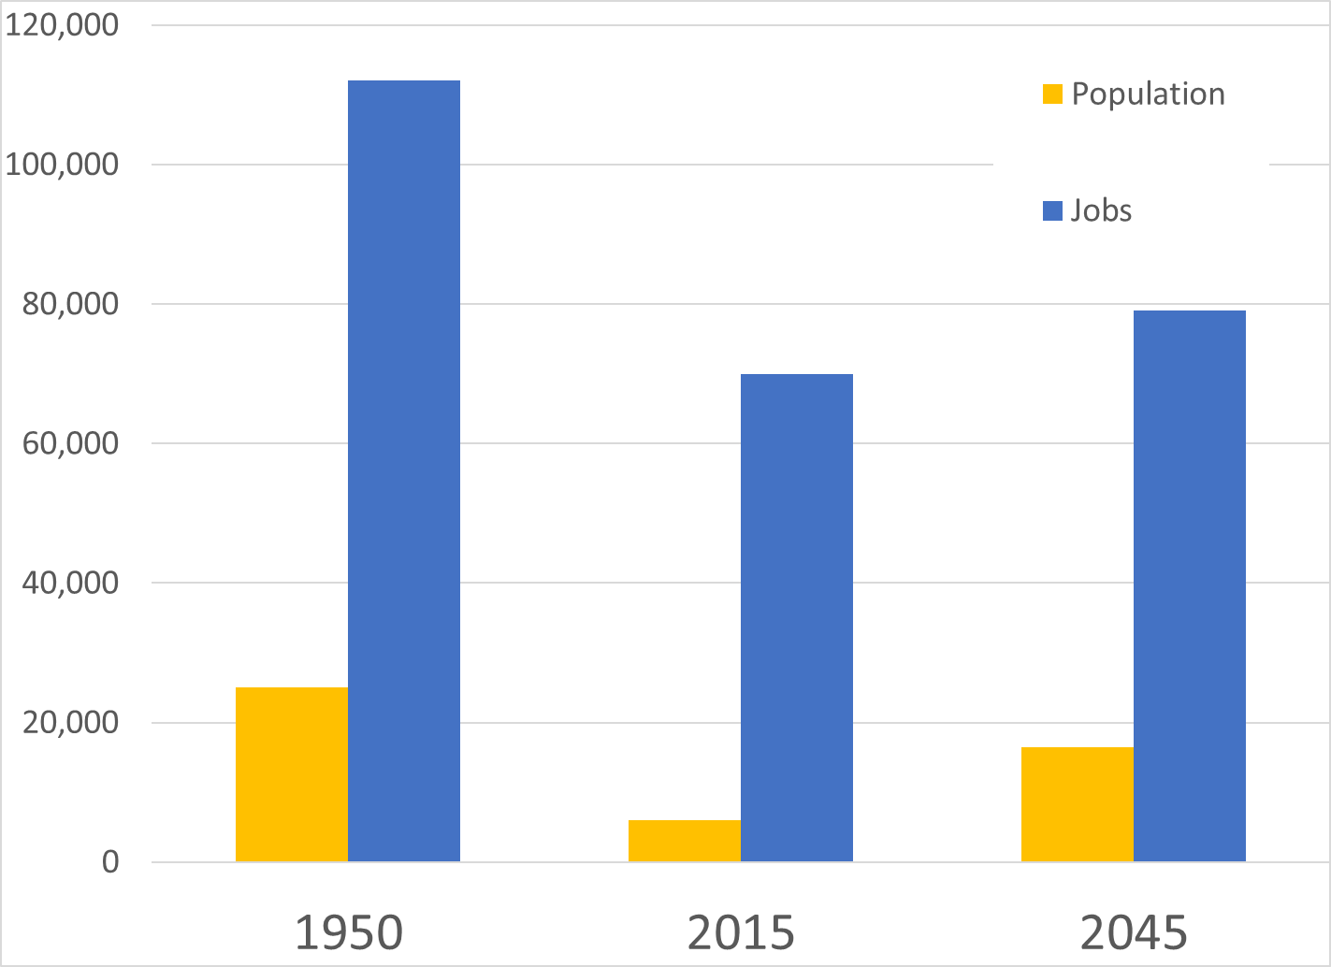
I-375 History
Built between 1959 and 1964
Originally cost $50M to build (~$300M today)
Approximately 1.1 miles in length

Slide 4
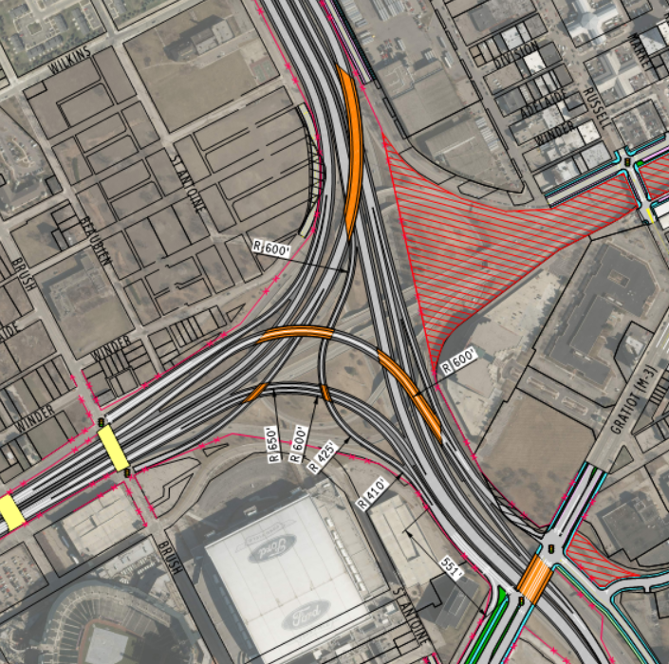
Existing and Proposed Interchange Configuration

Slide 5
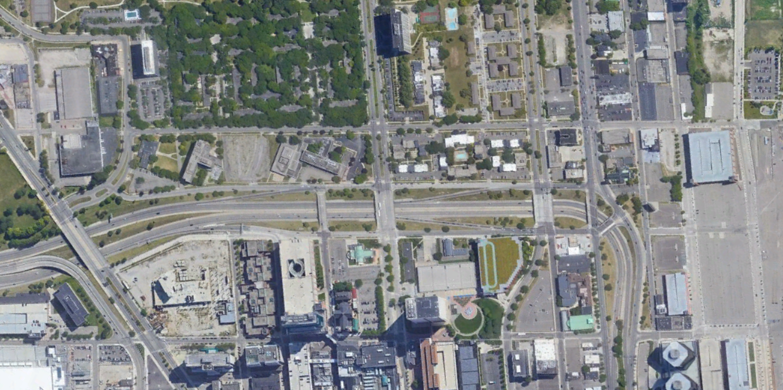
Existing I-375 Configuration
Two partial interchanges
One-way frontage roads
Low-speed curve is a safety concern.
Depressed Freeway

Slide 6
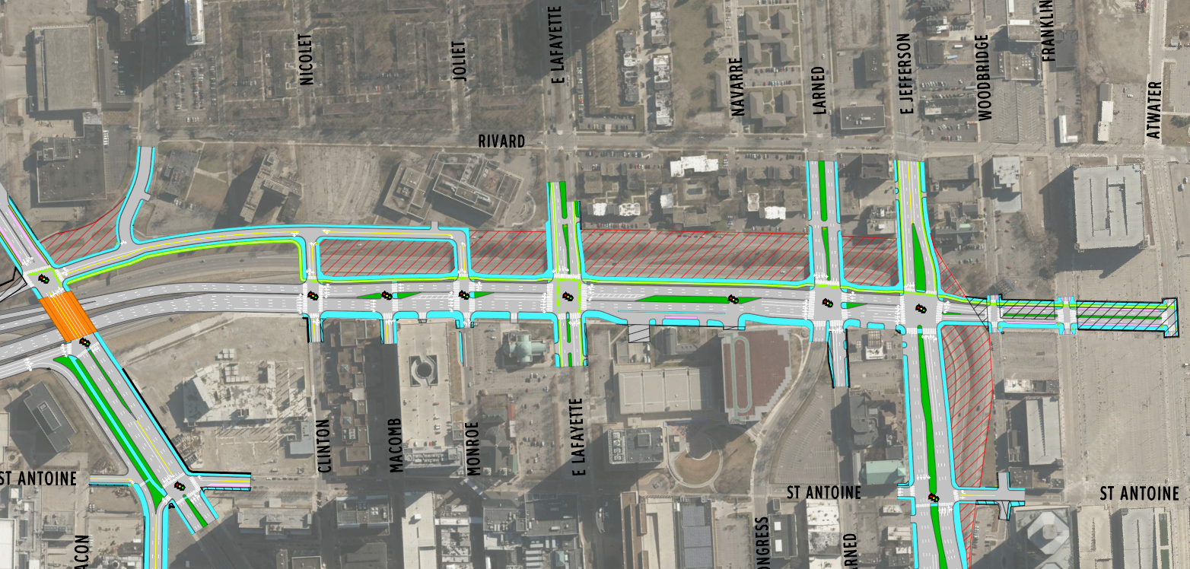
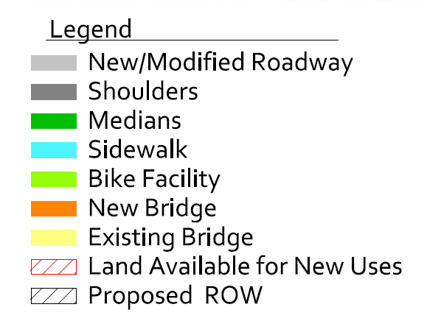
Proposed I-375 Configuration
Proposed two-way bicycle facility between Gratiot Avenue and the Riverfront.
10-ft sidewalks proposed along the new local road.
375
25-ft sidewalks proposed along the Boulevard.
Boulevard is at-grade and reconnects the City street grid.
Existing Lafayette bike lanes connected across the Boulevard to downtown.

Slide 7
Traditional Analysis Process

Slide 8
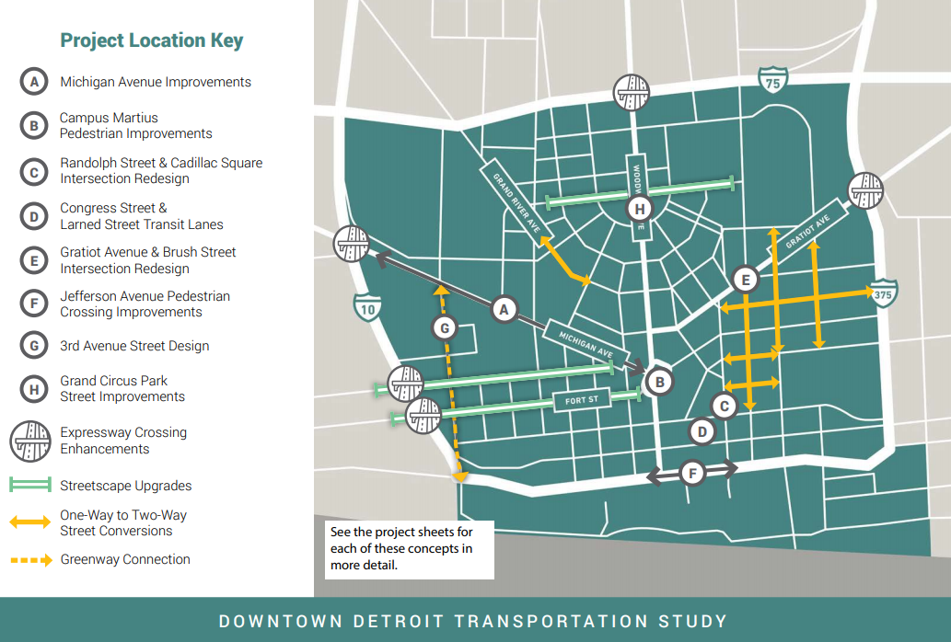
Challenges
Traditional forecasting method doesn't consider enough design factors
Need to consider other factors, such as pedestrian needs/demand
Need to consider viable parallel routes if the I-375 corridor handled less traffic
Other one-way to two-way conversions with Downtown Detroit

Slide 9
Modified Build Traffic Analysis Process

Slide 10
Background on SEMCOG Model
Traditional Four-Step Model (Trip Generation, Trip Distribution, Mode Choice, Assignment)
5 Time Periods
6 Different Vehicle Classes (SOV, HOV2, HOV3, Light Truck, Medium Truck, Heavy Truck)
9.2 million trips in 2015 and 9.9 million trips in 2045 (7.6% increase)
AM Peak Period
6:30 - 9:00 AM
1,293,422 trips (2015)
1,380,081 trips (2045)
Mid-day
9:00 AM – 2:30 PM
2,450,922 trips (2015)
2,640,451 trips (2045)
PM Peak Period
2:30 – 6:30 PM
2,833,827 trips (2015)
3,048.382 trips (2045)
Evening
6:30 – 10:00 PM
1,655,311 trips (2015)
1,787,216 trips (2045)
Overnight
10:00 PM – 6:30 AM
997,962 trips (2015)
1,074,653 trips (2045)

Slide 11
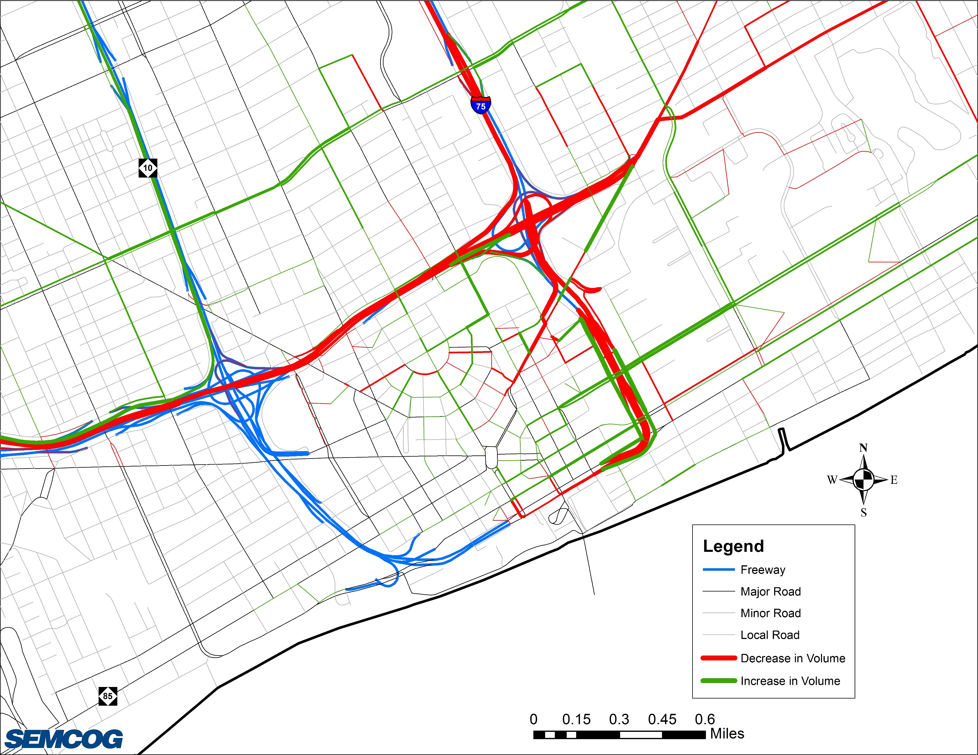
Results from the 2040 PM TDM Model
Comparison of No-Build versus the Build

Slide 12
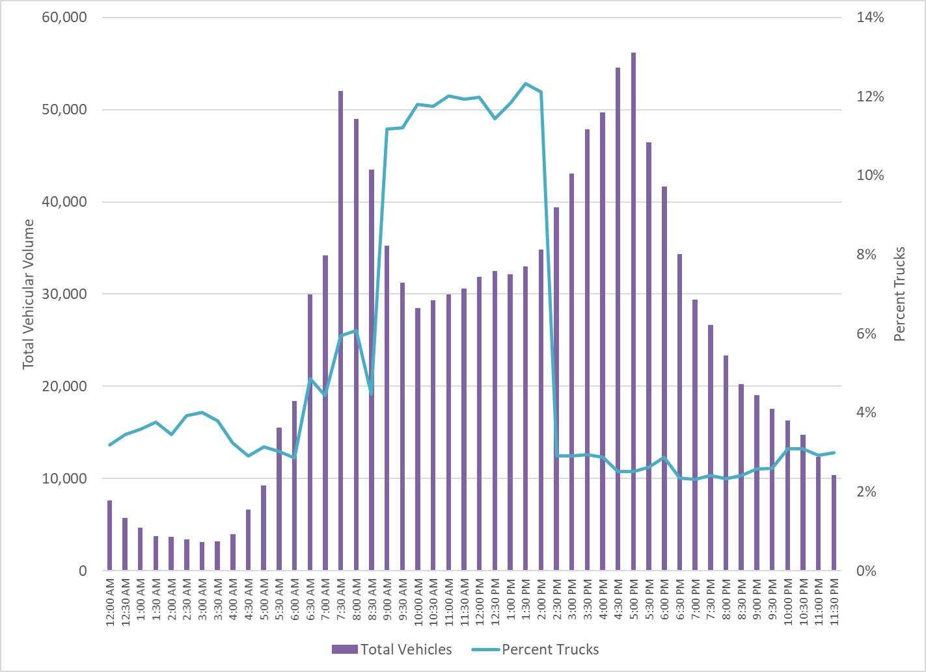
Benefits of a DTA Model
Able to have a more refined time periods
Trips are divided into individual vehicles, which have individual routes
Includes traffic signals and turn lanes
More realistic response to queueing and delays
Includes a percentage of those using GPS and real-time traffic information
Overnight
AM Peak
Mid-day
Evening
PM Peak

Slide 13
Development of the DTA Model
Define the Subarea
Software Platform (DynusT / DynuStudio)
Create the Roadway Network / TAZ Layer
Determine Signal Timing Locations
Traffic Count Development
Origin-Destination (OD) Matrix Development for 2015
Travel Time Development
Model Calibration for 2015
Development of 2045 Future Year Model
Started development of the DTA model in
June 2018
and finalized in
August 2018
Development of the 2045 model occurred in October 2018

Slide 14
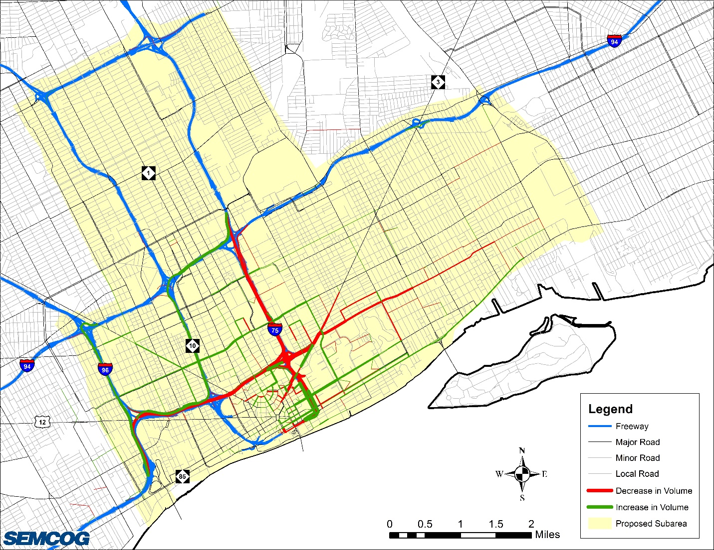
Defining the Subarea
Ran the AM and PM Peak Period E6 2015 Model with the roadway conversion
Determined which roadways had a change in 100 vehicles per hour OR a >10% change in traffic volumes
AM Peak Period
PM Peak Period

Slide 15
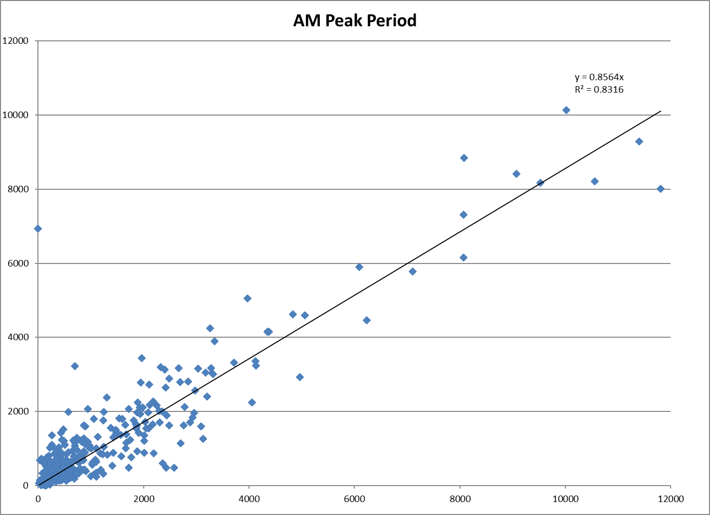
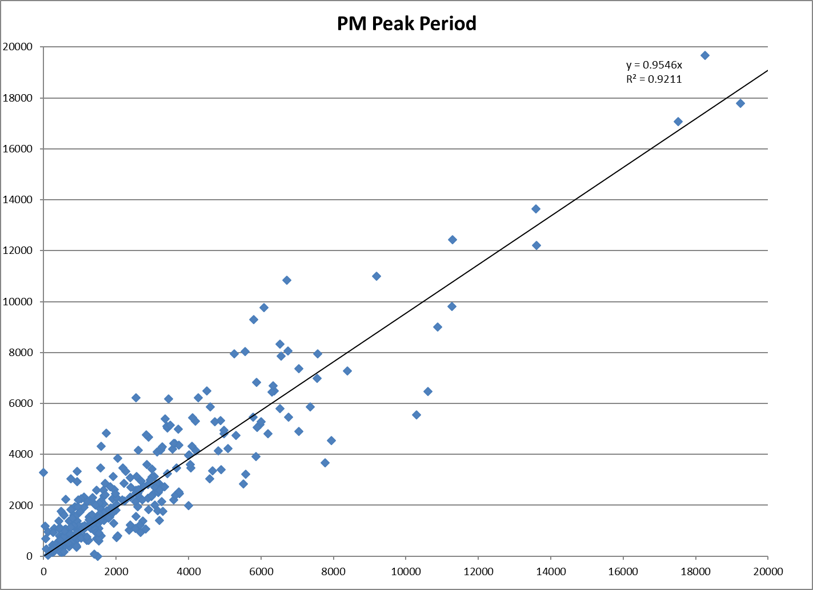
Model Calibration

Slide 16
2015 and 2045 Subarea Trips
Year and Class | AM | MD | PM | EV | NT | Total
2015 Cars | 187,790 | 339,290 | 377,489 | 182,379 | 117,346 | 1,204,294
2015 Trucks | 10,657 | 51,342 | 12,909 | 3,705 | 3,604 | 82,218
2015 Total | 198,447 | 390,633 | 390,398 | 186,085 | 120,950 | 1,286,512
2045 Cars | 205,032 | 370,081 | 412,193 | 203,661 | 130,339 | 1,321,306
2045 Trucks | 10,445 | 50,303 | 12,518 | 3,632 | 3,532 | 80,431
2045 Total | 215,478 | 420,384 | 424,711 | 207,292 | 133,871 | 1,401,737
Car Difference (2045-2015) | 17,243 | 30,791 | 34,704 | 21,281 | 12,993 | 117,012
Car % Diff | 9.2% | 9.1% | 9.2% | 11.7% | 11.1% | 9.7%
Truck Difference (2045-2015) | -212 | -1,039 | -391 | -74 | -72 | -1,787
Truck % Diff | -2% | -2% | -3% | -2% | -2% | -2%
Total Difference | 17,031 | 29,752 | 34,313 | 21,208 | 12,921 | 115,224
Total % Diff | 8.6% | 7.6% | 8.8% | 11.4% | 10.7% | 9.0%
2045 % Trucks | 5% | 12% | 3% | 2% | 3% | 6%

Slide 17
2015 DTA Model Results
Parameter | With Freeway (No-Build) |  |  | With Boulevard (Build)
 | Number of Vehicles | Average Travel Time (min) | Average Travel Distance (miles) | Number of Vehicles | Average Travel Time (min) | Average Travel Distance (miles)
Subarea | 1,246,121 | 7.7 | 4.3 | 1,246,121 | 7.9 | 4.3
SB I-375 | 41,908 | 10.3 | 6.7 | 24,247 | 10.6 | 6.6
NB I-375 | 44,664 | 11.5 | 7.1 | 30,979 | 13.5 | 7.4
SB Madison Ramp | 4,722 | 12.8 | 6.6 | 6,094 | 10.9 | 6.6
NB Madison Ramp | 4,816 | 11.1 | 6.3 | - | - | -
EB Gratiot Connector* | 10,986 | 9.8 | 6.0 | - | - | -
WB Gratiot Connector* | 21,245 | 10.9 | 6.5 | - | - | -
SB Gratiot Ramp (without Madison) | - | - | - | 16,308 | 10.1 | 6.2
NB Gratiot Ramp | - | - | - | 13,632 | 11.6 | 6.5
EB/NB Brush Ramp | 1,341 | 9.3 | 4.5 | 5,723 | 10.9 | 6.0
SB Brush Ramp | - | - | - | 3,816 | 14.6 | 6.1
Total (without Subarea) | 129,682 | 10.9 | 6.7 | 100,792 (-22%) | 11.7 (+0.8) | 6.7

Slide 18
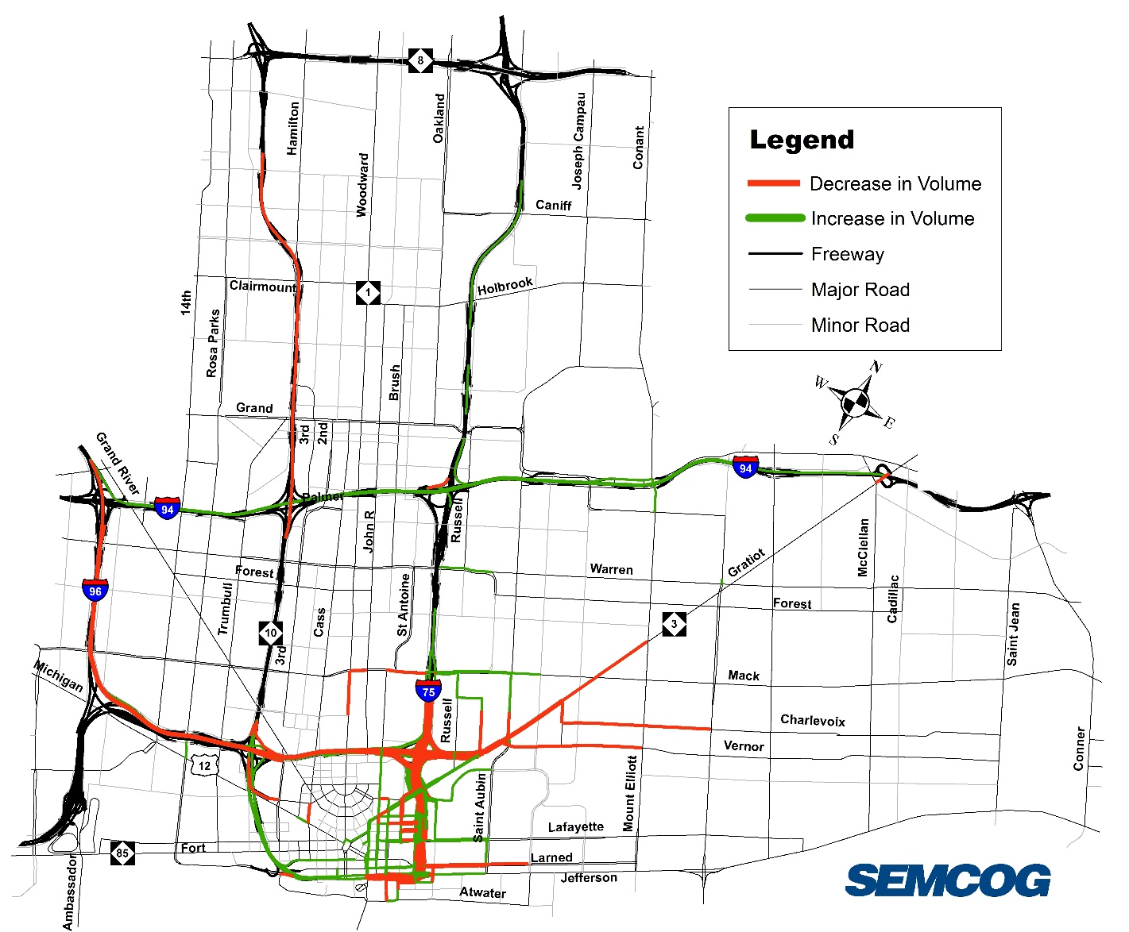
2015 DTA Model Results
Volumes within the I-375 corridor will decrease by 30% to 60%
Volumes on Gratiot Avenue will decrease north of the Gratiot Connector and increase south of Antietam Avenue
Volumes will increase on Clinton, Macomb, Lafayette, Brush, Beaubien, Larned, and Congress
Volumes will decrease on Monroe
Volumes along WB Jefferson Avenue west of I-375 may increase
Volumes along the NB I-375 Service Drive / New Road will increase
No roadways are near or over capacity before or after the conversion, except for the New Local Road north of Clinton Street, which is close to capacity but not over

Slide 19
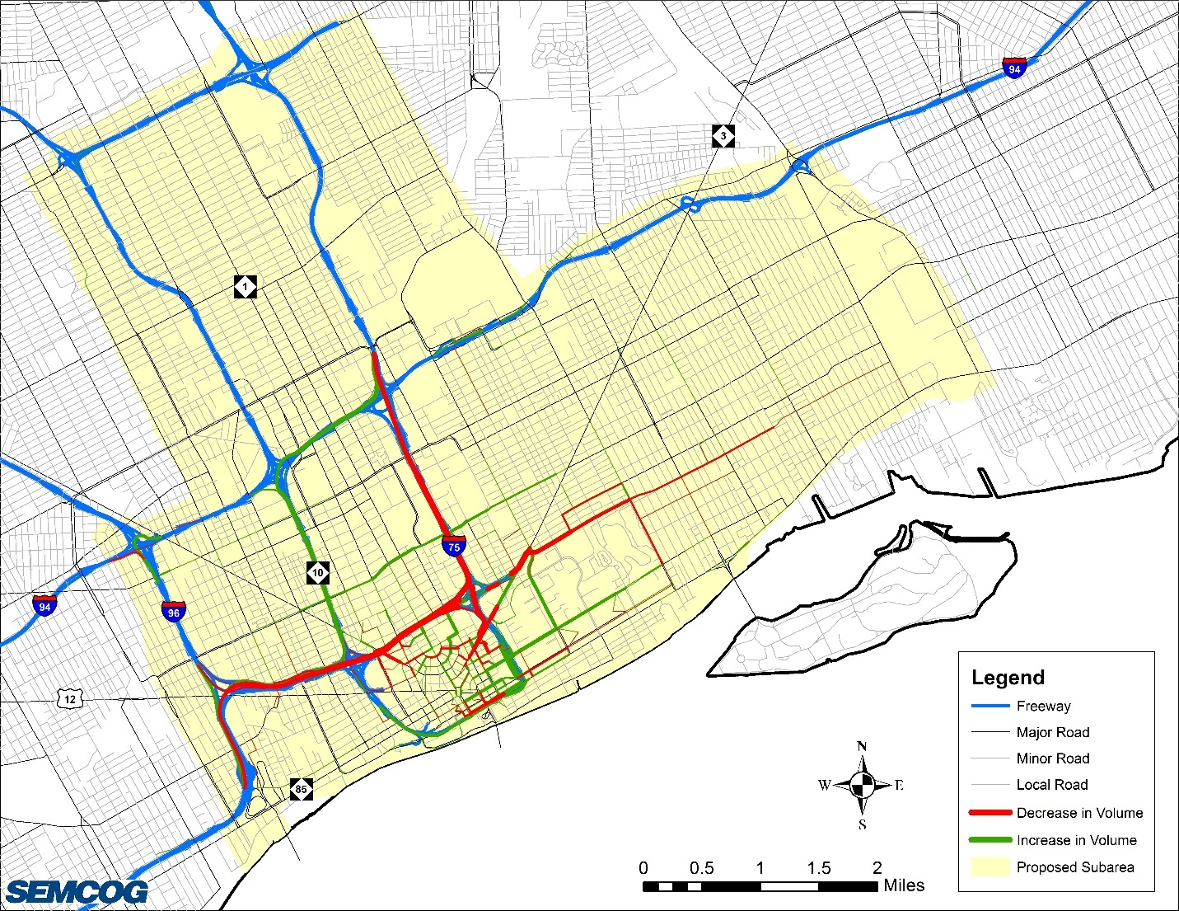
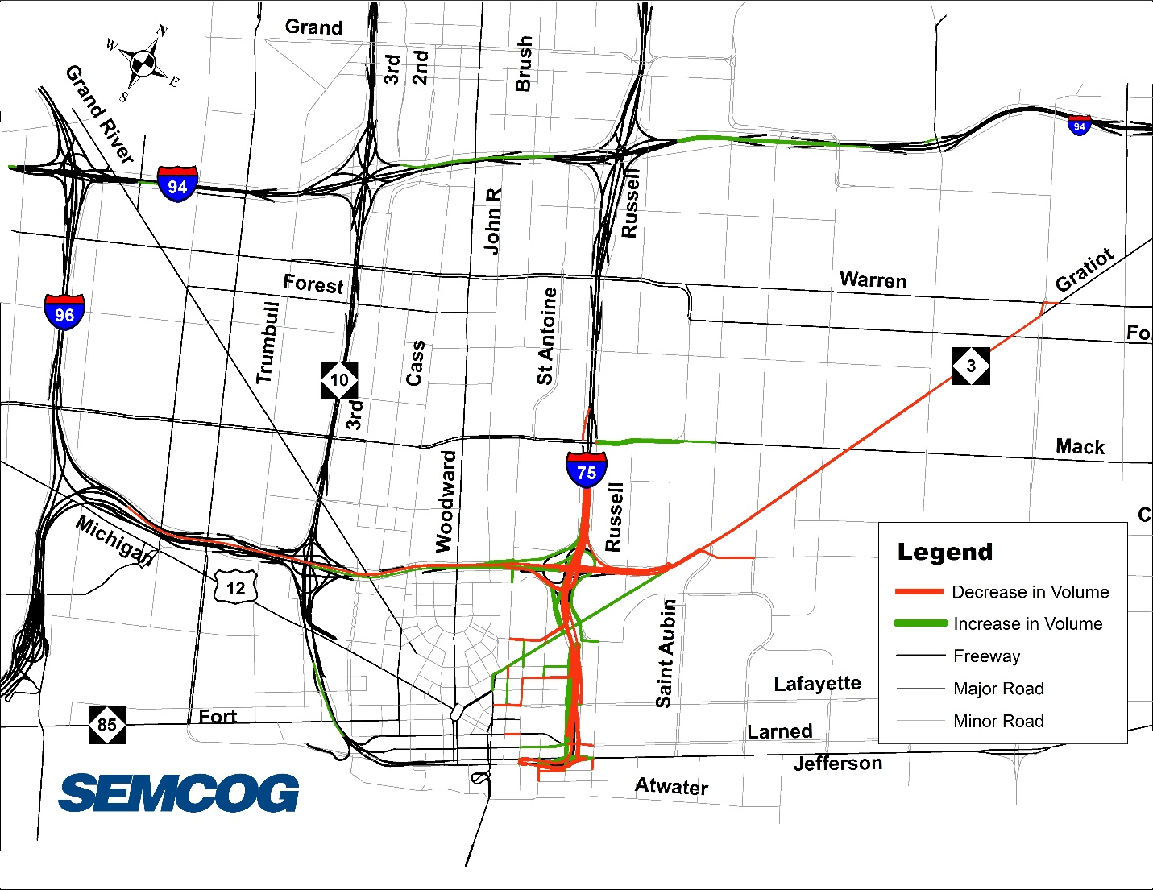
2045 AM Peak Comparison – Regional vs DTA Model
Regional Model Results – AM Peak PERIOD
DTA Model Results – AM Peak HOUR

Slide 20
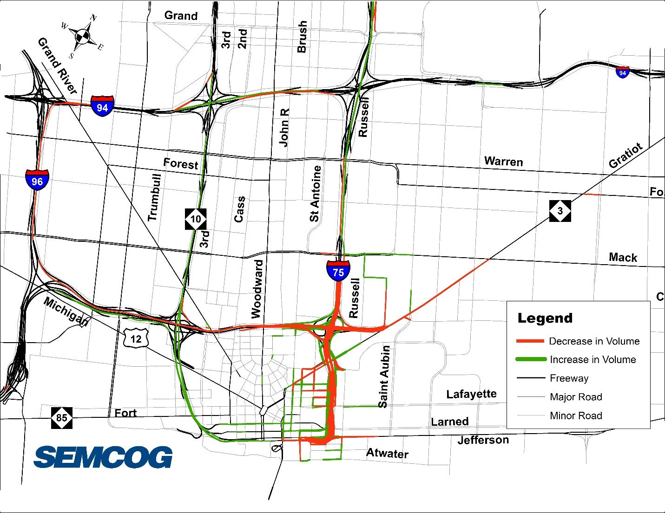
2045 PM Peak Comparison – Regional vs DTA Model
Regional Model Results – PM Peak PERIOD
DTA Model Results – PM Peak HOUR

Slide 21
The use of the DTA Model
Used to INFORM the microsimulation VISSIM Model
Evaluated the impacts/diversion that the alternative would have in the larger subarea and not just along the corridor
Determined which additional intersections should be evaluated due to the impacts
Base Year Daily Model Results

Slide 22
Questions

Slide 23
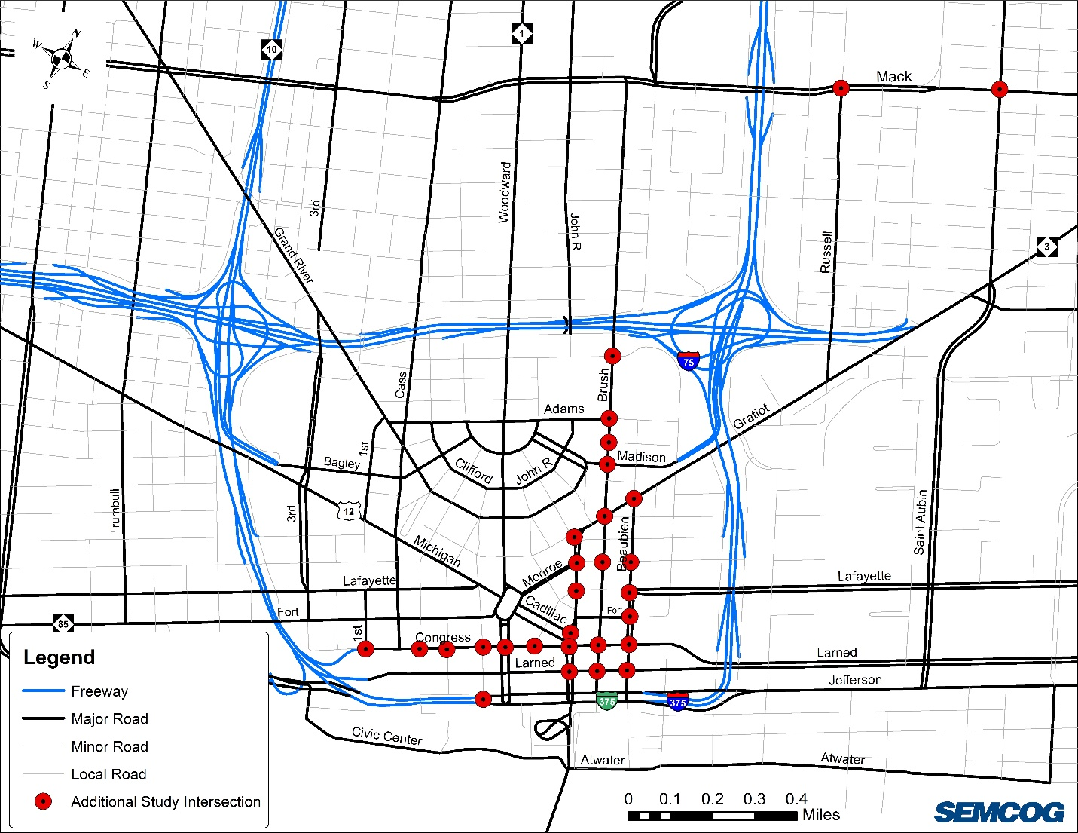
Additional Study Intersections
Collected turning movement counts at all additional study intersections
Utilized Synchro to determine Levels of Service
1 intersection was below LOS D – was already LOS F in existing
Suggested mitigation measures to improve LOS for individual movements with LOS E or F

