Slide 1
Accessibility vs. Origin-Destination Information: Do They Measure the Same Thing?
Shuang “Bobie” Guo
Assistant Transportation Researcher
Texas A&M Transportation Institute
Notes:
Good morning, everyone.
Thank you all very much for coming.
My name is Shuang “Bobie” Guo. I’m an Assistant Transportation Researcher, from the Texas A&M Transportation Institute.
I’m here today to talk about “Accessibility vs. Origin-Destination Information: Do They Measure the Same Thing?”.

Slide 2
Introduction
How To Compare Accessibility and Origin-Destination Information?
https://www.clutchgl.com/apples-oranges-best-practices-comparing-rates/
Notes:
Before I start, I’d like to ask you a simple question “How do you compare apples and oranges?”
Over the last decade, we’ve seen a shift in focus from measuring mobility [delay-based measures] to also measuring accessibility [destination-based measures].
Both concepts do share similarities. They both consider all transportation modes, even including the mobility substitutes, like telecommuting. But accessibility appears to be a much broader concept. It not only focuses on the connections between modes (inter-modality), but also recognizes the social and environmental costs (externalities) of transportation.
However, due to the theoretical and methodological complexities, accessibility measures, if and when calculated, are difficult to effectively understand and communicate to others.
Could there be another option since accessibility measures do not actually measure real decisions as they only identify the universe of possible options a person could choose? Could a Better Option to measuring Accessibility Exist? Unfortunately, I do not know the answers yet. But we have an emerging type of cellular probe data called Origin-Destination (OD) information, which is more feasible and has mass amounts of data. Well, now with this new type of data, we can finally compare two seemingly different concepts or “apples and oranges”.

Slide 3
Concept
Transforming into having a comparable “denominator”
https://www.teepublic.com/t-shirt/3218786-comparing-apples-to-oranges
Notes:
Back to the apples and oranges question. One answer could be “Well, we’re both fruit.” That’s correct!
While there is a theoretical premise linking information from OD data and accessibility measures together, one cannot assume they measure the same thing. It’s more like understanding a theoretical set of possible behaviors or a actual set of behaviors.
However, by transforming both concepts into having a comparable “denominator,” we can establish how closely related the measures and data are to one another. If the two concepts are similar, we can assume they do in fact roughly measure the same thing, and we would only need to examine one of the two for most use cases. If they greatly differ, the question then becomes which should we use.

Slide 4
Methodology
Use a cumulative-based accessibility measure with focus on the land-use and transport components.
Measure the number of available jobs by automobile within a certain amount of time (30 minutes in the study).
Select three urban areas in Texas representing a large, medium, and small metropolitan area:
Austin-Round Rock, TX, CBSA (large);
Waco, TX, CBSA (medium);
Abilene, TX, CBSA (small).
CBSA: Core-Based Statistical Area.
Measure and Study Area Selection
Notes:
In this research study, we used the cumulative-based accessibility measure as it’s the most commonly used due to its ease of calculation and ability to be communicated and understood by lay audiences.
Number of available jobs by automobile within 30 minutes was used as the performance measure. The reason why we selected automobile as the transportation mode is because it is the most directly comparable transportation mode between the geographic areas and across the datasets.
Three metropolitan areas in Texas were selected for analysis, representing a large, medium, and small metropolitan area.
This provided us a measure of diversity to determine if similarities existed throughout regional size. Additionally, metropolitan areas where Origin-destination (OD) information were readily available for use were selected.
Next, let’s take a look at the data sources.

Slide 5
Methodology
2015 U.S. Census block groups using the Topologically Integrated Geographic Encoding and Referencing (TIGER) program;
Accessibility Data
2015 Longitudinal Employer-Household Dynamics (LEHD) Origin-Destination Employment Statistics (LODES) Origin-Destination Dataset
2011-2015 American Community Survey 5-Year Estimates
Origin-Destination Data
2015 INRIX GPS Origin-Destination Dataset (a daily time period between February, 2015 and May, 2015)
Data Sources
Notes:
Boundaries for three study areas were obtained from TIGER products, to match the data sources .
Both were analyzed at the Census Block Group Level while Origin-Destination data were aggregated from the Census Block to the Census Block Group.

Slide 6
Methodology
Accessibility Data Calculation
Notes:
SHORT
Accessibility Data Calculation: total number of jobs and number of jobs accessible by worker (within a 30-minute radius) at the census block group level.
The accessibility calculation used the ACS and LODES datasets mentioned earlier.
For accessibility calculations, we identified centroids of census block groups and created contour maps to calculate the total number of jobs and number of jobs accessible by worker. Using these performance measures, we were able to calculate job accessibility through ArcGIS.
LONG
Thirty-minute-driving-time contour maps were created for each census block group using Service Area Analysis under Network Analyst extension in ArcGIS. Centroids of census block groups were used as the Facilities for network analysis class. Thirty-minute service area polygons were generated for each Facility (centroid of each census block group). Value of total number of all jobs within thirty-minute-driving-time was determined and value of number of jobs accessible by worker was calculated for each census block group. Then job accessibility was calculated at the census block group level using ArcGIS Calculate Geometry tool function. Output layers were later broken down into five percentiles for interpretation and visualization purposes.

Slide 7
Methodology
Origin-Destination Data Calculation
Notes:
SHORT
Origin-Destination Data Calculation: number of in-block group trips, out-block group trips, origins, and destinations all accessible from X census block group in X CBSA within a 30-minute radius.
The origin-destination trip density calculation used the INRIX GPS data mentioned earlier.
For Origin-Destination data calculations, we were able to map the number of in-block group trips and out-block group trips and construct a heatmap in ArcGIS of trip density of origin and trip density of destination.
LONG
Trip density was calculated at the census block group level using ArcGIS Calculate Geometry tool function. Trip density was illustrated as heatmap representing trip density of origin and trip density of destination. Output layers were later broken down into various breaks for interpretation and visualization purposes.

Slide 8
Methodology
Use “common denominator” for each measure:
Theoretical number of jobs one could travel
Accessibility: X% of the region’s total jobs are accessible within a 30 minute drive from Y block group.
Actual number of jobs one do travel
Destination Density: All ≤30 minute trips made from Y block group represent X’% of the region’s total ≤30 minute trips.
Accessibility and Origin-Destination Information Comparison
Notes:
Remember the “We’re both fruit” answer to the apples and oranges question?
Differences were compared using Theoretical number of jobs one could travel and Actual number of jobs one do travel .
Generally speaking, accessibility and Origin-Destination both seek to understand roughly the same information: where can one travel? The first measures a theoretical set of total destinations to which one could travel, while the other shows where people actually do travel. For example, while a person may have access to 3,500 jobs within 30 minutes, that person will generally only go to one of those options.

Slide 9
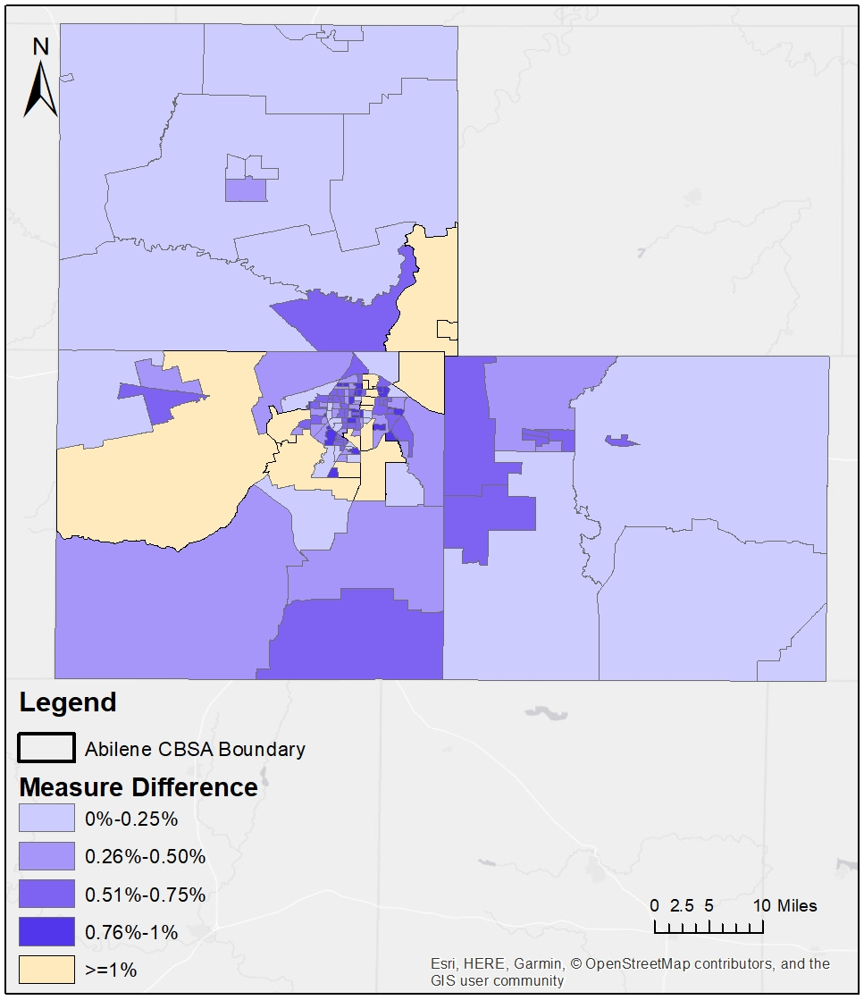
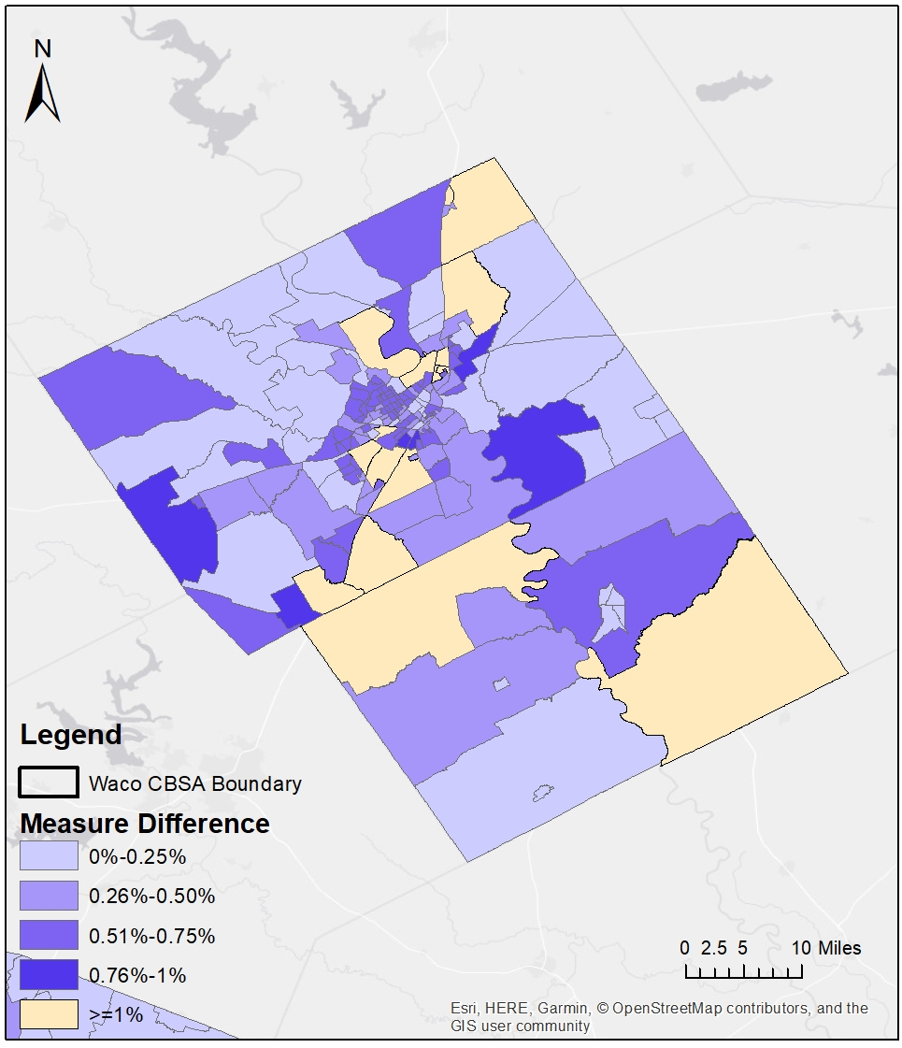
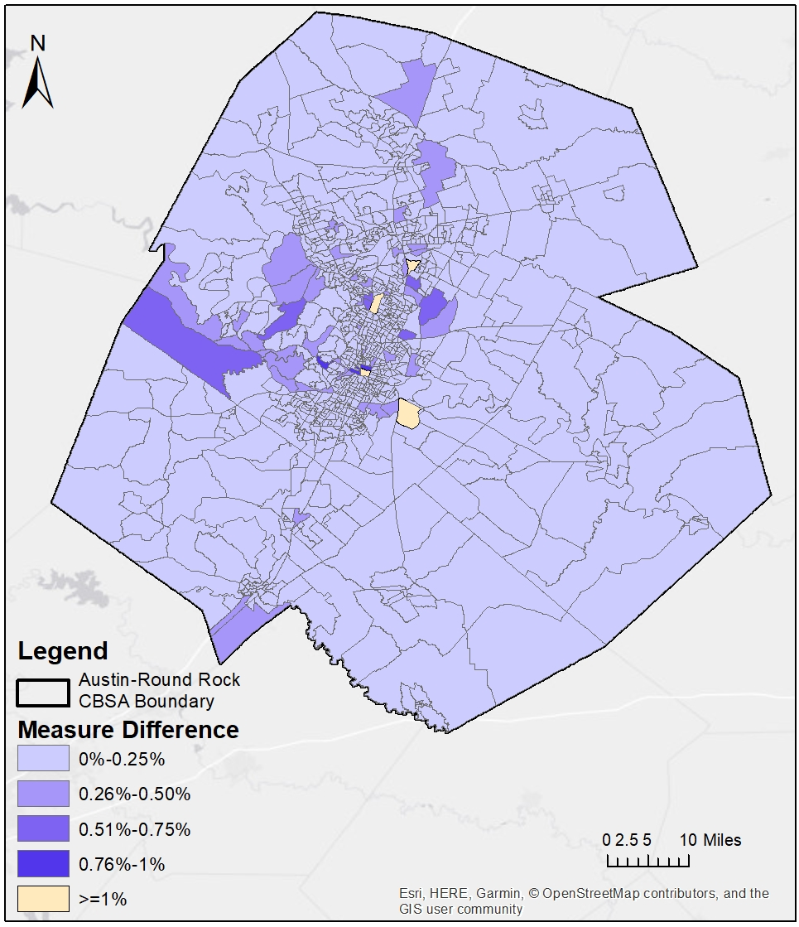
Results: Accessibility VS. Destination Density Abilene Waco Austin
Notes:
For all census block groups in all three study areas, the median difference between the accessibility and destination density measures was 0.09% with the mean at 0.25%. This indicates a vast concentration around the two being similar to each other’s measurement.
Note that the differences between the two measures are largely less than one percent. This indicates that though these two concepts (apples and oranges) are measuring different aspects of a similar fundamental notion, they both roughly arrive at the same conclusion.
Also note that the differences between Austin and the other two areas may indicate that the two measures exhibit smaller differences between each other as the number of OD data points increase. Since Austin is a significantly larger city, there were more OD pairs to pull from within the analysis.

Slide 10
Conclusion
How To Compare Accessibility and Origin-Destination Information?
http://will5nevercome.com/post/108076324051/when-i-say-somethings-like-comparing-apples-to/
Notes:
In conclusion, two measures can return similar results as each other, potentially capturing similar measurements.
As the use of Origin-Destination data continues to increase and has a potential to revolutionize traditionally-calculated accessibility measures, future studies should attempt to incorporate both more metropolitan areas and more data (as they become available).
Future research should:
Conduct statistical analysis between two datasets;
Expand temporal and spatial breath of the datasets;
Incorporate multiple travel modes and trip types.

Slide 11
Q&A
Phil Lasley, Ph.D., AICP, PMP
Assistant Research Scientist
Texas A&M Transportation Institute
Tel: 512-407-1113
Fax: 979-845-6008
Email: P-Lasley@tti.tamu.edu
Shuang “Bobie” Guo
Assistant Transportation Researcher
Texas A&M Transportation Institute
Tel: 979-317-2462
Fax: 979-845-6008
Email: S-Guo@tti.tamu.edu

