Slide 1
Survey Data Imputation with the MICE Package in R
Andrew Rohne
June 3, 2019

Slide 2
Background
Work Started at OKI
This became an experiment
Knew of some basic imputation R packages
(and examples!)
Used Package… then wondered how well it worked
Notes:
This work does not represent an RSG project!

Slide 3
The Why…
Instructions on Internet made it sound EASY and GREAT!
BUT…
The Internet example used continuous (air quality sensor reading) data.
[Persons | Workers | Vehicles] per household and Income Category are interval/categorical.
Notes:
The tutorials are such that one can just ‘feed it data and tell it to work… no configuration. Despite the examples using continuous measured data, it did note the methods to use for factor data.

Slide 4
The Data…
OKI Establishment Survey
250 Establishments
Random sampling of visitors
1,254 samples
Only valid samples (removed all N/As, etc).

Slide 5
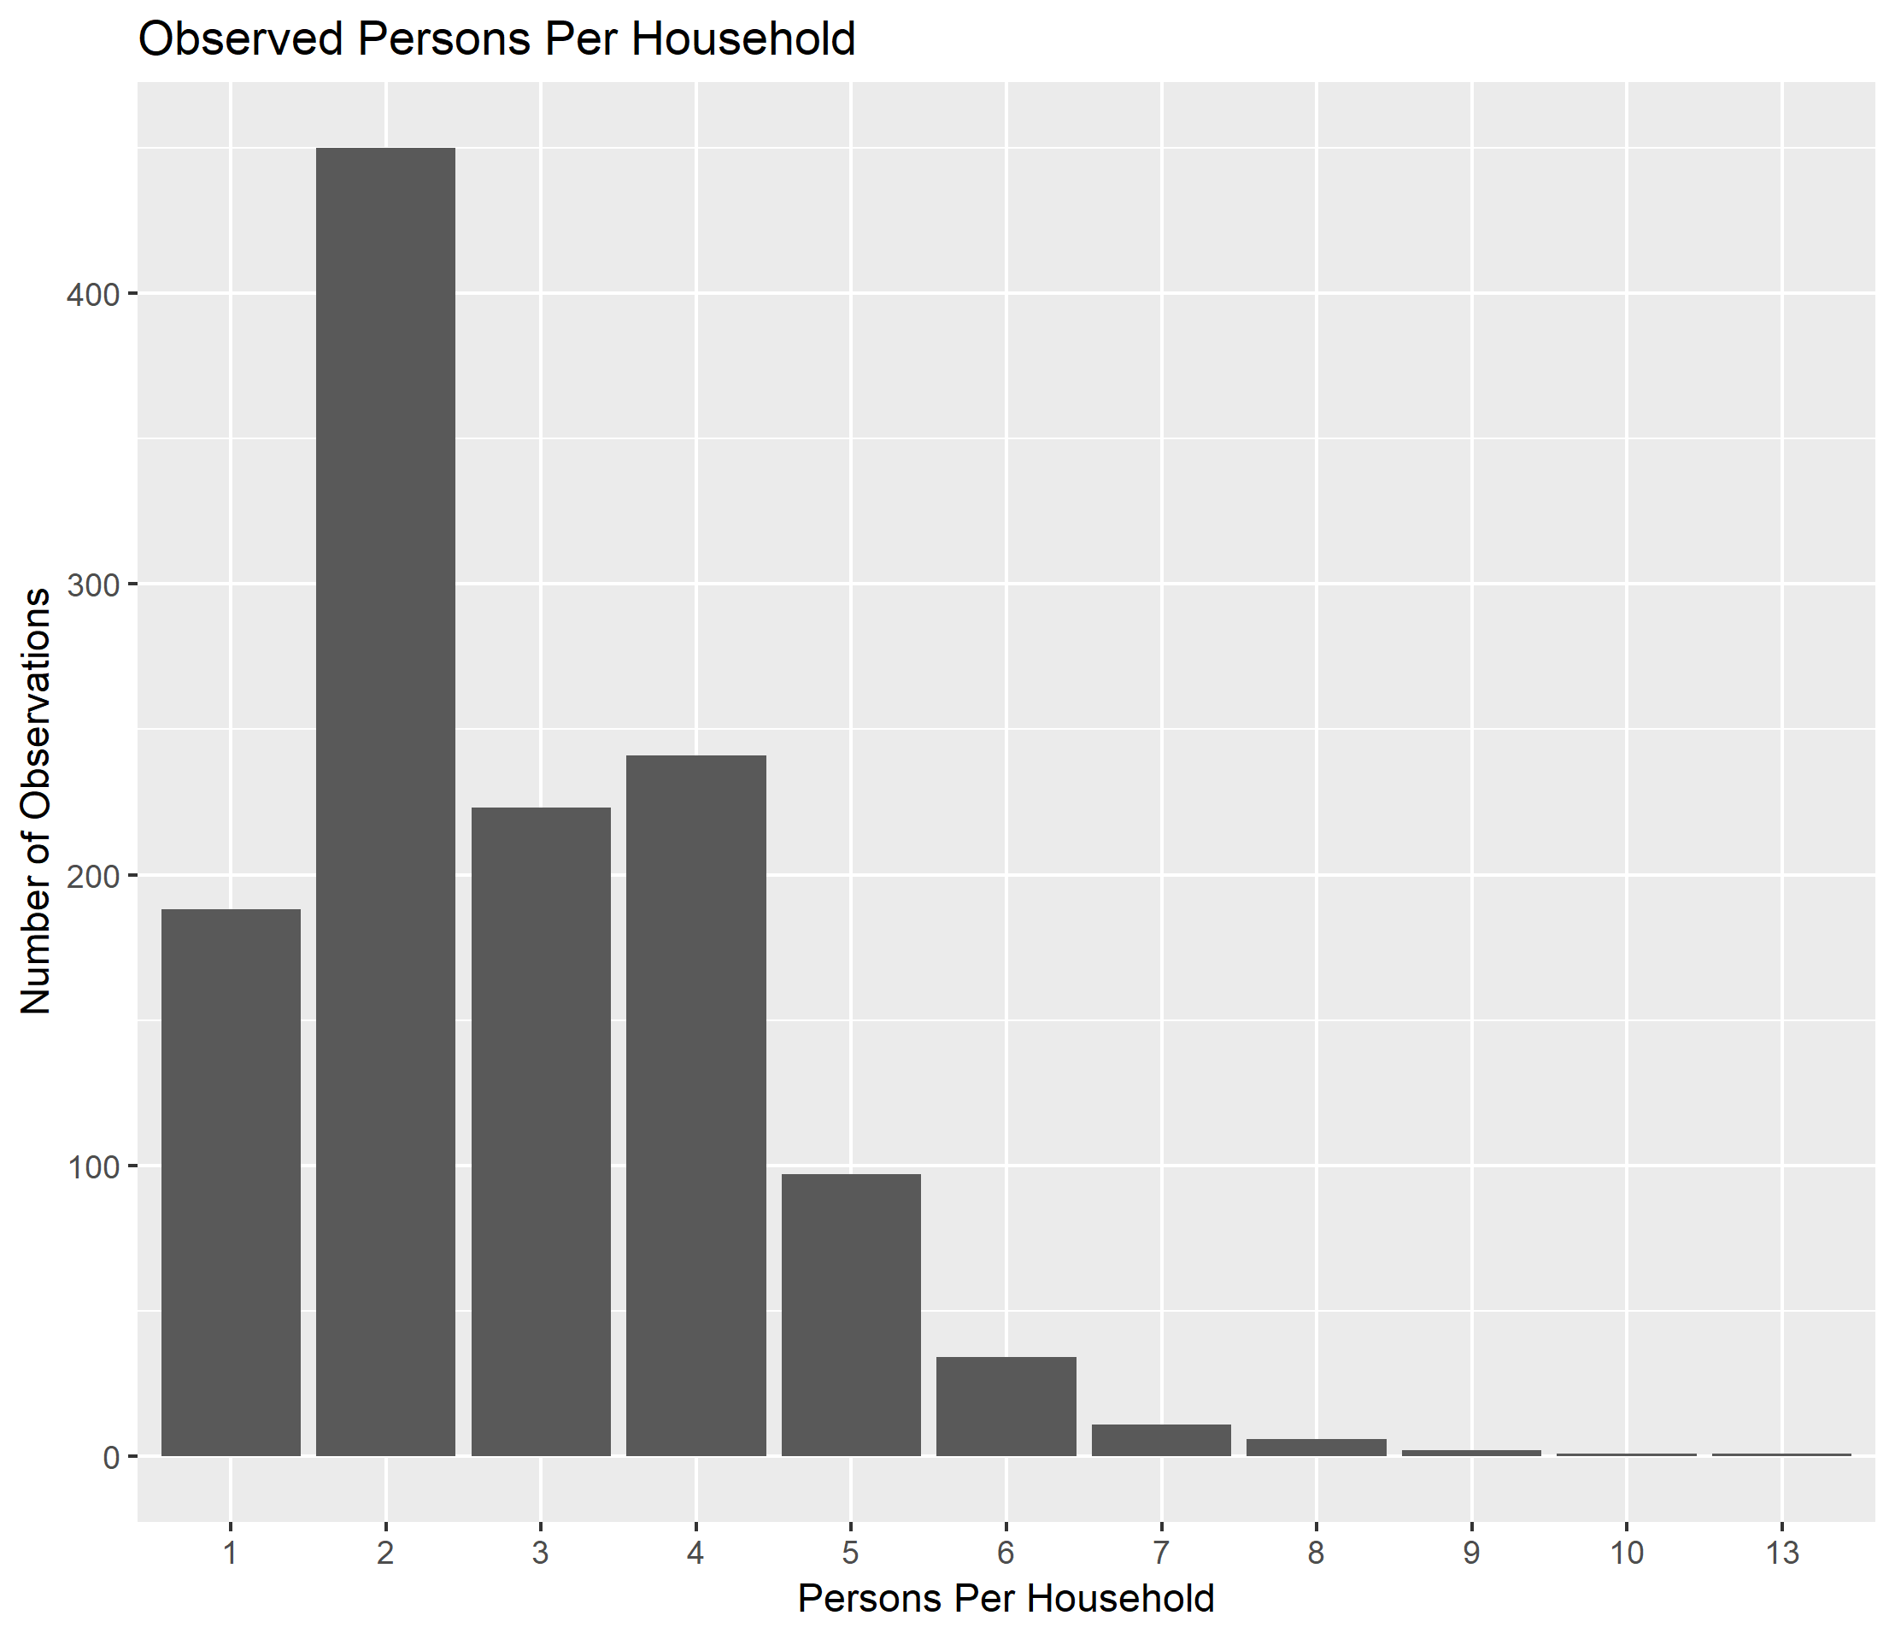

Slide 6
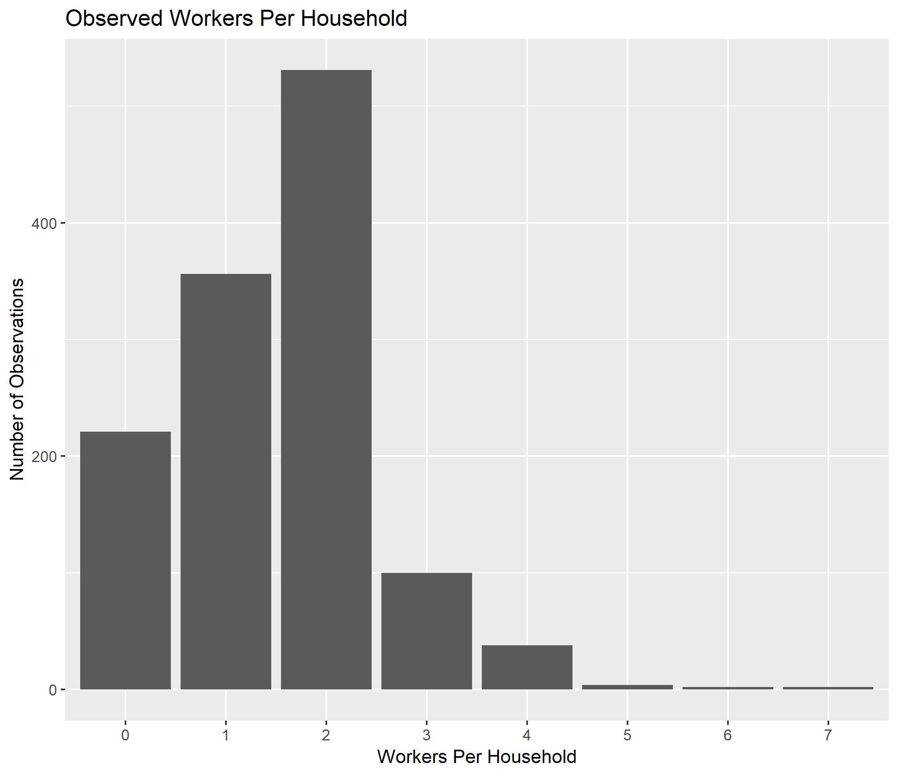

Slide 7
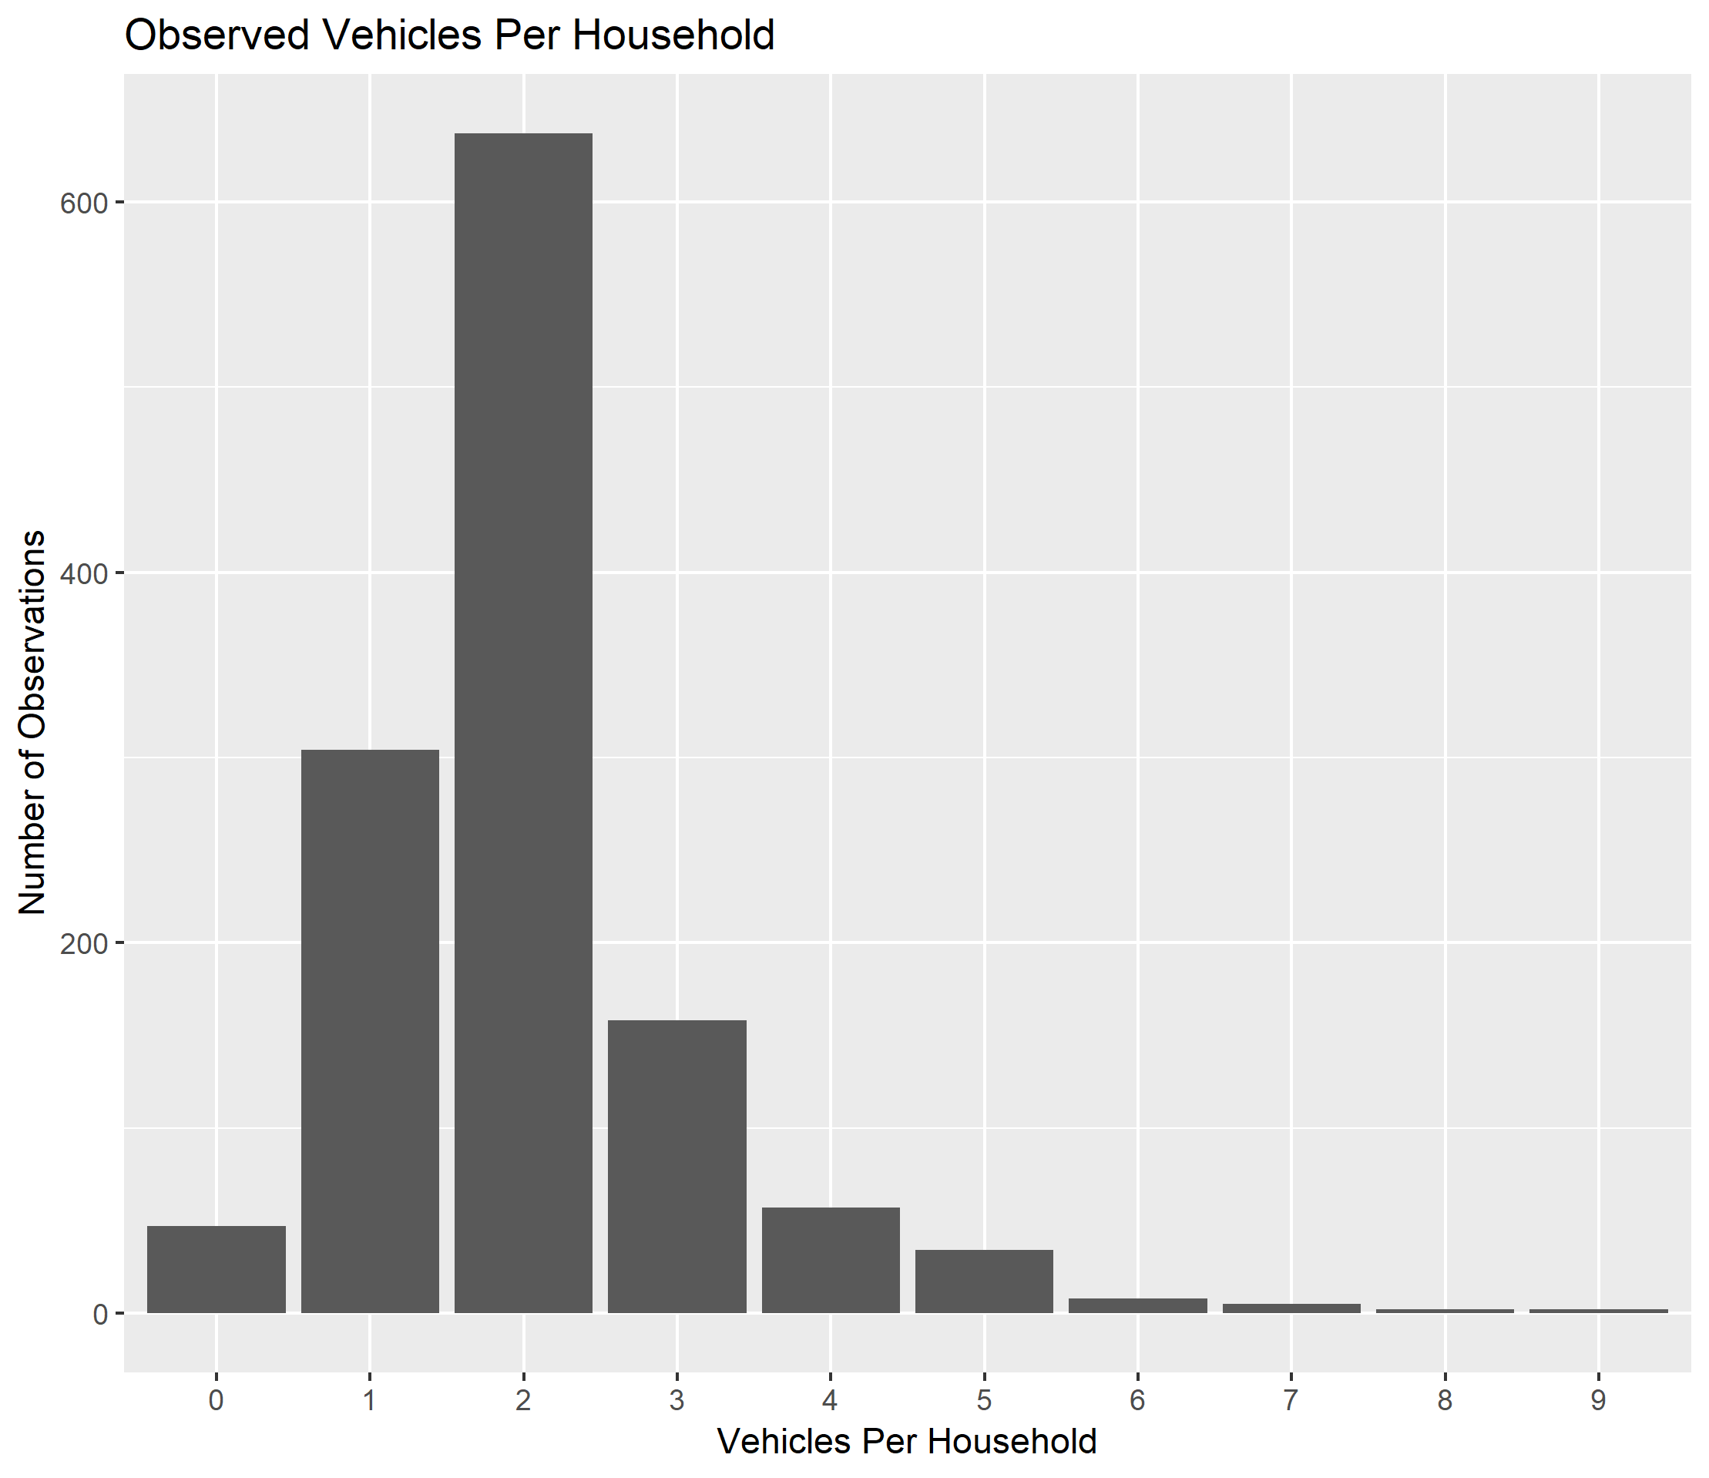

Slide 8
Methodology
Clean Dataset – no N/As!
Remove 5% at Random
Impute that 5%
Compare Against Original Dataset

Slide 9
Imputation Methods
Polytomous regression
Linear discriminant analysis
Ordered logit
Notes:
Polytomous regression is multinomial logistic regression. Linear discriminant analysis uses Bayes Theorem to classify responses. Ordered logit is a logit based method traditionally used with ordered survey responses

Slide 10
Important Note!
“EASY”

Slide 11
Detailed Results

Slide 12
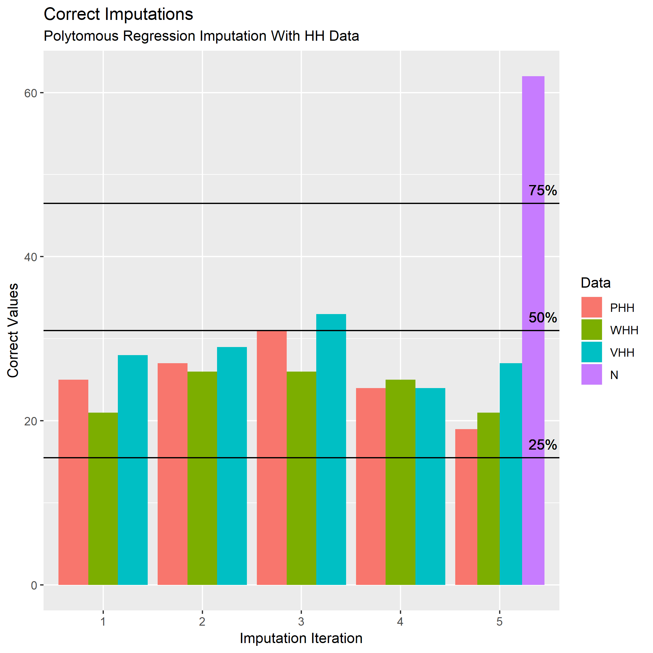

Slide 13
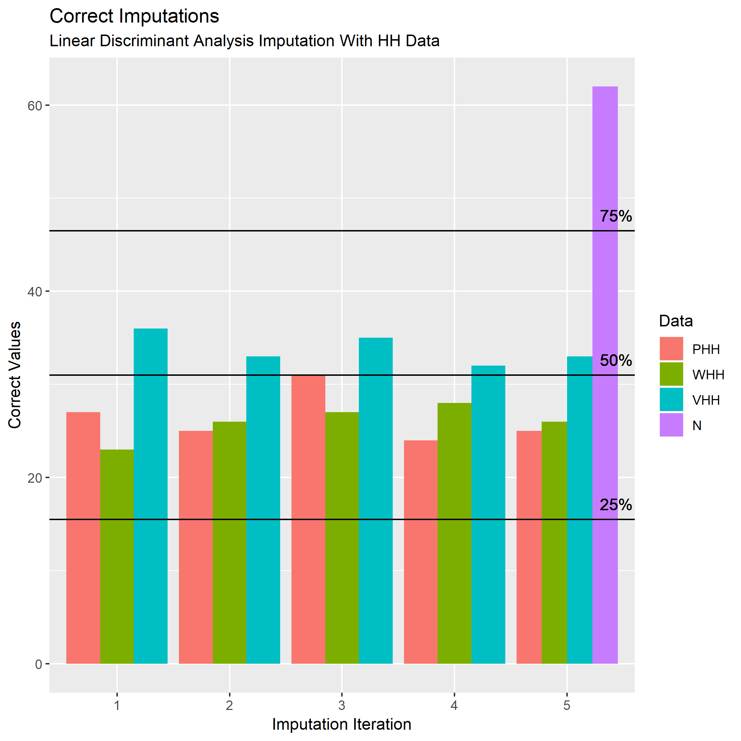

Slide 14
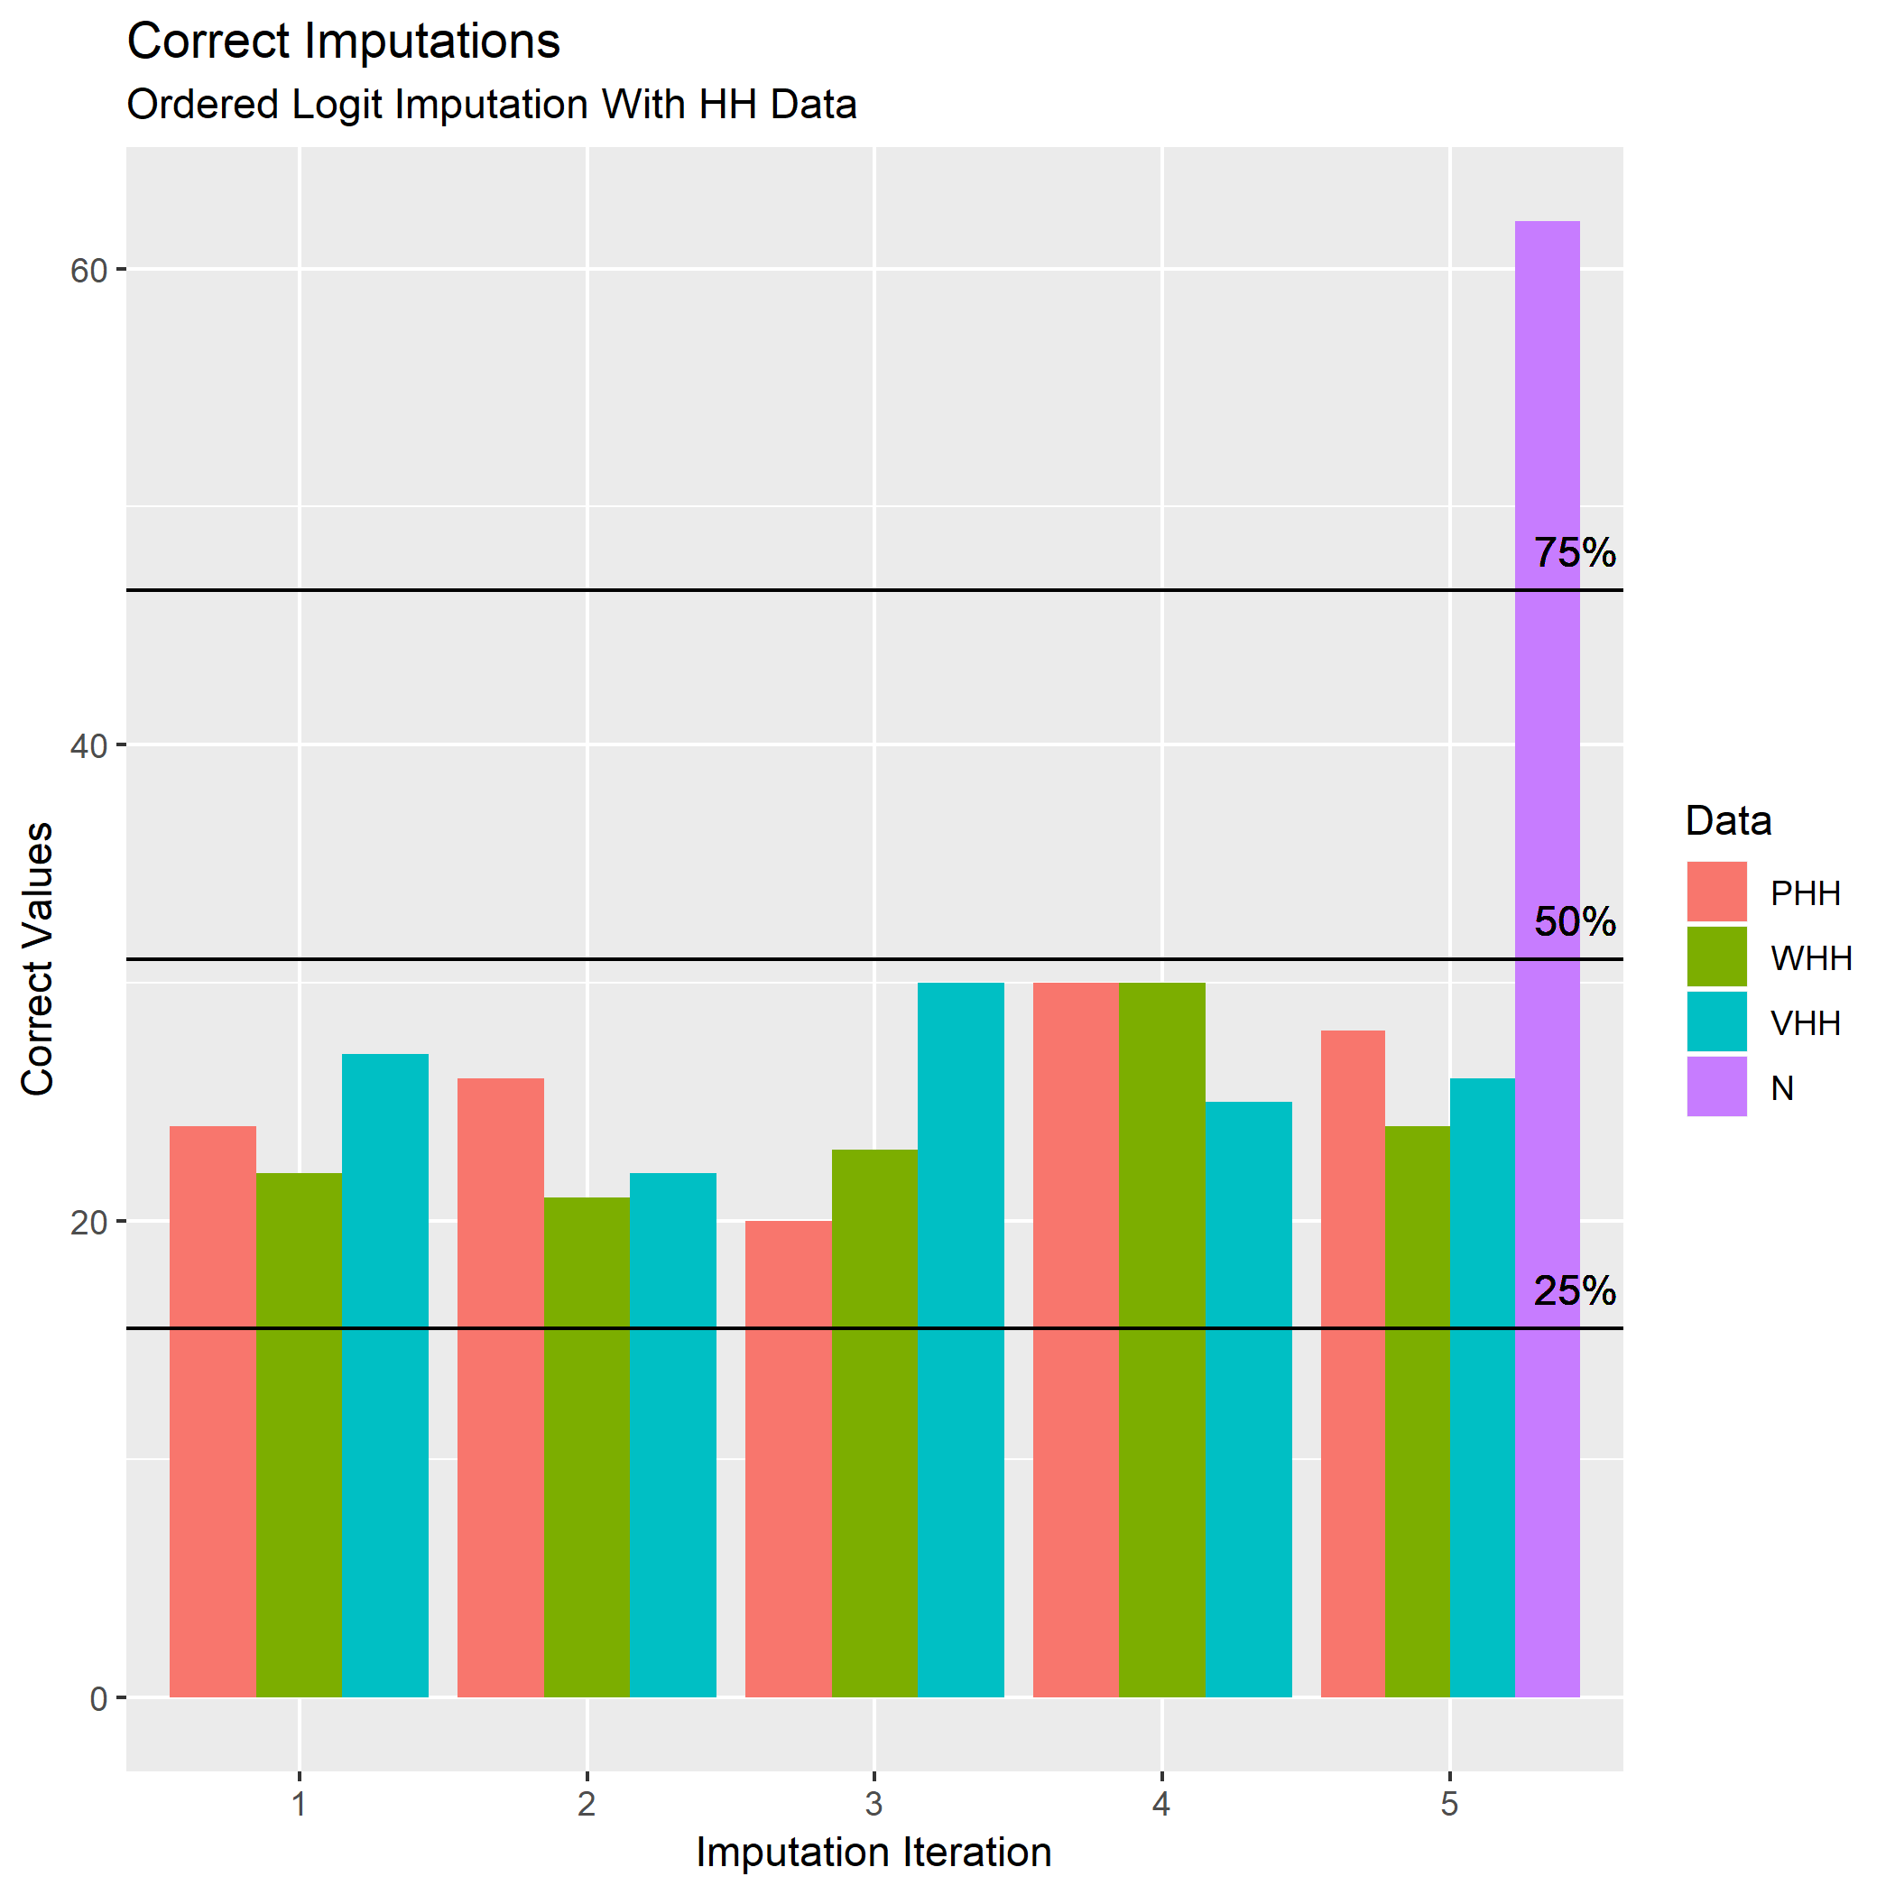

Slide 15
Aggregate Results

Slide 16
Persons Per Household
Group | Polytomous Regression | Linear Discriminant Analysis | Ordered Logit
PHH Actual | 2.852 | 2.852 | 2.852
PHH Before | 2.857 | 2.857 | 2.857
PHH Imputed | 2.862 | 2.844 | 2.859
Notes:
This didn’t do too bad

Slide 17
Workers Per Household
Group | Polytomous Regression | Linear Discriminant Analysis | Ordered Logit
PHH Actual | 1.528 | 1.528 | 1.528
PHH Before | 1.539 | 1.539 | 1.539
PHH Imputed | 1.531 | 1.527 | 1.537
Notes:
The random 5% caused a pretty significant bias

Slide 18
Vehicles Per Household
Group | Polytomous Regression | Linear Discriminant Analysis | Ordered Logit
PHH Actual | 2.047 | 2.047 | 2.047
PHH Before | 2.044 | 2.044 | 2.044
PHH Imputed | 2.050 | 2.038 | 2.065

Slide 19
Conclusions
Simplistic Imputation + Detailed Data Not Reliable In This Case
Simplistic Imputation + Aggregate Data Mostly Fine, but Fruitless Endeavor

Slide 20
Andrew Rohne
Senior Consultant
andrew.rohne@rsginc.com

