Slide 1
The Integration of Regional MPO Models into the Georgia Statewide Travel Demand Model
Presenter: Ali Etezady (Ph.D. student, Georgia Tech)
Project team: Giovanni Circella, Tim Welch, Abi Widita, Habte Kassa (GDOT)
17th TRB AppCon
Portland, Oregon
June 3rd , 2019

Slide 2
Purpose
Integrate the local MPO model zonal systems, data, and transportation networks into the Georgia Statewide Travel Demand Model.
Allow for easy and accurate communication between the models
Help transportation planning efforts to be better coordinated between the state and local (MPO) jurisdictions.
Simplify the future maintenance of the statewide model.

Slide 3
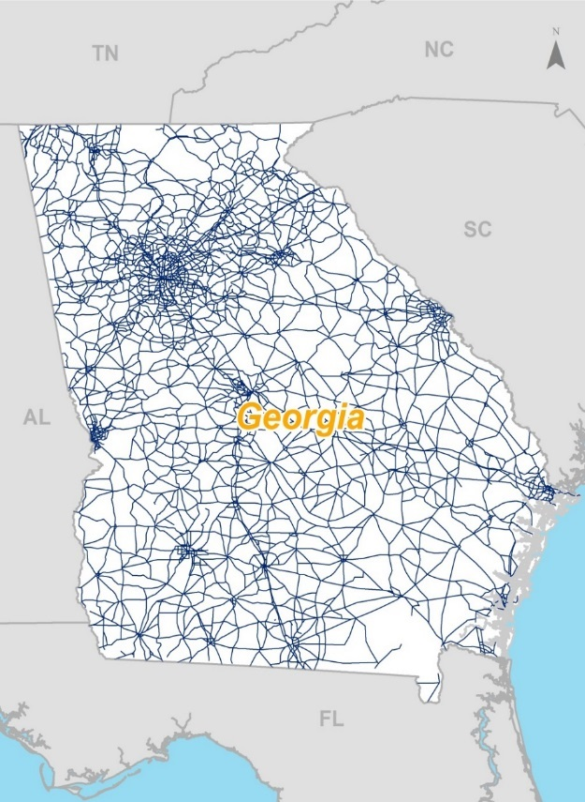
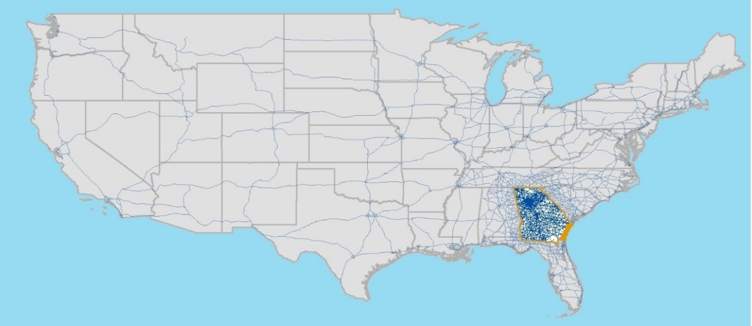
GSTDM Goals and Coverage
Goals
To assist in multimodal transportation planning for passengers and freight, in particular for long distance and rural travel
To evaluate the impacts of major transportation infrastructure and land use investment strategies within Georgia
Coverage
National in scope representing 48 states and the District of Columbia
Focus on the State of Georgia
Model not intended to be used
outside Georgia
Source: HNTB , 2017

Slide 4
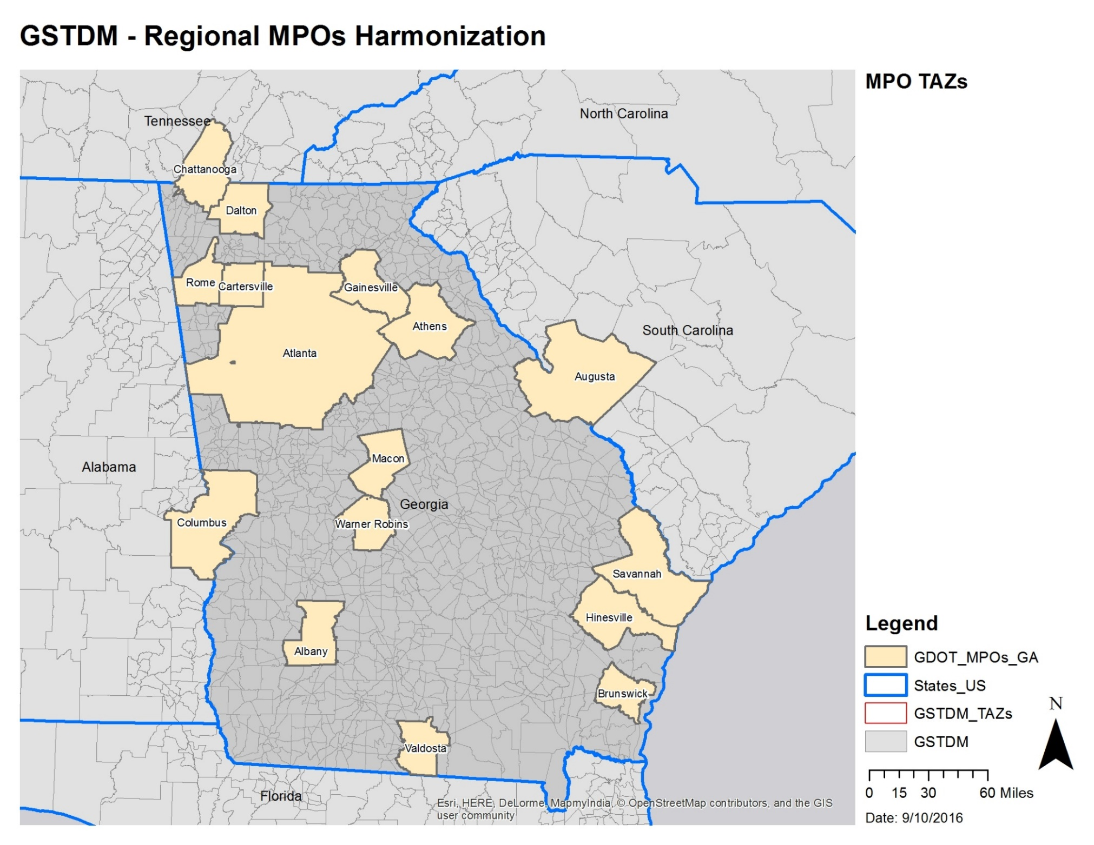

Slide 5
Methodology: TAZ integration
The approach we employed consists of two parts:
Automation process
Manual checks
This approach re-draws the GSTDM TAZs starting from the MPO TAZ geographies, ensuring full consistency between GSTDM and MPO TAZs.
The automated process ensures perfect nesting of MPO TAZs into the GSTDM as the result of this step.
A manual check helps optimizing the output to match administrative boundaries, census blocks, geographical features, and transportation networks.

Slide 6
Methodology - cont’d
Step 1. Identify the longitude (X) and latitude (Y) centroids of MPO TAZs.
Step 2. Spatially join GSTDM TAZs to the MPO TAZs XY Centroids so that each MPO TAZ Centroid is matched with the GSTDM TAZ in which they fit.
Step 3. Dissolve the MPO TAZs based on the GSTDM TAZ IDs which produces the end result of automation process.
Step 4. Manual checks are performed to make further adjustments.
Notes:
Step1: these are used to match information from GSTDM TAZs ID.
Step2: This info is imported into the MPO TAZ layer so that the MPO TAZ polygons have the GSTDM TAZ IDs.

Slide 7
Output
The GSTDM TAZs are redrawn using the geographies from MPO TAZs.
The new GSTDM TAZs have boundaries that are close enough to the old TAZs (minimizing the changes, e.g. centroids in most cases remain in the same location) and allow 100% consistency with MPO TAZs.
The GSTDM TAZs are now “linked” to the MPO TAZs:
This allows easy matching of input and output data across models
In the future, if MPO boundaries change, it is easy to maintain consistency between MPO and GSTDM TAZs

Slide 8
Output (example from Albany MPO)
MPO_TAZ | GSTDM_TAZ | County
233 | 1420 | Dougherty
234 | 1420 | Dougherty
235 | 1420 | Dougherty
236 | 1420 | Dougherty
237 | 1420 | Dougherty
239 | 1420 | Dougherty
240 | 1420 | Dougherty
241 | 1420 | Dougherty
242 | 1420 | Dougherty
243 | 1420 | Dougherty
244 | 1420 | Dougherty
245 | 1420 | Dougherty
246 | 1420 | Dougherty
247 | 1420 | Dougherty

Slide 9
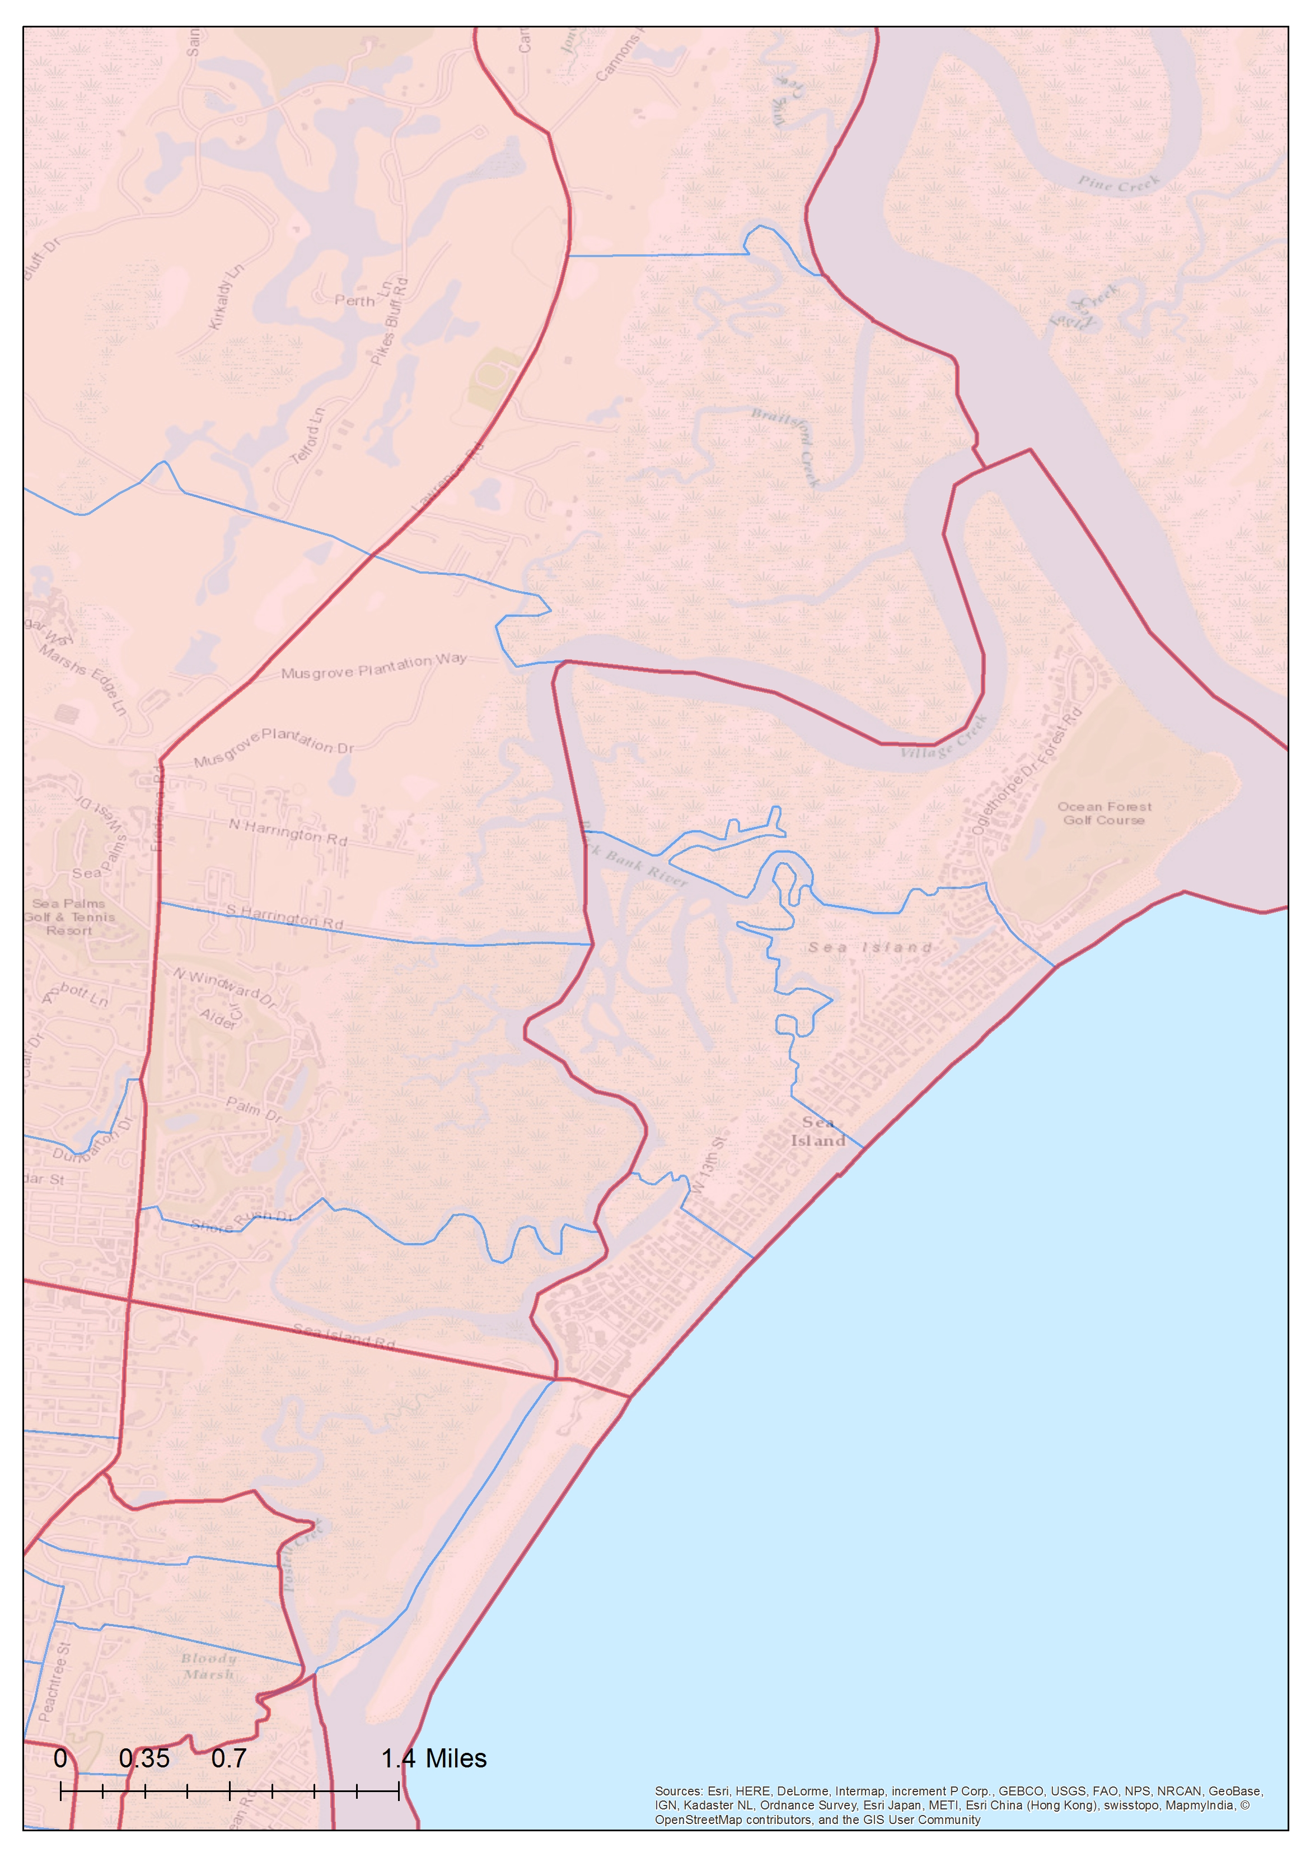
Sample output:
Brunswick MPO
Green line - (left)
Existing GSTDM TAZs
Red line - (right)
Proposed GSTDM TAZs

Slide 10
Methodology: Network integration
This approach imports the portions of the MPO transportation networks of statewide relevance in the GSTDM.
In this process, we identified the portions of the MPO networks that should be added to the statewide network:
We linked each MPO network to the statewide zonal system and;
Assigned trips to the MPO network based on an O-D matrix that uses the statewide zonal system.
Additional criteria were employed for manually revision.

Slide 11
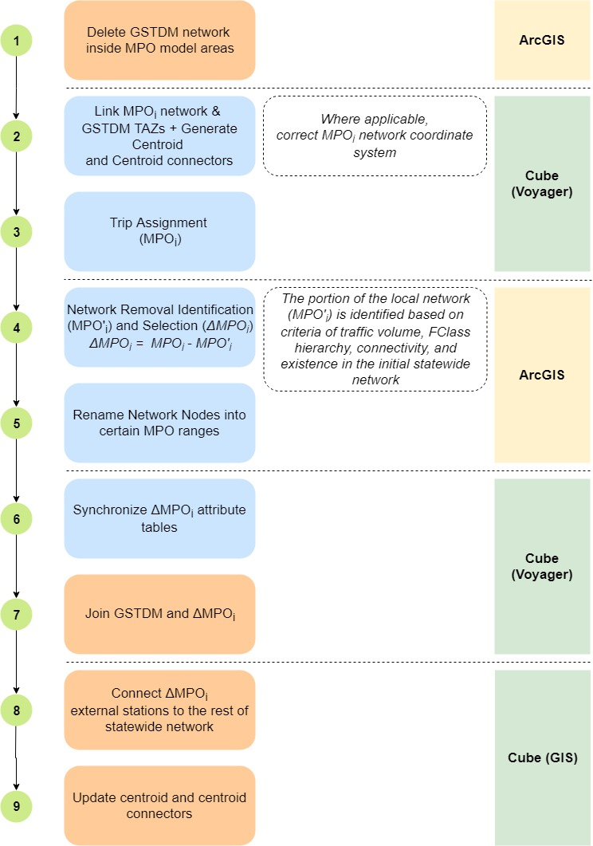
Methodology - cont’d
The figure illustrates the procedure employed to integrate the statewide and MPO networks.

Slide 12
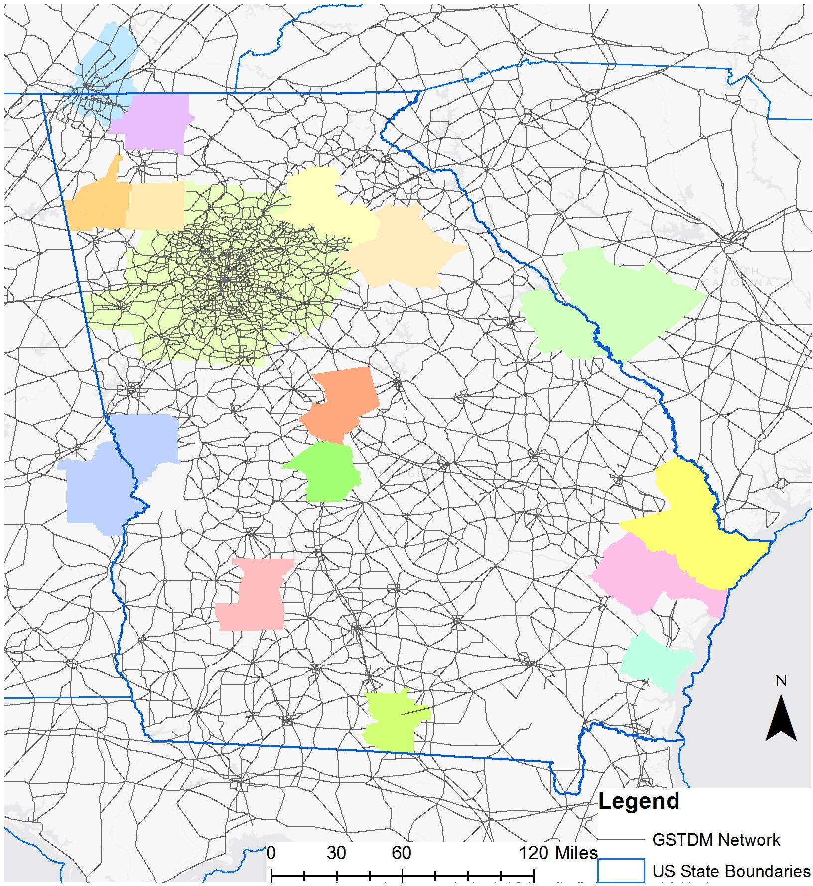
Step 1
Delete GSTDM network inside MPO model areas

Slide 13
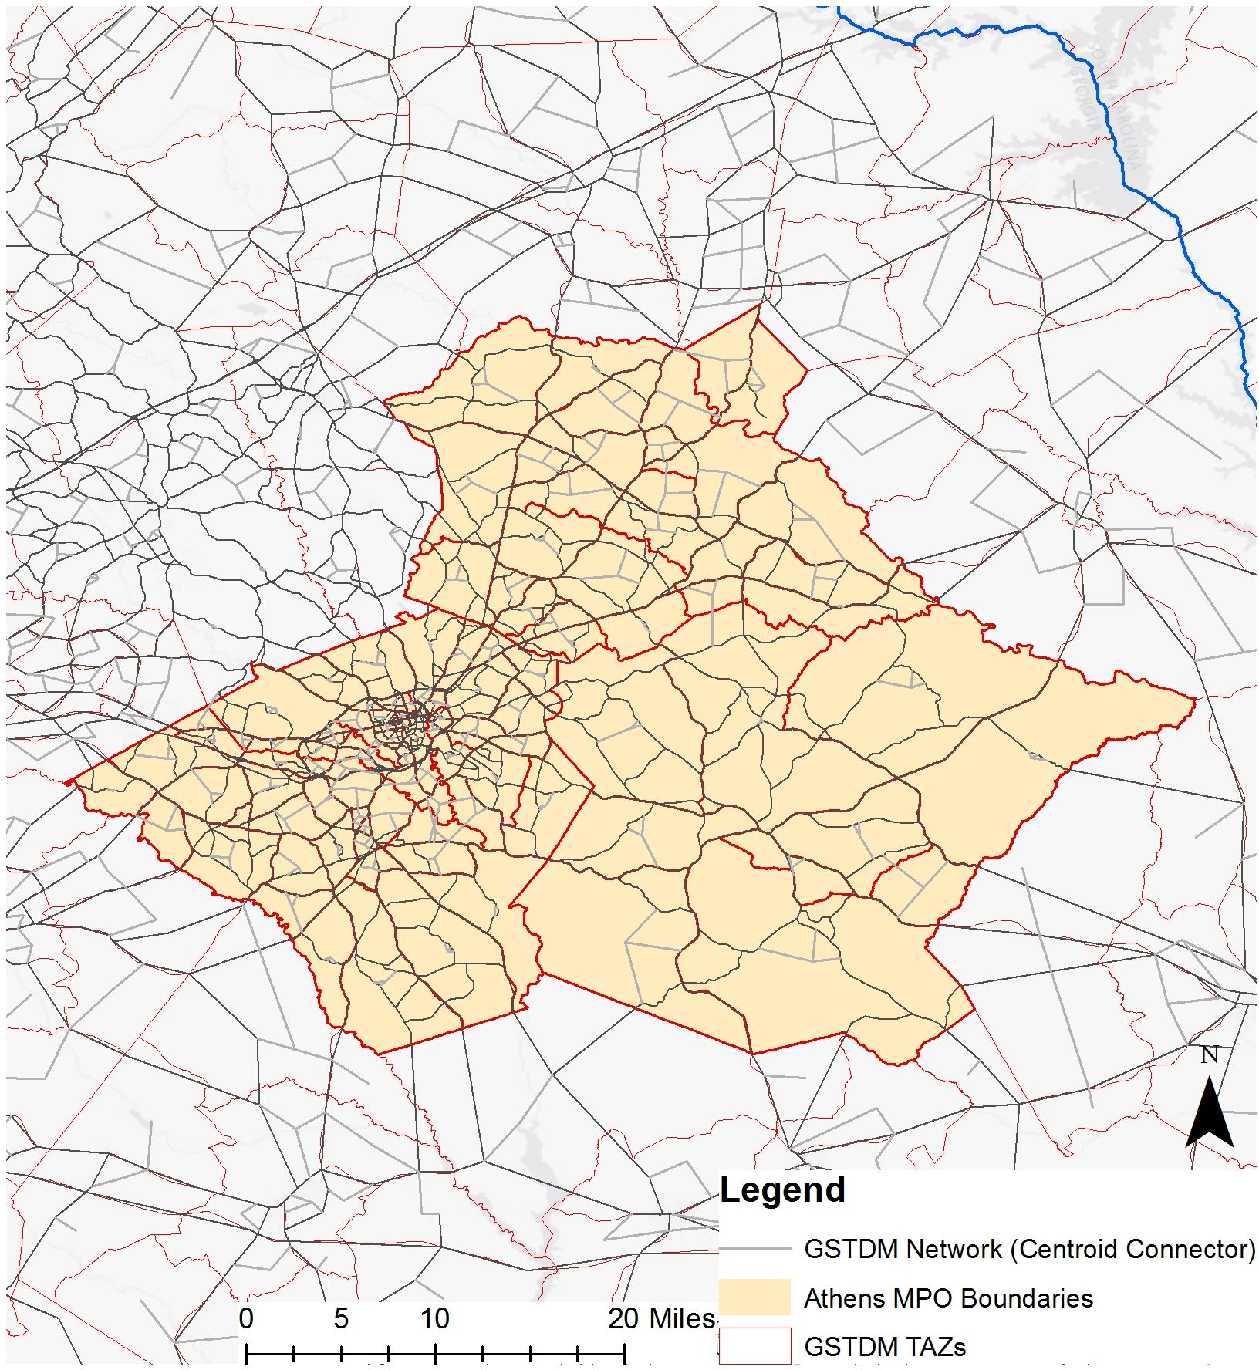
Step 2-3
Link MPO networks with GSTDM TAZs and run trip assignment

Slide 14
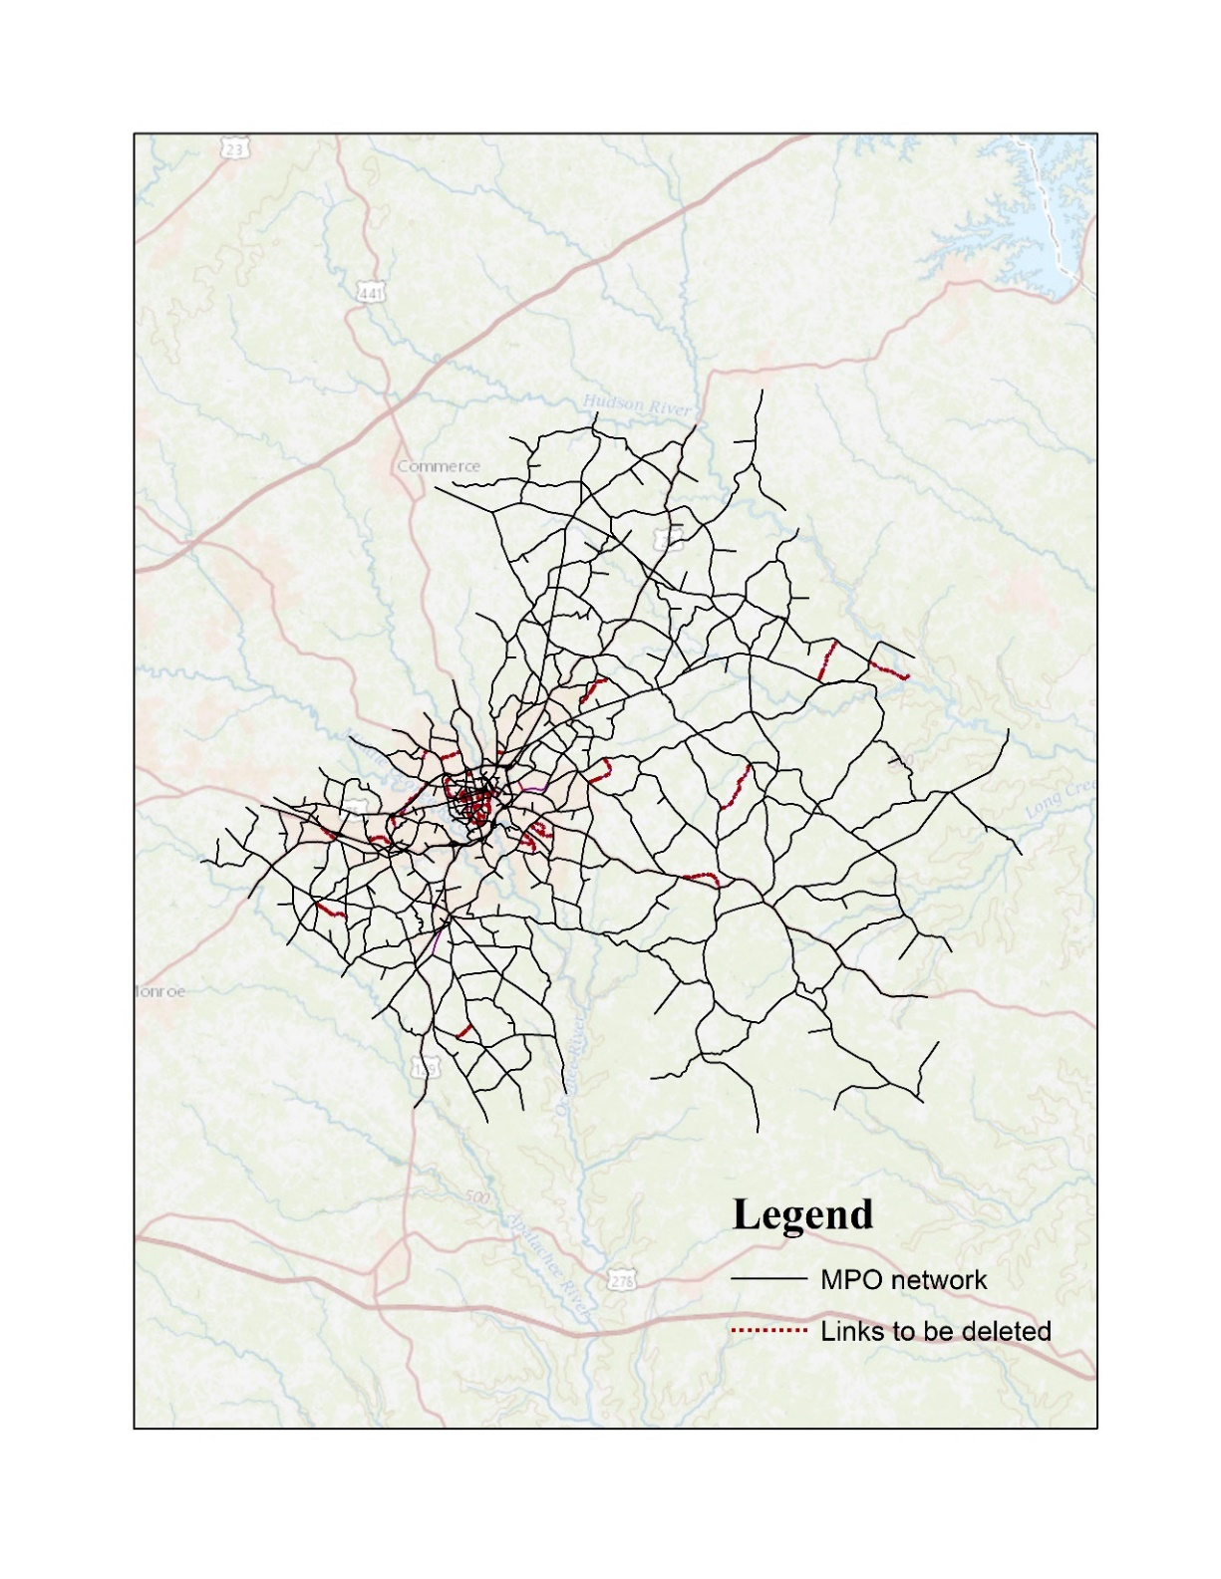
Step 4-5
Identify the portions of the MPO network that are relevant for statewide modeling purposes

Slide 15
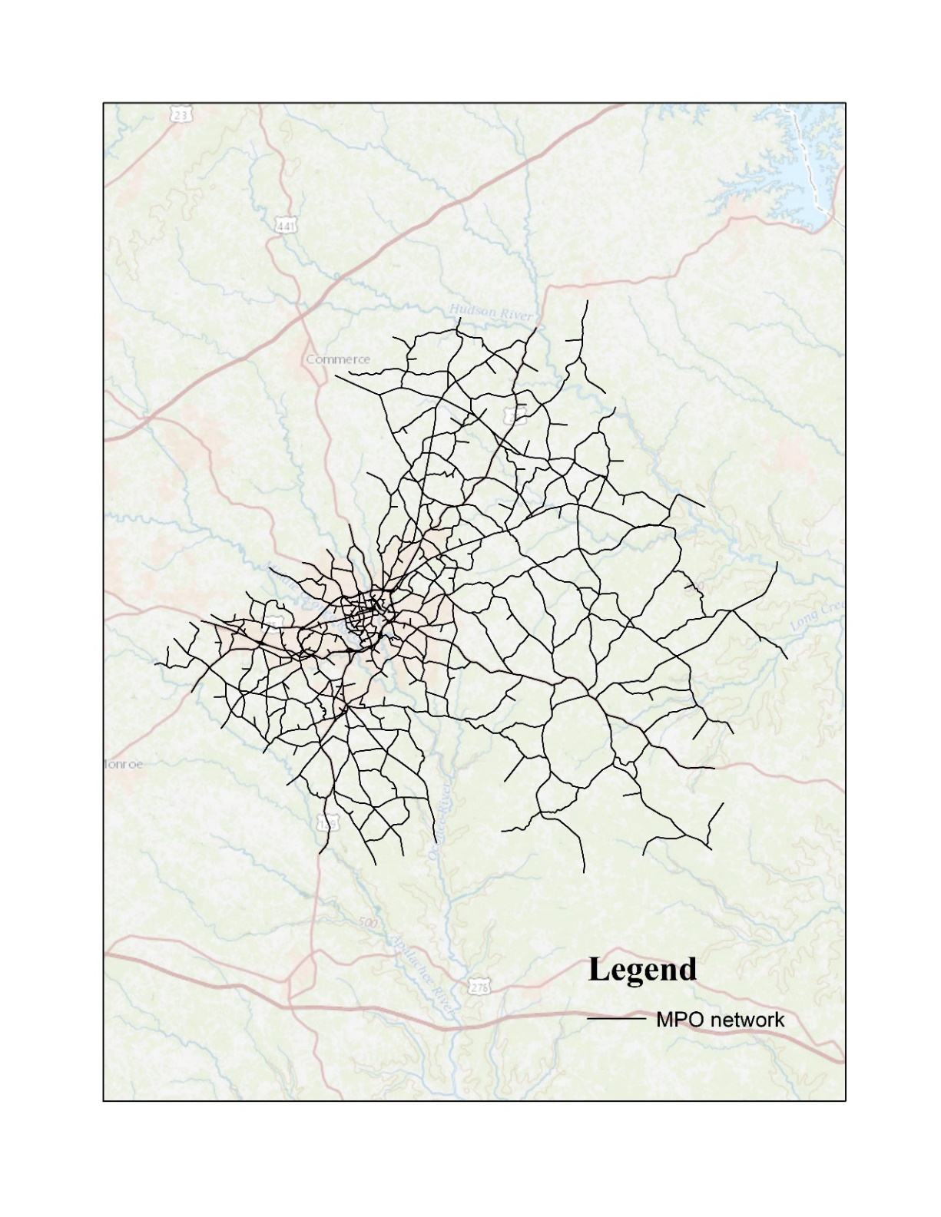
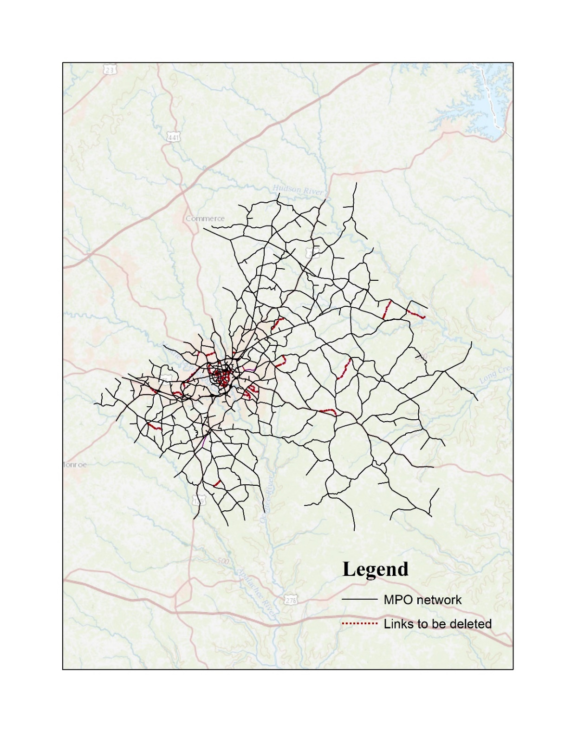
Step 4-5
Identify the portions of the MPO network that are relevant for statewide modeling purposes

Slide 16
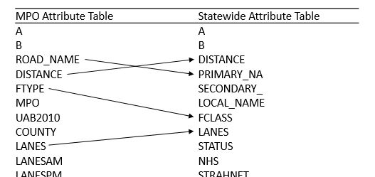
Step 6
Synchronize the attribute tables of the MPO and GSTDM networks

Slide 17
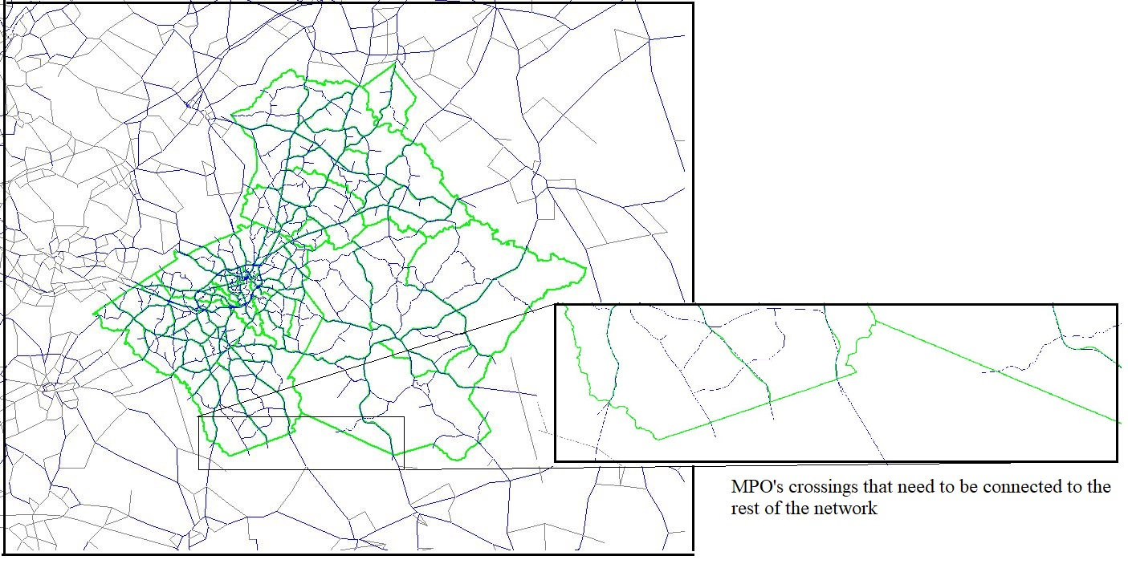
Step 7-8
Join the selection portion of the MPO network with the GSTDM network and connect the external stations

Slide 18
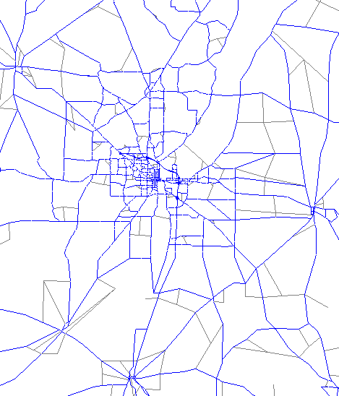
Step 9
Generate new centroid connectors for the MPO area based on statewide TAZs

Slide 19
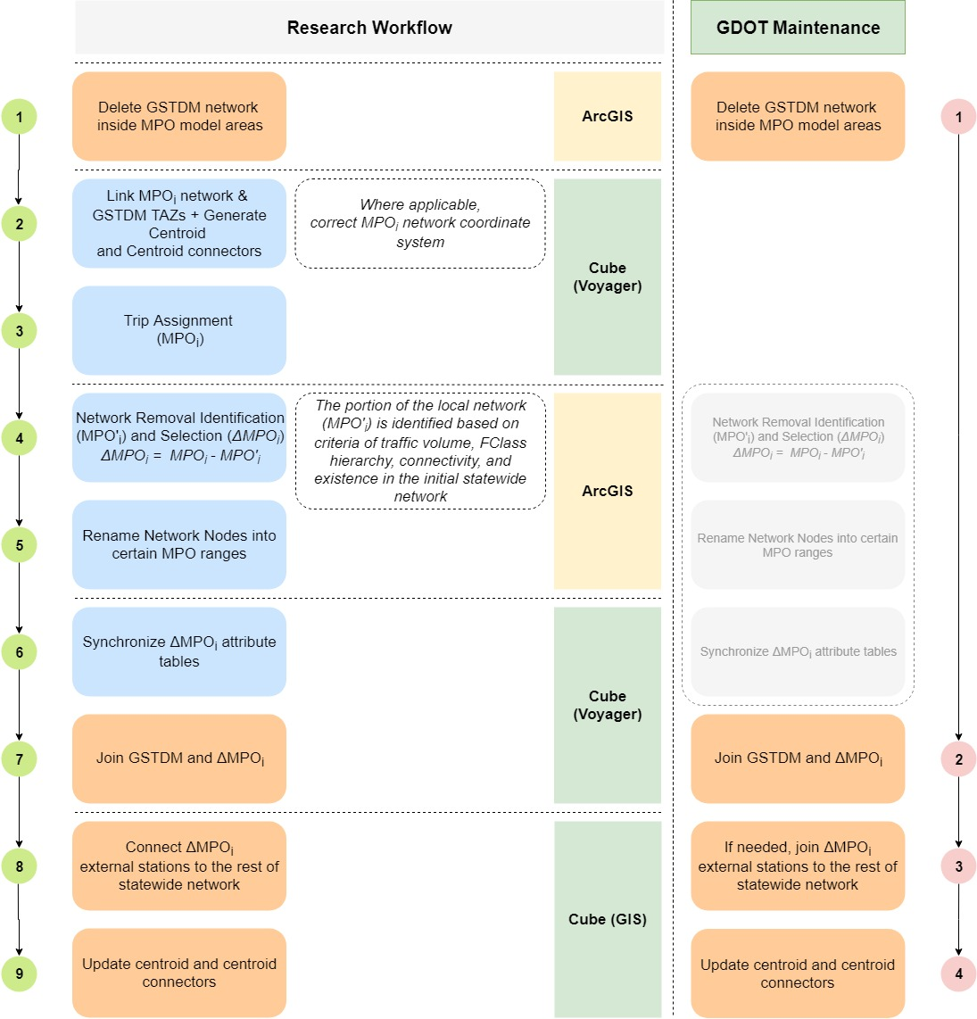
Network maintenance
Simplified maintenance: only a few steps will need to be run in future updates.
This will work as long as the appropriate changes in the MPO and GSTDM models are implemented and maintained over time.

Slide 20
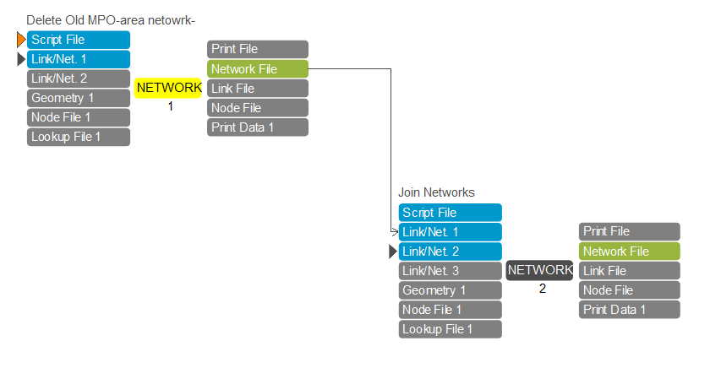
Cube maintenance catalogue
Fourteen steps in the catalogue per the 14 MPOs:
Everything is set up for each MPO
User simply needs to rename and transfer the statewide and MPO networks to the assigned folder
Run!

Slide 21
Recommendations
Adopt a protocol that uses the same sources and standards to generate and maintain socio-economic data, TAZs, and road networks, at both the statewide- and MPO-level.
Adequate consideration should be given to the benefits offered by increasing the total number of statewide TAZs, i.e., the same MPO-level TAZs in the GSTDM model.
Statewide and MPO models should use the same network attribute table.

Slide 22
Any Questions?!
Ali Etezady
(etezady@gatech.edu)

