Slide 1
Exploratory Scenario Planning in the Long Range Transportation Planning Process: The Atlanta Region’s Analysis Experience
17th TRB Transportation Planning Application
June 2019

Slide 2
The Atlanta Region’s Historic Growth Patterns and Low Transit Use Creates Unique Challenges
2nd Largest Geographic Urban Area in the Nation (in square miles); Lower-density in Nature
Rapid Growth Brings 90,000 New Residents Per Year (2017)
Most Residents Travel Outside of Their Home Communities to Work
Limited Transit Options Place an Overreliance on Driving Alone

Slide 3
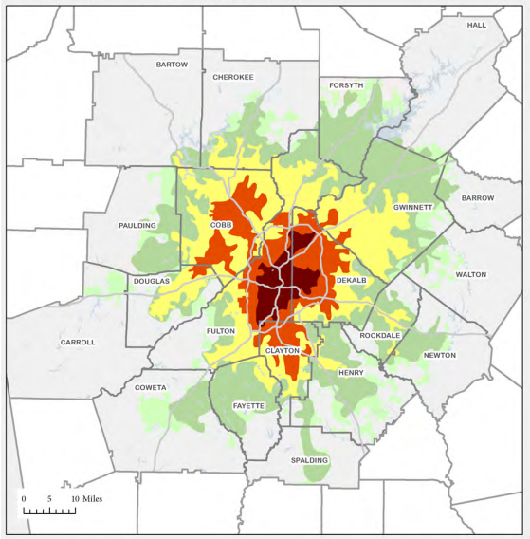
Since 1950 the Atlanta Region has Expanded Faster than Any Large Area in the Nation
Region Today
5.6 million people
2.9 million jobs
Region 2040
1950
8.1 million people
4.0 million jobs
1970
1990
2000
2010

Slide 4
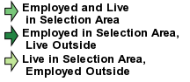
60% of Gwinnett County’s Employed Residents (over 206,000) Work Outside of the County
Source: US Census Bureau

Slide 5
There is no single path to “Win the Future”

Slide 6
“Normative” scenario development process
SHIFTS IN LAND USES
EXISTING
MODEL RESULTS
NEW TRANSPORTATION OPTIONS

Slide 7
Many type of Travel Demand Models
Trip
3 Step
4 Step
Hybrid
Hybrid-Tripbased
Hybrid-Tourbased
Tour
Aggregated Simple Tour based
Disaggregated Tour based
Activity
Standard
Advanced 4 step
Enhanced
Advanced
Notes:
There are many types of travel demand models. There is not one perfect model design. It has to be good for your purpose and needs.
The most important element is how we understand and we use the tool wisely.
My humble opinion, any model form is good as long as we understand the result and use that data well.

Slide 8
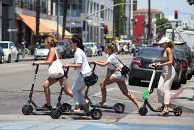

Slide 9
Exploratory Scenario Planning
Allows us to look at current and projected issues from multiple perspectives so our plans are dynamic and resilient.

Slide 10
Key Drivers of Change for the Atlanta Region
Water Supply
Autonomous Vehicles
Climate Change Regulations
Aging of the Population
Transportation Finance Structure
Intelligent Infrastructure/Technology
Spatial, Racial, and Economic Equity
Port Traffic
Ridehailing/
Carsharing
Notes:
These are the nine key drivers…

Slide 11
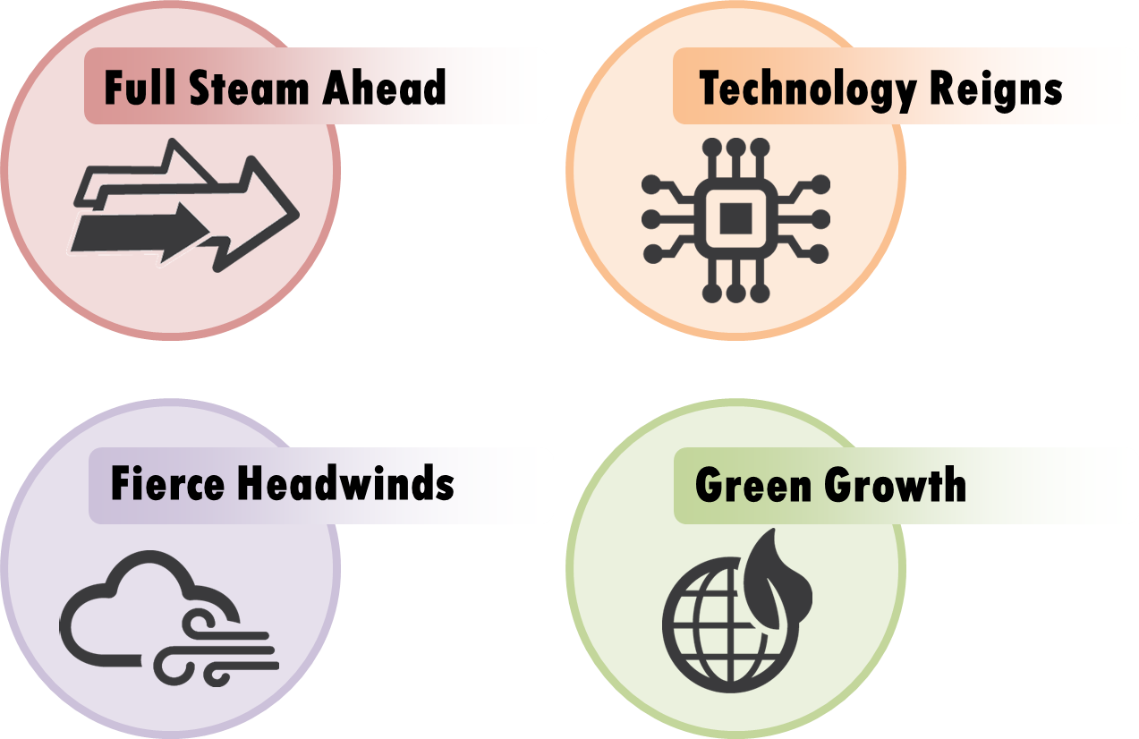
Identifying relationships between drivers is key to the development of alternate futures

Slide 12
Alternate futures analyzed
4
Baseline alternate futures
324 vs. 2
4
Key variables
Arterial lane miles
Transit service
Autonomous vehicles and car service use
Congestion charges
3
Settings per variable
Alternate futures to explore
High
Medium
Low

Slide 13
The actual future? Nobody knows.
Plausible Futures
Actual Future (?)

Slide 15
Personalized Alternate Futures
Notes:
We plan to use the scenario planning exercise and today’s conversation to begin to inform the planning process for the next long range plan update in 2020. However, we hope to expand the conversation beyond this building. With this in mind, we are planning to launch an online scenario planning visualization game…

Slide 16
Kyung-Hwa Kim
kkim@atlantaregional.org
470-378-1562
Performance Analysis and Monitoring Manager
Atlanta Regional Commission

