Slide 1

Analyze This: Multi-Geographic/Temporal Resolution (MG/TR) Performance Assessment
Web-based Analysis and Reporting Tools for NYSDOT and NYS MPOs
Catherine T. Lawson
University at Albany/Albany Visualization and Infomatics Lab (AVAIL)
TRBAppcon
June 2-5, 2019
Portland, Oregon

Slide 2



Project Partners:
University Transportation Research Center (UTRC)
NYSDOT
NYSAMPO

Slide 3

National Performance Measurement
Research Dataset (NPMRDS)
NPMRDS is an aggregated dataset made by the company HERE until Feb 2017, now aggregated by INRIX
  Provided by FHWA at no cost to states and MPOs
  Based on commercial and passenger probe data
  Collected and post-processed into 5-minute intervals
  Geo-located on the National Highway System (NHS)
  Segmented into Traffic Message Channels (TMCs)
    Based on navigational software company (Garmin/TomTom) needs
Big Data: Terrabites in size, the subset being examined contains 441,000,000 Data Points

Slide 4
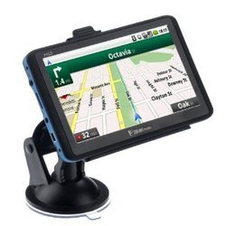

Source of NPMRDS Probe Speed Data
GPS
Phone

Slide 5
Performance Measures
Map-21 (PM3) Reporting

Slide 6
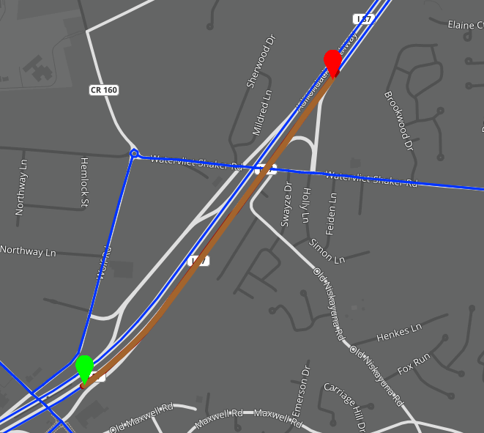
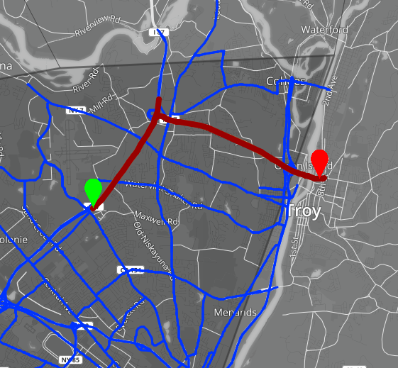
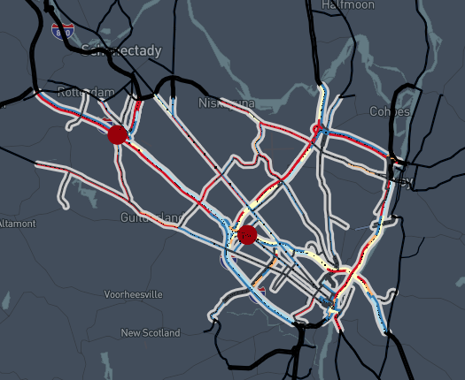
Multi-Geographic Resolution:
Segment || Route || Multi-Route Corridor || Network
Creation and editing tools make geographies
fully customizable

Slide 7
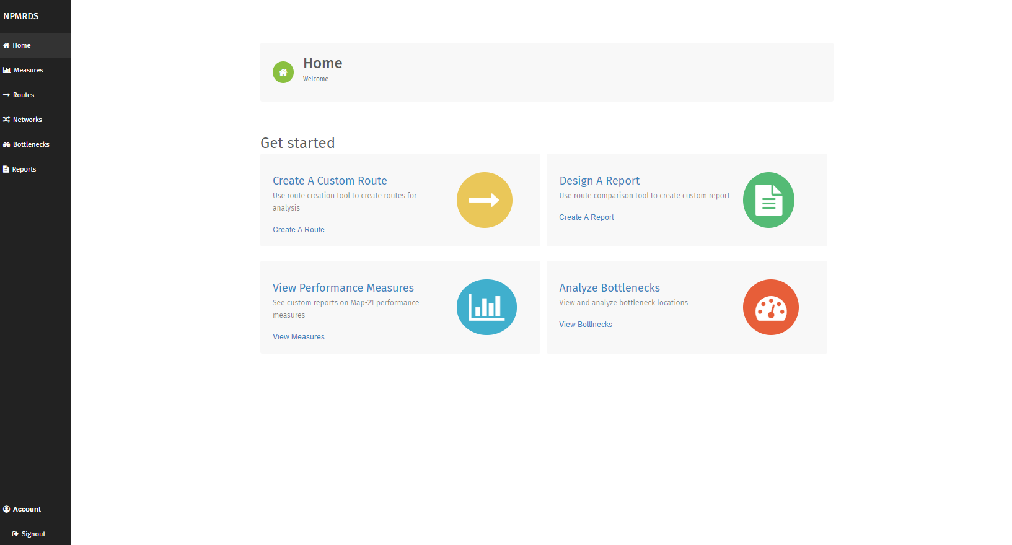
The NPMRDS Dashboard

Slide 8
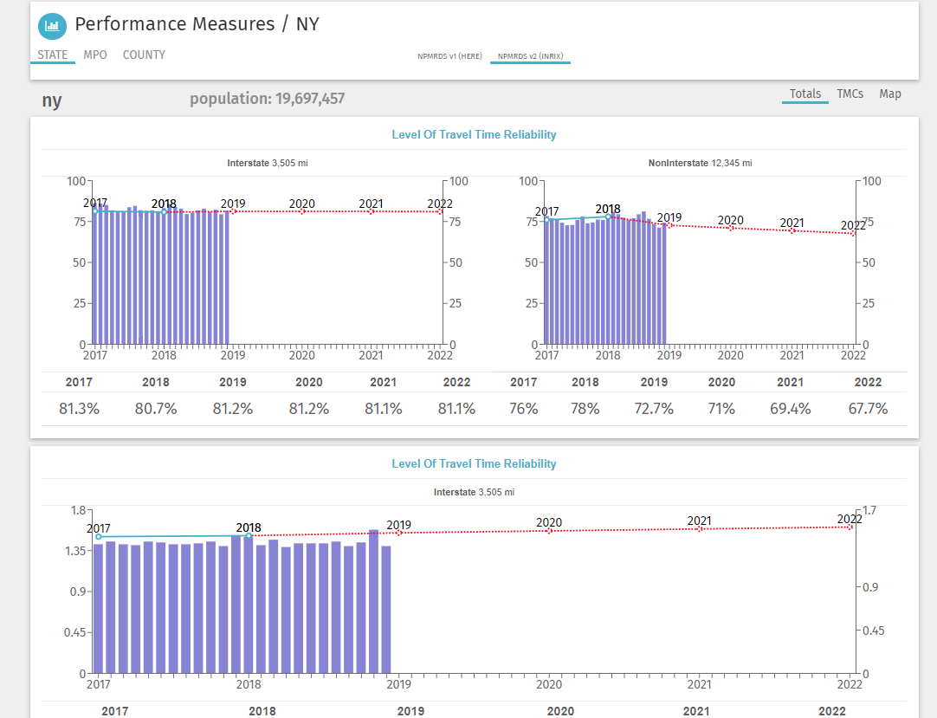
NPMRDS Tool for State PM3 Reporting

Slide 9
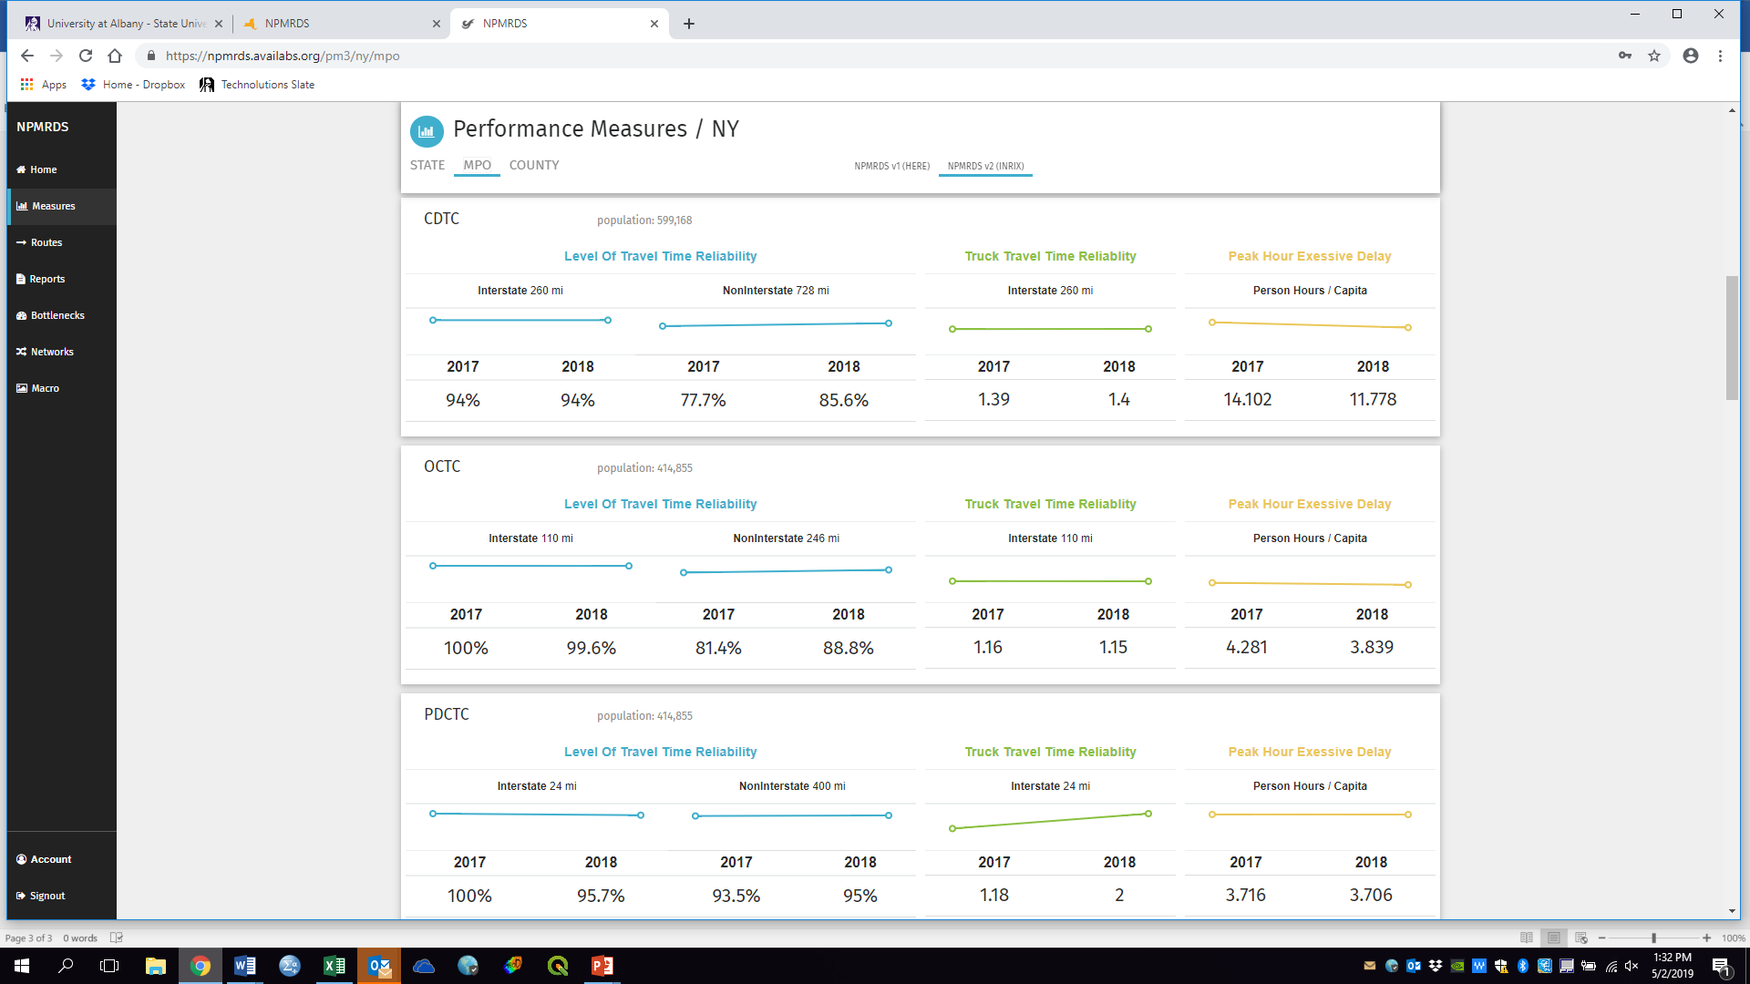
NPMRDS Tool for MPO PM3 Reporting
Peak Hour Excessive Delay
Peak Hour Excessive Delay
Peak Hour Excessive Delay

Slide 10
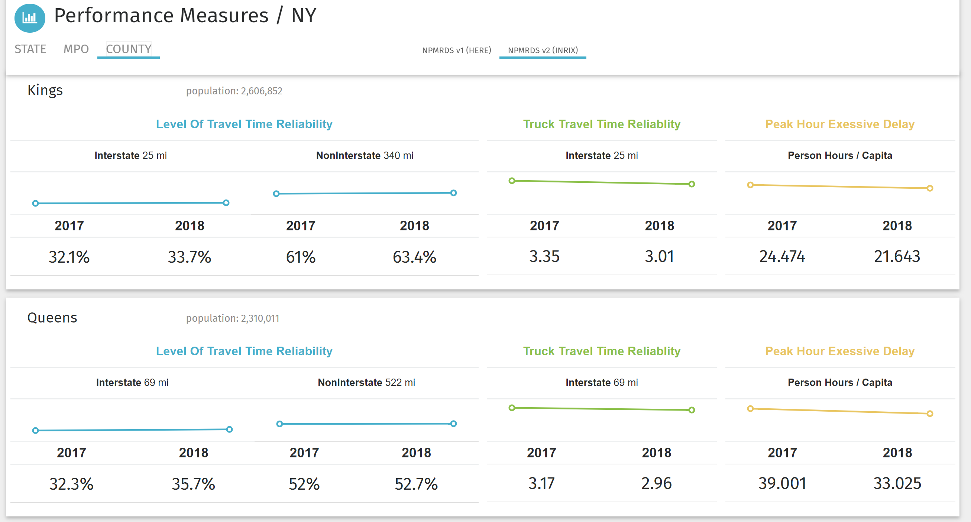
Performance Measurement Tool for County Level:
Compare PM3 measures within MPOs across the state
Peak Hour Excessive Delay
Peak Hour Excessive Delay

Slide 11
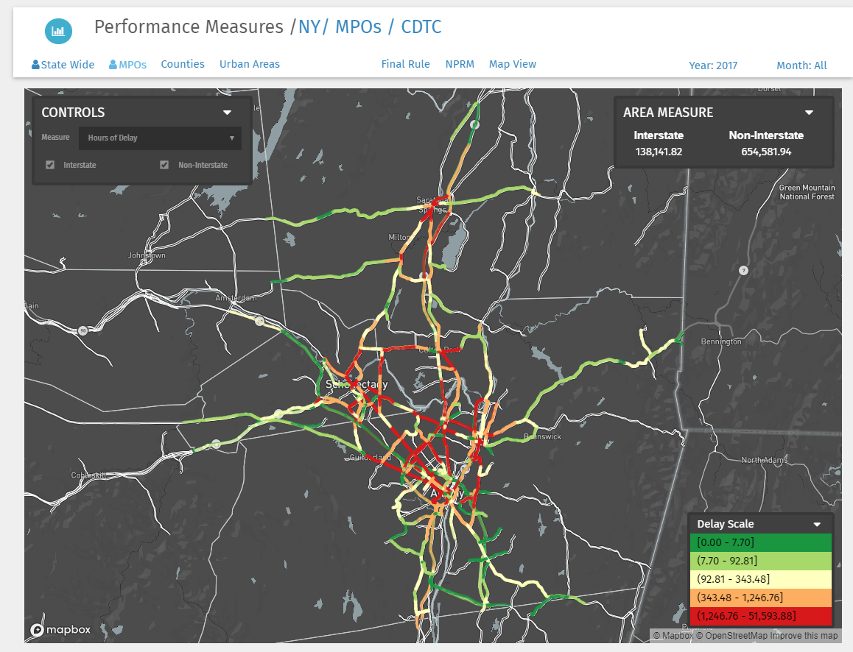
Map-21 Performance Measure Scores by Segment
Hours of Delay in the Capital Region (CDTC)

Slide 12
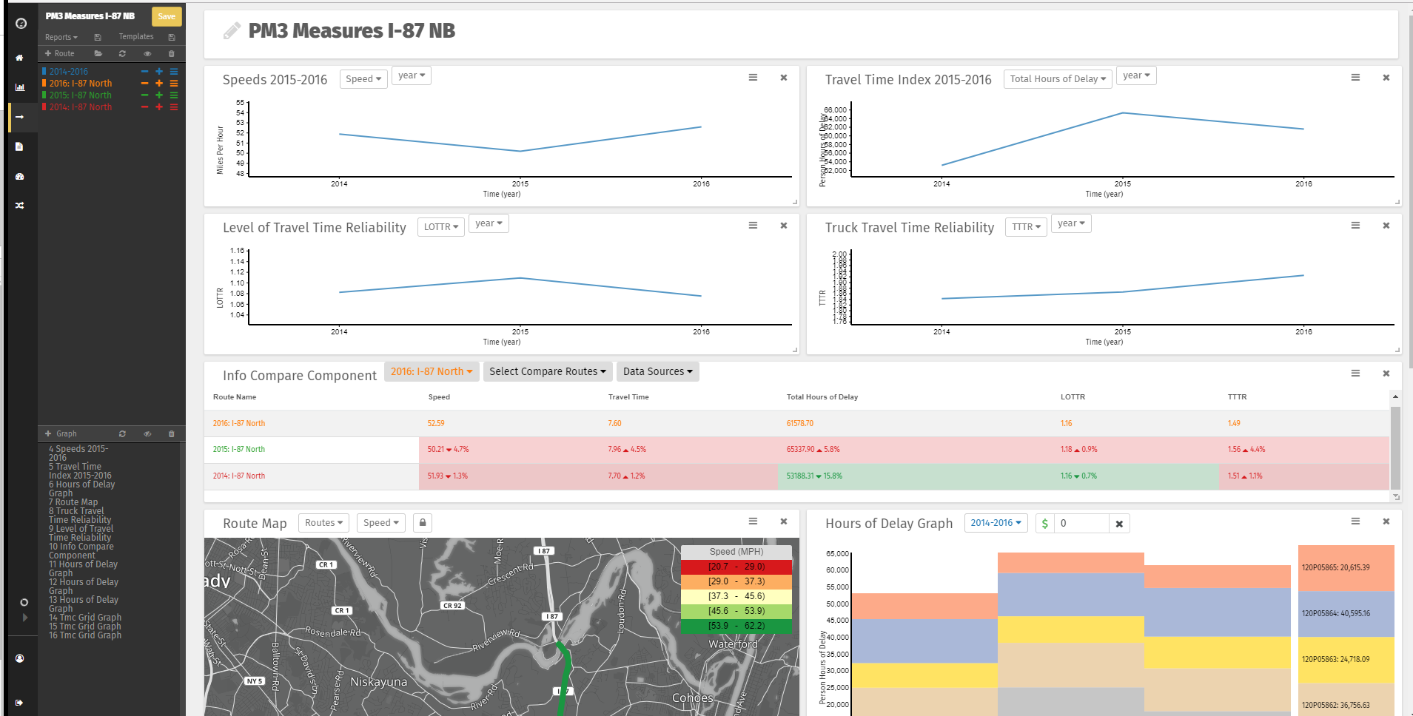
Digging Deeper: Pinpoint Analysis of
PM3 Performance Measures on Routes and Corridors

Slide 13
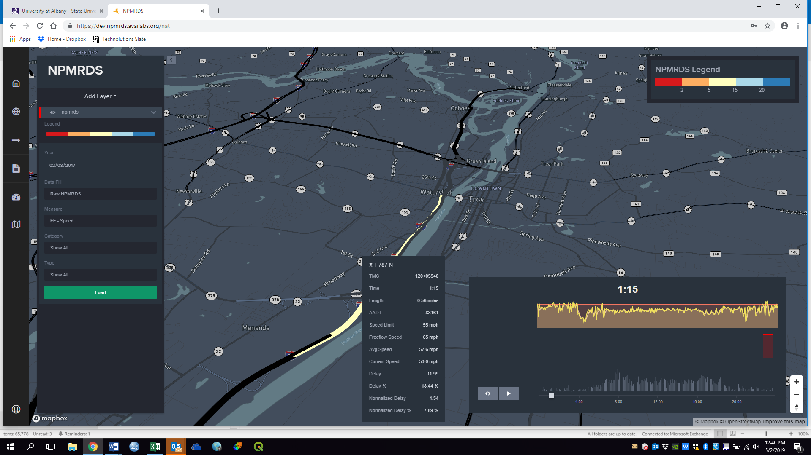
Data in Action:
TMC Level Analysis Tool

Slide 14
Network Selection:
TMC Identification Details

Slide 15
Specific Day 5-minute Analysis

Slide 16
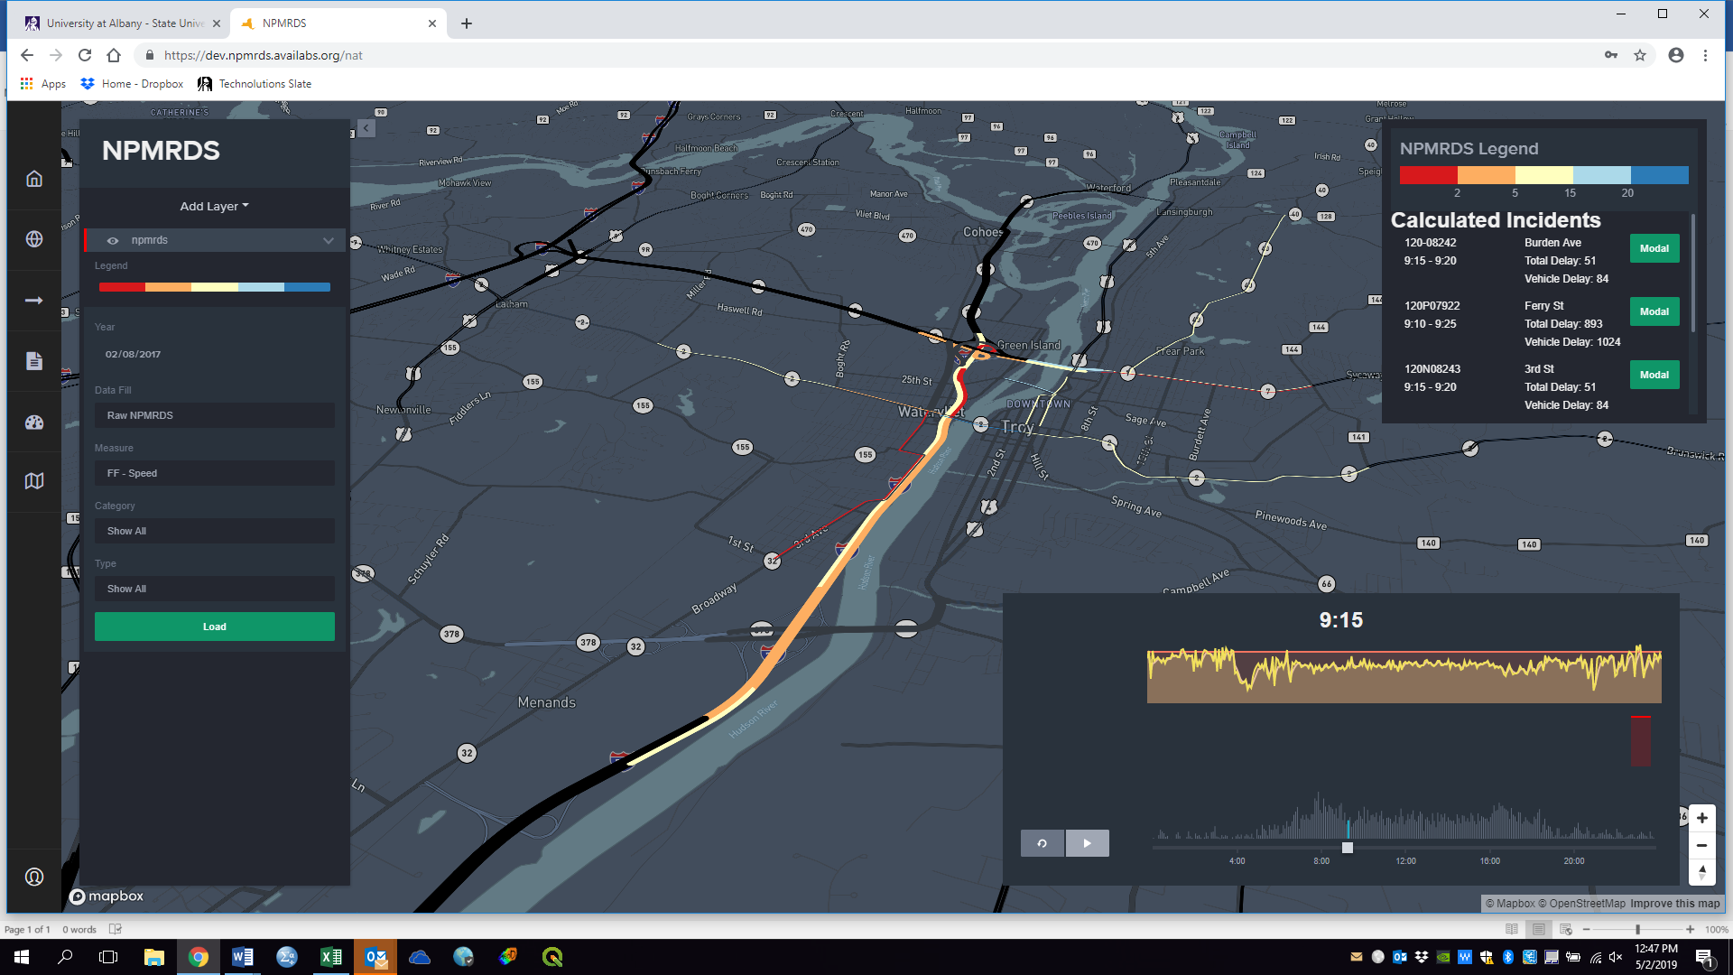
Calculated Incidents Analysis

Slide 17
Incidents Analysis Mapped on the Network

Slide 18
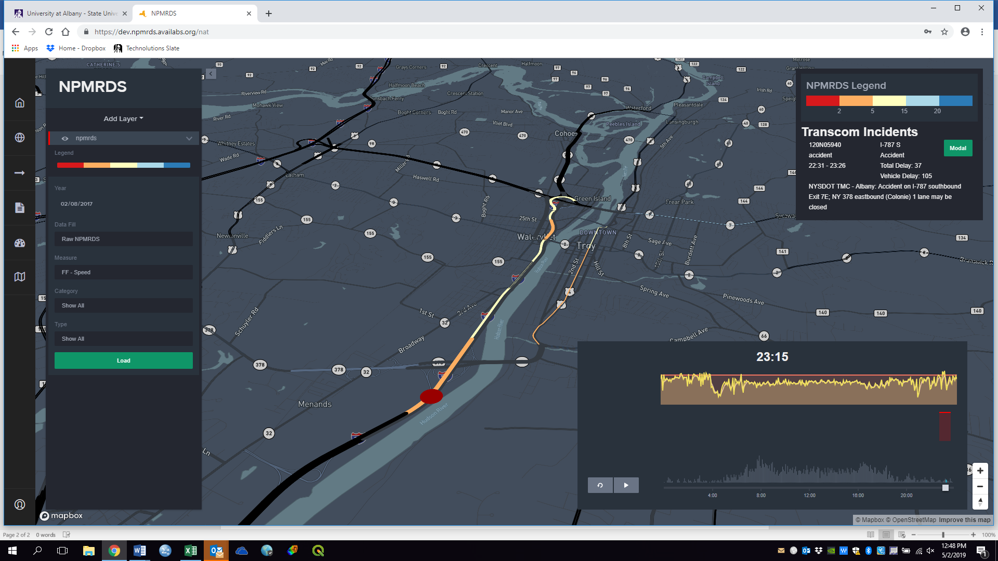
TRANSCOM Incidents Analysis

Slide 19
TRANSCOM Incidents Mapped on the Network

Slide 20
TRANSCOM Incidents Identified on the “Clock”

Slide 21
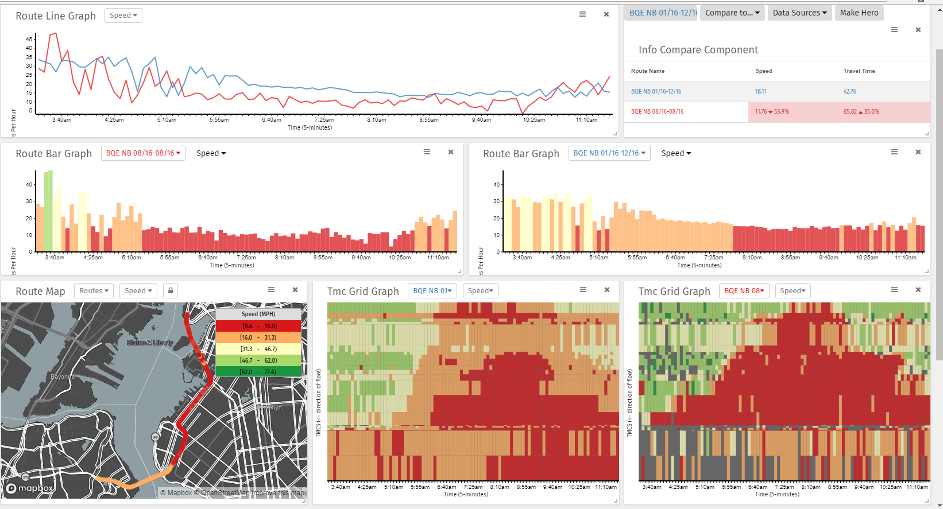
Incident Case Study: Beer Truck Rollover on the BQE

Slide 22
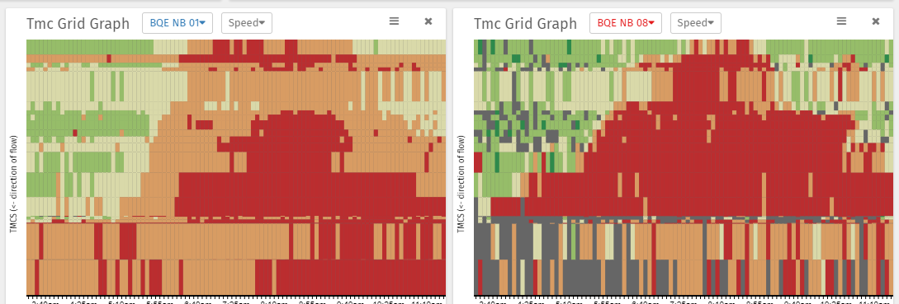
Incident Case Study: Beer Truck Rollover on the BQE
Average Day
Incident
Direction of Travel
Time Of Day

Slide 23
QUESTIONS?
Contact Info:
Catherine T. Lawson, PhD
lawsonc@albany.edu
Albany Visualization and Informatics Lab (AVAIL)
www.availabs.org

