Slide 1
Practical methods for incorporation of Autonomous Vehicles (AVs) in an activity based travel model and scenario analysis
Gaurav Vyas, Peter Vovsha (INRO)
Pooneh Famili (WSP)
Greg Giaimo, Rebekah Anderson (Ohio DOT)
Vladimir Livshits, Haidong Zhu (MAG)

Slide 2
Requirements for consistent modeling of AVs
One generic approach that can handle regular vehicles and AVs in a single modeling framework:
  Not a special AV model or post-processing!
  AV penetration rate as a scenario parameter:
    If 0% - standard ABM for all HHs
    If 100% - AV version for all HHs
    If between 0% and 100% - HHs are split into 2 groups
    Separate penetration rate for shared AVs in TNC
  Other essential parameters / AV assumptions:
    Listed in the global control file
    Due to many factors of uncertainty multiple scenario analysis is essential

Slide 3
AV impacts reflected in travel model

Slide 4

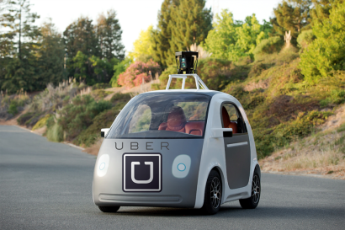
AV impacts on travel demand
How vehicles are used:
  Non-drivers will have access to cars
  Cars become available at any location any time
  Empty repositioning trips to facilitate intra-household car sharing and avoid parking cost
Home
Work
Shop
Shop

Slide 5
AV impacts on travel demand
How people view travel:
  In-vehicle time productivity → Improved accessiblity
  AV as access mode to transit
3 plagues of transit access today:
Walk too long
PNR needs parking and extra car
KNR needs driver
AV solves all 3!
Home
K_{R}NR
Work

Slide 6
AV routing layer
Translation of person trips to vehicle trips is non-trivial for AVs

Slide 7
AV impacts on network performance
Improved capacity and speed
Capacity improvement curve
Speed improvement curve

Slide 8
Parameters introduced for scenario analysis
Owned AV Proportion
0%
100%
Shared AV Proportion
0%
100%
Auto In-vehicle time productivity bonus
0%
Same as non-AV
75%
Perceived auto travel time 25%
Minimum age for travel alone
5 years
16 years
Current license age
AV TNC Fare discount
0%
100%
Free AV TNCs
Roadway capacity improvement factor
1
No improvement
2
Double capacity for 100% AV
Speed improvement factor
1
No improvement
1.5
50% faster

Slide 9
Scenarios: Phoenix, AZ
Scenario Id | Scenario name | HH Owned AV proportion | TNC AV proportion | TNC AV discount | Auto IVTT productivity bonus | Minimum age for travel alone | TNC promotion factor | Capacity improvement |  | Speed improvement
 |  |  |  |  |  |  |  | Freeways | Other | Freeways | Other
1 | Owned convenient AVs | 100% | 0% | 0% | 50% | 16 | 0 | 1 | 1 | 1 | 1
2 | Owned access AVs w/ road cap effect | 100% | 0% | 0% | 25% | 10 | 0 | 1.50 | 1.25 | 1.25 | 1
3 | Shared AVs/TNC | 0% | 100% | 90% | 0% | 16 | 0 | 1 | 1 | 1 | 1
4 | All effects | 100% | 100% | 90% | 50% | 10 | 0 | 2.00 | 1.50 | 1.35 | 1
5 | Very convenient TNC | 0% | 100% | 90% | 0% | 16 | 3 | 1 | 1 | 1 | 1

Slide 10
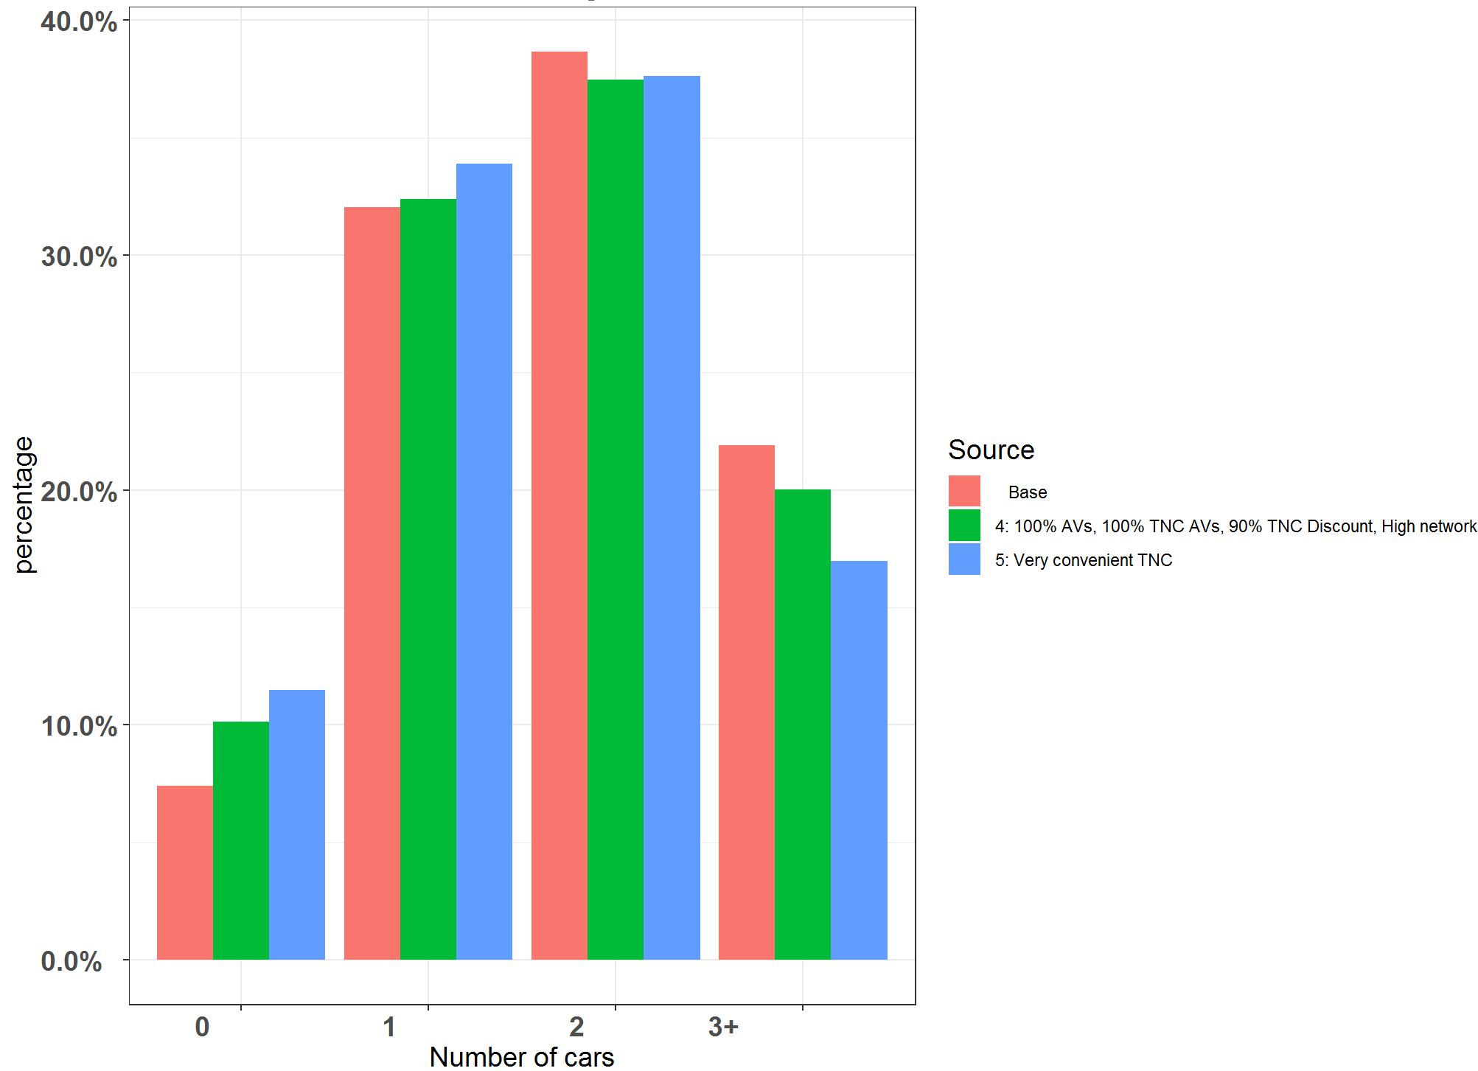
Impact on car ownership
Decrease in car ownership due to cheap TNC and AVs
Notes:
Model does not see cost of owning a vehicle
The model may require further tuning to logically decrease car ownership in extreme TNC scenarios

Slide 11
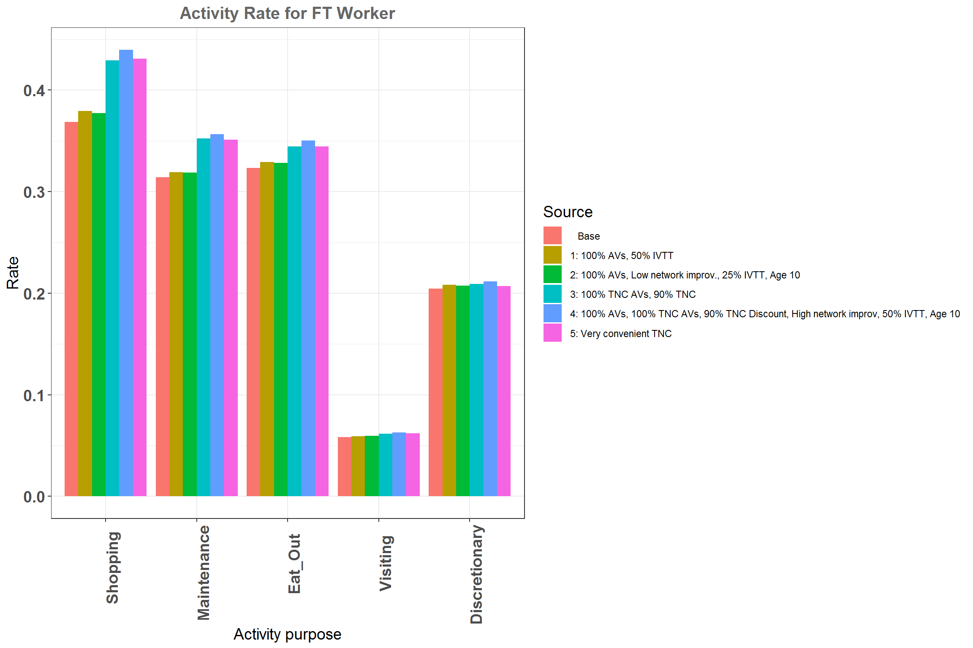
Impact on activity participation: Full-time workers
Increase in activity participation rate due to improvement in accessibilities
Notes:
Substantial increase in activity rates for shopping, maintenance, and eat-out

Slide 12
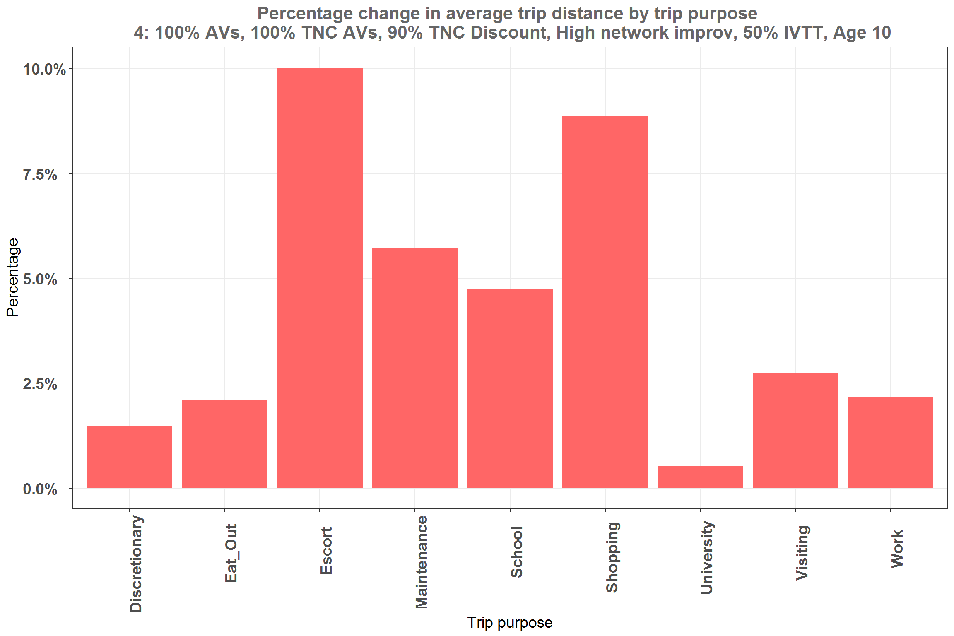
Impact on trip length: All Effects scenario
Increase in average trip length
Not substantial increase due to land-use and time-space constraints
Notes:
Increase in average trip length due to change in perception of auto IVTT. Though the change is not as substantial as some other research. 1: Land-use is same, 2: time-space constraint. Discounting the travel time coefficient does not mean that individual has double the time for travel. The model still operates with fixed time budget of 24 hrs

Slide 13
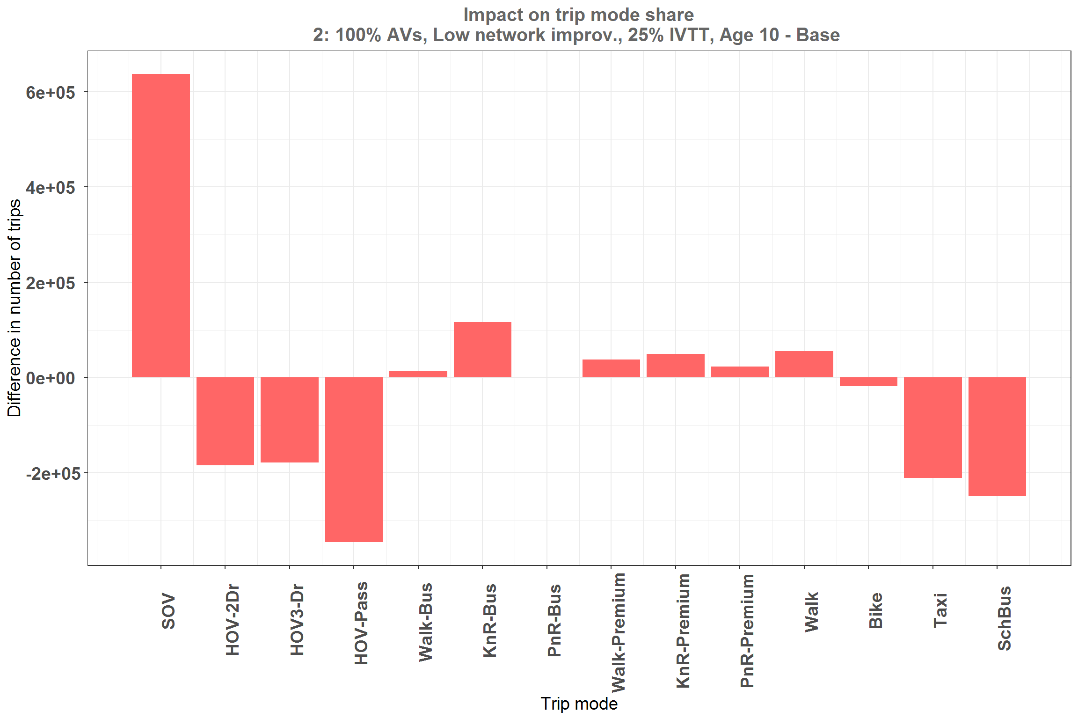
Impact on mode choice: 100% Owned AVs
Increase in SOV
Decrease in HOV passenger
Decrease in school bus
Increase in Transit
Notes:
Cheap TNC still a very attractive alternative. The decrease in number of SOV trips is lesser than previous scenario which didn’t have private AVs

Slide 14
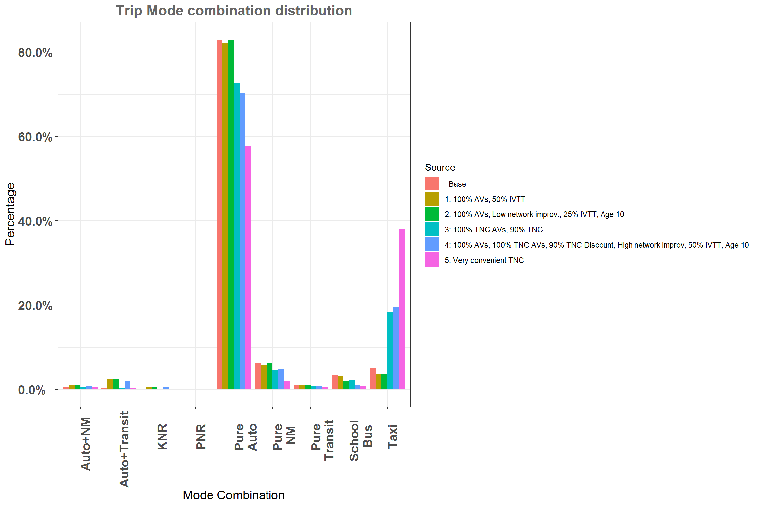
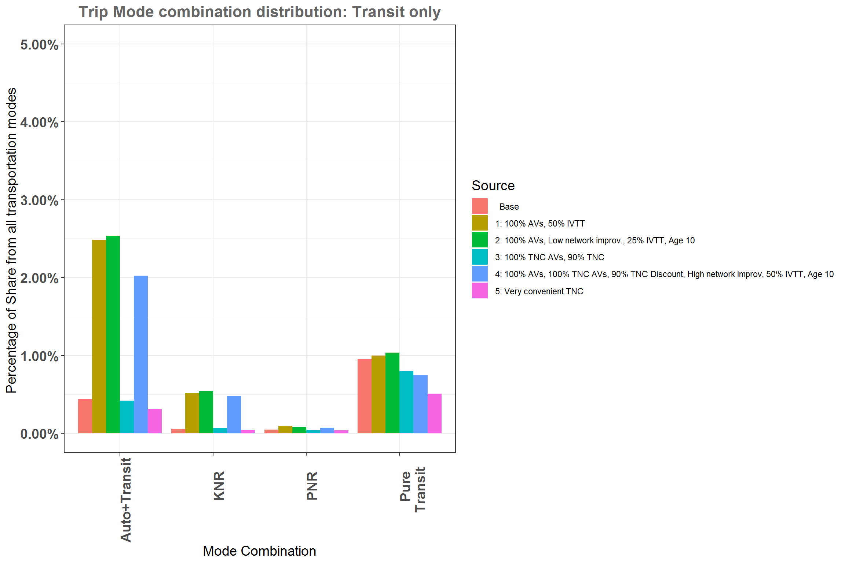
Impact on multi-modal tours
Increase in Auto+transit tours for owned AV scenarios
AV solves first and last mile issue
Notes:
Property of Avs that they can be made available at any place and any time made it easier to use it with other travel modes. For AV scenarios, we see an increase in auto+transit and KNR tours.

Slide 15
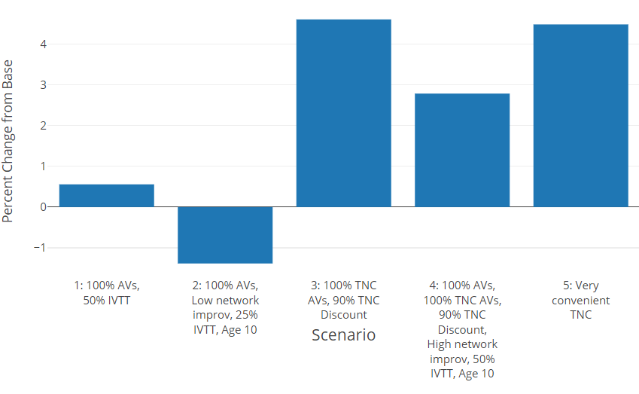
Impact on regional person trips
Notes:
Reduction in person trips in scenario 2 is due to reduction in school escorting stop on commute tours.
Cheaper TNC improved the accessibility significantly led to a significant increase in number of person trips

Slide 16
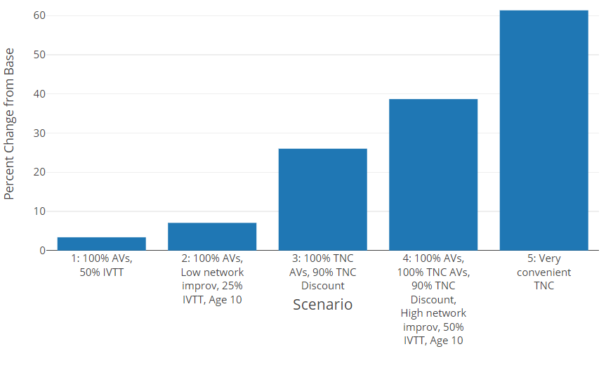
Impact on regional vehicle trip
60% increase for Very Convenient TNC scenario
Notes:
Add a lot of short empty trips for TNC scenarios. Impact on total VMT?

Slide 17
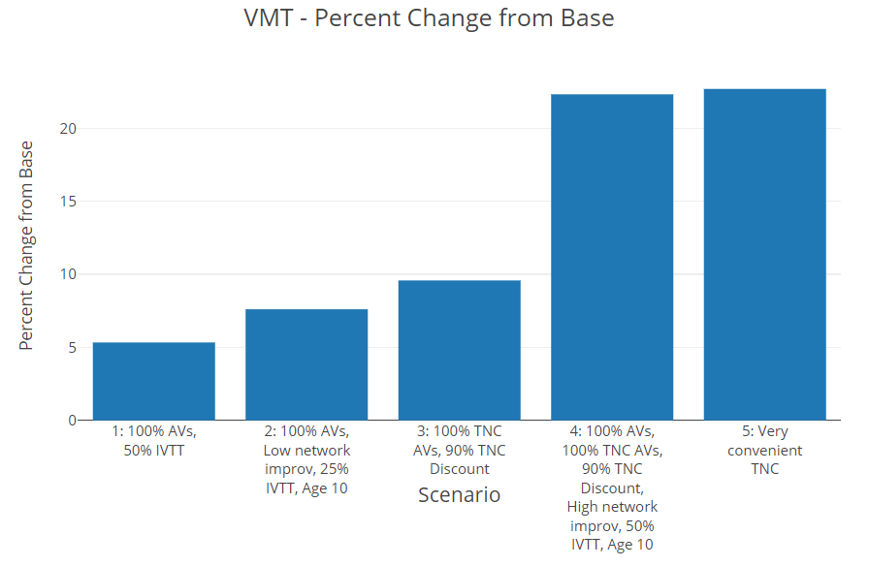
Impact on regional VMT
23% increase for Very Convenient TNC scenario
Notes:
Even though 60% increase in vehicle trips, VMT increase is close to 25%. Shows empty short trips.

Slide 18
Key conclusions
Advanced ABM is the most appropriate tool to incorporate a wide range of AV impacts and effects:
  More fundamental activity participation changes
  More fluid travel arrangements, tour structure, and car use
The impacts are less significant compared to many previous studies:
  Many previous studies were based on a priori assumptions
  Not that much growth in trip rates, trip length, and VMT
    AVs changes the perception of travel but not the physical time available
Modal shift:
  Transit mode redistribution is favor of rapid transit and K_{R}NR
Most substantial changes:
  Less escorting
  More multi-modal combinations
More scenarios are required!

