Slide 1
Dynamic Traffic Assignment Modeling in the South Puget Sound area Thurston Regional Planning Council
TRB Applications Conference
June 2, 2019

Slide 2
TRPC MODELING Team
Clyde Scott – Senior Transportation Modeler – scottc@trpc.org
Aaron Grimes – Senior Transportation Modeler – grimesa@trpc.org
Theressa Julius – Associate Planner – juliust@trpc.org

Slide 3
Overview

Slide 4
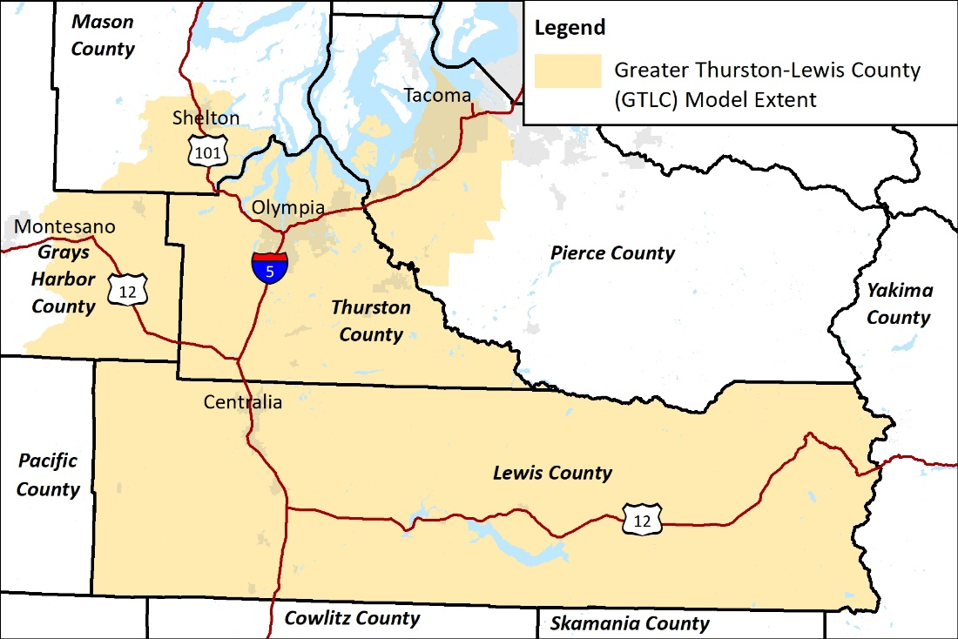
Macro Travel Demand Model
Multimodal
since 1990s

Slide 5
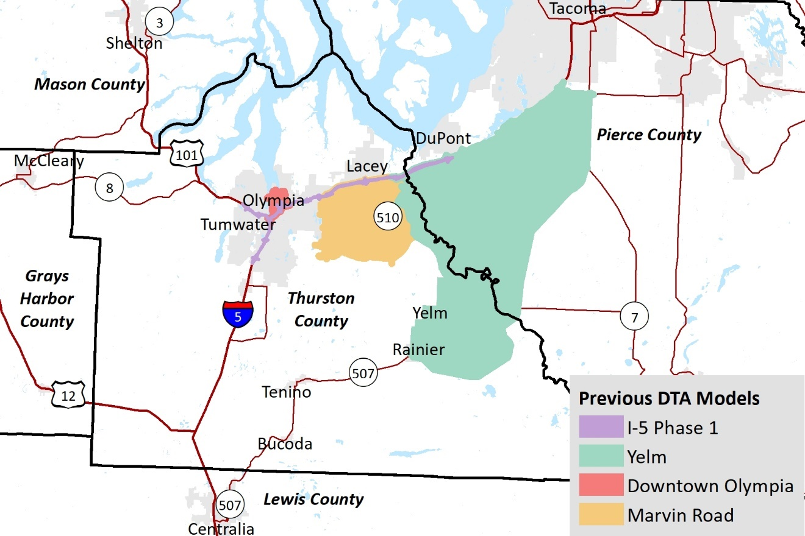
Subarea DTA Models
2016/2017

Slide 6
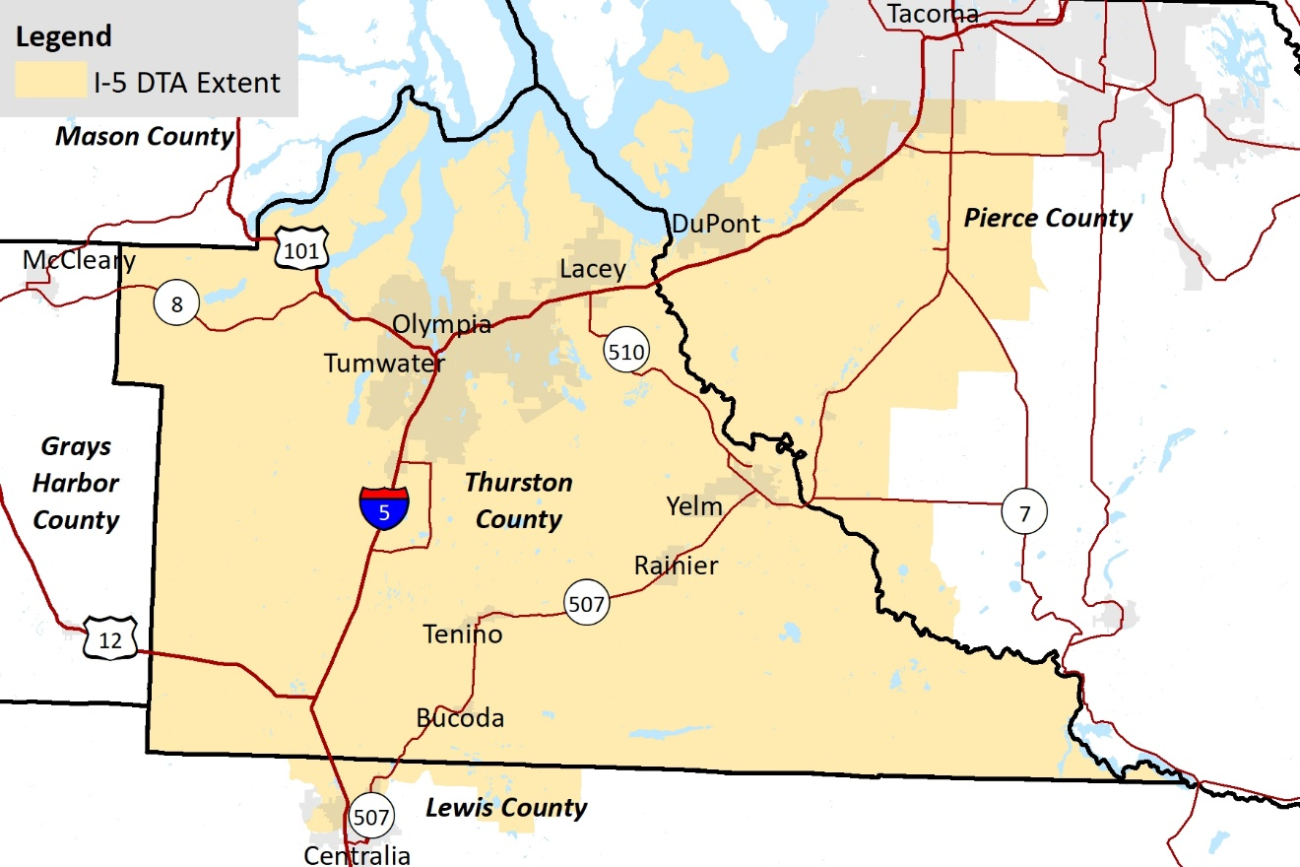
Regional DTA

Slide 7
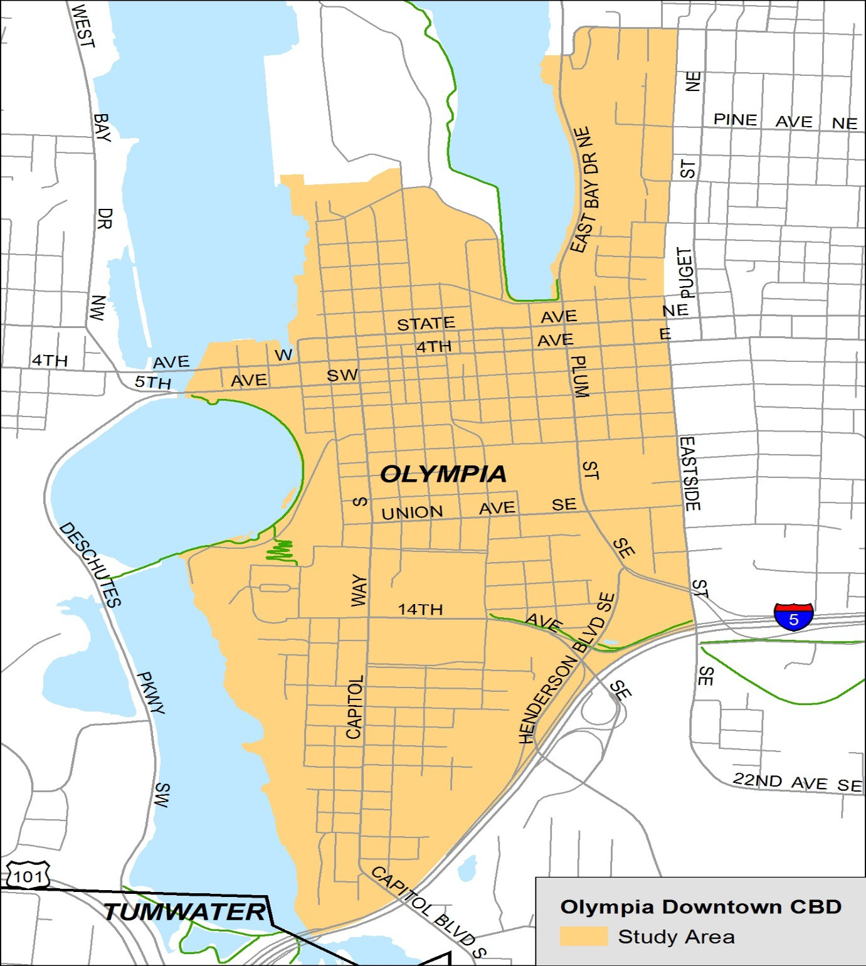
Downtown Olympia DTA

Slide 8
Purpose
Analyze alternative configurations of the major north-south street (Capitol Way & Washington St.)
A variety of lane reduction strategies to accommodate bike lanes

Slide 9
Downtown Olympia DTA
Notes:
Parking maneuvers delays that influential travel and signals on Capitol Way – 23 second per vehicle to parallel park based on field observations.
Parallel Parking (PP) – (Red) (unused mode) used to simulate the traffic blockage/delay during the parking event. With all other vehicle types are Lt. Blue.
We modeled 25 parking events in the corridor between 3-4 pm - 12 NB and 13 SB

Slide 10
Challenges
Sizing the sub area
Synchro integration for signal optimization
Calibrating the gridded downtown detail

Slide 11
I-5 Study

Slide 12
Purpose
Analyze a range of alternatives for the I-5 Corridor through urban Thurston County after improvements are made on the freeway to the north.
Alternatives range from land use alternatives to travel demand management to transit to widening
Needed both AM and PM models

Slide 13
Regional DTA Detail
Network -1,283 Centroids & 3,083 road miles
In Thurston County
950 TAZs – 2,197 road miles
280,000 population, Signals (233), gates, ramp meters, roundabouts, diverging diamond interchange, turn pockets, truck lane/road restrictions
Demand 5 hrs in 30 min increments: 10 Trip Tables
District to District demand adjustment in macro model

Slide 14
Regional DTA used for I-5 Project
Corridor improvements underway
Study Area

Slide 15
I-5 DTA
Mounts Road Area

Slide 16
Challenges
Demand adjustment counts and DTA flow
Calibration / Validation
Signal optimization (maximize throughput) in 2040 for periphery
Range of performance measures

