Slide 1

Metro’s Multi-Criteria Evaluation toolkit
Linking benefit-cost principles, social equity analysis
and data visualization into transportation planning

Slide 2
MCE Motivation
Enhance Metro’s transportation decision-support methods:
  Use benefit-cost analysis in a “triple bottom line” framework
  Treat travel forecast outputs and costs comprehensively (“roll-up”)
  Make different measures comparable (“apples to apples”)
  Understand who benefits (“equity”)
  Do all the above reasonably quickly & efficiently (“cost-effective analytics”)
Support Multiple Levels of Analysis:
  Plan (e.g. RTP)
  Corridor or “Package” (e.g. Value Pricing Phase 1)
  Major Projects (BRT and Highway Expansion)
Notes:
Use benefit cost analysis in a “triple bottom line” framework: Our agency is being asked to address new, more comprehensive set of planning and policy questions related to 1) Economic Vitality of the region 2) Environmental Stewardship and 3) Social Equity impacts.
Treat forecasts and costs comprehensively: Support our decision support systems by including a more comprehensive set of criteria – rather than just looking at traditional transportation BCA measures of travel time savings, reductions in emissions, increasing safety and vehicle operating cost savings…..we’ve included the health benefits of physical activity, accessibility improvement benefits, travel time reliability and veh. ownership cost savings.
Comparable measures: more comparability between criteria when monetizing benefits allows for “apples to apples” comparison
Equity: more explicit equity analysis allows us to better understand who is both served and underserved in various transportation investments.
Cost effectiveness: benefits calculator is integrated with the regional travel demand model. It operates at the same geographic, mode and market segmentation detail needed in our transportation BCA.

Slide 3
Benefit-Cost Principles
Uses monetary value as the metric to support decision-making by making different characteristics comparable.
Q: Does an investment (relative to no or different investment) produce more benefits than costs?
  To invest or not to invest
  To prioritize investments
  To better “design” a given investment
Q: Who benefits?
  Harder to answer this question with past tools

Slide 4
Total Benefits--“Rollup”
Notes:
The end result of the MCE toolkit is a rollup or scorecard. An example of which is shown here in the 4 column table.
- On the left are the triple bottom line initiatives.
The second column in from the left are the 10 benefits being measured and monetized.
The 3rd and 4th columns are example scores relative to a No-Build scenario.

Slide 5
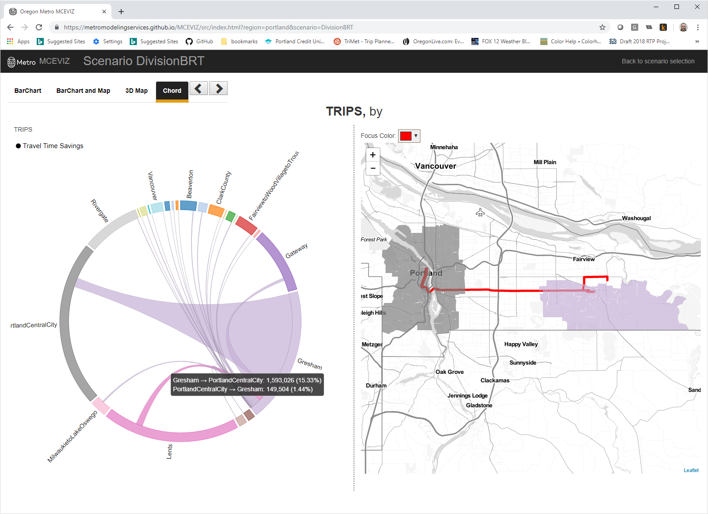
Travel Time Savings Benefits
Or “How quickly can I get there now?”
Takeaways:
Relatively large changes in travel time savings are seen in the project's area of influence.
Gains to downtown travel market are due to the fact that the BRT stops are less frequent than local bus and preferential lane treatments.
Notes:
With a comprehensive set of monetized benefits in place for scenarios such as the financially constrained minus the no-build, we then turned to visualization of results to help reach consensus in the planning process.
On the right side of this graphic is an overview of the project route in red (15 mile BRT running between Gresham and downtown Portland) with two sample travel markets highlighted.
On the left we show a Chord diagram chart visualizing minutes of travel time saved. The outermost part of the circle is the share of total regional travel time savings realized by travel market. The chords represent where travel time savings are realized throughout the region.

Slide 6
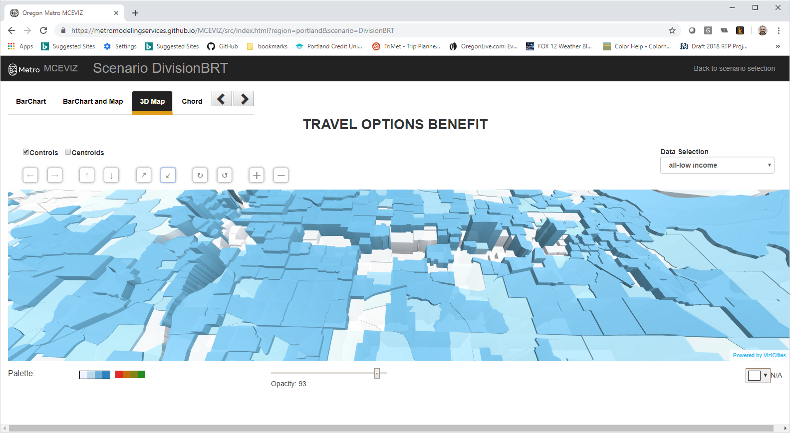
Travel Options Benefits
Or “How many more places can I get to now?”
Takeaways:
Relatively large changes in travel options benefit are seen in zones in the project's area of influence
Gains and losses in adjacent zones, due to the fact that the BRT stops are further apart than the existing bus stops
Notes:
Travel options is an MCE benefit that measures improved accessibility as a result of a transportation investment. When visualized as a 3d flyover chart we begin to realize the TAZ’s that are benefitting the most over the no-build case. Again, the project extent runs parallel thru the high polygons and intersects with the white polygons.
- Gains and loses are a result of BRT stop spacing being further from some zone as compared to the no-build local bus option. We also see new markets with increased accessibility as a result of crossing over our Tillikum Crossing bike/ped/transit only bridge to head into downtown vs. the no-build hawthorne bridge crossing.

Slide 7
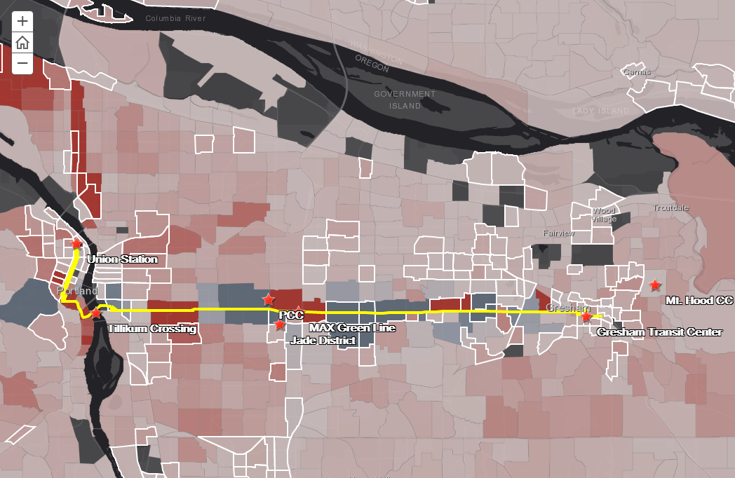
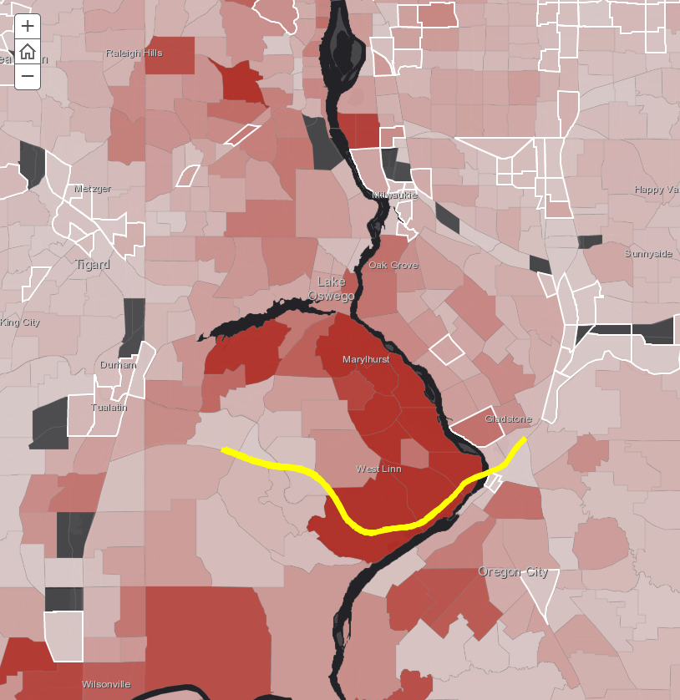
Equity Lens: Marginalized Communities
Or “Who benefits now?”
BRT:
Highest travel-time and travel options
benefits are for middle-income transit users.
Project affects travel option benefits in zones that represent marginalized areas.
Highway Capacity Expansion:
Highest travel-time benefits are for high-income drivers.
Project has a relatively small effect on travel option benefits for marginalized communities.
Notes:
Equity Lens: Marginalized Communities
When measuring equity benefits, it is very important to consider communities that have historically been marginalized.
- The graphic in the top right is visualizing travel options benefits from the new BRT line. We see that this line intersects with a lot of designated low-income TAZ’s (outlined in white).
- The graphic in the bottom left shows travel options benefits for a highway capacity expansion project to the south end of the Metro Region that adds approximately 13 miles of an additional travel lane (highlighted in yellow). Most of the accessibility benefits are realized near the project but these benefits tend to be outside of designated low-income TAZ’s.

Slide 8
Conclusions:
Social Return on Investment approach to Alternatives Analysis
  Triple-bottom line dimensions
  Explicit equity analysis
Data Visualizer effective to tell meaningful benefit stories.
MCE code is checked into GitHub, integrated with current demand models and running on Metro servers.
https://github.com/MetroModelingServices/metro_mce

